Slide 1
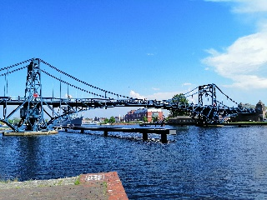
Macroeconomics
Wilhelmshaven
This lecture will be recorded and
Subsequently uploaded in the
world-wide-web
Prof. Dr. Bernhard Köster
Jade-Hochschule Wilhelmshaven
http://www.bernhardkoester.de/vorlesungen/inhalt.html

Slide 2

Macroeconomics
Winter term 2026
Prof. Dr. Bernhard Köster

Slide 3
Prof. Dr. Bernhard Köster
Room: S 113
Street: Friedrich-Paffrath-Straße 101
location: 26389 Wilhelmshaven
Tel. +49 4421 985-2766
Email: bernhard.koester@jade-hs.de
Consultation hour: by arrangement
or just have a look into my office!
or Webex/Zoom …

Slide 4
Literature
Blanchard, Macroeconomics
Mankiw/Taylor, Economics
Mankiw/Taylor, Macroeconomics
Barro Macroeconomics, A Modern Approach
Krugman, Economics
Burda and Wyplosz, Macroeconomics A European Text
Ben J. Heijdra Foundations of Modern Macroeconomics
Peter B. Sørensen/Hans J. Whitta-Jacobsen Introducing Advanced Macroeconomics
ocw https://ocw.mit.edu/

Slide 5
General
As in every lecture you should read further. Reading different bookes gives you a deeper insight, since economics is social science and therefore, we do not have the „only truth“
Although, there are many good textbooks, I`m one the „old“ lectures who does not just take the slides of the „Mankiw“ or the „Blanchard“. I`m creating my own slides and I`ll show my point of view on Macroeconomics. Nevertheless, many things will be similar as in the standard textbooks.
In the end my content is what matters for the exam. You get
  Slides
  Excercises
  Videos
  Review Questions

Slide 6
Data Sources
Institutions Statistisches Bundesamt Bundesbank Eurostat EZB FED BoE OECD IMF Worldbank SVR BA | Economic scientific Institutes Cesifo DIW IAB IfW IMK IW IWH KOF RWI ZEW Bruegel NIESR ESRI NBER Peterson Institue Brookins Institution

Slide 7

Economics
What is economics?
There is no general answer:
Economics is what Economists do! (Tautology)
„National economics is, if poeple wonder, why they do not have any money. There are many reasons, the most meaningful reasons are the scientific ones.“ (Kurt Tucholsky, 1931)

Slide 8
Economics – Definitions
Economics is the study of economies, at both the level of individuals and of society as a whole (Krugman and Wells, 2004, p. 2).
Economics is the study of how human beings coordinate their wants and desires, given the decision-making mechanisms, social customs, and political realities of the society (Colander, 2006a, p. 4).
Economics is the study of how society manages its scarce resources (Mankiw, 2001, p. 4).
See in general this nice essay:
Retrospectives: On the Definition of Economics
Roger E. Backhouse
Steven G. Medema
JOURNAL OF ECONOMIC PERSPECTIVES
VOL. 23, NO. 1, WINTER 2009
(pp. 221-33)

Slide 9
Economic Analysis:
Description of the economic events (Diagnosis)
Model building in order to explain the economic development (Theoretical design)
Matching Theory and Reality (Evaluation)
  Forecasting the future economic development based on the evaluated models
  Advisor of politicians and governments in economic issues

Slide 10
Economists as Scientists and Advisors
If economists try to explain the world, they work as scientists
If economists try to change the world, they work as advisors, since chosing one specific model means to use their own conviction

Slide 11




Positive and normative issue
Positive issues are descriptive and want to explain the functioning of the world. In this case the issue is totally neutral
Normative issues are judging how the world is functioning. Thus the own conviction influence the result. In this case the issue is not neutral

Slide 12

Examples – positive/normative?
A minimum wage causes unemployment of low skilled workers.
The higher income of some people due to the introduction of a minimum wage outweigh the higher unemployment of other people
Increasing oil prices increase the demand for electro mobiliy
Car manufactores of combustion engines have to incorporate the cost of CO₂-Emissions causing climate change
The 500 Bil. Euro Infrastructure and Climate Programm of the German government reduces due to higher interest payments the national budget and therefore tightens the possibilities of future generations

Slide 13

Microeconomics
Behaviour of single persons
Analyzing single enterprises, households
Demand of one household for i.e. food
Supply of one enterprise for cars
Demand of one construction enterprise for cement
Macroeconomics
Looking at the whole economy
Analyzing economic aggregates
Total demand of all households → total consumption
Total supply of all enterprises → aggregate production
Total Demand of enterprises for investment
Analyzing aggregates gives deeper insight in general connections
But we loose information of important details
Compare with statistics → building aggregates like mean and variance in order to describe a data set!!

Slide 14

Macroeconomic Questions
Impact of labour market developments on the whole economic development?
Impact of the interest rate decisions of central banks on general interest rate developments?
Impact of demographic changes on capital accumulation?
Global changes in the relation of USA/EU vs China and their impact on international trade?
Effects of economic programs against climate change on income distributions and economic growth?
Effects of the russian attac on Ukraine on economic developments, since Russia is the largest supplier of raw materials in the world?
What impact is the erratic economic policy of the current US administration having on the global economy?

Slide 15




Macroeconomic issues
Economic growth of the german economy 2025 +0,2%
Inflation rate Germany 2025 is 2,2%
Government debt of Germany is in 2025 2,8 Billionen Euro
Retirement age raises in Germany until 2030 from 65 to 67 years
The interest rate on the main refinancing operations (MRO) of the ECB is 2,9% on September 2026.
In 2023 the last Atomic power plant in Germany has been shut down and the Coal power plants are planned to be shut down in 2038.
In Wilhelmshaven the first german LNG-Terminal started to operate in 2022. In May 2025 a second LNG-Terminal has been opened

Slide 16
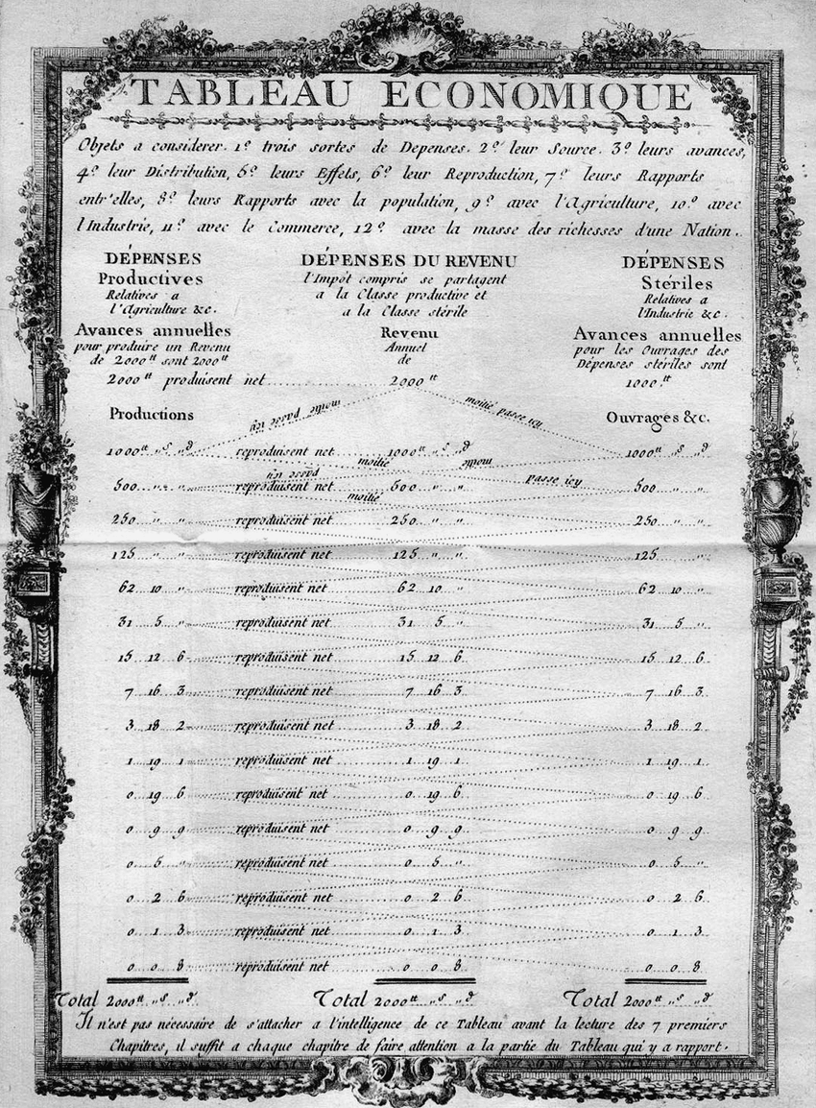



The historical circular flow of income
The french physician François Quesnay (1694-1774) compared the blood circulation with economic developments and visualized the interdependencies in his Tableau Economique.
The economy is divided in to three classes:
Classe productive (P): agricultural sector
Classe propiétaire (E): Noble man and clergy man (land owners)
Classe stérile (H): Trade (merchants) and manufacturing (artisians) sector
Zigzag tableau économique from the frontispiece of Élémens de la philosophie rurale (1767)

Slide 17


General Visualization of the circular flow of income
P
E
H
Account form:
 | P | E | H
P
E
H
Matrix form:
P
Grafics form:
E
H

Slide 18
Example
Starting point: P produced commodities valued with 5MU (monetary units)
Own consumption of P 2MU
Buying manufactored commodities P 1MU
Rent for the land P 2MU
E Agricultural products E 1MU
H Agricultural products H 2MU
Illustrate the circular flow of income in accout, matrix and graphics form. Which assumption is needed?

Slide 19
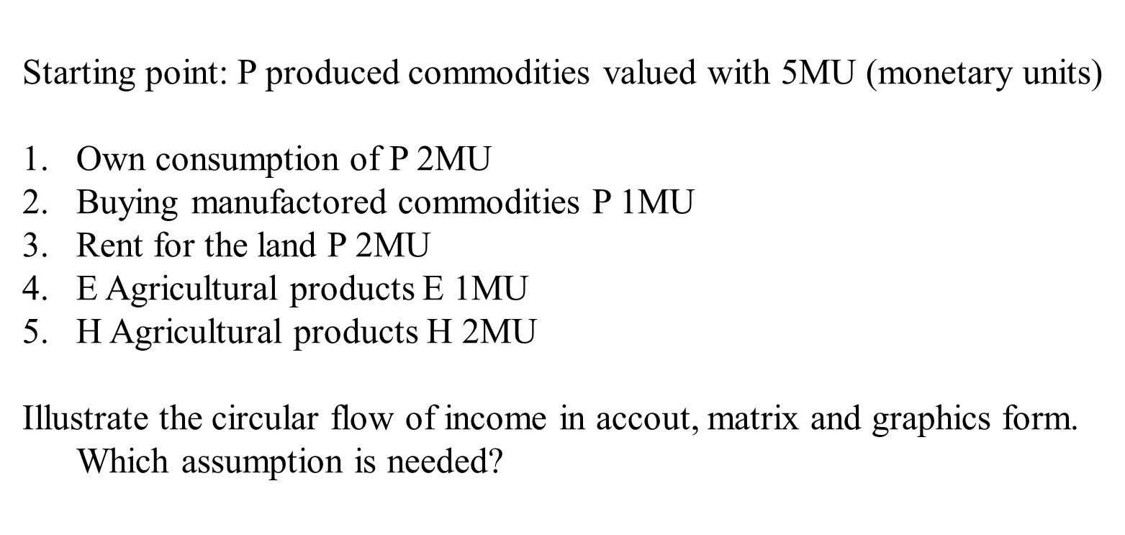
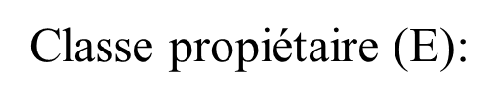
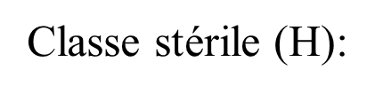











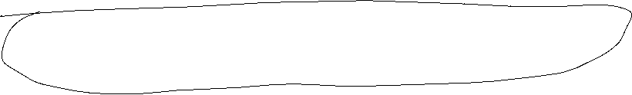
Account form
Classe productive (P):
P
E
H

Slide 20







1. Own consumption of P 2MU
2. Buying manufactored commodities P 1MU
3. Rent for the land P 2MU
4. E Agricultural products E 1MU
5. H Agricultural products H 2MU
6. E is buying for 1 MU from H
Matrix form
In/Out | P | E | H
P
E
H

Slide 21











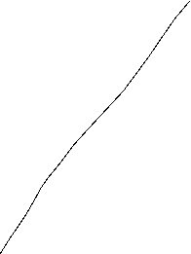






1. Own consumption of P 2MU
2. Buying manufactored commodities P 1MU
3. Rent for the land P 2MU
4. E Agricultural products E 1MU
5. H Agricultural products H 2MU
6. E is buying for 1 MU from H
Grafical form
P
E
H

Slide 22



The modern circular flow of income
4 Sectors:
Households (H), Government (G), Enterprises (E), Overseas (A)
The circular flow of income is closed via the sector of the financial institutions (FI). Via FI savings and investment is processed or assets and liabilities against the overseas sector
Arrows represents always money flows between the sectors
The circle is closed if at any sector we have incoming flow equals outgoing flow (Axiom of the closed circle).
→ Every relevant flows are considered

Slide 23







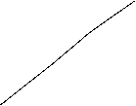

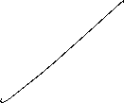



















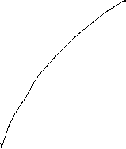

The modern circular flow of income of an open economy

Slide 24
Circular flow of income of an open economy
C_{H}: Consumption of Housholds
G: Government H: households A: Overseas
FI: Financial institutions
E: Enterprises
Y_{H/E}: Salary of Households paid by Enterprises
G
T_{H}: Tax payment of the households
Y_{H/G}
T_{E}: Tax payment of the enterprises
Z_{H}
Z_{E}
C_{G}
Z_{E}: Transfer from Government to Enterprises
T_{H}
Z_{H}: Transfer from Government to Households
Y_{H/G}: Salary of Households paid by the government
C_{St}: Consumption of the Government
I_{G}
T_{E}
EX: Exports
S_{G}
Y_{H/E}
IM: Imports
H
E
NT: Net Transfer from Households to foreign countries
C_{H}
EX
I_{E}: Investment of Enterprises
I_{H}
I_{E}
I_{H}: Investment of Households
S_{H}
IM
S_{E}
I_{St}: Investment of the Government
S_{U}: Savings of Enterprises
S_{H}: Savings of Households
CA=EX-IM-NT
S_{St}: Savings of the Government
FI
A
CA: Current accout equals by The axoim of te closed circle CA=EX-IM-NT
NT

Slide 25





National account system (NAS)
National accounts provide information to analyse the structure of economies and their development over time. They contain a wide range of statistics describing an economy in various ways. The main GDP aggregates provide an overview about key economic developments..
Information, Forecast, international comparision
Since 1995 NAS is standardized in the (European System of National and Regional Accounts, ESA)

Slide 26









Gross domestic product
Gross domestic product (GDP) is the total market value of all the goods and services produced within a country’s borders in a specific time period (i.e. 1 year) used for final consumption

Slide 27














GDP
„market value“
In order to aggregate different goods and service their market prices are considered.
Some goods do not have a market price. In this case production prices are considered
For public services wages public employees are considered
„all“
owner-occupied residential property is value by an average market rent.
Some goods and service cannot be statistically counted and are therefore not included into GDP (i. e. black market, educational performance of parents, honory posts)

Slide 28

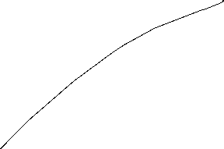






GDP
„goods and services“
material and immaterial goods
„wihin a countries borders“:
domestic concept = national concept
+ factor income of non citizens in the considered country
– factor income of citizens of the considered country from abroad
„specific time period “
Quater or year
„final consumption“
Only value added is considered =
Production – intermediate consumption

Slide 29


Calculating GDP
Production approach – Value added of all economic sectors (activities)
Expenditure approach – final uses of goods and services (consumption, investment,
government expentitures, net exports (Ex-Im)
Income approach – Distribution of income on the different factors of production
(capital and labor)
Notes:
29

Slide 30
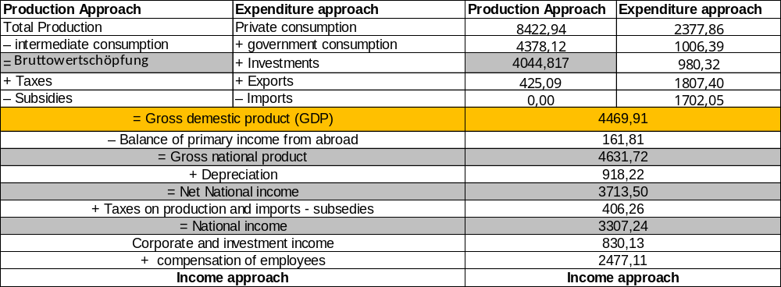







Gross dpmestic Product (Germany 2025)
Source: Destatis, current prices, Bil. Euro
Notes:
30

Slide 31
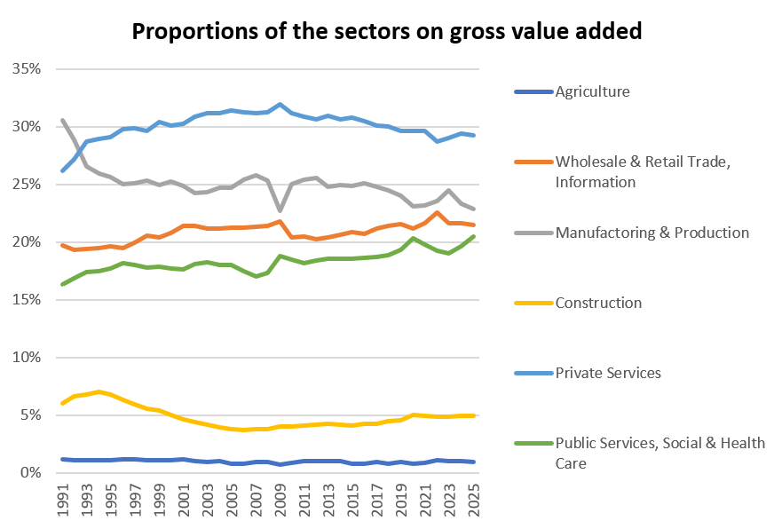
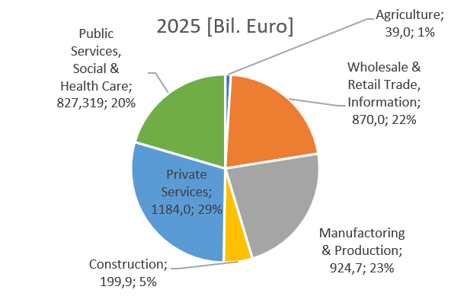




Production approach – Gross value added + taxes – subsidies = GDP (Germany 2025)
Source: Destatis, current prices, Bil. Euro

Slide 32
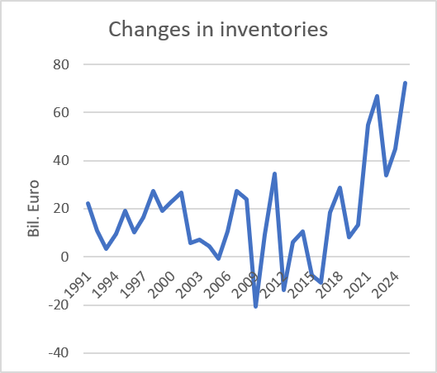
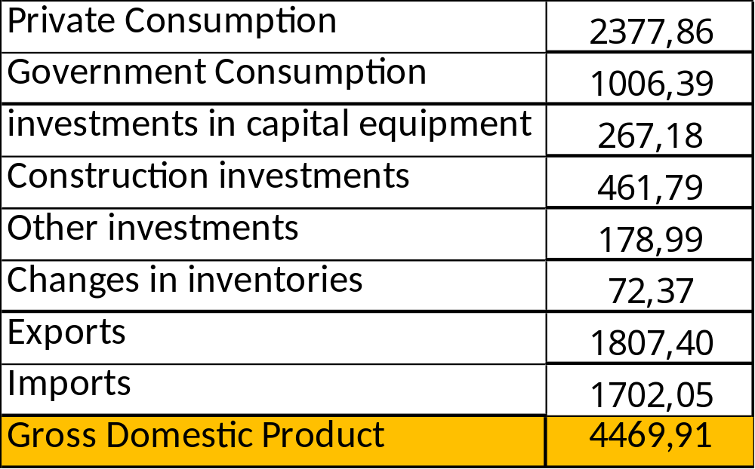





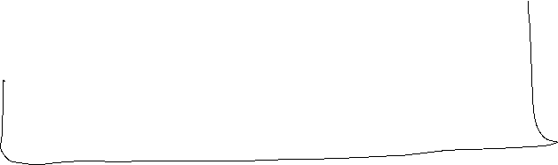


Expenditure approach Germany 2025
}
Consumption
}
Gross capital
investment
}
External contribution
Source: Destatis ,current prices, Mrd. Euro

Slide 33
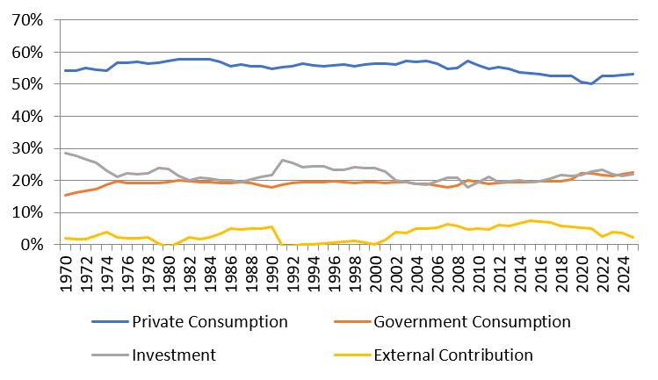



Development of the nominal proportions of the expenditure sectors of GDP (Germany)
Source: Destatis, current prices

Slide 34


Income approach
The income approach counts the different typs contributing to national income.
Mainly we look at the income from the general factors of production: Capital and Labor. Thus we count corporate and investment income from capital and compensation of employees from labor. The aggregate variable measuring the division of national income is the
compensation of employees
Labor Share =
national income

Slide 35
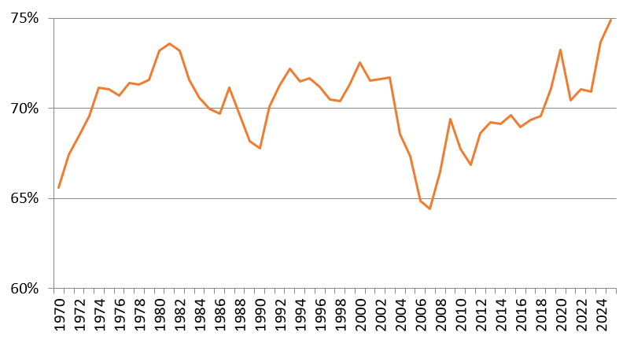
Development of the labor share (Germany): Income approach
Source: Destatis

Slide 36


Magic Square
Steady and appropriate economic growth
External balance
Price level stability
High level of employment

Slide 37
Gesetz zur Förderung der Stabilität und des Wachstums der Wirtschaft (StabG 1967)
Law on the Promotion of Economic Stability and Growth
§ 1
Bund und Länder haben bei ihren wirtschafts- und finanzpolitischen Maßnahmen die Erfordernisse des gesamtwirtschaftlichen Gleichgewichts zu beachten. Die Maßnahmen sind so zu treffen, dass sie im Rahmen der marktwirtschaftlichen Ordnung gleichzeitig zur Stabilität des Preisniveaus, zu einem hohen Beschäftigungsstand und außenwirtschaftlichem Gleichgewicht bei stetigem und angemessenem Wirtschaftswachstum.
The federal and state governments must take into account the requirements of macroeconomic balance in their economic and fiscal policy. The policy has to be within the framework of the market economy, they simultaneously contribute to price stability, a high level of employment and external economic balance, with steady and appropriate economic growth.

Slide 38
Angemessenes stetiges Wirtschaftswachstum
When measuring overall economic performance, the question arises as to how to deal with a situation in which the value of GDP in monetary units or euros increases solely due to price inflation.
-> Therefor we distinguish between nominal and real economic growth.
Relative change of the nominal GDP compared to the previous period (year)
Difference because of changes in prices
Difference because of changes in quantity
In order to do not count changes in prices, the real GDP is calculated with repected to the prices of the previous year,
Since only a change because higher prices does not count for an increase of overall economic performance!

Slide 39
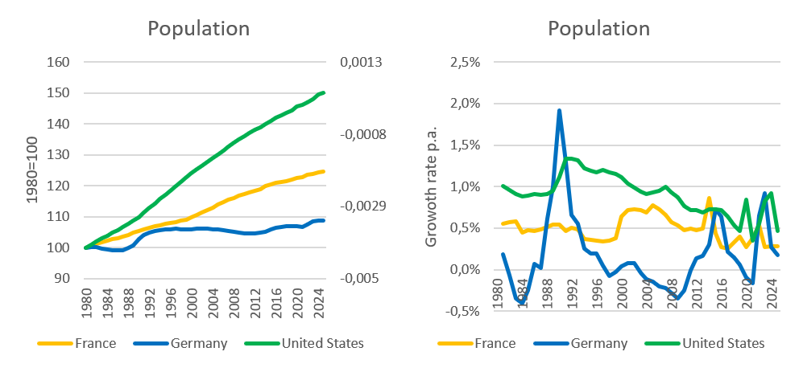
Steady and appropriate economic growth
Indicators
Growth of real GDP
→ change of overall economic performance, not including singular changes in prices (price adjusted GDP)
Growth of real GDP per capita
→ since in general new inhabitants will increase GDP, we also to adjust for population growth
→ In developed countries an growth rate of GDP of roughly 1%-3% p.a. is claimed to be appropriate on average, without high volatily around this traget growth rate.
Source: IMF

Slide 40
Calculating real GDP
Since 2005 real GDP is calculated via a chain index (caution, in many textbooks and in the web real GDP is explained due to a fixed price bases, but this is wrong!).
Real GDP is the value of final goods and services calculated via constant prices of the previous year. We set a base year in time t wird equal to Index_{real}(t)=100 and the indices of the following years are the calculated recursively
GDP(t+1) in prices of t
Index_{real}(t+1) = Index_{real}(t)
GDP(t) in prices of t
P₁(t)•X₁(t+1)+P₂(t) •X₂(t+1)+…
= Index_{real}(t)
P₁(t) •X₁(t)+P₂(t) •X₂(t)+…
with P₁, P_{2,}… prices of goods an services 1,2,… ;X₁, X₂,… quantities of goods an services 1,2,… and time t

Slide 41
Real economic growth and GDP-Deflator
Real economic change is the realtive change of the chain-index of real GDP:
GDP-Index_{real}(t) – GDP-Index_{real}(t-1)
Real economic growth = g(t)=
GDP-Index_{real}(t-1)
GDP-Index_{nom}(t)
BIP-Deflator(t) = 100
GDP-Index_{real}(t)
The relative change of the BIP-Deflator represents the pure price effectof the realative change of nominal GDP
(in opposite to case, if real GDP would be calculated via a fixed price base, since then, the BIP-Deflator itself represents the price effect, be careful, if you read other text books!)

Slide 42
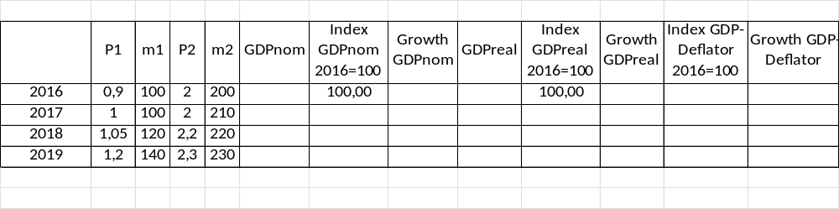
Example

Slide 43
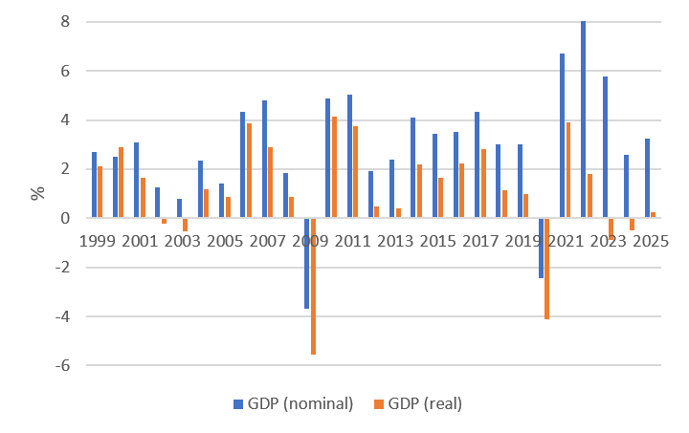
Nominal and real economic growth (Germany)
Source: Destatis

Slide 44
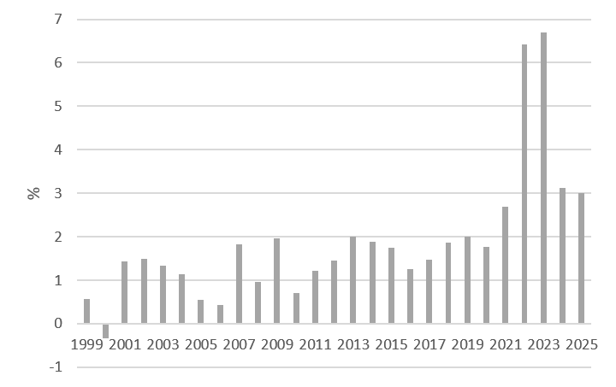
Relative change of the GDP-Deflator (Germany)
Source: Destatis

Slide 45
Nominale GDP/real GDP/GDP-Deflator
The realtive change of nominal GDP represents changes in prices and quantities.
The realtive change of real GDP represents changes in quantities and therefore counts for the change of economic performance
With the realtive change of the GDP-Deflator we can correct nominal growth in order to obtain real growth

Slide 46
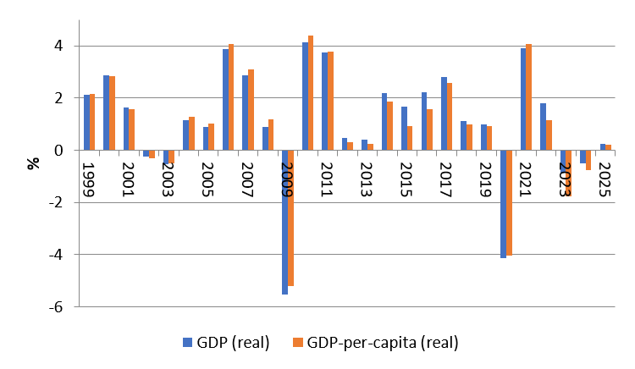
Difference of economic growth measured via real GDP and real GDP per capita (Germany)
Source: Destatis

Slide 47
Why price level stabiliy?
reasons:
In a market economy price give the signal of scarcity of goods and services, therefore the overall price level should not to be to volatile.
preservation of the value of money over time
Avoiding transaction cost because of new price declarations (menue costs)
Injustice in the creditor-debtor relationship
Stable decisions between consumption and saving

Slide 48
Measuring the value of money
In order to determine the puchasing power of money we cannot only look at single prices. Therefore we calculate an average of many prices.
→ The value of money is measured in a price index. This price index is base on representative choice of a basket of single goods.

Slide 49
Calculating Inflation
Choice of the basket of single goods
  Determine the relevant goods and services, a representative household is consuming
  Weighting the goods due to their significanse in the consumption plan of the representative household
Dertermine the prices:
  Looking up the prices of the goods in the chosen basket for a given time t.
Value of the basket:
  Multiply the determined prices with the chosen weight. Summing up give the Value of the basket for the given time t.

Slide 50
Calculating Inflation
Choose a base year t₀ :
  The Price-Index of the base year t₀ is set to 100.
  Index of time t is calculated as value of the basket at time t divided by the value of the basket in t₀ multiplied by 100
Calculating inflation:
  Inflation equals the rate of change of the Price-Index.

Slide 51
Harmonized Indices of consumer Prices (HICP)
Definition Eurostat:
The Harmonised Indices of Consumer Prices (HICP) measure the changes over time in the prices of consumer goods and services acquired by households. They give a comparable measure of inflation as they are calculated according to harmonised definitions. Data is available on a monthly and annual basis, broken down by detailed consumption categories.
$HICP=\sum_{i=1}^{n}{g_{i}∙p_{i}}$ $g_{i}$: Weight of i-th good
$p_{i}$: Price of i-th good
A personal inflation calculator

Slide 52
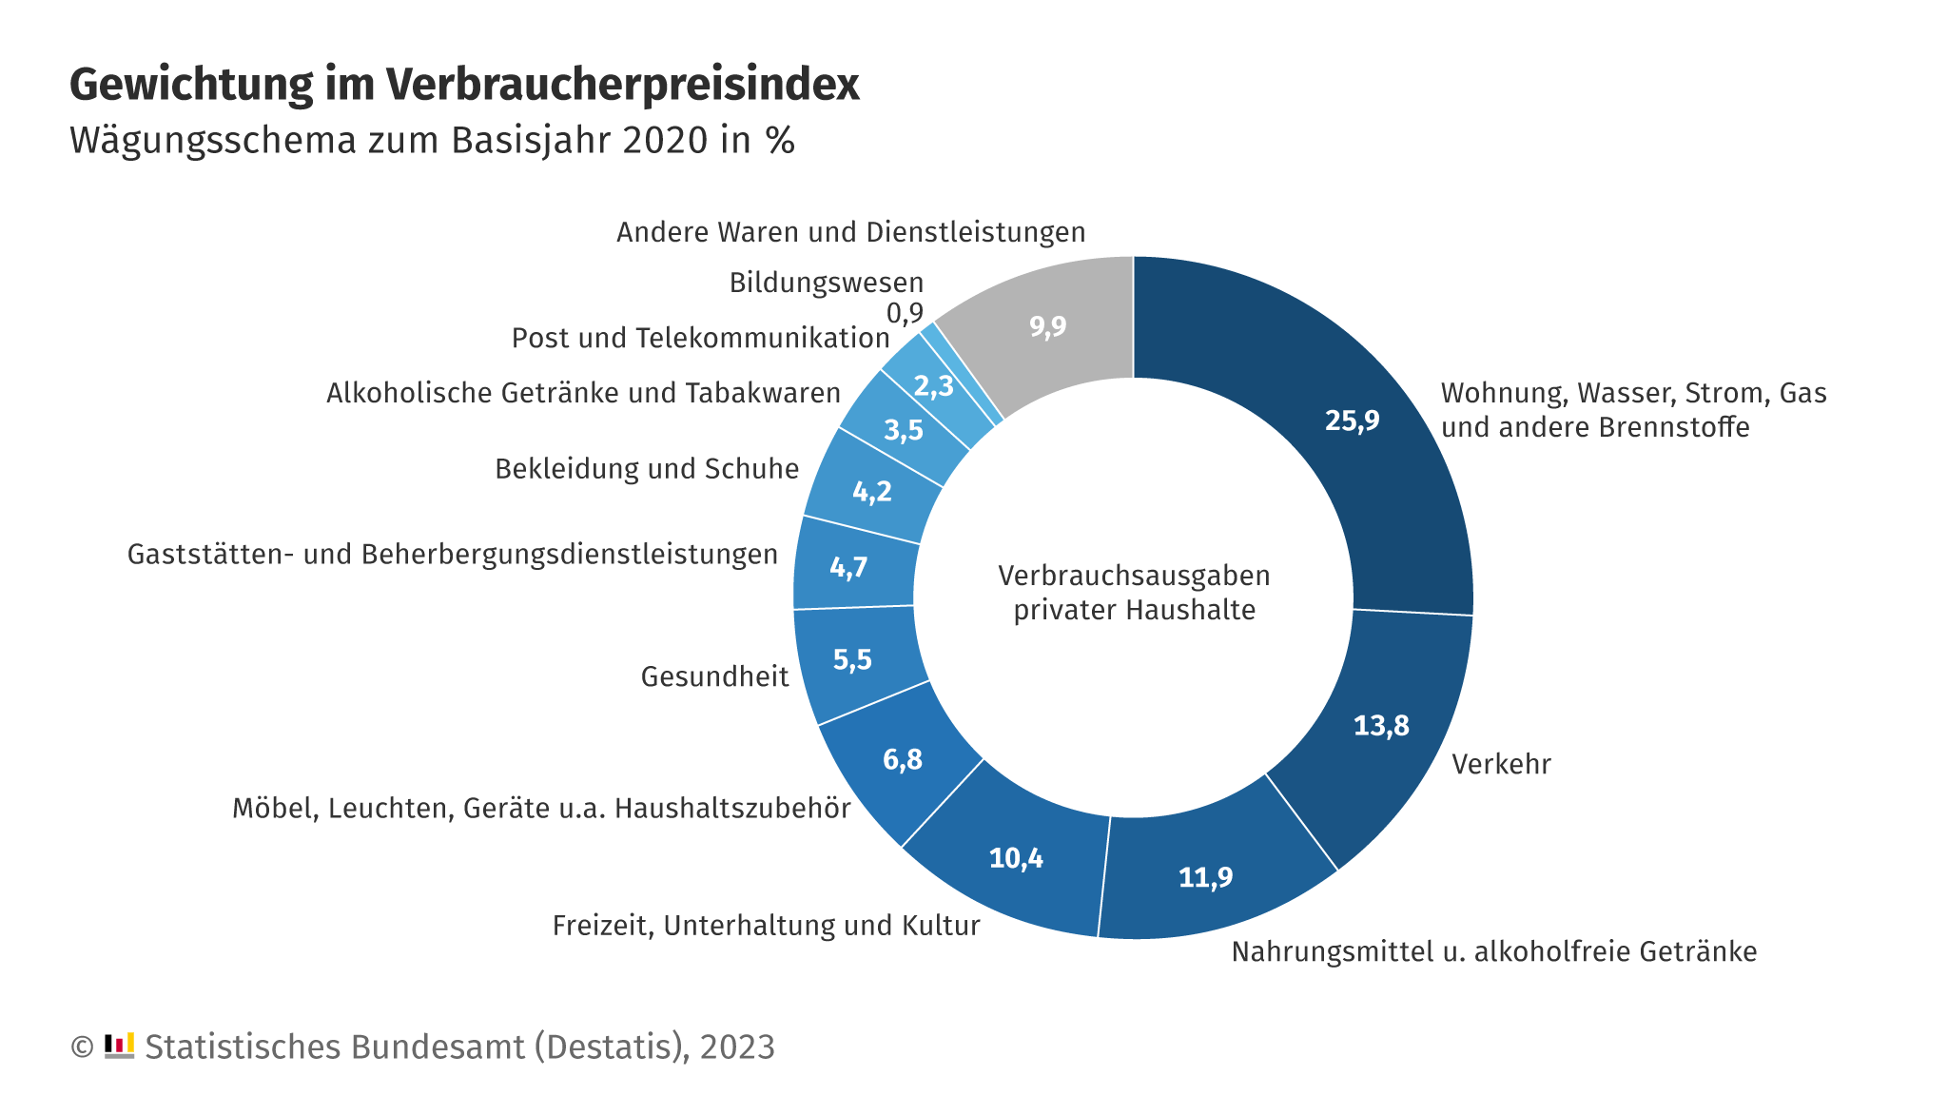
Wägungsschema des Verbraucherpreisindex
Oder das Preiskaleidoskop des Stabu
https://www.destatis.de/DE/Themen/Wirtschaft/Preise/Verbraucherpreisindex/PreisKaleidoskopUebersicht.html
Hier könnt Ihr eure eigene Inflationsrate ausrechnen
https://www.destatis.de/DE/Service/Statistik-Visualisiert/persoenlicher-inflationsrechner-uebersicht.html
Video Destatis
https://www.destatis.de/DE/Themen/Wirtschaft/Preise/Verbraucherpreisindex/inflation.html

Slide 53
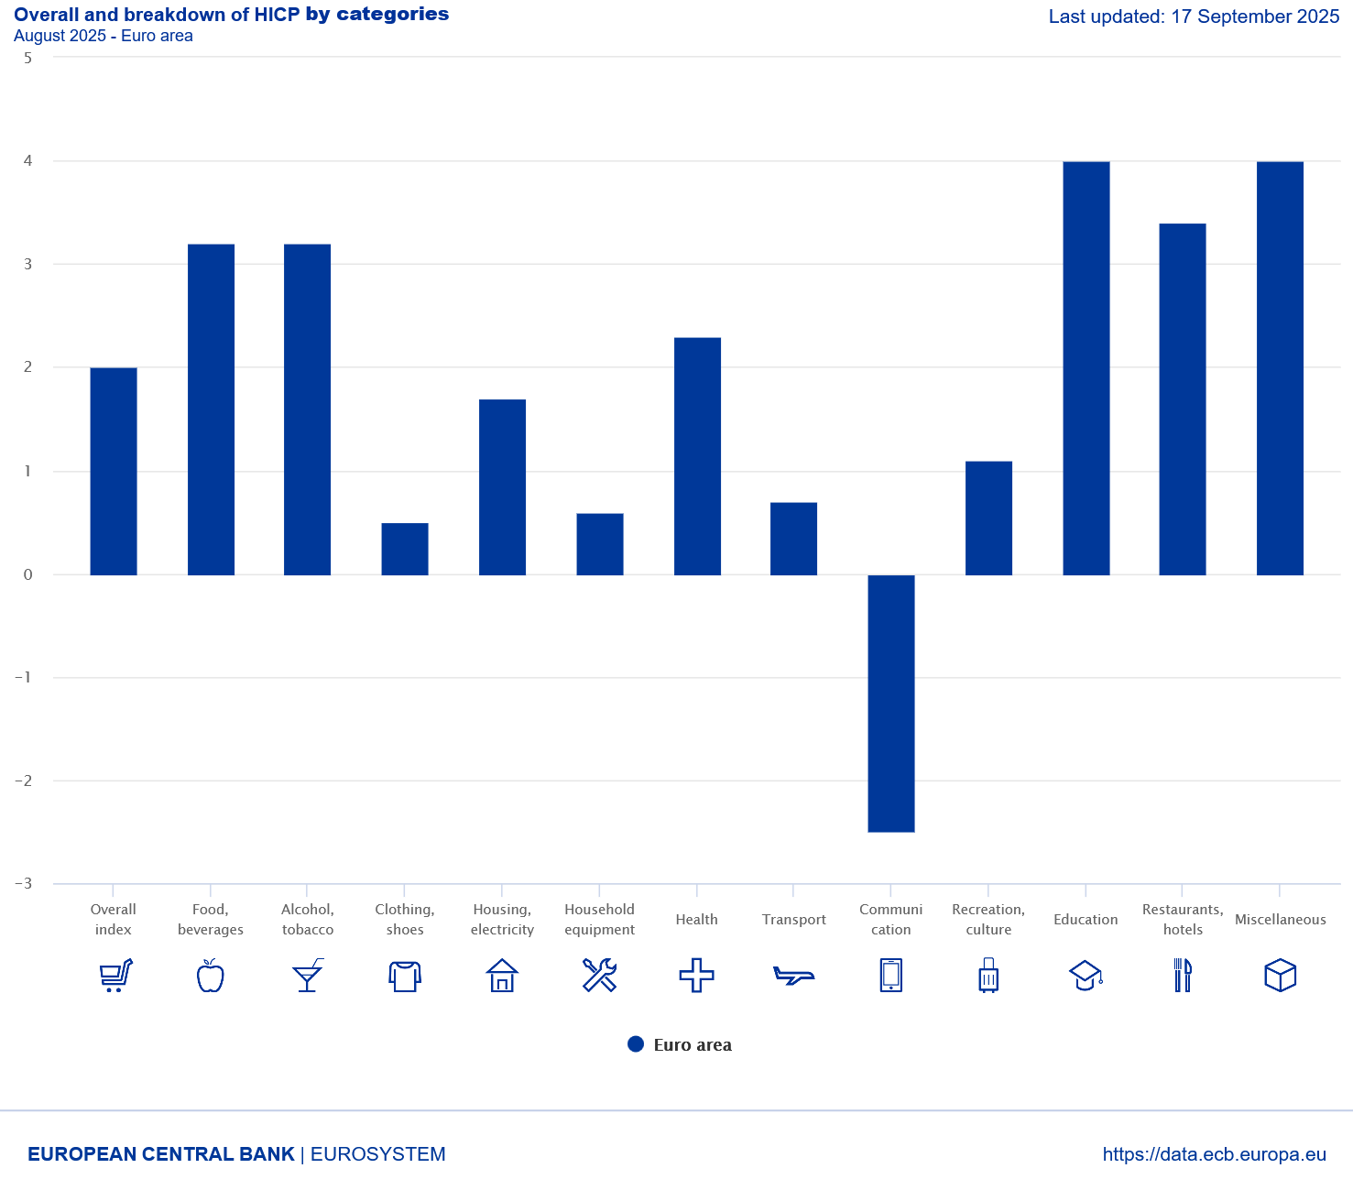
Weighting scheme of the HCPI
https://www.ecb.europa.eu/stats/macroeconomic_and_sectoral/hicp/html/index.en.html

Slide 54
Price level stability
Price level stability is in general calculated via the consumer price index (CPI) or in the Eurozone the harmonized consumer price index (HCPI).
Definition of price level stability of the European central bank:
The ECB’s Governing Council considers that price stability is best maintained by aiming for 2% inflation over the medium term. Inflation is measured by the Harmonised Index of Consumer Prices (HICP). The Governing Council’s commitment to the 2% target is symmetric. This means that we consider negative and positive deviations from the target to be equally undesirable.

Slide 55
Inflation
The inflation rate is the relative change of CPI with respect to the previous year. :
$Inflation\left(t\right)=\frac{CPI(t)−CPI(t−1) }{CPI(t−1)}$ t: time index

Slide 56
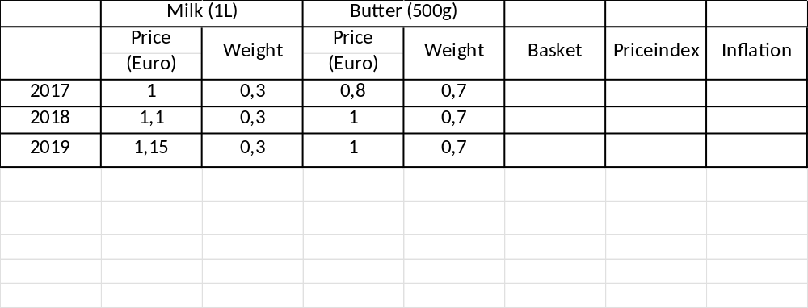
Calcuate the price index 2017 – 2019 (2017=100)
Inflation rates 2018 und 2019, and the average inflation 2018 – 2019.
Beispiel

Slide 57
Different Preisindices
Consumer price index → general inflation, relevant for private consumption
GDP-Deflator → Index for the whole economy, scope of distirbution in wage negotiations
Export- and Import prices → Indices for international trade (relevant for „imported“ inflation)
Wolesale price index→ Whole sale trade is some kind of an early indicator for inflation based on CPI.

Slide 58
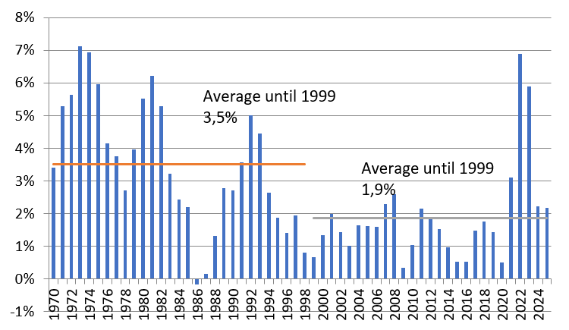
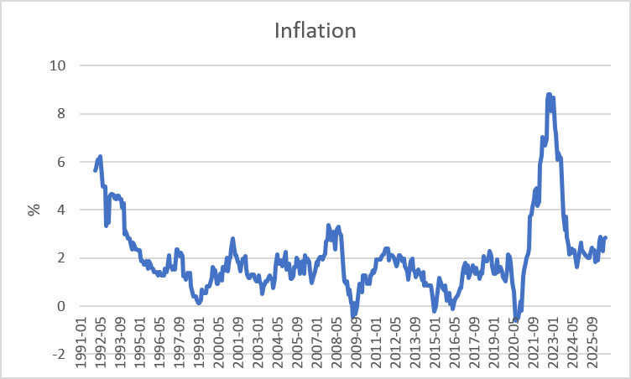
Inflation Germany
Yearly
Monthy p.a.
Source: Destatis

Slide 59
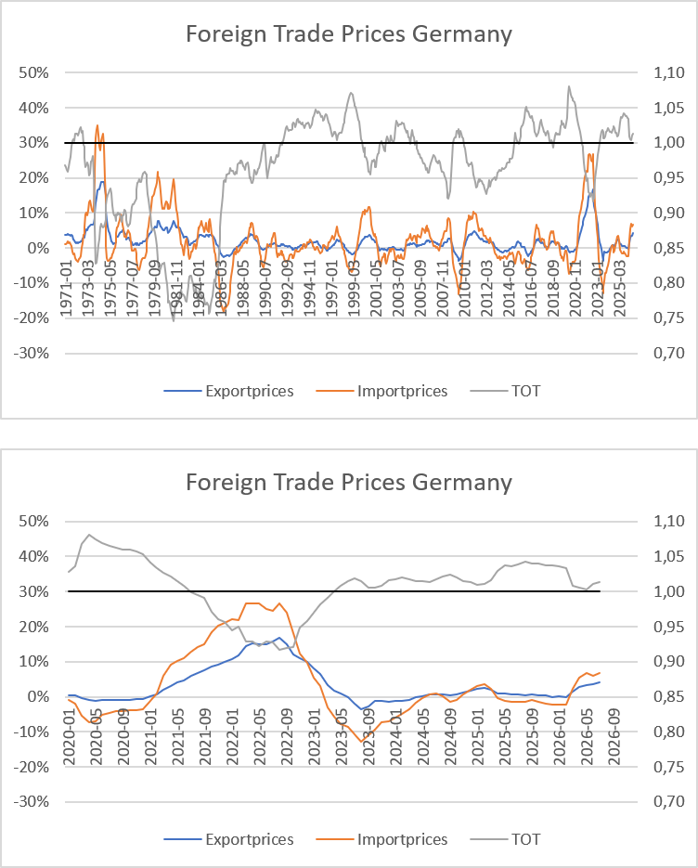
Foreign Trade Prices Germany
Source: Destatis, YoY

Slide 60
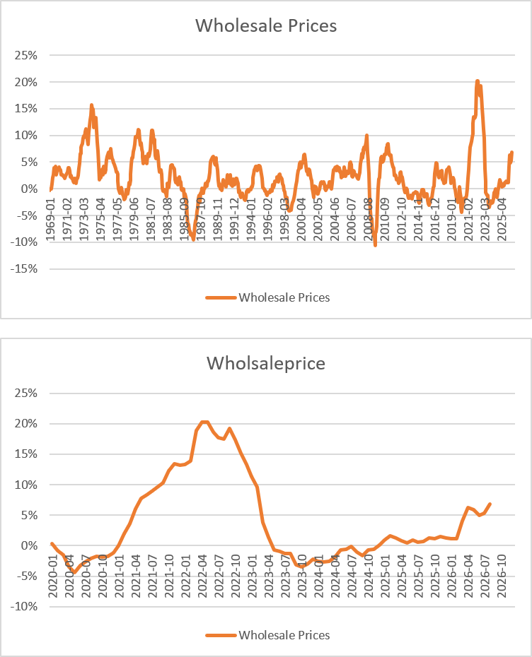
Wholesale Prices Germany
Source: Bundesbank, YoY

Slide 61
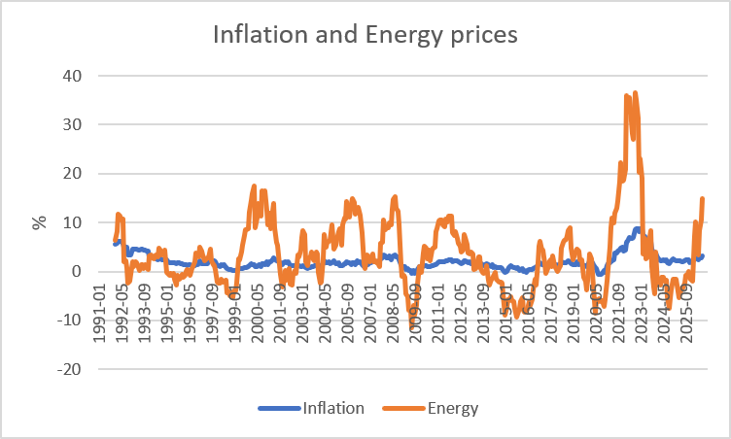
CPI and the Energy component (Germany)
Source: Bundesbank

Slide 62
Energy and Inflation
The weight of the energy component is roughly 10% in CPI.
Calculate inflation, if energy price have fallen by 15% and all other prices stayed the same.

Slide 63
High level of employment
Principal aim is to reach a state of full employment.
→ every person willing has a job.
The general variable to measure unemployment is the unemployment rate.
In Germany a level of 3%-4% unemployment rate is considered as a state of full eployment.

Slide 64
Unemployment definition BA
(registered unemployed people)
Age between 15 – 65 (67) years
Defined by the Social Code, Book III (SGB III), the unemployed include all those who are
temporarily not employed or work in a job for fewer than 15 hours per week,
seek employment subject to social insurance contributions for at least 15 hours per week,
and in the process are available for placement efforts undertaken by the employment agencies or institutions administering basic security benefits for job-seekers
and have registered there as unemployed.

Slide 65
Unemployment definition ILO
Unemployed is any person aged between 15 and 74 years
who was not in employment, but actively sought work over the four weeks preceding the survey
and would be available for starting a job within two weeks.
In this context, it is irrelevant whether the persons concerned are registered with a government authority and receive social benefits from there

Slide 66
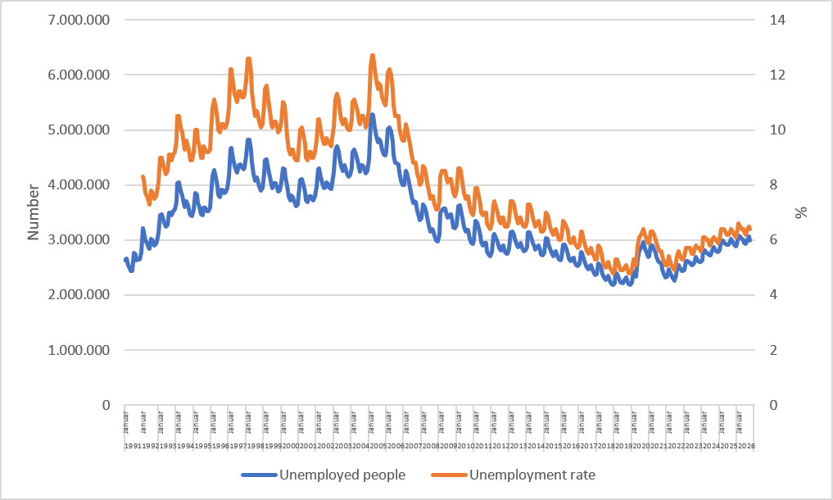
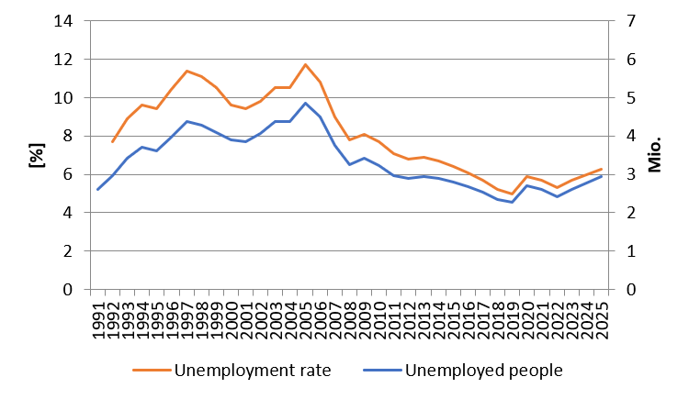
Monthly development of unemployment in Germany
Source: BA

Slide 67
Types of unemployment
Short-term: seasonal and frictional unemployment
Medium-term: cyclical unemployment
Long-term: structural unemployment

Slide 68
Short term unemployment
seasonal unemployment:
Fluctuation in production during a year i.e. in theagricultural sector or the construction sector
Fuctuations in demand during the year i.e. in Tourism sector because of the weather or because of school holidays
Hiring cycles
frictional unemployment :
Incomplete information in the labour market causes a mismatch between job seeking poeple and poeple seeking enterprises
  Transition time between on job and another new job
  Additional time because of moving from one location to another

Slide 69
Medium- and long-term unemployment
Cyclical unemployment:
Within the business cycle we have an under utilization of potential output → causing a decrease in labor demand
Structural unemployment :
Sectoral change, i.e. legislative amendment (Change in Energy politics)
→ job loss in the coal industry or the nuclear sector
Technological change, i.e. digitalization of many process will change the labor market dramatically (i.e. AI)
              → new skills are neede in the future
Regional descrepancy in job demand and supply specially because of the demographic change in the rural area

Slide 70
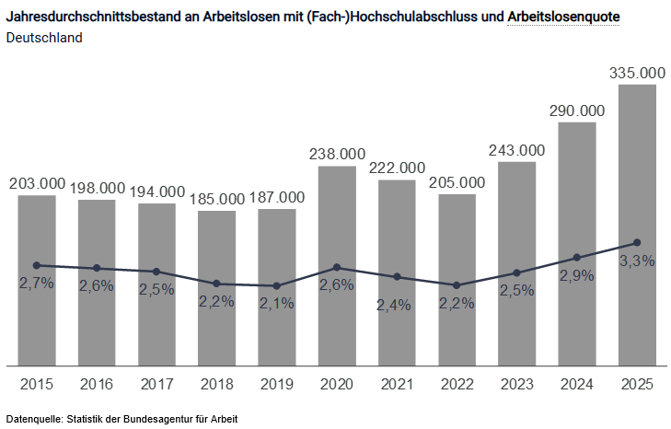
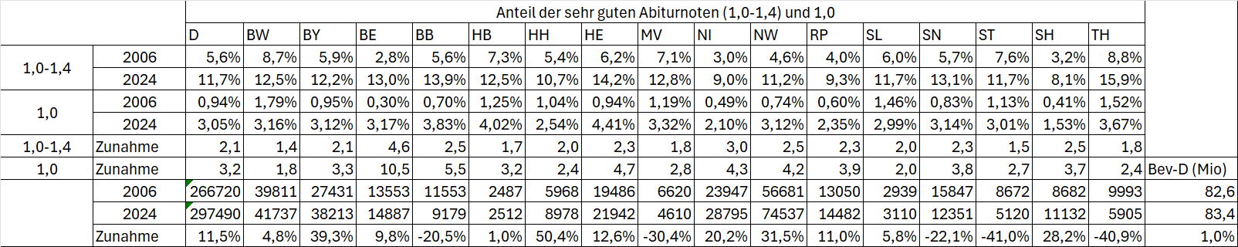
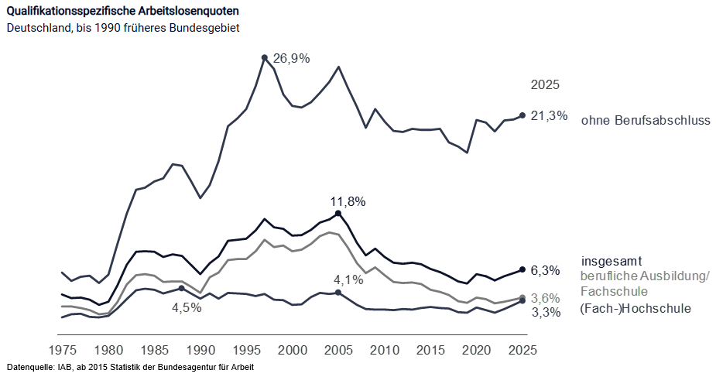
Exkurs: Graduate Unemployment (Source: BA)

Slide 71
Hidden unemployment
People in qualification programs
Early retirement
Short time work
Job creation sheme

Slide 72
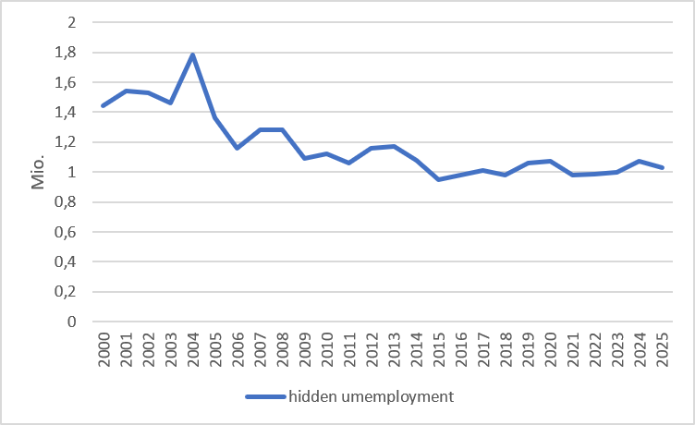
Hidden unemployment Germany
Hidden reserve in programs:
Neither employed nor registered as unemployed. Examples: further education, language courses, early retirement
Hidden reserve in the narrower sense:
Not currently looking for work, but fundamentally willing to take up employment
Source: IAB

Slide 73
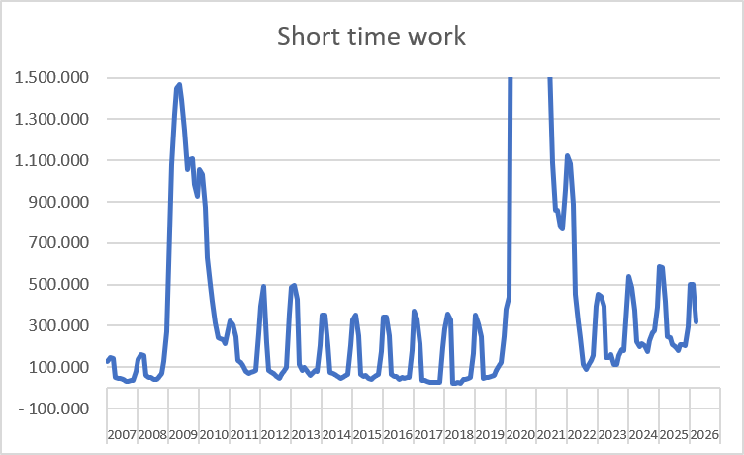
Short time work: Germany
Source: BA

Slide 74
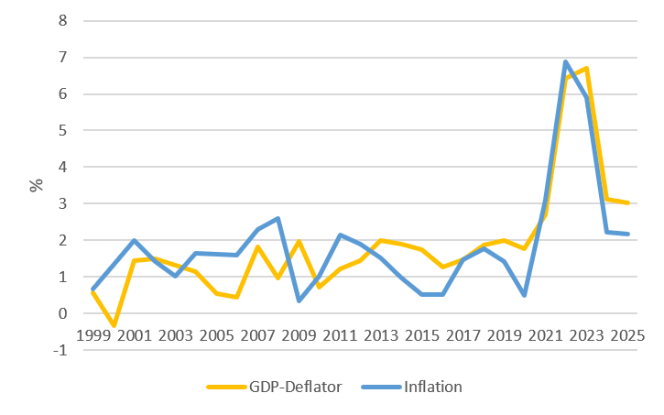
Importance of CPI und GDP-Deflator for the Labour market
Source: Destatis,

Slide 75
External balance
There is no generally accepted definition!
This aim has to be understood within the historical context. Until 1973 we had a system of fixed exchange rates in the world. Every convertible currency was fixed in realtion to the US-Dollar → In such a framework it is suitable to balance i.e. the current accout or the trade balance, because otherwise the own currency can be out under pressure
But in 1973 the system of Bretton woods collapsed! Since the, we have free floating currencies, and therefore there is no need anymore for a balanced current account. Nevertheless you find in textbooks the following aims:
Andere Interpretationen:
Balanced trade balance
Balanced current account
Low fluctuating currency
Low susceptibility from foreign economies

Slide 76
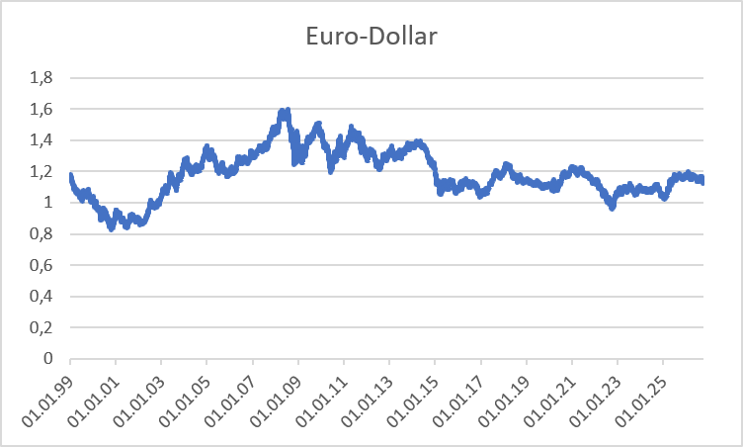
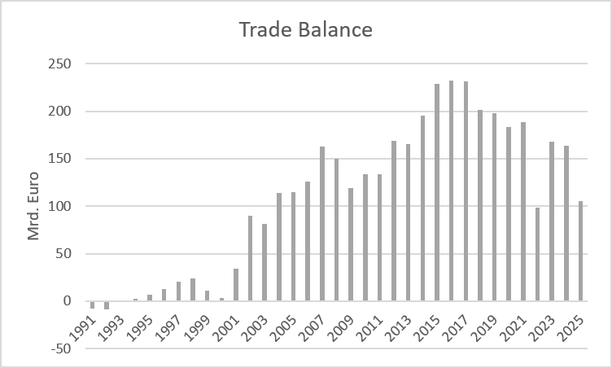
International economic relationships Germany
Source: Bundesbank
Exchange rate Euro – Dollar
Trade balance

Slide 77
Balance of Payments
Definition of Balance of Payments:
The balance of payments is a summary of all the international transactions of a country and its citizens during a specified period of time. This period is usually of one year, though many countries have now started preparing the quarterly accounts for the purposes of forecasting.
Caution:
In the balance of payments we count flow, while usually in a balance sheet you report stocks!
Notes:
77

Slide 78
Balance ofpayments
A. Current Account
B.Capital account
C. Financial account
A1. Balance of goods
A2. Balance of services
A3. Primary income (payments form work (wages) oder inverstments (dividends)
A4. Secondary income (payments from government (tax, refunds) or one way transfers i.e. disaster relief)
B1. Capital transfers
B1. Direct investment
B2. Porfolio investment
B3. Financial derivative
B4. Reserve investement
B5. Other investment
Notes:
78

Slide 79
Further economic goals
Fair balanced income distribution → German constitution Art. 72 Satz 2 GG
Sustainable ecological conditions → German constitution Art. 20a GG
Sustainable public financial budget → German constitution Art. 109 Satz 3 GG
→ Maastricht criteria 3% Deficit
60% government debt ratio

Slide 80
Fair balanced income distribution
Art. 72 Satz 2 GG
(2) Due to article 74 Abs. 1 Nr. 4, 7, 11, 13, 15, 19a, 20, 22, 25 and 26 the federal government has legislative power if and to the extent that the establishment of equivalent living conditions within the federal territory or the preservation of legal or economic unity in the national interest requires federal legislation.

Slide 81
Sustainable ecological conditions
Art. 20a GG
The state shall also protect the natural foundations of life and animals in accordance with the constitutional order through legislation and, in accordance with the law and justice, through the executive power and the judiciary, in responsibility for future generations.

Slide 82
Sustainable public financial budget
(1) The Federation and the Länder shall be autonomous and independent of each other in their budgetary management.(2) The Federation and the Länder shall jointly fulfill the obligations of the Federal Republic of Germany under European Community legal acts based on Article 104 of the Treaty establishing the European Community to maintain budgetary discipline and, within this framework, shall take into account the requirements of overall economic balance.(3) The budgets of the Federation and the Länder shall, in principle, be balanced without revenue from loans. The Federation and the Länder may provide for rules to take account symmetrically, in times of economic expansion and contraction, of the effects of economic developments that deviate from the normal situation, as well as for an exception for natural disasters or exceptional emergency situations that are beyond the control of the state and significantly affect the state's financial position. A corresponding repayment arrangement must be provided for the exemption. The details are regulated for the federal budget in Article 115, with the proviso that sentence 1 is complied with if the revenue from loans does not exceed 0.35 percent in relation to nominal gross domestic product. The amount by which defense expenditures, federal expenditures for civil protection and civil defense, as well as for intelligence services and for the protection of information technology systems, exceed the amount of revenues from loans to be taken into account shall be deducted from the amount of revenues from loans to be taken into account. The amount by which defense spending, federal spending on civil protection and civil defense, intelligence services, IT systems protection, and aid to states attacked in violation of international law exceeds 1 percent of nominal gross domestic product shall be deducted from the revenue from loans to be taken into account. The states as a whole shall comply with sentence 1 if the revenue from loans generated by them does not exceed 0.35 percent in relation to nominal gross domestic product. The distribution of the borrowing permitted for the states as a whole in accordance with sentence 6 among the individual states shall be regulated by a federal law with the consent of the Bundesrat. The details for the budgets of the states shall be regulated by the states within the framework of their constitutional powers. Existing state regulations that fall short of the borrowing limit specified in sentence 7 shall cease to have effect.

Slide 83
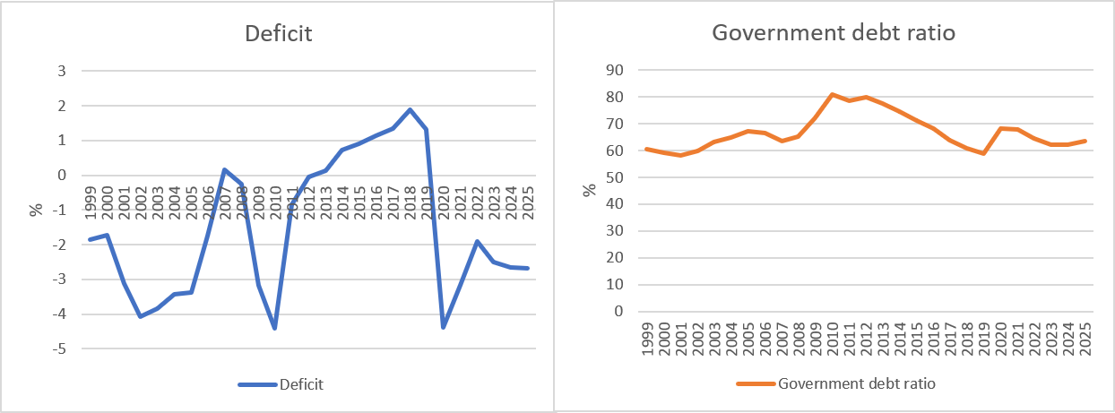
Development of the public budget and debt (Germany)
Cource: Destatis, Bundesbank
Deficit: Public Budget in relation to GDP
Government debt ratio : governemnt debt in relation to GDP

