Slide 1

Macroeconomics
Wilhelmshaven
This lecture will be recorded and
Subsequently uploaded in the
world-wide-web
Prof. Dr. Bernhard Köster
Jade-Hochschule Wilhelmshaven
http://www.bernhardkoester.de/vorlesungen/inhalt.html

Slide 2
Gross domestic product
Gross domestic product (GDP) is the total market value of all the goods and services produced within a country’s borders in a specific time period (i.e. 1 year) used for final consumption

Slide 3
GDP
„market value“
In order to aggregate different goods and service their market prices are considered.
Some goods do not have a market price. In this case production prices are considered
For public services wages public employees are considered
„all“
owner-occupied residential property is value by an average market rent.
Some goods and service cannot be statistically counted and are therefore not included into GDP (i. e. black market, educational performance of parents, honory posts)

Slide 4
GDP
„goods and services“
material and immaterial goods
„wihin a countries borders“:
domestic concept = national concept
+ factor income of non citizens in the considered country
– factor income of citizens of the considered country from abroad
„specific time period “
Quater or year
„final consumption“
Only value added is considered =
Production – intermediate consumption

Slide 5
Calculating GDP
Production approach – Value added of all economic sectors (activities)
Expenditure approach – final uses of goods and services (consumption, investment,
government expentitures, net exports (Ex-Im)
Income approach – Distribution of income on the different factors of production
(capital and labor)
Notes:
5

Slide 6
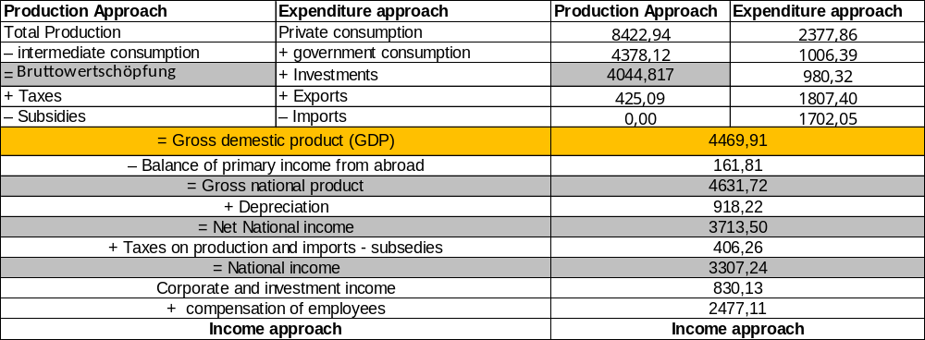
Gross dpmestic Product (Germany 2025)
Source: Destatis, current prices, Bil. Euro
Notes:
6

Slide 7
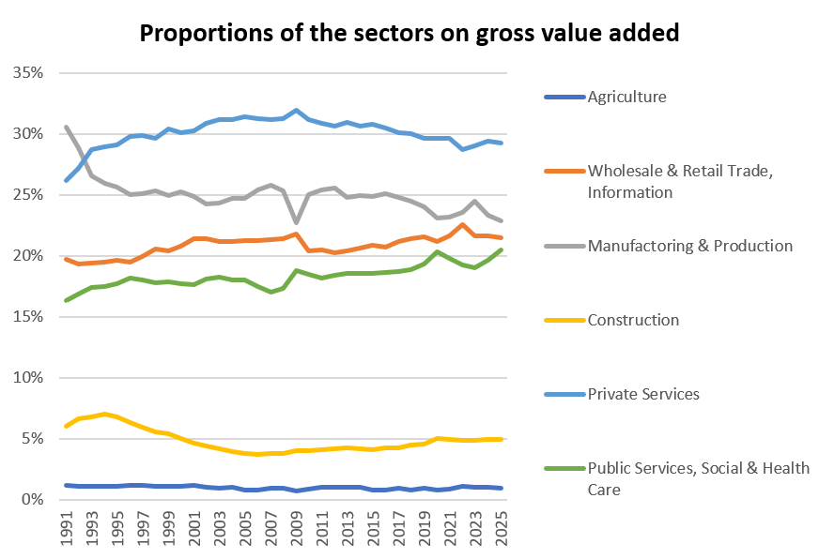
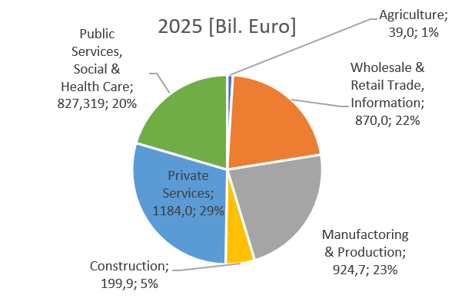
Production approach – Gross value added + taxes – subsidies = GDP (Germany 2025)
Source: Destatis, current prices, Bil. Euro

Slide 8
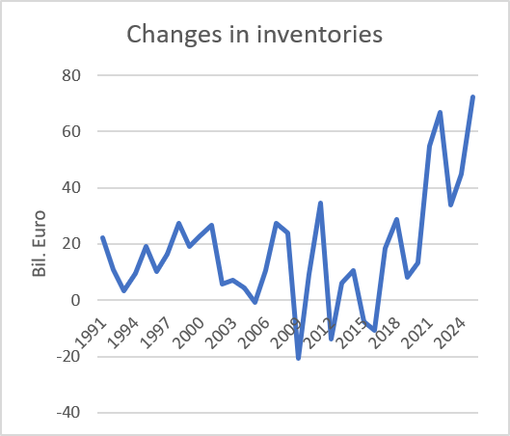
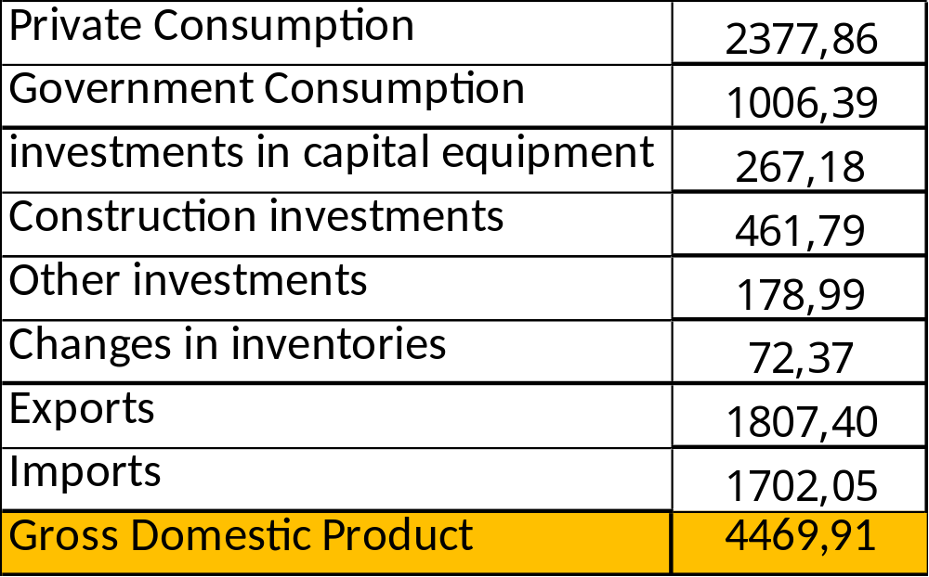
Expenditure approach Germany 2025
}
Consumption
}
Gross capital
investment
}
External contribution
Source: Destatis ,current prices, Mrd. Euro

Slide 9
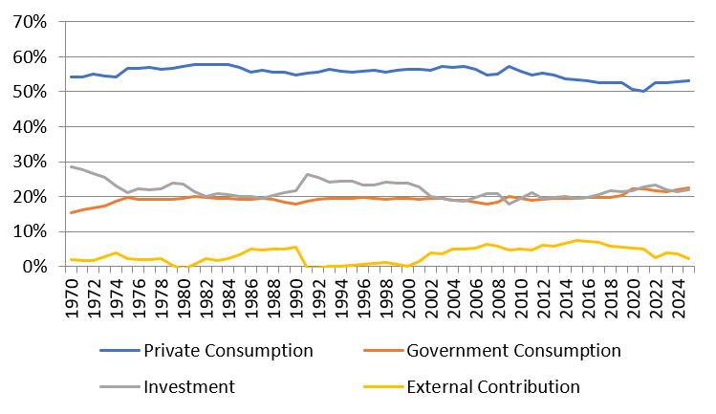
Development of the nominal proportions of the expenditure sectors of GDP (Germany)
Source: Destatis, current prices

Slide 10
Income approach
The income approach counts the different typs contributing to national income.
Mainly we look at the income from the general factors of production: Capital and Labor. Thus we count corporate and investment income from capital and compensation of employees from labor. The aggregate variable measuring the division of national income is the
compensation of employees
Labor Share =
national income

Slide 11
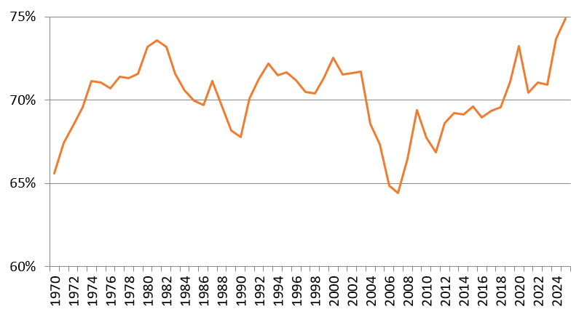
Development of the labor share (Germany): Income approach
Source: Destatis

