Slide 1




AS-AD-Model
Within the Keynesianschen IS-LM-Modell we find prices in order to obtain the real amount of money M/p but p is assumed to be constant
In the following, we relax this extreme assumption and assume partially flexible prices. But especially at the labour market, we still assume, that enterprises have some market power and thus they can demand a specific markup over marginal costs (i.e. monopolistic competition, oligopol, …)
Together with these assumptions we derive
Aggregated Supply: AS
Aggregated Demand: AD
Notes:
1

Slide 2


Aggregated supply: AS-Curve ($Y^{S}$) – General explaination
Keynesian Theory of rigid wages
Keynesian theory of rigid prices
Keynesian theory expectations
Notes:
2

Slide 3



Keynesian Theory of rigid wages
Within the profit maximization of enterprices, wages are one of the main cost factors.
If wages are constant in the short run marginal profits are rising, if output prices increase
Thus enterprises have an incentive to increase production if the price level is increasing.
Altogether we obtain an increased aggregated demand if price level has increased

Slide 4
Keynesian theory of rigid prices
Additionally to constant wages also prices of other goods and services are assumed to be rigid in the short run
Assume a decreasing price level in general. But some enterprices will not reduces their prices due to rigidities
In the following these enterprises will face falling revenues due to falling sales.
Overall this results in a lower aggregated supply triggered by a lower price level.

Slide 5

Keynesian theory expectations
In general we assume, that economic agents cannot perfectly distinguish between a general change in price level and their own relative prices
Therefore in a situation of a falling general price level, enterprises can mistakenly assume, that their own prices have fallen relative to other output prices.
Hence they will reduce their production
Similarily workers can mistakenly assume, if the price level has fallen, that their reduced own nominal wages imply a relative decrease of real wages
Hence they will reduce their work effort
Overall we obtain falling aggreagted supply if price level is falling

Slide 6
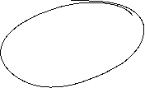


Aggreagted supply: AS-Kurve ($Y^{S}$)
p
AS:
$$Y^{S}$$
Y
Aggregated supply AS: $Y^{S}(\overset{+}{\overbrace{p}})$
Notes:
6

Slide 7


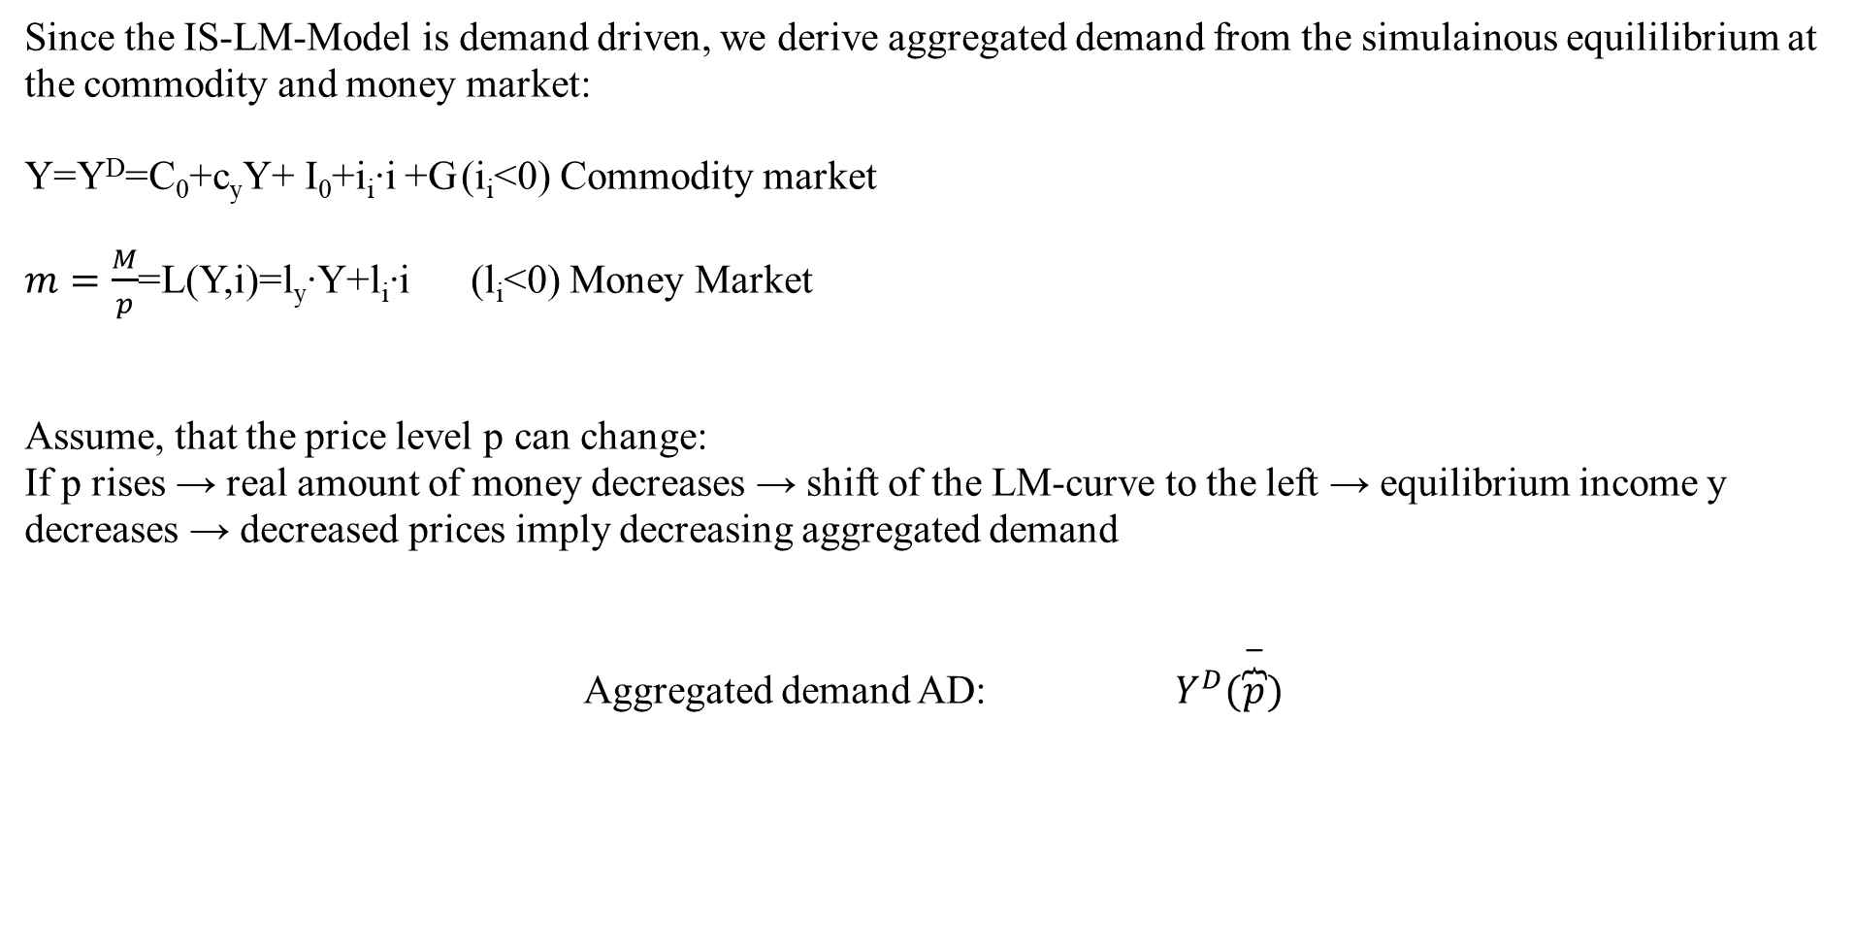

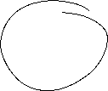
Aggregated demand
Since the IS-LM-Model is demand driven, we derive aggregated demand from the simulainous equililibrium at the commodity and money market:
Y=Y^{D}=C₀+c_{y}Y+ I₀+i_{i}∙i +G (i_{i}<0) Commodity market
$m=\frac{M}{p}$=L(Y,i)=l_{y}∙Y+l_{i}∙i (l_{i}<0) Money Market
Assume, that the price level p can change:
If p rises → real amount of money decreases → shift of the LM-curve to the left → equilibrium income y decreases → decreased prices imply decreasing aggregated demand
Aggregated demand AD: $Y^{D}(\overset{−}{\overbrace{p}})$
Notes:
7

Slide 8
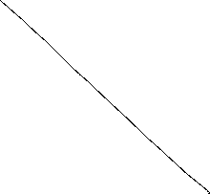
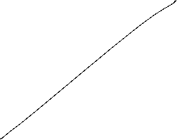
Grafical derivation of the AD-curve
i
LM-curve (p₀)
p₁>p₀
i*(p₀)
IS-curve
P
Y*(p₀)
Y
AD-curve
Y

Slide 9
AS-AD-Model
p
AS-curve
p*
AD-curve
Y*
Y
We obtain a Supply-Demand-Diagram in prices and output similar to microeconomic theory
Caution! The derivation of AS and AD should not be confound with micro economic explaination of demand via utility maximization for demand profit maximazation for supply!
Altogether (p*,Y*) represents the short-run-equilibrium in the economy.

Slide 10






Short-run and long-run perspective in the AS-AD-Model
Long-run supply
AS_{long}
p
AS-curve
p*
AD-curve
Y_{n}=Y*
Y
In the long run prices are totally flexible and therefore expected prices will coincide with actual prices. Therefore in the long-run output depends mainly on the framework conditions of the economy (education, infrastructure, resources,…), in general on the level of technology. The possible output dependent of framework conditions is called natural out and does not depend anymore on prices. Therefore Y_{n}=Y* can be identified with a long-run Supply, which is vertical in the p-y-diagram

Slide 11
Monetary and fiscal policy in the AS-AD-Model
Explain the impact of
a nominal increase of the amount of money
an increase of government expenditure
Within the AS-AD-Model in a short-run and long-run perspective

Slide 12

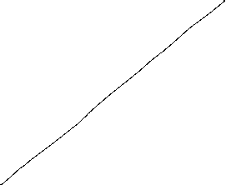

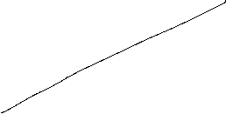





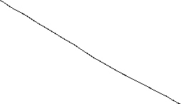
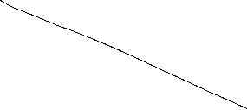


Fiscal policy in the AS-AD-Model
AS_{long}
LM
i
IS
P
Y_{n}
Y
AS
p₀
A
AD
Y_{n}
Y

Slide 13
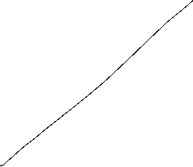

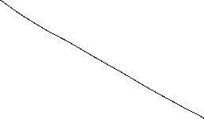

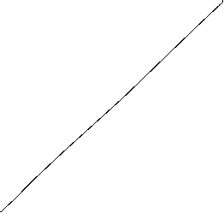
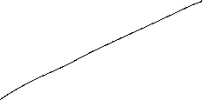

Monetary policy in the AS-AD-Model
AS_{lang}
LM
i
IS
P
Y_{n}
Y
AS
p₀
A
AD
Y_{n}
Y

Slide 14
Summary AS-AD-Model/IS-LM-Model
The impact of monetary and fiscal policy within the short run AS-AD-Model is reduced compared to the IS-LM-Model since the change in prices absorb some amount of the expansive effect.
With respect to the long-run supply-curve monetary and fiscal policy within the AS-AD-Modell do not have any expansive effect on output, only prices will increase. But keep in mind, that this requires perfect competion in commodity and expecially labour markets!
Caution! Since we have neither in the AS-AD-Model nor in the IS-LM-Model an explicit time dependence, we have to keep in mind that theoretically all effects happens simultanously. In reality adjustments have a time delay and also the framework conditions can change in time. Therefore, we will also have structual changes during time. Especially „good“ economic policy tries to increase the technology level and natural output.

Slide 15




The Neoclassical Model

Slide 16
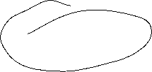
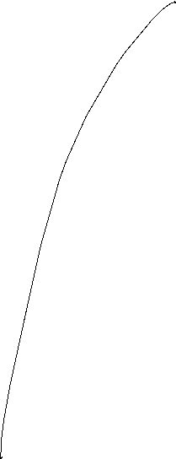






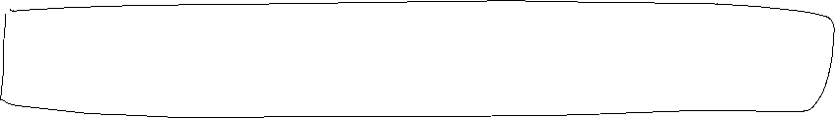

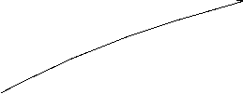




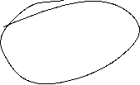



Aggregated Production

Slide 17


Neoclassical production: positive diminishing productivity
Y = A ∙ F(K,L)
Suppose K=constant
$$Y$$
$$\text{L}$$

Slide 18





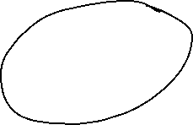
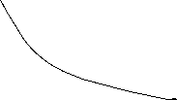
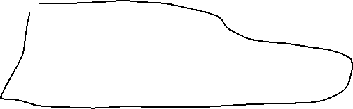


Neoclassical model: Labor market − Labor demand
Profit: $π=py\left(A,K,L\right)−(iK+wL)$
Optimality condition:
Derivation of the demand function:

Slide 19
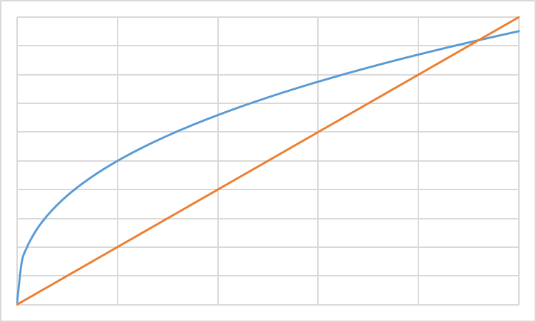
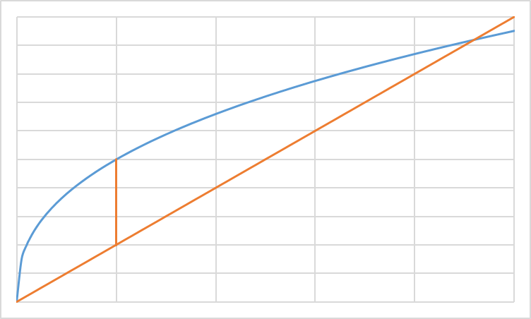
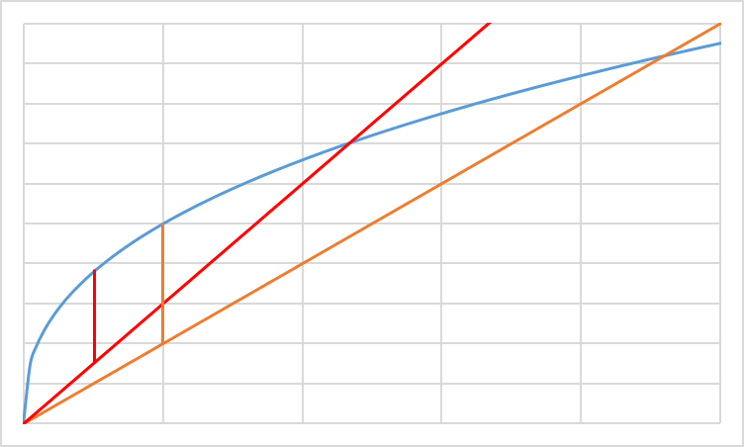


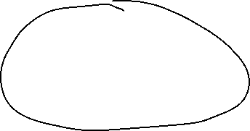
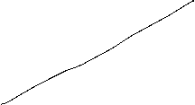




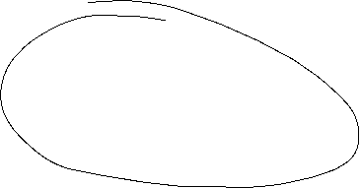

Profit maximization L (grafical)
ω=w/p real wage
Cost; Output
ω₂L: real cost
ω₁L: real cost
y(L): Output
L
L*(ω₂)
L*(ω₁)
L^{D}(ω)
ω

Slide 20
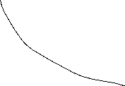

Neoclassical model: Capital market − Capital demand
Profit: $π=py\left(A,K,L\right)−(iK+wL)$
Optimality condition:
Derivation of the demand function:

Slide 21
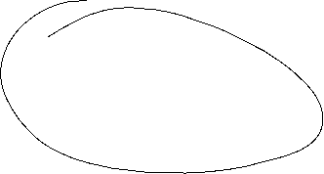
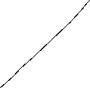
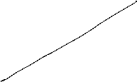
Profit maximization K (grafical)
r=i/p Real interest rate
Cost; Output
r₂L: real cost
r₁L: real cost
y(K): Output
K
K*(r₂)
K*(r₁)
K^{D}(r)
r

Slide 22













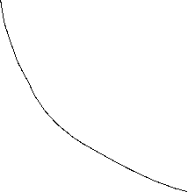



Slide 23













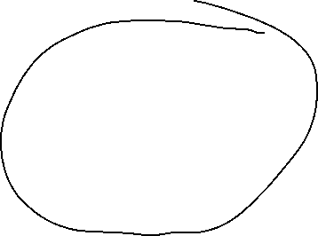






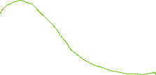


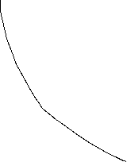






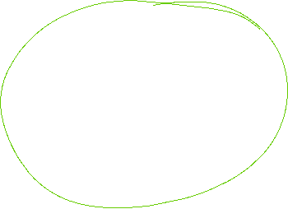



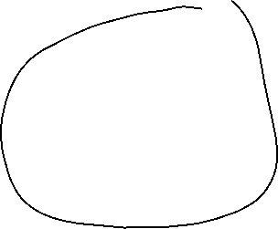




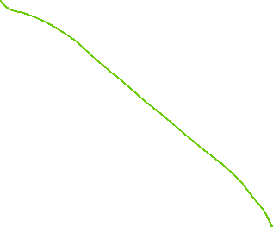

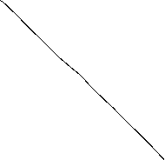
Labor supply
Untilty function: u(f,c)
Budget restriction: pc=wL
und $\overline{L}$-L=f
c
f

Slide 24

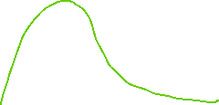

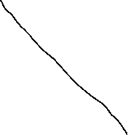






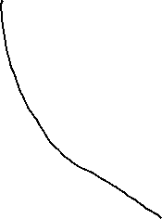


Capital supply
Utility function: u(c₁,c₂)
Budget restriction: m= c₁+s
und (1+i)s= c₂
c₂
c₁

Slide 25


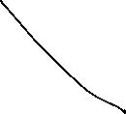


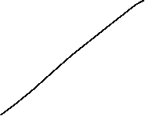






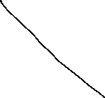
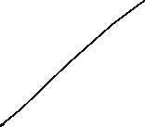

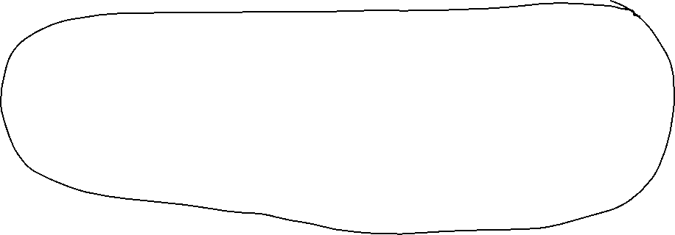
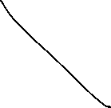

Capital market- und Labor market equilibrium

Slide 26
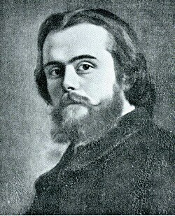
Walras´ law
Marie-Esprit-Léon Walras (16 December 1834 – 5 January 1910) was a French mathematical economist
Professor of Political Economy at the University of Lausanne
Éléments d'économie politique pure (1874)
start of the mathematization of economics establishing the concept of general equilibrium

Slide 27

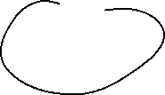



Neoclassic: Say´s law and natural unemployment

Slide 28















Neoclassical model: Say´s law
Income
Jean-Baptiste Say (5 January 1767 Lyon – 15 November 1832 Paris)
French economist and businessman
Traité d'économie politique, ou Simple exposition de la manière dont se forment, se distribuent et se consomment les richesse (1803)
Say`s law
Enterprises
Households
Consumption
Investment
Savings
Capital markets

Slide 29




Neoclassical synthesis
$$p$$
$$ω=\frac{w}{p}$$
$$y$$
$$L$$

Slide 30













Neoclassical model of general equilibrium
production
price and real wages
Produktionsniveau
Preis- und Reallohnniveau
$$p$$
$$y^{S}$$
$$w^{∗}$$
$$p^{∗}$$
$$y^{D}(p,G,M)$$
$${\left(\frac{w}{p}\right)}^{∗}$$
$$ω=\frac{w}{p}$$
$$y^{∗}$$
$$y$$
$$L^{∗}$$
$$L^{S}$$
$$L^{D}$$
$$L$$
Production function
Produktionsfunktion
Labormarket
Arbeitsmarkt

Slide 31
Monetary and Fiscal policy in the Neocalssical theory
In the neocalssical theory monetary and fiscal policy have ultimately no effect on real variables since the production level y^{S} depends only on the framework conditions of the economy. Thus only the production function and preferences of households are relevant. Whilst this framework is not change production level y* and real wage $ω$* stays unchanged.
Monetary policy: An increase of the amount of money shifts the curve of the camebridge equation to the leftand thus price level is increased 1:1. Therefore an increased amount of money increases nominal wages, but this increase is totally absorbed by the increase of price implying, that real wages $ω$* are not changed and so the level of output y*
Fiscal policy: Increased governement expenditure increases the demand for goods in general. Enterprises can react via an increase of quantity and prices. This time in opposite to Keynes prices are fully flexible and therefore additional demand is totally absorbed by an increase of prices and again that real wages $ω$* are not changed and so the level of output y*

Slide 32
Neoclassical and Keynesian theory
In the short run an impulse via fiscal policy can work, since in practice prices are not fully flexible. But in the long run prices will change and artificially stimulated demand will be absorbed via an price level increase.
A similar reasoning is seein case of monetary policy. An induced increase of the amount of money channeled byreduced interest rates can stimulated investment if prices are rigid in the short run. But in the long rund will become flexible and adjust and thus the stimulus will be absorbed by anincreasing price level.
In general, we have:
→ Keynes: short run
→ Neoclassic: long Frist
Caution! We are in social sciences and thus, there is no „true“ model, since we can always change the framework conditions by ourselves. Please stay sceptical if people tell you, that the economy functions in a specific way. It is much more important to observe the circumstances and apply the „right“ theory in the „right“ time. For example the development of inflation rates over the last 10 years can be well explained via a crossing from keynesan theory to neoclassical theory
Notes:
32

Slide 33



Apple2000, Salmo trutta fario-1, CC BY-SA 3.0
Encyclopedia britannica
© Hans Hillewaert, Platichthys flesus 1, CC BY-SA 4.0
Notes:
33

