Slide 1





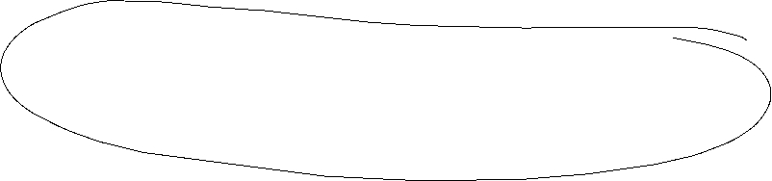


IS/LM-Model
Until now in the Keynesian model we have no prices ( respectively we normalized P=1 and therefore P vanishes in all equations) since due to the demand oriented view supply and demand equalizes only because of adjustments of quantities on the production side.
Additionally the money market is not incorporated and the connection between nominal and real variables is missing. But this link is essential in a modern economy since in general goods an services are measured in money.
The connection between the goods market and the money market is realized via interest rates steering Investment and money demand
The resulting model is still demand oriented and called the IS/LM-Model

Slide 2




IS/LM-Model
IS: Investment = Saving (or Income = Expenditure)
► Commodity market
LM: Liquidity Preference = Money Supply
► Money market
The IS-curve represents the equilibrium at the goods market with I=S or Y^{D}=Y
Caution! I=S is in this case a condition and not an (ex post) identity as in the circular flow!
Equilibrium at the money market
money supply = money demand
While we obtain money demand via the Keynesian function of money demand.
The LM-Curve represents then the equilibrium at the money market

Slide 3
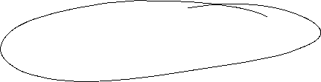




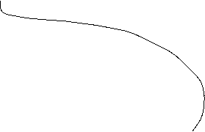



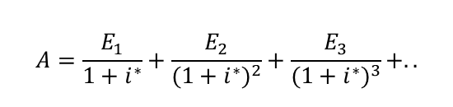






Interest rates and Investment (Keynes` marginal efficiency of capital)
Investment depends interest rate i:
I(i)=I₀+i_{i}∙i with i_{i} <0 I_{0>0} Autonomous investment and i_{i} <0 why?
The yield i* or marginal efficiency of capital of an investment is compared with i the interest rate of the capital market. For example we calculate the internal rate of return
⇒ the Investment is done if i*>i
⇒ The aggregated investment in the economy corresponds to the sum of all investments with i*>i.
Interest rates reflects the opportunity costs of a specific investment.
$$A=\frac{E_{1}}{1+i^{∗}}+\frac{E_{2}}{{(1+i^{∗})}^{2}}+\frac{E_{3}}{{(1+i^{∗})}^{3}}+..$$

Slide 4



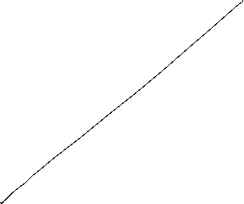








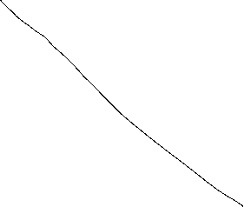

The IS-curve
Y^{D}
Y
i
Equilibrium at the commodity market
The IS-curve is the locus of all (i,y)-combinations of commodity market equilibria
The IS-curve is decreasing in y
Y

Slide 5


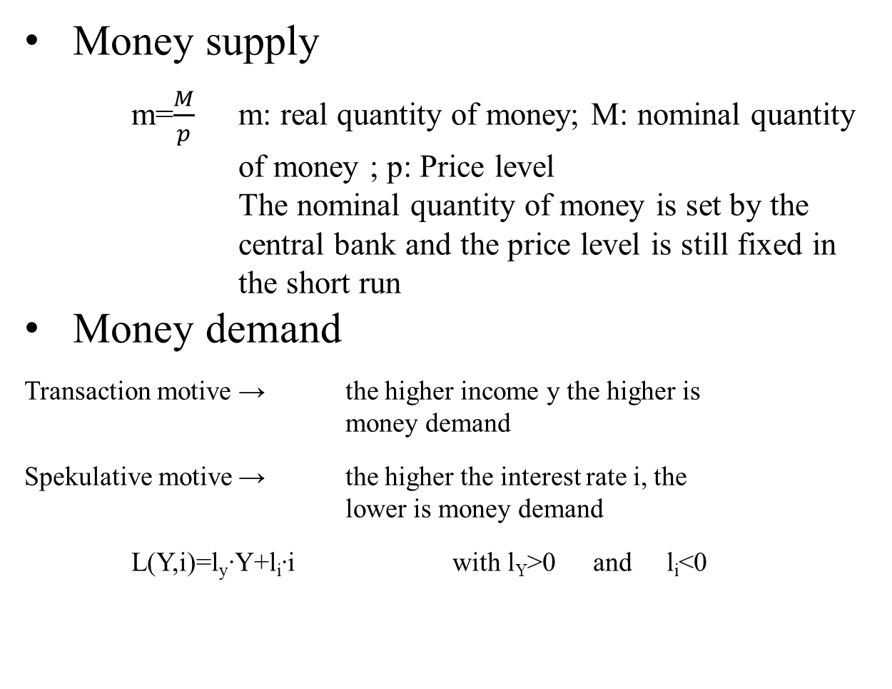


Money market
Money supply
m=$\frac{M}{p}$ m: real quantity of money; M: nominal quantity of money ; p: Price level
The nominal quantity of money is set by the central bank and the price level is still fixed in the short run
Money demand
Transaction motive → the higher income y the higher is money demand
Spekulative motive → the higher the interest rate i, the lower is money demand
L(Y,i)=l_{y}∙Y+l_{i}∙i with l_{Y}>0 and l_{i}<0

Slide 6


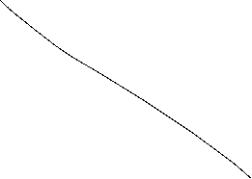




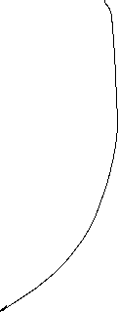


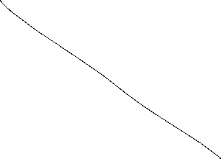
The LM-curve
$$i$$
$$i$$
L, M/p
y
Equilibrium at the money market
The LM-curve is the locus of all (i,y)-combinations of money market equilibria
The LM-curve is increasing in y

Slide 7
Overall equilibrium
i
LM-curve
i*
IS-curve
Y*
Y
The Intersection of LM- und IS-curve is the overall equilibrium
→ money and commodity market are simultanously in equilibrium

Slide 8
Example
C(Y)=C₀+c_{y}∙Y=50+0,8Y
I(i)=I₀+i_{i}∙i=30-300i
G=20
L(Y,r)=l_{y}∙Y+l_{i}∙i=0,5Y – 250i
M=400 p=2
Determine the IS-Kurve
Determine the LM-Kurve
Determine the simultanous equilibrium at the money and commidity market with equilibrium interest rate i* and income Y*

Slide 9

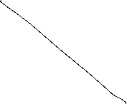


C(Y)=C₀+c_{y}∙Y=50+0,8Y I(i)=I₀+i_{i}∙i=30-300i G=20
L(Y,r)=l_{y}∙Y+l_{i}∙i=0,5Y – 250i M=400 p=2

Slide 10

Fiscal policy in the IS-LM-Model
+ ΔG
Y^{D}
Y^{D}=Y
Y^{D}(i₁, G+ ΔG)
Y^{D}(i₁, G)
C₀+I(i₁)+G+ΔG
C₀+I(i₁)+G
∆G >0
Y*₁(G)
Y*₂(G +∆G)
Y
i
i₁
IS(G)
IS(G +∆G)
Y*₁(i₁, G)
Y*₁(i₁, G +∆G)
Y

Slide 11







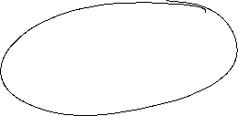












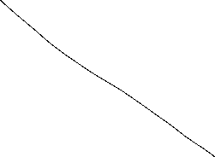

Fiscal policy in the IS-LM-Model
G↑ -> + ΔG
i
LM
IS(G)
i*(G)
Y* (G)
Y

Slide 12
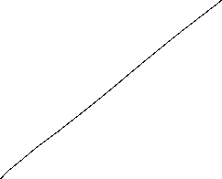













Monetary policy in the IS-LM-Model
+ ΔM
$$M/p$$
LM($M$)
$$i$$
$$i$$
$\text{i}\text{∗}\text{1}$($\text{Y}\text{1} ,M$)
$L(\text{Y}\text{1}$)
L, M/p
Y₁

Slide 13

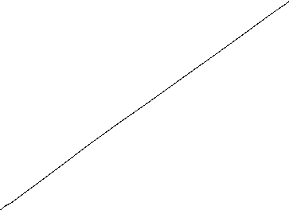




Monetary policy in the IS-LM-Model
M↑ -> + ΔM
i
LM(M)
IS
i*(M)
Y* (M)
Y

Slide 14
Example
C(Y)=C₀+c_{y}∙Y=50+0,8Y
I(i)=I₀+i_{i}∙i=30-300i
G=20
L(Y,i)=l_{y}∙Y+l_{i}∙i=0,5Y – 250i
M=400 p=2
Determine the fiscal impulse if government expenditure doubles.
Determine the monetary impuls if the quantity of money is increased by 25%.

Slide 15

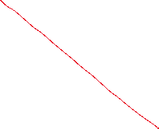
C(Y)=C₀+c_{y}∙Y=50+0,8Y I(i)=I₀+i_{i}∙i=30-300i G=20
L(Y,r)=l_{y}∙Y+l_{i}∙i=0,5Y – 250i M=400 p=2
Determine the fiscal impulse if government expenditure doubles.

Slide 16




C(Y)=C₀+c_{y}∙Y=50+0,8Y I(i)=I₀+i_{i}∙i=30-300i G=20
L(Y,r)=l_{y}∙Y+l_{i}∙i=0,5Y – 250i M=400 p=2
Determine the monetary impuls if the quantity of money is increased by 25%.

Slide 17
Example

Slide 18




AS-AD-Model
Within the Keynesianschen IS-LM-Modell we find prices in order to obtain the real amount of money M/p but p is assumed to be constant
In the following, we relax this extreme assumption and assume partially flexible prices. But especially at the labour market, we still assume, that enterprises have some market power and thus they can demand a specific markup over marginal costs (i.e. monopolistic competition, oligopol, …)
Together with these assumptions we derive
Aggregated Supply: AS
Aggregated Demand: AD
Notes:
18

Slide 19


Aggregated supply: AS-Curve ($Y^{S}$) – General explaination
Keynesian Theory of rigid wages
Keynesian theory of rigid prices
Keynesian theory expectations
Notes:
19

Slide 20



Keynesian Theory of rigid wages
Within the profit maximization of enterprices, wages are one of the main cost factors.
If wages are constant in the short run marginal profits are rising, if output prices increase
Thus enterprises have an incentive to increase production if the price level is increasing.
Altogether we obtain an increased aggregated demand if price level has increased

Slide 21
Keynesian theory of rigid prices
Additionally to constant wages also prices of other goods and services are assumed to be rigid in the short run
Assume a decreasing price level in general. But some enterprices will not reduces their prices due to rigidities
In the following these enterprises will face falling revenues due to falling sales.
Overall this results in a lower aggregated supply triggered by a lower price level.

Slide 22

Keynesian theory expectations
In general we assume, that economic agents cannot perfectly distinguish between a general change in price level and their own relative prices
Therefore in a situation of a falling general price level, enterprises can mistakenly assume, that their own prices have fallen relative to other output prices.
Hence they will reduce their production
Similarily workers can mistakenly assume, if the price level has fallen, that their reduced own nominal wages imply a relative decrease of real wages
Hence they will reduce their work effort
Overall we obtain falling aggreagted supply if price level is falling

Slide 23
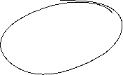


Aggreagted supply: AS-Kurve ($Y^{S}$)
p
AS:
$$Y^{S}$$
Y
Aggregated supply AS: $Y^{S}(\overset{+}{\overbrace{p}})$
Notes:
23

Slide 24


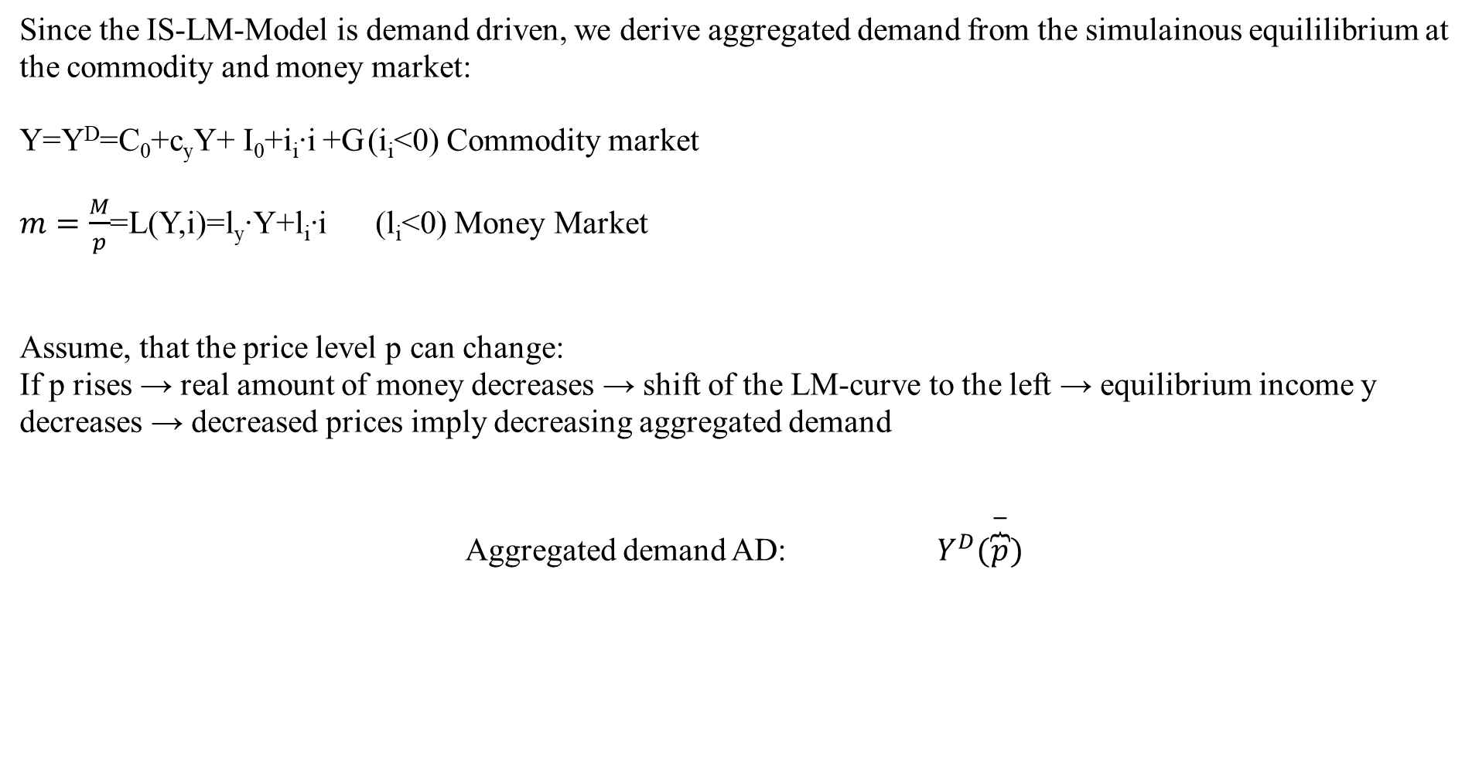

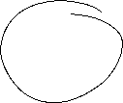
Aggregated demand
Since the IS-LM-Model is demand driven, we derive aggregated demand from the simulainous equililibrium at the commodity and money market:
Y=Y^{D}=C₀+c_{y}Y+ I₀+i_{i}∙i +G (i_{i}<0) Commodity market
$m=\frac{M}{p}$=L(Y,i)=l_{y}∙Y+l_{i}∙i (l_{i}<0) Money Market
Assume, that the price level p can change:
If p rises → real amount of money decreases → shift of the LM-curve to the left → equilibrium income y decreases → decreased prices imply decreasing aggregated demand
Aggregated demand AD: $Y^{D}(\overset{−}{\overbrace{p}})$
Notes:
24

Slide 25
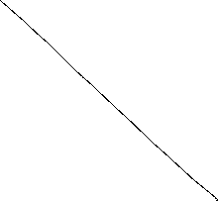
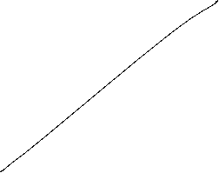
Grafical derivation of the AD-curve
i
LM-curve (p₀)
p₁>p₀
i*(p₀)
IS-curve
P
Y*(p₀)
Y
AD-curve
Y

Slide 26
AS-AD-Model
p
AS-curve
p*
AD-curve
Y*
Y
We obtain a Supply-Demand-Diagram in prices and output similar to microeconomic theory
Caution! The derivation of AS and AD should not be confound with micro economic explaination of demand via utility maximization for demand profit maximazation for supply!
Altogether (p*,Y*) represents the short-run-equilibrium in the economy.

Slide 27





Short-run and long-run perspective in the AS-AD-Model
Long-run supply
AS_{long}
p
AS-curve
p*
AD-curve
Y_{n}=Y*
Y
In the long run prices are totally flexible and therefore expected prices will coincide with actual prices. Therefore in the long-run output depends mainly on the framework conditions of the economy (education, infrastructure, resources,…), in general on the level of technology. The possible output dependent of framework conditions is called natural out and does not depend anymore on prices. Therefore Y_{n}=Y* can be identified with a long-run Supply, which is vertical in the p-y-diagram

Slide 28
Monetary and fiscal policy in the AS-AD-Model
Explain the impact of
a nominal increase of the amount of money
an increase of government expenditure
Within the AS-AD-Model in a short-run and long-run perspective

Slide 29

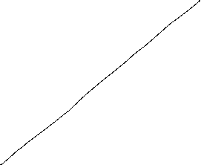

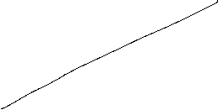





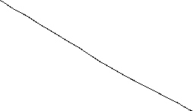
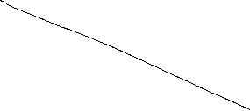


Fiscal policy in the AS-AD-Model
AS_{long}
LM
i
IS
P
Y_{n}
Y
AS
p₀
A
AD
Y_{n}
Y

Slide 30
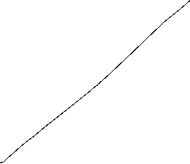

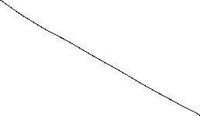

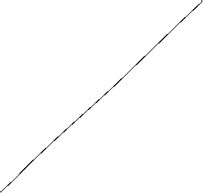
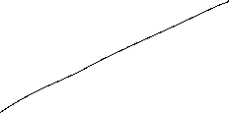

Monetary policy in the AS-AD-Model
AS_{lang}
LM
i
IS
P
Y_{n}
Y
AS
p₀
A
AD
Y_{n}
Y

Slide 31
Summary AS-AD-Model/IS-LM-Model
The impact of monetary and fiscal policy within the short run AS-AD-Model is reduced compared to the IS-LM-Model since the change in prices absorb some amount of the expansive effect.
With respect to the long-run supply-curve monetary and fiscal policy within the AS-AD-Modell do not have any expansive effect on output, only prices will increase. But keep in mind, that this requires perfect competion in commodity and expecially labour markets!
Caution! Since we have neither in the AS-AD-Model nor in the IS-LM-Model an explicit time dependence, we have to keep in mind that theoretically all effects happens simultanously. In reality adjustments have a time delay and also the framework conditions can change in time. Therefore, we will also have structual changes during time. Especially „good“ economic policy tries to increase the technology level and natural output.

Slide 32




The Neoclassical Model

Slide 33
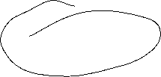
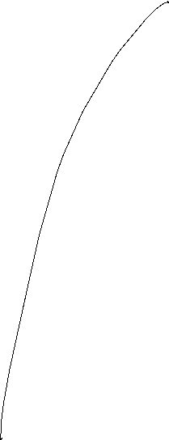








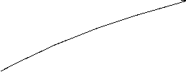




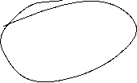



Aggregated Production

Slide 34


Neoclassical production: positive diminishing productivity
Y = A ∙ F(K,L)
Suppose K=constant
$$Y$$
$$\text{L}$$

Slide 35


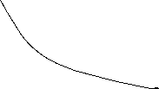

Neoclassical model: Labor market − Labor demand
Profit: $π=py\left(A,K,L\right)−(iK+wL)$
Optimality condition:
Derivation of the demand function:

Slide 36
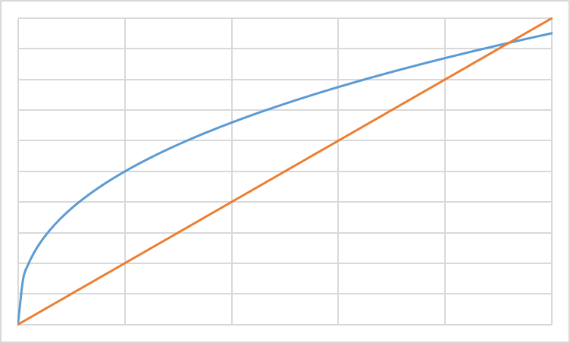
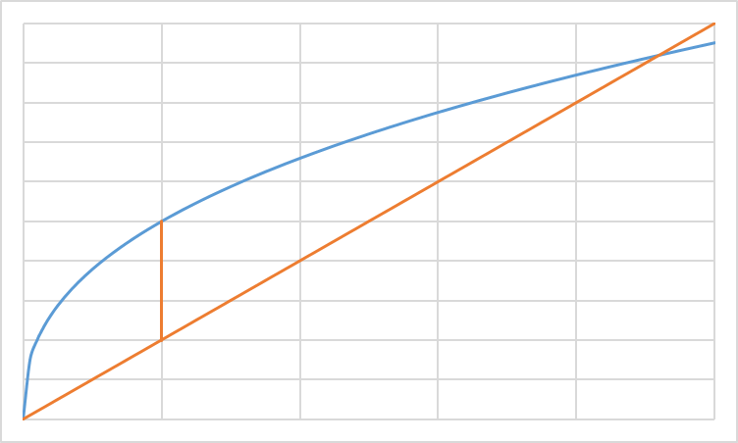
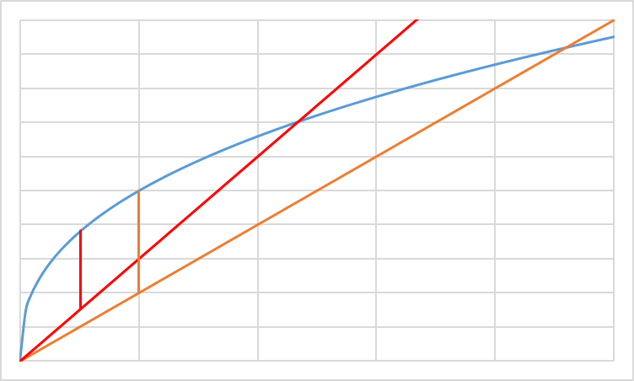

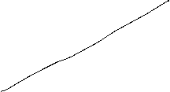


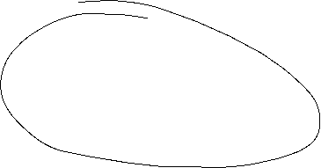

Profit maximization L (grafical)
ω=w/p real wage
Cost; Output
ω₂L: real cost
ω₁L: real cost
y(L): Output
L
L*(ω₂)
L*(ω₁)
L^{D}(ω)
ω

Slide 37
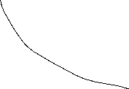

Neoclassical model: Capital market − Capital demand
Profit: $π=py\left(A,K,L\right)−(iK+wL)$
Optimality condition:
Derivation of the demand function:

Slide 38
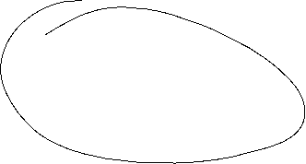
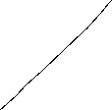
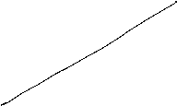
Profit maximization K (grafical)
r=i/p Real interest rate
Cost; Output
r₂L: real cost
r₁L: real cost
y(K): Output
K
K*(r₂)
K*(r₁)
K^{D}(r)
r

Slide 39












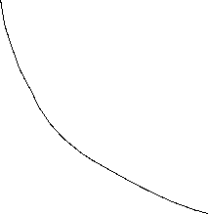


Slide 40














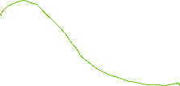

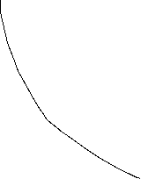









Labor supply
Untilty function: u(f,c)
Budget restriction: pc=wL
und $\overline{L}$-L=f
c
f

Slide 41
Capital supply
Utility function: u(c₁,c₂)
Budget restriction: m= c₁+s
und (1+i)s=c
c₂
c₁

Slide 42
Capital market- und Labor market equilibrium

Slide 43
Walras´ law

Slide 44
Neoclassic: Say´s law and natural unemployment

Slide 45
Neoclassical model: Say´s law
Income
Enterprises
Households
Consumption
Investment
Savings
Capital markets

Slide 46

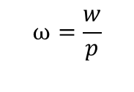


Neoclassical synthesis
$$p$$
$$ω=\frac{w}{p}$$
$$y$$
$$L$$

Slide 47













Neoclassical model of general equilibrium
production
price and real wages
Produktionsniveau
Preis- und Reallohnniveau
$$p$$
$$y^{S}$$
$$w^{∗}$$
$$p^{∗}$$
$$y^{D}(p,G,M)$$
$${\left(\frac{w}{p}\right)}^{∗}$$
$$ω=\frac{w}{p}$$
$$y^{∗}$$
$$y$$
$$L^{∗}$$
$$L^{S}$$
$$L^{D}$$
$$L$$
Production function
Produktionsfunktion
Labormarket
Arbeitsmarkt

Slide 48
Monetary and Fiscal policy in the Neocalssical theory
In the neocalssical theory monetary and fiscal policy have ultimately no effect on real variables since the production level y^{S} depends only on the framework conditions of the economy. Thus only the production function and preferences of households are relevant. Whilst this framework is not change production level y* and real wage $ω$* stays unchanged.
Monetary policy: An increase of the amount of money shifts the curve of the camebridge equation to the leftand thus price level is increased 1:1. Therefore an increased amount of money increases nominal wages, but this increase is totally absorbed by the increase of price implying, that real wages $ω$* are not changed and so the level of output y*
Fiscal policy: Increased governement expenditure increases the demand for goods in general. Enterprises can react via an increase of quantity and prices. This time in opposite to Keynes prices are fully flexible and therefore additional demand is totally absorbed by an increase of prices and again that real wages $ω$* are not changed and so the level of output y*

Slide 49
Neoclassical and Keynesian theory
In the short run an impulse via fiscal policy can work, since in practice prices are not fully flexible. But in the long run prices will change and artificially stimulated demand will be absorbed via an price level increase.
A similar reasoning is seein case of monetary policy. An induced increase of the amount of money channeled byreduced interest rates can stimulated investment if prices are rigid in the short run. But in the long rund will become flexible and adjust and thus the stimulus will be absorbed by anincreasing price level.
In general, we have:
→ Keynes: short run
→ Neoclassic: long Frist
Caution! We are in social sciences and thus, there is no „true“ model, since we can always change the framework conditions by ourselves. Please stay sceptical if people tell you, that the economy functions in a specific way. It is much more important to observe the circumstances and apply the „right“ theory in the „right“ time. For example the development of inflation rates over the last 10 years can be well explained via a crossing from keynesan theory to neoclassical theory
Notes:
49

Slide 50



Apple2000, Salmo trutta fario-1, CC BY-SA 3.0
Encyclopedia britannica
© Hans Hillewaert, Platichthys flesus 1, CC BY-SA 4.0
Notes:
50

