Slide 1

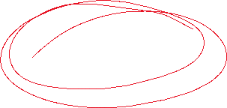

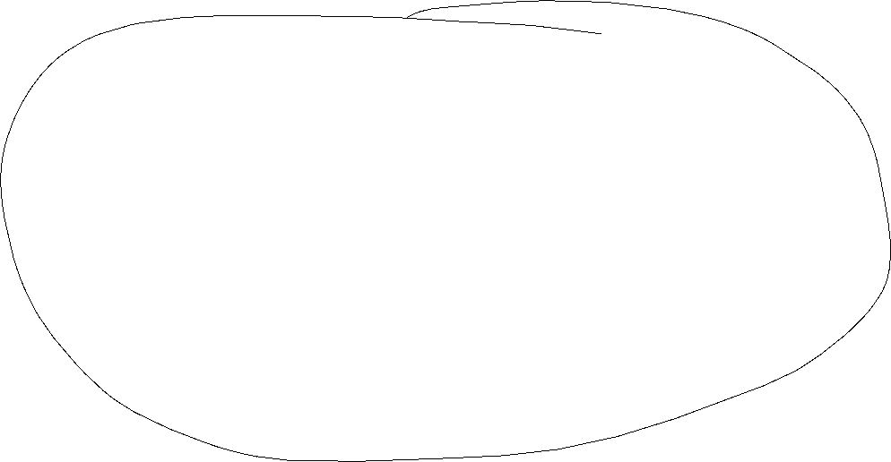


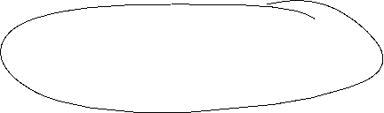

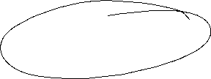


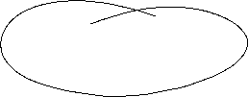
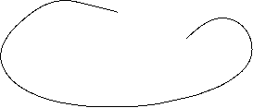
Keynesian Economics
Short run:
  Production capacities are not fully utilized
  Consumptions- and investment plans are totally fulfilled
  Only the supply-side to adjust due to changes
  Supply and demand are only equalized via changes in production not in prices.
  In the short run prices are fixed
  Aggregate Demand determines the equilibrium in the economy.

Slide 2














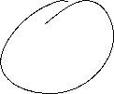








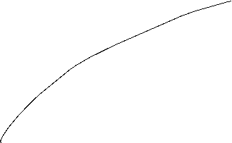


































Keynesian Cross
Aggregate demand Y^{D}:
Y^{D}=C+I+G
C (private consumption); I (Investment); G (Government expenditure); I and G sare exogenously fixed variables, C depends positively on aggregate income (production) Y
Keynesian consumption function:
C(Y)=C₀+c_{y}Y C₀>0 (autonous consumption); 0<c_{y}<1(marginal propensity to consum)
Euqilibrium: With aggregate income (production) Y is determined by the aggreate demand Y^{D} →
Y=Y^{D}=C₀+c_{y}Y+I+G
Notes:
2

Slide 3



Consumption
In Germany the savings rate is roughly s_{y}= 11% :
What is then the consumption rate c_{y}?
Income Y is divided into consumption and savings (compare the circular flow!)
→c_{y}+ s_{y} =1 → c_{y}=1 – s_{y} =89 %
Interpretation: If we have1000 additional Euros, then 890 Euros are directly spent for consumption (first derivative of the consumption function!)

Slide 4





Consumption
Consumption C(y)
C(y)= C₀+c_{y}Y=100+0,89Y
+ 0,89€ Consumption
corresponds to savings of 0,11€
+ 1€ Income
Autonomous consumption
C₀ =100
Income (y)

Slide 5


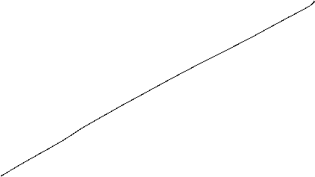




























Keynesian Cross
Expenditure(Y^{D})
Income(Y)

Slide 6

Commodity Market euqilibrium
Income =
Expenditure Y^{D}=C₀+c_{y}Y+I+G
45°-Line: locus of every possibility with
Y^{D}=Y → possible equlibria
Linear linear through the origin with
Slope 1
Y^{D}=Y
Expenditure (Y^{D})
Intersection or 45°-Line and aggregate demand
Y^{D}=Y=Y*
Investment I +
Government expenditure G
consumption C(Y)=C₀+c_{y}Y
Investment I
+
Governement
expenditure G
Aggregate demand not dependent on income Y
Autonomous Consumption C₀
45°
Y^{D}=Y=Y*
Income(Y)
Intersection or 45°-Line and aggregate demand
  Equilibrium: Expenditure (Y^{D}) = Income (Y) = Production (Y) = Y*

Slide 7





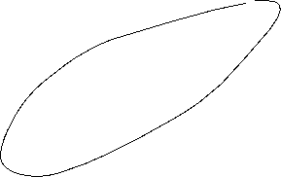













Adaption process
Equilibrium Y^{D}=Y=Y*
Y=Y^{D}
Expenditure (Y^{D})
Production larger than demand
Inventory built-up
Expenditure(Y^{D}) = Demand
Y*
Demand larger than Production
Iinventory has to decrease
45°
$$Y_{0}$$
Y*
$$Y_{0}′$$
Income (Y)

Slide 8
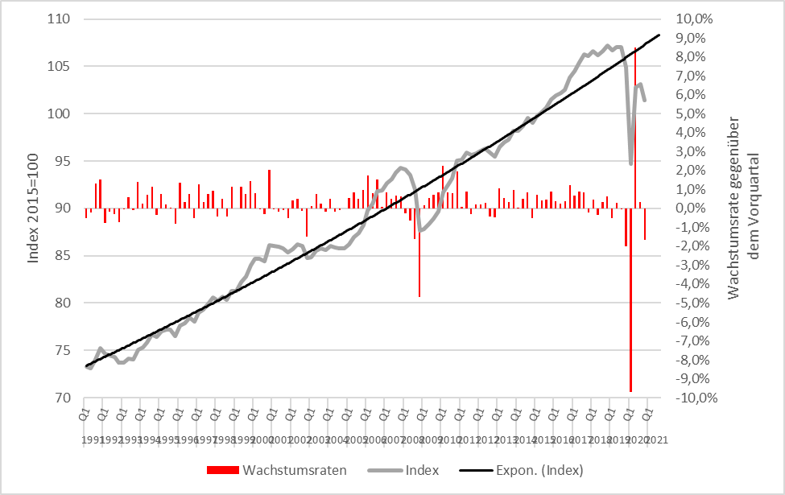
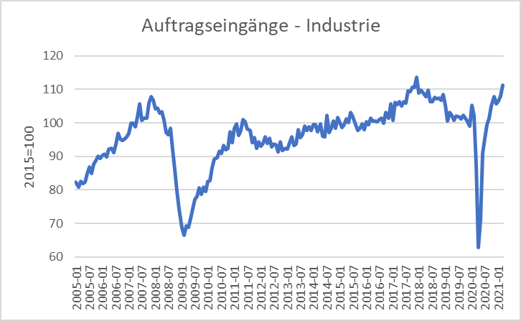



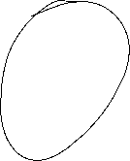


Scrappage Allowance 2009 (Germany): Increase of government expenditure 5 Bil. €
Real economic growth
Incoming orders
Source: Destatis

Slide 9












Multiplier: Scrappage Allowance in the Keynesian Commodity Market
Y^{D}=Y
Expenditure (Y^{D})
$${Expenditure}_{0} ({\text{Y}\text{D}}_{0})$$
Multiplier$=\frac{∆Y}{∆G}$
$$Y_{0}$$
$$Y_{1}$$
Income (Y)

Slide 10







Multiplier effect
External increase of demand, increase of government expenditure of ∆G = 5 and marginal propensity to consum of c_{y}=0,9:
→ additional government consumption ∆G increases directly income Y bei ∆Y₁= ∆G
→
Notes:
10

Slide 11
(Government expenditure) Multiplier
Multiplier: How much increases one variable, if another variable increase by one unit
Government expenditure Multiplier:
Change of equilibrium income, of governement expenditure increases by one unit.
Notes:
11

Slide 12
Multiplier effect (example)
C(Y)= 100+0,8Y; I=400; G=200
Calculate equlibrium income?
Change in equilibrium income, if governement expenditure increases by 100
Calculate the government expenditure multiplier?
Notes:
12

Slide 13


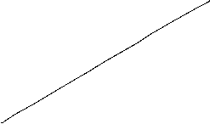

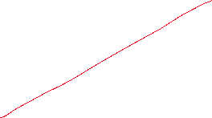







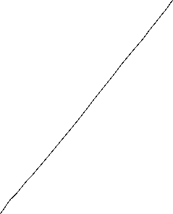



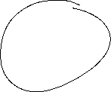





C(Y)= 100+0,8Y; I=400; G=200
Calculate equlibrium income?
Change in equilibrium income, if governement expenditure increases by 100
Calculate the government expenditure multiplier?
Y^{D}
Y
Notes:
13

Slide 14

Consequences of Keynesian economics
Disequilibria over time are possible
→ Aggregate demand is too low in order to fully utilize labor force.
→ Permant high unemployment level
→ Aggregate demand exceeds the capacity of production.
→ Economy is overheating
Especially full employment is not reached via a euqilibrium process, but can only be reached within a specific parameter constellation of the Economy → the Economy needs external interference!
Notes:
14

Slide 15





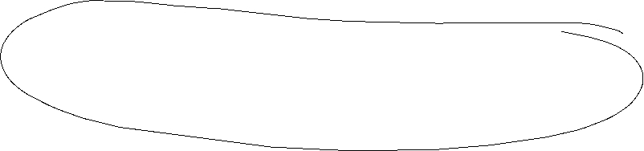


IS/LM-Model
Until now in the Keynesian model we have no prices ( respectively we normalized P=1 and therefore P vanishes in all equations) since due to the demand oriented view supply and demand equalizes only because of adjustments of quantities on the production side.
Additionally the money market is not incorporated and the connection between nominal and real variables is missing. But this link is essential in a modern economy since in general goods an services are measured in money.
The connection between the goods market and the money market is realized via interest rates steering Investment and money demand
The resulting model is still demand oriented and called the IS/LM-Model

Slide 16






IS/LM-Model
IS: Investment = Saving (or Income = Expenditure)
► Commodity market
LM: Liquidity Preference = Money Supply
► Money market
The IS-curve represents the equilibrium at the goods market with I=S or Y^{D}=Y
Caution! I=S is in this case a condition and not an (ex post) identity as in the circular flow!
Equilibrium at the money market
money supply = money demand
While we obtain money demand via the Keynesian function of money demand.
The LM-Curve represents then the equilibrium at the money market

Slide 17
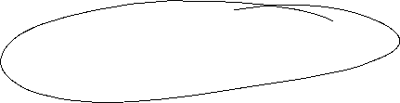




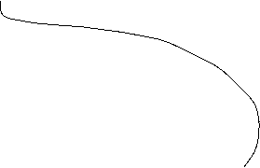



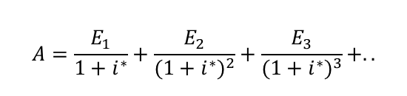






Interest rates and Investment (Keynes` marginal efficiency of capital)
Investment depends interest rate i:
I(i)=I₀+i_{i}∙i with i_{i} <0 I_{0>0} Autonomous investment and i_{i} <0 why?
The yield i* or marginal efficiency of capital of an investment is compared with i the interest rate of the capital market. For example we calculate the internal rate of return
⇒ the Investment is done if i*>i
⇒ The aggregated investment in the economy corresponds to the sum of all investments with i*>i.
Interest rates reflects the opportunity costs of a specific investment.
$$A=\frac{E_{1}}{1+i^{∗}}+\frac{E_{2}}{{(1+i^{∗})}^{2}}+\frac{E_{3}}{{(1+i^{∗})}^{3}}+..$$

Slide 18



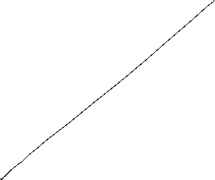








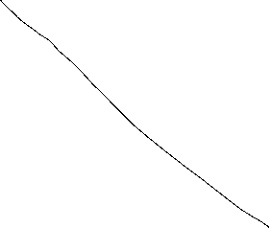

The IS-curve
Y^{D}
Y
i
Equilibrium at the commodity market
The IS-curve is the locus of all (i,y)-combinations of commodity market equilibria
The IS-curve is decreasing in y
Y

Slide 19


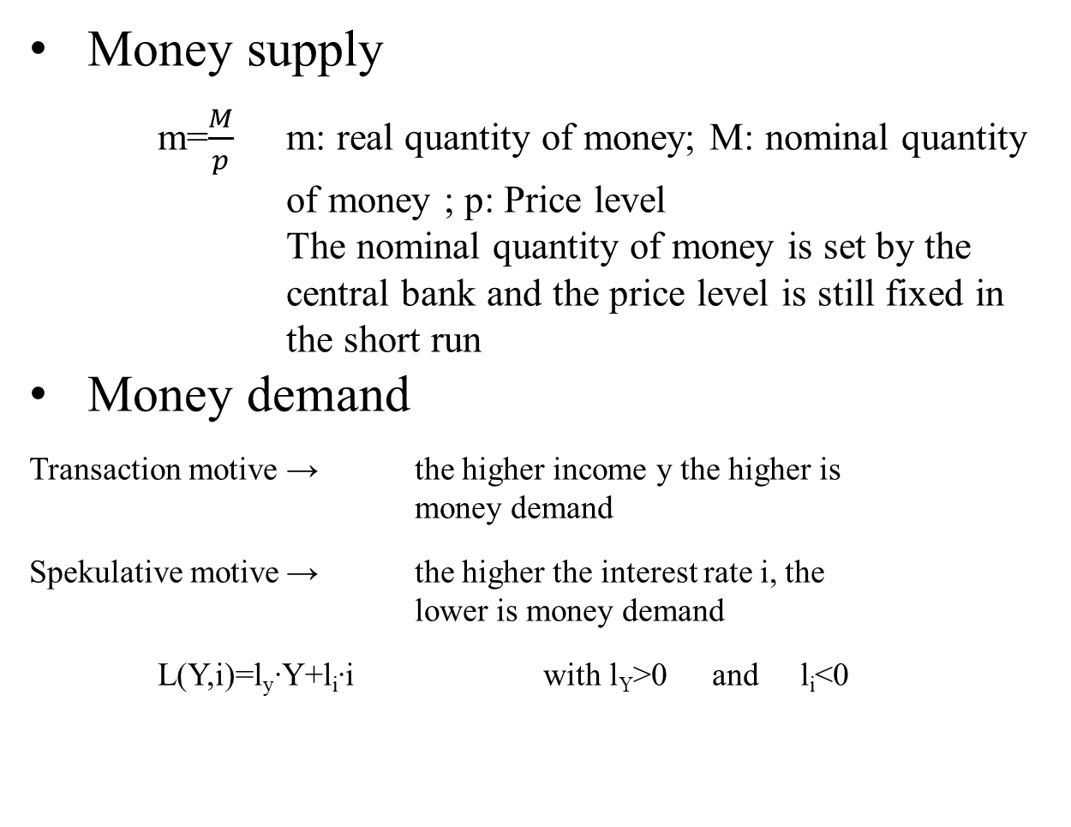

Money market
Money supply
  m=$\frac{M}{p}$ m: real quantity of money; M: nominal quantity of money ; p: Price level
  The nominal quantity of money is set by the central bank and the price level is still fixed in the short run
Money demand
Transaction motive → the higher income y the higher is money demand
Spekulative motive → the higher the interest rate i, the lower is money demand
L(Y,i)=l_{y}∙Y+l_{i}∙i with l_{Y}>0 and l_{i}<0

Slide 20


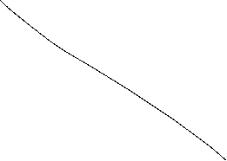




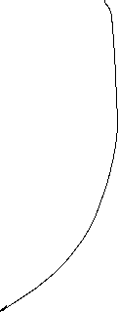


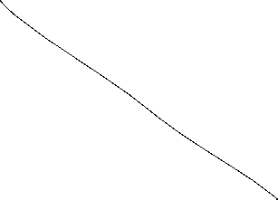



The LM-curve
$$i$$
$$i$$
L, M/p
y
Equilibrium at the money market
The LM-curve is the locus of all (i,y)-combinations of money market equilibria
The LM-curve is increasing in y

Slide 21


Overall equilibrium
i
LM-curve
i*
IS-curve
Y*
Y
The Intersection of LM- und IS-curve is the overall equilibrium
→ money and commodity market are simultanously in equilibrium

Slide 22
Example
C(Y)=C₀+c_{y}∙Y=50+0,8Y
I(i)=I₀+i_{i}∙i=30-300i
G=20
L(Y,r)=l_{y}∙Y+l_{i}∙i=0,5Y – 250i
M=400 p=2
Determine the IS-Kurve
Determine the LM-Kurve
Determine the simultanous equilibrium at the money and commidity market with equilibrium interest rate i* and income Y*

Slide 23

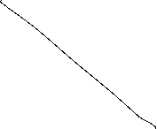


C(Y)=C₀+c_{y}∙Y=50+0,8Y I(i)=I₀+i_{i}∙i=30-300i G=20
L(Y,r)=l_{y}∙Y+l_{i}∙i=0,5Y – 250i M=400 p=2

Slide 24

Fiscal policy in the IS-LM-Model
+ ΔG
Y^{D}
Y^{D}=Y
Y^{D}(i₁, G+ ΔG)
Y^{D}(i₁, G)
C₀+I(i₁)+G+ΔG
C₀+I(i₁)+G
∆G >0
Y*₁(G)
Y*₂(G +∆G)
Y
i
i₁
IS(G)
IS(G +∆G)
Y*₁(i₁, G)
Y*₁(i₁, G +∆G)
Y

Slide 25







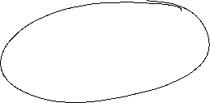










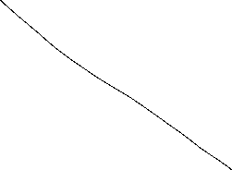
Fiscal policy in the IS-LM-Model
G↑ -> + ΔG
i
LM
IS(G)
i*(G)
Y* (G)
Y

Slide 26

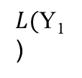




Monetary policy in the IS-LM-Model
+ ΔM
$$M/p$$
LM($M$)
$$i$$
$$i$$
$\text{i}\text{∗}\text{1}$($\text{Y}\text{1} ,M$)
$L(\text{Y}\text{1}$)
L, M/p
Y₁

Slide 27
Monetary policy in the IS-LM-Model
M↑ -> + ΔM
i
LM(M)
IS
i*(M)
Y* (M)
Y

Slide 28
Example
C(Y)=C₀+c_{y}∙Y=50+0,8Y
I(i)=I₀+i_{i}∙i=30-300i
G=20
L(Y,i)=l_{y}∙Y+l_{i}∙i=0,5Y – 250i
M=400 p=2
Determine the fiscal impulse if government expenditure doubles.
Determine the monetary impuls if the quantity of money is increased by 25%.

Slide 29
Example

