Slide 1
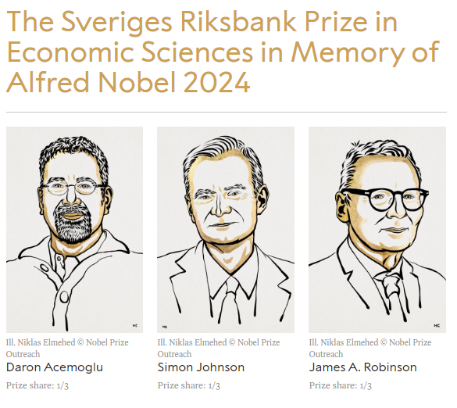
Nobel Prize 2024
https://www.nobelprize.org/prizes/economic-sciences/2024/summary/

Slide 2
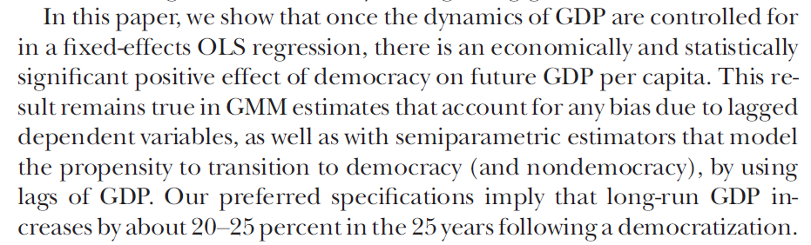
Nobel Prize 2024
Daron Acemoglu, Suresh Naidu, Pascual Restrepo, James A. Robinson ,Journal of Political Economy, 2019, vol. 127, no 1, conomy, 2019, vol. 127, no. Democracy Does Cause Growth

Slide 3
Interested in growth theory?? Klick here https://www.theigc.org/sites/default/files/2016/06/acemoglu-2007.pdf

