Slide 1

Macroeconomics
Wilhelmshaven
This lecture will be recorded and
Subsequently uploaded in the
world-wide-web
Prof. Dr. Bernhard Köster
Jade-Hochschule Wilhelmshaven
http://www.bernhardkoester.de/vorlesungen/inhalt.html

Slide 2


Wilhelmshaven
Dirk Gerlach
Leiter Stab der Hv-Präsidentin
Bundesbank – Filiale Hannover
Money, interest and prices
–
basics and current problems of European monetary policy
Dienstag 10.12.2024
Jade Hochschule Wilhelmshaven
10:15 – 11:45 Uhr: S123
Ansprechpartner:
Prof. Dr. Bernhard Köster
bernhard.koester@jade-hs.de

Slide 3

Macroeconomics
Winter Term 2024
Prof. Dr. Bernhard Köster

Slide 4

Nobel Prize 2024
https://www.nobelprize.org/prizes/economic-sciences/2024/summary/

Slide 5
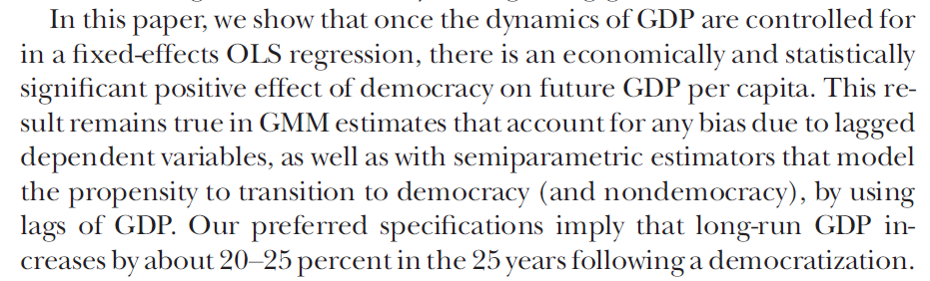
Nobel Prize 2024
Daron Acemoglu, Suresh Naidu, Pascual Restrepo, James A. Robinson ,Journal of Political Economy, 2019, vol. 127, no 1, conomy, 2019, vol. 127, no. Democracy Does Cause Growth
http://www.bernhardkoester.de/vorlesungen/Macro_Jade_WiSe_2024/institutions-as-the-fundamental-cause-of-long-run-.pdf
http://www.bernhardkoester.de/vorlesungen/Macro_Jade_WiSe_2024/DemocracyDoesCauseGrowth.pdf

Slide 6
Interested in growth theory?? Klick here https://www.theigc.org/sites/default/files/2016/06/acemoglu-2007.pdf

Slide 7









Slide 8




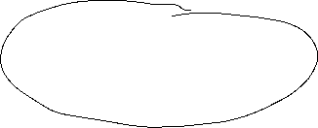
























Magic Square
Steady and appropriate economic growth
External balance
Price level stability
High level of employment

Slide 9
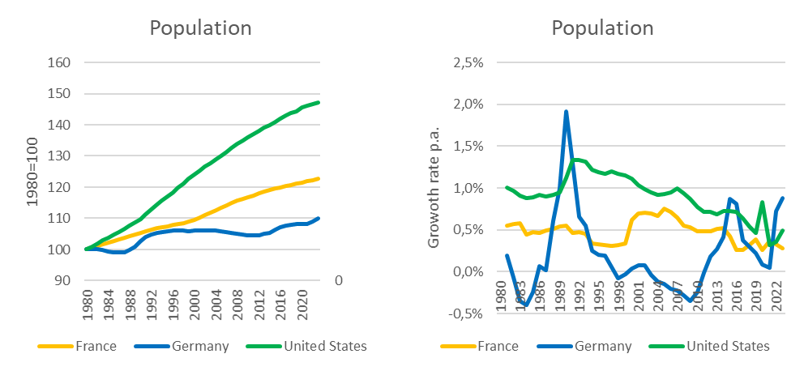
















Steady and appropriate economic growth
Indicators
Growth of real GDP
→ change of overall economic performance, not including singular changes in prices (price adjusted GDP)
Growth of real GDP per capita
→ since in general new inhabitants will increase GDP, we also to adjust for population growth
→ In developed countries an growth rate of GDP of roughly 1%-3% p.a. is claimed to be appropriate on average, without high volatily around this traget growth rate.
Source: IMF

Slide 10










Nominal versus real economic growth
Relative change of the nominal GDP compared to the previous period (year)
Difference because of changes in prices
Difference because of changes in quantity
In order to do not count changes in prices, the real GDP is calculated with repected to the prices of the previous year,
Since only a change because higher prices does not count for an increase of overall economic performance!

Slide 11






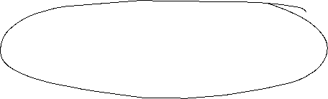








Calculating real GDP
Since 2005 real GDP is calculated via a chain index (caution, in many textbooks and in the web real GDP is explained due to a fixed price bases, but this is wrong!).
Real GDP is the value of final goods and services calculated via constant prices of the previous year. We set a base year in time t wird equal to Index_{real}(t)=100 and the indices of the following years are the calculated recursively
GDP(t+1) in prices of t
Index_{real}(t+1) = Index_{real}(t)
GDP(t) in prices of t
P₁(t)•X₁(t+1)+P₂(t) •X₂(t+1)+…
= Index_{real}(t)
P₁(t) •X₁(t)+P₂(t) •X₂(t)+…
with P₁, P_{2,}… prices of goods an services 1,2,… ;X₁, X₂,… quantities of goods an services 1,2,… and time t

Slide 12





Real economic growth and GDP-Deflator
Real economic change is the realtive change of the chain-index of real GDP:
GDP-Index_{real}(t) – GDP-Index_{real}(t-1)
Real economic growth = g(t)=
GDP-Index_{real}(t-1)
GDP-Index_{nom}(t)
GDP-Deflator(t) = 100
GDP-Index_{real}(t)
The relative change of the BIP-Deflator represents the pure price effectof the realative change of nominal GDP
(in opposite to case, if real GDP would be calculated via a fixed price base, since then, the GDP-Deflator itself represents the price effect, be careful, if you read other text books!)

Slide 13
Example

Slide 14











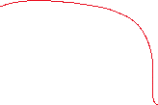







Example

Slide 15
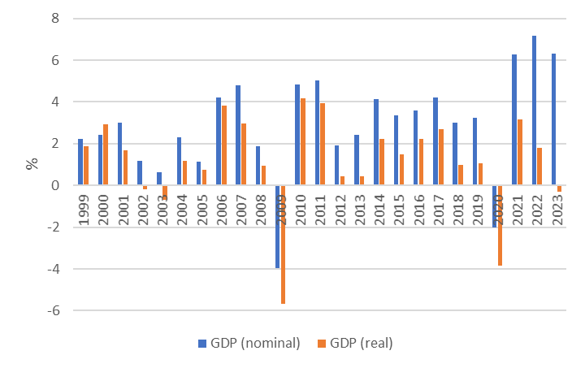


















Nominal and real economic growth (Germany)
Source: Destatis

Slide 16
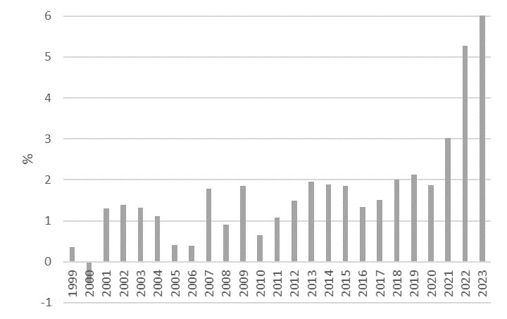

Relative change of the GDP-Deflator (Germany)
Source: Destatis

Slide 17
Nominale GDP/real GDP/GDP-Deflator
The realtive change of nominal GDP represents changes in prices and quantities.
The realtive change of real GDP represents changes in quantities and therefore counts for the change of economic performance
With the realtive change of the GDP-Deflator we can correct nominal growth in order to obtain real growth

Slide 18
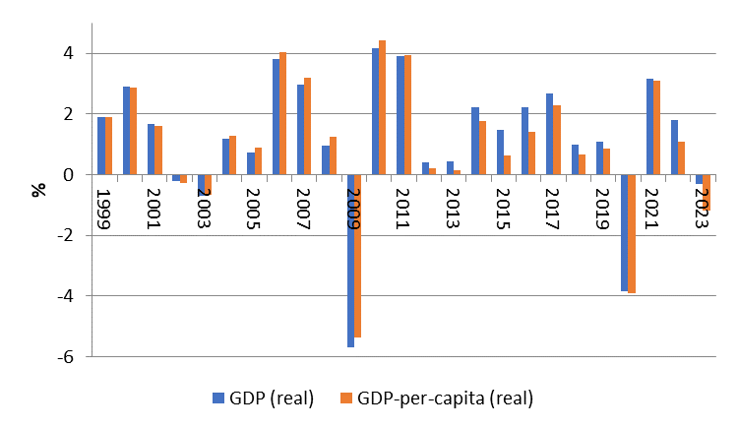







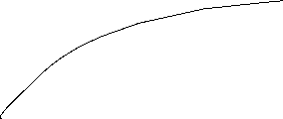
Difference of economic growth measured via real GDP and real GDP per capita (Germany)
Source: Destatis

Slide 19



Price level stability
Price level stability is in general calculated via the consumer price index (CPI) or in the Eurozone the harmonized consumer price index (HCPI).
Definition of price level stability of the European central bank:
The ECB’s Governing Council considers that price stability is best maintained by aiming for 2% inflation over the medium term. Inflation is measured by the Harmonised Index of Consumer Prices (HICP). The Governing Council’s commitment to the 2% target is symmetric. This means that we consider negative and positive deviations from the target to be equally undesirable.

Slide 20






Why price level stabiliy?
reasons:
In a market economy price give the signal of scarcity of goods and services, therefore the overall price level should not to be to volatile.
preservation of the value of money over time
Avoiding transaction cost because of new price declarations (menue costs)
Injustice in the creditor-debtor relationship
Stable decisions between consumption and saving

Slide 21
Measuring the value of money
In order to determine the puchasing power of money we cannot only look at single prices. Therefore we calculate an average of many prices.
→ The value of money is measured in a price index. This price index is base on representative choice of a basket of single goods.

Slide 22


Calculating Inflation
Choice of the basket of single goods
  Determine the relevant goods and services, a representative household is consuming
  Weighting the goods due to their significanse in the consumption plan of the representative household
Dertermine the prices:
  Looking up the prices of the goods in the chosen basket for a given time t.
Value of the basket:
  Multiply the determined prices with the chosen weight. Summing up give the Value of the basket for the given time t.

Slide 23
Calculating Inflation
Choose a base year t₀ :
  The Price-Index of the base year t₀ is set to 100.
  Index of time t is calculated as value of the basket at time t divided by the value of the basket in t₀ multiplied by 100
Calculating inflation:
  Inflation equals the rate of change of the Price-Index.

Slide 24


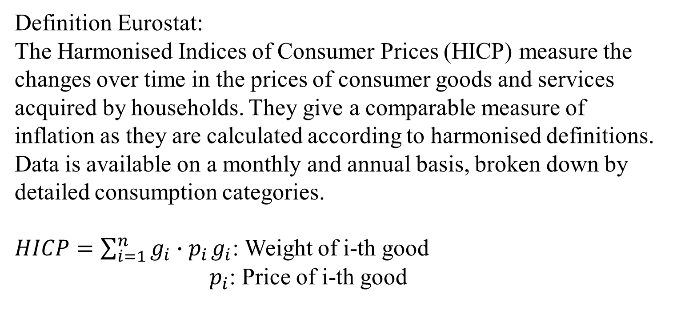

Harmonized Indices of consumer Prices (HICP)
Definition Eurostat:
The Harmonised Indices of Consumer Prices (HICP) measure the changes over time in the prices of consumer goods and services acquired by households. They give a comparable measure of inflation as they are calculated according to harmonised definitions. Data is available on a monthly and annual basis, broken down by detailed consumption categories.
$HICP=\sum_{i=1}^{n}{g_{i}∙p_{i}}$ $g_{i}$: Weight of i-th good
$p_{i}$: Price of i-th good
A personal inflation calculator

Slide 25
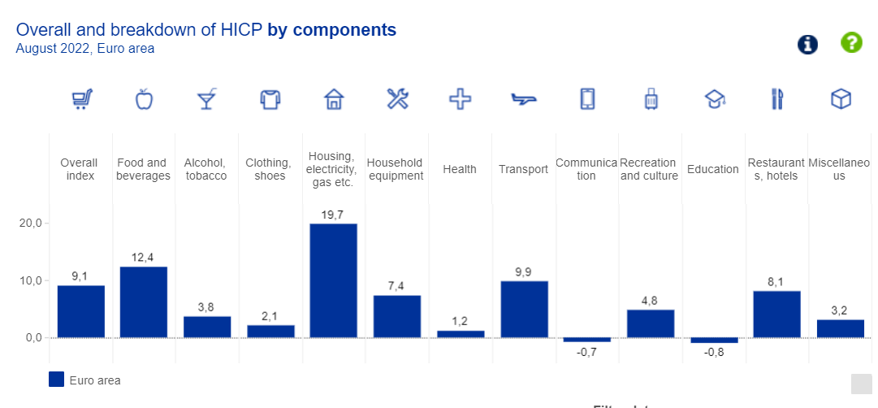


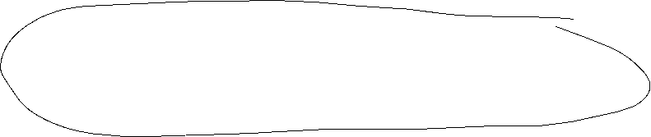


Weight scheme of the HCPI
https://www.ecb.europa.eu/stats/macroeconomic_and_sectoral/hicp/html/index.en.html

Slide 26
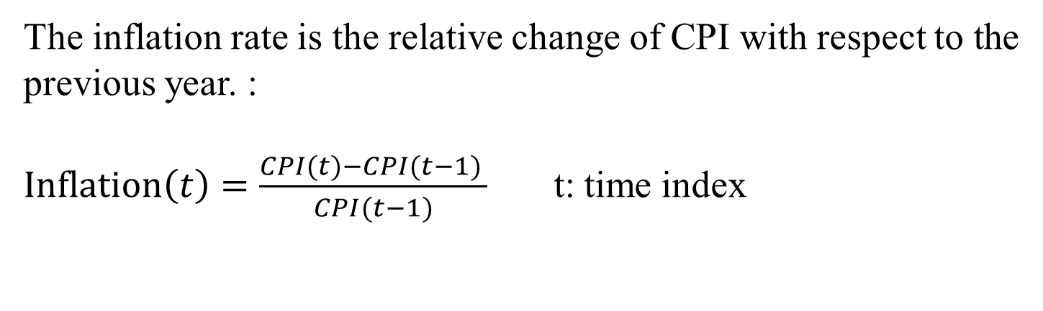

Inflation
The inflation rate is the relative change of CPI with respect to the previous year. :
$Inflation\left(t\right)=\frac{CPI(t)−CPI(t−1) }{CPI(t−1)}$ t: time index

Slide 27

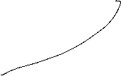


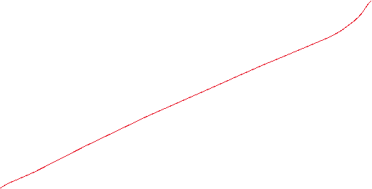

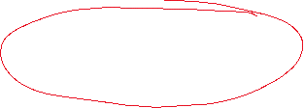







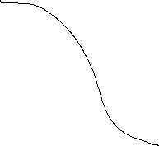





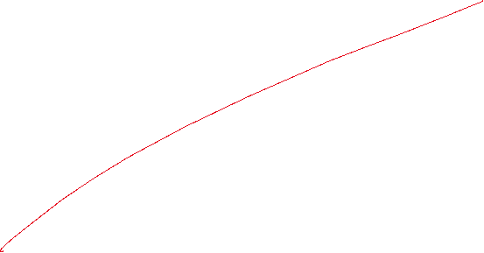








Calcuate the price index 2017 – 2019 (2017=100)
Inflation rates 2018 und 2019, and the average inflation 2018 – 2019.
Beispiel

Slide 28
Different Preisindices
Consumer price index → general inflation, relevant for private consumption
GDP-Deflator → Index for the whole economy, scope of distirbution in wage negotiations
Export- and Import prices → Indices for international trade (relevant for „imported“ inflation)
Wolesale price index→ Whole sale trade is some kind of an early indicator for inflation based on CPI.

Slide 29
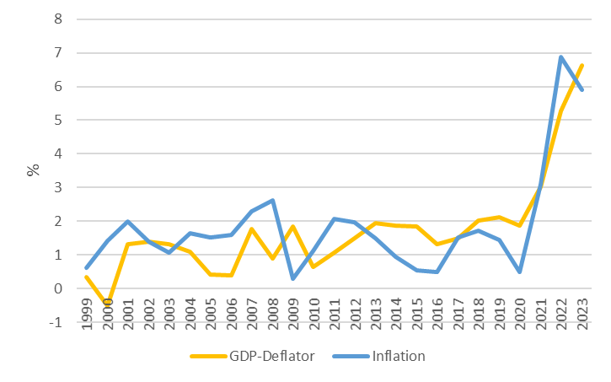





















CPI und GDP-Deflator
Source: Destatis,

Slide 30
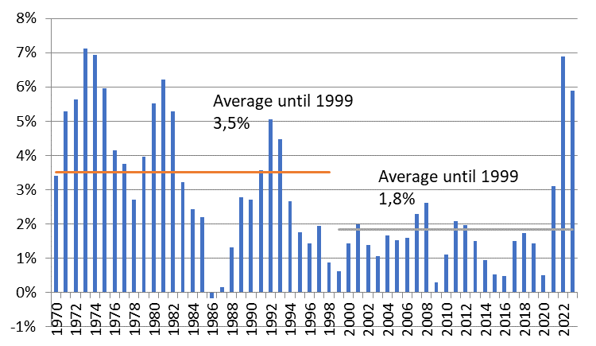
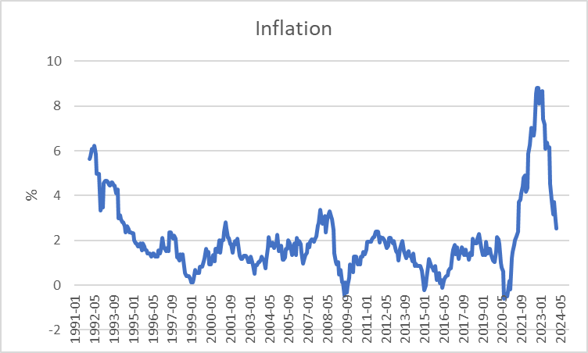




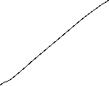











Inflation Germany
Yearly
Monthy p.a.
Source: Destatis

Slide 31
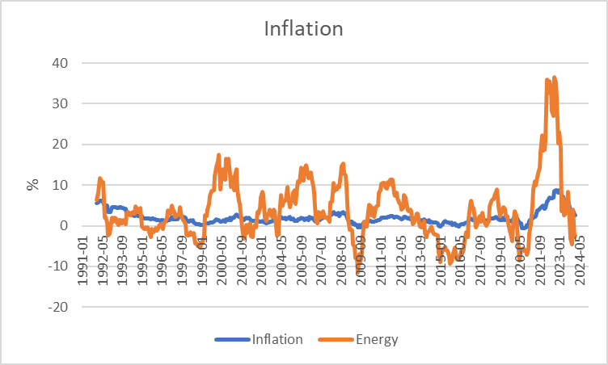





CPI and the Energy component (Germany)
Source: Bundesbank

Slide 32



Energy and Inflation
The weight of the energy component is roughly 10% in CPI.
Calculate inflation, if energy price have fallen by 20% and all other prices stayed the same.

Slide 33

















High level of employment
Principal aim is to reach a state of full employment.
→ every person willing has a job.
The general variable to measure unemployment is the unemployment rate.
In Germany a level of 3%-4% unemployment rate is considered as a state of full eployment.

Slide 34
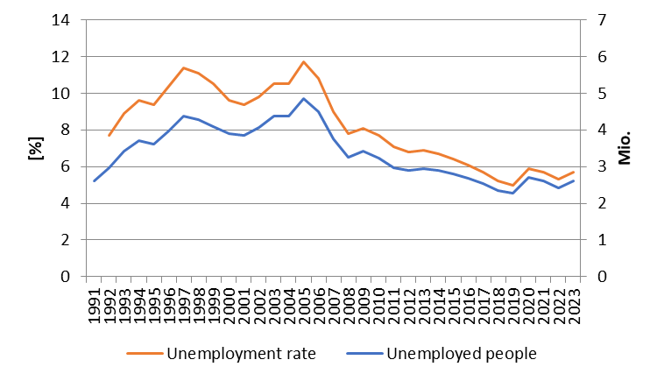













Development of unemployment in Germany
Source: BA

Slide 35




Unemployment definition BA
(registered unemployed people)
Age between 15 – 65 (67) years
Defined by the Social Code, Book III (SGB III), the unemployed include all those who are
temporarily not employed or work in a job for fewer than 15 hours per week,
seek employment subject to social insurance contributions for at least 15 hours per week,
and in the process are available for placement efforts undertaken by the employment agencies or institutions administering basic security benefits for job-seekers
and have registered there as unemployed.

Slide 36



Unemployment definition ILO
Unemployed is any person aged between 15 and 74 years
who was not in employment, but actively sought work over the four weeks preceding the survey
and would be available for starting a job within two weeks.
In this context, it is irrelevant whether the persons concerned are registered with a government authority and receive social benefits from there

Slide 37
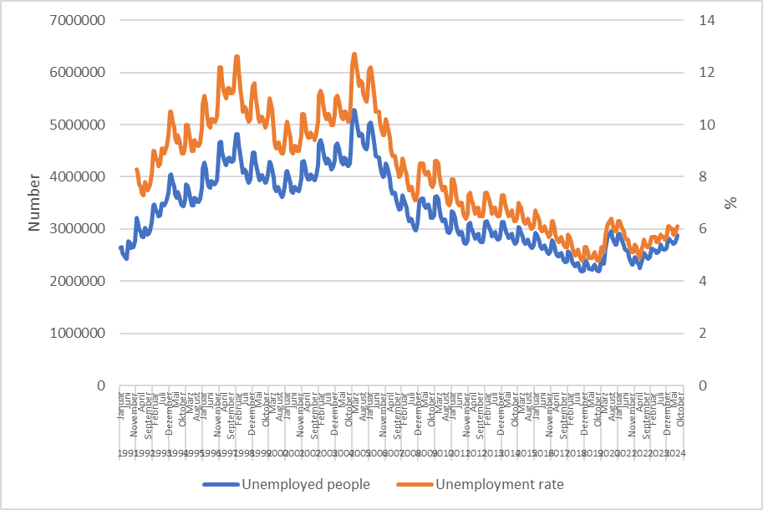











Monthly development of unemployment in Germany
Source: BA

Slide 38



Types of unemployment
Short-term: seasonal and frictional unemployment
Medium-term: cyclical unemployment
Long-term: structural unemployment

Slide 39




Short term unemployment
seasonal unemployment:
Fluctuation in production during a year i.e. in the agricultural sector or the construction sector
Fuctuations in demand during the year i.e. in Tourism sector because of the weather or because of school holidays
Hiring cycles
frictional unemployment :
Incomplete information in the labour market causes a mismatch between job seeking poeple and poeple seeking enterprises
  Transition time between on job and another new job
  Additional time because of moving from one location to another

Slide 40




Medium- and long-term unemployment
Cyclical unemployment:
Within the business cycle we have an under utilization of potential output → causing a decrease in labor demand
Structural unemployment :
Sectoral change, i.e. legislative amendment (Change in Energy politics)
→ job loss in the coal industry or the nuclear sector
Technological change, i.e. digitalization of many process will change the labor market dramatically (i.e. AI)
              → new skills are needed in the future
Regional descrepancy in job demand and supply specially because of the demographic change in the rural area

Slide 41
Hidden unemployment
People in qualification programs
Early retirement
Short time work
Job creation sheme

Slide 42
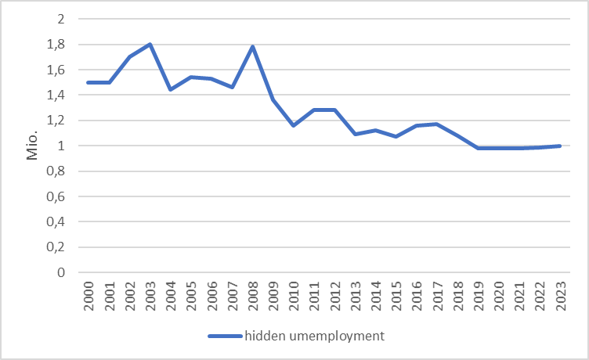


Hidden unemployment Germany
Source: IAB

Slide 43
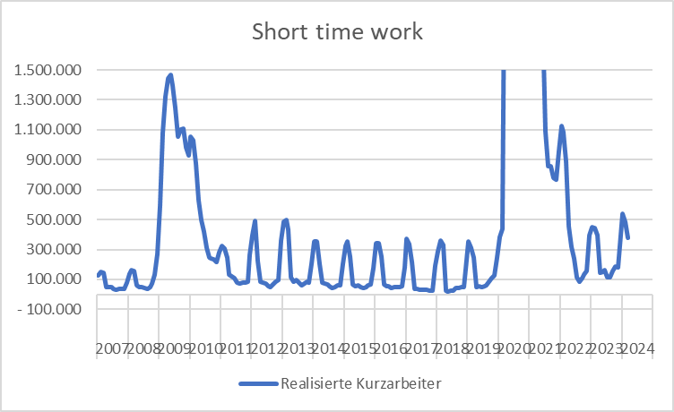

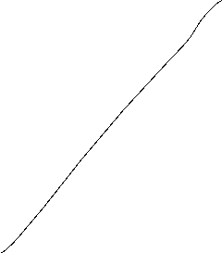







Source: BA
Development of short-time-work in Germany

Slide 44
External balance
There is no generally accepted definition!
This aim has to be understood within the historical context. Until 1973 we had a system of fixed exchange rates in the world. Every convertible currency was fixed in realtion to the US-Dollar → In such a framework it is suitable to balance i.e. the current accout or the trade balance, because otherwise the own currency can be out under pressure
But in 1973 the system of Bretton woods collapsed! Since the, we have free floating currencies, and therefore there is no need anymore for a balanced current account. Nevertheless you find in textbooks the following aims:
Andere Interpretationen:
Balanced trade balance
Balanced current account
Low fluctuating currency
Low susceptibility from foreign economies

Slide 45
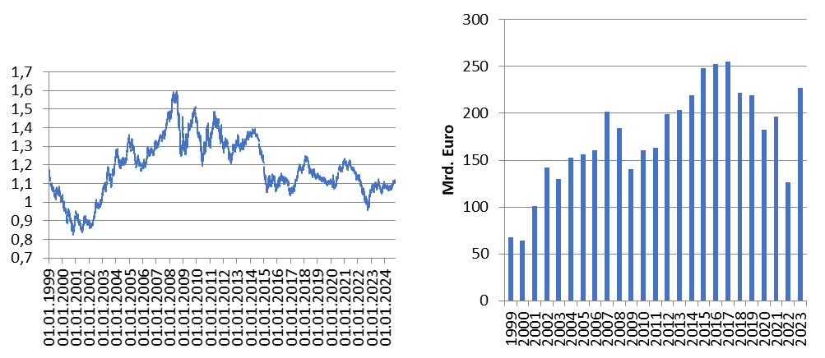
International economic relationships Germany
Source: Bundesbank
Exchange rate Euro – Dollar
Trade balance

Slide 46
Balance of Payments
Definition of Balance of Payments:
The balance of payments is a summary of all the international transactions of a country and its citizens during a specified period of time. This period is usually of one year, though many countries have now started preparing the quarterly accounts for the purposes of forecasting.
Caution:
In the balance of payments we count flow, while usually in a balance sheet you report stocks!
Notes:
46

Slide 47
Balance ofpayments
A. Current Account
B.Capital account
C. Financial account
A1. Balance of goods
A2. Balance of services
A3. Primary income (payments form work (wages) oder inverstments (dividends)
A4. Secondary income (payments from government (tax, refunds) or one way transfers i.e. disaster relief)
B1. Capital transfers
B1. Direct investment
B2. Porfolio investment
B3. Financial derivative
B4. Reserve investement
B5. Other investment
Notes:
47

Slide 48
Further economic goals
Fair balanced income distribution → German constitution Art. 72 Satz 2 GG
Sustainable ecological conditions → German constitution Art. 20a GG
Sustainable public financial budget → German constitution Art. 109 Satz 3 GG
→ Maastricht criteria 3% Deficit
60% government debt ratio

Slide 49
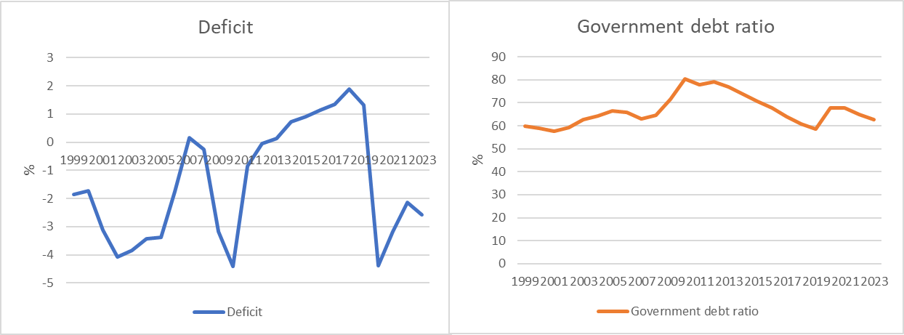
Development of the public budget and debt (Germany)
Cource: Destatis, Bundesbank
Deficit: Public Budget in relation to GDP
Government debt ratio : governemnt debt in relation to GDP

Slide 50
Economic Forecast Sept HRI 2024

Slide 51
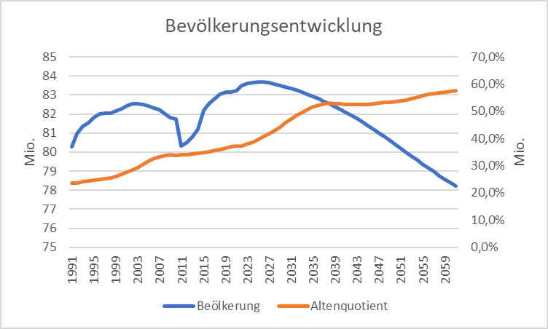
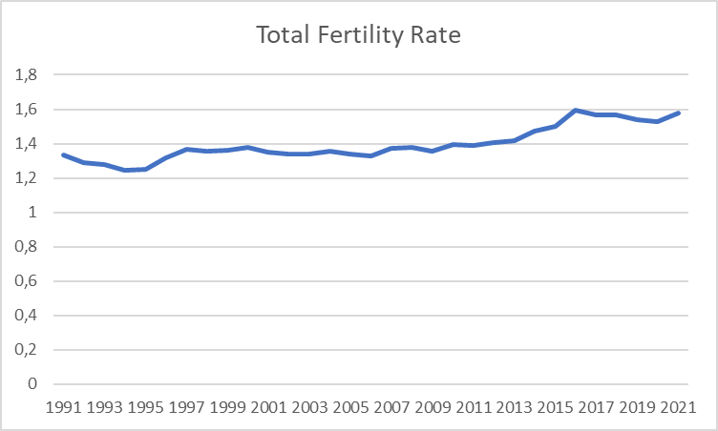
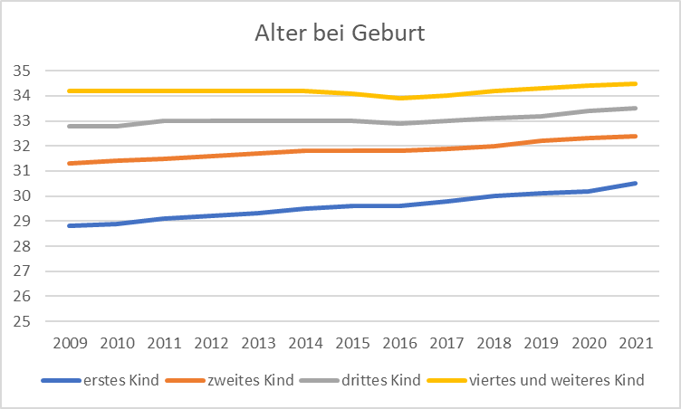
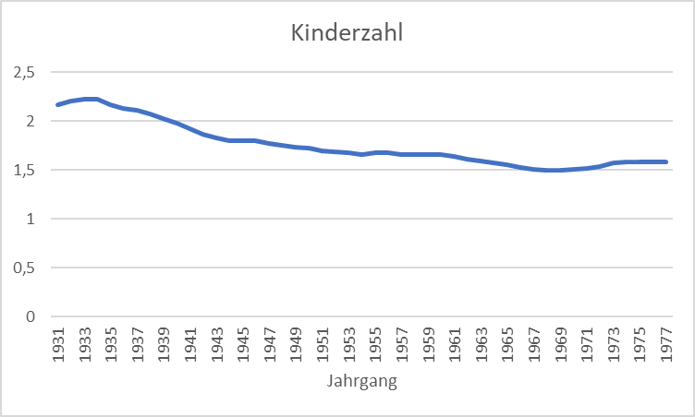
Exkurs: Demographics in Germany
Quelle: Destatis

Slide 52
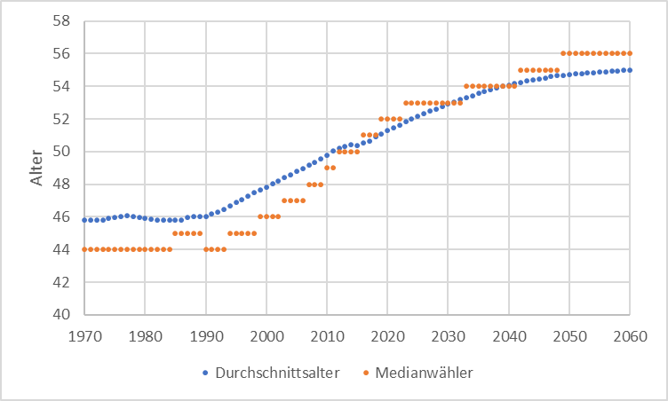
Median Voter
Quelle: Statistisches Bundesamt

Slide 53
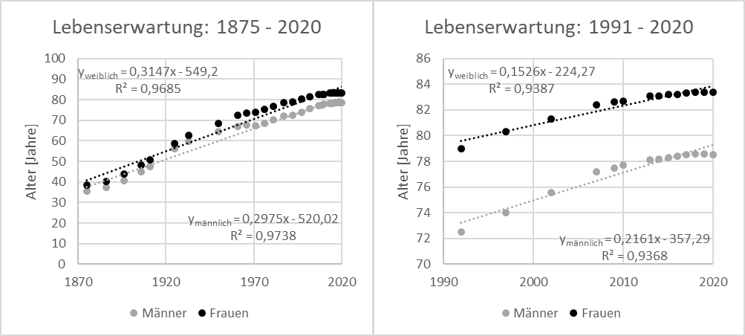
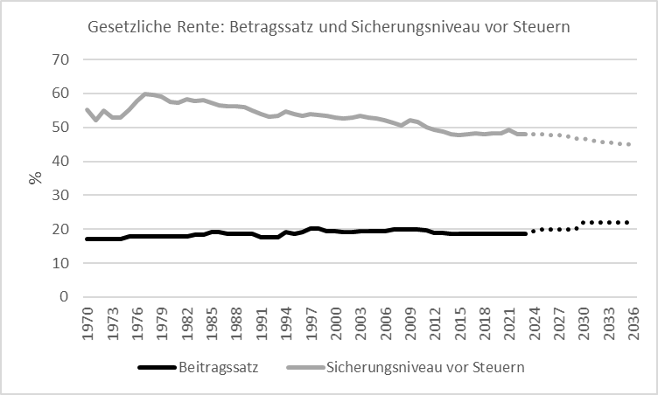
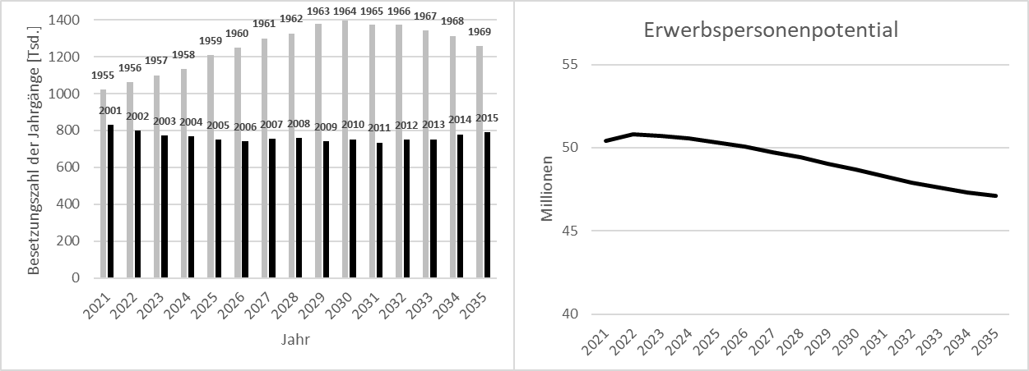
Exkurs Pensions + Labor Market Germany
Quelle: Statistisches Bundesamt

Slide 54
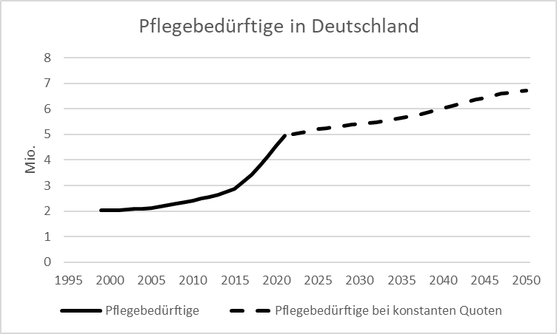
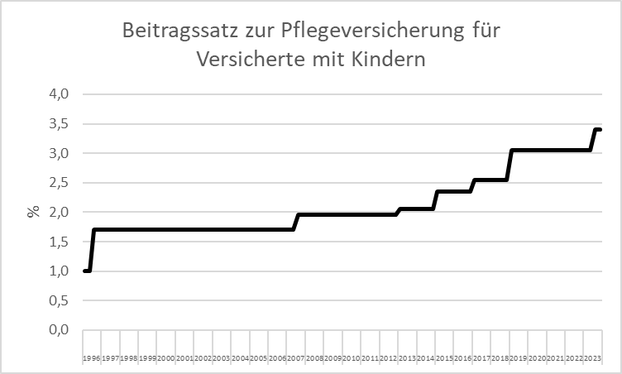
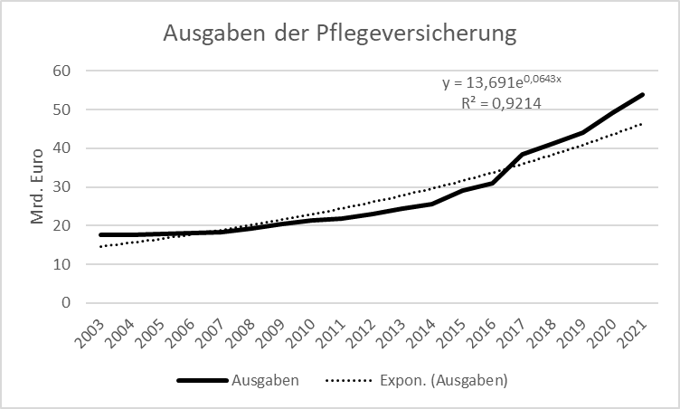
Exkurs Care Germany
Quelle: Statistisches Bundesamt

