Slide 1

Macroeconomics
Wilhelmshaven
This lecture will be recorded and
Subsequently uploaded in the
world-wide-web
Prof. Dr. Bernhard Köster
Jade-Hochschule Wilhelmshaven
http://www.bernhardkoester.de/vorlesungen/inhalt.html

Slide 2

Macroeconomics
Winter Term 2024
Prof. Dr. Bernhard Köster

Slide 3
National account system (NAS)
National accounts provide information to analyse the structure of economies and their development over time. They contain a wide range of statistics describing an economy in various ways. The main GDP aggregates provide an overview about key economic developments..
Information, Forecast, international comparision
Since 1995 NAS is standardized in the (European System of National and Regional Accounts, ESA)

Slide 4










Gross domestic product and Gross national product
Gross domestic product (GDP) is the total market value of all the finished goods and services produced within a country’s borders in a specific time period (i.e. 1 year) (domestic concept)
Gross National Product (GNP) is the total market value of all finished goods and services produced by a country’s citizens in a specific time period (i.e. 1 year).
(national concept)

Slide 5









GDP
„market value“
In order to aggregate different goods and service their market prices are considered.
Some goods do not have a market price. In this case production prices are considered
For public services wages public employees are considered
„all“
owner-occupied residential property is value by an average market rent.
Some goods and service cannot be statistically counted and are therefore not included into GDP (i. e. black market, educational performance of parents, honory posts)

Slide 6


GDP
„finished“
Only value added is considered =
Production – intermediate consumption
„goods and services“
material and immaterial goods
„wihin a countries borders“:
national concept = domestic concept
– factor income of non citizens in the considered country
+ factor income of citizens of the considered country from abroad
„specific time period “
Quater or year

Slide 7












Calculating GDP
Production approach – Value added of all economic sectors (activities)
Expenditure approach – final uses of goods and services (consumption, investment,
government expentitures, net exports (Ex-Im)
Income approach – Distribution of income on the different factors of production
(capital and labor)
Notes:
7

Slide 8















Gross national Product (Germany 2023)
Notes:
8

Slide 9
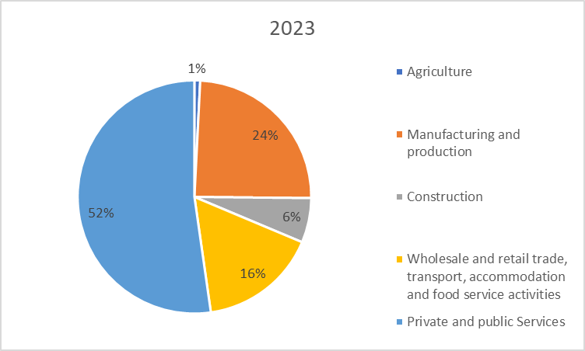






Production approach – Gross value added (Germany 2023)
Gross value added (GVA)
+ taxes
– subsidies
= GDP
Source: Destatis, current prices, Bil. Euro

Slide 10
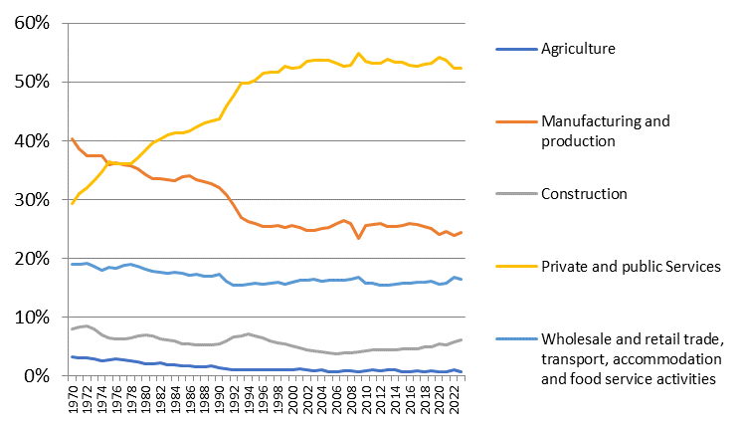




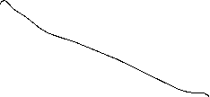


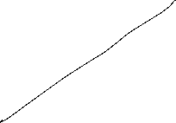
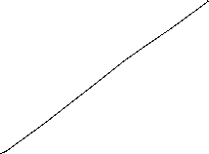

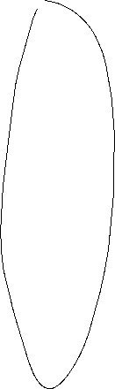
Development of the nominal proportions of the sectors of gross value added (Germany)
Source: Destatis, current prices

Slide 11
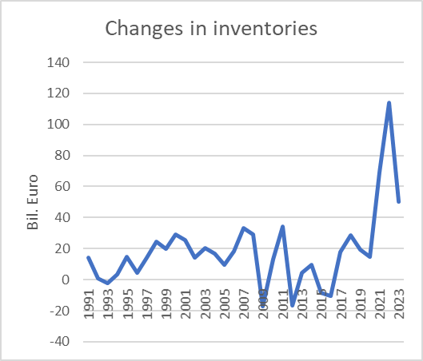












Expenditure approach Germany 2023
}
Consumption
}
Gross capital
investment
}
External contribution
Source: Destatis ,current prices, Mrd. Euro

Slide 12
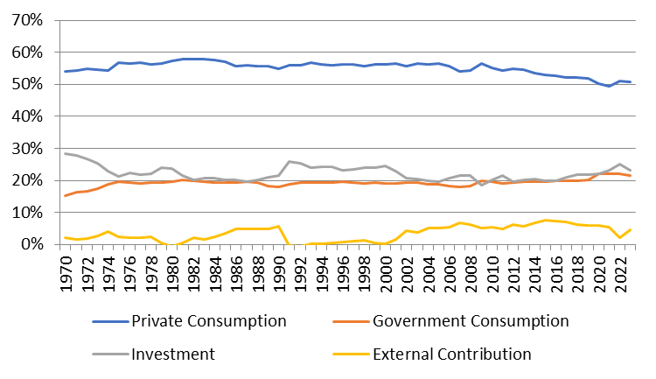






Development of the nominal proportions of the expenditure sectors of GDP (Germany)
Source: Destatis, current prices

Slide 13

Income approach
The income approach counts the different typs contributing to national income.
Mainly we look at the income from the general factors of production: Capital and Labor. Thus we count corporate and investment income from capital and compensation of employees from labor. The aggregate variable measuring the division of national income is the
compensation of employees
Labor Share =
national income

Slide 14
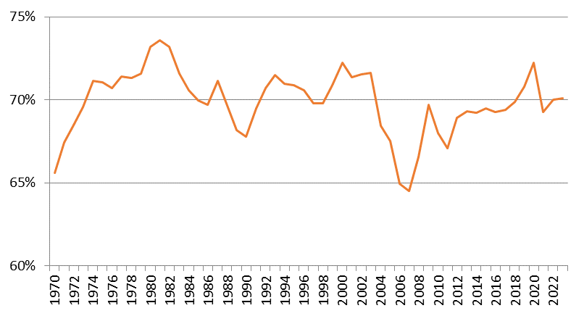
Development of the labor share (Germany): Income approach
Source: Destatis

Slide 15

Nobel Prize 2024
https://www.nobelprize.org/prizes/economic-sciences/2024/summary/

Slide 16
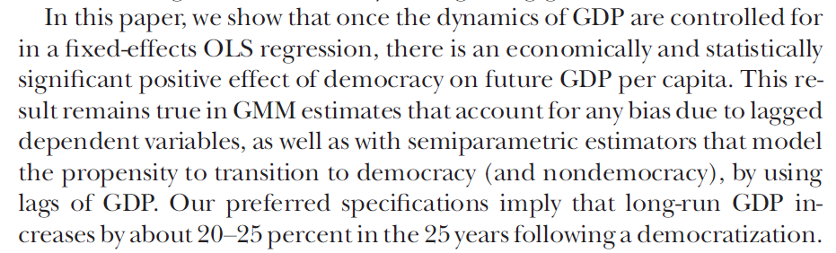
Nobel Prize 2024
Daron Acemoglu, Suresh Naidu, Pascual Restrepo, James A. Robinson ,Journal of Political Economy, 2019, vol. 127, no 1, conomy, 2019, vol. 127, no. Democracy Does Cause Growth
http://www.bernhardkoester.de/vorlesungen/Macro_Jade_WiSe_2024/institutions-as-the-fundamental-cause-of-long-run-.pdf
http://www.bernhardkoester.de/vorlesungen/Macro_Jade_WiSe_2024/DemocracyDoesCauseGrowth.pdf

Slide 17
Interested in growth theory?? Klick here https://www.theigc.org/sites/default/files/2016/06/acemoglu-2007.pdf

Slide 18
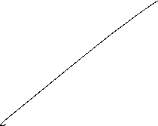






Slide 19

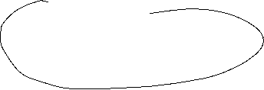
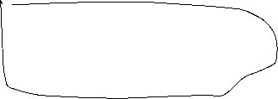









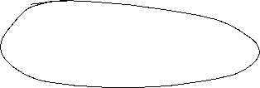






Magic Square
Steady and appropriate economic growth
External balance
Price level stability
High level of employment

Slide 20
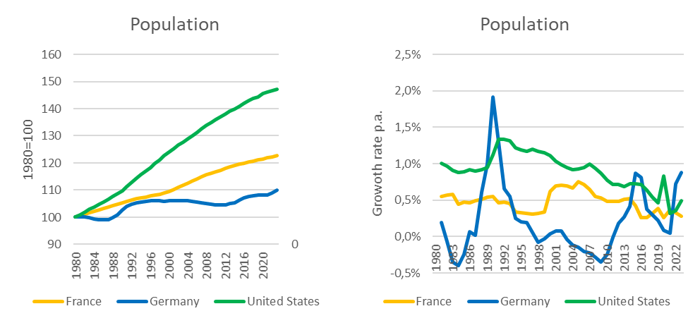















Steady and appropriate economic growth
Indicators
Growth of real GDP
→ change of overall economic performance, not including singular changes in prices (price adjusted GDP)
Growth of real GDP per capita
→ since in general new inhabitants will increase GDP, we also to adjust for population growth
→ In developed countries an growth rate of GDP of roughly 1%-3% p.a. is claimed to be appropriate on average, without high volatily around this traget growth rate.
Source: IMF

Slide 21






Nominal versus real economic growth
Relative change of the nominal GDP compared to the previous period (year)
Difference because of changes in prices
Difference because of changes in quantity
In order to do not count changes in prices, the real GDP is calculated with repected to the prices of the previous year,
Since only a change because higher prices does not count for an increase of overall economic performance!

Slide 22



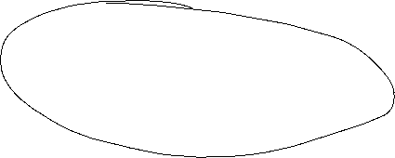




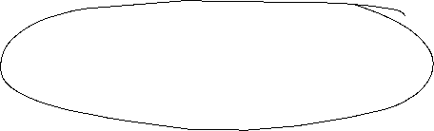




Calculating real GDP
Since 2005 real GDP is calculated via a chain index (caution, in many textbooks and in the web real GDP is explained due to a fixed price bases, but this is wrong!).
Real GDP is the value of final goods and services calculated via constant prices of the previous year. We set a base year in time t wird equal to Index_{real}(t)=100 and the indices of the following years are the calculated recursively
GDP(t+1) in prices of t
Index_{real}(t+1) = Index_{real}(t)
GDP(t) in prices of t
P₁(t)•X₁(t+1)+P₂(t) •X₂(t+1)+…
= Index_{real}(t)
P₁(t) •X₁(t)+P₂(t) •X₂(t)+…
with P₁, P_{2,}… prices of goods an services 1,2,… ;X₁, X₂,… quantities of goods an services 1,2,… and time t

Slide 23


Real economic growth and GDP-Deflator
Real economic change is the realtive change of the chain-index of real GDP:
GDP-Index_{real}(t) – GDP-Index_{real}(t-1)
Real economic growth = g(t)=
GDP-Index_{real}(t-1)
GDP-Index_{nom}(t)
GDP-Deflator(t) = 100
GDP-Index_{real}(t)
The relative change of the BIP-Deflator represents the pure price effectof the realative change of nominal GDP
(in opposite to case, if real GDP would be calculated via a fixed price base, since then, the GDP-Deflator itself represents the price effect, be careful, if you read other text books!)

Slide 24
Example

Slide 25







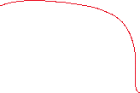





Example

Slide 26
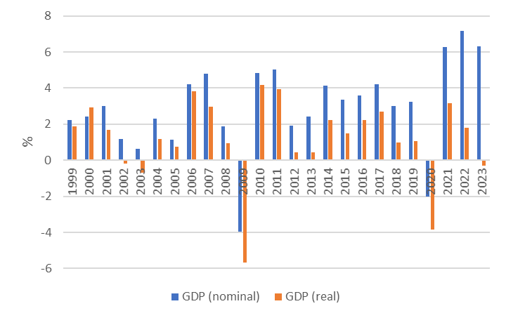
Nominal and real economic growth (Germany)
Source: Destatis

Slide 27
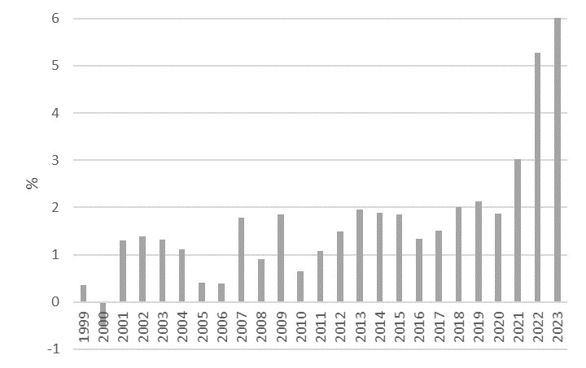
Relative change of the GDP-Deflator (Germany)
Source: Destatis

Slide 28
Nominale GDP/real GDP/GDP-Deflator
The realtive change of nominal GDP represents changes in prices and quantities.
The realtive change of real GDP represents changes in quantities and therefore counts for the change of economic performance
With the realtive change of the GDP-Deflator we can correct nominal growth in order to obtain real growth

Slide 29
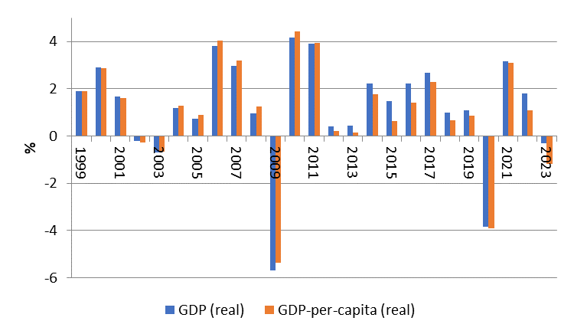
Difference of economic growth measured via real GDP and real GDP per capita (Germany)
Source: Destatis

Slide 30
Price level stability
Price level stability is in general calculated via the consumer price index (CPI) or in the Eurozone the harmonized consumer price index (HCPI).
Definition of price level stability of the European central bank:
The ECB’s Governing Council considers that price stability is best maintained by aiming for 2% inflation over the medium term. Inflation is measured by the Harmonised Index of Consumer Prices (HICP). The Governing Council’s commitment to the 2% target is symmetric. This means that we consider negative and positive deviations from the target to be equally undesirable.

Slide 31
Why price level stabiliy?
reasons:
In a market economy price give the signal of scarcity of goods and services, therefore the overall price level should not to be to volatile.
preservation of the value of money over time
Avoiding transaction cost because of new price declarations (menue costs)
Injustice in the creditor-debtor relationship
Stable decisions between consumption and saving

Slide 32
Measuring the value of money
In order to determine the puchasing power of money we cannot only look at single prices. Therefore we calculate an average of many prices.
→ The value of money is measured in a price index. This price index is base on representative choice of a basket of single goods.

Slide 33
Calculating Inflation
Choice of the basket of single goods
  Determine the relevant goods and services, a representative household is consuming
  Weighting the goods due to their significanse in the consumption plan of the representative household
Dertermine the prices:
  Looking up the prices of the goods in the chosen basket for a given time t.
Value of the basket:
  Multiply the determined prices with the chosen weight. Summing up give the Value of the basket for the given time t.

Slide 34
Calculating Inflation
Choose a base year t₀ :
  The Price-Index of the base year t₀ is set to 100.
  Index of time t is calculated as value of the basket at time t divided by the value of the basket in t₀ multiplied by 100
Calculating inflation:
  Inflation equals the rate of change of the Price-Index.

Slide 35
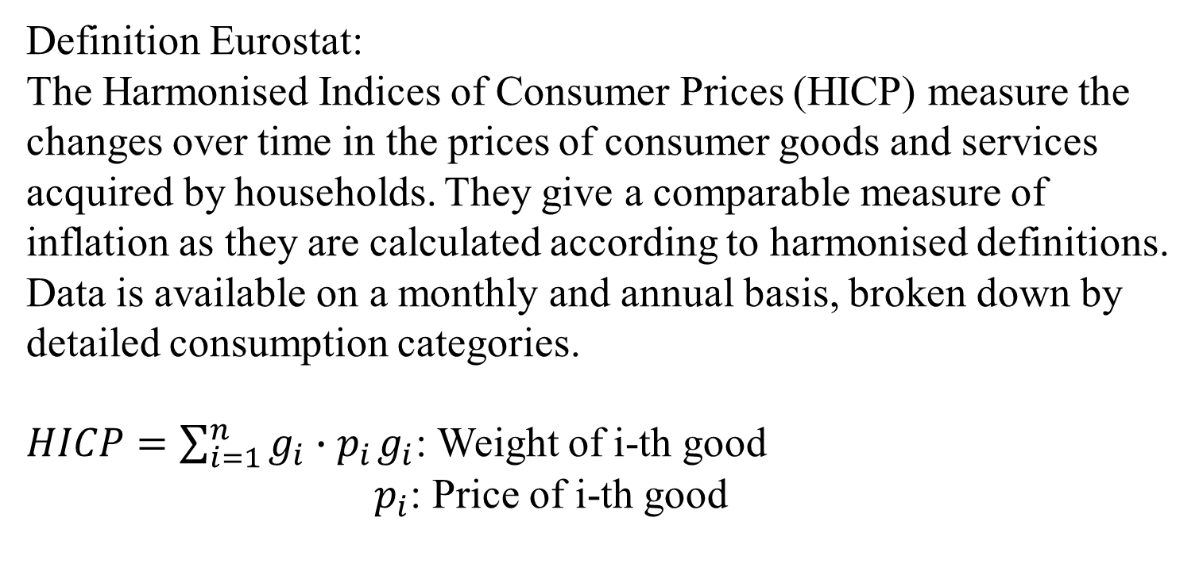
Harmonized Indices of consumer Prices (HICP)
Definition Eurostat:
The Harmonised Indices of Consumer Prices (HICP) measure the changes over time in the prices of consumer goods and services acquired by households. They give a comparable measure of inflation as they are calculated according to harmonised definitions. Data is available on a monthly and annual basis, broken down by detailed consumption categories.
$HICP=\sum_{i=1}^{n}{g_{i}∙p_{i}}$ $g_{i}$: Weight of i-th good
$p_{i}$: Price of i-th good
A personal inflation calculator

Slide 36
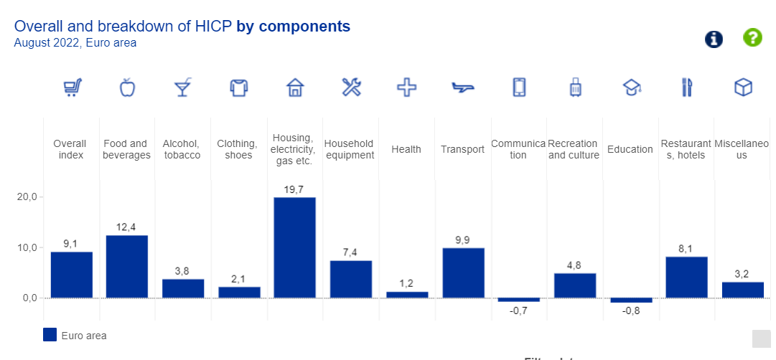
Weight scheme of the HCPI
https://www.ecb.europa.eu/stats/macroeconomic_and_sectoral/hicp/html/index.en.html

Slide 37
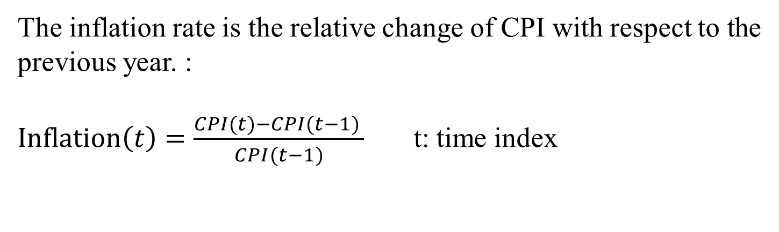
Inflation
The inflation rate is the relative change of CPI with respect to the previous year. :
$Inflation\left(t\right)=\frac{CPI(t)−CPI(t−1) }{CPI(t−1)}$ t: time index

Slide 38
Calcuate the price index 2017 – 2019 (2017=100)
Inflation rates 2018 und 2019, and the average inflation 2018 – 2019.
Beispiel

Slide 39
Different Preisindices
Consumer price index → general inflation, relevant for private consumption
GDP-Deflator → Index for the whole economy, scope of distirbution in wage negotiations
Export- and Import prices → Indices for international trade (relevant for „imported“ inflation)
Wolesale price index→ Whole sale trade is some kind of an early indicator for inflation based on CPI.

Slide 40
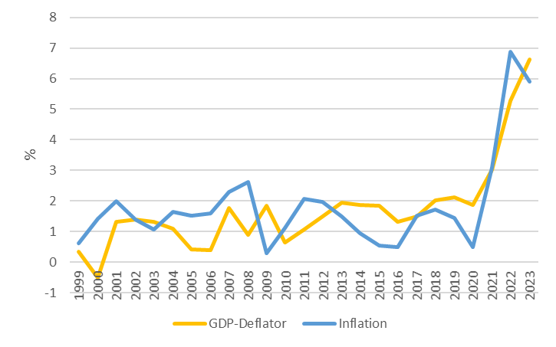
CPI und GDP-Deflator
Source: Destatis,

Slide 41
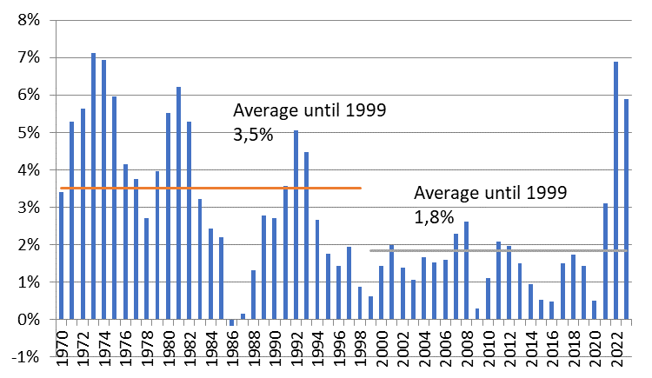
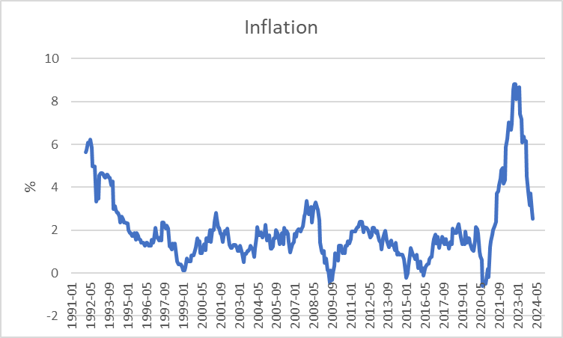
Inflation Germany
Yearly
Monthy p.a.
Source: Destatis

Slide 42
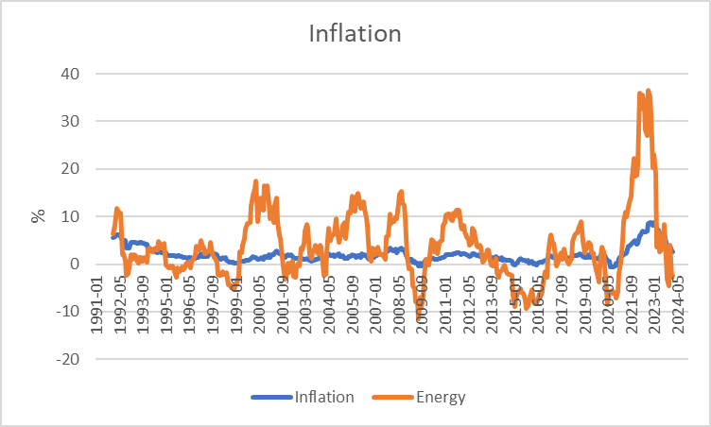
CPI and the Energy component (Germany)
Source: Bundesbank

Slide 43
Energy and Inflation
The weight of the energy component is roughly 10% in CPI.
Calculate inflation, if energy price have fallen by 20% and all other prices stayed the same.

Slide 44
High level of employment
Principal aim is to reach a state of full employment.
→ every person willing has a job.
The general variable to measure unemployment is the unemployment rate.
In Germany a level of 3%-4% unemployment rate is considered as a state of full eployment.

Slide 45
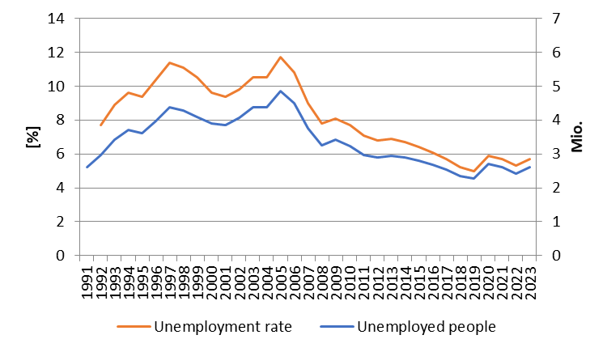
Development of unemployment in Germany
Source: BA

Slide 46
Unemployment definition BA
(registered unemployed people)
Age between 15 – 65 (67) years
Defined by the Social Code, Book III (SGB III), the unemployed include all those who are
temporarily not employed or work in a job for fewer than 15 hours per week,
seek employment subject to social insurance contributions for at least 15 hours per week,
and in the process are available for placement efforts undertaken by the employment agencies or institutions administering basic security benefits for job-seekers
and have registered there as unemployed.

Slide 47
Unemployment definition ILO
Unemployed is any person aged between 15 and 74 years
who was not in employment, but actively sought work over the four weeks preceding the survey
and would be available for starting a job within two weeks.
In this context, it is irrelevant whether the persons concerned are registered with a government authority and receive social benefits from there

Slide 48
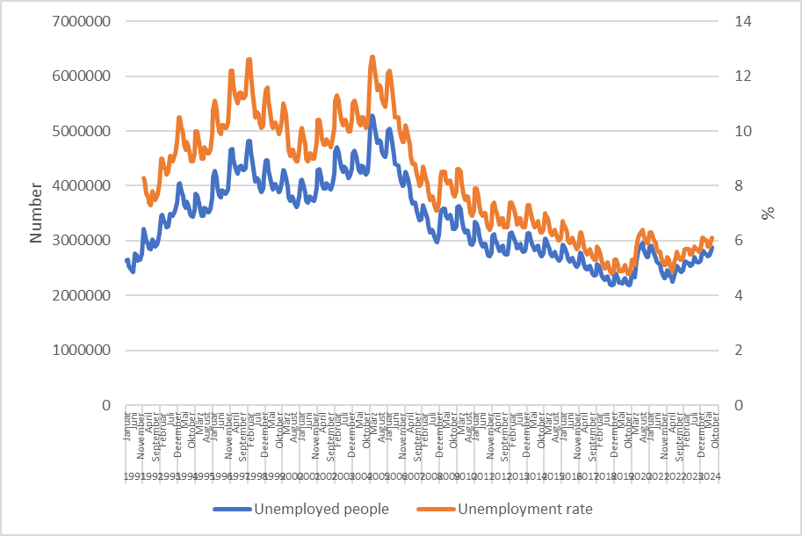
Monthly development of unemployment in Germany
Source: BA

Slide 49
Types of unemployment
Short-term: seasonal and frictional unemployment
Medium-term: cyclical unemployment
Long-term: structural unemployment

Slide 50
Short term unemployment
seasonal unemployment:
Fluctuation in production during a year i.e. in theagricultural sector or the construction sector
Fuctuations in demand during the year i.e. in Tourism sector because of the weather or because of school holidays
Hiring cycles
frictional unemployment :
Incomplete information in the labour market causes a mismatch between job seeking poeple and poeple seeking enterprises
  Transition time between on job and another new job
  Additional time because of moving from one location to another

Slide 51
Medium- and long-term unemployment
Cyclical unemployment:
Within the business cycle we have an under utilization of potential output → causing a decrease in labor demand
Structural unemployment :
Sectoral change, i.e. legislative amendment (Change in Energy politics)
→ job loss in the coal industry or the nuclear sector
Technological change, i.e. digitalization of many process will change the labor market dramatically (i.e. AI)
              → new skills are neede in the future
Regional descrepancy in job demand and supply specially because of the demographic change in the rural area

Slide 52
Hidden unemployment
People in qualification programs
Early retirement
Short time work
Job creation sheme

Slide 53
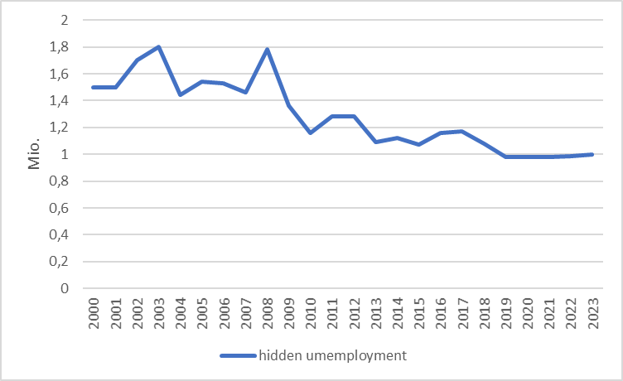
Hidden unemployment Germany
Source: IAB

Slide 54
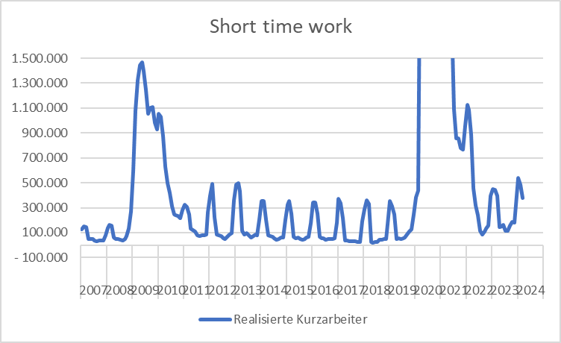
Source: BA
Development of short-time-work in Germany

Slide 55
External balance
There is no generally accepted definition!
This aim has to be understood within the historical context. Until 1973 we had a system of fixed exchange rates in the world. Every convertible currency was fixed in realtion to the US-Dollar → In such a framework it is suitable to balance i.e. the current accout or the trade balance, because otherwise the own currency can be out under pressure
But in 1973 the system of Bretton woods collapsed! Since the, we have free floating currencies, and therefore there is no need anymore for a balanced current account. Nevertheless you find in textbooks the following aims:
Andere Interpretationen:
Balanced trade balance
Balanced current account
Low fluctuating currency
Low susceptibility from foreign economies

Slide 56
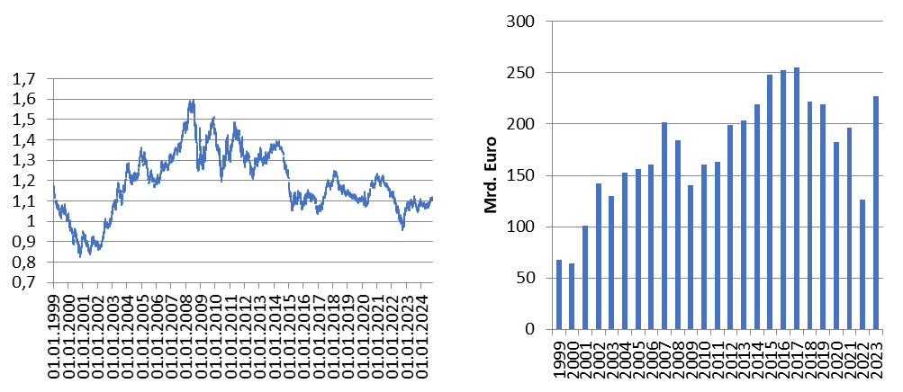
International economic relationships Germany
Source: Bundesbank
Exchange rate Euro – Dollar
Trade balance

Slide 57
Balance of Payments
Definition of Balance of Payments:
The balance of payments is a summary of all the international transactions of a country and its citizens during a specified period of time. This period is usually of one year, though many countries have now started preparing the quarterly accounts for the purposes of forecasting.
Caution:
In the balance of payments we count flow, while usually in a balance sheet you report stocks!
Notes:
57

Slide 58
Balance ofpayments
A. Current Account
B.Capital account
C. Financial account
A1. Balance of goods
A2. Balance of services
A3. Primary income (payments form work (wages) oder inverstments (dividends)
A4. Secondary income (payments from government (tax, refunds) or one way transfers i.e. disaster relief)
B1. Capital transfers
B1. Direct investment
B2. Porfolio investment
B3. Financial derivative
B4. Reserve investement
B5. Other investment
Notes:
58

Slide 59
Further economic goals
Fair balanced income distribution → German constitution Art. 72 Satz 2 GG
Sustainable ecological conditions → German constitution Art. 20a GG
Sustainable public financial budget → German constitution Art. 109 Satz 3 GG
→ Maastricht criteria 3% Deficit
60% government debt ratio

Slide 60
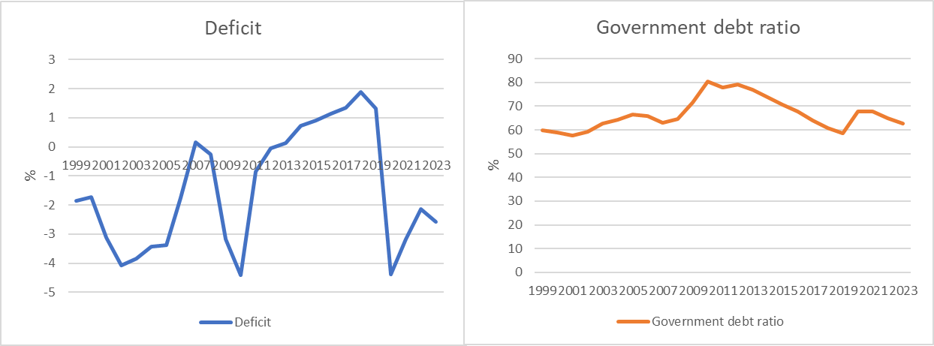
Development of the public budget and debt (Germany)
Cource: Destatis, Bundesbank
Deficit: Public Budget in relation to GDP
Government debt ratio : governemnt debt in relation to GDP

