Slide 1





Macroeconomics
Wilhelmshaven
This lecture will be recorded and
Subsequently uploaded in the
world-wide-web
Prof. Dr. Bernhard Köster
Jade-Hochschule Wilhelmshaven
http://www.bernhardkoester.de/vorlesungen/inhalt.html

Slide 2

Macroeconomics
Winter Term 2024
Prof. Dr. Bernhard Köster

Slide 3
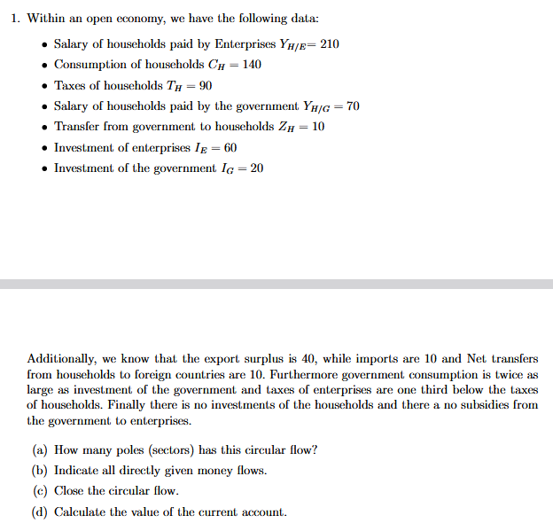
















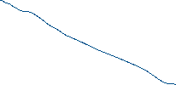












Slide 5
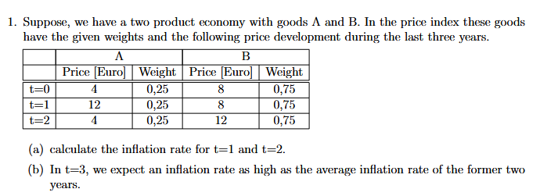

Slide 6
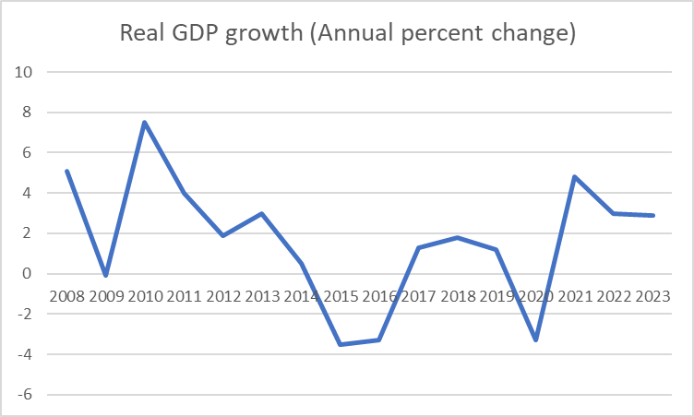
Country data: IMF datamapper
IMF DataMapper
https://www.imf.org/external/datamapper/profile/CAQ
-> click on IMF datamapper
-> click on data sets
-> World economic outlook
-> choose the asked parameters i.e. real GDP growth
-> i.e. you have Brazil
-> Download the data in an excel-file
-> present the data since the global financial crisis (2008-2023)
-> calculate the average real gdp growth rate (2008-2023)
1,63%

Slide 7
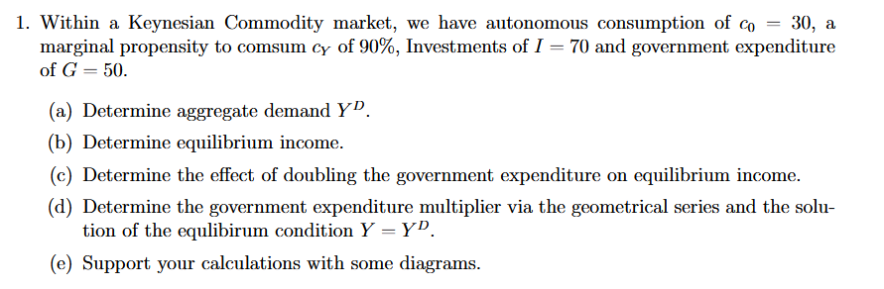


















Slide 8
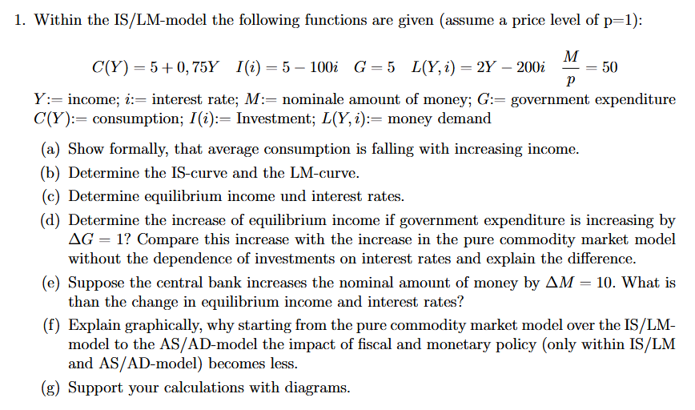
















Slide 9
