Slide 1


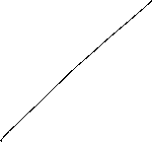


Macroeconomics
Wilhelmshaven
This lecture will be recorded and
Subsequently uploaded in the
world-wide-web
Prof. Dr. Bernhard Köster
Jade-Hochschule Wilhelmshaven
http://www.bernhardkoester.de/vorlesungen/inhalt.html

Slide 2

Macroeconomics
Winter Term 2024
Prof. Dr. Bernhard Köster

Slide 3
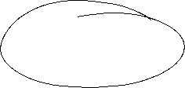


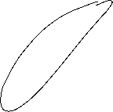








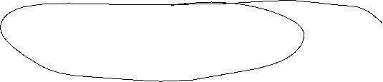


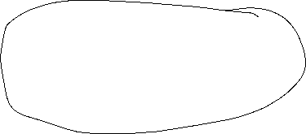




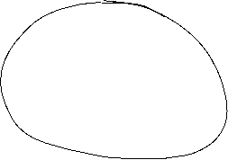



The Neoclassical Model

Slide 4







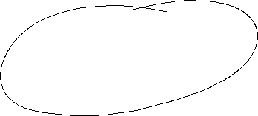
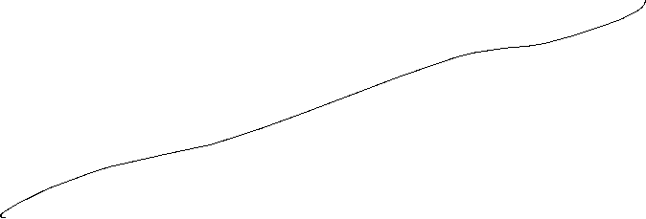





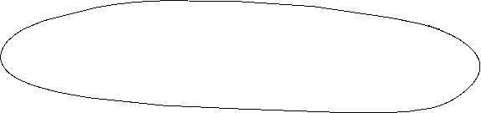


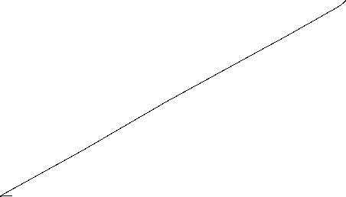





Aggregated Production

Slide 5

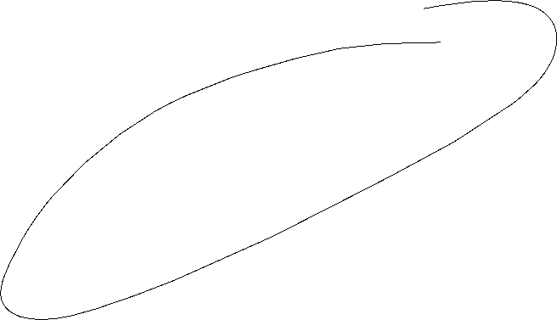



Neoclassical production: positive diminishing productivity
Y = A ∙ F(K,L)
Suppose K=constant
$$Y$$
$$\text{L}$$

Slide 6




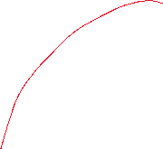
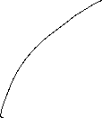



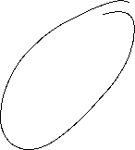

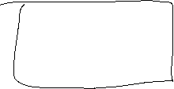
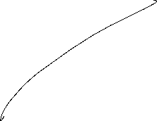





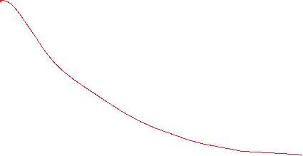

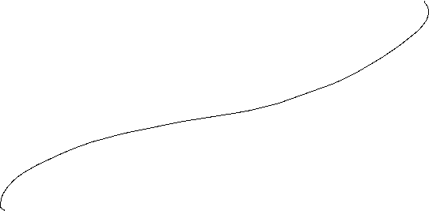






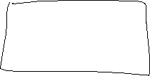

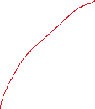


Neoclassic: Labor market − labor demand

Slide 7
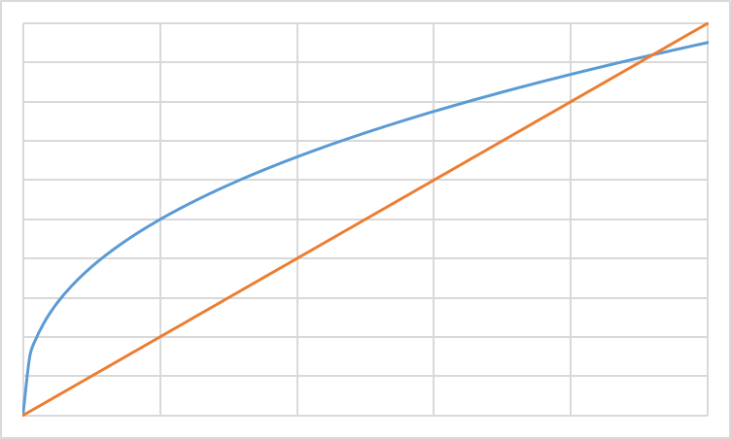
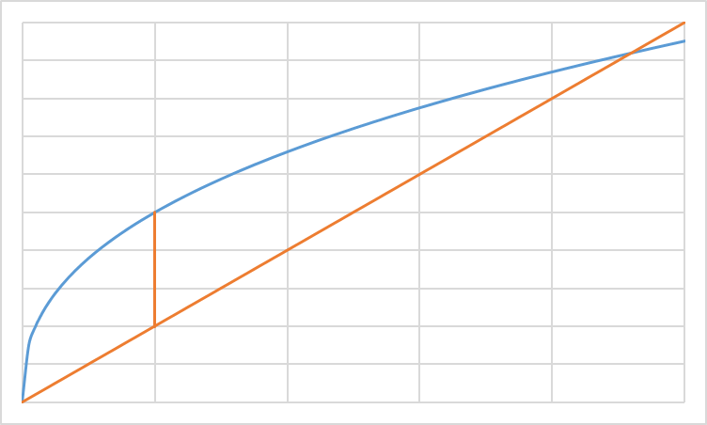
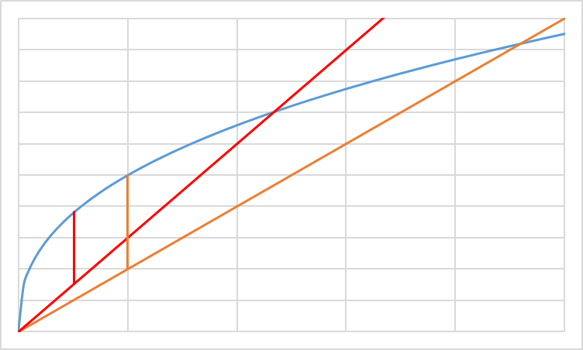

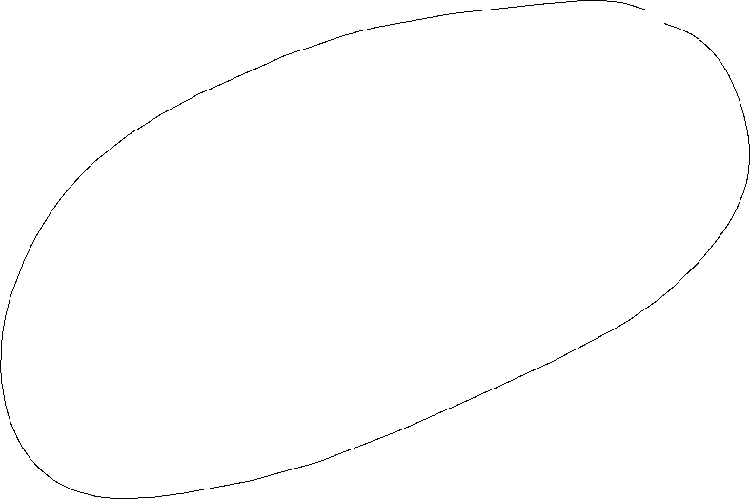


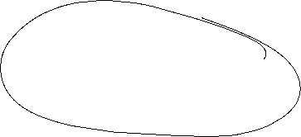




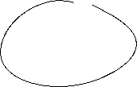
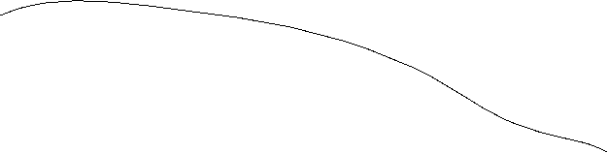





Profit maximization with respect to L: Labor demand
ω=w/p Real wage
Costs; Output
ω₂L: real Costs
ω₁L: real Costs
y(L): Output
L
L*(ω₂)
L*(ω₁)
L^{D}(ω)
ω₁ < ω ₂
ω

Slide 8

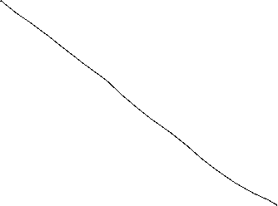



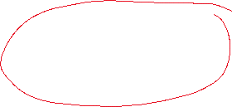



















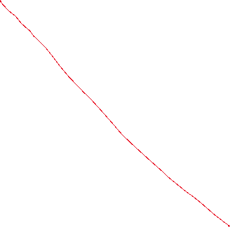



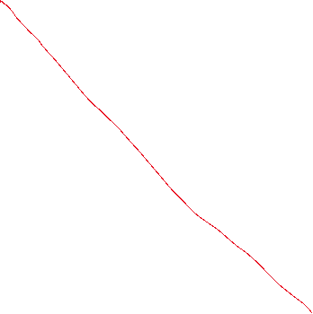

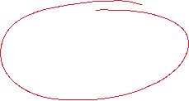
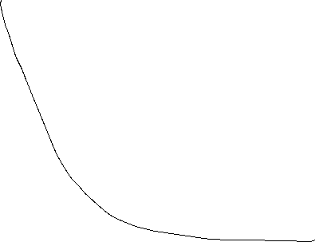






Labor supply
Utility function: u(c,f)
Budget restriction: pc=wL
und $\overline{L}$-L=f
c
f

Slide 9









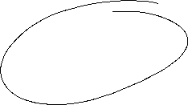






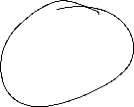

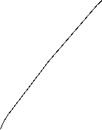

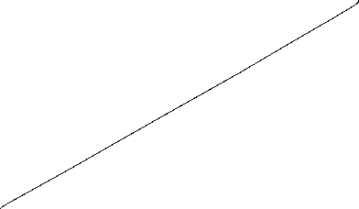



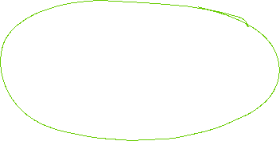
Neoclassic: Labor market − Labor supply

Slide 10
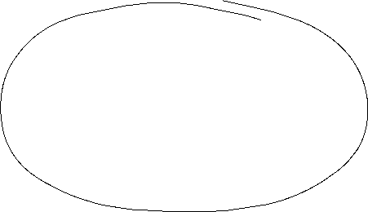
Labor market − Labor supply
In general we assume in neoclassical theory, that the labor market determine the level of output. Thus via the labor market equilibrium we obtain the supply of production dependent on real wages Y^{S}(ω*) in our economy
L
L^{S}(ω)
L^{D}(ω)
L*
ω*
ω
In opposite to the keynesian theory, we assume that the economy is supply side driven via Y^{S} and equilibrium with demand (Y^{S}=Y^{D}) is reached, that this time demand follows supply.

Slide 11

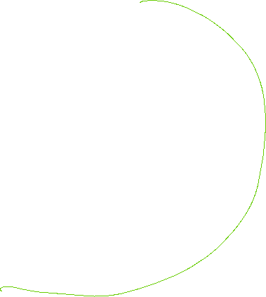


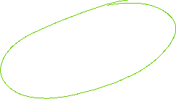
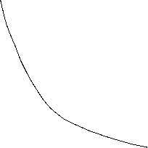
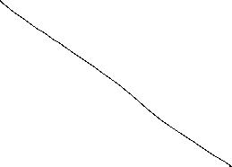


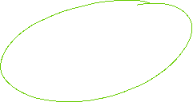


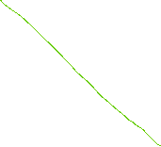









Capital market

Slide 12

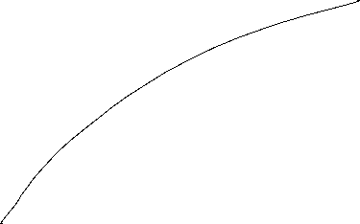
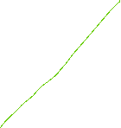
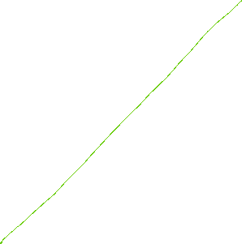
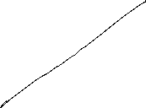
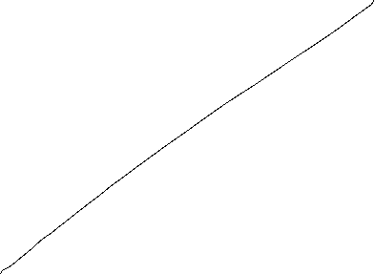

Capital market

Slide 13



Capital market

Slide 14








Walras´ law

Slide 15







Neoclassic: Say´s law and natural unemployment

Slide 16






















Neoclassical synthesis
$$p$$
$$ω=\frac{w}{p}$$
$$y$$
$$L$$

Slide 17





















Neoclassical model of general equilibrium
production
price and real wages
Produktionsniveau
Preis- und Reallohnniveau
$$p$$
$$y^{S}$$
$$w^{∗}$$
$$p^{∗}$$
$$y^{D}(p,G,M)$$
$${\left(\frac{w}{p}\right)}^{∗}$$
$$ω=\frac{w}{p}$$
$$y^{∗}$$
$$y$$
$$L^{∗}$$
$$L^{S}$$
$$L^{D}$$
$$L$$
Production function
Produktionsfunktion
Labormarket
Arbeitsmarkt

Slide 18

Monetary and Fiscal policy in the Neocalssical theory
In the neocalssical theory monetary and fiscal policy have ultimately no effect on real variables since the production level y^{S} depends only on the framework conditions of the economy. Thus only the production function and preferences of households are relevant. Whilst this framework is not change production level y* and real wage $ω$* stays unchanged.
Monetary policy: An increase of the amount of money shifts the curve of the camebridge equation to the leftand thus price level is increased 1:1. Therefore an increased amount of money increases nominal wages, but this increase is totally absorbed by the increase of price implying, that real wages $ω$* are not changed and so the level of output y*
Fiscal policy: Increased governement expenditure increases the demand for goods in general. Enterprises can react via an increase of quantity and prices. This time in opposite to Keynes prices are fully flexible and therefore additional demand is totally absorbed by an increase of prices and again that real wages $ω$* are not changed and so the level of output y*

Slide 19

Neoclassical and Keynesian theory
In the short run an impulse via fiscal policy can work, since in practice prices are not fully flexible. But in the long run prices will change and artificially stimulated demand will be absorbed via an price level increase.
A similar reasoning is seein case of monetary policy. An induced increase of the amount of money channeled byreduced interest rates can stimulated investment if prices are rigid in the short run. But in the long rund will become flexible and adjust and thus the stimulus will be absorbed by anincreasing price level.
In general, we have:
→ Keynes: short run
→ Neoclassic: long run
Caution! We are in social sciences and thus, there is no „true“ model, since we can always change the framework conditions by ourselves. Please stay sceptical if people tell you, that the economy functions in a specific way. It is much more important to observe the circumstances and apply the „right“ theory in the „right“ time. For example the development of inflation rates over the last 10 years can be well explained via a crossing from keynesan theory to neoclassical theory
Notes:
19

Slide 20



Apple2000, Salmo trutta fario-1, CC BY-SA 3.0
Encyclopedia britannica
© Hans Hillewaert, Platichthys flesus 1, CC BY-SA 4.0
Notes:
20

