Slide 1


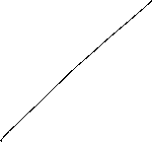


Macroeconomics
Wilhelmshaven
This lecture will be recorded and
Subsequently uploaded in the
world-wide-web
Prof. Dr. Bernhard Köster
Jade-Hochschule Wilhelmshaven
http://www.bernhardkoester.de/vorlesungen/inhalt.html

Slide 2


Wilhelmshaven
Dirk Gerlach
Leiter Stab der Hv-Präsidentin
Bundesbank – Filiale Hannover
Money, interest and prices
–
basics and current problems of European monetary policy
Dienstag 10.12.2024
Jade Hochschule Wilhelmshaven
10:15 – 11:45 Uhr: S123
Ansprechpartner:
Prof. Dr. Bernhard Köster
bernhard.koester@jade-hs.de

Slide 3

Macroeconomics
Winter Term 2024
Prof. Dr. Bernhard Köster

Slide 4









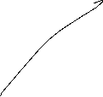
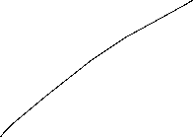

Short-run and long-run perspective in the AS-AD-Model
Long-run supply
AS_{long}
p
AS-curve
p*
AD-curve
Y_{n}=Y*
Y
In the long run prices are totally flexible and therefor expected prices will coincide with actual prices. Therefore in the long-run output depends mainly on the framework conditions of the economy (education, infrastructure, resources,…), in general on the level of technology. The possible output dependent of framework conditions is called natural output and does not depend anymore on prices. Therefore Y_{n}=Y* can be identified with a long-run Supply, which is vertical in the p-y-diagram

Slide 5

Monetary and fiscal policy in the AS-AD-Model
Explain the impact of
a nominal increase of the amount of money
an increase of government expenditure
Within the AS-AD-Model in a short-run and long-run perspective

Slide 6
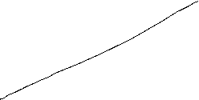
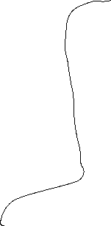




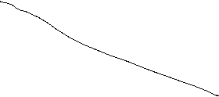

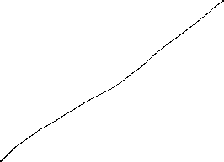
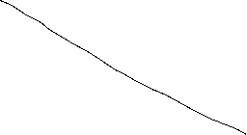
Fiscal policy in the AS-AD-Model
AS_{long}
LM
i
IS
P
Y_{n}
Y
AS
p
A
AD
Y_{n}
Y

Slide 7


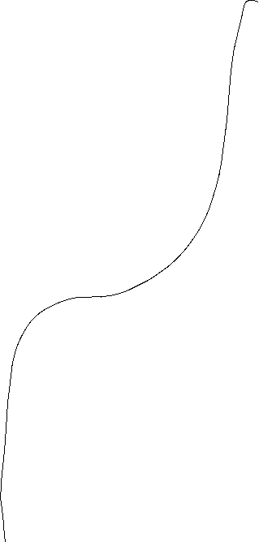


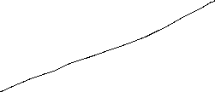

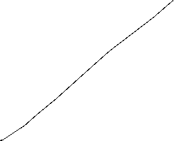
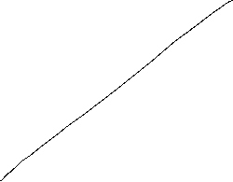
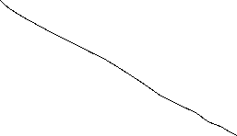

Monetary policy in the AS-AD-Model
AS_{long}
LM
i
IS
Y_{n}
AS‘‘
Y
P
AS
p₀
A
AD
Y_{n}
Y

Slide 8


Summary AS-AD-Model/IS-LM-Model
The impact of monetary and fiscal policy within the short run AS-AD-Model is reduced compared to the IS-LM-Model since the change in prices absorb some amount of the expansive effect.
With respect to the long-run supply-curve monetary and fiscal policy within the AS-AD-Modell do not have any expansive effect on output, only prices will increase. But keep in mind, that this requires perfect competion in commodity and expecially labour markets!
  Caution! Since we have neither in the AS-AD-Model nor in the IS-LM-Model an explicit time dependence, we have to keep in mind that theoretically all effects happens simultanously. In reality adjustments have a time delay and also the framework conditions can change in time. Therefore, we will also have structual changes during time. Especially „good“ economic policy tries to increase the technology level and natural output.

Slide 9
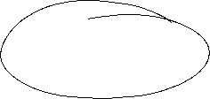


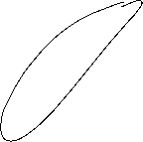








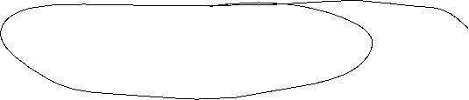





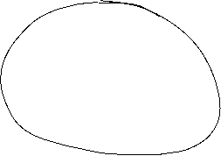



The Neoclassical Model

Slide 10







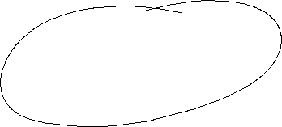
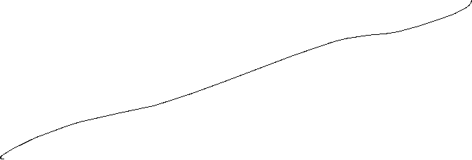





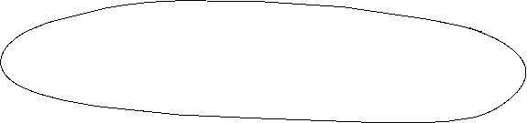


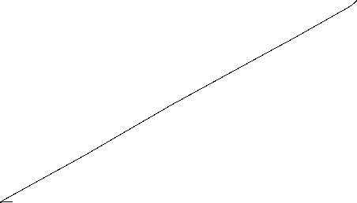





Aggregated Production

Slide 11




Neoclassical production: positive diminishing productivity
Y = A ∙ F(K,L)
Suppose K=constant
$$Y$$
$$\text{L}$$

Slide 12









Neoclassic: Labor market − labor demand

Slide 13
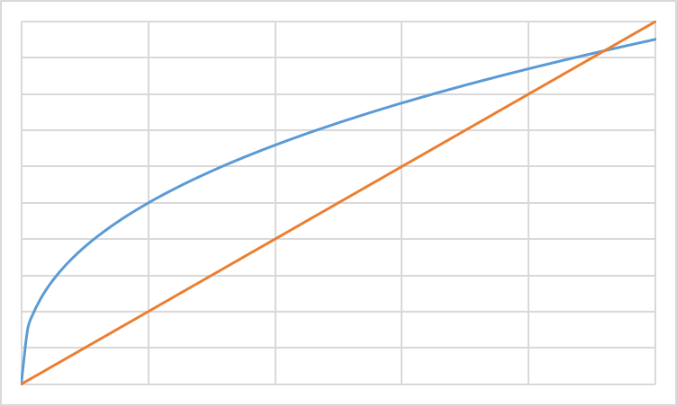
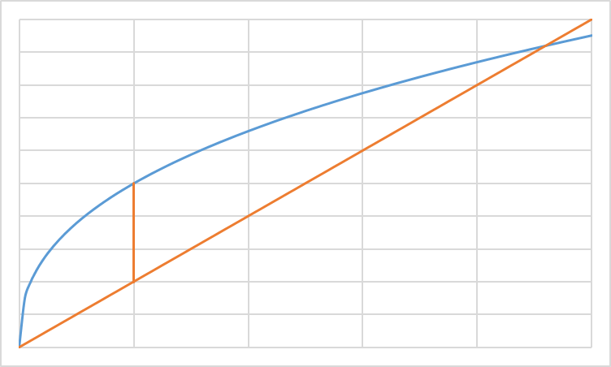
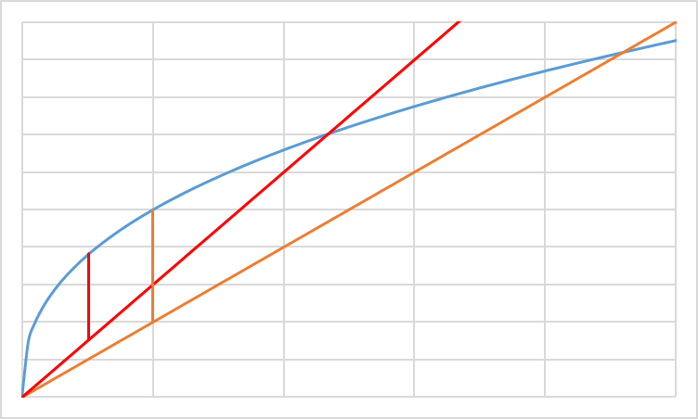

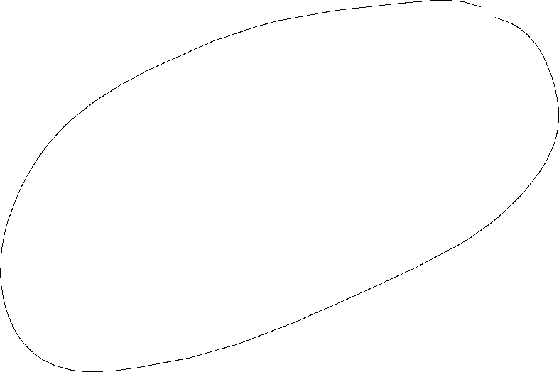


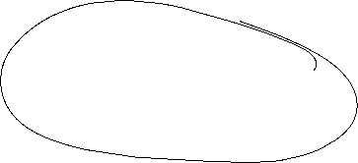




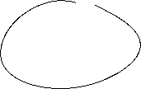
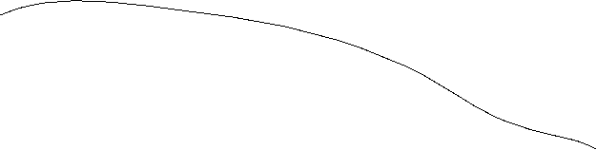





Profit maximization with respect to L: Labor demand
ω=w/p Real wage
Costs; Output
ω₂L: real Costs
ω₁L: real Costs
y(L): Output
L
L*(ω₂)
L*(ω₁)
L^{D}(ω)
ω₁ < ω ₂
ω

Slide 14

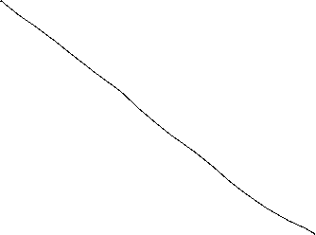






















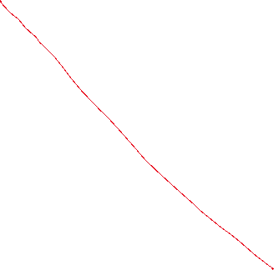



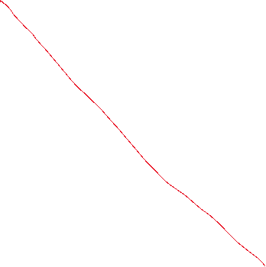

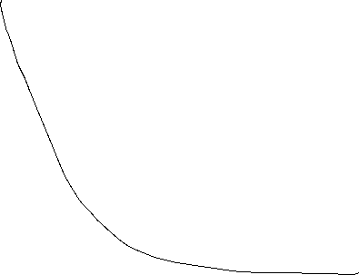






Labor supply
Utility function: u(c,f)
Budget restriction: pc=wL
und $\overline{L}$-L=f
c
f

Slide 15







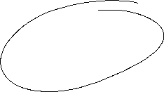





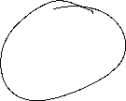

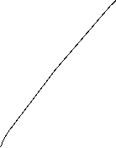

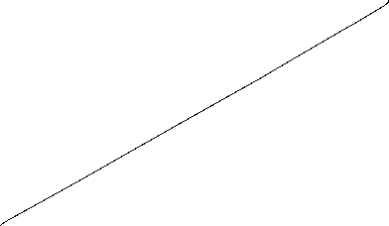



Neoclassic: Labor market − Labor supply

Slide 16
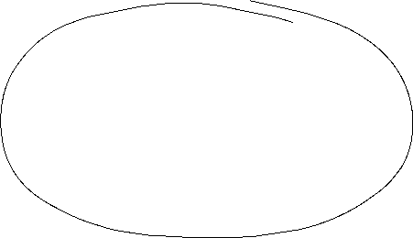
Labor market − Labor supply
In general we assume in neoclassical theory, that the labor market determine the level of output. Thus via the labor market equilibrium we obtain the supply of production dependent on real wages Y^{S}(ω*) in our economy
L
L^{S}(ω)
L^{D}(ω)
L*
ω*
ω
In opposite to the keynesian theory, we assume that the economy is supply side driven via Y^{S} and equilibrium with demand (Y^{S}=Y^{D}) is reached, that this time demand follows supply.

Slide 17
Walras´ law

Slide 18
Neoclassic: Say´s law and natural unemployment

Slide 19

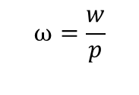


Neoclassical synthesis
$$p$$
$$ω=\frac{w}{p}$$
$$y$$
$$L$$

Slide 20













Neoclassical model of general equilibrium
production
price and real wages
Produktionsniveau
Preis- und Reallohnniveau
$$p$$
$$y^{S}$$
$$w^{∗}$$
$$p^{∗}$$
$$y^{D}(p,G,M)$$
$${\left(\frac{w}{p}\right)}^{∗}$$
$$ω=\frac{w}{p}$$
$$y^{∗}$$
$$y$$
$$L^{∗}$$
$$L^{S}$$
$$L^{D}$$
$$L$$
Production function
Produktionsfunktion
Labormarket
Arbeitsmarkt

Slide 21
Monetary and Fiscal policy in the Neocalssical theory
In the neocalssical theory monetary and fiscal policy have ultimately no effect on real variables since the production level y^{S} depends only on the framework conditions of the economy. Thus only the production function and preferences of households are relevant. Whilst this framework is not change production level y* and real wage $ω$* stays unchanged.
Monetary policy: An increase of the amount of money shifts the curve of the camebridge equation to the leftand thus price level is increased 1:1. Therefore an increased amount of money increases nominal wages, but this increase is totally absorbed by the increase of price implying, that real wages $ω$* are not changed and so the level of output y*
Fiscal policy: Increased governement expenditure increases the demand for goods in general. Enterprises can react via an increase of quantity and prices. This time in opposite to Keynes prices are fully flexible and therefore additional demand is totally absorbed by an increase of prices and again that real wages $ω$* are not changed and so the level of output y*

Slide 22
Neoclassical and Keynesian theory
In the short run an impulse via fiscal policy can work, since in practice prices are not fully flexible. But in the long run prices will change and artificially stimulated demand will be absorbed via an price level increase.
A similar reasoning is seein case of monetary policy. An induced increase of the amount of money channeled byreduced interest rates can stimulated investment if prices are rigid in the short run. But in the long rund will become flexible and adjust and thus the stimulus will be absorbed by anincreasing price level.
In general, we have:
→ Keynes: short run
→ Neoclassic: long Frist
Caution! We are in social sciences and thus, there is no „true“ model, since we can always change the framework conditions by ourselves. Please stay sceptical if people tell you, that the economy functions in a specific way. It is much more important to observe the circumstances and apply the „right“ theory in the „right“ time. For example the development of inflation rates over the last 10 years can be well explained via a crossing from keynesan theory to neoclassical theory
Notes:
22

Slide 23



Apple2000, Salmo trutta fario-1, CC BY-SA 3.0
Encyclopedia britannica
© Hans Hillewaert, Platichthys flesus 1, CC BY-SA 4.0
Notes:
23

