Slide 1


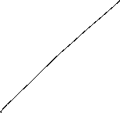


Macroeconomics
Wilhelmshaven
This lecture will be recorded and
Subsequently uploaded in the
world-wide-web
Prof. Dr. Bernhard Köster
Jade-Hochschule Wilhelmshaven
http://www.bernhardkoester.de/vorlesungen/inhalt.html

Slide 2


Wilhelmshaven
Dirk Gerlach
Leiter Stab der Hv-Präsidentin
Bundesbank – Filiale Hannover
Money, interest and prices
–
basics and current problems of European monetary policy
Dienstag 10.12.2024
Jade Hochschule Wilhelmshaven
10:15 – 11:45 Uhr: S123
Ansprechpartner:
Prof. Dr. Bernhard Köster
bernhard.koester@jade-hs.de

Slide 3

Macroeconomics
Winter Term 2024
Prof. Dr. Bernhard Köster

Slide 4
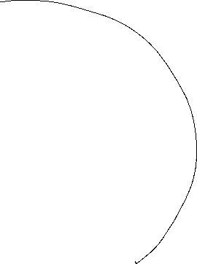
Overall equilibrium
i
LM-curve
i*
IS-curve
Y*
Y
The Intersection of LM- und IS-curve is the overall equilibrium
→ money and commodity market are simultanously in equilibrium

Slide 5
Example
C(Y)=C₀+c_{y}∙Y=50+0,8Y
I(i)=I₀+i_{i}∙i=30-300i
G=20
L(Y,i)=l_{y}∙Y+l_{i}∙i=0,5Y – 250i
M=400 p=2
Determine the IS-Kurve
Determine the LM-Kurve
Determine the simultanous equilibrium at the money and commidity market with equilibrium interest rate i* and income Y*

Slide 6
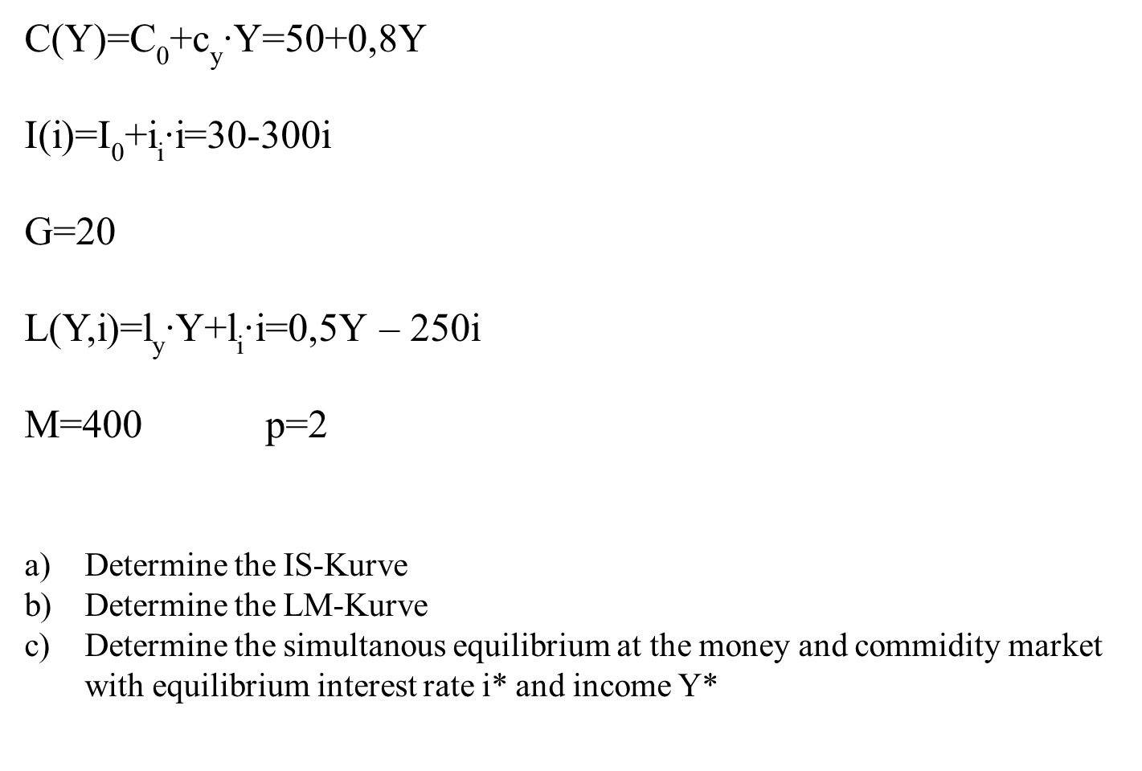



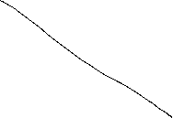

Slide 7


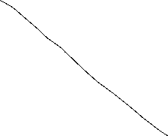
Fiscal policy in the IS-LM-Model
+ ΔG
Y^{D}
Y^{D}=Y
Y^{D}(G)
C₀+I(i₁)+G
∆G >0
Y*₁(G)
Y
i
i₁
IS(G)
Y*₁(G)
Y*₁(G +∆G)
Y

Slide 8
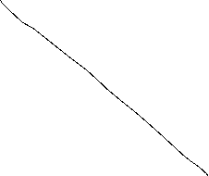

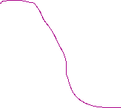

Fiscal policy in the IS-LM-Model
G↑
i
LM
IS(G₁)
i*(G₂)
i*(G₁)
Y* (G₁)
Y

Slide 9


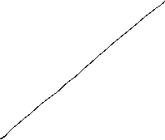

Monetary policy in the IS-LM-Model
+ ΔM
$$M/p$$
LM($M$)
$$i$$
$$i$$
$i_{0}$($M$)
$L(\text{Y}\text{0}$)
L, M/p
Y₀

Slide 10
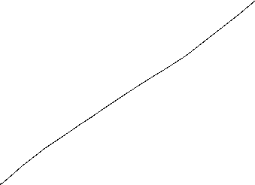

Monetary policy in the IS-LM-Model
M↑
i
M₁<M₂
LM(M₁)
i*(M₁)
IS Kurve
Y* (M₁)
Y

Slide 11
Example
C(Y)=C₀+c_{y}∙Y=50+0,8Y
I(i)=I₀+i_{i}∙i=30-300i
G=20
L(Y,i)=l_{y}∙Y+l_{i}∙i=0,5Y – 250i
M=400 p=2
Determine the fiscal impulse if government expenditure doubles.
Determine the monetary impuls if the quantity of money is increased by 25%.
Determine the fiscal impulse if government expenditure doubles.
Determine the monetary impuls if the quantity of money is increased by 25%.

Slide 12
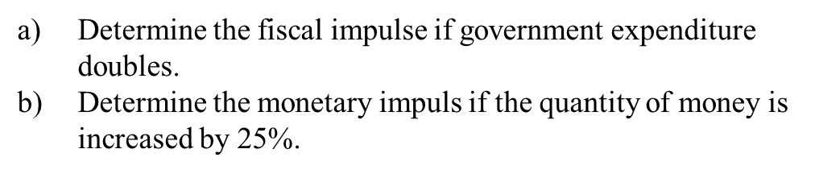




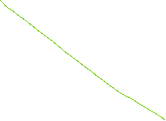


Slide 13



Slide 14


AS-AD-Model
Within the Keynesianschen IS-LM-Modell we find prices in order to obtain the real amount of money M/p but p is assumed to be constant
In the following, we relax this extreme assumption and assume partially flexible prices. But especially at the labour market, we still assume, that enterprises have some market power and thus they can demand a specific markup over marginal costs (i.e. monopolistic competition, oligopol, …)
Together with these assumptions we derive
  Aggregated Supply: AS
  Aggregated Demand: AD
Notes:
14

Slide 15

Aggregated supply: AS-Curve ($Y^{S}$) – General explaination
Keynesian Theory of rigid wages
Keynesian theory of rigid prices
Keynesian theory expectations
Notes:
15

Slide 16









Keynesian Theory of rigid wages
Within the profit maximization of enterprices, wages are one of the main cost factors.
If wages are constant in the short run marginal profits are rising, if output prices increase
Thus enterprises have an incentive to increase production if the price level is increasing.
Altogether we obtain an increased aggregated demand if price level has increased

Slide 17






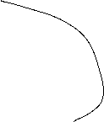
Keynesian theory of rigid prices
Additionally to constant wages also prices of other goods and services are assumed to be rigid in the short run
Assume a decreasing price level in general. But some enterprices will not reduces their prices due to rigidities
In the following these enterprises will face falling revenues due to falling sales.
Overall this results in a lower aggregated supply triggered by a lower price level.

Slide 18








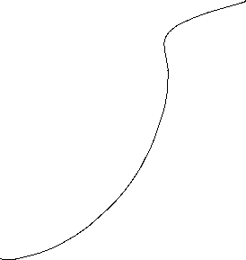


Keynesian theory expectations
In general we assume, that economic agents cannot perfectly distinguish between a general change in price level and their own relative prices
Therefore in a situation of a falling general price level, enterprises can mistakenly assume, that their own prices have fallen relative to other output prices.
Hence they will reduce their production
Similarily workers can mistakenly assume, if the price level has fallen, that their reduced own nominal wages imply a relative decrease of real wages
Hence they will reduce their work effort
Overall we obtain falling aggreagted supply if price level is falling

Slide 19






Aggreagted supply: AS-Kurve ($Y^{S}$)
p
AS:
$$Y^{S}$$
Y
Aggregated supply AS: $Y^{S}(\overset{+}{\overbrace{p}})$
Notes:
19

Slide 20




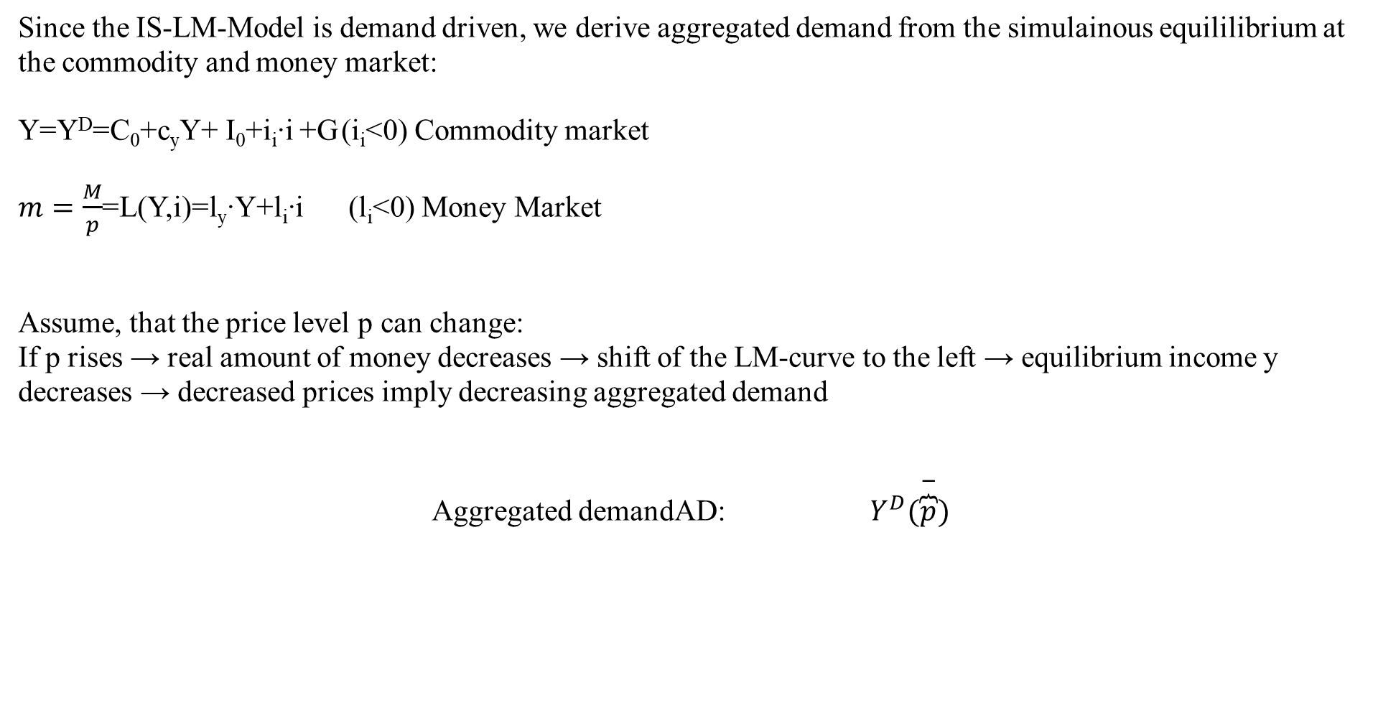
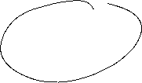

Aggregated demand
Since the IS-LM-Model is demand driven, we derive aggregated demand from the simulainous equililibrium at the commodity and money market:
Y=Y^{D}=C₀+c_{y}Y+ I₀+i_{i}∙i +G (i_{i}<0) Commodity market
$m=\frac{M}{p}$=L(Y,i)=l_{y}∙Y+l_{i}∙i (l_{i}<0) Money Market
Assume, that the price level p can change:
If p rises → real amount of money decreases → shift of the LM-curve to the left → equilibrium income y decreases → decreased prices imply decreasing aggregated demand
Aggregated demandAD: $Y^{D}(\overset{−}{\overbrace{p}})$
Notes:
20

Slide 21
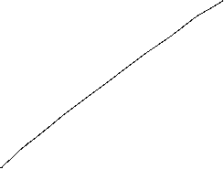
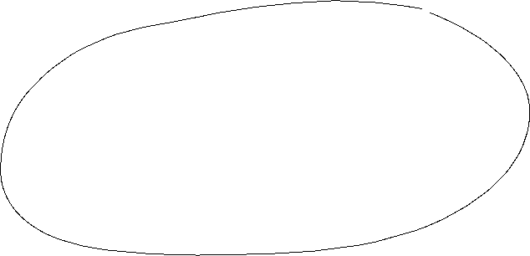
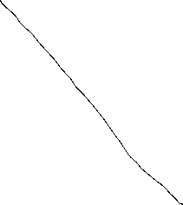
Grafical derivation of the AD-curve
i
LM-curve (p₀)
p₁>p₀
i*(p₀)
IS-curve
P
Y*(p₀)
Y
p₀
AD-curve
Y*(p₀)
Y

Slide 22



AS-AD-Model
p
AS-curve
p*
AD-curve
Y*
Y
We obtain a Supply-Demand-Diagram in prices and output similar to microeconomic theory
Caution! The derivation of AS and AD should not be confound with micro economic explaination of demand via utility maximization for demand profit maximazation for supply!
Altogether (p*,Y*) represents the short-run-equilibrium in the economy.

Slide 23
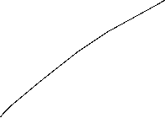




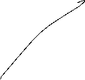
Short-run and long-run perspective in the AS-AD-Model
Long-run supply
AS_{long}
p
AS-curve
p*
AD-curve
Y_{n}=Y*
Y
In the long run prices are totally flexible and therefor expected prices will coincide with actual prices. Therefore in the long-run output depends mainly on the framework conditions of the economy (education, infrastructure, resources,…), in general on the level of technology. The possible output dependent of framework conditions is called natural output and does not depend anymore on prices. Therefore Y_{n}=Y* can be identified with a long-run Supply, which is vertical in the p-y-diagram

Slide 24

Monetary and fiscal policy in the AS-AD-Model
Explain the impact of
a nominal increase of the amount of money
an increase of government expenditure
Within the AS-AD-Model in a short-run and long-run perspective

Slide 25
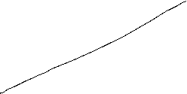
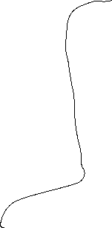




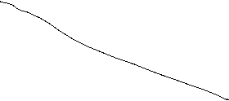

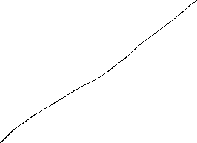
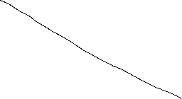
Fiscal policy in the AS-AD-Model
AS_{long}
LM
i
IS
P
Y_{n}
Y
AS
p
A
AD
Y_{n}
Y

Slide 26


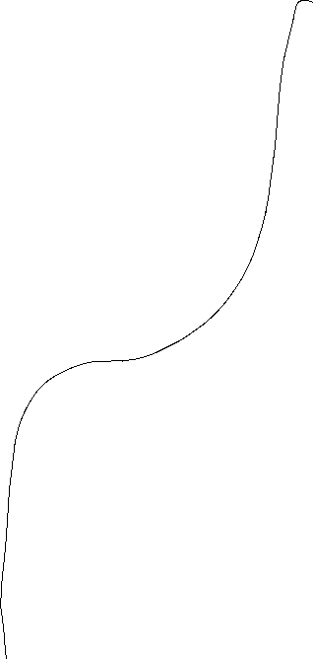


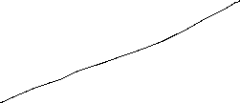

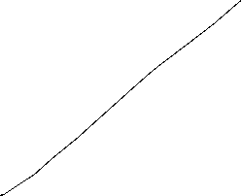
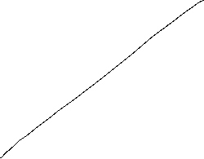
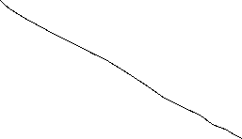

Monetary policy in the AS-AD-Model
AS_{long}
LM
i
IS
Y_{n}
AS‘‘
Y
P
AS
p₀
A
AD
Y_{n}
Y

Slide 27


Summary AS-AD-Model/IS-LM-Model
The impact of monetary and fiscal policy within the short run AS-AD-Model is reduced compared to the IS-LM-Model since the change in prices absorb some amount of the expansive effect.
With respect to the long-run supply-curve monetary and fiscal policy within the AS-AD-Modell do not have any expansive effect on output, only prices will increase. But keep in mind, that this requires perfect competion in commodity and expecially labour markets!
  Caution! Since we have neither in the AS-AD-Model nor in the IS-LM-Model an explicit time dependence, we have to keep in mind that theoretically all effects happens simultanously. In reality adjustments have a time delay and also the framework conditions can change in time. Therefore, we will also have structual changes during time. Especially „good“ economic policy tries to increase the technology level and natural output.

Slide 28



The Neoclassical Model

Slide 29
Aggregated Production

Slide 30


Neoclassical production: positive diminishing productivity
Y = A ∙ F(K,L)
Suppose K=constant
$$Y$$
$$\text{L}$$

Slide 31
Neoclassic: Labor market − labor demand

Slide 32
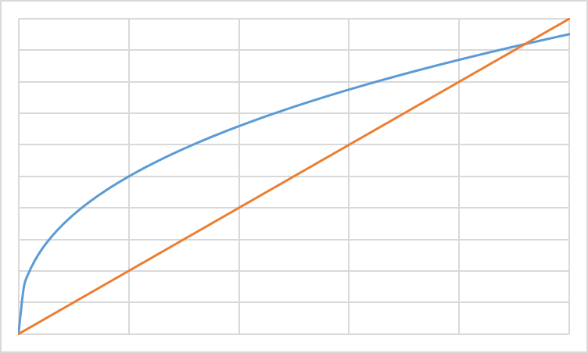
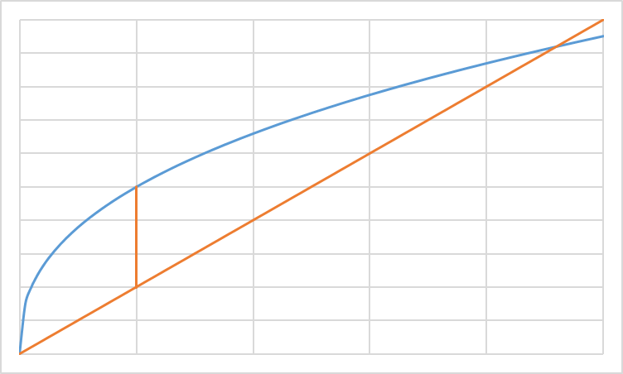
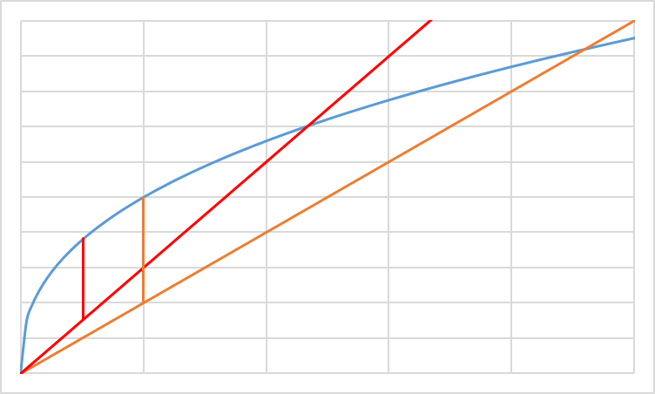
Profit maximization with respect to L: Labor demand
ω=w/p Real wage
Costs; Output
ω₂L: real Costs
ω₁L: real Costs
y(L): Output
L
L*(ω₂)
L*(ω₁)
L^{D}(ω)
ω₁ < ω ₂
ω

Slide 33

Labor supply
Utility function: u(c,f)
Budget restriction: pc=wL
und $\overline{L}$-L=f
c
f

Slide 34
Neoclassic: Labor market − Labor supply

Slide 35
Labor market − Labor supply
In general we assume in neoclassical theory, that the labor market determine the level of output. Thus via the labor market equilibrium we obtain the supply of production dependent on real wages Y^{S}(ω*) in our economy
L
L^{S}(ω)
L^{D}(ω)
L*
ω*
ω
In opposite to the keynesian theory, we assume that the economy is supply side driven via Y^{S} and equilibrium with demand (Y^{S}=Y^{D}) is reached, that this time demand follows supply.

Slide 36
Walras´ law

Slide 37
Neoclassic: Say´s law and natural unemployment

Slide 38

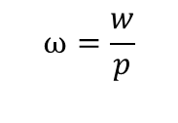


Neoclassical synthesis
$$p$$
$$ω=\frac{w}{p}$$
$$y$$
$$L$$

Slide 39













Neoclassical model of general equilibrium
production
price and real wages
Produktionsniveau
Preis- und Reallohnniveau
$$p$$
$$y^{S}$$
$$w^{∗}$$
$$p^{∗}$$
$$y^{D}(p,G,M)$$
$${\left(\frac{w}{p}\right)}^{∗}$$
$$ω=\frac{w}{p}$$
$$y^{∗}$$
$$y$$
$$L^{∗}$$
$$L^{S}$$
$$L^{D}$$
$$L$$
Production function
Produktionsfunktion
Labormarket
Arbeitsmarkt

Slide 40
Monetary and Fiscal policy in the Neocalssical theory
In the neocalssical theory monetary and fiscal policy have ultimately no effect on real variables since the production level y^{S} depends only on the framework conditions of the economy. Thus only the production function and preferences of households are relevant. Whilst this framework is not change production level y* and real wage $ω$* stays unchanged.
Monetary policy: An increase of the amount of money shifts the curve of the camebridge equation to the leftand thus price level is increased 1:1. Therefore an increased amount of money increases nominal wages, but this increase is totally absorbed by the increase of price implying, that real wages $ω$* are not changed and so the level of output y*
Fiscal policy: Increased governement expenditure increases the demand for goods in general. Enterprises can react via an increase of quantity and prices. This time in opposite to Keynes prices are fully flexible and therefore additional demand is totally absorbed by an increase of prices and again that real wages $ω$* are not changed and so the level of output y*

Slide 41
Neoclassical and Keynesian theory
In the short run an impulse via fiscal policy can work, since in practice prices are not fully flexible. But in the long run prices will change and artificially stimulated demand will be absorbed via an price level increase.
A similar reasoning is seein case of monetary policy. An induced increase of the amount of money channeled byreduced interest rates can stimulated investment if prices are rigid in the short run. But in the long rund will become flexible and adjust and thus the stimulus will be absorbed by anincreasing price level.
In general, we have:
→ Keynes: short run
→ Neoclassic: long Frist
Caution! We are in social sciences and thus, there is no „true“ model, since we can always change the framework conditions by ourselves. Please stay sceptical if people tell you, that the economy functions in a specific way. It is much more important to observe the circumstances and apply the „right“ theory in the „right“ time. For example the development of inflation rates over the last 10 years can be well explained via a crossing from keynesan theory to neoclassical theory
Notes:
41

Slide 42



Apple2000, Salmo trutta fario-1, CC BY-SA 3.0
Encyclopedia britannica
© Hans Hillewaert, Platichthys flesus 1, CC BY-SA 4.0
Notes:
42

