Slide 1

Macroeconomics
Wilhelmshaven
This lecture will be recorded and
Subsequently uploaded in the
world-wide-web
Prof. Dr. Bernhard Köster
Jade-Hochschule Wilhelmshaven
http://www.bernhardkoester.de/vorlesungen/inhalt.html

Slide 2


Wilhelmshaven
Vorstellung des Jahresgutachtens des Sachverständigenrats zur Begutachtung der gesamtwirtschaftlichen Entwicklung
Dr. Christopher Zuber
(Referent für Makroökonomik und Produktivität im Stab des SVR)
Dienstag 26. November 2024
Jade Hochschule Wilhelmshaven
10:15 – 11:45 Uhr, gHs
Hybrid, zoom-link
https://jade-hs.zoom-x.de/j/64843766756?pwd=lSRgFjY6B9HOpFZirXrOI5dD6BYTVM.1
Ansprechpartner:
Prof. Dr. Bernhard Köster
bernhard.koester@jade-hs.de
www.bernhardkoester.de

Slide 3

Wilhelmshaven
Dirk Gerlach
Leiter Stab der Hv-Präsidentin
Bundesbank – Filiale Hannover
Money, interest and prices
–
basics and current problems of European monetary policy
Dienstag 10.12.2024
Jade Hochschule Wilhelmshaven
10:15 – 11:45 Uhr: S123
Ansprechpartner:
Prof. Dr. Bernhard Köster
bernhard.koester@jade-hs.de

Slide 4

Macroeconomics
Winter Term 2024
Prof. Dr. Bernhard Köster

Slide 5


Monetary policy of the ECB
The ECB’s Governing Council considers that price stability is best maintained by aiming for 2% inflation over the medium term. Inflation is measured by the Harmonised Index of Consumer Prices (HICP). The Governing Council’s commitment to the 2% target is symmetric. This means that we consider negative and positive deviations from the target to be equally undesirable.

Slide 6


Classical monetary instruments of the ECB
Main refinancing operations: The main refinancing operations, with a weekly frequency and a maturity of one week, are the most important monetary policy instrument used by the Eurosystem for money market management.
          → The main refinancing operations (MRO) rate is “in general” the key interest rate of the central bank for steering the money market
Deposit facility: The deposit facility rate is one of the three interest rates the ECB sets every six weeks as part of its monetary policy. The rate defines the interest banks receive for depositing money with the central bank overnight.
Marginal lending facility: The marginal lending facility rate is the interest rate banks pay when they borrow from the ECB overnight. When they do this, they have to provide collateral, for example securities, to guarantee that the money will be paid back.
Minimum reserve: The minimum amount of reserves a credit institution is required to hold with a central bank.

Slide 7

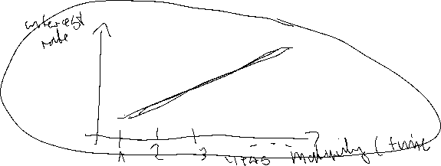


Monetary policy in practice
Modern central banks try to influence via thir interest rate policy the economic performance of the economy. But in practice „directly“ they can only influence the short-term interest rates of the financial markets. Therefore in Europe the ECB has the aim to „steer“ the ESTR (Euro short term rate). ESTR represents the interest rate level of the overnight interbank interest rate in the european banking sector.
  Classical effect of an key interest rate cut of the central bank:
    Short term interest rate↓ →Shifting investments to longer term bonds with higher interest rates
      Prices of longer term bonds increase → Adjustment of interest rates over different maturities
But „in general“ we will have a difference between interest rates for
different maturities. This relationship is called Yield Curve.
Notes:
7

Slide 8

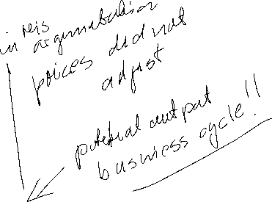

Classical effect of monetary policy via consumption and investment
In general, we assume that the central bank can influence directly and indirectly the interest rates in the economy:
Cutting interest rates will in general expand credit demand:
→ expands credit based investment and consumption
→ increase the utilization of production, which pushes economic growth
→ but, if the economy starts to produce at the limit of their capacity, profits will start to stagnate or expected profits will even fall.
→ pushing liqudity via low interest rates will not increase investment anymore
→ in the end pushing liquity and increasing the amount of money only creates inflation

Slide 9
Classical effect of monetary policy via stock markets
Interest rate cut of the central bank
→ Yields of bonds decline.
→ In the short run, stock investments are more attractive than n investment in bonds
→ This will in general will increase stock market prices until yields at the bond market and the stock market will adjust.
→ Thus, via the increase of prices at capital markets income of investors will increase
→ increase of investment and consumption in general
→ … (see former slide!)
→ in the end pushing liquity and increasing the amount of money only creates inflation

Slide 10

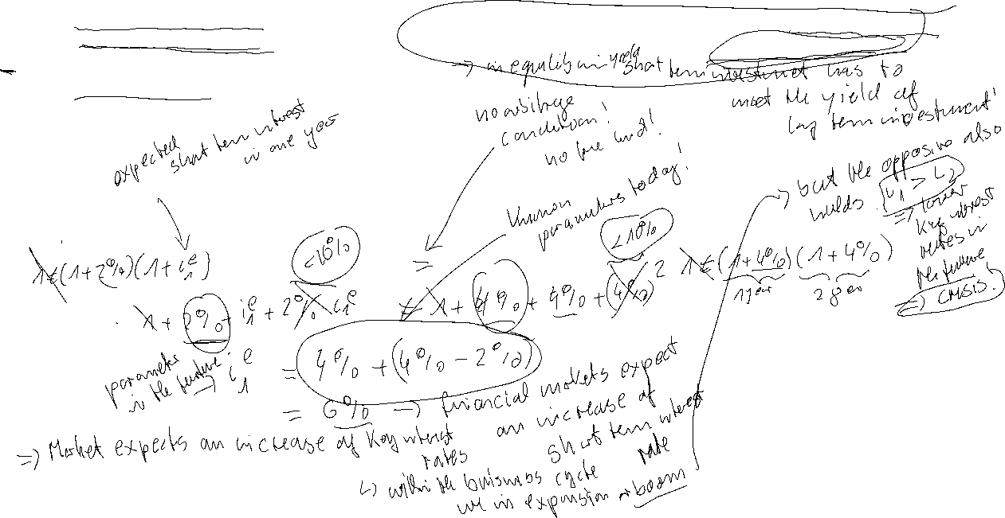
Yield curve: Market expectation theory (Example)
i₁: interest rate 1 year (p.a.) 2%
i₂: interest rate 2 years (p.a.) 4%
i₁e: expected interest rate 1 year in 1 year (p.a.)???
Investment 1 Euro
Assume long term and short term investments are perfect substitues, investors are risk neutral and we have perfect capital markets
1 Euro
Short term?
Long term?
Compare the two investments1
→ short term expected interest rate =
longterm interest rate + difference between long term and short term interest rates
Notes:
10

Slide 11




Yield Curve: Liquidity premium theory
Preferences between creditors and debtors differ. Investors are in general risk avers.
→ Creditors will demand a premium since they lower their liquidity for the maturity of the loan. For this loss of liquidity they want to be compensated.
→ the longer the maturity higher the liquidity premium
→ in general we expect long term interest rates to be higher than short term interest rates
Notes:
11

Slide 12


Yield curve: Market Segmentation Theory
A risk arises for an investor if the investment horizon does not coincides with the term of the security
Maturity > Investment horizon → price risk
Maturity < Investment horizon → income risk
Investors try to reduce their risk
→ the market will be segmented into areas maturity and investment horizon will match
financial assets are no perfect substitutes
Notes:
12

Slide 13
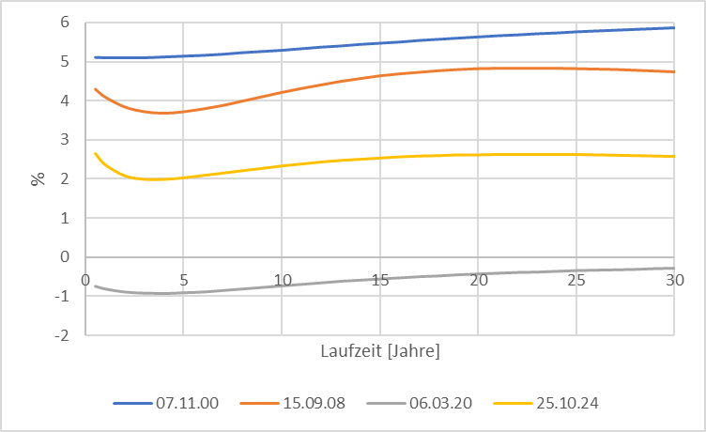











Source: Bundesbank
Yield curve (Germany)
Notes:
13

Slide 14
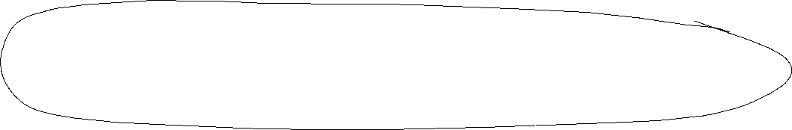

Monetary policy since the financial crisis (overview)
Key interest rates down to 0%
ECB is switching to fixed-rate tender procedure with full allotment for all its refinancing operations, meaning that it would supply all funds demanded at a fixed interest rate.
Downgrade the rating requirements
Introducing long term refinancing opterations up to one year
Liquidity provision of foreign currency (Euro-US-Dollar-swaps)

Slide 15






Monetary policy since the financial crisis (overview)
Two 3-years tender with 500 Bil. Euro Winter 2011/12 (Bazooka) especially for the italien and spanish banking sector
Minimum reserve rate dwon from 2% to 1% January 2012
Draghi Put/“Whatever it takes“ (26.07.2012)
“Within our mandate, the ECB is ready to do whatever it takes to preserve the euro.
and believe me, it will be enough.”
https://qz.com/1038954/whatever-it-takes-five-years-ago-today-mario-draghi-saved-the-euro-with-a-momentous-speech/
Start of buying low rating government bonds (26.09.2012)
Different programs to buy government and private bonds at the secondary financial markets according to the capital key of the eurozone. Especially buying a monthly volume up to 60 Bil. Euros. 2015 -> stop July 2022 (only reinvestment!)
  https://www.ecb.europa.eu/mopo/implement/app/html/index.en.html
PEPP: Pandemic emergency purchase programme (March 2020) Volume 1,7 Tril. Euros (Oct 2022)
  https://www.ecb.europa.eu/mopo/implement/pepp/html/index.en.html
Increase of interest rates since July 2022

Slide 16
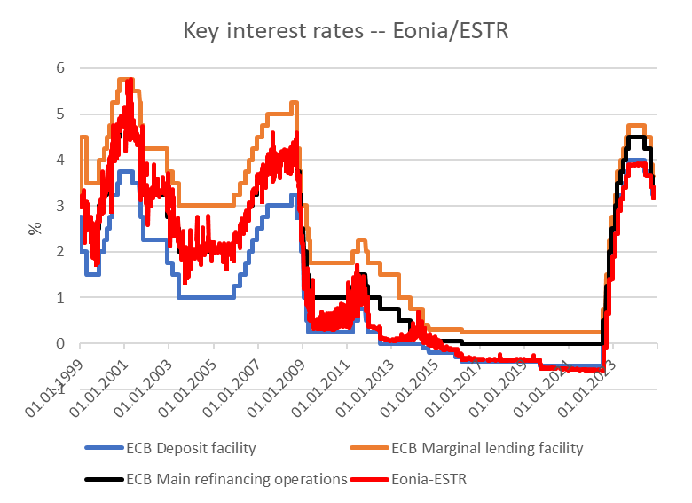






Key rates ECB
Source: ECB,

Slide 17
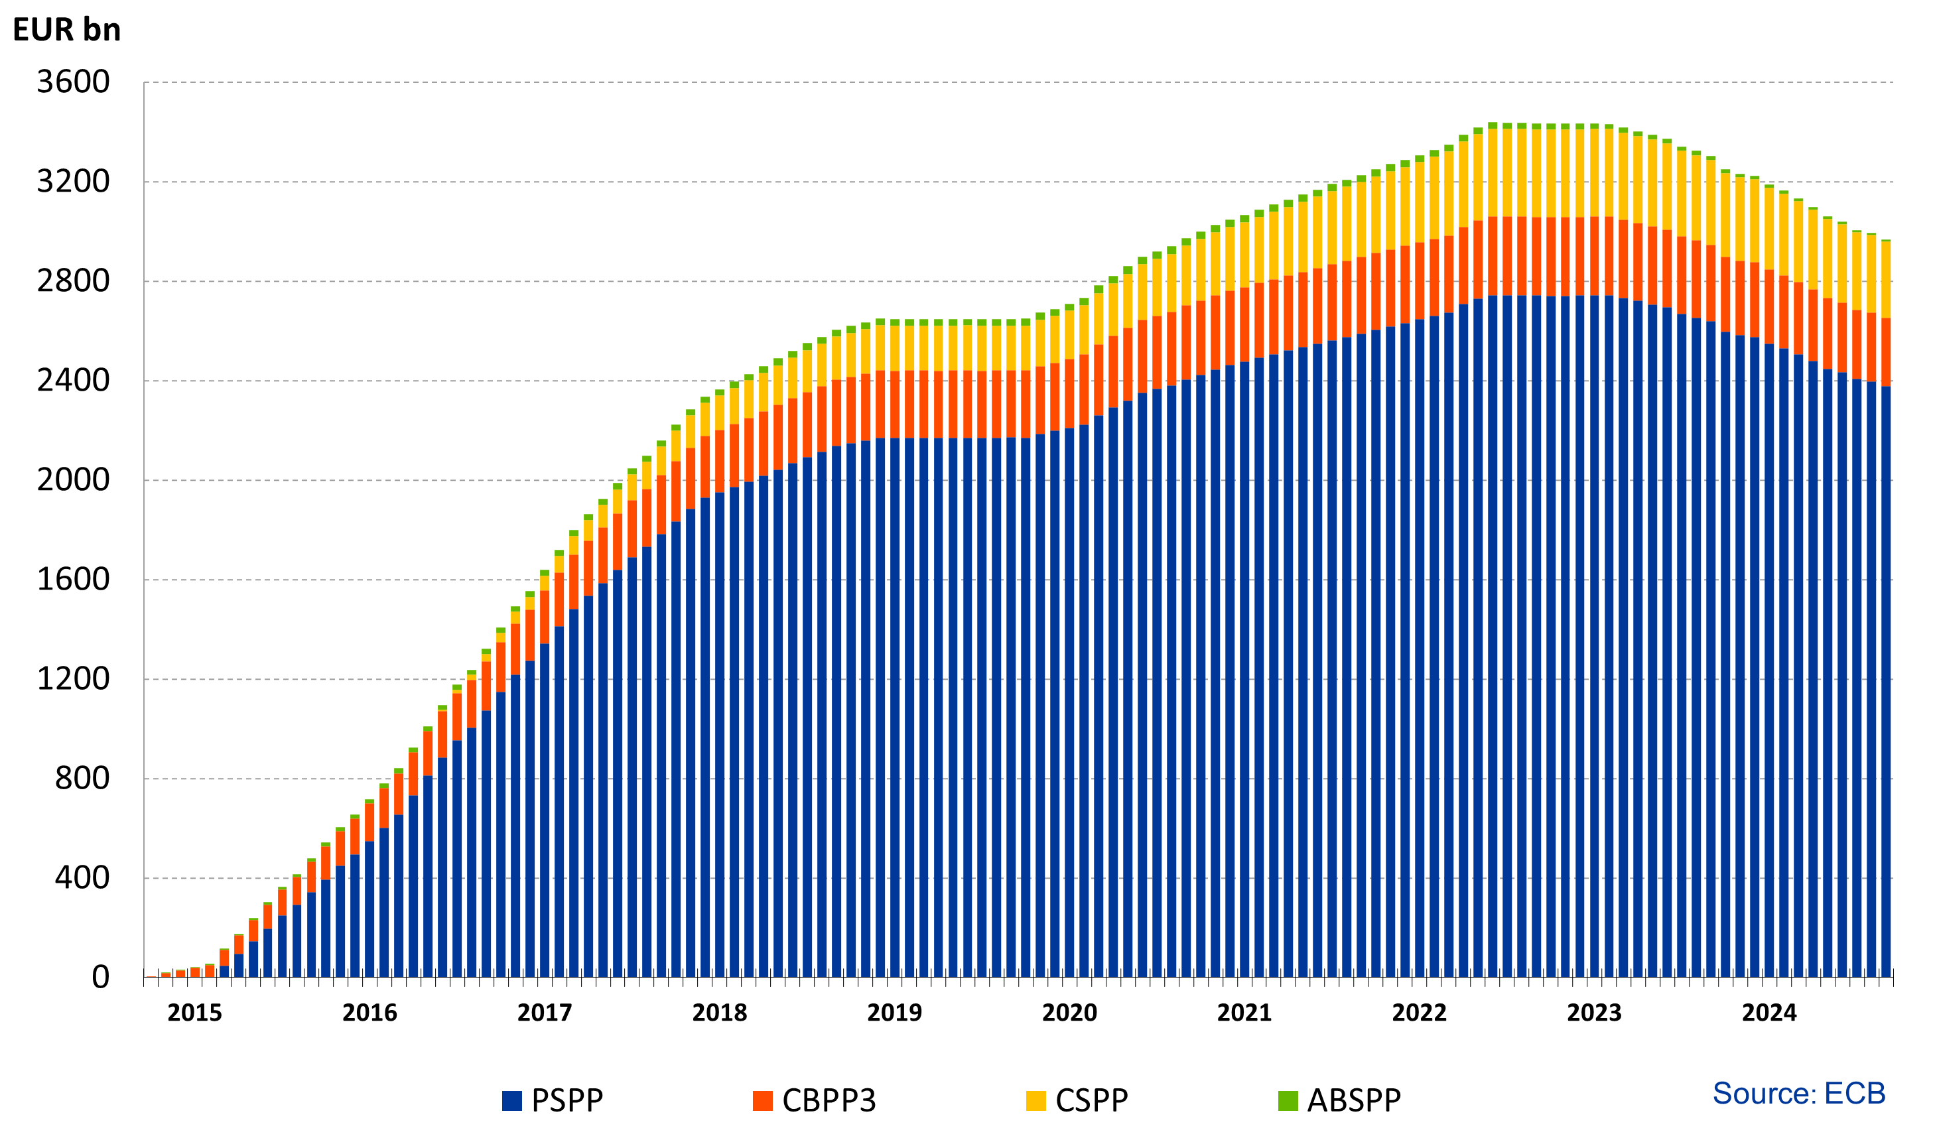












Financial markets interventions of the ECB since 2015 without PEPP
Source: ECB, Asset Purchase Program
https://www.ecb.europa.eu/mopo/implement/omt/html/index.en.html

Slide 18
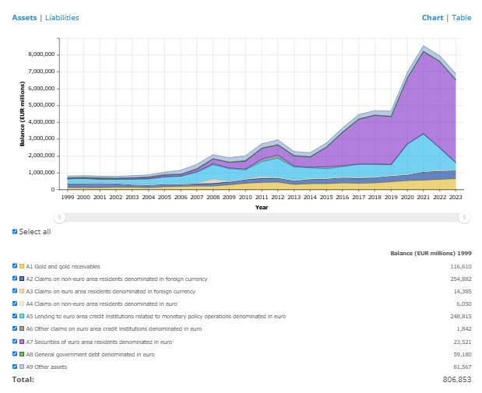





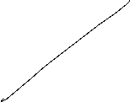


ECB balance sheet
Source: ECB

Slide 19
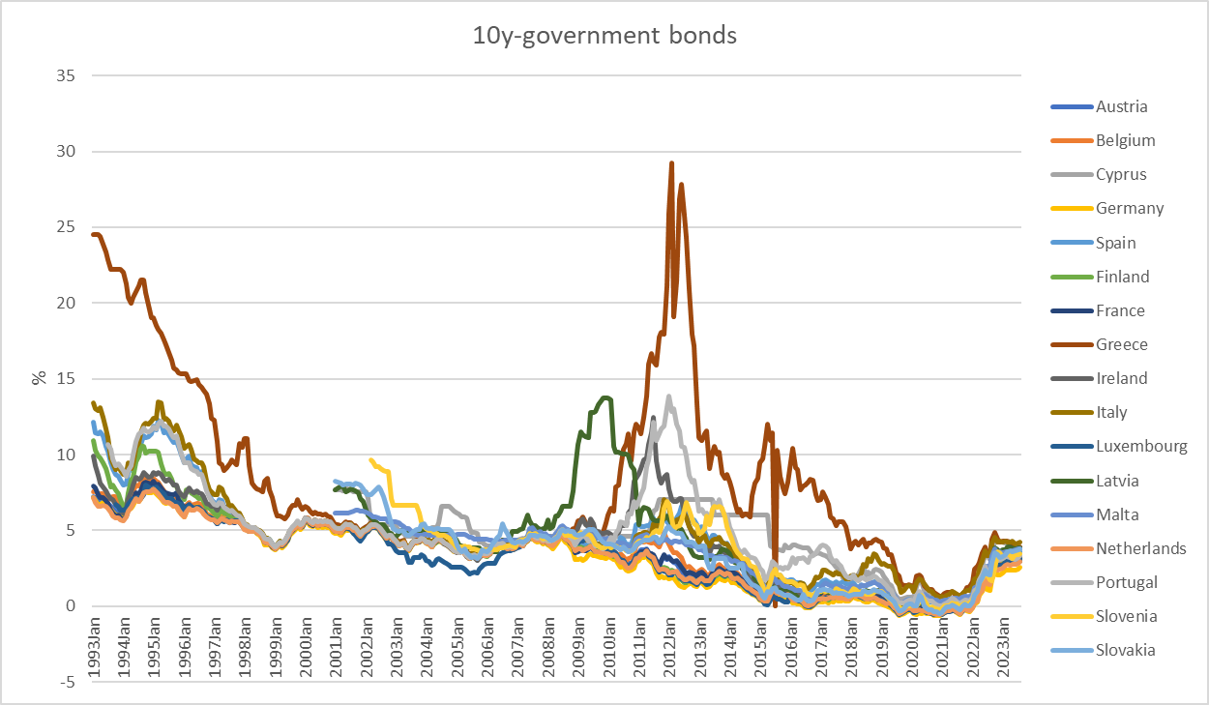



















10 Year government bonds Eurozone
Source: ECB

Slide 20
Keynesian Economics
Short run:
  Production capacities are not fully utilized
  Consumptions- and investment plans are totally fulfilled
  Only the supply-side to adjust due to changes
  Supply and demand are only equalized via changes in production not in prices.
  Aggregate Demand determines the equilibrium in the economy.

Slide 21
Keynesian Cross
Aggregate demand Y^{D}:
Y^{D}=C+I+G
C (private consumption); I (Investment); G (Government expenditure); I and G sare exogenously fixed variables, C depends positively on aggregate income (production) Y
Keynesian consumption function:
C(Y)=C₀+c_{y}Y C₀>0 (autonous consumption); 0<c_{y}<1(marginal propensity to consum)
Euqilibrium: With aggregate income (production) Y is determined by the aggreate demand Y^{D} →
Y=Y^{D}=C₀+c_{y}Y+I+G
Notes:
21

Slide 22
Consumption
In Germany the savings rate is roughly s_{y}= 11% :
What is then the consumption rate c_{y}?
Income Y is divided into consumption and savings (compare the circular flow!)
→c_{y}+ s_{y} =1 → c_{y}=1 – s_{y} =89 %
Interpretation: If we have1000 additional Euros, then 890 Euros are directly spent for consumption (first derivative of the consumption function!)

Slide 23
Consumption
Consumption C(y)
C(y)= C₀+c_{y}Y=100+0,89Y
+ 0,89€ Consumption
corresponds to savings of 0,11€
+ 1€ Income
Autonomous consumption
C₀ =100
Income (y)

Slide 24
Keynesian Cross
Einkommen(Y),
Expenditure(Y^{D})
Income(Y)

Slide 25
Commodity Market euqilibrium
Income =
Expenditure Y^{D}=C₀+c_{y}Y+I+G
45°-Line: locus of every possibility with
Y^{D}=Y → possible equlibria
Linear linear through the origin with
Slope 1
Y^{D}=Y
Income(Y),
Expenditure (Y^{D})
Intersection or 45°-Line and aggregate demand
Y^{D}=Y=Y*
Investment I +
Government expenditure G
consumption C(Y)=C₀+c_{y}Y
Investment I
+
Governement
expenditure G
Aggregate demand not dependent on income Y
Autonomer Konsum C₀
45°
Y^{D}=Y=Y*
Income(Y)
Intersection or 45°-Line and aggregate demand
  Equilibrium: Expenditure (Y^{D}) = Income (Y) = Production (Y) = Y*

Slide 26
Adaption process
Income(Y),
Expenditure (Y^{D})
Equilibrium Y^{D}=Y=Y*
Y=Y^{D}
Production larger than demand
Inventory built-up
Expenditure(Y^{D}) = Demand
Y*
Etc.
Demand larger than Production
Iinventory has to decrease
45°
$$Y_{0}$$
Y*
$$Y_{0}′$$
Einkommen(Y)

Slide 27
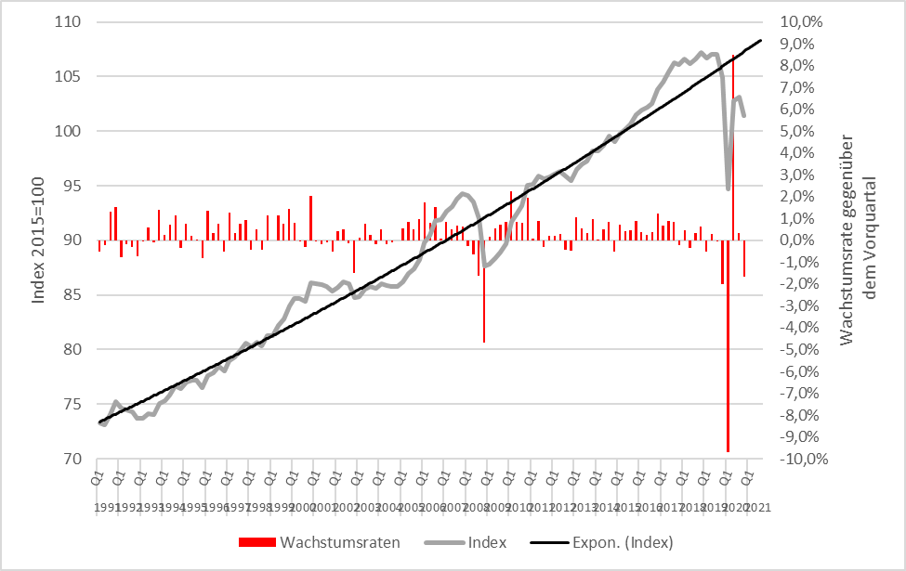
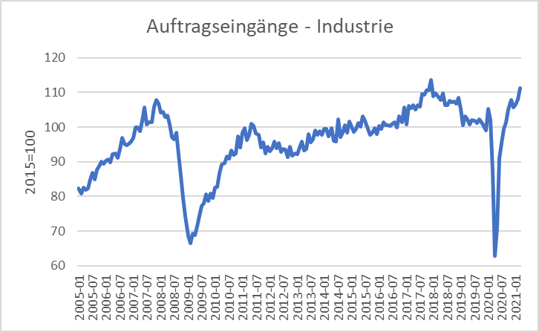
Scrappage Allowance 2009 (Germany): Increase of government expenditure 5 Bil. €
Real economic growth
Incoming orders
Source: Destatis

Slide 28


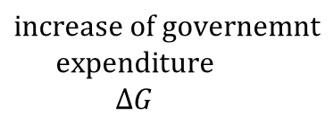
Multiplier effect
: Scrappage Allowance 2009 within the Keynesian cross
Y^{D}=Y
Income(Y),
Expenditure (Y^{D})
$${Expenditure}_{0} ({\text{Y}\text{D}}_{0})$$
Multiplicator$=\frac{∆Y}{∆G}$
$$increase of governemnt$$
$$expenditure$$
$$∆G$$
$$Y_{0}$$
$$Y_{1}$$
Income (Y)

Slide 29
Multiplier effect
External increase of demand, increase of government expenditure of ∆G = 5 and marginal propensity to consum of c_{y}=0,9:
→ additional government consumption ∆G increases directly income Y bei ∆Y₁= ∆G
→
Notes:
29

Slide 30
(Government expenditure) Multiplier
Multiplier: How much increases one variable, if another variable increase by one unit
Government expenditure Multiplier:
Change of equilibrium income, of governement expenditure increases by one unit.
Notes:
30

Slide 31
Multiplier effect (example)
C(Y)= 100+0,8Y; I=400; G=200
Calculate equlibrium income?
Change in equilibrium income, if governement expenditure increades by 100
Calculate the government expenditure multiplier?
Notes:
31

Slide 32
Y, Y^{D}
Y
Notes:
32

Slide 33
Consequences of Keynesian economics
Disequilibria over time are possible
→ Aggregate demand is too low in order to fully utilize labor force.
→ Permant high unemployment level
→ Aggregate demand exceeds the capacity of production.
→ Economy is overheating
Especially full employment is not reached via a euqilibrium process, but can only be reached within a specific parameter constellation of the Economy → the Economy needs external interference!
Notes:
33

Slide 34
IS/LM-Model
Until now in the Keeynsian model we have no prices ( respectively we normalized P=1 and therefore P vanishes in all equations) since due to the demand oriented view supply and demand equalizes only because of adjustments of quantities on the production side.
Additionally the money market is not incorporated and the connection between nominal and real variables is missing. But this link is essential in a modern economy since in general goods an services are measured in money.
The connection between the goods market and the money market is realized via interest rates steering Investment and money demand
The resulting model is still demand oriented and called the IS/LM-Model

Slide 35
IS/LM-Model
IS: Investment = Saving (or Income = Expenditure)
► Commodity market
LM: Liquidity Preference = Money Supply
► Money market
The IS-curve represents the equilibrium at the goods market with I=S or Y^{D}=Y
Caution! I=S is in this case a condition and not an (ex post) identity as in the circular flow!
Equilibrium at the money market
money supply = money demand
While we obtain money demand via the Keynesian function of money demand.
The LM-Kurve represents then the equilibrium at the money market

Slide 36
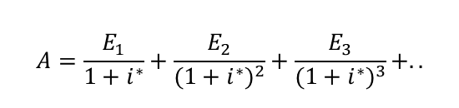
Interest rates and Investment (Keynes` marginal efficiency of capital)
Investment depends interest rate i:
I(i)=I₀+i_{i}∙i with i_{i} <0 I_{0>0} Autonomous investment and i_{i} <0 why?
The yield i* or marginal efficiency of capital of an investment is compared with i the interest rate of the capital market. For example we calculate the internal rate of return
⇒ the Investment is done if i*>i
⇒ The aggregated investment in the economy corresponds to the sum of all investments with i*>i.
Interest rates reflects the opportunity costs of a specific investment.
$$A=\frac{E_{1}}{1+i^{∗}}+\frac{E_{2}}{{(1+i^{∗})}^{2}}+\frac{E_{3}}{{(1+i^{∗})}^{3}}+..$$

Slide 37
The IS-curve
Y^{D}
Y
i
Equilibrium at the commodity market
The IS-curve is the locus of all (i,y)-combinations of commodity market equilibria
The IS-curve is decreasing in y
Y

Slide 38
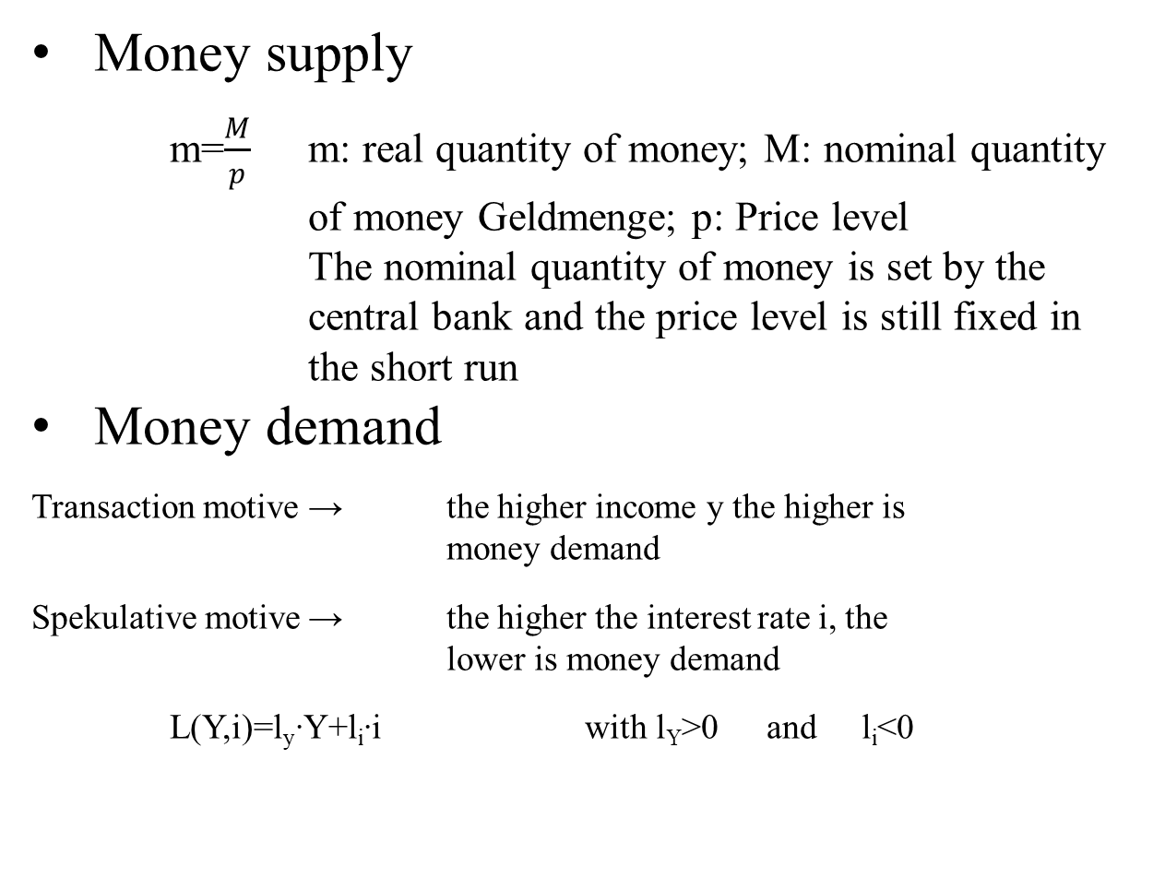
Money market
Money supply
  m=$\frac{M}{p}$ m: real quantity of money; M: nominal quantity of money Geldmenge; p: Price level
  The nominal quantity of money is set by the central bank and the price level is still fixed in the short run
Money demand
Transaction motive → the higher income y the higher is money demand
Spekulative motive → the higher the interest rate i, the lower is money demand
L(Y,i)=l_{y}∙Y+l_{i}∙i with l_{Y}>0 and l_{i}<0

Slide 39
The LM-curve
$$i$$
$$i$$
L, M/p
y
Equilibrium at the money market
The LM-curve is the locus of all (i,y)-combinations of money market equilibria
The LM-curve is increasing in y

Slide 40
Overall equilibrium
i
LM-curve
i*
IS-curve
Y*
Y
The Intersection of LM- und IS-curve is the overall equilibrium
→ money and commodity market are simultanously in equilibrium

Slide 41
Example
C(Y)=C₀+c_{y}∙Y=50+0,8Y
I(i)=I₀+i_{i}∙i=30-300i
G=20
L(Y,r)=l_{y}∙Y+l_{i}∙i=0,5Y – 250i
M=400 p=2
Determine the IS-Kurve
Determine the LM-Kurve
Determine the simultanous equilibrium at the money and commidity market with equilibrium interest rate i* and income Y*

Slide 43
Fiscal policy in the IS-LM-Model
+ ΔG
Y^{D}
Y^{D}=Y
Y^{D}(G)
C₀+I(i₁)+G
∆G >0
Y*₁(G)
Y
i
i₁
IS(G)
Y*₁(G)
Y*₁(G +∆G)
Y

Slide 44
Fiscal policy in the IS-LM-Model
G↑
i
LM
IS(G₁)
i*(G₂)
i*(G₁)
Y* (G₁)
Y

Slide 45
Monetary policy in the IS-LM-Model
+ ΔM
$$M/p$$
LM($M$)
$$i$$
$$i$$
$i_{0}$($M$)
$L(\text{Y}\text{0}$)
L, M/p
Y₀

Slide 46
Monetary policy in the IS-LM-Model
M↑
i
M₁<M₂
LM(M₁)
i*(M₁)
IS Kurve
Y* (M₁)
Y

Slide 47
Example
C(Y)=C₀+c_{y}∙Y=50+0,8Y
I(i)=I₀+i_{i}∙i=30-300i
G=20
L(Y,i)=l_{y}∙Y+l_{i}∙i=0,5Y – 250i
M=400 p=2
Determine the fiscal impulse if government expenditure doubles.
Determine the monetary impuls if the quantity of money is increased by 25%.

Slide 48
Example

