Slide 1

Macroeconomics
Wilhelmshaven
This lecture will be recorded and
Subsequently uploaded in the
world-wide-web
Prof. Dr. Bernhard Köster
Jade-Hochschule Wilhelmshaven
http://www.bernhardkoester.de/vorlesungen/inhalt.html

Slide 2


Wilhelmshaven
Dirk Gerlach
Leiter Stab der Hv-Präsidentin
Bundesbank – Filiale Hannover
Money, interest and prices
–
basics and current problems of European monetary policy
Dienstag 10.12.2024
Jade Hochschule Wilhelmshaven
10:15 – 11:45 Uhr: S123
Ansprechpartner:
Prof. Dr. Bernhard Köster
bernhard.koester@jade-hs.de

Slide 3

Macroeconomics
Winter Term 2024
Prof. Dr. Bernhard Köster

Slide 4
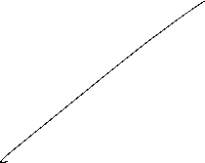











Slide 5




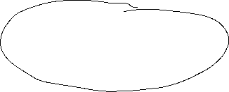

























Magic Square
Steady and appropriate economic growth
External balance
Price level stability
High level of employment

Slide 6




Unemployment definition BA
(registered unemployed people)
Age between 15 – 65 (67) years
Defined by the Social Code, Book III (SGB III), the unemployed include all those who are
temporarily not employed or work in a job for fewer than 15 hours per week,
seek employment subject to social insurance contributions for at least 15 hours per week,
and in the process are available for placement efforts undertaken by the employment agencies or institutions administering basic security benefits for job-seekers
and have registered there as unemployed.

Slide 7



Unemployment definition ILO
Unemployed is any person aged between 15 and 74 years
who was not in employment, but actively sought work over the four weeks preceding the survey
and would be available for starting a job within two weeks.
In this context, it is irrelevant whether the persons concerned are registered with a government authority and receive social benefits from there

Slide 8
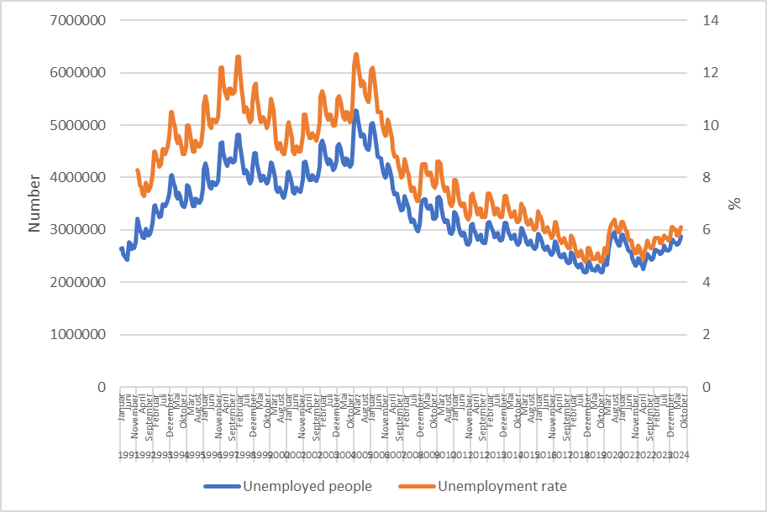
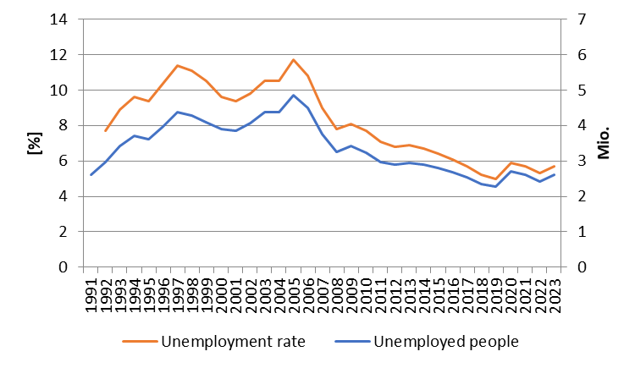














Monthly development of unemployment in Germany
Source: BA

Slide 9



Types of unemployment
Short-term: seasonal and frictional unemployment
Medium-term: cyclical unemployment
Long-term: structural unemployment

Slide 10








Short term unemployment
seasonal unemployment:
Fluctuation in production during a year i.e. in the agricultural sector or the construction sector
Fuctuations in demand during the year i.e. in Tourism sector because of the weather or because of school holidays
Hiring cycles
frictional unemployment :
Incomplete information in the labour market causes a mismatch between job seeking poeple and poeple seeking enterprises
  Transition time between on job and another new job
  Additional time because of moving from one location to another

Slide 11










Medium- and long-term unemployment
Cyclical unemployment:
Within the business cycle we have an under utilization of potential output → causing a decrease in labor demand
Structural unemployment :
Sectoral change, i.e. legislative amendment (Change in Energy politics)
→ job loss in the coal industry or the nuclear sector
Technological change, i.e. digitalization of many process will change the labor market dramatically (i.e. AI)
              → new skills are needed in the future
Regional descrepancy in job demand and supply specially because of the demographic change in the rural area

Slide 12
Hidden unemployment
People in qualification programs
Early retirement
Short time work
Job creation sheme

Slide 13
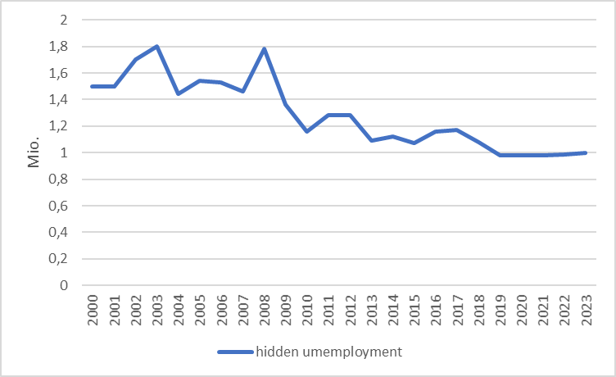



Hidden unemployment Germany
Source: IAB

Slide 14
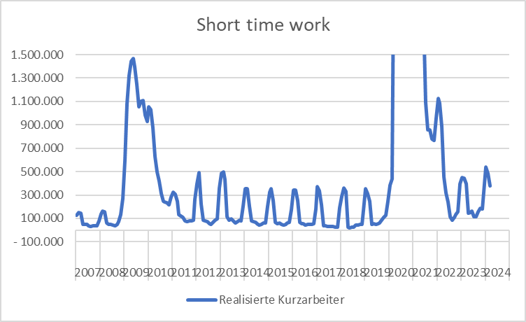


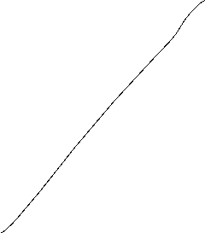












Source: BA
Development of short-time-work in Germany

Slide 15





















External balance
There is no generally accepted definition!
This aim has to be understood within the historical context. Until 1973 we had a system of fixed exchange rates in the world. Every convertible currency was fixed in relation to the US-Dollar → In such a framework it is suitable to balance i.e. the current accout or the trade balance, because otherwise the own currency can be out under pressure
But in 1973 the system of Bretton woods collapsed! Since the, we have free floating currencies, and therefore there is no need anymore for a balanced current account. Nevertheless you find in textbooks the following aims:
Andere Interpretationen:
Balanced trade balance
Balanced current account
Low fluctuating currency
Low susceptibility from foreign economies

Slide 16
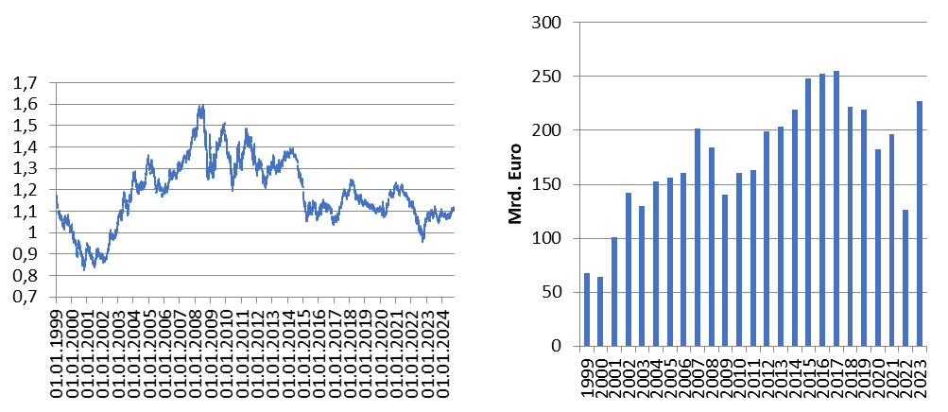

International economic relationships Germany
Source: Bundesbank
Exchange rate Euro – Dollar
Trade balance

Slide 17



Balance of Payments
Definition of Balance of Payments:
The balance of payments is a summary of all the international transactions of a country and its citizens during a specified period of time. This period is usually of one year, though many countries have now started preparing the quarterly accounts for the purposes of forecasting.
Caution:
In the balance of payments we count flow, while usually in a balance sheet you report stocks!
Notes:
17

Slide 18





Balance ofpayments
A. Current Account
B.Capital account
C. Financial account
A1. Balance of goods
A2. Balance of services
A3. Primary income (payments form work (wages) oder inverstments (dividends)
A4. Secondary income (payments from government (tax, refunds) or one way transfers i.e. disaster relief)
B1. Capital transfers
B1. Direct investment
B2. Portfolio investment
B3. Financial derivative
B4. Reserve investment
B5. Other investment
Notes:
18

Slide 19













Further economic goals
Fair balanced income distribution → German constitution Art. 72 Satz 2 GG
Sustainable ecological conditions → German constitution Art. 20a GG
Sustainable public financial budget → German constitution Art. 109 Satz 3 GG
→ Maastricht criteria 3% Deficit
60% government debt ratio

Slide 20
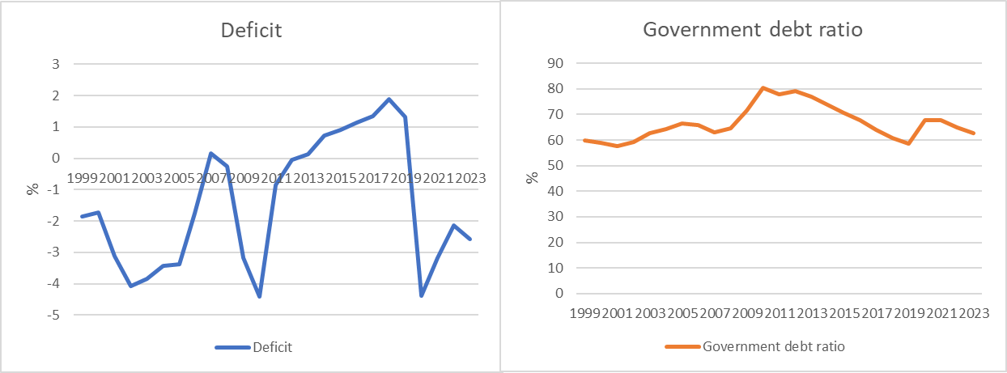














Development of the public budget and debt (Germany)
Cource: Destatis, Bundesbank
Deficit: Public Budget in relation to GDP
Government debt ratio : governemnt debt in relation to GDP

Slide 21










Economic Forecast Sept HRI 2024

Slide 22
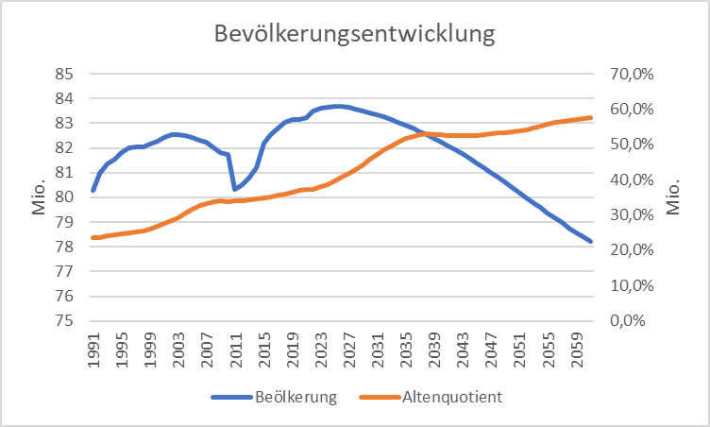
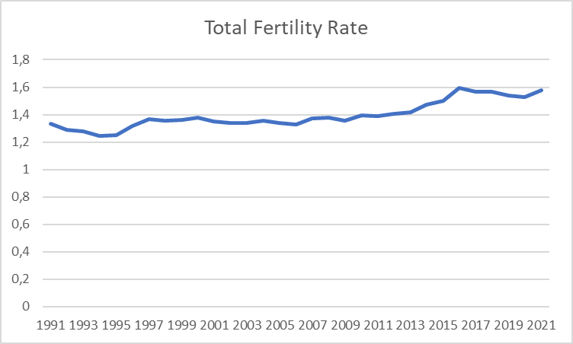
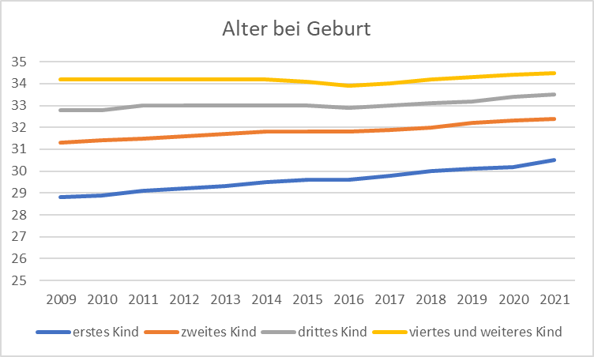
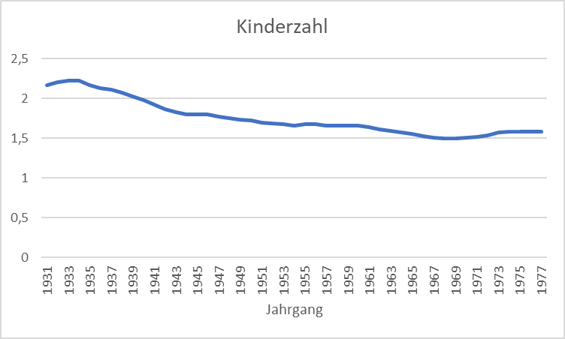












Exkurs: Demographics in Germany
Quelle: Destatis

Slide 23
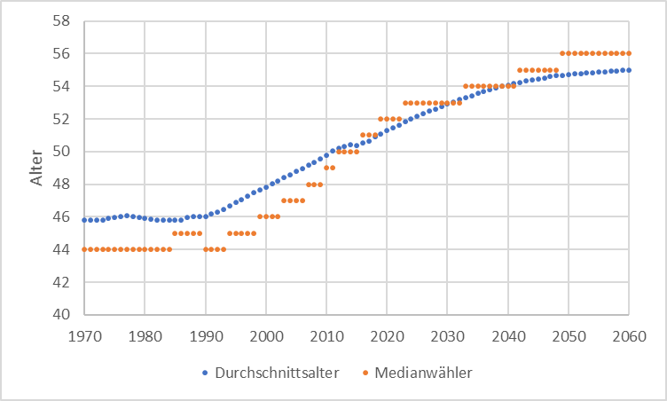




Median Voter
Quelle: Statistisches Bundesamt

Slide 24
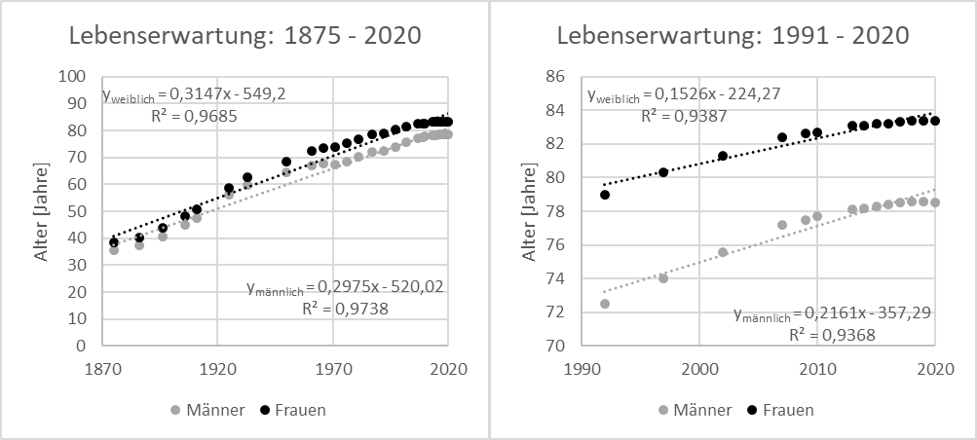
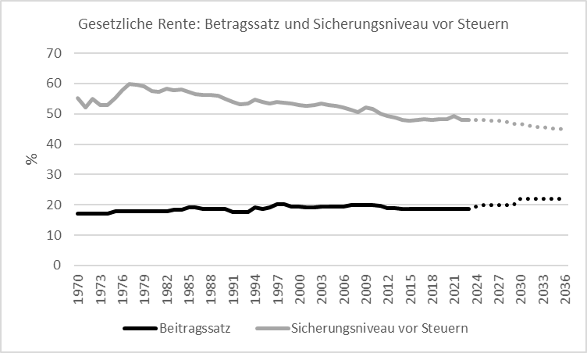
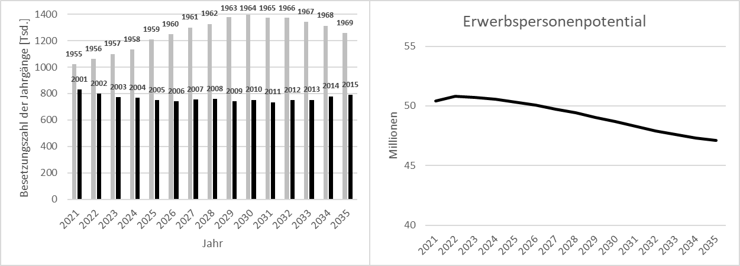
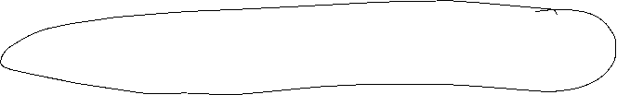







Exkurs Pensions + Labor Market Germany
Quelle: Statistisches Bundesamt

Slide 25
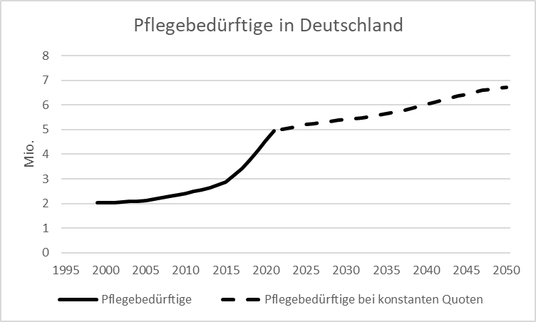
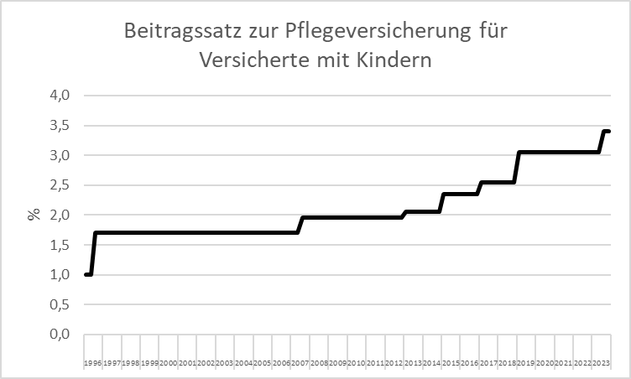
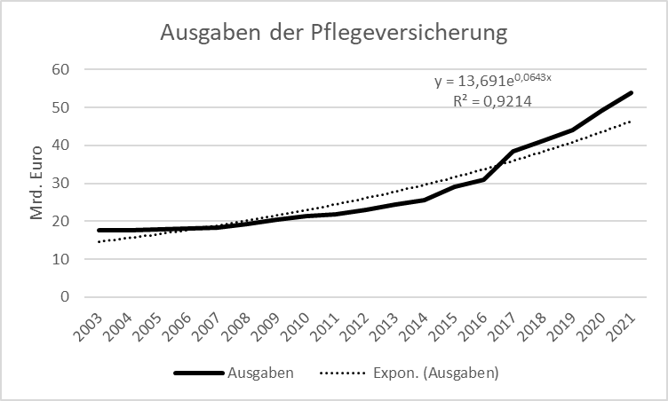



Exkurs Care Germany
Quelle: Statistisches Bundesamt

Slide 26



Economic growth and the business cycle
The business cycle is measured by the fluctuations of real GDP in time around some long time trend.
Real GDP
Expansion
Peak
Recession
Trough
time
Notes:
26

Slide 27






Business cycle
Expansion: Increase of production; increasing Utilization of production capacities;
falling unemployment; moderatly increasing prices
Peak: Full or Overutilization of production capacities;
increasing extra hours; increasing wages and prices;
beginning stagnation. Production cannot meet total demand any more
Recession: falling production; increasing unemployment;
declining consumption
Trough: Low level production, high unemployment
Notes:
27

Slide 28


Potential Output
In general, we want to limit the fluctuations within the business cycle.
In order to have a reference for the fluctuations, the concept of potential output is developed:
Potential output is the maximum amount an economy can produce over the long run (production at full capacity).
In the long run it should be the economic aime to increase potential output, since the pure development of real GDP can be below or above the production possibilities of an economy.
But: Potential output is only a theoretical concept. Therefore the true value of potential out is difficult to estimate.
Notes:
28

Slide 29
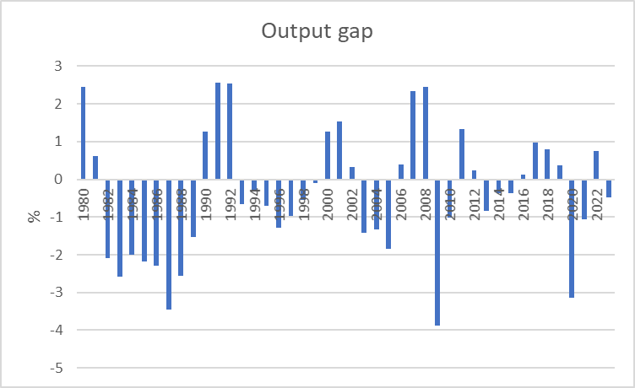





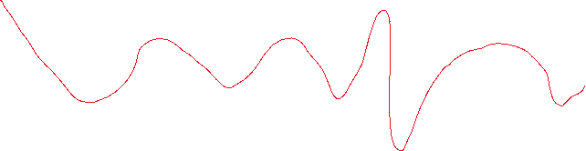





Output gap (Germany)
Out put gap = (GDP – Potential Output)/Potential Output
Source: IWF
Notes:
29

Slide 30
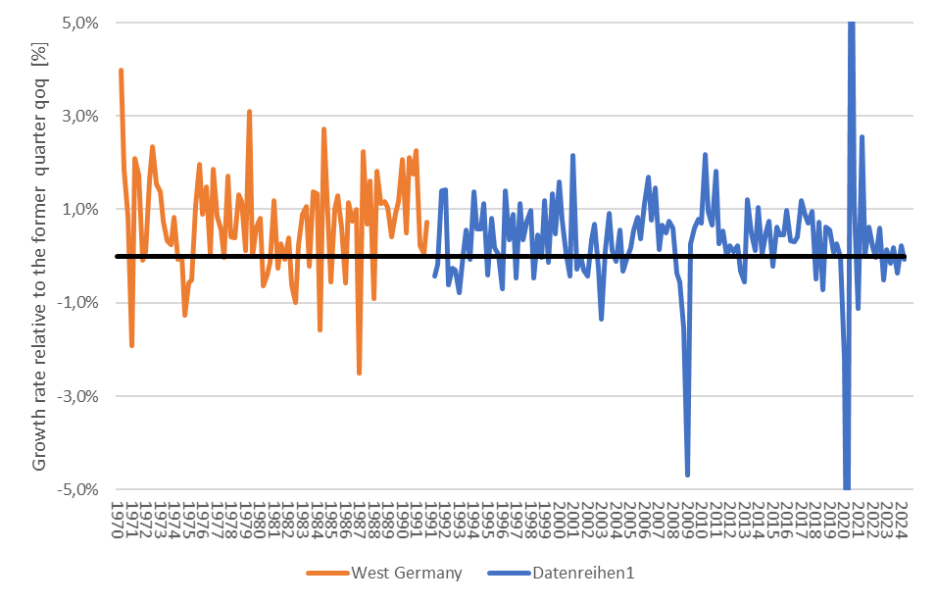


Business cycle Germany in the long run
Find economic historical events in the business cycle
Source: Destatis; Price, season and calendar adjusted

Slide 31
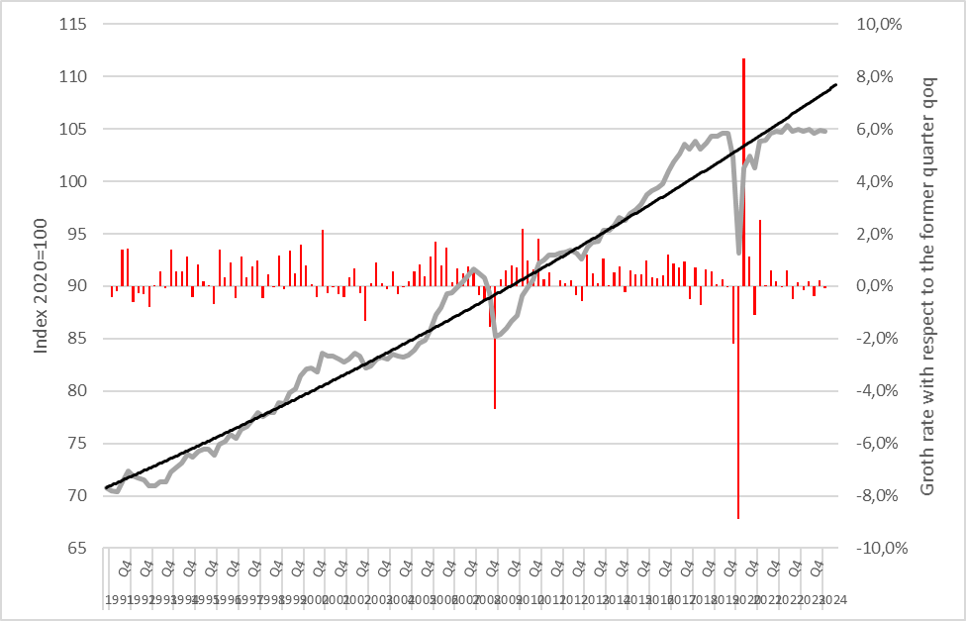


Real GDP growth rate Germany
Source: Destatis; Price, season and calendar adjusted

Slide 32



Money
Properties of goods in order to have the character of money:
Scarcity
Divisibility
Equality
Storability
Transferability

Slide 33

Functions of money
In a modern economy, we define money as a good, which fullfills the followining functions:
Medium of exchange and payment method
Store of value
Unit of account

Slide 34




Medium of exchange and payment method
Money simplifies the process of echange, since suppliers and demanders do not meet physically in order to echange goods.
Money reduces transactions costs
Money simplifies the division of labour in the production process

Slide 35
Store of value
Time difference between income and expenditure
Shifting consumption plans into the future
Money is in competition with other assets (i.e. stocks, bonds, …) but in general money has the higher degree of liquidity

Slide 36


Unit of account
Standardization of general valuation
Possibility to express with relative prices,it is the exchange ratio between real goods.
Money is the basis of the national account system. Thus prices menasured in money are the weights of real goods in GDP. These prices are the outcome of an market process and represent therefore the information of the whole economy

Slide 37



Motives for holding money
Transaction motive
Need for liquidity because of both time and local difference between income an expenditure in
Precautionary demand
Holding money because of the general uncertainty of economic developments and unexpected expenditures in particular
Speculative motive
The speculative motive is based on the general choice between holding money and bonds. If interest rates are low, in general more poeple will expect that interest rates will rise in the future and thus bond prices will decline. Therefore in general agents will hold more money at low interest rates than at high interest rates since they wait for a situation where bond prices will rise again. Thus we obtain a negative dependence between money demand an interest rates.
Another explaination for the negative dependence between money demand and interest rates are the classical opportunity costs of holding money, since money can be interpreted as an asset with interest rate zero and thus is less attractive compared to assets with a positive interest rate.

Slide 38
Money Demand
In general the volume of transactions will be proportional to income.
  Positive dependence of money demand on income
Precautionary demand is inpricipal dependent of expected transactions in the future
  Positive dependence of money demand on income
Due to the speculative motive or the interpretation of the opporunity costs of holding money, we obtain a negative dependence of money demand on interest rates
$$Money demand=L^{D}(Y,i)$$
+
-

Slide 39
Interest rates and inflation – Fisher Relation
Suppose an investment of amount K with the nomnal interest rate i p.a.:
After one year, we obtain K(1+i) Euros
But, suppose we have an inflation of $π$, we need K(1+ $π$) Euros in order to purchase the same basket of goods as in the period before
Thus in real units, we we have to discount K(1+i) Euro with 1/(1+ $π$)
→ $1+r=\frac{1+i}{1+π}$ (r: real interest rate i: nominal interest rate)
for „small“ i,$π$ (<10%) we obtain (1. order Taylor expansion!)
$r=i−π$ (Fisher Relation)
Since investment is often a decision in the future, we also use
$r=i−π^{e}$ ($π^{e}$: expected inflation)

Slide 40
Modern understanding of money
In our modern world with flexible exchange rates we do not have a „physical“ anchor anymore. Until 1931 we had the so called gold standard (bis 1931) or after World War II we had until 1973 the System of Bretton Woods, which was anchored by the US-Dollar backed by gold.
Modern money is „only“ based on the promise to pay of our Central banks and therefore in the trust in the stability of our countries. Therefore we call our money
→„fiat money“

Slide 41
Monetary aggregates
M0 : cash (not defined in the Eurozone)
M1 : The sum of currency in circulation and overnight deposits (cash + sight deposits)
M2 : M1 +
deposits redeemable at notice of up to three months and deposits with an agreed maturity of up to two years
M3 : M2 +
repurchase agreements,
money market fund shares/units and
debt securities with a maturity of up to two years.

Slide 42
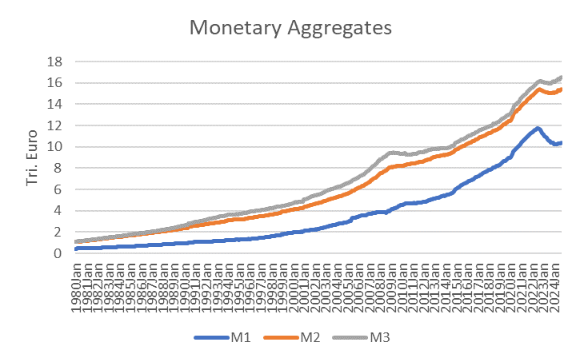
Monetary aggregates
Aug 2023
M3: 16,5 Tri. Euro
M2: 15,4 Tri. Euro
M1: 10,4 Tri. Euro

Slide 43
Quantity theory of money
(total amount of money) x (velocity of money)
=
(price level) x (real output)
→ if in short term we assume the velocity of money as constant and real output is changing also slowly relative to prices, we obtain a directly proportional dependence between the growth rate of money and inflation.

Slide 44
Quantity theory of money and Money Demand
M∙V = P∙Y → M = P∙Y/V
Within the money market equilibrium we obtain:
M=M^{d} (money demand)
Cash holding coefficient: k = 1/V → M^{d} = k ∙ P ∙ Y
Assuming k to be constant in the short-run, then the level of transactions representet by PY determines the level of money demand M^{d}
→ The real money demand M^{d}/P therefore depends only
on Y and we obtain:
Money Demand $=L^{D}(Y)$

Slide 45
Monetary growth and Inflation
Calculating the total differential of M∙V = P∙Y → ΔM/M+ ΔV/V = ΔP/P+ ΔY/Y
Assuming again V to be constant in the short run
→
$$π(inflation)=g_{M}(monetray growth rate)−g_{Y}(GDP−growth rate)$$
“usual” GDP-growth ($g_{Y}>0$, approx. 1%-3% for developed economies. Then these economies need a certain monetary growth due to the increase of total transactions over time)
$g_{Y}$ in the long run depends mainly on the technological progress (compare with potential output!)
→ excessive monetary growth translates according
to quantity theory of money into inflation!
Milton Friedman (nobel laureate 1976):
“Inflation is always and everywhere a monetary phenomenon.”

Slide 46
Classical Dichotomy
Reale Variables: Measured in physical units – quantities and relative prices, for example
  quantity of output produced
  real wage: output earned per hour of work
  real interest rate: output earned in the future
  by lending one unit of output today
Nominale Variables: Measured in money units
  nominal wage: Dollars per hour of work.
  nominal interest rate: Dollars earned in future
  by lending one dollar today.
  the price level: The amount of dollars needed
  to buy a representative basket of goods.

Slide 47
Classical Dichotomy
Classical Dichotomy: In Theory, we have an independence between real and nominal variables.
Neutrality of money: Changes in monetary aggregates do not have any influence on real variables. At least in long run “money is veil”.

Slide 48
Central bank and money creation
Balance sheet
Assets | Liabilities
Net holdings of foreign reserves (incl. gold) | Currency in circulation
Credits to domestic banking sector | Deposits of the domestic banking sector (i.e. deposit facility, minimum reserve)
Other assets | Other liabilities
  Changing for example assets via buying/selling foreign currency or changing deposits increases or lowers the monetary base

Slide 49
Active money creation via commercial banks
  Commercial banks obtain deposits from their customers.
  These deposits will be partially lend to other customers and appear as deposits at other banks.
  This initiates a multiplier process for creation of money, since the „new“ sight deposits have also the character of money.
  In general commercial banks are limited by the required minimum reserve ratio set by the central banks. In general commercial banks hold a higher reserve ratio than the officially required reserved in order to insure against a „bank run“. Anyhow during the financial crisis 2008/09 we had some bank runs and after Lehman bankruptcy 16.09.2008 there was a danger of a general „bank run“.

Slide 50
Money creation: Example
Commercial bank 1 holds deposits of 1 Mio. Euros. According to an reserve ratio of 10% commercial bank 2 obtain the leftover as deposits.
1. Calculate the amount of deposits of commercial bank 2?
Commercial bank 2 has the same reserve ratio, thus commercial bank 3 obtains also the leftover as deposits … .
2. Calculate the total amount of new deposits?

Slide 51
Money creation

Slide 52
Active money creation (money multiplier)
Commercial bank 1 (CB1) holds deposits D with reserve ratio R
→ CB 1 holds back the proportion R of depostis D, thus CB2 obtains
(1-R)D new deposits
→ CB 2 holds back (1-R)RD of deposits, thus CB3
(1-R)(1-R)D new deposits …..
.
.
→ Total amount of new deposits:
[(1-R)+(1-R)²+(1-R)³+….]D=D/r
→ 1/R is called the „money multiplier“

Slide 53
Monetary policy of the ECB
The ECB’s Governing Council considers that price stability is best maintained by aiming for 2% inflation over the medium term. Inflation is measured by the Harmonised Index of Consumer Prices (HICP). The Governing Council’s commitment to the 2% target is symmetric. This means that we consider negative and positive deviations from the target to be equally undesirable.

Slide 54
Classical monetary instruments of the ECB
Main refinancing operations: The main refinancing operations, with a weekly frequency and a maturity of one week, are the most important monetary policy instrument used by the Eurosystem for money market management.
          → The main refinancing operations (MRO) rate is “in general” the key interest rate of the central bank for steering the money market
Deposit facility: The deposit facility rate is one of the three interest rates the ECB sets every six weeks as part of its monetary policy. The rate defines the interest banks receive for depositing money with the central bank overnight.
Marginal lending facility: The marginal lending facility rate is the interest rate banks pay when they borrow from the ECB overnight. When they do this, they have to provide collateral, for example securities, to guarantee that the money will be paid back.
Minimum reserve: The minimum amount of reserves a credit institution is required to hold with a central bank.

Slide 55
Monetary policy in practice
Modern central banks try to influence via thir interest rate policy the economic performance of the economy. But in practice „directly“ they can only influence the short-term interest rates of the financial markets. Therefore in Europe the ECB has the aim to „steer“ the ESTR (Euro short term rate). ESTR represents the interest rate level of the overnight interbank interest rate in the european banking sector.
  Classical effect of an key interest rate cut of the central bank:
    Short term interest rate↓ →Shifting investments to longer term bonds with higher interest rates
      Prices of longer term bonds increase → Adjustment of interest rates over different maturities
But „in general“ we will have a difference between interest rates for
different maturities. This relationship is called Yield Curve.
Notes:
55

Slide 56
Classical effect of monetary policy via consumption and investment
In general, we assume that the central bank can influence directly and indirectly the interest rates in the economy:
Cutting interest rates will in general expand credit demand:
→ expands credit based investment and consumption
→ increase the utilization of production, which pushes economic growth
→ but, if the economy starts to produce at the limit of their capacity, profits will start to stagnate or expected profits will even fall.
→ pushing liqudity via low interest rates will not increase investment anymore
→ in the end pushing liquity and increasing the amount of money only creates inflation

Slide 57
Classical effect of monetary policy via stock markets
Interest rate cut of the central bank
→ Yields of bonds decline.
→ In the short run, stock investments are more attractive than n investment in bonds
→ This will in general will increase stock market prices until yields at the bond market and the stock market will adjust.
→ Thus, via the increase of prices at capital markets income of investors will increase
→ increase of investment and consumption in general
→ … (see former slide!)
→ in the end pushing liquity and increasing the amount of money only creates inflation

Slide 58
Yield curve: Market expectation theory (Example)
i₁: interest rate 1 year (p.a.) 2%
i₂: interest rate 2 years (p.a.) 4%
i₁e: expected interest rate 1 year in 1 year (p.a.)???
Investment 1 Euro
Assume long term and short term investments are perfect substitues, investors are risk neutral and we have perfect capital markets
1 Euro
Short term?
Long term?
Compare the two investments1
→ short term expected interest rate =
longterm interest rate + difference between long term and short term interest rates
Notes:
58

Slide 59
Yield Curve: Liquidity premium theory
Preferences between creditors and debtors differ. Investors are in general risk avers.
→ Creditors will demand a premium since they lower their liquidity for the maturity of the loan. For this loss of liquidity they want to be compensated.
→ the longer the maturity higher the liquidity premium
→ in general we expect long term interest rates to be higher than short term interest rates
Notes:
59

Slide 60
Yield curve: Market Segmentation Theory
Für einen Anleger entsteht ein Risiko, wenn sich der Anlagehorizont nicht
mit der Laufzeit des Wertpapiers deckt
Maturity > Investment horizon → price risk
Maturity < Investment horizon → income risk
Investors try to reduce their risk
→ the market will be segmented into areas maturity and investment horizon will match
financial assets are no perfect substitutes
Notes:
60

Slide 61
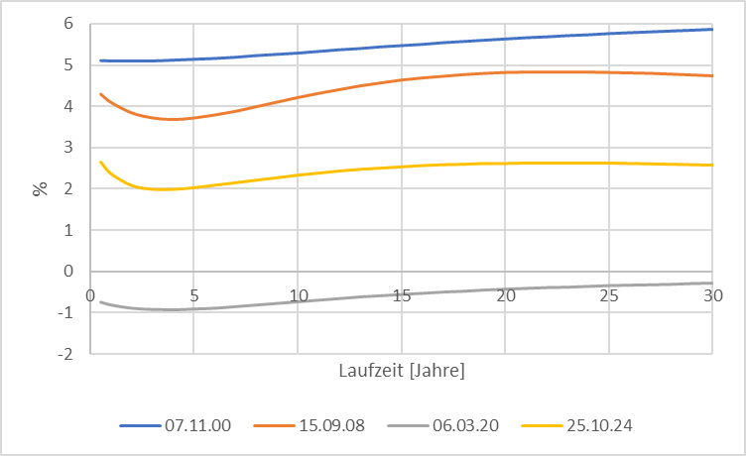
Source: Bundesbank
Yield curve (Germany)
Notes:
61

Slide 62
Monetary policy since the financial crisis (overview)
Key interest rates down to 0%
ECB is switching to fixed-rate tender procedure with full allotment for all its refinancing operations, meaning that it would supply all funds demanded at a fixed interest rate.
Downgrade the rating requirements
Introducing long term refinancing opterations up to one year
Liquidity provision of foreign currency (Euro-US-Dollar-swaps)

Slide 63
Monetary policy since the financial crisis (overview)
Two 3-years tender with 500 Bil. Euro Winter 2011/12 (Bazooka) especially for the italien and spanish banking sector
Minimum reserve rate dwon from 2% to 1% January 2012
Draghi Put/“Whatever it takes“ (26.07.2012)
“Within our mandate, the ECB is ready to do whatever it takes to preserve the euro.
and believe me, it will be enough.”
https://qz.com/1038954/whatever-it-takes-five-years-ago-today-mario-draghi-saved-the-euro-with-a-momentous-speech/
Start of buying low rating government bonds (26.09.2012)
Different programs to buy government and private bonds at the secondary financial markets according to the capital key of the eurozone. Especially buying a monthly volume up to 60 Bil. Euros. 2015 -> stop July 2022 (only reinvestment!)
  https://www.ecb.europa.eu/mopo/implement/app/html/index.en.html
PEPP: Pandemic emergency purchase programme (March 2020) Volume 1,7 Tril. Euros (Oct 2022)
  https://www.ecb.europa.eu/mopo/implement/pepp/html/index.en.html
Increase of interest rates since July 2022

Slide 64
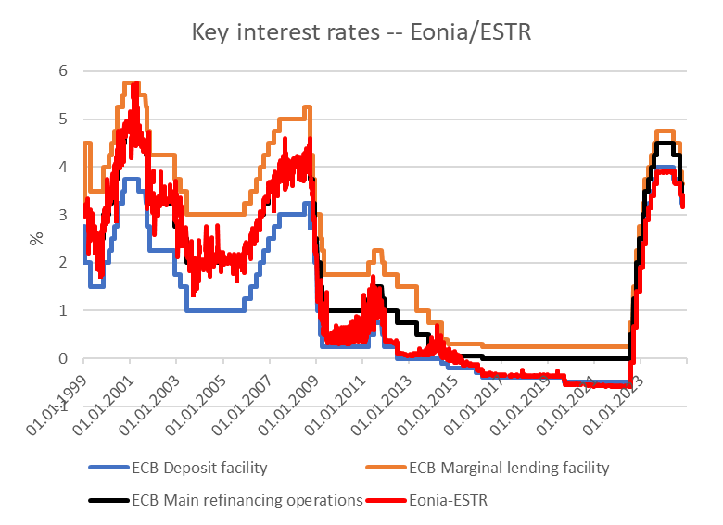
Key rates ECB
Source: ECB,

Slide 65
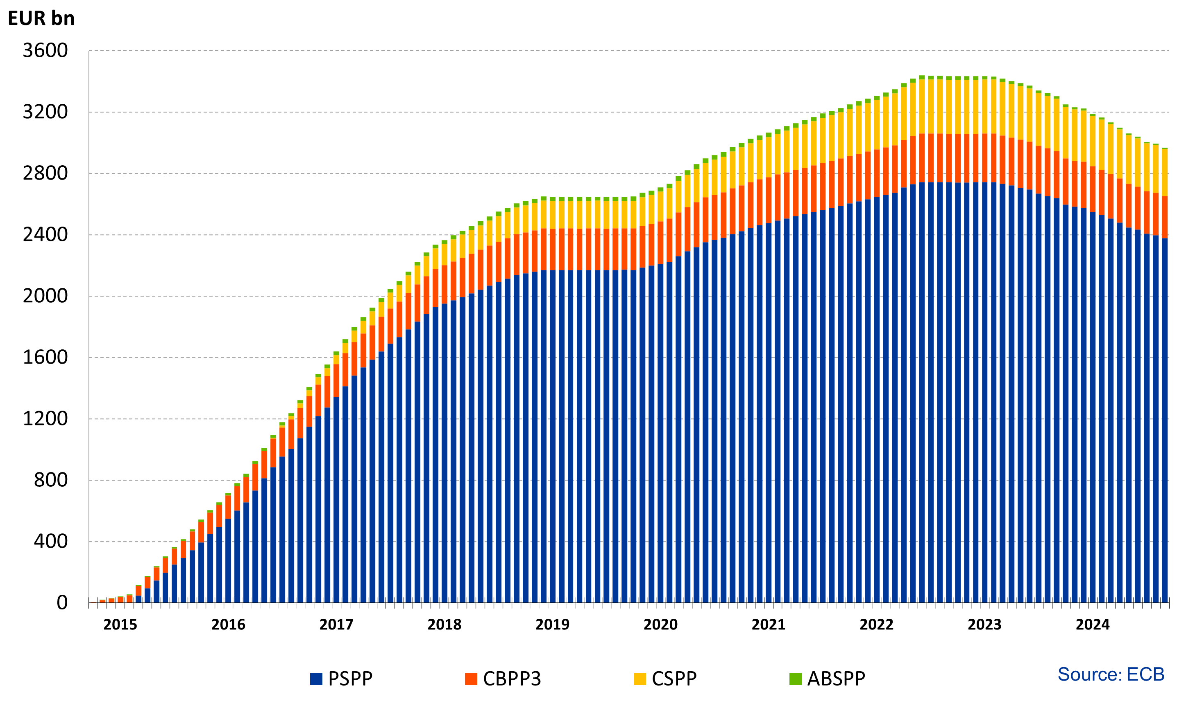
Financial markets interventions of the ECB since 2015 without PEPP
Source: ECB, Asset Purchase Program
https://www.ecb.europa.eu/mopo/implement/omt/html/index.en.html

Slide 66
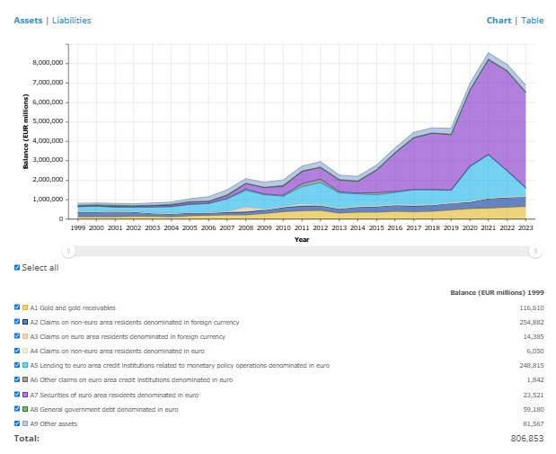
ECB balance sheet
Source: ECB

Slide 67
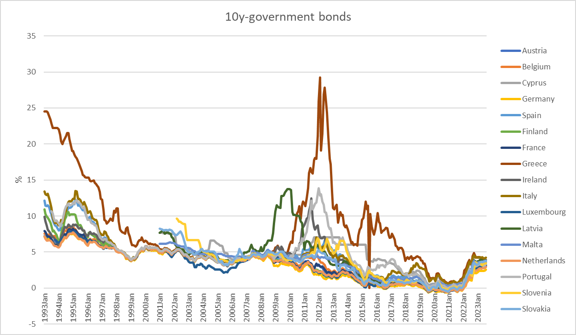
10 Year government bonds Eurozone
Source: ECB

