Slide 1
Macroeconomics
Wilhelmshaven
This lecture will be recorded and
Subsequently uploaded in the
world-wide-web
Prof. Dr. Bernhard Köster
Jade-Hochschule Wilhelmshaven
http://www.bernhardkoester.de/vorlesungen/inhalt.html

Slide 2
Macroeconomics
Winter term 2024
Prof. Dr. Bernhard Köster

Slide 3
Economic Forecast Sept HRI 2024

Slide 4
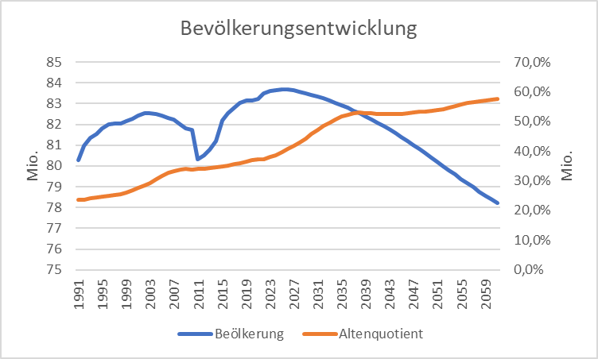
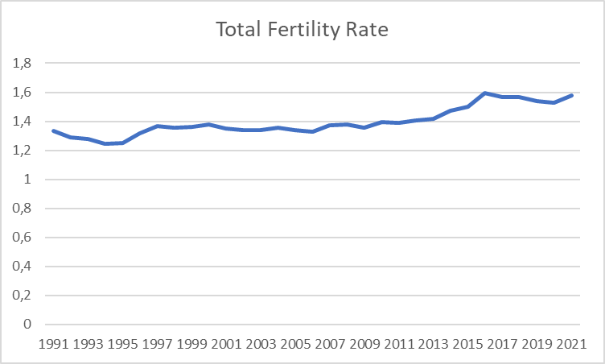
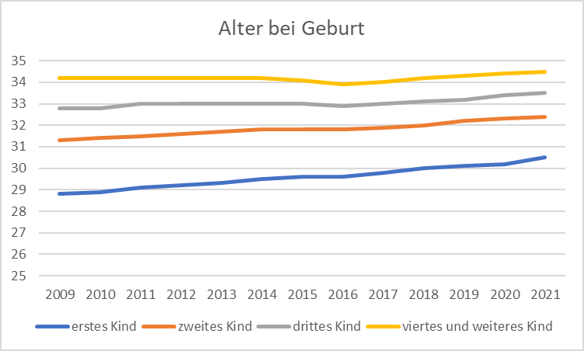
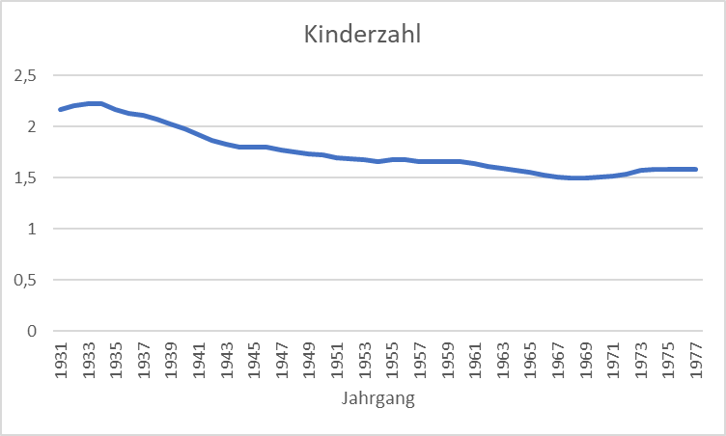
Exkurs: Demographics in Germany
Quelle: Destatis

Slide 5
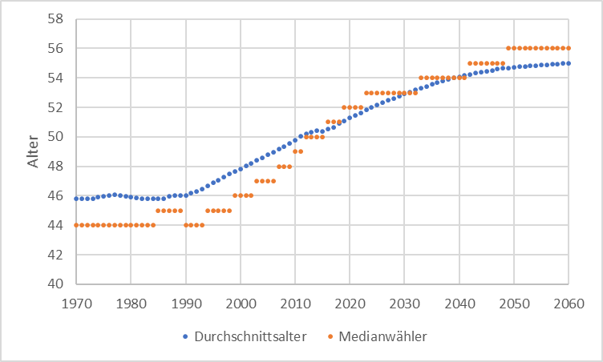
Median Voter
Quelle: Statistisches Bundesamt

Slide 6
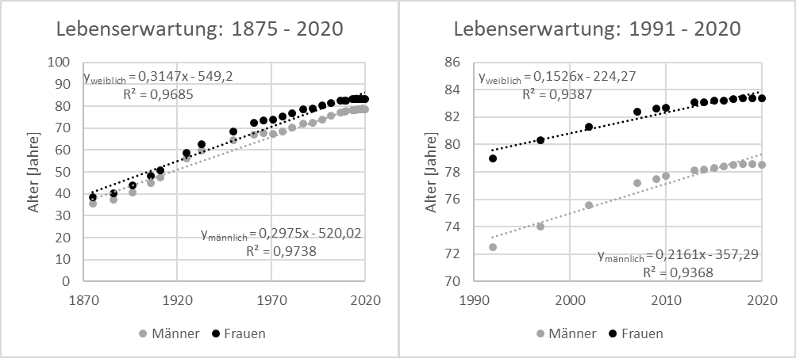
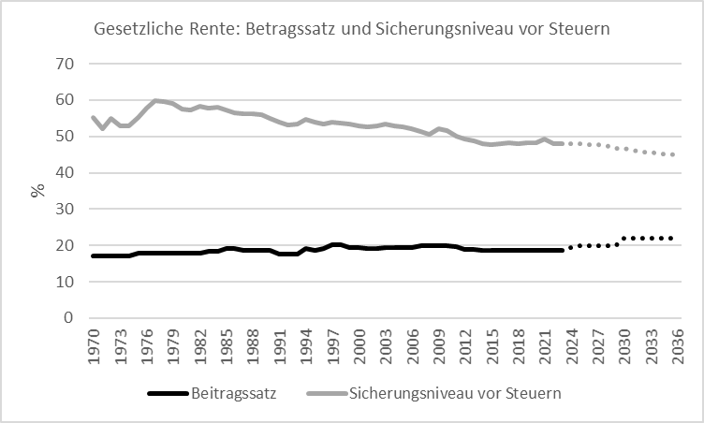
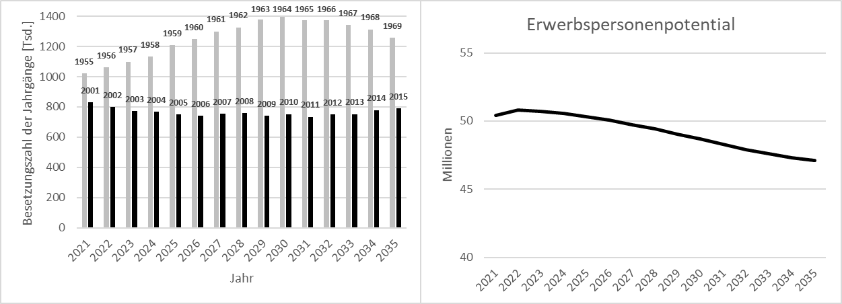
Exkurs Pensions + Labor Market Germany
Quelle: Statistisches Bundesamt

Slide 7
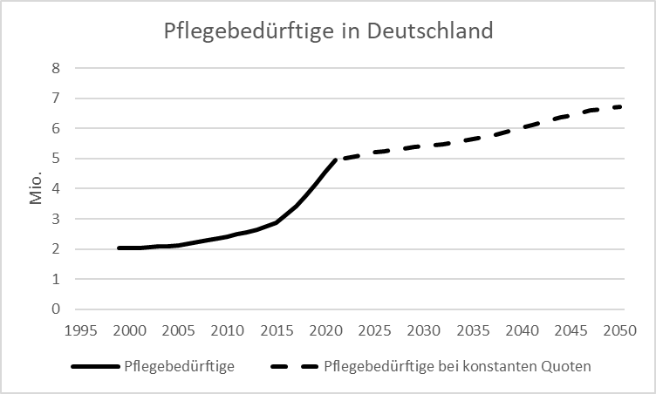
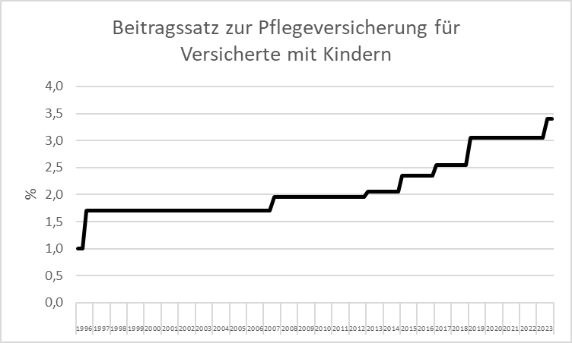
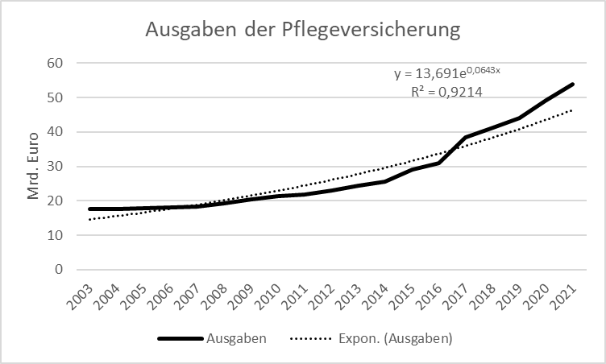
Exkurs Care Germany
Quelle: Statistisches Bundesamt

