Slide 1
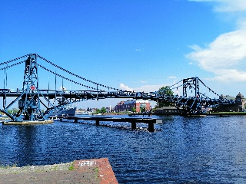
Macroeconomics
Wilhelmshaven
This lecture will be recorded and
Subsequently uploaded in the
world-wide-web
Prof. Dr. Bernhard Köster
Jade-Hochschule Wilhelmshaven
http://www.bernhardkoester.de/vorlesungen/inhalt.html

Slide 2
Magic Square
Steady and appropriate economic growth
External balance
Price level stability
High level of employment

Slide 3
High level of employment
Principal aim is to reach a state of full employment.
→ every person willing has a job.
The general variable to measure unemployment is the unemployment rate.
In Germany a level of 3%-4% unemployment rate is considered as a state of full eployment.

Slide 4
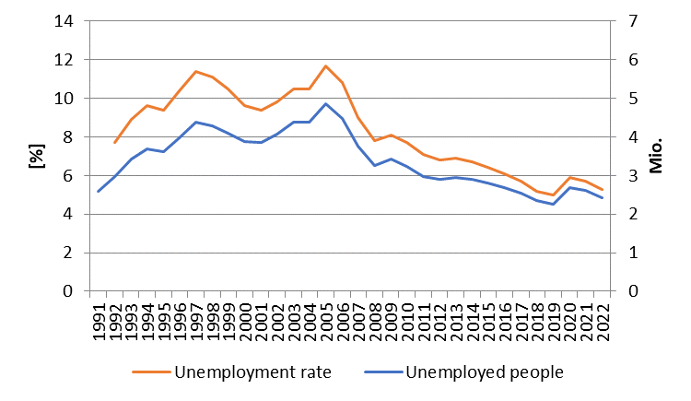
Development of unemployment in Germany
Source: BA

Slide 5
Unemployment definition BA
(registered unemployed people)
Age between 15 – 65 (67) years
Defined by the Social Code, Book III (SGB III), the unemployed include all those who are
temporarily not employed or work in a job for fewer than 15 hours per week,
seek employment subject to social insurance contributions for at least 15 hours per week,
and in the process are available for placement efforts undertaken by the employment agencies or institutions administering basic security benefits for job-seekers
and have registered there as unemployed.

Slide 6
Unemployment definition ILO
Unemployed is any person aged between 15 and 74 years
who was not in employment, but actively sought work over the four weeks preceding the survey
and would be available for starting a job within two weeks.
In this context, it is irrelevant whether the persons concerned are registered with a government authority and receive social benefits from there

Slide 7
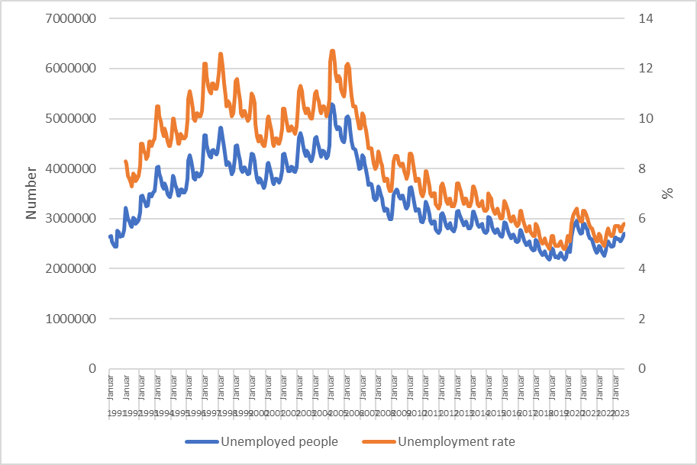
Monthly development of unemployment in Germany
Source: BA

Slide 8
Types of unemployment
Short-term: seasonal and frictional unemployment
Medium-term: cyclical unemployment
Long-term: structural unemployment

Slide 9
Short term unemployment
seasonal unemployment:
Fluctuation in production during a year i.e. in theagricultural sector or the construction sector
Fuctuations in demand during the year i.e. in Tourism sector because of the weather or because of school holidays
Hiring cycles
frictional unemployment :
Incomplete information in the labour market causes a mismatch between job seeking poeple and poeple seeking enterprises
Transition time between on job and another new job
Additional time because of moving from one location to another

Slide 10
Medium- and long-term unemployment
Cyclical unemployment:
Within the business cycle we have an under utilization of potential output → causing a decrease in labor demand
Structural unemployment :
Sectoral change, i.e. legislative amendment (Energiewende)
→ job loss in the coal industry or the nuclear sector
Technological change, i.e. digitalization of many process will change the labor market dramatically
→ new skills are need in the future
Regional descrepancy in job demand and supply specially because of the demographic change in the rural area

Slide 11
Hidden unemployment
People in qualification programs
Early retirement
Short time work
Job creation sheme

Slide 12
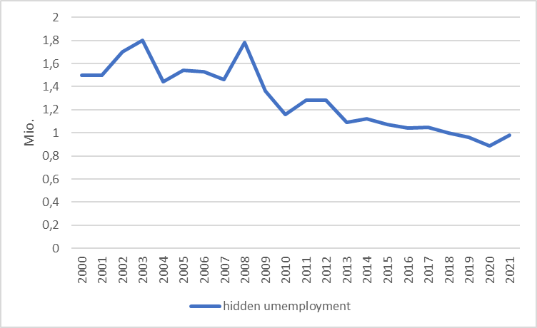
Hidden unemployment Germany
Source: IAB

Slide 13
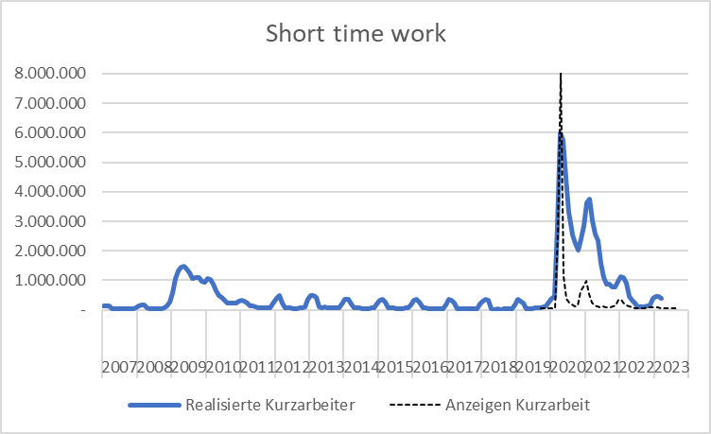
Source: BA
Development of short-time-work in Germany

Slide 14
External balance
There is no generally accepted definition!
This aim has to be understood within the historical context. Until 1973 we had a system of fixed exchange rates in the world. Every convertible currency was fixed in realtion to the US-Dollar → In such a framework it is suitable to balance i.e. the current accout or the trade balance, because otherwise the own currency can be out under pressure
But in 1973 the system of Bretton woods collapsed! Since the, we have free floating currencies, and therefore there is no need anymore for a balanced current account. Nevertheless you find in textbooks the following aims:
Other Interpretations:
Balanced trade balance
Balanced current account
Low fluctuating currency
Low susceptibility from foreign economies

Slide 15
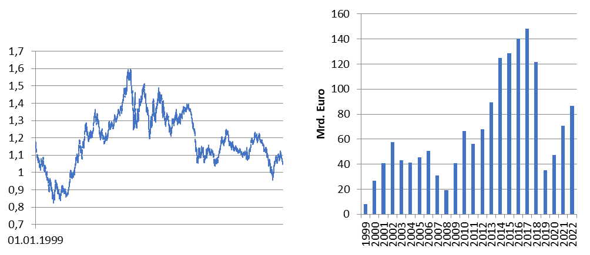
International economic relationships Germany
Source: Bundesbank
Exchange rate Euro – Dollar
Trade balance

Slide 16
Balance of Payments
Definition of Balance of Payments:
The balance of payments is a summary of all the international transactions of a country and its citizens during a specified period of time. This period is usually of one year, though many countries have now started preparing the quarterly accounts for the purposes of forecasting.
Caution:
In the balance of payments we count flow, while usually in a balance sheet you report stocks!
Notes:
16

Slide 17
Balance ofpayments
A. Current Account
B.Capital account
C. Financial account
A1. Balance of goods
A2. Balance of services
A3. Primary income (payments form work (wages) oder inverstments (dividends)
A4. Secondary income (payments from government (tax, refunds) or one way transfers i.e. disaster relief)
B1. Capital transfers
B1. Direct investment
B2. Porfolio investment
B3. Financial derivative
B4. Reserve investement
B5. Other investment
Notes:
17

Slide 18
Further economic goals
Fair balanced income distribution → German constitution Art. 72 Satz 2 GG
Sustainable ecological conditions → German constitution Art. 20a GG
Sustainable public financial budget → German constitution Art. 109 Satz 3 GG
→ Maastricht criteria 3% Deficit
60% government debt ratio

Slide 19
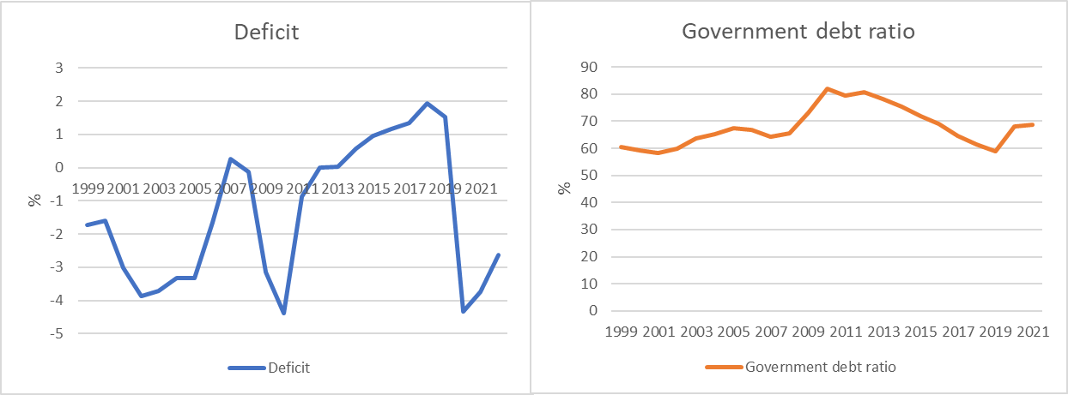
Development of the public budget and debt (Germany)
Cource: Destatis, Bundesbank
Deficit: Public Budget in relation to GDP
Government debt ratio : governemnt debt in relation to GDP

Slide 20
