Slide 1

Macroeconomics
Wilhelmshaven
This lecture will be recorded and
Subsequently uploaded in the
world-wide-web
Prof. Dr. Bernhard Köster
Jade-Hochschule Wilhelmshaven
http://www.bernhardkoester.de/vorlesungen/inhalt.html

Slide 2
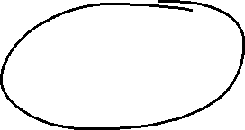





The modern circular flow of income
4 Sectors:
Households (H), Government (G), Enterprises (E), Overseas (A)
The circular flow of income is closed via the sector of the financial institutions (FI). Via FI savings and investment is processed or assets and liabilities against the overseas sector
Arrows represents always money flows between the sectors
The circle is closed if at any sector we have incoming flow equals outgoing flow (Axiom of the closed circle).
→ Every relevant flows are considered

Slide 3
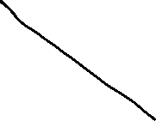




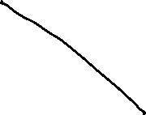
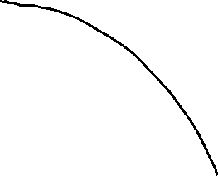

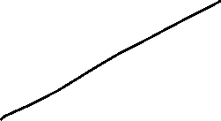
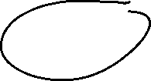







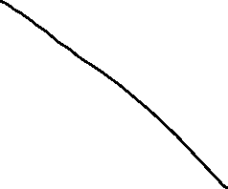
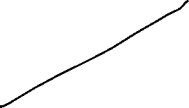





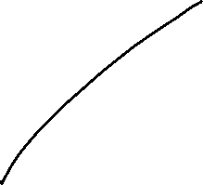



The modern circular flow of income of an open economy

Slide 4
















Circular flow of income of an open economy
C_{H}: Consumption of Housholds
G: Government H: households A: Overseas
FI: Financial institutions
E: Enterprises
Y_{H/E}: Salary of Households paid by Enterprises
G
T_{H}: Tax payment of the households
Y_{H/G}
T_{E}: Tax payment of the enterprises
Z_{H}
Z_{E}
C_{G}
Z_{E}: Transfer from Government to Enterprises
T_{H}
Z_{H}: Transfer from Government to Households
Y_{H/G}: Salary of Households paid by the government
C_{St}: Consumption of the Government
I_{G}
T_{E}
EX: Exports
S_{G}
Y_{H/E}
IM: Imports
H
E
NT: Net Transfer from Households to foreign countries
C_{H}
EX
I_{E}: Investment of Enterprises
I_{H}
I_{E}
I_{H}: Investment of Households
S_{H}
IM
S_{E}
I_{St}: Investment of the Government
S_{U}: Savings of Enterprises
S_{H}: Savings of Households
CA=EX-IM-NT
S_{St}: Savings of the Government
FI
A
CA: Current accout equals by The axoim of te closed circle CA=EX-IM-NT
NT

Slide 5




National account system (NAS)
National accounts provide information to analyse the structure of economies and their development over time. They contain a wide range of statistics describing an economy in various ways. The main GDP aggregates provide an overview about key economic developments..
Information, Forecast, international comparision
Since 1995 NAS is standardized in the EU (European System of National and Regional Accounts, ESA)

Slide 6








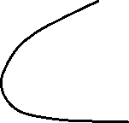
















Gross domestic product and Gross national product
Gross domestic product (GDP) is the total market value of all the finished goods and services produced within a country’s borders in a specific time period (i.e. 1 year) (domestic concept)
Gross National Product (GNP) is the total market value of all finished goods and services produced by a country’s citizens in a specific time period (i.e. 1 year).
(national concept)

Slide 7







GDP
„market value“
In order to aggregate different goods and service their market prices are considered.
Some goods do not have a market price. In this case production prices are considered
For public services wages public employees are considered
„all“
owner-occupied residential property is value by an average market rent.
Some goods and service cannot be statistically counted and are therefore not included into GDP (i. e. black market, educational performance of parents, honory posts)

Slide 8



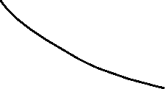
GDP
„finished“
Only value added is considered =
Production – intermediate consumption
„goods and services“
material and immaterial goods
„wihin a countries borders“:
national concept = domestic concept
– factor income of non citizens in the considered country
+ factor income of citizens of the considered country from abroad
„specific time period “
Quater or year

Slide 9






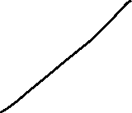








Calculating GDP
Production approach – Value added of all economic sectors (activities)
Expenditure approach – final uses of goods and services (consumption, investment,
government expentitures, net exports (Ex-Im)
Income approach – Distribution of income on the different factors of production
(capital and labor)
Notes:
9

Slide 10
Gross national Product (Germany 2022)
Notes:
10

Slide 11
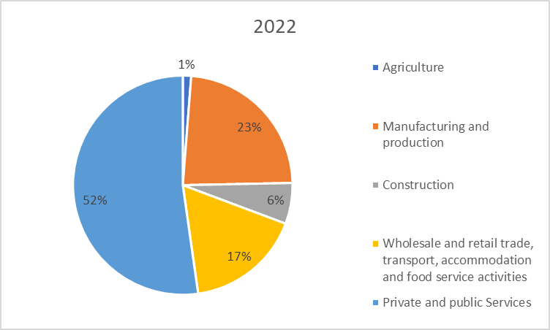
Production approach – Gross value added (Germany 2021)
Gross value added (GVA)
+ taxes
– subsidies
= GDP
Source: Destatis, current prices, Bil. Euro

Slide 12
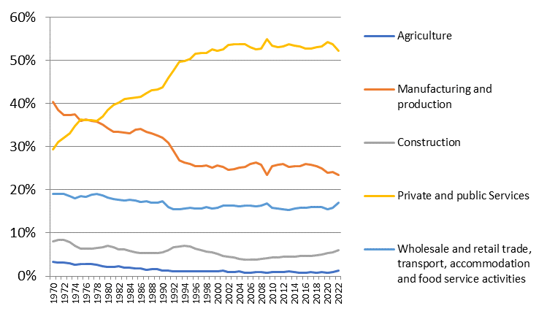
Development of the nominal proportions of the sectors of gross value added (Germany)
Source: Destatis, current prices

Slide 13
Expenditure approach Germany 2022
}
Consumption
}
Gross capital investment
}
External contribution
Source: Destatis ,current prices, Mrd. Euro

Slide 14
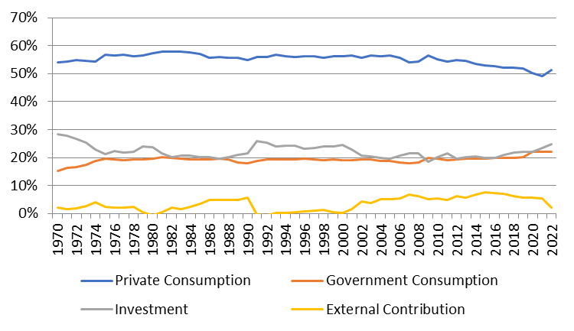
Development of the nominal proportions of the expenditure sectors of GDP (Germany)
Source: Destatis, current prices

Slide 15
Income approach
The income approach counts the different typs contributing to national income.
Mainly we look at the income from the general factors of production: Capital and Labor. Thus we count corporate and investment income from capital and compensation of employees from labor. The aggregate variable measuring the division of national income is the
compensation of employees
Labor Share =
national income

Slide 16
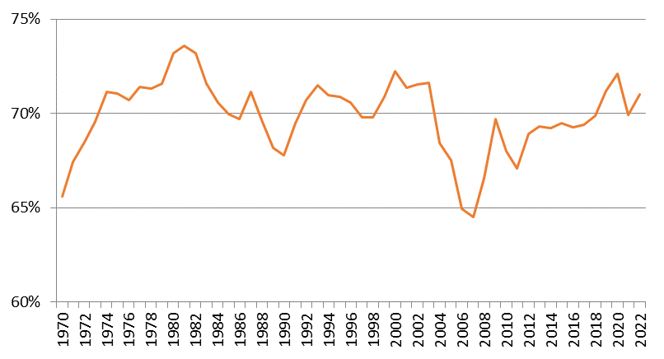
Development of the labor share (Germany): Income approach
Source: Destatis

Slide 17
Magic Square
Steady and appropriate economic growth
External balance
Price level stability
High level of employment

Slide 18
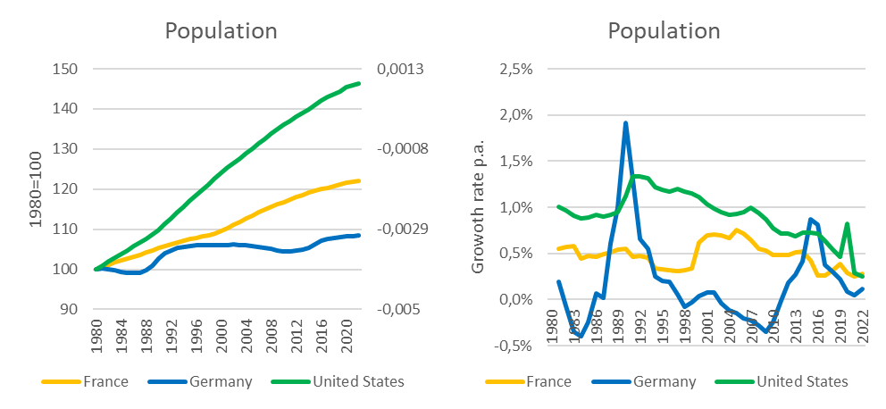
Steady and appropriate economic growth
Indicators
Growth of real GDP
→ change of overall economic performance, not including singular changes in prices (price adjusted GDP)
Growth of real GDP per capita
→ since in general new inhabitants will increase GDP, we also to adjust for population growth
→ In developed countries an growth rate of GDP of roughly 1%-3% p.a. is claimed to be appropriate on average, without high volatily around this traget growth rate.
Source: IMF

Slide 19
Nominal versus real economic growth
Relative change of the nominal GDP compared to the previous period (year)
Difference because of changes in prices
Difference because of changes in quantity
In order to do not count changes in prices, the real GDP is calculated with repected to the prices of the previous year,
Since only a change because higher prices does not count for an increase of overall economic performance!

Slide 20
Calculating real GDP
Since 2005 real GDP is calculated via a chain index (caution, in many textbooks and in the web real GDP is explained due to a fixed price bases, but this is wrong!).
Real GDP is the value of final goods and services calculated via constant prices of the previous year. We set a base year in time t wird equal to Index_{real}(t)=100 and the indices of the following years are the calculated recursively
GDP(t+1) in prices of t
Index_{real}(t+1) = Index_{real}(t)
GDP(t) in prices of t
P₁(t)•X₁(t+1)+P₂(t) •X₂(t+1)+…
= Index_{real}(t)
P₁(t) •X₁(t)+P₂(t) •X₂(t)+…
with P₁, P_{2,}… prices of goods an services 1,2,… ;X₁, X₂,… quantities of goods an services 1,2,… and time t

Slide 21
Real economic growth and GDP-Deflator
Real economic change is the realtive change of the chain-index of real GDP:
GDP-Index_{real}(t) – GDP-Index_{real}(t-1)
Real economic growth = g(t)=
GDP-Index_{real}(t-1)
GDP-Index_{nom}(t)
BIP-Deflator(t) = 100
GDP-Index_{real}(t)
The relative change of the BIP-Deflator represents the pure price effectof the realative change of nominal GDP
(in opposite to case, if real GDP would be calculated via a fixed price base, since then, the BIP-Deflator itself represents the price effect, be careful, if you read other text books!)

Slide 22
Example

Slide 23
Example

Slide 24
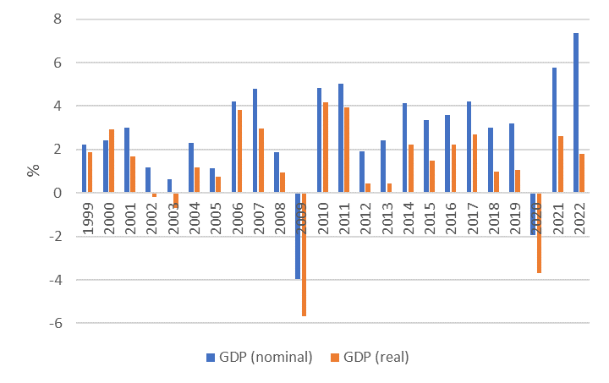
Nominal and real economic growth (Germany)
Source: Destatis

Slide 25
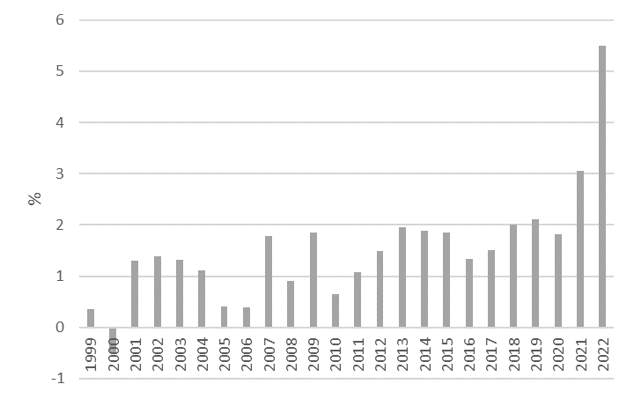
Relative change of the GDP-Deflator (Germany)
Source: Destatis

Slide 26
Nominale GDP/real GDP/GDP-Deflator
The realtive change of nominal GDP represents changes in prices and quantities.
The realtive change of real GDP represents changes in quantities and therefore counts for the change of economic performance
With the realtive change of the GDP-Deflator we can correct nominal growth in order to obtain real growth

Slide 27
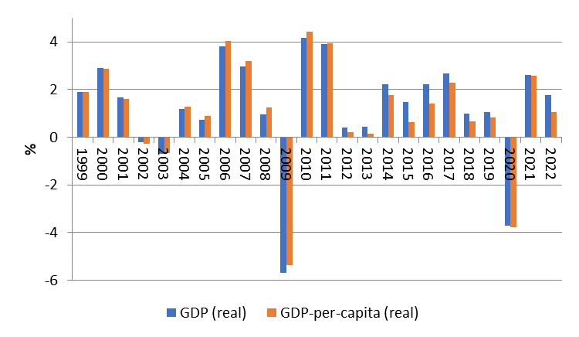
Difference of economic growth measured via real GDP and real GDP per capita (Germany)
Source: Destatis

