Slide 1





Macroeconomics
Wilhelmshaven
This lecture will be recorded and
Subsequently uploaded in the
world-wide-web
Prof. Dr. Bernhard Köster
Jade-Hochschule Wilhelmshaven
http://www.bernhardkoester.de/vorlesungen/inhalt.html

Slide 2









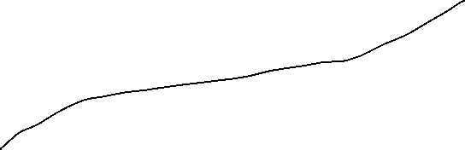










AS-AD-Model
Within the Keynesianschen IS-LM-Modell we find prices in order to obtain the real amount of money M/p but p is assumed to be constant
In the following, we relax this extreme assumption and assume partially flexible prices. But especially at the labour market, we still assume, that enterprises have some market power and thus they can demand a specific markup over marginal costs (i.e. monopolistic competition, oligopol, …)
Together with these assumptions we derive
  Aggregated Supply: AS
  Aggregated Demand: AD
Notes:
2

Slide 3
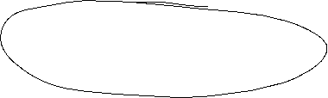
Aggregated supply: AS-Curve ($Y^{S}$) – General explaination
Keynesian Theory of rigid wages
Keynesian theory of rigid prices
Keynesian theory expectations
Notes:
3

Slide 4

Keynesian Theory of rigid wages
Within the profit maximization of enterprices, wages are one of the main cost factors.
If wages are constant in the short run marginal profits are rising, if output prices increase
Thus enterprises have an incentive to increase production if the price level is increasing.
Altogether we obtain an increased aggregated demand if price level has increased

Slide 5
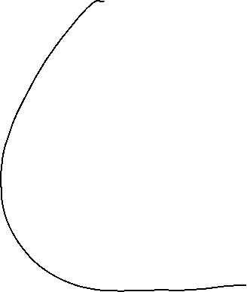

Keynesian theory of rigid prices
Additionally to constant wages also prices of other goods and services are assumed to be rigid in the short run
Assume a decreasing price level in general. But some enterprices will not reduces their prices due to rigidities
In the following these enterprises will face falling revenues due to falling sales.
Overall this results in a lower aggregated supply triggered by a lower price level.

Slide 6
Keynesian theory expectations
In general we assume, that economic agents cannot perfectly distinguish between a general change in price level and their own relative prices
Therefore in a situation of a falling general price level, enterprises can mistakenly assume, that their own prices have fallen relative to other output prices.
Hence they will reduce their production
Similarily workers can mistakenly assume, if the price level has fallen, that their reduced own nominal wages imply a relative decrease of real wages
Hence they will reduce their work effort
Overall we obtain falling aggreagted supply if price level is falling

Slide 7


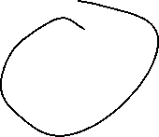





Aggreagted supply: AS-Kurve ($Y^{S}$)
p
AS:
$$Y^{S}$$
Y
Aggregated supply AS: $Y^{S}(\overset{+}{\overbrace{p}})$
Notes:
7

Slide 8

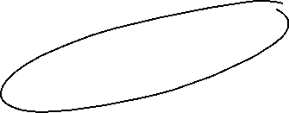



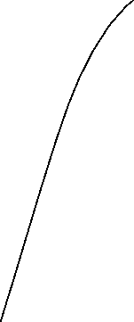




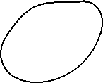










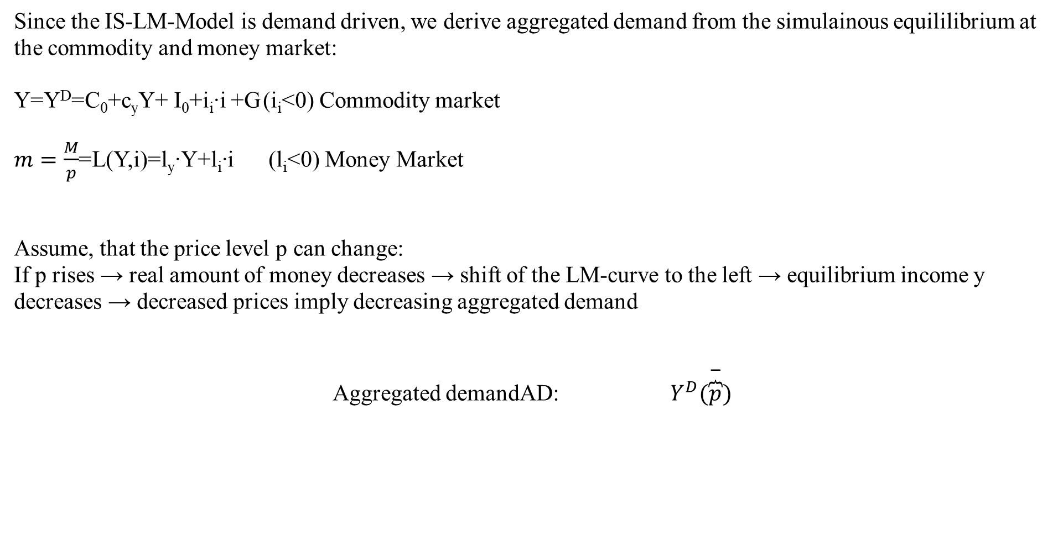
Aggregated demand
Since the IS-LM-Model is demand driven, we derive aggregated demand from the simulainous equililibrium at the commodity and money market:
Y=Y^{D}=C₀+c_{y}Y+ I₀+i_{i}∙i +G (i_{i}<0) Commodity market
$m=\frac{M}{p}$=L(Y,i)=l_{y}∙Y+l_{i}∙i (l_{i}<0) Money Market
Assume, that the price level p can change:
If p rises → real amount of money decreases → shift of the LM-curve to the left → equilibrium income y decreases → decreased prices imply decreasing aggregated demand
Aggregated demandAD: $Y^{D}(\overset{−}{\overbrace{p}})$
Notes:
8

Slide 9





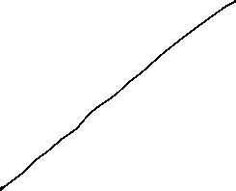




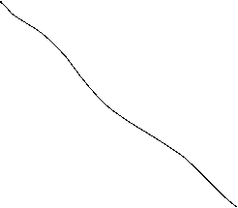

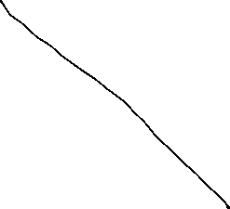
Grafical derivation of the AD-curve
i
LM-curve (p₀)
p₁>p₀
i*(p₀)
IS-curve
P
Y*(p₀)
Y
p₀
AD-curve
Y*(p₀)
Y

Slide 10



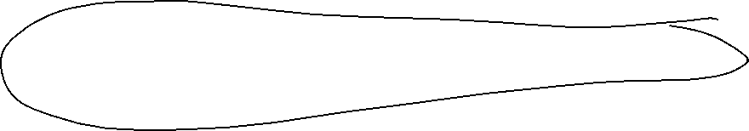


AS-AD-Model
p
AS-curve
p*
AD-curve
Y*
Y
We obtain a Supply-Demand-Diagram in prices and output similar to microeconomic theory
Caution! The derivation of AS and AD should not be confound with micro economic explaination of demand via utility maximization for demand profit maximazation for supply!
Altogether (p*,Y*) represents the short-run-equilibrium in the economy.

Slide 11






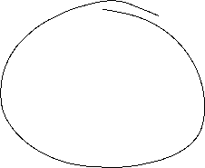





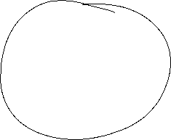
Short-run and long-run perspective in the AS-AD-Model
Long-run supply
AS_{long}
p
AS-curve
p*
AD-curve
Y_{n}=Y*
Y
In the long run prices are totally flexible and therefor expected prices will coincide with actual prices. Therefore in the long-run output depends mainly on the framework conditions of the economy (education, infrastructure, resources,…), in general on the level of technology. The possible output dependent of framework conditions is called natural out and does not depend anymore on prices. Therefore Y_{n}=Y* can be identified with a long-run Supply, which is vertical in the p-y-diagram

Slide 12
Monetary and fiscal policy in the AS-AD-Model
Explain the impact of
a nominal increase of the amount of money
an increase of government expenditure
Within the AS-AD-Model in a short-run and long-run perspective

Slide 13


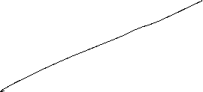








Fiscal policy in the AS-AD-Model
AS_{long}
LM
i
IS
P
Y_{n}
Y
AS
p
A
AD
Y_{n}
Y

Slide 14
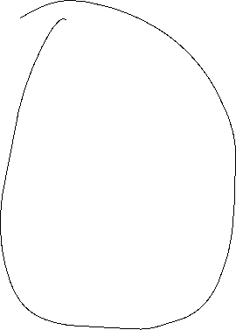



Monetary policy in the AS-AD-Model
AS_{lang}
LM
i
IS
Y_{n}
AS‘‘
Y
P
AS
p₀
A
AD
Y_{n}
Y

Slide 15
Summary AS-AD-Model/IS-LM-Model
The impact of monetary and fiscal policy within the short run AS-AD-Model is reduced compared to the IS-LM-Model since the change in prices absorb some amount of the expansive effect.
With respect to the long-run supply-curve monetary and fiscal policy within the AS-AD-Modell do not have any expansive effect on output, only prices will increase. But keep in mind, that this requires perfect competion in commodity and expecially labour markets!
  Caution! Since we have neither in the AS-AD-Model nor in the IS-LM-Model an explicit time dependence, we have to keep in mind that theoretically all effects happens simultanously. In reality adjustments have a time delay and also the framework conditions can change in time. Therefore, we will also have structual changes during time. Especially „good“ economic policy tries to increase the technology level and natural output.

Slide 16

The Neoclassical Model

Slide 17
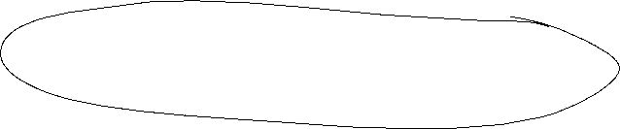


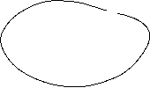



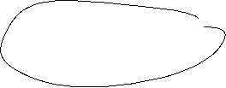

Aggregated Production

Slide 18









Neoclassical production: positive diminishing productivity
Y = A ∙ F(K,L)
Suppose K=constant
$$Y$$
$$\text{L}$$

Slide 19





Neoclassic: Labor market − labor demand

Slide 20
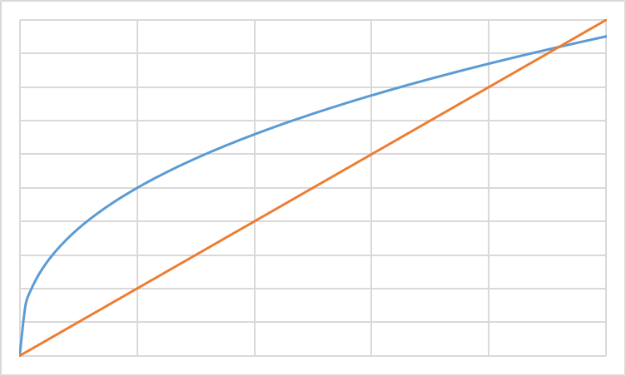
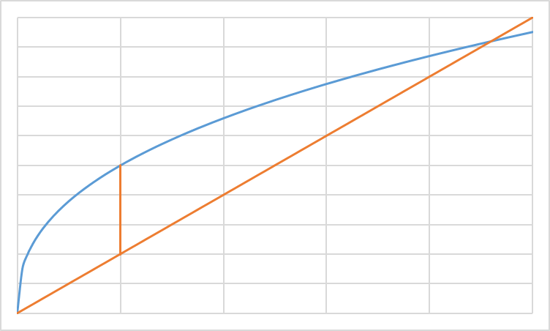
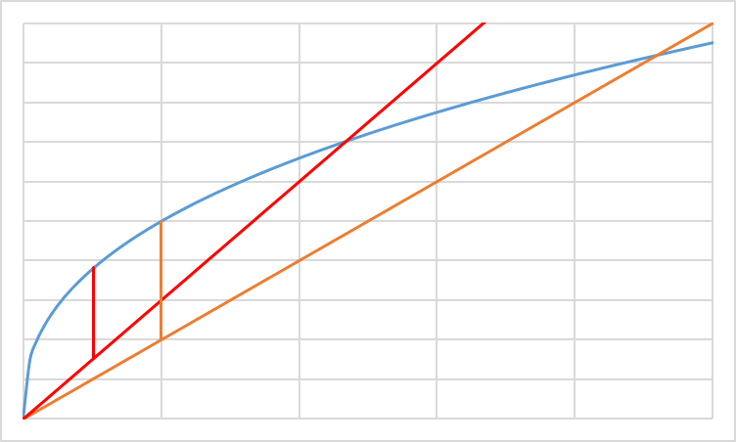
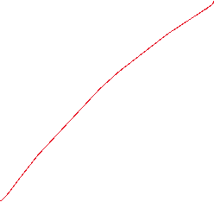
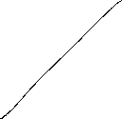



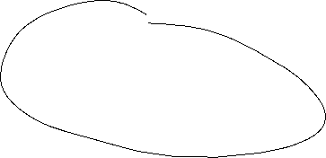


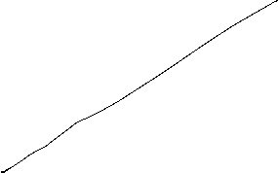



Profit maximization with respect to L: Labor demand
ω=w/p Real wage
Costs; Output
ω₂L: real Costs
ω₁L: real Costs
y(L): Output
L
L*(ω₂)
L*(ω₁)
L^{D}(ω)
ω₁ < ω ₂
ω

Slide 21






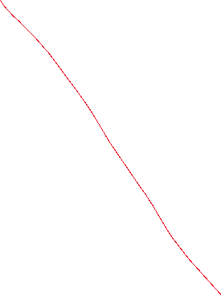



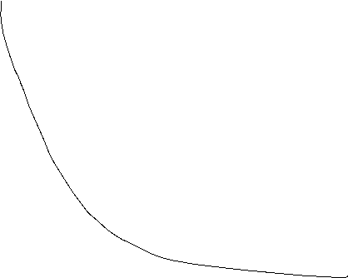






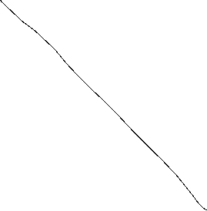


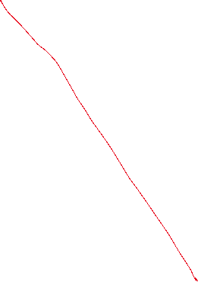


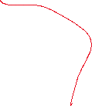




Labor supply
Utility function: u(c,f)
Budget restriction: pc=wL
und $\overline{L}$-L=f
c
f

Slide 22


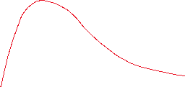





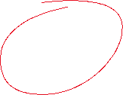
Neoclassic: Labor market − Labor supply

Slide 23

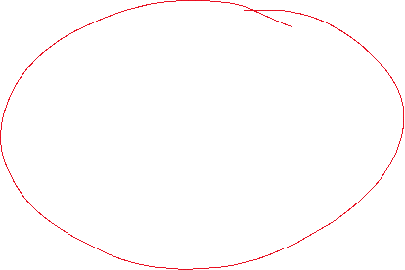


Labor market − Labor supply
In general we assume in neoclassical theory, that the labor market determine the level of output. Thus via the labor market equilibrium we obtain the supply of production dependent on real wages Y^{S}(ω*) in our economy
L
L^{S}(ω)
L^{D}(ω)
L*
ω*
ω
In opposite to the keynesian theory, we assume that the economy is supply side driven via Y^{S} and equilibrium with demand (Y^{S}=Y^{D}) is reached, that this time demand follows supply.

Slide 24
Walras´ law

Slide 25

Neoclassic: Say´s law and natural unemployment

Slide 26





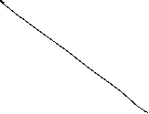




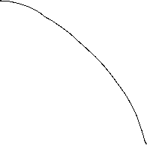
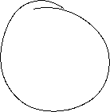




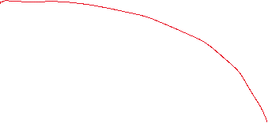
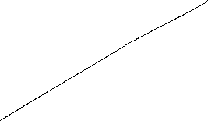
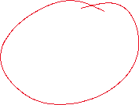
Neoclassical synthesis
$$p$$
$$ω=\frac{w}{p}$$
$$y$$
$$L$$

Slide 27



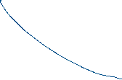

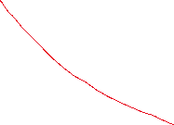




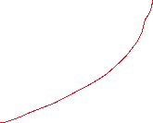
Neoclassical model of general equilibrium
production
price and real wages
Produktionsniveau
Preis- und Reallohnniveau
$$p$$
$$y^{S}$$
$$w^{∗}$$
$$p^{∗}$$
$$y^{D}(p,G,M)$$
$${\left(\frac{w}{p}\right)}^{∗}$$
$$ω=\frac{w}{p}$$
$$y^{∗}$$
$$y$$
$$L^{∗}$$
$$L^{S}$$
$$L^{D}$$
$$L$$
Production function
Produktionsfunktion
Labormarket
Arbeitsmarkt

Slide 28
Monetary and Fiscal policy in the Neocalssical theory
In the neocalssical theory monetary and fiscal policy have ultimately no effect on real variables since the production level y^{S} depends only on the framework conditions of the economy. Thus only the production function and preferences of households are relevant. Whilst this framework is not change production level y* and real wage $ω$* stays unchanged.
Monetary policy: An increase of the amount of money shifts the curve of the camebridge equation to the leftand thus price level is increased 1:1. Therefore an increased amount of money increases nominal wages, but this increase is totally absorbed by the increase of price implying, that real wages $ω$* are not changed and so the level of output y*
Fiscal policy: Increased governement expenditure increases the demand for goods in general. Enterprises can react via an increase of quantity and prices. This time in opposite to Keynes prices are fully flexible and therefore additional demand is totally absorbed by an increase of prices and again that real wages $ω$* are not changed and so the level of output y*

Slide 29

Neoclassical and Keynesian theory
In the short run an impulse via fiscal policy can work, since in practice prices are not fully flexible. But in the long run prices will change and artificially stimulated demand will be absorbed via an price level increase.
A similar reasoning is seein case of monetary policy. An induced increase of the amount of money channeled byreduced interest rates can stimulated investment if prices are rigid in the short run. But in the long rund will become flexible and adjust and thus the stimulus will be absorbed by anincreasing price level.
In general, we have:
→ Keynes: short run
→ Neoclassic: long Frist
Caution! We are in social sciences and thus, there is no „true“ model, since we can always change the framework conditions by ourselves. Please stay sceptical if people tell you, that the economy functions in a specific way. It is much more important to observe the circumstances and apply the „right“ theory in the „right“ time. For example the development of inflation rates over the last 10 years can be well explained via a crossing from keynesan theory to neoclassical theory
Notes:
29

Slide 30

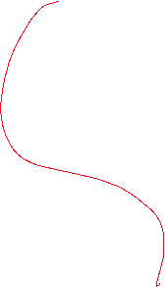



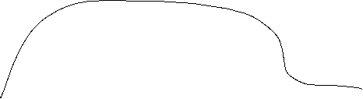




Notes:
30

Slide 31
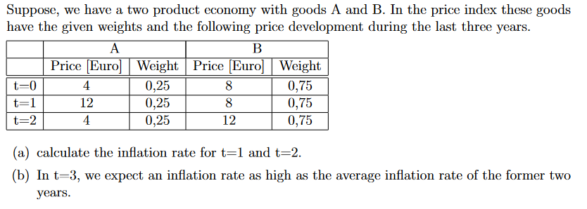








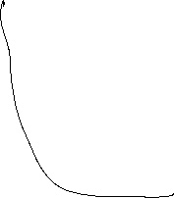






Ánd assume real interest rate in t=3 are 10% calculate the nominal interst rates in t=3
Notes:
31

Slide 32

























Notes:
32

Slide 33










Notes:
33

Slide 34
Notes:
34

