Slide 1





Macroeconomics
Wilhelmshaven
This lecture will be recorded and
Subsequently uploaded in the
world-wide-web
Prof. Dr. Bernhard Köster
Jade-Hochschule Wilhelmshaven
http://www.bernhardkoester.de/vorlesungen/inhalt.html

Slide 2





IS/LM-Model
Until now in the Keynesian model we have no prices ( respectively we normalized P=1 and therefore P vanishes in all equations) since due to the demand oriented view supply and demand equalizes only because of adjustments of quantities on the production side.
Additionally the money market is not incorporated and the connection between nominal and real variables is missing. But this link is essential in a modern economy since in general goods an services are measured in money.
The connection between the goods market and the money market is realized via interest rates steering Investment and money demand
The resulting model is still demand oriented and called the IS/LM-Model

Slide 3

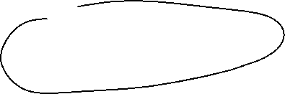












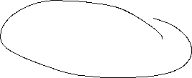
IS/LM-Model
IS: Investment = Saving (or Income = Expenditure)
► Commodity market
LM: Liquidity Preference = Money Supply
► Money market
The IS-curve represents the equilibrium at the goods market with I=S or Y^{D}=Y
Caution! I=S is in this case a condition and not an (ex post) identity as in the circular flow!
Equilibrium at the money market
money supply = money demand
While we obtain money demand via the Keynesian function of money demand.
The LM-Kurve represents then the equilibrium at the money market

Slide 4



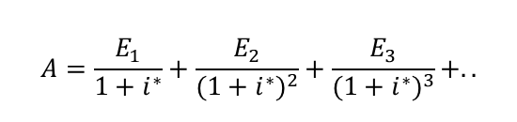



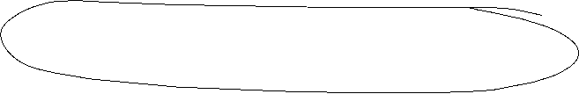


Interest rates and Investment (Keynes` marginal efficiency of capital)
Investment depends interest rate i:
I(i)=I₀+i_{i}∙i with i_{i} <0 I_{0>0} Autonomous investment and i_{i} <0 why?
The yield i* or marginal efficiency of capital of an investment is compared with i the interest rate of the capital market. For example we calculate the internal rate of return
⇒ the Investment is done if i*>i
⇒ The aggregated investment in the economy corresponds to the sum of all investments with i*>i.
Interest rates reflects the opportunity costs of a specific investment.
$$A=\frac{E_{1}}{1+i^{∗}}+\frac{E_{2}}{{(1+i^{∗})}^{2}}+\frac{E_{3}}{{(1+i^{∗})}^{3}}+..$$

Slide 5



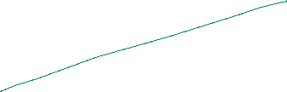

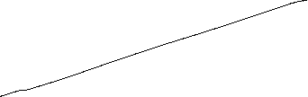
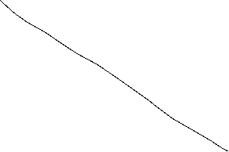


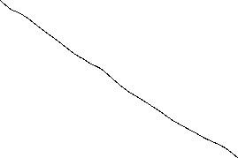
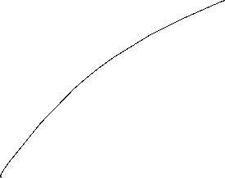






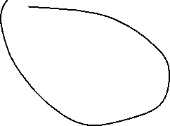









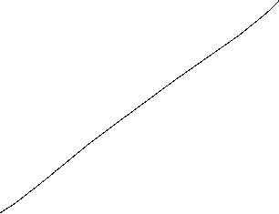
The IS-curve
Y^{D}
Y
i
Equilibrium at the commodity market
The IS-curve is the locus of all (i,y)-combinations of commodity market equilibria
The IS-curve is decreasing in y
Y

Slide 6





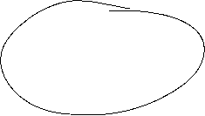



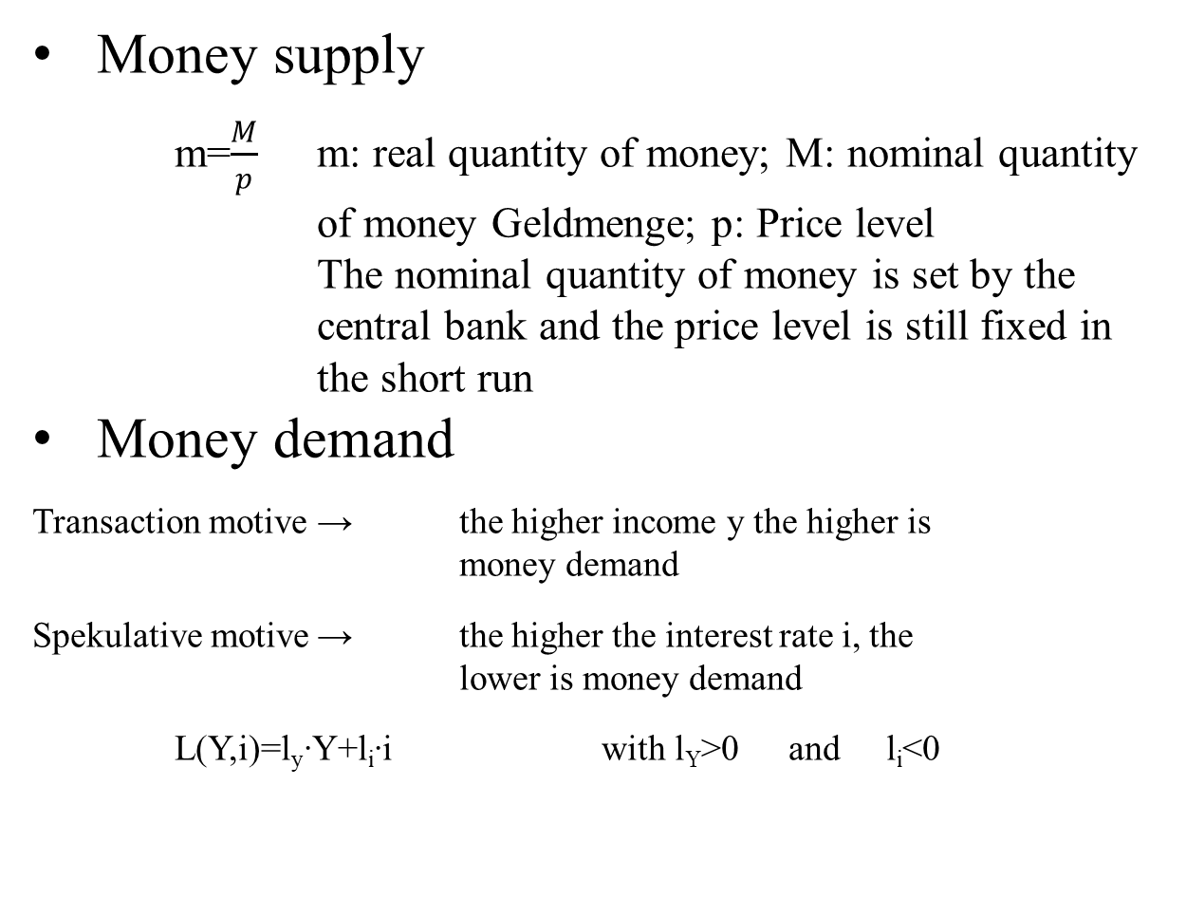
Money market
Money supply
  m=$\frac{M}{p}$ m: real quantity of money; M: nominal quantity of money Geldmenge; p: Price level
  The nominal quantity of money is set by the central bank and the price level is still fixed in the short run
Money demand
Transaction motive → the higher income y the higher is money demand
Spekulative motive → the higher the interest rate i, the lower is money demand
L(Y,i)=l_{y}∙Y+l_{i}∙i with l_{Y}>0 and l_{i}<0

Slide 7
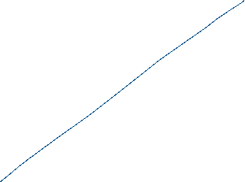





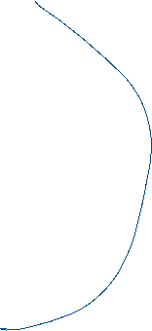
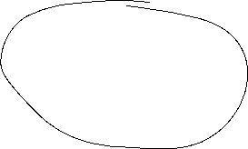
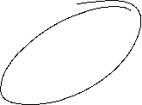
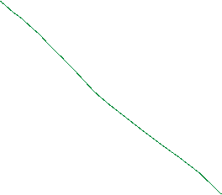


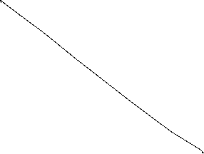





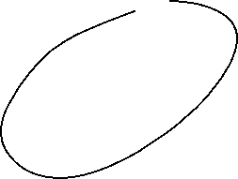



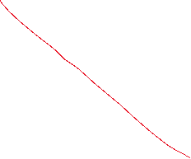

The LM-curve
$$i$$
$$i$$
L, M/p
y
Equilibrium at the money market
The LM-curve is the locus of all (i,y)-combinations of money market equilibria
The LM-curve is increasing in y

Slide 8

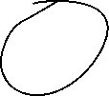
Overall equilibrium
i
LM-curve
i*
IS-curve
Y*
Y
The Intersection of LM- und IS-curve is the overall equilibrium
→ money and commodity market are simultanously in equilibrium

Slide 9




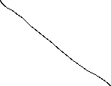





Example
C(Y)=C₀+c_{y}∙Y=50+0,8Y
I(i)=I₀+i_{i}∙i=30-300i
G=20
L(Y,r)=l_{y}∙Y+l_{i}∙i=0,5Y – 250i
M=400 p=2
Determine the IS-Kurve
Determine the LM-Kurve
Determine the simultanous equilibrium at the money and commidity market with equilibrium interest rate i* and income Y*

Slide 11

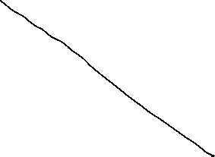
Fiscal policy in the IS-LM-Model
+ ΔG
Y^{D}
Y^{D}=Y
Y^{D}(G)
C₀+I(i₁)+G
∆G >0
Y*₁(G)
Y
i
i₁
IS(G)
Y*₁(G)
Y*₁(G +∆G)
Y

Slide 12







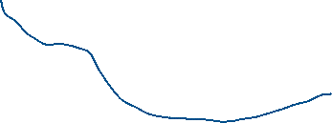
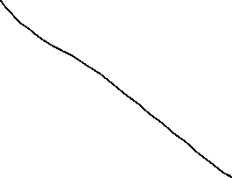





Fiscal policy in the IS-LM-Model
G↑
i
LM
IS(G₁)
i*(G₂)
i*(G₁)
Y* (G₁)
Y

Slide 13




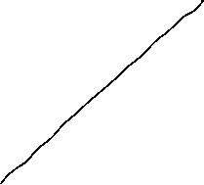





Monetary policy in the IS-LM-Model
+ ΔM
$$M/p$$
LM($M$)
$$i$$
$$i$$
$i_{0}$($M$)
$L(\text{Y}\text{0}$)
L, M/p
Y₀

Slide 14





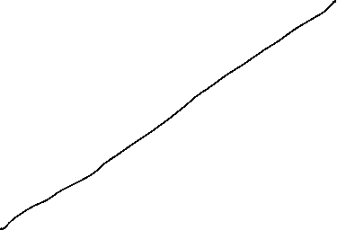



Monetary policy in the IS-LM-Model
M↑
i
M₁<M₂
LM(M₁)
i*(M₁)
IS Kurve
Y* (M₁)
Y

Slide 15

Example
C(Y)=C₀+c_{y}∙Y=50+0,8Y
I(i)=I₀+i_{i}∙i=30-300i
G=20
L(Y,i)=l_{y}∙Y+l_{i}∙i=0,5Y – 250i
M=400 p=2
Determine the fiscal impulse if government expenditure doubles.
Determine the monetary impuls if the quantity of money is increased by 25%.

Slide 16










Example
C(Y)=C₀+c_{y}∙Y=50+0,8Y
I(i)=I₀+i_{i}∙i=30-300i
G=20
L(Y,r)=l_{y}∙Y+l_{i}∙i=0,5Y – 250i
M=400 p=2

Slide 17







Example
C(Y)=C₀+c_{y}∙Y=50+0,8Y
I(i)=I₀+i_{i}∙i=30-300i
G=20
L(Y,r)=l_{y}∙Y+l_{i}∙i=0,5Y – 250i
M=400 p=2

Slide 18
Example

Slide 19









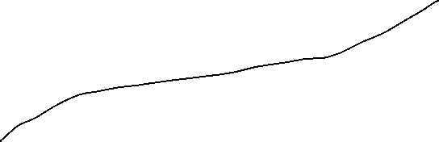










AS-AD-Model
Within the Keynesianschen IS-LM-Modell we find prices in order to obtain the real amount of money M/p but p is assumed to be constant
In the following, we relax this extreme assumption and assume partially flexible prices. But especially at the labour market, we still assume, that enterprises have some market power and thus they can demand a specific markup over marginal costs (i.e. monopolistic competition, oligopol, …)
Together with these assumptions we derive
  Aggregated Supply: AS
  Aggregated Demand: AD
Notes:
19

Slide 20
Aggregated supply: AS-Curve ($Y^{S}$) – General explaination
Keynesian Theory of rigid wages
Keynesian theory of rigid prices
Keynesian theory expectations
Notes:
20

Slide 21

Keynesian Theory of rigid wages
Within the profit maximization of enterprices, wages are one of the main cost factors.
If wages are constant in the short run marginal profits are rising, if output prices increase
Thus enterprises have an incentive to increase production if the price level is increasing.
Altogether we obtain an increased aggregated demand if price level has increased

Slide 22
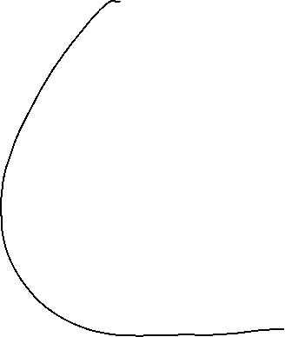

Keynesian theory of rigid prices
Additionally to constant wages also prices of other goods and services are assumed to be rigid in the short run
Assume a decreasing price level in general. But some enterprices will not reduces their prices due to rigidities
In the following these enterprises will face falling revenues due to falling sales.
Overall this results in a lower aggregated supply triggered by a lower price level.

Slide 23
Keynesian theory expectations
In general we assume, that economic agents cannot perfectly distinguish between a general change in price level and their own relative prices
Therefore in a situation of a falling general price level, enterprises can mistakenly assume, that their own prices have fallen relative to other output prices.
Hence they will reduce their production
Similarily workers can mistakenly assume, if the price level has fallen, that their reduced own nominal wages imply a relative decrease of real wages
Hence they will reduce their work effort
Overall we obtain falling aggreagted supply if price level is falling

Slide 24


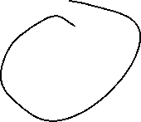





Aggreagted supply: AS-Kurve ($Y^{S}$)
p
AS:
$$Y^{S}$$
Y
Aggregated supply AS: $Y^{S}(\overset{+}{\overbrace{p}})$
Notes:
24

Slide 25


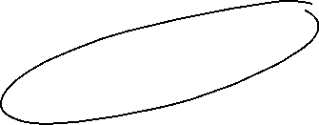

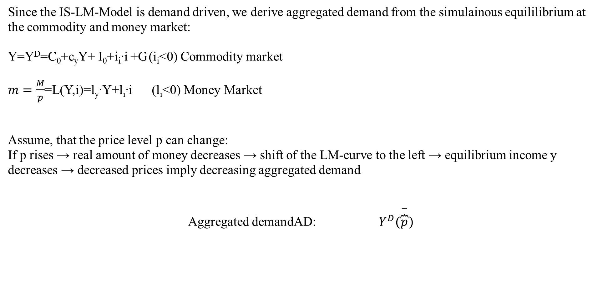


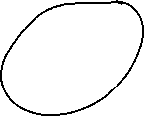


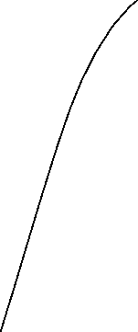

Aggregated demand
Since the IS-LM-Model is demand driven, we derive aggregated demand from the simulainous equililibrium at the commodity and money market:
Y=Y^{D}=C₀+c_{y}Y+ I₀+i_{i}∙i +G (i_{i}<0) Commodity market
$m=\frac{M}{p}$=L(Y,i)=l_{y}∙Y+l_{i}∙i (l_{i}<0) Money Market
Assume, that the price level p can change:
If p rises → real amount of money decreases → shift of the LM-curve to the left → equilibrium income y decreases → decreased prices imply decreasing aggregated demand
Aggregated demandAD: $Y^{D}(\overset{−}{\overbrace{p}})$
Notes:
25

Slide 26



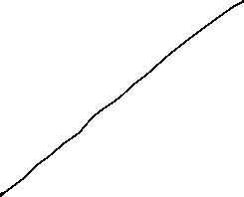




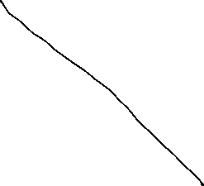
Grafical derivation of the AD-curve
i
LM-curve (p₀)
p₁>p₀
i*(p₀)
IS-curve
P
Y*(p₀)
Y
p₀
AD-curve
Y*(p₀)
Y

Slide 27



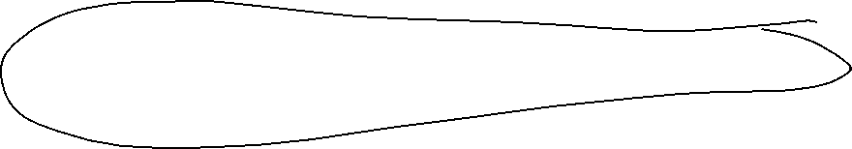

AS-AD-Model
p
AS-curve
p*
AD-curve
Y*
Y
We obtain a Supply-Demand-Diagram in prices and output similar to microeconomic theory
Caution! The derivation of AS and AD should not be confound with micro economic explaination of demand via utility maximization for demand profit maximazation for supply!
Altogether (p*,Y*) represents the short-run-equilibrium in the economy.

Slide 28
Short-run and long-run perspective in the AS-AD-Model
Long-run supply
AS_{long}
p
AS-curve
p*
AD-curve
Y_{n}=Y*
Y
In the long run prices are totally flexible and therefor expected prices will coincide with actual prices. Therefore in the long-run output depends mainly on the framework conditions of the economy (education, infrastructure, resources,…), in general on the level of technology. The possible output dependent of framework conditions is called natural out and does not depend anymore on prices. Therefore Y_{n}=Y* can be identified with a long-run Supply, which is vertical in the p-y-diagram

Slide 29
Monetary and fiscal policy in the AS-AD-Model
Explain the impact of
a nominal increase of the amount of money
an increase of government expenditure
Within the AS-AD-Model in a short-run and long-run perspective

Slide 30
Fiscal policy in the AS-AD-Model
AS_{long}
LM
i
IS
P
Y_{n}
Y
AS
p
A
AD
Y_{n}
Y

Slide 31
Monetary policy in the AS-AD-Model
AS_{lang}
LM
i
IS
Y_{n}
AS‘‘
Y
P
AS
p₀
A
AD
Y_{n}
Y

Slide 32
Summary AS-AD-Model/IS-LM-Model
The impact of monetary and fiscal policy within the short run AS-AD-Model is reduced compared to the IS-LM-Model since the change in prices absorb some amount of the expansive effect.
With respect to the long-run supply-curve monetary and fiscal policy within the AS-AD-Modell do not have any expansive effect on output, only prices will increase. But keep in mind, that this requires perfect competion in commodity and expecially labour markets!
  Caution! Since we have neither in the AS-AD-Model nor in the IS-LM-Model an explicit time dependence, we have to keep in mind that theoretically all effects happens simultanously. In reality adjustments have a time delay and also the framework conditions can change in time. Therefore, we will also have structual changes during time. Especially „good“ economic policy tries to increase the technology level and natural output.

