Slide 1

Macroeconomics
Wilhelmshaven
This lecture will be recorded and
Subsequently uploaded in the
world-wide-web
Prof. Dr. Bernhard Köster
Jade-Hochschule Wilhelmshaven
http://www.bernhardkoester.de/vorlesungen/inhalt.html

Slide 2


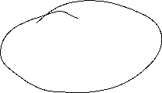




Keynesian Economics
Short run:
  Production capacities are not fully utilized
  Consumptions- and investment plans are totally fulfilled
  Only the supply-side to adjust due to changes
  Supply and demand are only equalized via changes in production not in prices.
  Aggregate Demand determines the equilibrium in the economy.

Slide 3

















Keynesian Cross
Aggregate demand Y^{D}:
Y^{D}=C+I+G
C (private consumption); I (Investment); G (Government expenditure); I and G sare exogenously fixed variables, C depends positively on aggregate income (production) Y
Keynesian consumption function:
C(Y)=C₀+c_{y}Y C₀>0 (autonous consumption); 0<c_{y}<1(marginal propensity to consum)
Euqilibrium: With aggregate income (production) Y is determined by the aggreate demand Y^{D} →
Y=Y^{D}=C₀+c_{y}Y+I+G
Notes:
3

Slide 4

Consumption
In Germany the savings rate is roughly s_{y}= 11% :
What is then the consumption rate c_{y}?
Income Y is divided into consumption and savings (compare the circular flow!)
→c_{y}+ s_{y} =1 → c_{y}=1 – s_{y} =89 %
Interpretation: If we have1000 additional Euros, then 890 Euros are directly spent for consumption (first derivative of the consumption function!)

Slide 5






Consumption
Consumption C(y)
C(y)= C₀+c_{y}Y=100+0,89Y
+ 0,89€ Consumption
corresponds to savings of 0,11€
+ 1€ Income
Autonomous consumption
C₀ =100
Income (y)

Slide 6



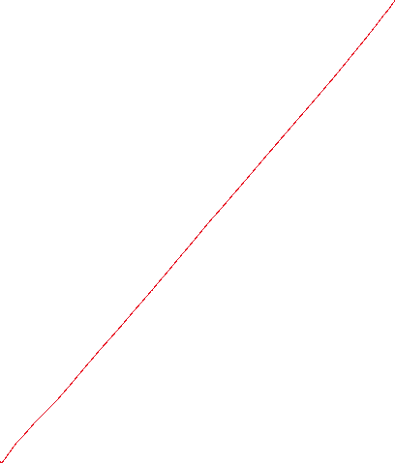



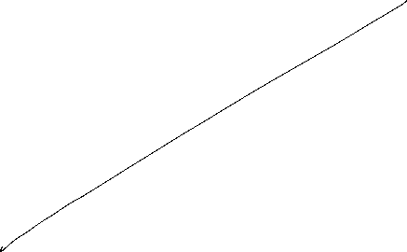



Keynesian Cross
Einkommen(Y),
Expenditure(Y^{D})
Income(Y)

Slide 7
Gütermarktgleichgewicht
Income =
Expenditure Y^{D}=C₀+c_{y}Y+I+G
45°-Line: locus of every possibility with
Y^{D}=Y → possible equlibria
Linear linear through the origin with
Slope 1
Y^{D}=Y
Income(Y),
Expenditure (Y^{D})
Intersection or 45°-Line and aggregate demand
Y^{D}=Y=Y*
Investment I +
Government expenditure G
consumption C(Y)=C₀+c_{y}Y
Investment I
+
Governement
expenditure G
Aggregate demand not dependent on income Y
Autonomer Konsum C₀
45°
Y^{D}=Y=Y*
Income(Y)
Intersection or 45°-Line and aggregate demand
  Equilibrium: Expenditure (Y^{D}) = Income (Y) = Production (Y) = Y*

Slide 8






Adaption process
Income(Y),
Expenditure (Y^{D})
Equilibrium Y^{D}=Y=Y*
Y=Y^{D}
Production larger than demand
Inventory built-up
Expenditure(Y^{D}) = Demand
Y*
Etc.
Demand larger than Production
Iinventory has to decrease
45°
$$Y_{0}$$
Y*
$$Y_{0}′$$
Einkommen(Y)

Slide 9
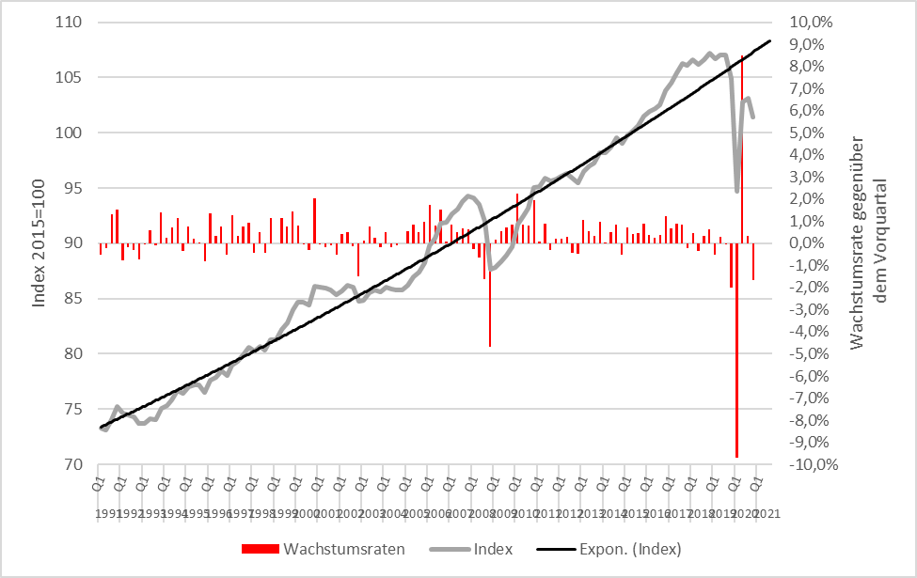
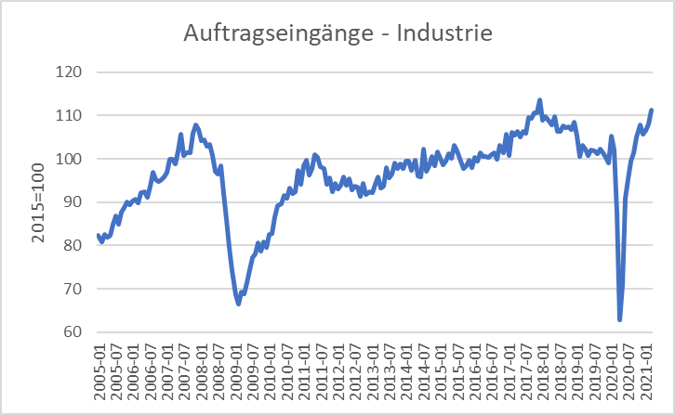




Scrappage Allowance 2009 (Germany): Increase of government expenditure 5 Bil. €
Real economic growth
Incoming orders
Source: Destatis

Slide 10

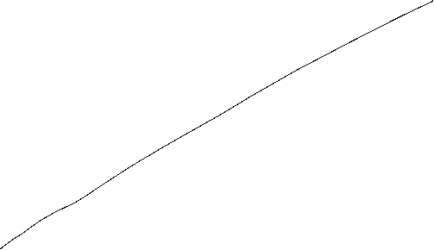




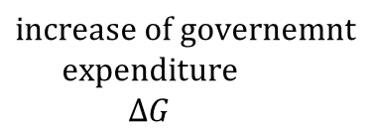
Der Multiplikatoreffekt: Die Abwrackprämie im Keynesianischen Gütermarktmodell
Y^{D}=Y
Income(Y),
Expenditure (Y^{D})
$${Expenditure}_{0} ({\text{Y}\text{D}}_{0})$$
Multiplicator$=\frac{∆Y}{∆G}$
$$increase of governemnt$$
$$expenditure$$
$$∆G$$
$$Y_{0}$$
$$Y_{1}$$
Income (Y)

Slide 11



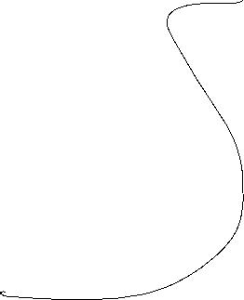

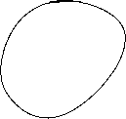



Multiplier effect
External increase of demand, increase of government expenditure of ∆G = 5 and marginal propensity to consum of c_{y}=0,9:
→ additional government consumption ∆G increases directly income Y bei ∆Y₁= ∆G
→
Notes:
11

Slide 12
(Government expenditure) Multiplier
Multiplier: How much increases one variable, if another variable increase by one unit
Government expenditure Multiplier:
Change of equilibrium income, of governement expenditure increases by one unit.
Notes:
12

Slide 13




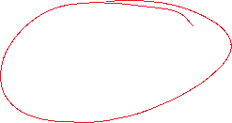










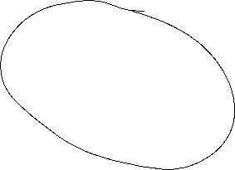


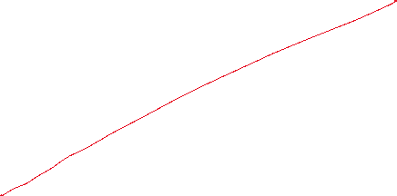

Keynesian Cross
Notes:
13

Slide 14




Multiplier effect (example)
C(Y)= 100+0,8Y; I=400; G=200
Calculate equlibrium income?
Change in equilibrium income, if governement expenditure increades by 100
Calculate the government expenditure multiplier?
Notes:
14

Slide 15
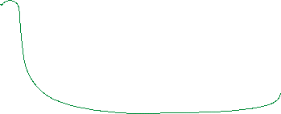




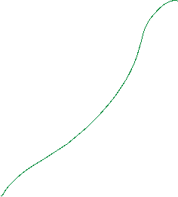


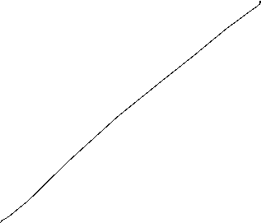











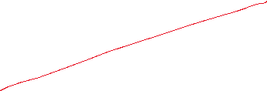





C(Y)= 100+0,8Y; I=400; G=200 $∆G=−60$
Y, Y^{D}
Y
Notes:
15

Slide 16
Consequences of Keynesian economics
Disequilibria over time are possible
→ Aggregate demand is too low in order to fully utilize labor force.
→ Permant high unemployment level
→ Aggregate demand exceeds the capacity of production.
→ Economy is overheating
Especially full employment is not reached via a euqilibrium process, but can only be reached within a specific parameter constellation of the Economy → the Economy needs external interference!
Notes:
16

Slide 17


IS/LM-Model
Until now in the Keynesian model we have no prices ( respectively we normalized P=1 and therefore P vanishes in all equations) since due to the demand oriented view supply and demand equalizes only because of adjustments of quantities on the production side.
Additionally the money market is not incorporated and the connection between nominal and real variables is missing. But this link is essential in a modern economy since in general goods an services are measured in money.
The connection between the goods market and the money market is realized via interest rates steering Investment and money demand
The resulting model is still demand oriented and called the IS/LM-Model

Slide 18










IS/LM-Model
IS: Investment = Saving (or Income = Expenditure)
► Commodity market
LM: Liquidity Preference = Money Supply
► Money market
The IS-curve represents the equilibrium at the goods market with I=S or Y^{D}=Y
Caution! I=S is in this case a condition and not an (ex post) identity as in the circular flow!
Equilibrium at the money market
money supply = money demand
While we obtain money demand via the Keynesian function of money demand.
The LM-Kurve represents then the equilibrium at the money market

Slide 19



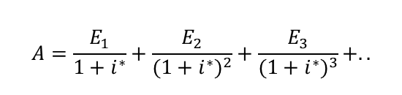



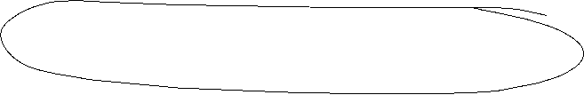


Interest rates and Investment (Keynes` marginal efficiency of capital)
Investment depends interest rate i:
I(i)=I₀+i_{i}∙i with i_{i} <0 I_{0>0} Autonomous investment and i_{i} <0 why?
The yield i* or marginal efficiency of capital of an investment is compared with i the interest rate of the capital market. For example we calculate the internal rate of return
⇒ the Investment is done if i*>i
⇒ The aggregated investment in the economy corresponds to the sum of all investments with i*>i.
Interest rates reflects the opportunity costs of a specific investment.
$$A=\frac{E_{1}}{1+i^{∗}}+\frac{E_{2}}{{(1+i^{∗})}^{2}}+\frac{E_{3}}{{(1+i^{∗})}^{3}}+..$$

Slide 20


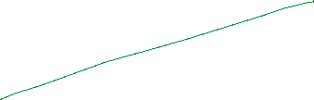


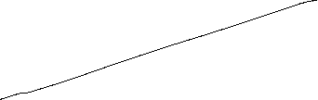
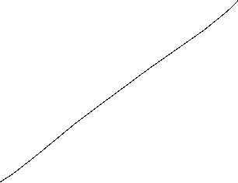
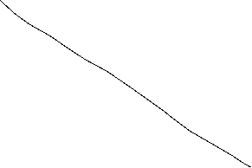

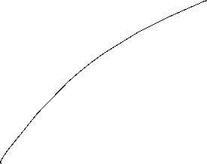




The IS-curve
Y^{D}
Y
i
Equilibrium at the commodity market
The IS-curve is the locus of all (i,y)-combinations of commodity market equilibria
The IS-curve is decreasing in y
Y

Slide 21

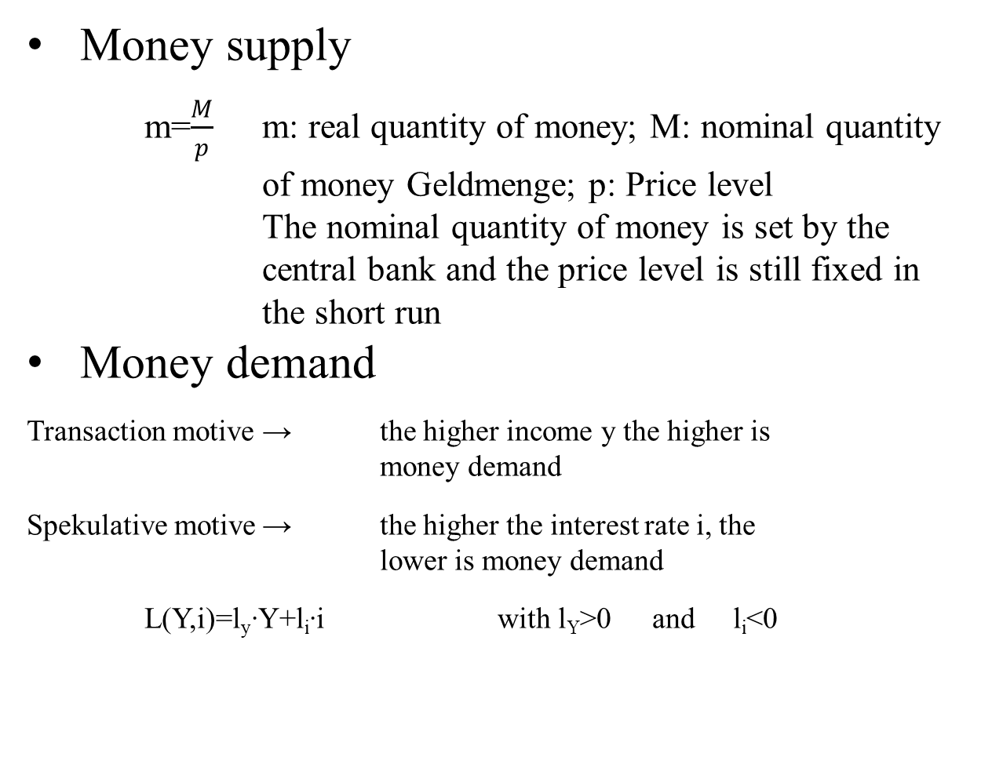
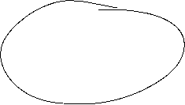
Money market
Money supply
  m=$\frac{M}{p}$ m: real quantity of money; M: nominal quantity of money Geldmenge; p: Price level
  The nominal quantity of money is set by the central bank and the price level is still fixed in the short run
Money demand
Transaction motive → the higher income y the higher is money demand
Spekulative motive → the higher the interest rate i, the lower is money demand
L(Y,i)=l_{y}∙Y+l_{i}∙i with l_{Y}>0 and l_{i}<0

Slide 22


The LM-curve
$$i$$
$$i$$
L, M/p
y
Equilibrium at the money market
The LM-curve is the locus of all (i,y)-combinations of money market equilibria
The LM-curve is increasing in y

Slide 23
Overall equilibrium
i
LM-curve
i*
IS-curve
Y*
Y
The Intersection of LM- und IS-curve is the overall equilibrium
→ money and commodity market are simultanously in equilibrium

Slide 24
Example
C(Y)=C₀+c_{y}∙Y=50+0,8Y
I(i)=I₀+i_{i}∙i=30-300i
G=20
L(Y,r)=l_{y}∙Y+l_{i}∙i=0,5Y – 250i
M=400 p=2
Determine the IS-Kurve
Determine the LM-Kurve
Determine the simultanous equilibrium at the money and commidity market with equilibrium interest rate i* and income Y*

Slide 26
Fiscal policy in the IS-LM-Model
+ ΔG
Y^{D}
Y^{D}=Y
Y^{D}(G)
C₀+I(i₁)+G
∆G >0
Y*₁(G)
Y
i
i₁
IS(G)
Y*₁(G)
Y*₁(G +∆G)
Y

Slide 27
Fiscal policy in the IS-LM-Model
G↑
i
LM
IS(G₁)
i*(G₂)
i*(G₁)
Y* (G₁)
Y

Slide 28
Monetary policy in the IS-LM-Model
+ ΔM
$$M/p$$
LM($M$)
$$i$$
$$i$$
$i_{0}$($M$)
$L(\text{Y}\text{0}$)
L, M/p
Y₀

Slide 29
Monetary policy in the IS-LM-Model
M↑
i
M₁<M₂
LM(M₁)
i*(M₁)
IS Kurve
Y* (M₁)
Y

Slide 30
Example
C(Y)=C₀+c_{y}∙Y=50+0,8Y
I(i)=I₀+i_{i}∙i=30-300i
G=20
L(Y,i)=l_{y}∙Y+l_{i}∙i=0,5Y – 250i
M=400 p=2
Determine the fiscal impulse if government expenditure doubles.
Determine the monetary impuls if the quantity of money is increased by 25%.

Slide 31
Example

Slide 32
AS-AD-Model
Within the Keynesianschen IS-LM-Modell we find prices in order to obtain the real amount of money M/p but p is assumed to be constant
In the following, we relax this extreme assumption and assume partially flexible prices. But especially at the labour market, we still assume, that enterprises have some market power and thus they can demand a specific markup over marginal costs (i.e. monopolistic competition, oligopol, …)
Together with these assumptions we derive
  Aggregated Supply: AS
  Aggregated Demand: AD
Notes:
32

Slide 33
Aggregated supply: AS-Curve ($Y^{S}$) – General explaination
Keynesian Theory of rigid wages
Keynesian theory of rigid prices
Keynesian theory expectations
Notes:
33

Slide 34
Keynesian Theory of rigid wages
Within the profit maximization of enterprices, wages are one of the main cost factors.
If wages are constant in the short run marginal profits are rising, if output prices increase
Thus enterprises have an incentive to increase production if the price level is increasing.
Altogether we obtain an increased aggregated demand if price level has increased

Slide 35
Keynesian theory of rigid prices
Additionally to constant wages also prices of other goods and services are assumed to be rigid in the short run
Assume a decreasing price level in general. But some enterprices will not reduces their prices due to rigidities
In the following these enterprises will face falling revenues due to falling sales.
Overall this results in a lower aggregated supply triggered by a lower price level.

Slide 36
Keynesian theory expectations
In general we assume, that economic agents cannot perfectly distinguish between a general change in price level and their own relative prices
Therefore in a situation of a falling general price level, enterprises can mistakenly assume, that their own prices have fallen relative to other output prices.
Hence they will reduce their production
Similarily workers can mistakenly assume, if the price level has fallen, that their reduced own nominal wages imply a relative decrease of real wages
Hence they will reduce their work effort
Overall we obtain falling aggreagted supply if price level is falling

Slide 37


Aggreagted supply: AS-Kurve ($Y^{S}$)
p
AS:
$$Y^{S}$$
Y
Aggregated supply AS: $Y^{S}(\overset{+}{\overbrace{p}})$
Notes:
37

Slide 38
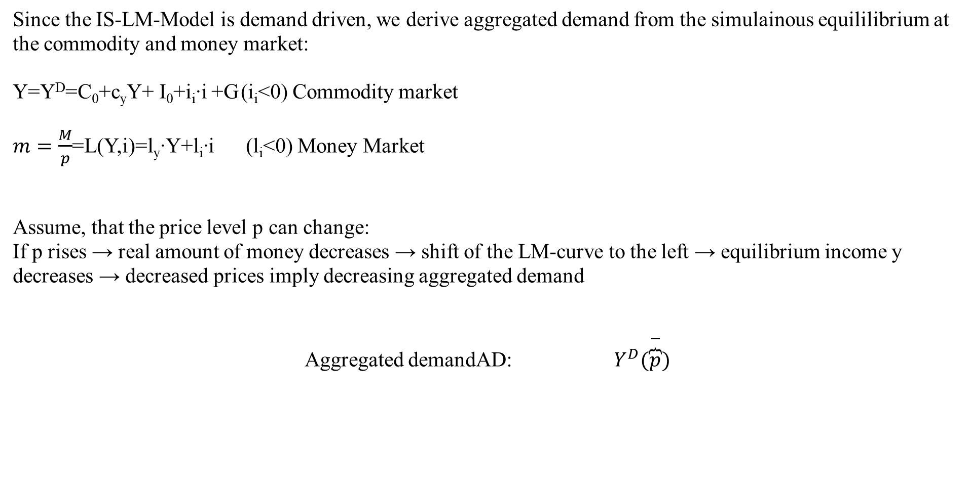
Aggregated demand
Since the IS-LM-Model is demand driven, we derive aggregated demand from the simulainous equililibrium at the commodity and money market:
Y=Y^{D}=C₀+c_{y}Y+ I₀+i_{i}∙i +G (i_{i}<0) Commodity market
$m=\frac{M}{p}$=L(Y,i)=l_{y}∙Y+l_{i}∙i (l_{i}<0) Money Market
Assume, that the price level p can change:
If p rises → real amount of money decreases → shift of the LM-curve to the left → equilibrium income y decreases → decreased prices imply decreasing aggregated demand
Aggregated demandAD: $Y^{D}(\overset{−}{\overbrace{p}})$
Notes:
38

Slide 39
Grafical derivation of the AD-curve
i
LM-curve (p₀)
p₁>p₀
i*(p₀)
IS-curve
P
Y*(p₀)
Y
p₀
AD-curve
Y*(p₀)
Y

Slide 40
AS-AD-Model
p
AS-curve
p*
AD-curve
Y*
Y
We obtain a Supply-Demand-Diagram in prices and output similar to microeconomic theory
Caution! The derivation of AS and AD should not be confound with micro economic explaination of demand via utility maximization for demand profit maximazation for supply!
Altogether (p*,Y*) represents the short-run-equilibrium in the economy.

Slide 41
Short-run and long-run perspective in the AS-AD-Model
Long-run supply
AS_{long}
p
AS-curve
p*
AD-curve
Y_{n}=Y*
Y
In the long run prices are totally flexible and therefor expected prices will coincide with actual prices. Therefore in the long-run output depends mainly on the framework conditions of the economy (education, infrastructure, resources,…), in general on the level of technology. The possible output dependent of framework conditions is called natural out and does not depend anymore on prices. Therefore Y_{n}=Y* can be identified with a long-run Supply, which is vertical in the p-y-diagram

Slide 42
Monetary and fiscal policy in the AS-AD-Model
Explain the impact of
a nominal increase of the amount of money
an increase of government expenditure
Within the AS-AD-Model in a short-run and long-run perspective

Slide 43
Fiscal policy in the AS-AD-Model
AS_{long}
LM
i
IS
P
Y_{n}
Y
AS
p
A
AD
Y_{n}
Y

Slide 44
Monetary policy in the AS-AD-Model
AS_{lang}
LM
i
IS
Y_{n}
AS‘‘
Y
P
AS
p₀
A
AD
Y_{n}
Y

Slide 45
Summary AS-AD-Model/IS-LM-Model
The impact of monetary and fiscal policy within the short run AS-AD-Model is reduced compared to the IS-LM-Model since the change in prices absorb some amount of the expansive effect.
With respect to the long-run supply-curve monetary and fiscal policy within the AS-AD-Modell do not have any expansive effect on output, only prices will increase. But keep in mind, that this requires perfect competion in commodity and expecially labour markets!
  Caution! Since we have neither in the AS-AD-Model nor in the IS-LM-Model an explicit time dependence, we have to keep in mind that theoretically all effects happens simultanously. In reality adjustments have a time delay and also the framework conditions can change in time. Therefore, we will also have structual changes during time. Especially „good“ economic policy tries to increase the technology level and natural output.

