Slide 1
Macroeconomics
Wilhelmshaven
This lecture will be recorded and
Subsequently uploaded in the
world-wide-web
Prof. Dr. Bernhard Köster
Jade-Hochschule Wilhelmshaven
http://www.bernhardkoester.de/vorlesungen/inhalt.html

Slide 2
Monetary aggregates
M0 : cash (not defined in the Eurozone)
M1 : The sum of currency in circulation and overnight deposits (cash + sight deposits)
M2 : M1 +
deposits redeemable at notice of up to three months and deposits with an agreed maturity of up to two years
M3 : M2 +
repurchase agreements,
money market fund shares/units and
debt securities with a maturity of up to two years.

Slide 3
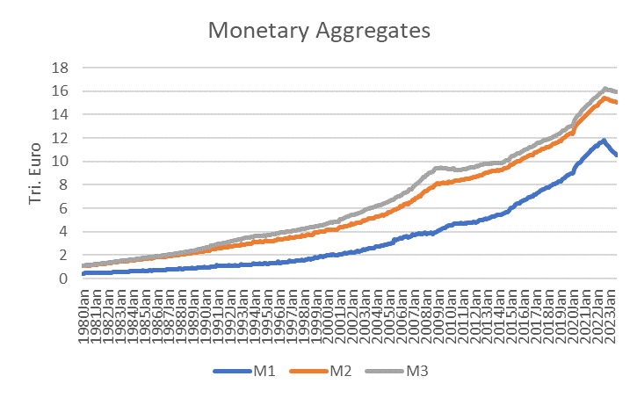
Monetary aggregates
Aug 2023
M3: 15,94 Tri. Euro
M2: 15,06 Tri. Euro
M1: 10,06 Tri. Euro

Slide 4
Quantity theory of money
(total amount of money) x (velocity of money)
=
(price level) x (real output)
→ if in short term we assume the velocity of money as constant and real output is changing also slowly relative to prices, we obtain a directly proportional dependence between the growth rate of money and inflation.

Slide 5
Quantity theory of money and Money Demand
M∙V = P∙Y → M = P∙Y/V
Within the money market equilibrium we obtain:
M=M^{d} (money demand)
Cash holding coefficient: k = 1/V → M^{d} = k ∙ P ∙ Y
Assuming k to be constant in the short-run, then the level of transactions representet by PY determines the level of money demand M^{d}
→ The real money demand M^{d}/P therefore depends only
on Y and we obtain:
Money Demand $=L^{D}(Y)$

Slide 6
Monetary growth and Inflation
Calculating the total differential of M∙V = P∙Y → ΔM/M+ ΔV/V = ΔP/P+ ΔY/Y
Assuming again V to be constant in the short run
→
$$π(inflation)=g_{M}(monetray growth rate)−g_{Y}(GDP−growth rate)$$
“usual” GDP-growth ($g_{Y}>0$, approx. 1%-3% for developed economies. Then these economies need a certain monetary growth due to the increase of total transactions over time)
$g_{Y}$ in the long run depends mainly on the technological progress (compare with potential output!)
→ excessive monetary growth translates according
to quantity theory of money into inflation!
Milton Friedman (nobel laureate 1976):
“Inflation is always and everywhere a monetary phenomenon.”

Slide 7
Classical Dichotomy
Real Variables: Measured in physical units – quantities and relative prices, for example
quantity of output produced
real wage: output earned per hour of work
real interest rate: output earned in the future by lending one unit of output today
Nominal Variables: Measured in money units
nominal wage: Dollars per hour of work.
nominal interest rate: Dollars earned in future by lending one dollar today.
the price level: The amount of dollars needed to buy a representative basket of goods.

Slide 8
Classical Dichotomy
Classical Dichotomy: In Theory, we have an independence between real and nominal variables.
Neutrality of money: Changes in monetary aggregates do not have any influence on real variables. At least in long run “money is veil”.

Slide 9
Central bank and money creation
Balance sheet
Assets | Liabilities
Net holdings of foreign reserves (incl. gold) | Currency in circulation
Credits to domestic banking sector | Deposits of the domestic banking sector (i.e. deposit facility, minimum reserve)
Other assets | Other liabilities
Changing for example assets via buying/selling foreign currency or changing deposits increases or lowers the monetary base

Slide 10
Active money creation via commercial banks
Commercial banks obtain deposits from their customers.
These deposits will be partially lend to other customers and appear as deposits at other banks.
This initiates a multiplier process for creation of money, since the „new“ sight deposits have also the character of money.
In general commercial banks are limited by the required minimum reserve ratio set by the central banks. In general commercial banks hold a higher reserve ratio than the officially required reserved in order to insure against a „bank run“. Anyhow during the financial crisis 2008/09 we had some bank runs and after Lehman bankruptcy 16.09.2008 there was a danger of a general „bank run“.

Slide 11
Money creation: Example
Commercial bank 1 holds deposits of 1 Mio. Euros. According to an reserve ratio of 10% commercial bank 2 obtain the leftover as deposits.
1. Calculate the amount of deposits of commercial bank 2?
Commercial bank 2 has the same reserve ratio, thus commercial bank 3 obtains also the leftover as deposits … .
2. Calculate the total amount of new deposits?

Slide 12
Active money creation (money multiplier)
Commercial bank 1 (CB1) holds deposits D with reserve ratio R
→ CB 1 holds back the proportion R of depostis D, thus CB2 obtains
(1-R)D new deposits
→ CB 2 holds back (1-R)RD of deposits, thus CB3
(1-R)(1-R)D new deposits …..
.
.
→ Total amount of new deposits:
[(1-R)+(1-R)²+(1-R)³+….]D=D/r
→ 1/R is called the „money multiplier“

Slide 13
Monetary policy of the ECB
The ECB’s Governing Council considers that price stability is best maintained by aiming for 2% inflation over the medium term. Inflation is measured by the Harmonised Index of Consumer Prices (HICP). The Governing Council’s commitment to the 2% target is symmetric. This means that we consider negative and positive deviations from the target to be equally undesirable.

Slide 14
Classical monetary instruments of the ECB
Main refinancing operations: The main refinancing operations, with a weekly frequency and a maturity of one week, are the most important monetary policy instrument used by the Eurosystem for money market management.
→ The main refinancing operations (MRO) rate is “in general” the key interest rate of the central bank for steering the money market
Deposit facility: The deposit facility rate is one of the three interest rates the ECB sets every six weeks as part of its monetary policy. The rate defines the interest banks receive for depositing money with the central bank overnight.
Marginal lending facility: The marginal lending facility rate is the interest rate banks pay when they borrow from the ECB overnight. When they do this, they have to provide collateral, for example securities, to guarantee that the money will be paid back.
Minimum reserve: The minimum amount of reserves a credit institution is required to hold with a central bank.

Slide 15
Monetary policy in practice
Modern central banks try to influence via thir interest rate policy the economic performance of the economy. But in practice „directly“ they can only influence the short-term interest rates of the financial markets. Therefore in Europe the ECB has the aim to „steer“ the ESTR (Euro short term rate). ESTR represents the interest rate level of the overnight interbank interest rate in the european banking sector.
Classical effect of an key interest rate cut of the central bank:
Short term interest rate↓ →Shifting investments to longer term bonds with higher interest rates
Prices of longer term bonds increase → Adjustment of interest rates over different maturities
But „in general“ we will have a difference between interest rates for
different maturities. This relationship is called Yield Curve.
Notes:
15

Slide 16
Classical effect of monetary policy via consumption and investment
In general, we assume that the central bank can influence directly and indirectly the interest rates in the economy:
Cutting interest rates will in general expand credit demand:
→ expands credit based investment and consumption
→ increase the utilization of production, which pushes economic growth
→ but, if the economy starts to produce at the limit of their capacity, profits will start to stagnate or expected profits will even fall.
→ pushing liqudity via low interest rates will not increase investment anymore
→ in the end pushing liquity and increasing the amount of money only creates inflation

Slide 17
Classical effect of monetary policy via stock markets
Interest rate cut of the central bank
→ Yields of bonds decline.
→ In the short run, stock investments are more attractive than n investment in bonds
→ This will in general will increase stock market prices until yields at the bond market and the stock market will adjust.
→ Thus, via the increase of prices at capital markets income of investors will increase
→ increase of investment and consumption in general
→ … (see former slide!)
→ in the end pushing liquity and increasing the amount of money only creates inflation

Slide 18
Yield curve: Market expectation theory (Example)
i₁: interest rate 1 year (p.a.) 2%
i₂: interest rate 2 years (p.a.) 4%
i₁e: expected interest rate 1 year in 1 year (p.a.)???
Investment 1 Euro
Assume long term and short term investments are perfect substitues, investors are risk neutral and we have perfect capital markets
1 Euro
Short term?
Long term?
Compare the two investments1
→ short term expected interest rate =
longterm interest rate + difference between long term and short term interest rates
Notes:
18

Slide 19
Yield Curve: Liquidity premium theory
Preferences between creditors and debtors differ. Investors are in general risk avers.
→ Creditors will demand a premium since they lower their liquidity for the maturity of the loan. For this loss of liquidity they want to be compensated.
→ the longer the maturity higher the liquidity premium
→ in general we expect long term interest rates to be higher than short term interest rates
Notes:
19

Slide 20
Yield curve: Market Segmentation Theory
We have a risk, if maturity for investments do not match the preference of investors
Maturity > Investment horizon → price risk
Maturity < Investment horizon → income risk
Investors try to reduce their risk
→ the market will be segmented into areas maturity and investment horizon will match
financial assets are no perfect substitutes
Notes:
20

Slide 21
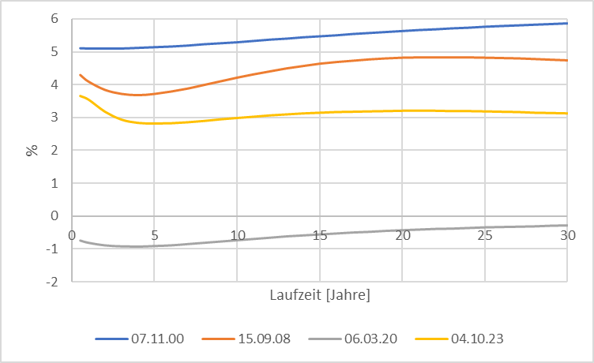
Source: Bundesbank
Yield curve (Germany)
Notes:
21

Slide 22
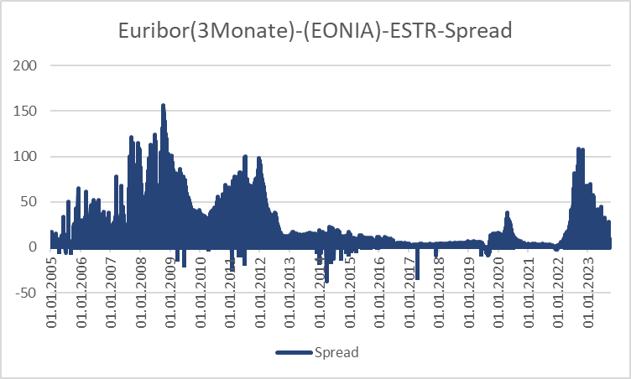
Source: Bundesbank
Stress indicators of the financial markets

Slide 23
Monetary policy since the financial crisis (overview)
Key interest rates down to 0%
ECB is switching to fixed-rate tender procedure with full allotment for all its refinancing operations, meaning that it would supply all funds demanded at a fixed interest rate.
Downgrade the rating requirements
Introducing long term refinancing opterations up to one year
Liquidity provision of foreign currency (Euro-US-Dollar-swaps)

Slide 24
Monetary policy since the financial crisis (overview)
Two 3-years tender with 500 Bil. Euro Winter 2011/12 (Bazooka) especially for the italien and spanish banking sector
Minimum reserve rate down from 2% to 1% January 2012
Draghi Put/“Whatever it takes“ (26.07.2012)
“Within our mandate, the ECB is ready to do whatever it takes to preserve the euro.
and believe me, it will be enough.”
https://qz.com/1038954/whatever-it-takes-five-years-ago-today-mario-draghi-saved-the-euro-with-a-momentous-speech/
Start of buying low rating government bonds (26.09.2012)
Different programs to buy government and private bonds at the secondary financial markets according to the capital key of the eurozone. Especially buying a monthly volume up to 60 Bil. Euros. 2015 -> stop July 2022 (only reinvestment!)
https://www.ecb.europa.eu/mopo/implement/app/html/index.en.html
PEPP: Pandemic emergency purchase programme (March 2020) Volume 1,7 Tril. Euros (Oct 2022)
https://www.ecb.europa.eu/mopo/implement/pepp/html/index.en.html
Increase of interest rates since July 2022

Slide 25
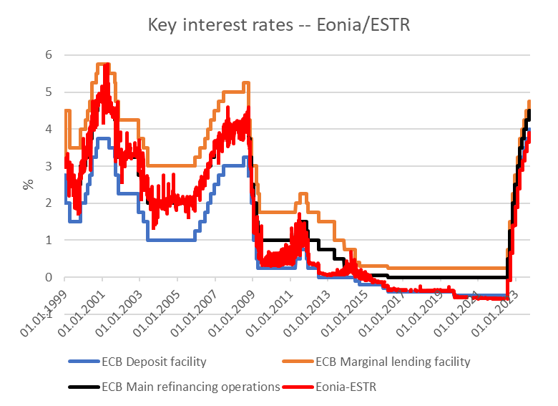
Key rates ECB
Source: ECB,

Slide 26
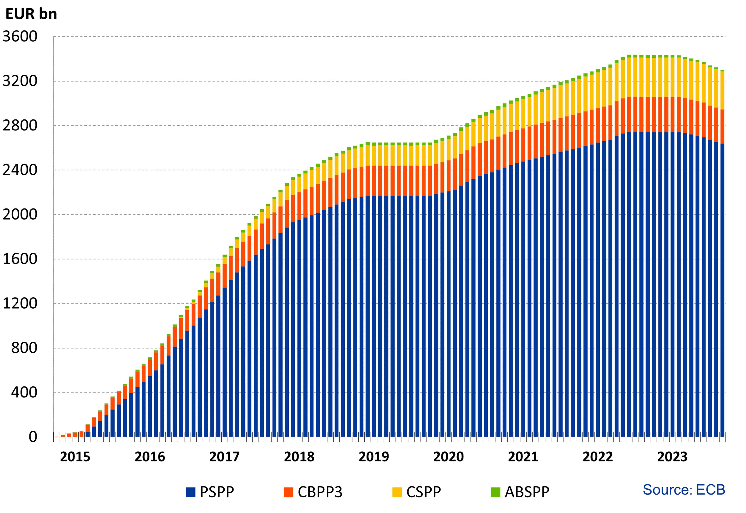
Financial markets interventions of the ECB since 2015 without PEPP
Source: ECB, Asset Purchase Program
https://www.ecb.europa.eu/mopo/implement/omt/html/index.en.html

Slide 27
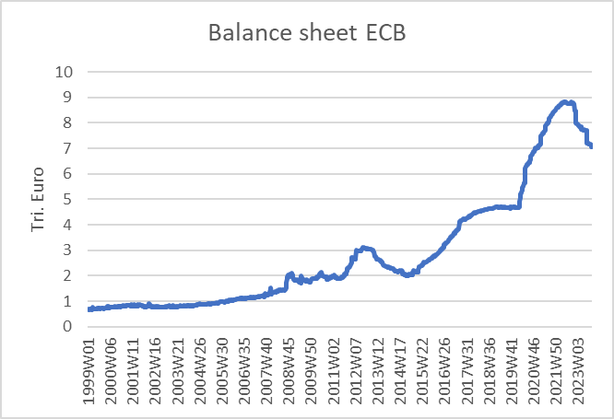
ECB balance sheet
Source: ECB

Slide 28
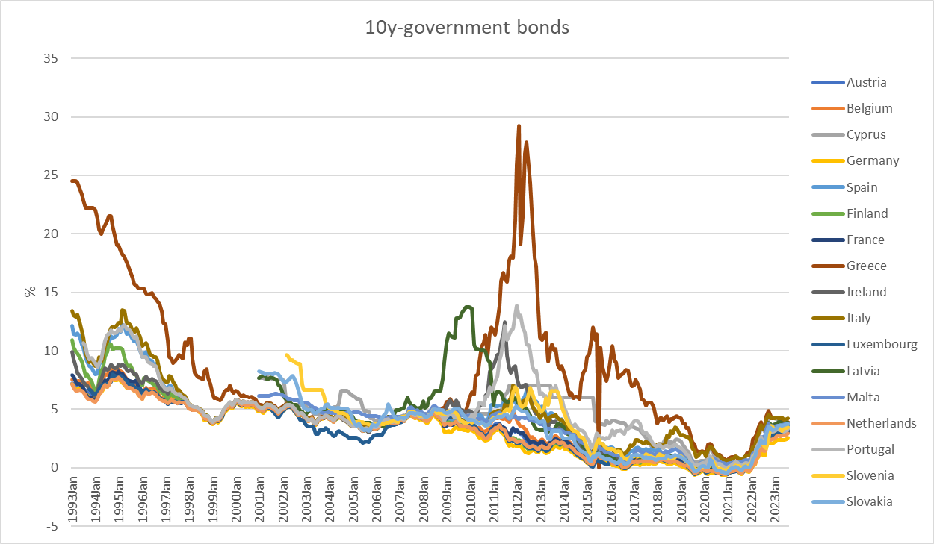
10 Year government bonds Eurozone
Source: ECB

Slide 29
Keynesian Economics
Short run:
Production capacities are not fully utilized
Consumptions- and investment plans are totally fulfilled
Only the supply-side to adjust due to changes
Supply and demand are only equalized via changes in production not in prices.
Aggregate Demand determines the equilibrium in the economy.

Slide 30
Keynesian Cross
Aggregate demand Y^{D}:
Y^{D}=C+I+G
C (private consumption); I (Investment); G (Government expenditure); I and G sare exogenously fixed variables, C depends positively on aggregate income (production) Y
Keynesian consumption function:
C(Y)=C₀+c_{y}Y C₀>0 (autonous consumption); 0<c_{y}<1(marginal propensity to consum)
Euqilibrium: With aggregate income (production) Y is determined by the aggreate demand Y^{D} →
Y=Y^{D}=C₀+c_{y}Y+I+G
Notes:
30

Slide 31
Consumption
In Germany the savings rate is roughly s_{y}= 11% :
What is then the consumption rate c_{y}?
Income Y is divided into consumption and savings (compare the circular flow!)
→c_{y}+ s_{y} =1 → c_{y}=1 – s_{y} =89 %
Interpretation: If we have1000 additional Euros, then 890 Euros are directly spent for consumption (first derivative of the consumption function!)

Slide 32
Consumption
Consumption C(y)
C(y)= C₀+c_{y}Y=100+0,89Y
+ 0,89€ Consumption corresponds to savings of 0,11€
+ 1€ Income
Autonomous consumption
C₀ =100
Income (y)

Slide 33
Keynesian Cross
Einkommen(Y), Expenditure(Y^{D})
Income(Y)

Slide 34
Gütermarktgleichgewicht
Income =
Expenditure Y^{D}=C₀+c_{y}Y+I+G
45°-Line: locus of every possibility with
Y^{D}=Y → possible equlibria
Linear linear through the origin with
Slope 1
Y^{D}=Y
Income(Y), Expenditure (Y^{D})
Intersection or 45°-Line and aggregate demand
Y^{D}=Y=Y*
Investment I +
Government expenditure G
consumption C(Y)=C₀+c_{y}Y
Investment I
+
Governement
expenditure G
Aggregate demand not dependent on income Y
Autonomer Konsum C₀
45°
Y^{D}=Y=Y*
Income(Y)
Intersection or 45°-Line and aggregate demand
Equilibrium: Expenditure (Y^{D}) = Income (Y) = Production (Y) = Y*

Slide 35
Adaption process
Income(Y), Expenditure (Y^{D})
Equilibrium Y^{D}=Y=Y*
Y=Y^{D}
Production larger than demand
Inventory built-up
Expenditure(Y^{D}) = Demand
Y*
Etc.
Demand larger than Production
Iinventory has to decrease
45°
$$Y_{0}$$
Y*
$$Y_{0}′$$
Einkommen(Y)

Slide 36
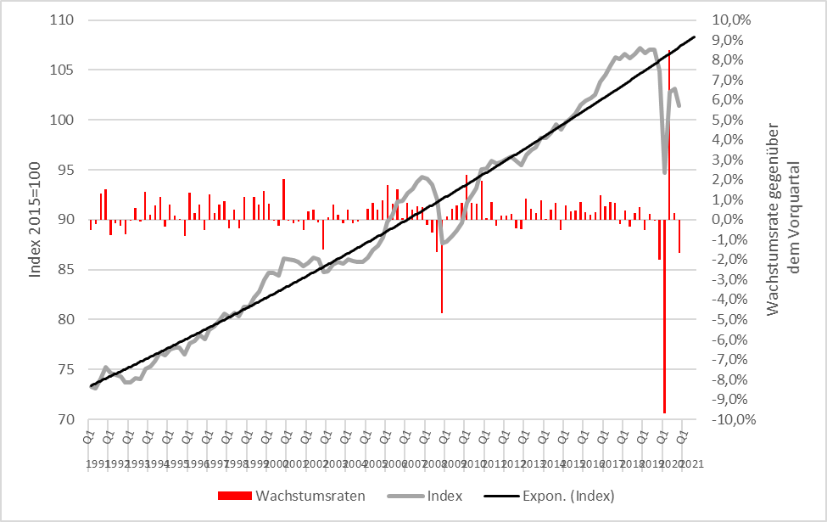
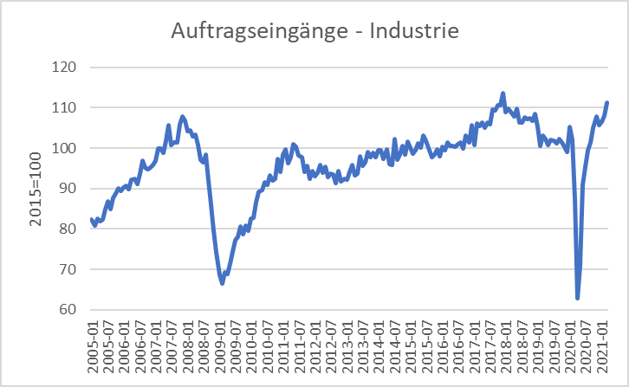
Scrappage Allowance 2009 (Germany): Increase of government expenditure 5 Bil. €
Real economic growth
Incoming orders
Source: Destatis

Slide 37
Der Multiplikatoreffekt: Die Abwrackprämie im Keynesianischen Gütermarktmodell
Y^{D}=Y
Income(Y), Expenditure (Y^{D})
$${Expenditure}_{0} ({\text{Y}\text{D}}_{0})$$
Multiplicator$=\frac{∆Y}{∆G}$
$$increase of governemnt$$
$$expenditure$$
$$∆G$$
$$Y_{0}$$
$$Y_{1}$$
Income (Y)

Slide 38
Multiplier effect
External increase of demand, increase of government expenditure of ∆G = 5 and marginal propensity to consum of c_{y}=0,9:
→ additional government consumption ∆G increases directly income Y bei ∆Y₁= ∆G
→
Notes:
38

Slide 39
(Government expenditure) Multiplier
Multiplier: How much increases one variable, if another variable increase by one unit
Government expenditure Multiplier:
Change of equilibrium income, of governement expenditure increases by one unit.
Notes:
39

Slide 40
Multiplier effect (example)
C(Y)= 100+0,8Y; I=400; G=200
Calculate equlibrium income?
Change in equilibrium income, if governement expenditure increades by 100
Calculate the government expenditure multiplier?
Notes:
40

Slide 41
Y, Y^{D}
Y
Notes:
41

Slide 42
Consequences of Keynesian economics
Disequilibria over time are possible
→ Aggregate demand is too low in order to fully utilize labor force.
→ Permant high unemployment level
→ Aggregate demand exceeds the capacity of production.
→ Economy is overheating
Especially full employment is not reached via a euqilibrium process, but can only be reached within a specific parameter constellation of the Economy → the Economy needs external interference!
Notes:
42

Slide 43
IS/LM-Model
Until now in the Keeynsian model we have no prices ( respectively we normalized P=1 and therefore P vanishes in all equations) since due to the demand oriented view supply and demand equalizes only because of adjustments of quantities on the production side.
Additionally the money market is not incorporated and the connection between nominal and real variables is missing. But this link is essential in a modern economy since in general goods an services are measured in money.
The connection between the goods market and the money market is realized via interest rates steering Investment and money demand
The resulting model is still demand oriented and called the IS/LM-Model

Slide 44
IS/LM-Model
IS: Investment = Saving (or Income = Expenditure)
► Commodity market
LM: Liquidity Preference = Money Supply
► Money market
The IS-curve represents the equilibrium at the goods market with I=S or Y^{D}=Y
Caution! I=S is in this case a condition and not an (ex post) identity as in the circular flow!
Equilibrium at the money market
money supply = money demand
While we obtain money demand via the Keynesian function of money demand.
The LM-Kurve represents then the equilibrium at the money market

Slide 45
Interest rates and Investment (Keynes` marginal efficiency of capital)
Investment depends interest rate i:
I(i)=I₀+i_{i}∙i with i_{i} <0 I_{0>0} Autonomous investment and i_{i} <0 why?
The yield i* or marginal efficiency of capital of an investment is compared with i the interest rate of the capital market. For example we calculate the internal rate of return
⇒ the Investment is done if i*>i
⇒ The aggregated investment in the economy corresponds to the sum of all investments with i*>i.
Interest rates reflects the opportunity costs of a specific investment.
$$A=\frac{E_{1}}{1+i^{∗}}+\frac{E_{2}}{{(1+i^{∗})}^{2}}+\frac{E_{3}}{{(1+i^{∗})}^{3}}+..$$

Slide 46
The IS-curve
Y^{D}
Y
i
Equilibrium at the commodity market
The IS-curve is the locus of all (i,y)-combinations of commodity market equilibria
The IS-curve is decreasing in y
Y

Slide 47
Money market
Money supply
m=$\frac{M}{p}$ m: real quantity of money; M: nominal quantity of money Geldmenge; p: Price level
The nominal quantity of money is set by the central bank and the price level is still fixed in the short run
Money demand
Transaction motive → the higher income y the higher is money demand
Spekulative motive → the higher the interest rate i, the lower is money demand
L(Y,i)=l_{y}∙Y+l_{i}∙i with l_{Y}>0 and l_{i}<0

Slide 48
The LM-curve
$$i$$
$$i$$
L, M/p
y
Equilibrium at the money market
The LM-curve is the locus of all (i,y)-combinations of money market equilibria
The LM-curve is increasing in y

Slide 49
Overall equilibrium
i
LM-curve
i*
IS-curve
Y*
Y
The Intersection of LM- und IS-curve is the overall equilibrium
→ money and commodity market are simultanously in equilibrium

Slide 50
Example
C(Y)=C₀+c_{y}∙Y=50+0,8Y
I(i)=I₀+i_{i}∙i=30-300i
G=20
L(Y,r)=l_{y}∙Y+l_{i}∙i=0,5Y – 250i
M=400 p=2
Determine the IS-Kurve
Determine the LM-Kurve
Determine the simultanous equilibrium at the money and commidity market with equilibrium interest rate i* and income Y*

Slide 52
Fiscal policy in the IS-LM-Model
+ ΔG
Y^{D}
Y^{D}=Y
Y^{D}(G)
C₀+I(i₁)+G
∆G >0
Y*₁(G)
Y
i
i₁
IS(G)
Y*₁(G)
Y*₁(G +∆G)
Y

Slide 53
Fiscal policy in the IS-LM-Model
G↑
i
LM
IS(G₁)
i*(G₂)
i*(G₁)
Y* (G₁)
Y

Slide 54
Monetary policy in the IS-LM-Model
+ ΔM
$$M/p$$
LM($M$)
$$i$$
$$i$$
$i_{0}$($M$)
$L(\text{Y}\text{0}$)
L, M/p
Y₀

Slide 55
Monetary policy in the IS-LM-Model
M↑
i
M₁<M₂
LM(M₁)
i*(M₁)
IS Kurve
Y* (M₁)
Y

Slide 56
Example
C(Y)=C₀+c_{y}∙Y=50+0,8Y
I(i)=I₀+i_{i}∙i=30-300i
G=20
L(Y,i)=l_{y}∙Y+l_{i}∙i=0,5Y – 250i
M=400 p=2
Determine the fiscal impulse if government expenditure doubles.
Determine the monetary impuls if the quantity of money is increased by 25%.

Slide 57
Example

Slide 58
AS-AD-Model
Within the Keynesianschen IS-LM-Modell we find prices in order to obtain the real amount of money M/p but p is assumed to be constant
In the following, we relax this extreme assumption and assume partially flexible prices. But especially at the labour market, we still assume, that enterprises have some market power and thus they can demand a specific markup over marginal costs (i.e. monopolistic competition, oligopol, …)
Together with these assumptions we derive
Aggregated Supply: AS
Aggregated Demand: AD
Notes:
58

Slide 59
Aggregated supply: AS-Curve ($Y^{S}$) – General explaination
Keynesian Theory of rigid wages
Keynesian theory of rigid prices
Keynesian theory expectations
Notes:
59

Slide 60
Keynesian Theory of rigid wages
Within the profit maximization of enterprices, wages are one of the main cost factors.
If wages are constant in the short run marginal profits are rising, if output prices increase
Thus enterprises have an incentive to increase production if the price level is increasing.
Altogether we obtain an increased aggregated demand if price level has increased

Slide 61
Keynesian theory of rigid prices
Additionally to constant wages also prices of other goods and services are assumed to be rigid in the short run
Assume a decreasing price level in general. But some enterprices will not reduces their prices due to rigidities
In the following these enterprises will face falling revenues due to falling sales.
Overall this results in a lower aggregated supply triggered by a lower price level.

Slide 62
Keynesian theory expectations
In general we assume, that economic agents cannot perfectly distinguish between a general change in price level and their own relative prices
Therefore in a situation of a falling general price level, enterprises can mistakenly assume, that their own prices have fallen relative to other output prices.
Hence they will reduce their production
Similarily workers can mistakenly assume, if the price level has fallen, that their reduced own nominal wages imply a relative decrease of real wages
Hence they will reduce their work effort
Overall we obtain falling aggreagted supply if price level is falling

Slide 63
Aggreagted supply: AS-Kurve ($Y^{S}$)
p
AS:
$$Y^{S}$$
Y
Aggregated supply AS: $Y^{S}(\overset{+}{\overbrace{p}})$
Notes:
63

Slide 64
Aggregated demand
Since the IS-LM-Model is demand driven, we derive aggregated demand from the simulainous equililibrium at the commodity and money market:
Y=Y^{D}=C₀+c_{y}Y+ I₀+i_{i}∙i +G (i_{i}<0) Commodity market
$m=\frac{M}{p}$=L(Y,i)=l_{y}∙Y+l_{i}∙i (l_{i}<0) Money Market
Assume, that the price level p can change:
If p rises → real amount of money decreases → shift of the LM-curve to the left → equilibrium income y decreases → decreased prices imply decreasing aggregated demand
Aggregated demandAD: $Y^{D}(\overset{−}{\overbrace{p}})$
Notes:
64

Slide 65
Grafical derivation of the AD-curve
i
LM-curve (p₀)
p₁>p₀
i*(p₀)
IS-curve
P
Y*(p₀)
Y
p₀
AD-curve
Y*(p₀)
Y

Slide 66
AS-AD-Model
p
AS-curve
p*
AD-curve
Y*
Y
We obtain a Supply-Demand-Diagram in prices and output similar to microeconomic theory
Caution! The derivation of AS and AD should not be confound with micro economic explaination of demand via utility maximization for demand profit maximazation for supply!
Altogether (p*,Y*) represents the short-run-equilibrium in the economy.

Slide 67
Short-run and long-run perspective in the AS-AD-Model
Long-run supply
AS_{long}
p
AS-curve
p*
AD-curve
Y_{n}=Y*
Y
In the long run prices are totally flexible and therefor expected prices will coincide with actual prices. Therefore in the long-run output depends mainly on the framework conditions of the economy (education, infrastructure, resources,…), in general on the level of technology. The possible output dependent of framework conditions is called natural out and does not depend anymore on prices. Therefore Y_{n}=Y* can be identified with a long-run Supply, which is vertical in the p-y-diagram

Slide 68
Monetary and fiscal policy in the AS-AD-Model
Explain the impact of
a nominal increase of the amount of money
an increase of government expenditure
Within the AS-AD-Model in a short-run and long-run perspective

Slide 69
Fiscal policy in the AS-AD-Model
AS_{long}
LM
i
IS
P
Y_{n}
Y
AS
p
A
AD
Y_{n}
Y

Slide 70
Monetary policy in the AS-AD-Model
AS_{lang}
LM
i
IS
Y_{n}
AS‘‘
Y
P
AS
p₀
A
AD
Y_{n}
Y

Slide 71
Summary AS-AD-Model/IS-LM-Model
The impact of monetary and fiscal policy within the short run AS-AD-Model is reduced compared to the IS-LM-Model since the change in prices absorb some amount of the expansive effect.
With respect to the long-run supply-curve monetary and fiscal policy within the AS-AD-Modell do not have any expansive effect on output, only prices will increase. But keep in mind, that this requires perfect competion in commodity and expecially labour markets!
Caution! Since we have neither in the AS-AD-Model nor in the IS-LM-Model an explicit time dependence, we have to keep in mind that theoretically all effects happens simultanously. In reality adjustments have a time delay and also the framework conditions can change in time. Therefore, we will also have structual changes during time. Especially „good“ economic policy tries to increase the technology level and natural output.

