Slide 1

Macroeconomics
Wilhelmshaven
This lecture will be recorded and
Subsequently uploaded in the
world-wide-web
Prof. Dr. Bernhard Köster
Jade-Hochschule Wilhelmshaven
http://www.bernhardkoester.de/vorlesungen/inhalt.html

Slide 2
National account system (NAS)
National accounts provide information to analyse the structure of economies and their development over time. They contain a wide range of statistics describing an economy in various ways. The main GDP aggregates provide an overview about key economic developments..
Information, Forecast, international comparision
Since 1995 NAS is standardized in the EUgilt für EU-Mitgliedsstaaten das Europäische System Volkswirtschaftlicher Gesamtrechnungen (European System of National and Regional Accounts, ESA)

Slide 3













Gross domestic product and Gross national product
Gross domestic product (GDP) is the total market value of all the finished goods and services produced within a country’s borders in a specific time period (i.e. 1 year) (domestic concept)
Gross National Product (GNP) is the total market value of all finished goods and services produced by a country’s citizens in a specific time period (i.e. 1 year).
(national concept)

Slide 4

















GDP
„market value“
In order to aggregate different goods and service their market prices are considered.
Some goods do not have a market price. In this case production prices are considered
For public services wages public employees are considered
„all“
owner-occupied residential property is value by an average market rent.
Some goods and service cannot be statistically counted and are therefore not included into GDP (i. e. black market, educational performance of parents, honory posts)

Slide 5









GDP
„finished“
Only value added is considered =
Production – intermediate consumption
„goods and services“
material and immaterial goods
„wihin a countries borders“:
national concept = domestic concept
– factor income of non citizens in the considered country
+ factor income of citizens of the considered country from abroad
„specific time period “
Quater or year

Slide 6










Calculating GDP
Production approach – Value added of all economic sectors (activities)
Expenditure approach – final uses of goods and services (consumption, investment,
government expentitures, net exports (Ex-Im)
Income approach – Distribution of income on the different factors of production
(capital and labor)
Notes:
6

Slide 7




























Gross national Product (Germany 2021)
Notes:
7

Slide 8
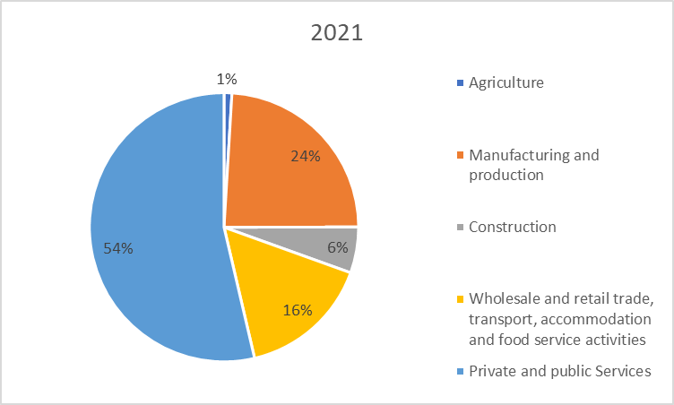











Production approach – Gross value added (Germany 2021)
Gross value added (GVA)
+ taxes
– subsidies
= GDP
Source: Destatis, current prices, Bil. Euro

Slide 9
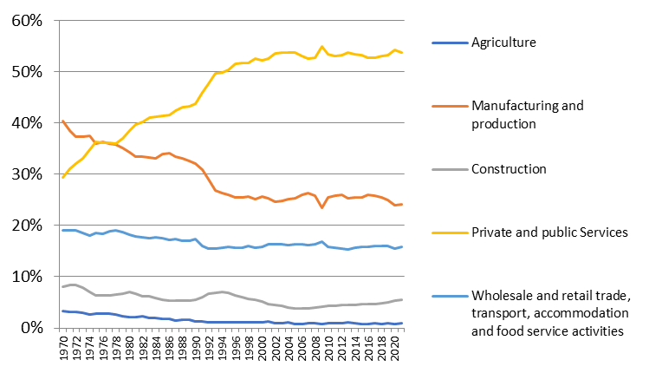







Development of the nominal proportions of the sectors of gross value added (Germany)
Source: Destatis, current prices

Slide 10




Expenditure approach Germany 2021
}
Consumption
}
Gross capital investment
}
External contribution
Source: Destatis ,current prices, Mrd. Euro

Slide 11
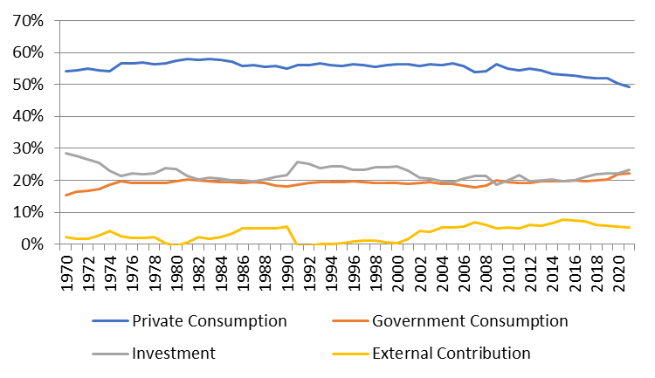





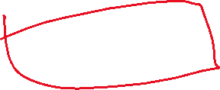





Development of the nominal proportions of the expenditure sectors of GDP (Germany)
Source: Destatis, current prices

Slide 12




Income approach
The income approach counts the different typs contributing to national income.
Mainly we look at the income from the general factors of production: Capital and Labor. Thus we count corporate and investment income from capital and compensation of employees from labor. The aggregate variable measuring the division of national income is the
compensation of employees
Labor Share =
national income

Slide 13
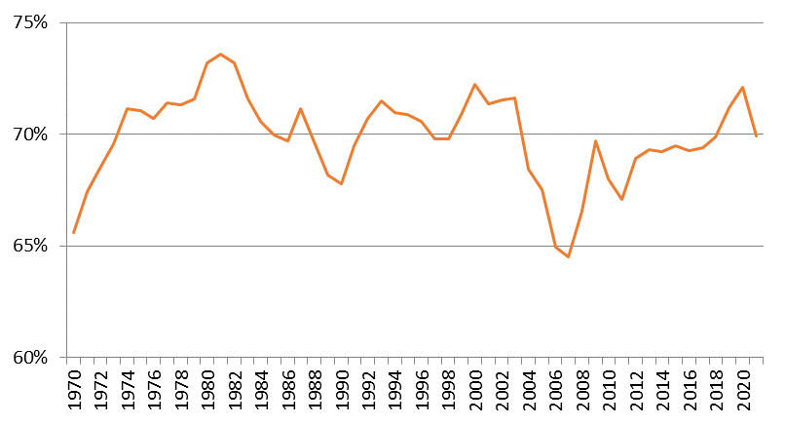


Development of the labor share (Germany): Income approach
Source: Destatis

