Slide 1
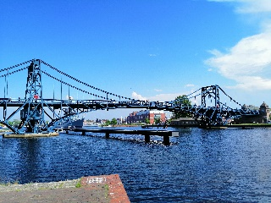
Macroeconomics
Wilhelmshaven
This lecture will be recorded and
Subsequently uploaded in the
world-wide-web
Prof. Dr. Bernhard Köster
Jade-Hochschule Wilhelmshaven
http://www.bernhardkoester.de/vorlesungen/inhalt.html

Slide 2

Macroeconomics
Winter term 2022
Prof. Dr. Bernhard Köster

Slide 3
Prof. Dr. Bernhard Köster
Room: S 113
Street: Friedrich-Paffrath-Straße 101
location: 26389 Wilhelmshaven
Tel. +49 4421 985-2766
Email: bernhard.koester@jade-hs.de
Consultation hour: by arrangement
or just have a look into my office!
or Webex/Zoom …

Slide 4
Literature
Blanchard, Macroeconomics
Mankiw/Taylor, Economics
Mankiw/Taylor, Macroeconomics
Barro Macroeconomics, A Modern Approach
Krugman, Economics
Burda and Wyplosz, Macroeconomics A European Text
Ben J. Heijdra Foundations of Modern Macroeconomics
Peter B. Sørensen/Hans J. Whitta-Jacobsen Introducing Advanced Macroeconomics

Slide 5
General
As in every lecture you should read further. Reading different bookes gives you a deeper insight, since economics is social science and therefore, we do not have the „only truth“
Although, there are many good textbooks, I`m one the „old“ lectures who does not just take the slides of the „Mankiw“ or the „Blanchard“. I`m creating my own slides and I`ll show my point of view on Macroeconomics. Nevertheless, many things will be similar as in the standard textbooks.
In the end my content is what matters for the exam. You get
  Slides
  Excercises
  Videos
  Review Questions

Slide 6









Data Sources
Institutions Statistisches Bundesamt Bundesbank Eurostat EZB FED BoE OECD IMF Worldbank SVR BA | Economic scientific Institutes Cesifo DIW IAB IfW IMK IW IWH KOF RWI ZEW Bruegel NIESR ESRI NBER Peterson Institue Brookins Institution

Slide 7
Economics
What is economics?
There is no general answer:
Economics is what Economists do! (Tautology)
„National economics is, if poeple wonder, why they do not have any money. There are many reasons, the most meaningful reasons are the scientific ones.“ (Kurt Tucholsky, 1931)

Slide 8
Economics – Definitions
Economics is the study of economies, at both the level of individuals and of society as a whole (Krugman and Wells, 2004, p. 2).
Economics is the study of how human beings coordinate their wants and desires, given the decision-making mechanisms, social customs, and political realities of the society (Colander, 2006a, p. 4).
Economics is the study of how society manages its scarce resources (Mankiw, 2001, p. 4).
See in general this nice essay:
Retrospectives: On the Definition of Economics
Roger E. Backhouse
Steven G. Medema
JOURNAL OF ECONOMIC PERSPECTIVES
VOL. 23, NO. 1, WINTER 2009
(pp. 221-33)

Slide 9
Economic Analysis:
Description of the economic events (Diagnosis)
Model building in order to explain the economic development (Theoretical design)
Matching Theory and Reality (Evaluation)
  Forecasting the future economic development based on the evaluated models
  Advisor of politicians and governments in economic issues

Slide 10
Economists as Scientists and Advisors
If economists try to explain the world, they work as scientists
If economists try to change the world, they work as advisors, since chosing one specific model means to use their own conviction

Slide 11
Positive and normative issue
Positive issues are descriptive and want to explain the functioning of the world. In this case the issue is totally neutral
Normative issues are judging how the world is functioning. Thus the own conviction influence the result. In this case the issue is not neutral

Slide 12
Examples – positive/normative?
A minimum wage causes unemployment of low skilled workers.
The higher income of some people due to the introduction of a minimum wage outweigh the higher unemployment of other people
Increasing oil prices increase the demand for electro mobiliy
Coal fired powwer stations have to incorporate the cost of CO₂-Emissions causing climate change
Increasing the military budget to 2% of GDP in Europe reduces due to higher interests payments the national budget and therefore tightens the possibilities of future generations

Slide 13
Microeconomics
Behaviour of single persons
Analyzing single enterprises, households
Demand of one household for i.e. food
Supply of one enterprise for cars
Demand of one construction enterprise for cement
Macroeconomics
Looking at the whole economy
Analyzing economic aggregates
Total demand of all households → total consumption
Total supply of all enterprises → aggregate production
Total Demand of enterprises for investment
Analyzing aggregates gives deeper insight in general connectionsGesamtzusammenhängen.
But we loose information of important details
Compare with statistics → building aggregates like mean and variance in order to describe a data set!!

Slide 14
Macroeconomic Questions
Impact of labour market developments on the whole economic development?
Impact of the interest rate decisions of central banks on general interest rate developments?
Impact of demographic changes on capital accumulation?
Global economic changes of the Corona crisis on international trade?
Effects of economic programs against climate change on income distributions and economic growth?
Effects of the russian attac on Ukraine on economic developments, since Russia is the largest supplier of raw materials in the world?

Slide 15
Macroeconomic issues
Economic growth of the german economy 2021 2,6%
Inflation rate Germany August 2022 bei 7,9%
Government debt Germany 2,45 Billionen Euro
Retirement age raises in Germany until 2030 from 65 to 67 years
The interest rate on the main refinancing operations (MRO) of the ECB has been raised to 0,75% on September 14th.
Until now next year (2023) the last Atomic power plants in Germany will be shut down
In Wilhelmshaven the first german LNG-Terminal will operate in the end of 2022

Slide 16
The historical circular flow of income
The french physician François Quesnay (1694-1774) compared the blood circulation with economic developments and visualized the interdependencies in his Tableau Economique.
The economy is divided in to three classes:
Classe productive (P): agricultural sector
Classe propiétaire (E): Noble man and clergy man (land owners)
Classe stérile (S): Trade (merchants) and manufacturing (artisians) sector

Slide 17





General Visualization of the circular flow of income
P
E
S
Account form:
 | P | E | S
P
E
S
Matrix form:
P
Grafics form:
E
S

Slide 18






Example
P produced commodities valued with 5ME
Own consumption of P 2ME
Buying manufactored commodities P 1ME
Rent for the land P 2ME
Agricultural products E 1ME
Agricultural products S 2ME
Illustrate the circular flow of income in accout, matrix and graphics form. Which assumption is needed?

Slide 19






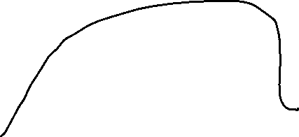

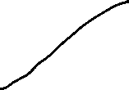

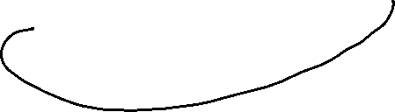







Own consumption of P 2ME
Buying manufactored commodities P 1ME
Rent for the land P 2ME
Agricultural products E 1ME
Agricultural products S 2ME
Account form
P
E
S

Slide 20












Own consumption of P 2ME
Buying manufactored commodities P 1ME
Rent for the land P 2ME
Agricultural products E 1ME
Agricultural products S 2ME
Matrix form
In/Out | P | E | S
P
E
S

Slide 21





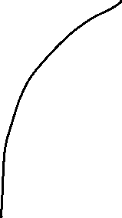












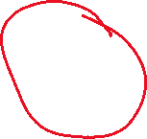
Own consumption of P 2ME
Buying manufactored commodities P 1ME
Rent for the land P 2ME
Agricultural products E 1ME
Agricultural products S 2ME
Grafical form
P
S
E

Slide 22
The modern circular flow of income
4 Sectors:
Households (H), Government (G), Enterprises (E), Overseas (A)
The circular flow of income is closed via the sector of the financial institutions (FI). Via FI savings and investment is processed or assets and liabilities against the overseas sector
Arrows represents always money flows between the sectors
The circle is closed if at any sector we have incoming flow equals outgoing flow (Axiom of the closed circle).
→ Every relevant flows are considered

Slide 23


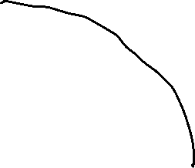





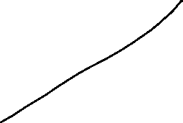








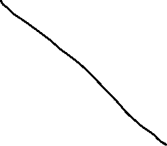


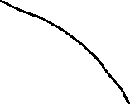



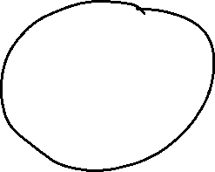
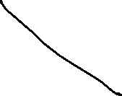










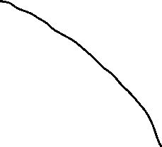
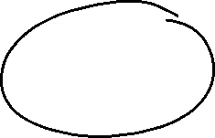

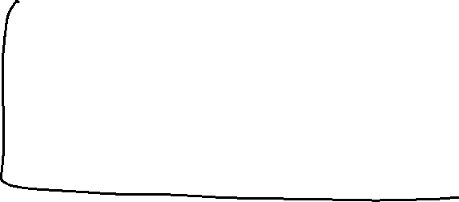
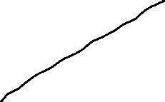


The modern circular flow of income of an open economy

Slide 24
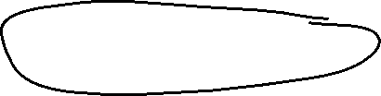


National account system (NAS)
National accounts provide information to analyse the structure of economies and their development over time. They contain a wide range of statistics describing an economy in various ways. The main GDP aggregates provide an overview about key economic developments..
Information, Forecast, international comparision
Since 1995 NAS is standardized in the (European System of National and Regional Accounts, ESA)

Slide 25
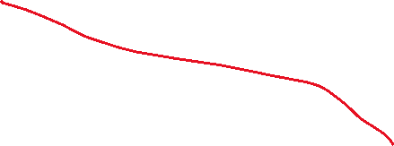



















Gross domestic product and Gross national product
Gross domestic product (GDP) is the total market value of all the finished goods and services produced within a country’s borders in a specific time period (i.e. 1 year) (domestic concept)
Gross National Product (GNP) is the total market value of all finished goods and services produced by a country’s citizens in a specific time period (i.e. 1 year).
(national concept)

Slide 26
GDP
„market value“
In order to aggregate different goods and service their market prices are considered.
Some goods do not have a market price. In this case production prices are considered
For public services wages public employees are considered
„all“
owner-occupied residential property is value by an average market rent.
Some goods and service cannot be statistically counted and are therefore not included into GDP (i. e. black market, educational performance of parents, honory posts)

Slide 27
GDP
„finished“
Only value added is considered =
Production – intermediate consumption
„goods and services“
material and immaterial goods
„wihin a countries borders“:
national concept = domestic concept
– factor income of non citizens in the considered country
+ factor income of citizens of the considered country from abroad
„specific time period “
Quater or year

Slide 28
Calculating GDP
Production approach – Value added of all economic sectors (activities)
Expenditure approach – final uses of goods and services (consumption, investment,
government expentitures, net exports (Ex-Im)
Income approach – Distribution of income on the different factors of production
(capital and labor)
Notes:
28

Slide 29
Gross national Product (Germany 2021)
Notes:
29

Slide 30
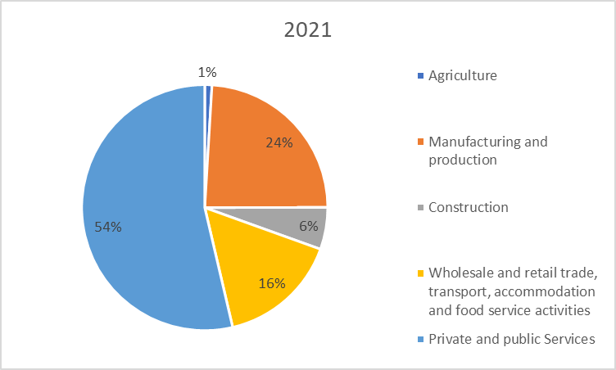
Production approach – Gross value added (Germany 2021)
Gross value added (GVA)
+ taxes
– subsidies
= GDP
Source: Destatis, current prices, Bil. Euro

Slide 31
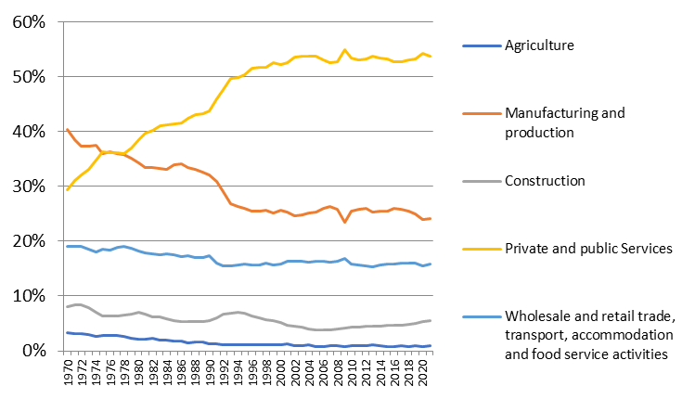
Development of the nominal proportions of the sectors of gross value added (Germany)
Source: Destatis, current prices

Slide 32
Expenditure approach Germany 2021
}
Consumption
}
Gross capital investment
}
External contribution
Source: Destatis ,current prices, Mrd. Euro

Slide 33
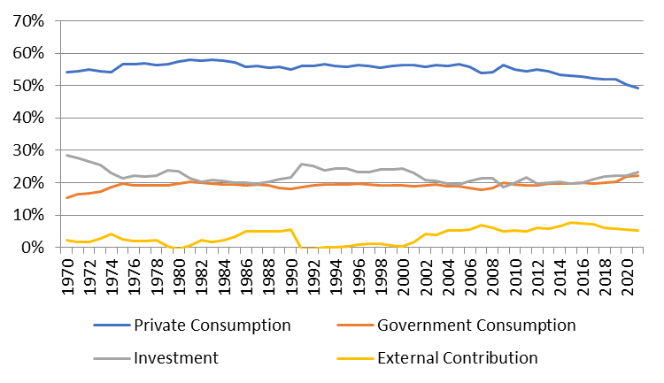
Development of the nominal proportions of the expenditure sectors of GDP (Germany)
Source: Destatis, current prices

Slide 34
Income approach
The income approach counts the different typs contributing to national income.
Mainly we look at the income from the general factors of production: Capital and Labor. Thus we count corporate and investment income from capital and compensation of employees from labor. The aggregate variable measuring the division of national income is the
compensation of employees
Labor Share =
national income

Slide 35
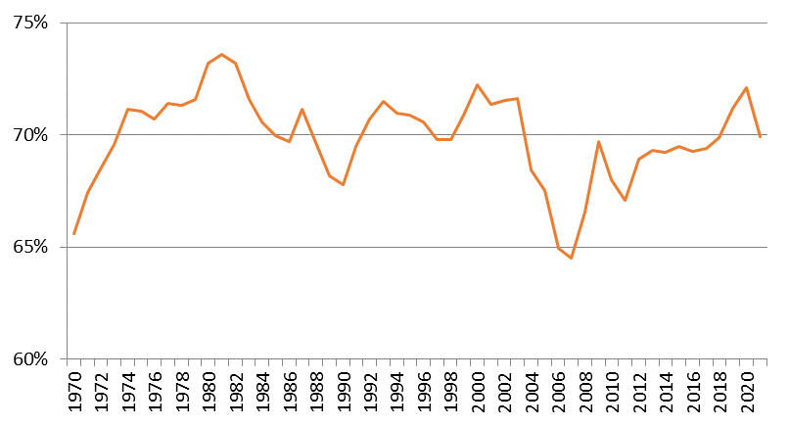
Development of the labor share (Germany): Income approach
Source: Destatis

