Slide 1


Macroeconomics
Wilhelmshaven
This lecture will be recorded and
Subsequently uploaded in the
world-wide-web
Prof. Dr. Bernhard Köster
Jade-Hochschule Wilhelmshaven
http://www.bernhardkoester.de/vorlesungen/inhalt.html

Slide 2

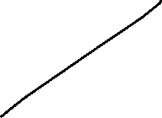
Yield Curve: Liquidity premium theory
Preferences between creditors and debtors differ. Investors are in general risk avers.
→ Creditors will demand a premium since they lower their liquidity for the maturity of the loan. For this loss of liquidity they want to be compensated.
→ the longer the maturity higher the liquidity premium
→ in general we expect long term interest rates to be higher than short term interest rates
Notes:
2

Slide 3
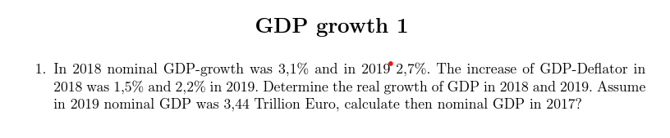
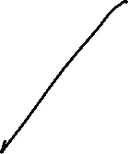



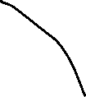
Notes:
3

Slide 4
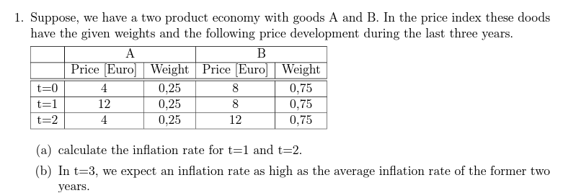

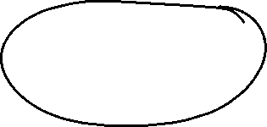












Notes:
4

Slide 5
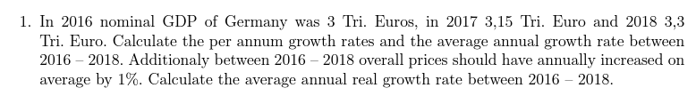





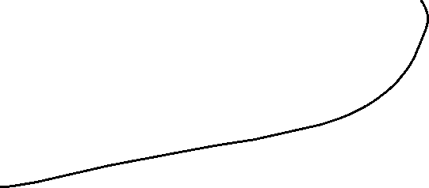
Notes:
5

