Slide 1
Macroeconomics
Wilhelmshaven
This lecture will be recorded and
Subsequently uploaded in the
world-wide-web
Prof. Dr. Bernhard Köster
Jade-Hochschule Wilhelmshaven
http://www.bernhardkoester.de/vorlesungen/inhalt.html

Slide 2
Yield curve: Market expectation theory (Example)
i₁: interest rate 1 year (p.a.) 2%
i₂: interest rate 2 years (p.a.) 4%
i₁e: expected interest rate 1 year in 1 year (p.a.)???
Investment 1 Euro
Assume long term and short term investments are perfect substitues, investors are risk neutral and we have perfect capital markets
1 Euro
Short term?
Long term?
Compare the two investments1
→ short term expected interest rate =
longterm interest rate + difference between long term and short term interest rates
Notes:
2

Slide 3
Yield Curve: Liquidity premium theory
Preferences between creditors and debtors differ. Investors are in general risk avers.
→ Creditors will demand a premium since they lower their liquidity for the maturity of the loan. For this loss of liquidity they want to be compensated.
→ the longer the maturity higher the liquidity premium
→ in general we expect long term interest rates to be higher than short term interest rates
Notes:
3

Slide 4
Yield curve: Market Segmentation Theory
Für einen Anleger entsteht ein Risiko, wenn sich der Anlagehorizont nicht
mit der Laufzeit des Wertpapiers deckt
Maturity > Investment horizon → price risk
Maturity < Investment horizon → income risk
Investors try to reduce their risk
→ the market will be segmented into areas maturity and investment horizon will match
financial assets are no perfect substitutes
Notes:
4

Slide 5
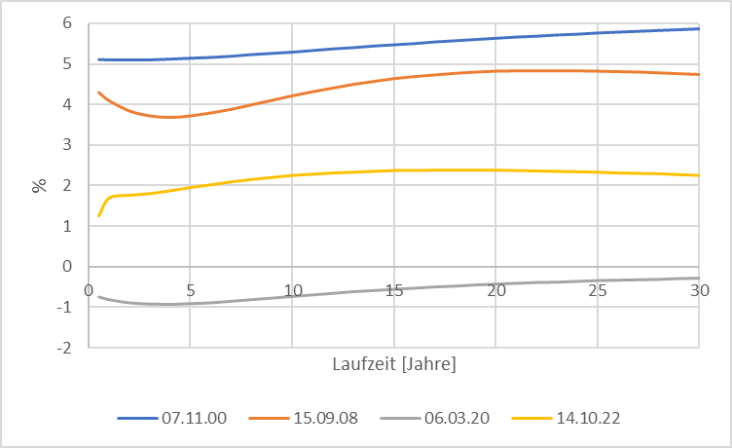
Source: Bundesbank
Yield curve (Germany)
Notes:
5

Slide 6
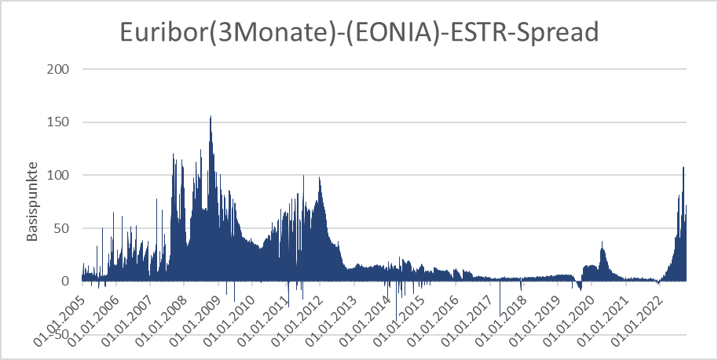
Source: Bundesbank
Stress indicators of the financial markets

Slide 7
Monetary policy since the financial crisis (overview)
Key interest rates down to 0%
ECB is switching to fixed-rate tender procedure with full allotment for all its refinancing operations, meaning that it would supply all funds demanded at a fixed interest rate.
Downgrade the rating requirements
Introducing long term refinancing opterations up to one year
Liquidity provision of foreign currency (Euro-US-Dollar-swaps)

Slide 8
Monetary policy since the financial crisis (overview)
Two 3-years tender with 500 Bil. Euro Winter 2011/12 (Bazooka) especially for the italien and spanish banking sector
Minimum reserve rate dwon from 2% to 1% January 2012
Draghi Put/“Whatever it takes“ (26.07.2012)
“Within our mandate, the ECB is ready to do whatever it takes to preserve the euro.
and believe me, it will be enough.”
https://qz.com/1038954/whatever-it-takes-five-years-ago-today-mario-draghi-saved-the-euro-with-a-momentous-speech/
Start of buying low rating government bonds (26.09.2012)
Different programs to buy government and private bonds at the secondary financial markets according to the capital key of the eurozone. Especially buying a monthly volume up to 60 Bil. Euros. 2015 -> stop July 2022 (only reinvestment!)
https://www.ecb.europa.eu/mopo/implement/app/html/index.en.html
PEPP: Pandemic emergency purchase programme (March 2020) Volume 1,7 Tril. Euros (Oct 2022)
https://www.ecb.europa.eu/mopo/implement/pepp/html/index.en.html
Increase of interest rates since July 2022

Slide 9
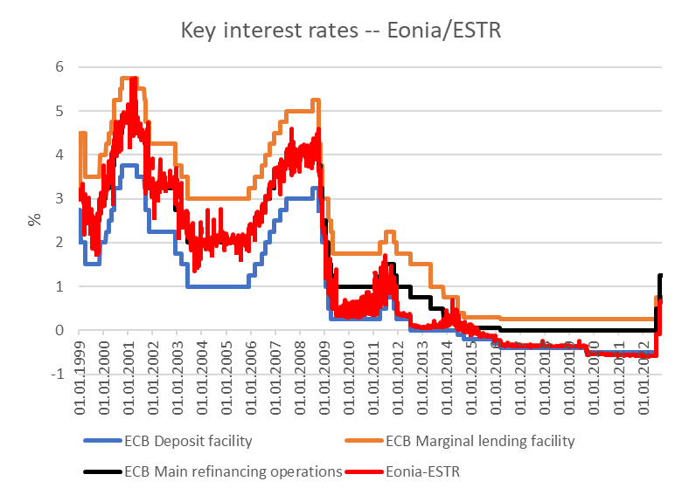
Key rates ECB
Source: ECB,

Slide 10
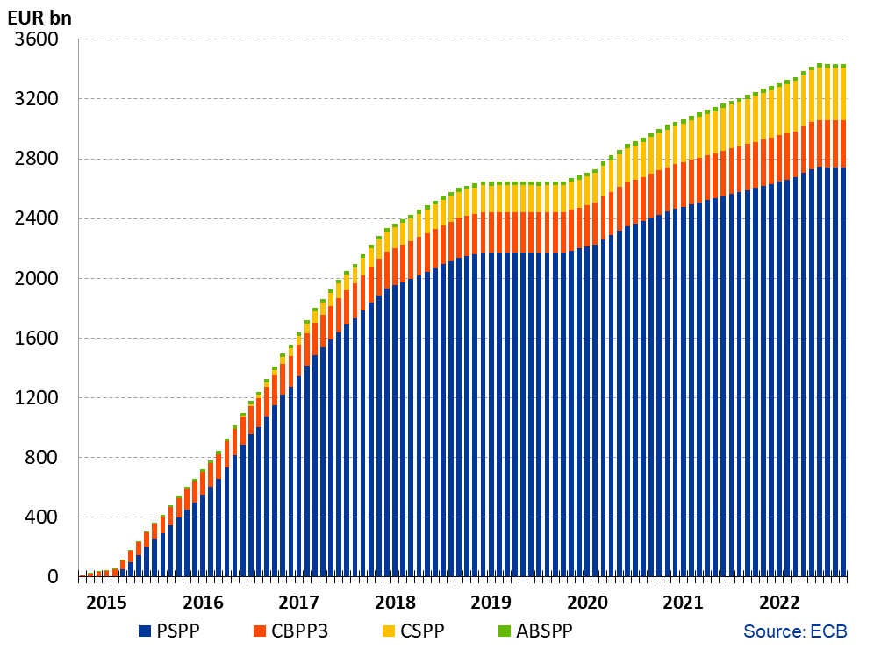
Financial markets interventions of the ECB since 2015 without PEPP
Source: ECB, Asset Purchase Program
https://www.ecb.europa.eu/mopo/implement/omt/html/index.en.html

Slide 11
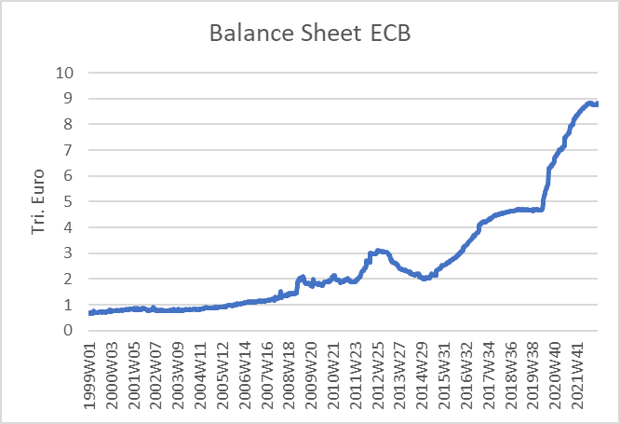
ECB balance sheet
Source: ECB

Slide 12
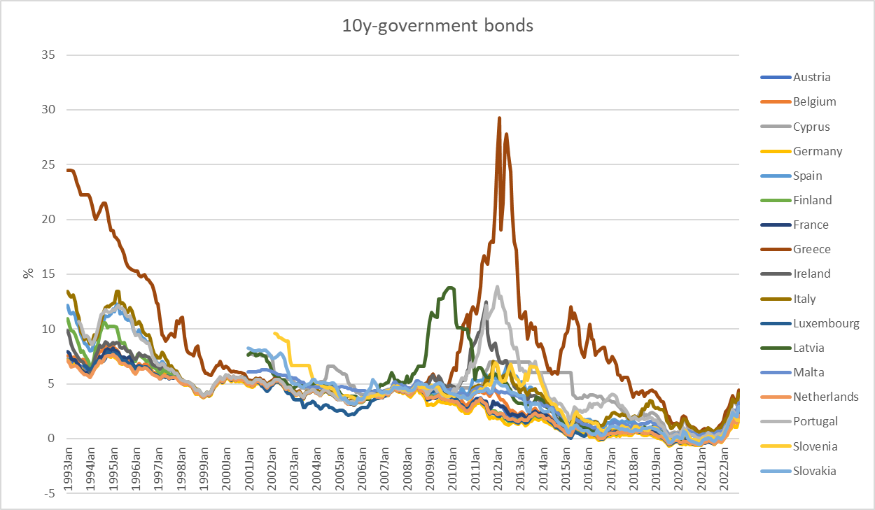
10 Year government bonds Eurozone
Source: ECB

