Slide 1
Macroeconomics
Wilhelmshaven
This lecture will be recorded and
Subsequently uploaded in the
world-wide-web
Prof. Dr. Bernhard Köster
Jade-Hochschule Wilhelmshaven
http://www.bernhardkoester.de/vorlesungen/inhalt.html

Slide 2
Central bank and money creation
Balance sheet
Assets | Liabilities
Net holdings of foreign reserves (incl. gold) | Currency in circulation
Credits to domestic banking sector | Deposits of the domestic banking sector (i.e. deposit facility, minimum reserve)
Other assets | Other liabilities
Changing for example assets via buying/selling foreign currency or changing deposits increases or lowers the monetary base

Slide 3
Active money creation via commercial banks
Commercial banks obtain deposits from their customers.
These deposits will be partially lend to other customers and appear as deposits at other banks.
This initiates a multiplier process for creation of money, since the „new“ sight deposits have also the character of money.
In general commercial banks are limited by the required minimum reserve ratio set by the central banks. In general commercial banks hold a higher reserve ratio than the officially required reserved in order to insure against a „bank run“. Anyhow during the financial crisis 2008/09 we had some bank runs and after Lehman bankruptcy 16.09.2008 there was a danger of a general „bank run“.

Slide 4
Commercial bank 1 holds deposits of 1 Mio. Euros. According to an reserve ratio of 10% commercial bank 2 obtain the leftover as deposits.
1. Calculate the amount of deposits of commercial bank 2?
Commercial bank 2 has the same reserve ratio, thus commercial bank 3 obtains also the leftover as deposits … .
2. Calculate the total amount of new deposits?
Money creation: Example

Slide 5
Money creation

Slide 6
Active money creation (money multiplier)
Commercial bank 1 (CB1) holds deposits D with reserve ratio R
→ CB 1 holds back the proportion R of depostis D, thus CB2 obtains
(1-R)D new deposits
→ CB 2 holds back (1-R)RD of deposits, thus CB3
(1-R)(1-R)D new deposits …..
.
.
→ Total amount of new deposits:
[(1-R)+(1-R)²+(1-R)³+….]D=D/R
→ 1/R is called the „money multiplier“

Slide 7
Monetary policy of the ECB
The ECB’s Governing Council considers that price stability is best maintained by aiming for 2% inflation over the medium term. Inflation is measured by the Harmonised Index of Consumer Prices (HICP). The Governing Council’s commitment to the 2% target is symmetric. This means that we consider negative and positive deviations from the target to be equally undesirable.

Slide 8
Classical monetary instruments of the ECB
Main refinancing operations: The main refinancing operations, with a weekly frequency and a maturity of one week, are the most important monetary policy instrument used by the Eurosystem for money market management.
→ The main refinancing operations (MRO) rate is “in general” the key interest rate of the central bank for steering the money market
Deposit facility: The deposit facility rate is one of the three interest rates the ECB sets every six weeks as part of its monetary policy. The rate defines the interest banks receive for depositing money with the central bank overnight.
Marginal lending facility: The marginal lending facility rate is the interest rate banks pay when they borrow from the ECB overnight. When they do this, they have to provide collateral, for example securities, to guarantee that the money will be paid back.
Minimum reserve: The minimum amount of reserves a credit institution is required to hold with a central bank.

Slide 9
Monetary policy in practice
Modern central banks try to influence via thir interest rate policy the economic performance of the economy. But in practice „directly“ they can only influence the short-term interest rates of the financial markets. Therefore in Europe the ECB has the aim to „steer“ the ESTR (Euro short term rate). ESTR represents the interest rate level of the overnight interbank interest rate in the european banking sector.
Classical effect of an key interest rate cut of the central bank:
Short term interest rate↓ →Shifting investments to longer term bonds with higher interest rates
Prices of longer term bonds increase → Adjustment of interest rates over different maturities
But „in general“ we will have a difference between interest rates for
different maturities. This relationship is called Yield Curve.
Notes:
9

Slide 10
Classical effect of monetary policy via consumption and investment
In general, we assume that the central bank can influence directly and indirectly the interest rates in the economy:
Cutting interest rates will in general expand credit demand:
→ expands credit based investment and consumption
→ increase the utilization of production, which pushes economic growth
→ but, if the economy starts to produce at the limit of their capacity, profits will start to stagnate or expected profits will even fall.
→ pushing liqudity via low interest rates will not increase investment anymore
→ in the end pushing liquity and increasing the amount of money only creates inflation

Slide 11
Classical effect of monetary policy via stock markets
Interest rate cut of the central bank
→ Yields of bonds decline.
→ In the short run, stock investments are more attractive than n investment in bonds
→ This will in general will increase stock market prices until yields at the bond market and the stock market will adjust.
→ Thus, via the increase of prices at capital markets income of investors will increase
→ increase of investment and consumption in general
→ … (see former slide!)
→ in the end pushing liquity and increasing the amount of money only creates inflation

Slide 12
Yield curve: Market expectation theory (Example)
i₁: interest rate 1 year (p.a.) 2%
i₂: interest rate 2 years (p.a.) 4%
i₁e: expected interest rate 1 year in 1 year (p.a.)???
Investment 1 Euro
Assume long term and short term investments are perfect substitues, investors are risk neutral and we have perfect capital markets
1 Euro
Short term?
Long term?
Compare the two investments1
→ short term expected interest rate =
longterm interest rate + difference between long term and short term interest rates
Notes:
12

Slide 13
Yield Curve: Liquidity premium theory
Preferences between creditors and debtors differ. Investors are in general risk avers.
→ Creditors will demand a premium since they lower their liquidity for the maturity of the loan. For this loss of liquidity they want to be compensated.
→ the longer the maturity higher the liquidity premium
→ in general we expect long term interest rates to be higher than short term interest rates
Notes:
13

Slide 14
Yield curve: Market Segmentation Theory
Für einen Anleger entsteht ein Risiko, wenn sich der Anlagehorizont nicht
mit der Laufzeit des Wertpapiers deckt
Maturity > Investment horizon → price risk
Maturity < Investment horizon → income risk
Investors try to reduce their risk
→ the market will be segmented into areas maturity and investment horizon will match
financial assets are no perfect substitutes
Notes:
14

Slide 15
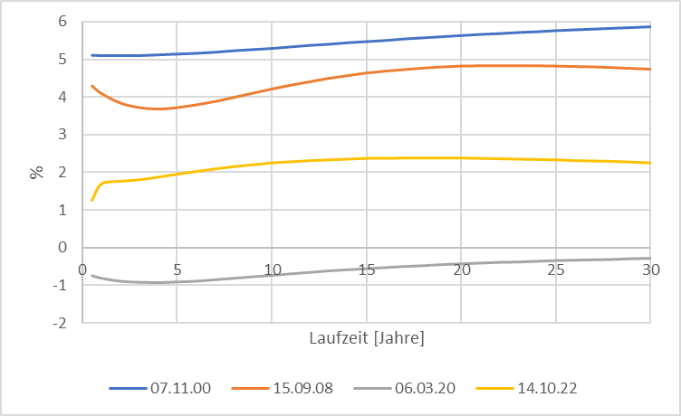
Source: Bundesbank
Yield curve (Germany)
Notes:
15

Slide 16
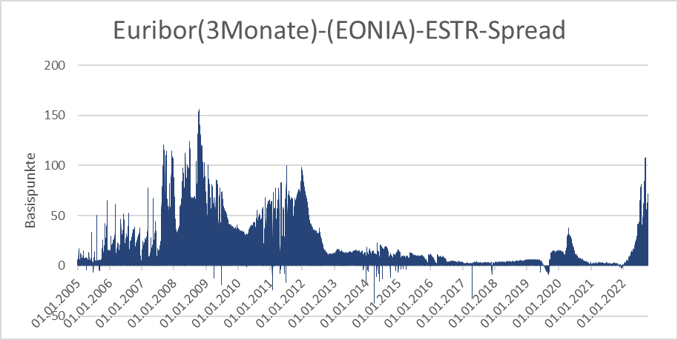
Source: Bundesbank
Stress indicators of the financial markets

Slide 17
Monetary policy since the financial crisis (overview)
Key interest rates down to 0%
ECB is switching to fixed-rate tender procedure with full allotment for all its refinancing operations, meaning that it would supply all funds demanded at a fixed interest rate.
Downgrade the rating requirements
Introducing long term refinancing opterations up to one year
Liquidity provision of foreign currency (Euro-US-Dollar-swaps)

Slide 18
Monetary policy since the financial crisis (overview)
Two 3-years tender with 500 Bil. Euro Winter 2011/12 (Bazooka) especially for the italien and spanish banking sector
Minimum reserve rate dwon from 2% to 1% January 2012
Draghi Put/“Whatever it takes“ (26.07.2012)
“Within our mandate, the ECB is ready to do whatever it takes to preserve the euro.
and believe me, it will be enough.”
https://qz.com/1038954/whatever-it-takes-five-years-ago-today-mario-draghi-saved-the-euro-with-a-momentous-speech/
Start of buying low rating government bonds (26.09.2012)
Different programs to buy government and private bonds at the secondary financial markets according to the capital key of the eurozone. Especially buying a monthly volume up to 60 Bil. Euros. 2015 -> stop July 2022 (only reinvestment!)
https://www.ecb.europa.eu/mopo/implement/app/html/index.en.html
PEPP: Pandemic emergency purchase programme (March 2020) Volume 1,7 Tril. Euros (Oct 2022)
https://www.ecb.europa.eu/mopo/implement/pepp/html/index.en.html
Increase of interest rates since July 2022

Slide 19
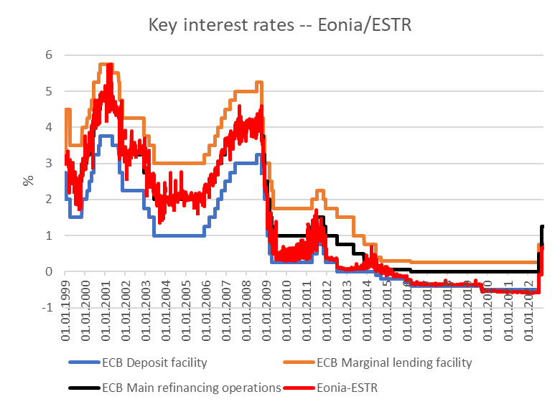
Key rates ECB
Source: ECB,

Slide 20
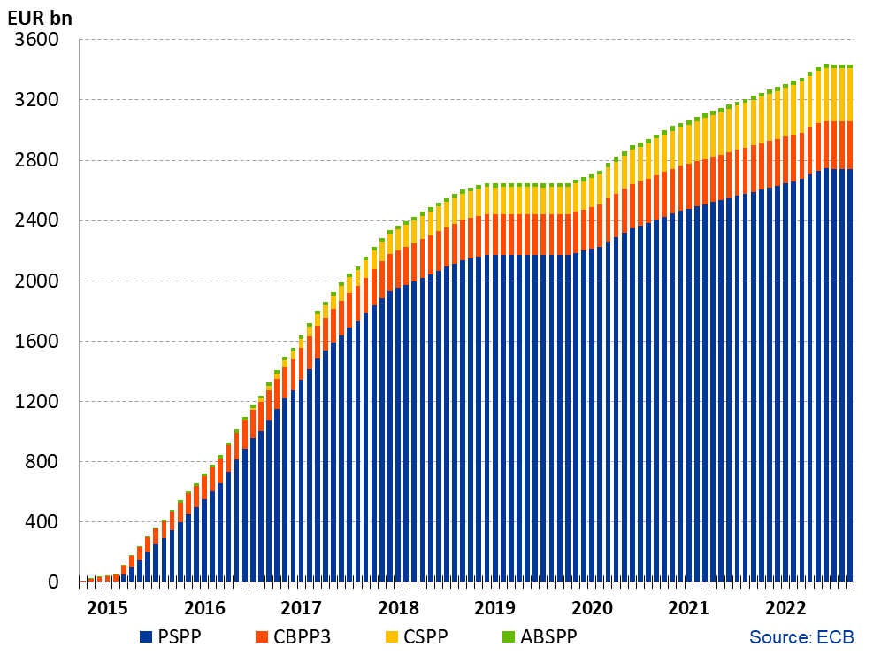
Financial markets interventions of the ECB since 2015 without PEPP
Source: ECB, Asset Purchase Program
https://www.ecb.europa.eu/mopo/implement/omt/html/index.en.html

Slide 21
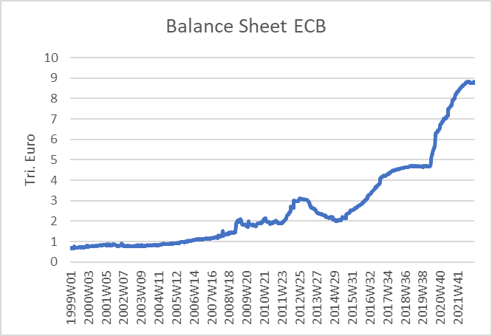
ECB balance sheet
Source: ECB

Slide 22
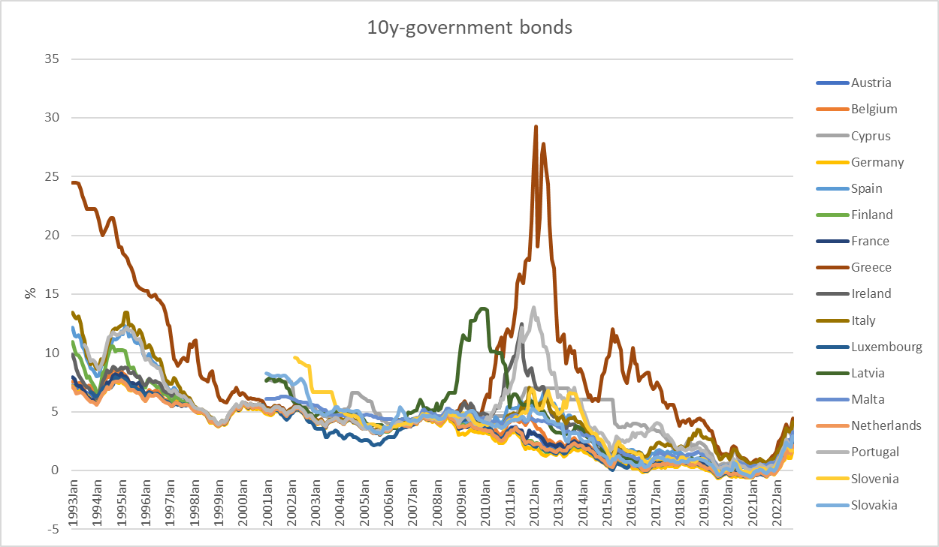
10 Year government bonds Eurozone
Source: ECB

