Slide 1
Macroeconomics
Wilhelmshaven
This lecture will be recorded and
Subsequently uploaded in the
world-wide-web
Prof. Dr. Bernhard Köster
Jade-Hochschule Wilhelmshaven
http://www.bernhardkoester.de/vorlesungen/inhalt.html

Slide 2
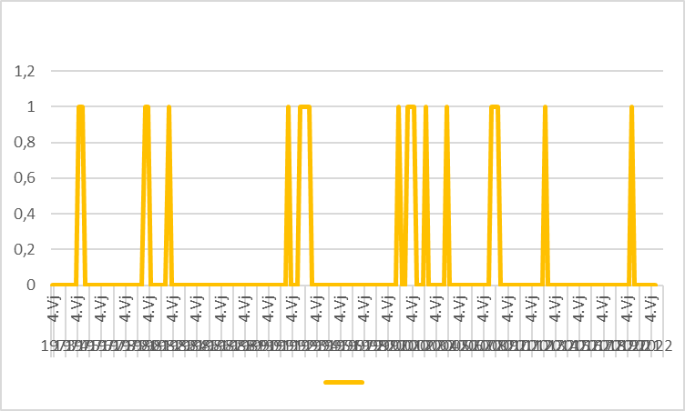
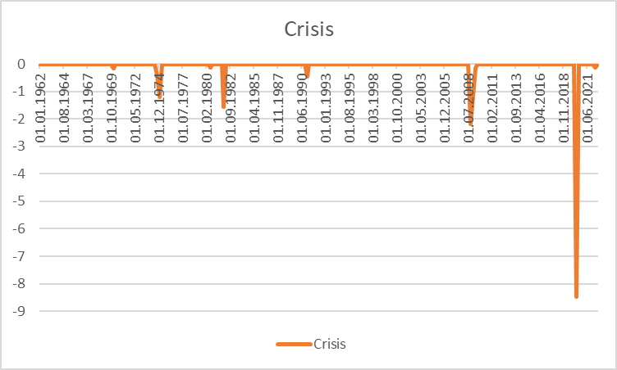
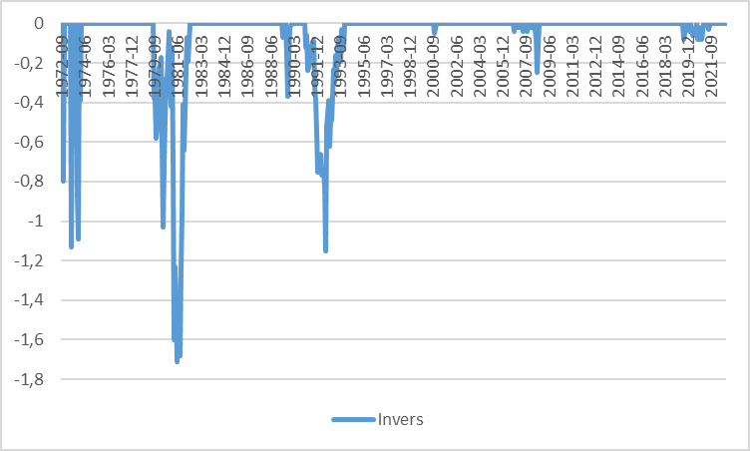
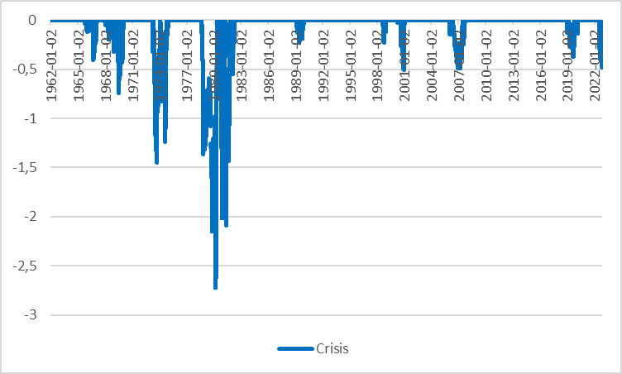
Germany
USA

Slide 3
Keynesian Economics
Short run:
Production capacities are not fully utilized
Consumptions- and investment plans are totally fulfilled
Only the supply-side to adjust due to changes
Supply and demand are only equalized via changes in production not in prices.
Aggregate Demand determines the equilibrium in the economy.

Slide 4
Keynesian Cross
Aggregate demand Y^{D}:
Y^{D}=C+I+G
C (private consumption); I (Investment); G (Government expenditure); I and G sare exogenously fixed variables, C depends positively on aggregate income (production) Y
Keynesian consumption function:
C(Y)=C₀+c_{y}Y C₀>0 (autonous consumption); 0<c_{y}<1(marginal propensity to consum)
Euqilibrium: With aggregate income (production) Y is determined by the aggreate demand Y^{D} →
Y=Y^{D}=C₀+c_{y}Y+I+G
Notes:
4

Slide 5
Consumption
Germany (2019) savings rate s_{y}= 10,9% :
What is then the consumption rate c_{y}?
Income Y is divided into consumption and savings (compare the circular flow!)
→c_{y}+ s_{y} =1 → c_{y}=1 – s_{y} =89,1 %
Interpretation: If we have1000 additional Euros, then 839,1 Euros are directly spent for consumption (first derivative of the consumption function!)

Slide 6
Consumption
Consumption C(y)
C(y)= C₀+c_{y}Y=100+0,838Y
+ 0,891€ Consumption corresponds to savings of 0,109€
+ 1€ Income
Autonomous consumption
C₀ =100
Income (y)

Slide 7
Keynesian Cross
Einkommen(Y), Expenditure(Y^{D})
Income(Y)

Slide 8
Gütermarktgleichgewicht
Income =
Expenditure Y^{D}=C₀+c_{y}Y+I+G
45°-Line: locus of every possibility with
Y^{D}=Y → possible equlibria
Linear linear through the origin with
Slope 1
Y^{D}=Y
Income(Y), Expenditure (Y^{D})
Intersection or 45°-Line and aggregate demand
Y^{D}=Y=Y*
Investment I +
Government expenditure G
consumption C(Y)=C₀+c_{y}Y
Investment I
+
Governement
expenditure G
Aggregate demand not dependent on income Y
Autonomer Konsum C₀
45°
Y^{D}=Y=Y*
Income(Y)
Intersection or 45°-Line and aggregate demand
Equilibrium: Expenditure (Y^{D}) = Income (Y) = Production (Y) = Y*

Slide 9
Adaption process
Income(Y), Expenditure (Y^{D})
Equilibrium Y^{D}=Y=Y*
Y=Y^{D}
Production larger than demand
Inventory built-up
Expenditure(Y^{D}) = Demand
Y*
Etc.
Demand larger than Production
Iinventory has to decrease
45°
$$Y_{0}$$
Y*
$$Y_{0}′$$
Einkommen(Y)

Slide 10
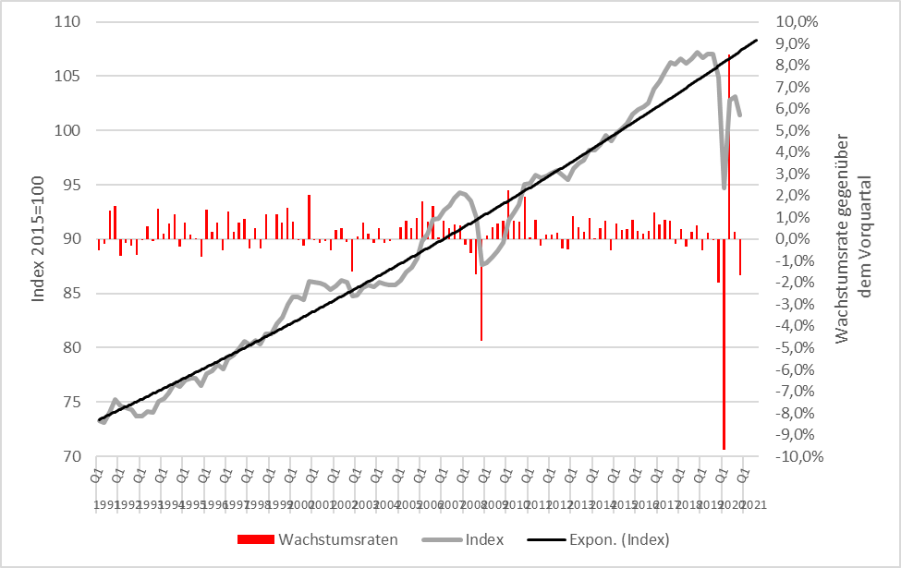
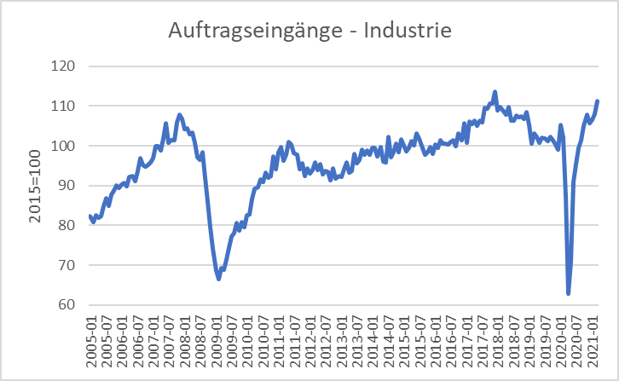
Scrappage Allowance 2009 (Germany): Increase of government expenditure 5 Bil. €
Real economic growth
Incoming orders
Source: Destatis

Slide 11
Der Multiplikatoreffekt: Die Abwrackprämie im Keynesianischen Gütermarktmodell
Y^{D}=Y
Income(Y), Expenditure (Y^{D})
$${Expenditure}_{0} ({\text{Y}\text{D}}_{0})$$
Multiplicator$=\frac{∆Y}{∆G}$
$$increase of governemnt$$
$$expenditure$$
$$∆G$$
$$Y_{0}$$
$$Y_{1}$$
Income (Y)

Slide 12
Multiplier effect
External increase of demand, increase of government expenditure of ∆G = 5 and marginal propensity to consum of c_{y}=0,9:
→ additional government consumption ∆G increases directly income Y bei ∆Y₁= ∆G
→
Notes:
12

Slide 13
(Government expenditure) Multiplier
Multiplier: How much increases one variable, if another variable increase by one unit
Government expenditure Multiplier:
Change of equilibrium income, of governement expenditure increases by one unit.
Notes:
13

Slide 14
Multiplier effect (example)
C(Y)= 100+0,8Y; I=400; G=200
Calculate equlibrium income?
Change in equilibrium income, if governement expenditure increades by 100
Calculate the government expenditure multiplier?
Notes:
14

Slide 15
Y, Y^{D}
Y
Notes:
15

Slide 16
Consequences of Keynesian economics
Disequilibria over time are possible
→ Aggregate demand is too low in order to fully utilize labor force.
→ Permant high unemployment level
→ Aggregate demand exceeds the capacity of production.
→ Economy is overheating
Especially full employment is not reached via a euqilibrium process, but can only be reached within a specific parameter constellation of the Economy → the Economy needs external interference!
Notes:
16

