Slide 1
Macroeconomics
Wilhelmshaven
This lecture will be recorded and
Subsequently uploaded in the
world-wide-web
Prof. Dr. Bernhard Köster
Jade-Hochschule Wilhelmshaven
http://www.bernhardkoester.de/vorlesungen/inhalt.html

Slide 2
Economic growth and the business cycle
The business cycle is measured by the fluctuations of real GDP in time around some long time trend.
Real GDP
Expansion
Peak
Recession
Trough
time
Notes:
2

Slide 3
Business cycle
Expansion: Increase of production; increasing Utilization of production capacities;
falling unemployment; moderatly increasing prices
Peak: Full or Overutilization of production capacities;
increasing extra ours; increasing wages and prices;
beginning stagnation. Production cannot meet total demand any more
Recession: falling production; increasing unemployment;
declining consumption
Trough: Low level production, high unemployment
Notes:
3

Slide 4
Potential Output
In general, we want to limit the fluctuations within the business cycle.
In order to have a reference for the fluctuations, the concept of potential output is developed:
Potential output is the maximum amount an economy can produce over the long run (production at full capacity).
In the long run it should be the economic aime to increase potential output, since the pure development of real GDP can be below or above the production possibilities of an economy.
But: Potential output is only a theoretical concept. Therefore the true value of potential out is difficult to estimate.
Notes:
4

Slide 5
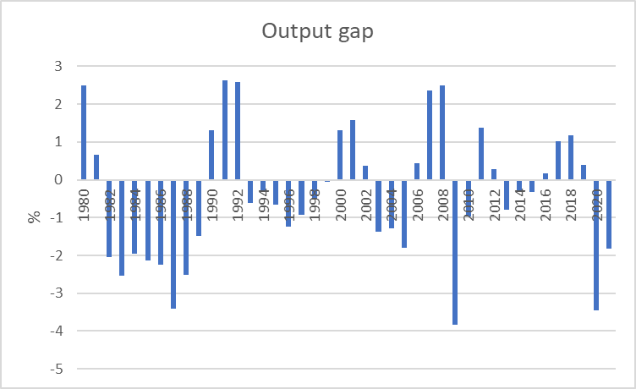
Output gap (Germany)
Out put gap = (GDP – Potential Output)/Potential Output
Source: IWF
Notes:
5

Slide 6
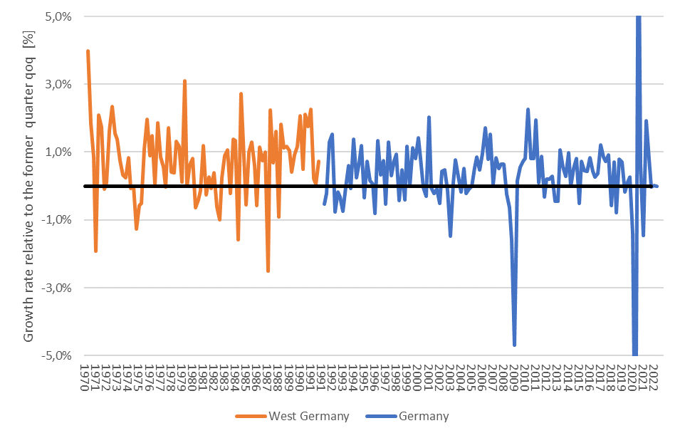
Business cycle Germany in the long run
Find economic historical events in the business cycle
Source: Destatis; Price, season and calendar adjusted

Slide 7
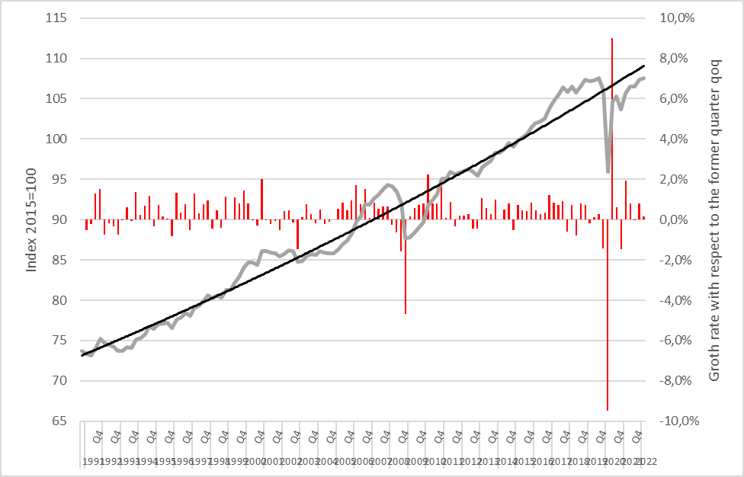
Real GDP growth rate Germany
Source: Destatis; Price, season and calendar adjusted

