Slide 1


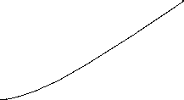


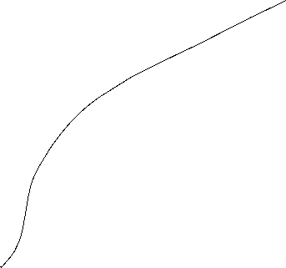
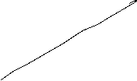



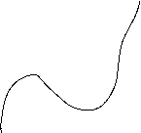
Short-run Output Gaps: Why do they matter?
Output Gap = Actual Output - Potential Output
_______________________________________
Potential Output
= Y - Y*
_______________________________________
Y*
(Y – Y*)/Y* > 0 → a positive output gap
is called expansionary gap
(Y – Y*)/Y* < 0 → a negative output gap
is called recessionary gap

Slide 2
Output Gaps: Two kinds of Costs
(Y – Y*)/Y* > 0 expansionary gap
inflation can be high
economy incurs costs of inflation
(Y – Y*)/Y* < 0 recessionary gap
unemployment rate high (above normal)
economy incurs costs of unemployment

Slide 3
Natural Rate of Unemployment
u* : Natural rate of unemployment
Mainly caused by:
frictional unemployment
structural unemployment
or
generally a worker who is not able to get a job because she doesn’t have the right skills.
⇒ The natural rate of unemployment is caused by supply side factors rather than demand side factors

Slide 4




Cyclical Unemployment
Actual unemployment rate = u
Natural unemployment rate = u*
Cyclical unemployment rate = u - u*
recessionary Gap: u - u* > 0
expansionary Gap: u - u* < 0

Slide 5





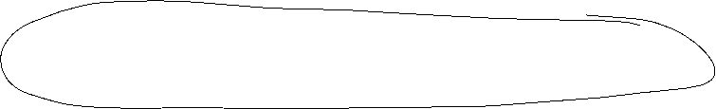


Relationship between unemployment and economic growth
In general, one would expect unemployment to fall when economic growth is high.
Thus, one could identify natural unemployment directly with potential output (cf. neoclassical theory and the long-run supply curve (AS)).
But Okun (1962) showed empirically:
Okun, Arthur M. (1962). “Potential GNP: Its Measurement and Significance.” Reprinted as Cowles Foundation Paper 190.
In general Okun´s law implies that if output growth is 1%-point over potential growth than unemployment falls only by 0,5%-points.
Okun, Arthur M. 1962. “Potential GNP: Its Measurement and Significance.” Reprinted as Cowles Foundation Paper 190.
Reasons:
Firms adjust employment less than one for one in response to deviations of output to the natural growth rate.
The labor force participation of the population increases over time (for Germany, especially the labor force participation of women).
Labor productivity increases (currently in particular due to digitalization)

Slide 6




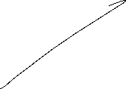











Okun’s Law
Arthur Melvin Okun based on
empirical observations (1962):
Every rise of 1%-point in cyclical unemployment is
associated with a lowering of 2%-points of the output gap.
−2(u - u*) = (Y – Y*)/Y* (Gap Version)
or
-2Δu = g_{y} – g_{Y*} (Growth Version)
g_{y}, g_{Y*}: growth rates of actual and potential out respectively
Δu: change in unemployment over time

Slide 7
Okun’s Law
In general Okun´s law implies that if output growth is 1%-point over potential growth than unemployment falls only by ½%-points.
Reasons:
Firms adjust employment less than one for one in response to deviations of output to the natural growth rate.
Labor participation increases
Labor productivity increases

Slide 8
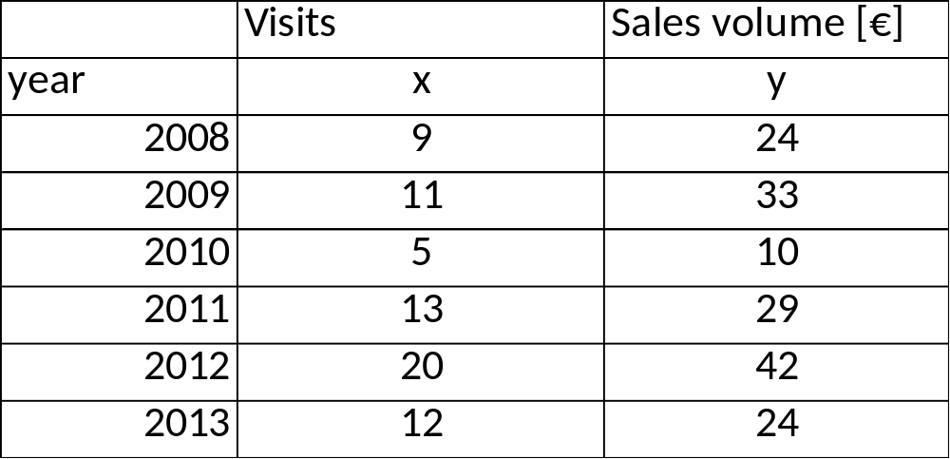


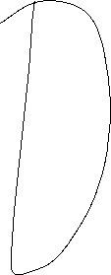




Linear Regression
Example:
A company wants to know how the sales volume depends on visits of representatives.
The company has collected the following data
c
We also want to answer the question, from a descriptive point of view, which sales volume we can expect, if we increase the visits up to x=30

Slide 9







Linear Regression
Via a linear regression we want to analyse the dependence between two variables
We distinguish between a dependent variable (y) and an independent variable (x)
(x) is also called the explanatory variable
A change of (x) implicates a change (y)
The linear regression defines an empirical relation via a linear function
i.e. y = f(x) = 3 + 2x or generally y = a + bx
c

Slide 10










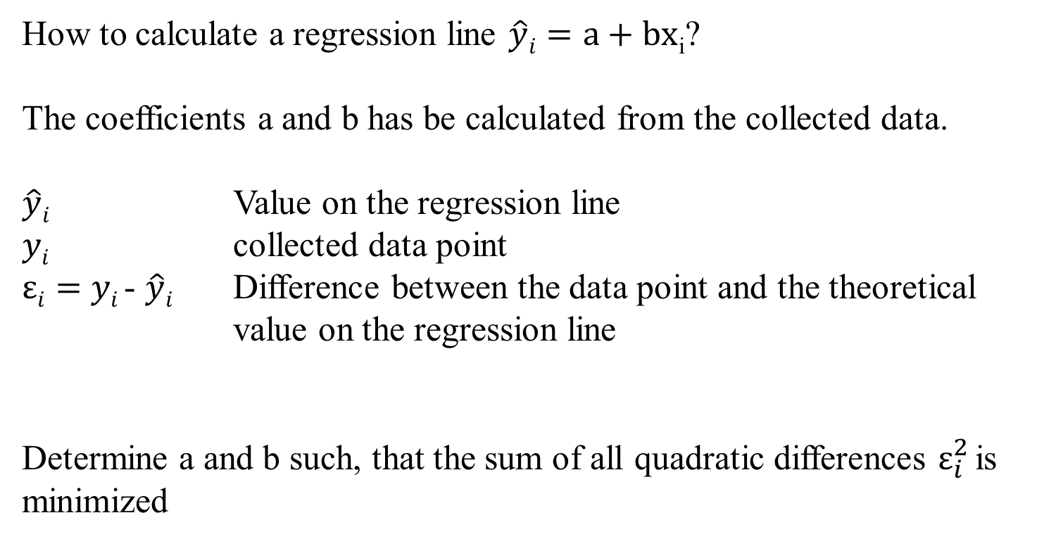

































Optimizing problem
How to calculate a regression line $\hat{y}i=a+bx$_{i}?
The coefficients a and b has be calculated from the collected data.
$\hat{y}i$ Value on the regression line
$yi$ collected data point
$εi=$ $yi$- $\hat{y}i$ Difference between the data point and the theoretical value on the regression line
Determine a and b such, that the sum of all quadratic differences $ε_{i}^{2}$is minimized
c

Slide 11
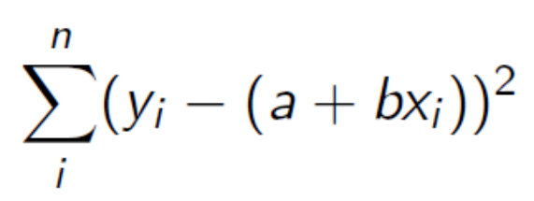
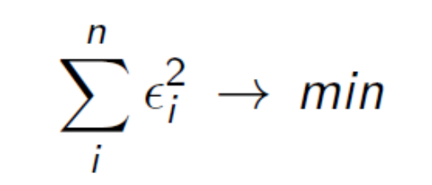


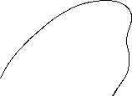





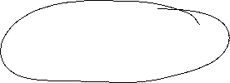










Least squared method
The formal optimizing problem
c

Slide 12
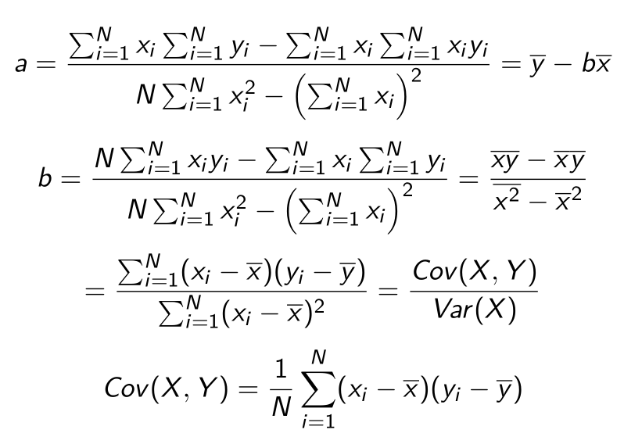
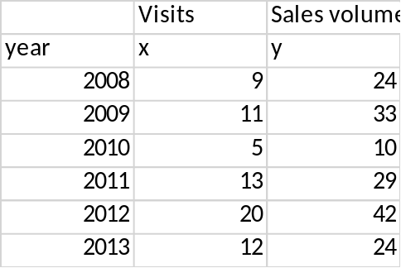

























Formulas
:
c

Slide 13
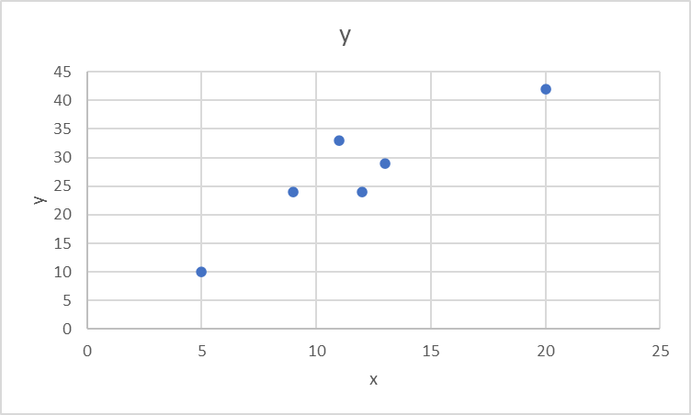
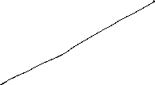
Linear Regression
 | Visits | Sales volume [€]
year | x | y | xy | x^2
2008 | 9 | 24 | 216 | 81
2009 | 11 | 33 | 363 | 121
2010 | 5 | 10 | 50 | 25
2011 | 13 | 29 | 377 | 169
2012 | 20 | 42 | 840 | 400
2013 | 12 | 24 | 288 | 144
c
b=
a=

Slide 14
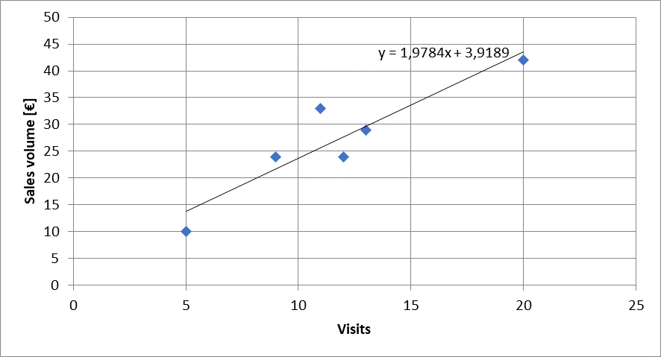



Calulating the regression line from empirical data
$$ei2$$
$\hat{y}i=a+bx$_{i}
c

Slide 15









Regressions coefficients
Regressions coefficient b
  Slope of the regression line.
  Determines the marginal effect of a change of one unit of the independent variable x onto the dependet variable y
Regressions coefficient a
  The value of the dependent variable if the independent variable x=0
    → intercept of the vertical axes
c

Slide 16



Correlation analysis
In principle for all data sets, we can calculate a regression line.
But we are also interested in the question meaningful is this calculated dependence?.
For this, we use the correlation analysis, wich gives the possibility to measure the strength of the dependence
For this, we use the correlation coefficient of Bravais-Pearson which is lying between -1 and +1
c

Slide 17








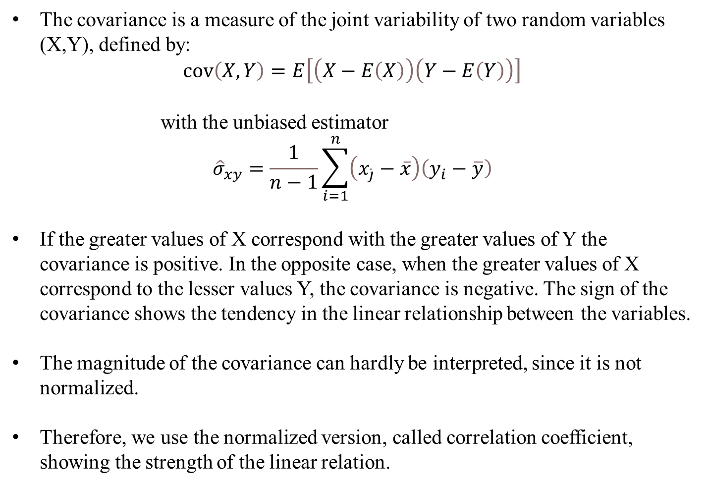

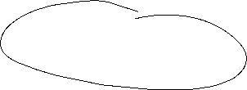

Covariance
The covariance is a measure of the joint variability of two random variables (X,Y), defined by:
$$\operatorname{cov}\left(X,Y\right)=E\left[\left(X−E\left(X\right)\right)\left(Y−E\left(Y\right)\right)\right]$$
with the unbiased estimator
$${\hat{σ}}_{xy}=\frac{1}{n−1}\sum_{i=1}^{n}{\left(x_{\dot{j}}−\overline{x}\right)\left(y_{i}−\overline{y}\right)}$$
If the greater values of X correspond with the greater values of Y the covariance is positive. In the opposite case, when the greater values of X correspond to the lesser values Y, the covariance is negative. The sign of the covariance shows the tendency in the linear relationship between the variables.
The magnitude of the covariance can hardly be interpreted, since it is not normalized.
Therefore, we use the normalized version, called correlation coefficient, showing the strength of the linear relation.
c

Slide 18
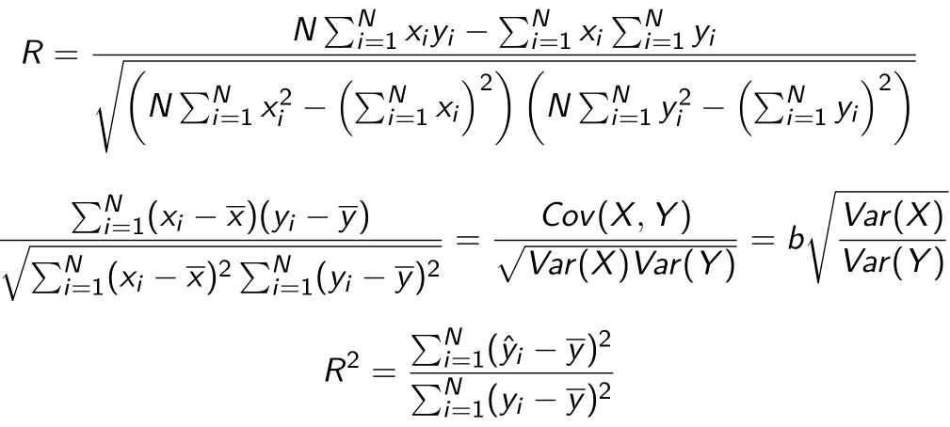










Correlation coefficient
General intervals for R
(0,0;0,2) → almost no dependence
[0,2;0,4) → low dependence
[0,4;0,6) → medium dependence
[0,6;0,8) → high dependence
[0,8;1,0) → almost full dependence
c

Slide 19
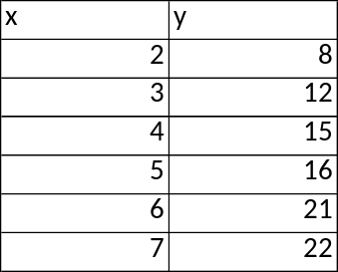
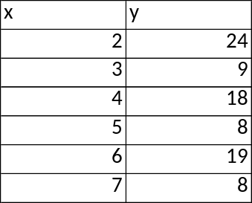
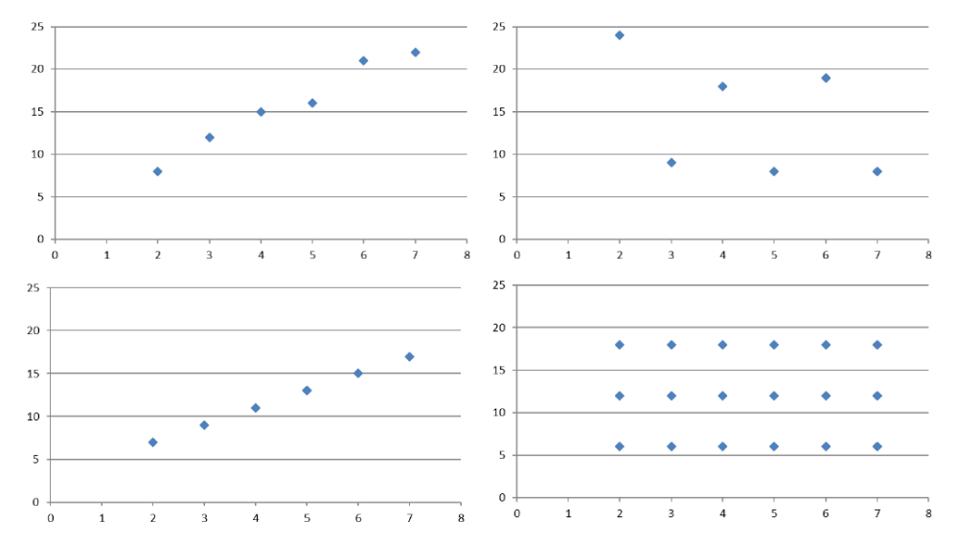




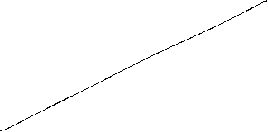




Correlation coefficiant examples
R=?
R=?
c
R=?
R=?

Slide 20

Coefficiant of determination R²
The squared correlation coefficiant R² is called coefficiant of determination.
In quantitative analysis, we often use the coefficiant of determination R², because it can be intuitively interpreted
But R² does not distinguish between + and – anymore.
R² is in the interval [0,1]
R² grafical interpretation:
  R² equals the proportion of variance explained by the model in relation to the total variance, i.e. how much percent is explained by the regression line
  (1-R²) equals the proportion of Variance not explained by the model in relation to the total variance, and has to be explained by other influencing factors
c

Slide 21
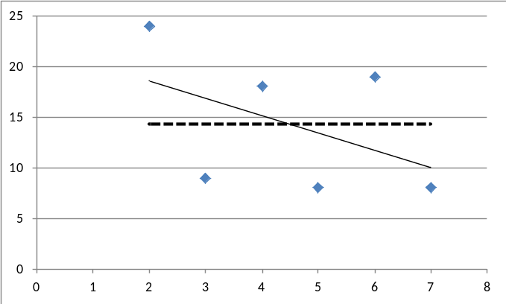
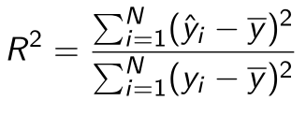






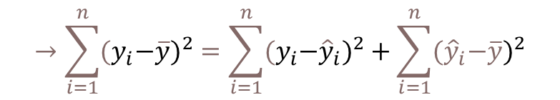
Coefficiant of determination R²
{
${\hat{y}}_{i}−\overline{y}$ explained difference
Total Difference
} Non explained difference
} Explained difference
${y_{i}−\hat{y}}_{i}$ not explained difference
Mean
$y_{i}−\overline{y}$ total difference
$$→\sum_{i=1}^{n}{{{(y}_{i}−\overline{y})}^{2}}=\sum_{i=1}^{n}{{{{(y}_{i}−\hat{y}}_{i})}^{2}}+\sum_{i=1}^{n}{{{(\hat{y}}_{i}−\overline{y})}^{2}}$$
Non explained squared difference y_{i}
total squared difference
explained squared difference
Mean
not explained squared difference
explained squared difference y_{i}
c
Total squared difference of y_{i}

Slide 22
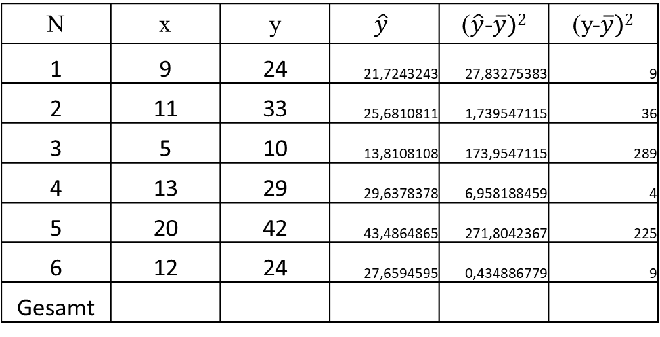
Coefficiant of determination R²
N | x | y | $$\hat{y}$$ | ($\hat{y}$-$\overline{y})2$ | (y-$\overline{y})2$
1 | 9 | 24 | 21,7243243 | 27,83275383 | 9
2 | 11 | 33 | 25,6810811 | 1,739547115 | 36
3 | 5 | 10 | 13,8108108 | 173,9547115 | 289
4 | 13 | 29 | 29,6378378 | 6,958188459 | 4
5 | 20 | 42 | 43,4864865 | 271,8042367 | 225
6 | 12 | 24 | 27,6594595 | 0,434886779 | 9
Gesamt
c
R²= R=

Slide 23
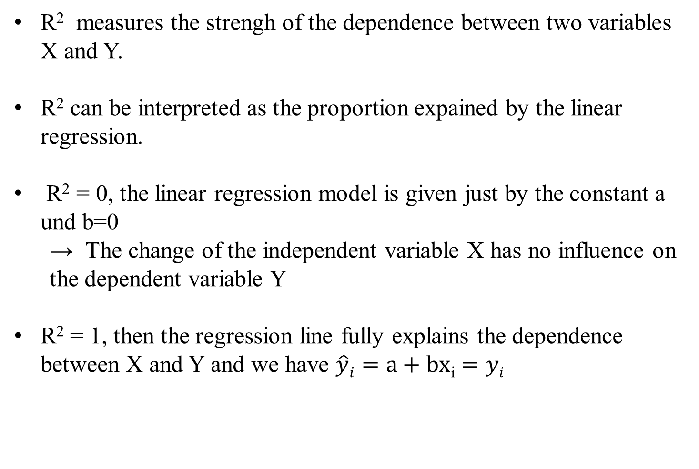
Interpretation of R²
R² measures the strengh of the dependence between two variables X and Y.
R² can be interpreted as the proportion expained by the linear regression.
R² = 0, the linear regression model is given just by the constant a und b=0
  → The change of the independent variable X has no influence on the dependent variable Y
R² = 1, then the regression line fully explains the dependence between X and Y and we have $\hat{y}i=a+bx$_{i} $=yi$
c

Slide 24
Estimation of Okun's Law - Country Analysis
Data: IMF Data mapper or other source. If you use quaterly data, think of
Show the data (1980-2025, per availability) of the variables Δu and g_{y} in a scatter plot
Linear regression of g_{y} and Δu .
Identify Okuns`s law with the regression parameters in g_{y} = -aΔu + g_{Y*} and interprete the parameters
Look for "meaningful" subperiods for your country for estimation purposes (consider especially structural breaks like crises, political changes,...)
Also evaluate your econometric analysis using the coefficient of determination R²
and the correlation coefficient R

Slide 25






















Estimating Okun’s La
Source: IMF Data Mapper
aΔu = g_{y} – g_{Y*}

Slide 26
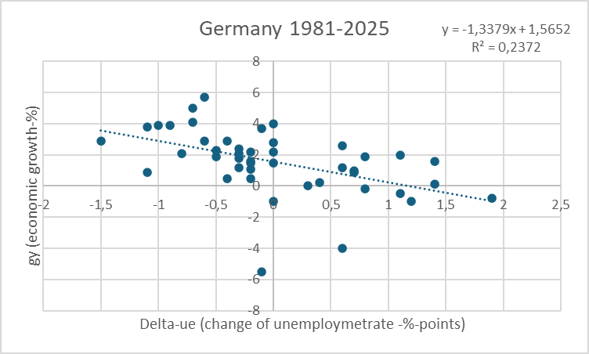
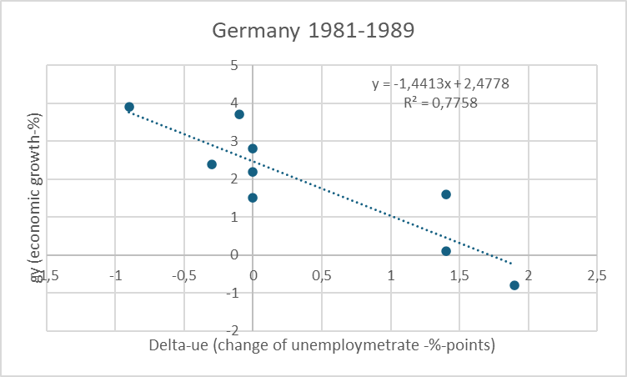
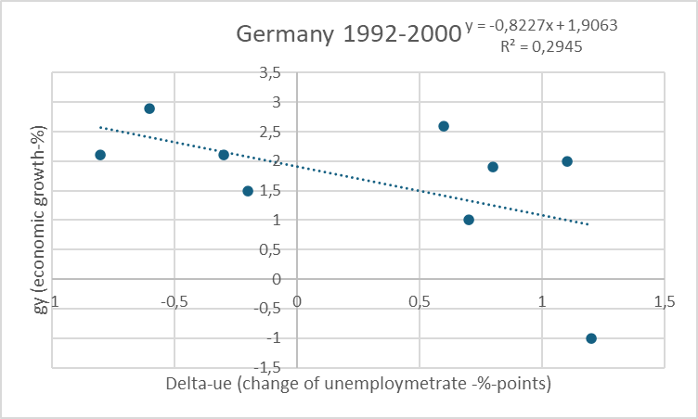
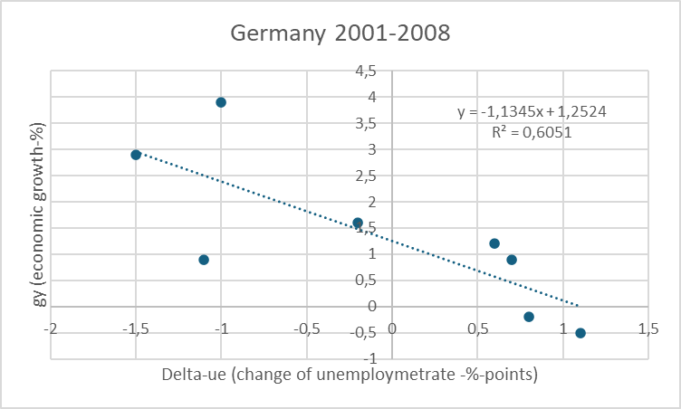


Estimating Okun’s Law for Germany

Slide 27
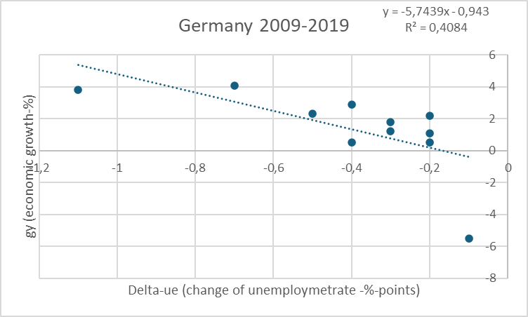
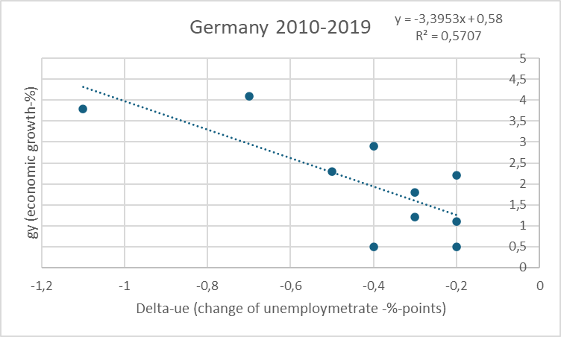
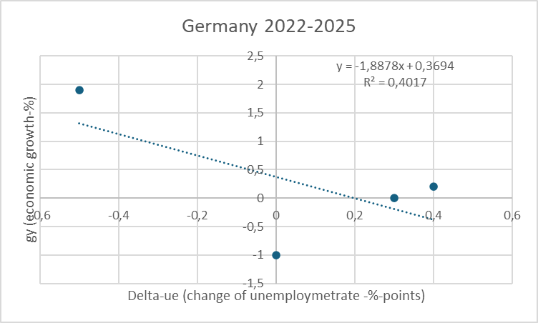
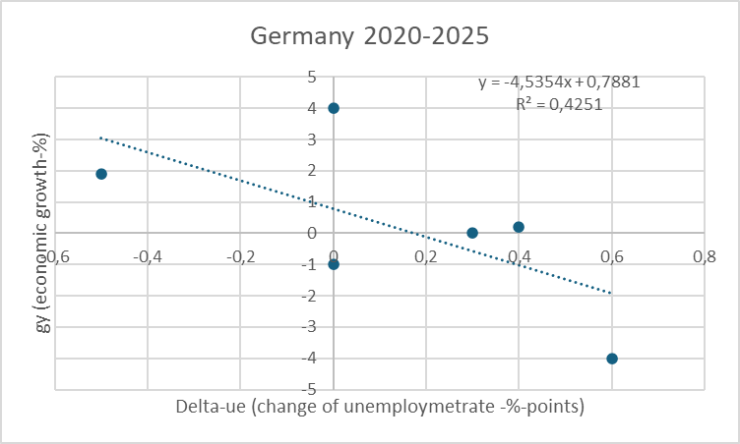



Estimating Okun’s Law for Germany

Slide 28
Inflation and Unemployment as macroeconomic targets
In practical economic policy, the primary direct objectives macroeconomic variables
inflation (π) and unemployment (u)
rather than economic growth
For example the 2%-target of the ECB or the dual target of the Fed pursuing the economic goals of maximum employment and price stability (i.e u = 6% in the aftermath of the financial crisis)
Although price level (p) and (y) are directly related to (π) and (u) these variables, but these variables are generally not used as operationalized target variables!

Slide 29



Inflation and Unemployment : Philippskurve
Transition from price level to inflation:
Price level (P) → Inflation (π) determine the perventage change!
Inflation: π_{t}=(P_{t}-P_{t-1})/P_{t-1}=P_{t}/P_{t-1}-1 relative change compared to the former period
Expected Inflation: π_{t}^{e}=(P_{t}^{e}-P_{t-1})/P_{t-1}=P_{t}^{e}/P_{t-1}-1 relative expected change compared to the former period
output (y) → unemployment (u)
Okuns law!
-A(u_{t}-u*)=(Y_{t}-Y*)/Y* (A>0)

Slide 30



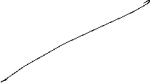























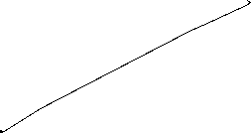









Philippskurve and short run aggregrated supply (AS-curve)
AS: Y_{t} = Y* + a(P_{t}-P_{t}^{e}) (a>0) (P_{t}^{e}: expected price level)
replace P_{t}/P_{t-1}=1+ π_{t} and P_{t}^{e}/P_{t-1}= 1+π_{t}^{e}
→ Y_{t} = Y* + a((1+ π_{t})P_{t-1} - (1+ π_{t}^{e})P_{t-1} )
= Y* + P_{t-1}a(π_{t} - π_{t}^{e})
= Y* + ã(π_{t} - π_{t}^{e}) with ã= P_{t-1}a>0
With given expectations, we obtain
or
P_{t}
π _{t}
$$AS$$
$AS$`
Y_{t}
Y_{t}

Slide 31





























Philippskurve and short run aggregrated supply (AS-curve) and Okun´s law
Okun´s law: -A(u_{t}-u*) = (Y_{t}-Y*)/Y* set Ã=AY*
⇒ -Ã(u_{t}-u*) = Y_{t}-Y* ⇒ Y*- Ã(u_{t}-u*) = Y_{t}
Together with the AS-curve we obtain:
Y*- Ã(u_{t}-u*) = Y_{t}=Y* + ã(π_{t} - π_{t}^{e})
⇒ - (Ã/ã)(u_{t}-u*) = π_{t} - π_{t}^{e}
⇒ π_{t} = π_{t}^{e} - β(u_{t}-u*) with β = (Ã/ã)>0 Expectation augmented Philipps curve
Y_{t} = Y* + ã(π_{t} - π_{t}^{e})
In its original form, the Phillips curve, like Okun's law, merely reflected the empirical finding that rising inflation tends to lead to falling unemployment.
Philipps, A. (1958) The Relation between Unemployment and the Rate of Change of Money Wages in the United Kingdom, 1861–1957, Economica, Vol. 25, S. 283–299
Phelps, Edmund S. (1967) “Phillips Curves, Expectations of Inflation and Optimal Employment over Time.” Economica, n.s., 34, no. 3, 254–281.
(Nobel Prize 2006)

Slide 32
Inflation, Unemployment, and the Phillips Curve
The Philipps curve states that inflation π depends on
  expected inflation π^{e}
  the deviation of unemployment fromt the natural rate u-u*
  For further analysis we add an supply shock ε
π = π^{e} - β(u-u*) + ε

Slide 33




The short run Phillips curve
π
Trade off between
unemployment and inflation
β
1
π^{e} + ε
u*
u

Slide 34

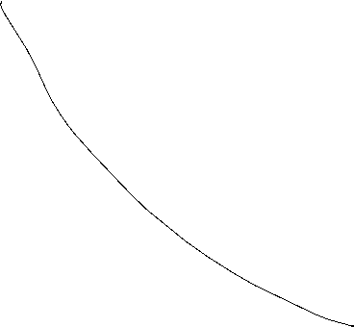







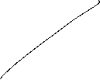


Long run Phillips Curve
π
2
π₂ =π₃
3
1
π₁
u*
u
u₂
u₃=u₁

Slide 35
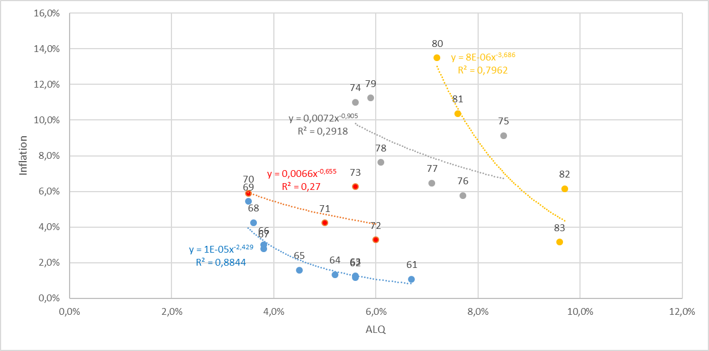






Philipps-curve USA I
Source: FRED
From the 1960 to 1980ies we seen an outward shift of the Philipps-curve
In this example, the regression used the Ansatz:
y=xª
Thus, the exponent can directly interpreted as the elasticity between x and y
e=(dy/y):(dx/x)
Can you show this ☺?.

Slide 36
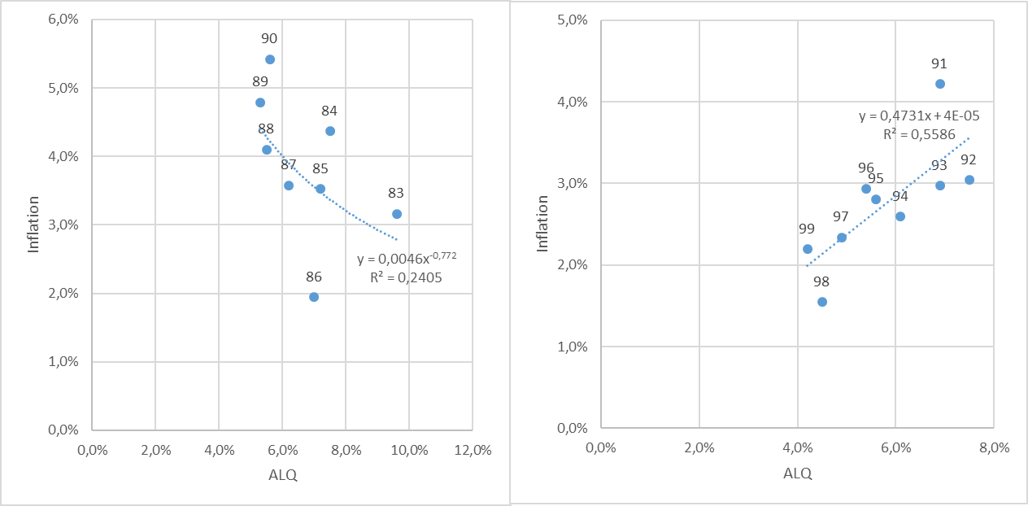




Philipps-curve USA II
Source: FRED
From the 1980ies to 2000, the data shows only a weak or even a inverted dependence between inflation and umemployment. A possible reason is the drastic change of the economic sircumstandes due to the break down of the soviet union and after that the dramatic change in the global economic dependencies

Slide 37
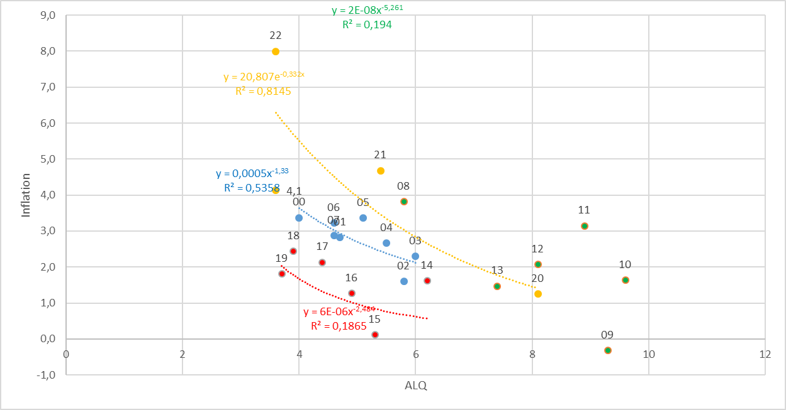





Philipps-curve USA III
Source: FRED
With the first push of globalization from 2000 until the financial crisis, again there is a quite stable „classical“ philipps-curve like dependence.
But within in following turmoil in the aftermath of the financial crisis, we had again no stable dependence again!
Using the data from 2020 to 2023 for a regression, we obtain a R^2=0,82. Are we therefore back to a stable dependence between inflation and unemployment?

Slide 38
Inflation – Economic Policy – Philipps curve
π
Longrun PC
Until the 1980, people were of the opinion thatone could freely choose the point on the Phillips curve via monetary or fiscal policy (cf. data before) and therefore could lower unemployment by allowing higher inflation rates
X
Then it was realized that expectations adjust and there is a rightward shift/rotation into the vertical of the Phillips curve!
c
c
π^{e}
Y
Shortrun PC
u*
u

Slide 39

Inflation – Economic Policy – Philipps curve
→ In order to be able to permanently reduce the unemployment rate π > π^{e} would have to apply permanently.
→ in the long run this is unrealistic and stable condition results!
→ thus, in principle, under rational expectations π = π^{e} will hold
→ thus u=u*
→ motion only on the long-run (vertical) Phillips curve possible!
→ Stagflation

Slide 40






The short run IS-LM-Model
► Modeling the goods market
IS: Investment = Saving
► Modelling the money market
LM: Money Supply = Money Demand (Liquidity Preference)

Slide 41



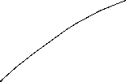

Commodity Market
Budget restriction of the economy:
Y = C(Y) + I(i= r+π^{e}) + G
Y: Income C: Consumption I: Investment G: Government expenditure
i: Nominal interest rate r: Real interest rate π^{e}: Inflation expectations
keynesian consumption hypotheses
“+“
opportunity costs
“−“
“(0,1)“
“+“
“−“
< 0
dY=∂C/∂Y∙dY + ∂I/∂i∙di ⇒ dr/dY = (1- ∂C/∂Y)/∂I/∂i
i
IS-curve
(investment=savings)
i.e IS: y=A-Bi A,B>0
Y

Slide 42

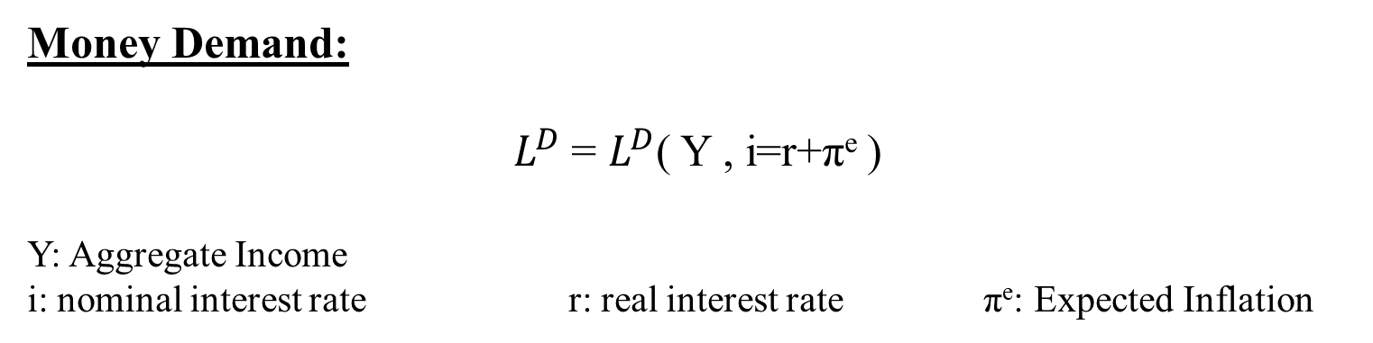
Money Market
Money Demand:
$L^{D}$= $L^{D}$( Y , i=r+π^{e} )
Y: Aggregate Income
i: nominal interest rate r: real interest rate π^{e}: Expected Inflation
Transaction motive
„+“
Opportunity cost, Speculations motive
„−“
Money Supply:
m=M/P
M: Nominal money supply P: Price level
Money market equilibrium:
m= $L^{D}$ ⇒ M/P=m= $L^{D}$(Y, i=r+π^{e} )

Slide 43









Die LM-Curve
$$\frac{M}{P}$$
LM Curve
i
Y₀ <Y₁ <Y₂
i
$$i_{2}$$
$$i_{1}$$
$$i_{0}$$
$$L(Y_{2})$$
$$L(Y_{0})$$
$$L(Y_{1})$$
Quantity of real money
Y₀
Y₁
Y₂

Slide 44



General Equilibrium
i
LM-Curve
i*
IS-Curve
Y*
Y
Intersection of LM- and IS-Curve determines the general equilibrium
with the simultanous equlibrium in the commodity and money market

Slide 45













































General Solution of the IS/LM-Model
Y = C(Y) + I(i) + G
m= $L^{D}$(Y, i )

Slide 46

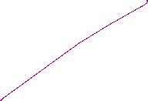


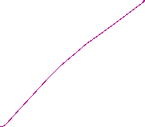
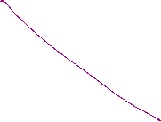




Monetary Policy within the IS-LM-Model
m= $L^{D}$(Y, i )

Slide 47
Monetary Policy within the IS-LM-Model
i
LM
LM`
i*(m₁)
i*(m₂)
IS curve
Y* (M₁)
Y* (M₂)
Y
m↑➔ LM right ➔ a given income Y corresponds to a lower interest rate i↓ on the money market ➔ the lower interest rate pushes investment at the commodity market I↑ ➔ overall increase of Y↑

Slide 48
Example
IS/LM-Model:
C(Y)=300+0,7Y I=100-200i G=50
L(Y,i)=2Y-1000i M=200 P=1
Determine the simultanous equilibrium at the commodity and money market.
Determine the effekt of a (c.p.) 5% increase of money supply.

Slide 49
Example
IS/LM-Model:
C(Y)=300+0,7Y I=100-200i G=50
L(Y,i)=2Y-1000i M=200 P=1
Determine the simultanous equilibrium at the commodity and money market.
Determine the effekt of a (c.p.) 5% increase of money supply.

Slide 50
IS-LM-Model and monetary policy
Direct interest rate effect – Capital cost effekt
Indirect interest rate effect – Substitution effect
– Income and wealth effect

Slide 51
IS-LM-Model and capital cost effekt
Central bank decreases interest rates
  refinancing costs decrease
    credit interest rates decrease
      higher loan growth and higher credit financed demand of investment and consumption
        increasing production

Slide 52
IS-LM-Model and substitution effect
Central bank decreases interest rates
  Rate of return of bonds are falling
    Stock market prices increase until stock market yield adjust to bond markets rate of return
      Income of stock owners increases, which increases demand of investment and consumption
        increasing production

Slide 53
IS-LM-Model and income effect
Central bank decreases interest rates
  credit interest rates decrease
    income redistribution between creditors and debtors
      Debtors becomes relatively richer and increase demand
        Since debtors are in general the poorer people in a society and poorer people consume relatively more (keynesian consumption hypothesis), the increase of demand by the poor outperforms the decrease of demand by the rich
          Increase of production

Slide 54
IS-LM-Model and wealth effect
Central bank decreases substantially interest rates
  risk of illequidity taking credits decreases
    increase of demand for durable consumption goods
      Especially demand for real estate increases
        Increase of production

Slide 55
Liquidity trap
Decrease of nominal interest rate to i=0%
  households become almost indifferent between holding money and holding bonds, as soon as they hold enough money for transactions
    The demand for money becomes highly interest rate elastic
      Further increase of money supply will not have any effect on nominal interest rates anymore

Slide 56



Liquidity trap
i
Y₀ <Y₁ <Y₂
i
$$L(Y_{1})$$
$$L(Y_{0})$$
$$L(Y_{2})$$
inelastic
range
highly
elastic
range
Quantity of real money
Y₀
Y₁
Y₂
Y
For low production LM is highly interest rate elastic with an nominal interest rate of zero. An increase in income does not imply an increase in interest rates
For larger interest rates LM becomes increasing and interest rate sensitive. An increase in income implies an increase in interest rates

Slide 57
Liquidity trap
i
LM(M₀ )
LM(M₁ )
LM(M₂ )
M₀ <M₁ <M₂
IS
Y₀
Y₂
Y₁
Y
Within the liquidity trap monetary policy has almost no impact, since in the interest rate elastic part LM does not shift substantially to the right.
Thus, it is possible that production cannot be pushed to natural output

Slide 58
Liquidity trap with inflation and deflation
Real interest rates depend on expected inflation. Suppose expected inflation is 10% and nominal interest rates are 0%:
r = i - π^{e} = 0% − 10% = -10%
If real interest rates are that negativ, consumption and investment are supposed to be quite high, sind „today money“ is much more valuable than „tomorrow money“.
In that case the liquidity trap will not be a serious problem.
  Additionally this is an incentive for the central bank to aggressively push expected inflation

Slide 59
Liquidity trap with inflation and deflation
Suppose the economy is in a situation of deflation and expected inflation is -5%:
r = i - π^{e} = 0% − (-5%) = 5%
Such high real interest rates have the potential to dampen the economy.
Traditional monetary policy cannot push the economy
An increase of real interest rates even shifts th IS-curve to the left and worsens the problem
  This is the reason, why a central bank deeply tries to prevent such a scenario

Slide 60
Money Market and the
Reaction Function of the Central Bank
In practice the central bank sets short term interest rates to meet its target level.
Most central banks communicate some kind of inflation target. Interest rates are therefore not only the outcome of an equilibrium process, but depend directly on the movements in prices
⇒ reaction function of the central bank
π↓ ⇒ r↓
Y↑ ⇒ r↑
⇒ r = i - π^{e} = r* + b(π - π*) +c(y - y*) b,c>0
π*: Inflation target y*: Potential output r*: Natural interest rate

Slide 61


Taylor-Rule
John B. Taylor:
Professor of Economics
(Stanford University)
Council of Economic Advisers
1976 – 77
1989 – 91
Under Secretary of the Treasury for International Affairs
2001 – 05
Source: Taylor, J., B, (1993) 195-214 North-Holland Discretion versus policy rules in practice, Carnegie-Rochester Conference Series on Public Policy 39, 195-214, North Holland
r = i - π^{e} = 2% + 0,5(π - π*) +0,5(y - y*)
r* =2% π*=2% b=c=0,5

Slide 62
Taylor-Rule simplified
r = i - π^{e} = = r* + b(π - π*) +c(y - y*)
Since π* and y* are constants, we set in the following
r = i - π^{e} = = α + bπ +cy
⇒ dr/dY = c > 0
r
TR-Curve
Y
Same dependence as the LM-curve!!

Slide 63
Short run equilibrium
r
TR
IS curve
Y
The intersection of the IS curve and the TR curve represents the short run equilibrium with fixed prices.
Mechanics are the same as in the case with LM-curve representing the
Money market equilibrium

Slide 64
Price adjusting process – Phillips Curve
Originally: Negative dependence between inflation and unemployment
together with
declining unemployment implies increasing output
⇒
π = π^{e} + δY δ >0
π
PC
Y

Slide 65
Monetary Policy Rule with flexible prices
Substitute the PC into the TR
⇒
Integrated monetary policy (MP) rule:
MP: r = r* + b[π^{e} + δY] + cY = a + b π^{e} + (bδ+c)Y
⇒
The coefficient on output (Y) is now (bδ+c) instead of c.
⇒
direct output affect in monetary policy through c
indirect effect through bδ.

Slide 66
Equilibrium with flexible prices
r
MP
TR
IS curve
Y
Taylor estimation for the Fed
https://www.atlantafed.org/cqer/research/taylor-rule#Tab1

Slide 67
Special cases of the MP-rule
Inflation targeting: c = 0
⇒ MP becomes flatter ⇒ real interest rates respond less to IS shocks that reduce output.
General Difference between ECB and Fed in their reaction on the different crisis during last 25 years
Output targeting:
Output targeting simply has a vertical TR or MP curve at the output target. Limiting case where the central bank is infinitely inflation-averse and δ is very large relative to b.
This seems to become more important since the financial crisis

Slide 68
Monetary Policy Rules
Simple rules
Policy instrument depends on a small set of variables
Easy to calculate
Predictable monetary policy
→ but in general not optimal
Optimal rules
Minimizing a loss function depending on all relevant variables
Often complicated
Not very predictable

Slide 69
Development of Monetary Policy
Historical view: The monetary policy instrument was assumed to be the money supply
Modern view: The policy instrument is the interest rate (signal rate, key rate, repo rate, etc)
“Ultra-modern” view: The policy instrument is in general central bank’s communication
+ forward guidance
Nobel Price 2026 Woodford

Slide 70
Money Supply Rules
Milton Friedman (1912-2006, Nobel Laureate 1976) suggested that central banks should follow a money supply rule.
Due to quantity theory of money, money supply should grow at a given rate in order to provide price stability.
P ● Y=M ● V
→ Fix Money Growth Rule
However: - Many countries have bad experience with monetary supply rules/targets
- Money demand (i.e. velocity V) is unstable; gives undesired volatility in the interest rate

Slide 71
Money Supply Rules
Former governour of Bank of Canada
"In Canada, we did not abandon money supply targets, they abandoned us".
Bank of England skips a monetary target at all, since:
“Whenever a bank makes a loan, it simultaneously creates a matching deposit in the borrower’s bank account, thereby creating new money.”
(BoE, 2014)

Slide 72
Time inconsistency of monetary policy
Why has central bank independence developed?
Is rule-based or "conservative" monetary policy superior to discretionary monetary policy?
Barro, R. and Gordon, D- (1983) Rules, Discretion, and Reputation in a Model of Monetary Policy, Journal of Monetary Economics 12 (July) 101-22.
Kydland, F. and Prescott, E. (1977) Rules Rather than Discretion: The Inconsistency of Optimal Plans, Journal of Political Economy 85 (June), 473-90
Kydland/Prescott Nobel Prize 2004

Slide 73
Loss function
Quadratic Approximation of deviations from targets
Inflation:
menue costs
uncertainty
transaction costs for obtaining information about future Inflation
Output:
wage rigidities would imply an output level below potential output → potential out put is weighted with k>1

Slide 74
Time Inconsistency Problem in Monetary Policy
Barro Gordon (1981) “A Positive Theory of Monetary Policy in a Natural Rate Model”
Philipps-curve:
y = y* + b (π - π^{e} ) (b>0)
Central bank loss function:
L =1/2[a (π –π*)² + (y -ky*)²]
a>0 k>1
π*, ky* Inflation and Output targets

Slide 75


Time Inconsistency Problem
Determine the following quantities of the time inconsistency problem from the minimization approach of the central bank with π*=0 for simplicity:
$min⁡\{L=\text{1/2[}\text{a} {\text{π}}^{2}\text{+}{(\text{y}\text{ −}\text{k}{ y}^{∗})}^{2}\}$ NB: ${y={ y}^{∗}+b(π−π}^{e})$ (Philippscurve, b>0)
Adaptation: Announcement of the CB: $π=0$ → public believes announcement $π^{e}=0$ → the CB increases 𝜋 according to the reaction function $π^{R}(π^{e}=0)$ → the central bank increases inflation to $π^{A}$
Discretionary: Announcement of the CB $π=0$ → the public anticipates the deviation of the CB and forms rational expectations according to the reaction function $π^{R} (π^{e}=π)$ → the central bank increases inflation to $π^{D}$ according to the rational expectations of the public
Commitment: Announcement CB $π=0$ → public believes announcement $π^{e}=0$ → CB sets$π^{C}=0$
Show formally: $L^{A}<L^{C}<L^{D}$ $π^{C}<π^{A}<π^{D}$ $y^{C}=y^{D}<y^{A}$

Slide 76
Time Inconsistency Problem – Calculation

Slide 77
Time Inconsistency Problem – Calculation – Reactionfunction
π^{e}
π

Slide 78
Time Inconsistency Problem – Outcome

Slide 79

Time Inconsistency Problem – Solutions
Reputation via “large” a → “Falcons” within the ECB
Rogoff, Kenneth (1985) The Optimal Degree of Commitment to an Intermediate Monetary get, Quarterly Journal of Economic 110 (November), 1169-90
Rule-based → Taylorregel or Inflation Targeting John B. Taylor, Discretion versus policy rules in practice (1993), Stanford University, Stanford, CA 94905“ Svensson, L.E.O. (2011) Inflation Targeting,” in Friedman, Benjamin M., and Michael Woodford, eds., Handbook of Monetary Economics, Volume 3b, chapter 22, Elsevier
Incentive Contracts → New Zealand Reserve Bank Act of 1989 Walsh, (1995) C.E. Is New Zealand's Reserve Bank Act of 1989 an Optimal Central Bank Contract? Journal of Money, Credit and Banking , Nov., 1995, Vol. 27, No. 4, Part 1 (Nov.,1995), pp. 1179-1191
Intertemporal view ($ρ$=Discountfaktor) L → $\sum_{t=0}^{∞}{\frac{1}{{\left(1+ρ\right)}^{t}}\text{(}\text{a}\text{(}\text{π}\text{t}\text{ –}\text{π}\text{∗)2 + (}\text{y}\text{t}\text{−}\text{ky}\text{∗) 2} })$ if $ρ$ is “low” the incentive for reputation is low!
With stochastic shocks the positive result for reputation is ambigous! Discretionary adjustment can be optimal!

Slide 80
Time Inconsistency Problem
Literature
Within my PhD-Thesis, I also addressed, the problem of transparency and setting optimal interest rates, within the supernational institution of the ECB:
Köster, B. J. (2011) Decision Rules, Transparency and Central Banks (Dissertation) Heidelberg
(especially Barro-Gordon-Model with transparency)
Alan Blinder had a nice example within education and incentives
U = U(Time to correct an exam„–“; effort of learning for the students„+“)
Alan S. Blinder. The rules-versus-discretion debate in the light of recent experience. Weltwirtschaftliches Archiv, 123:399–414, 1987.
“Course examinations are stressful experiences for students and teachers alike. We use them both to rank students and to make sure they master the course material. To most educators, the latter is by far the more important purpose. But the learning objective does not require that the exam actually be given. It is enough to announce the exam, let students prepare for it, and then call it off at the last minute. In a real sense, everyone will be better off if the exam is cancelled. Thus, it superficially seems to be the right thing to do. Yet it is rarely done, and for good reasons. Teachers know that this trick can only be pulled off once or twice. After that, students would cease believing the threat and would no longer study for exams. And that would be a real loss to bot faculty and students. Notice the obvious but important point that neither ignorance no incorrect objectives play any role in this example. An omniscient and benevolent despot presiding over the last year of the human race really would cancel exams. It's the optimal thing to do. The problem arises from taking a short-sighted perspective. It is cured by showing proper concern for the future consequences of current actions”

