Slide 1




















Okun’s Law
Arthur Melvin Okun based on
empirical observations (1962):
Every rise of 1%-point in cyclical unemployment is
associated with a lowering of 2%-points of the output gap.
−2(u - u*) = (Y – Y*)/Y* (Gap Version)
or
-2Δu = g_{y} – g_{Y*} (Growth Version)
g_{y}, g_{Y*}: growth rates of actual and potential out respectively
Δu: change in unemployment over time

Slide 2


Okun’s Law
In general Okun´s law implies that if output growth is 1%-point over potential growth than unemployment falls only by ½%-points.
Reasons:
Firms adjust employment less than one for one in response to deviations of output to the natural growth rate.
Labor participation increases
Labor productivity increases

Slide 3
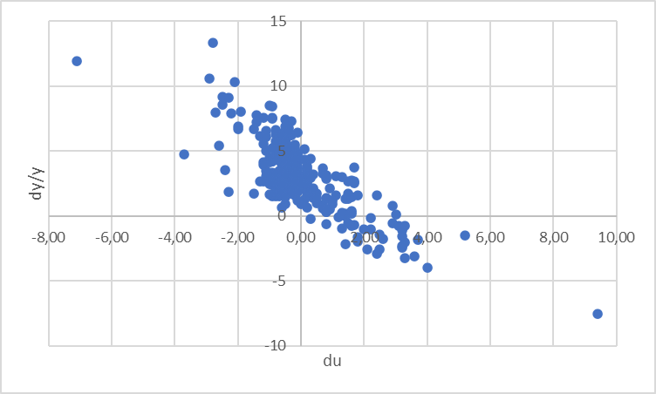












Estimating Okun’s Law: US-Data (1949 – )
https://fred.stlouisfed.org/
FRED-Data-Base
Real GDP-Growth vs
Change in unemployment rate
Source: FRED
Quarterly Data, seasonally adjusted. In order to eliminate effects within a year, we do not use the growth rate respectively to the former quarter but with respect to the quarter of the previous year. Therefore, the change of unemployment is also calculated with respect of the quarter of the previous year.

Slide 4
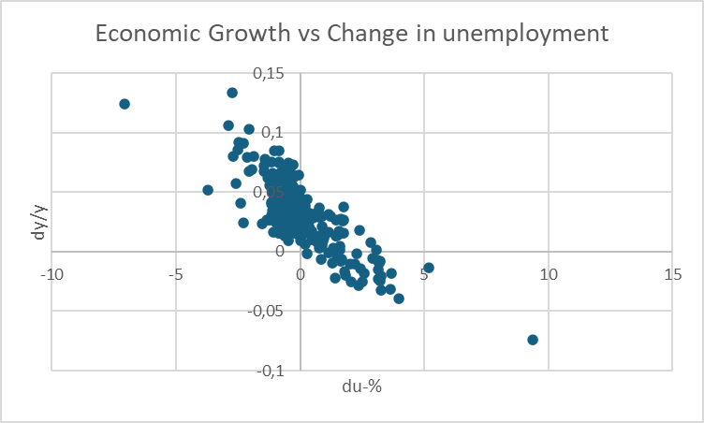






Estimating Okun’s Law: US-Data (1949 – )
https://fred.stlouisfed.org/
FRED-Data-Base
Real GDP-Growth vs
Change in unemployment rate
Source: FRED
Quarterly Data, seasonally adjusted. In order to eliminate effects within a year, we do not use the growth rate respectively to the former quarter but with respect to the quarter of the previous year. Therefore, the change of unemployment is also calculated with respect of the quarter of the previous year.

Slide 5







Estimation of Okun's Law - Country Analysis
Data: IMF Data mapper or other source. If you use quaterly data, think of
Contrast the data (1980-2024, per availability) of the variables Δu and g_{y} in a scatter plot
Linear regression of g_{y} and Δu .
Identify Okuns`s law with the regression parameters in g_{y} = -aΔu + g_{Y*} and interprete the parameters
Look for "meaningful" subperiods for your country for estimation purposes (consider especially structural breaks like crises, political changes,...)
Also evaluate your econometric analysis using the coefficient of determination R²
and the correlation coefficient R

Slide 6
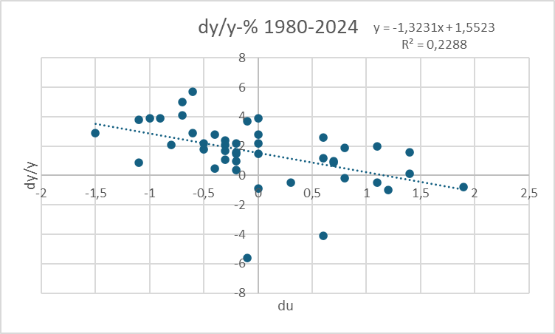
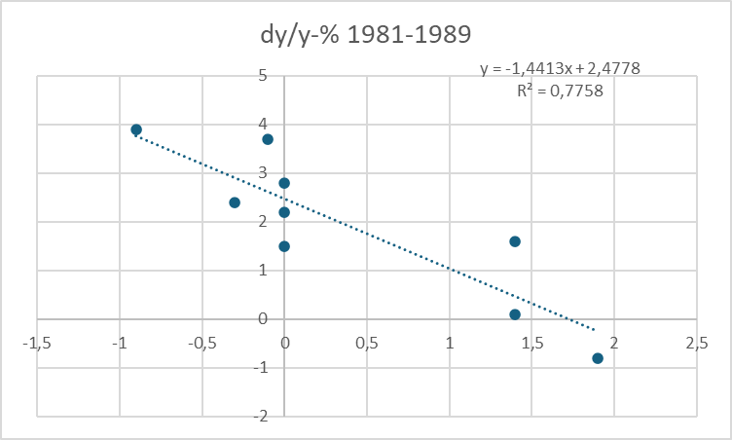
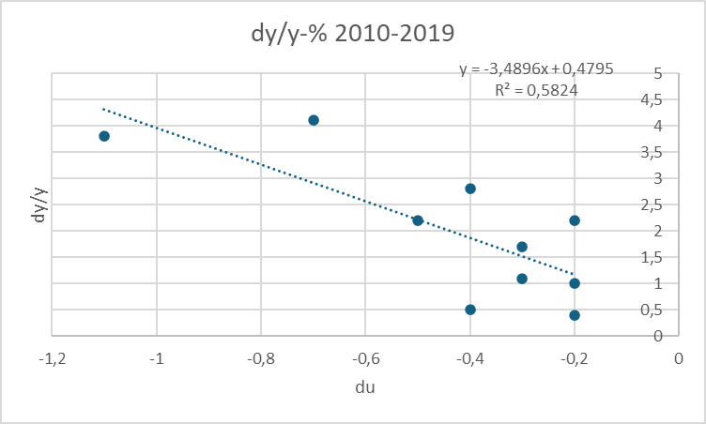
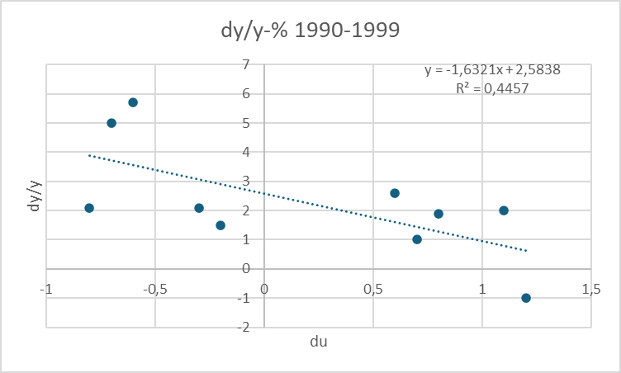
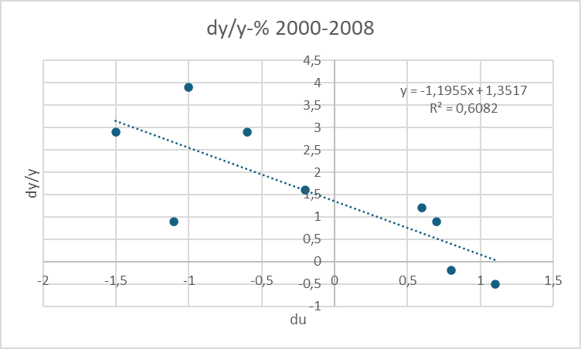
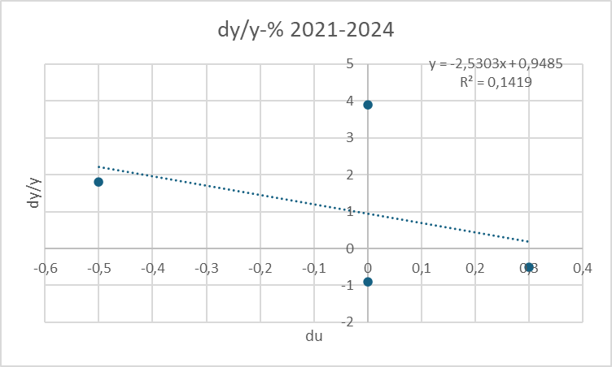
Estimating Okun’s Law: Country (1980 – 2024) Germany
Source: IMF Data Mapper

Slide 7





Inflation and Unemployment as macroeconomic targets
In practical economic policy, the primary direct objectives macroeconomic variables
inflation (π) and unemployment (u)
rather than economic growth
For example the 2%-target of the ECB or the dual target of the Fed pursuing the economic goals of maximum employment and price stability (i.e u = 6% in the aftermath of the financial crisis)
Although price level (p) and (y) are directly related to (π) and (u) these variables, but these variables are generally not used as operationalized target variables!

Slide 8




Inflation and Unemployment : Philippskurve
Transition from price level to inflation:
Price level (P) → Inflation (π) determine the perventage change!
Inflation: π_{t}=(P_{t}-P_{t-1})/P_{t-1}=P_{t}/P_{t-1}-1 relative change compared to the former period
Expected Inflation: π_{t}^{e}=(P_{t}^{e}-P_{t-1})/P_{t-1}=P_{t}^{e}/P_{t-1}-1 relative expected change compared to the former period
output (y) → unemployment (u)
Okuns law!
-A(u_{t}-u*)=(Y_{t}-Y*)/Y* (A>0)

Slide 9











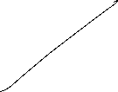







Philippskurve and short run aggregrated supply (AS-curve)
AS: Y_{t} = Y* + a(P_{t}-P_{t}^{e}) (a>0) (P_{t}^{e}: expected price level)
replace P_{t}/P_{t-1}=1+ π_{t} and P_{t}^{e}/P_{t-1}= 1+π_{t}^{e}
→ Y_{t} = Y* + a((1+ π_{t})P_{t-1} - (1+ π_{t}^{e})P_{t-1} )
= Y* + P_{t-1}a(π_{t} - π_{t}^{e})
= Y* + ã(π_{t} - π_{t}^{e}) with ã= P_{t-1}a>0
With given expectations, we obtain
or
P_{t}
π _{t}
$$AS$$
$AS$`
Y_{t}
Y_{t}

Slide 10












Philippskurve and short run aggregrated supply (AS-curve) and Okun´s law
Okun´s law: -A(u_{t}-u*) = (Y_{t}-Y*)/Y* set Ã=AY*
⇒ -Ã(u_{t}-u*) = Y_{t}-Y* ⇒ Y*- Ã(u_{t}-u*) = Y_{t}
Together with the AS-curve we obtain:
Y*- Ã(u_{t}-u*) = Y_{t}=Y* + ã(π_{t} - π_{t}^{e})
⇒ - (Ã/ã)(u_{t}-u*) = π_{t} - π_{t}^{e}
⇒ π_{t} = π_{t}^{e} - β(u_{t}-u*) with β = (Ã/ã)>0 Expectation augmented Philipps curve
Y_{t} = Y* + ã(π_{t} - π_{t}^{e})
In its original form, the Phillips curve, like Okun's law, merely reflected the empirical finding that rising inflation tends to lead to falling unemployment.
Philipps, A. (1958) The Relation between Unemployment and the Rate of Change of Money Wages in the United Kingdom, 1861–1957, Economica, Vol. 25, S. 283–299
Phelps, Edmund S. (1967) “Phillips Curves, Expectations of Inflation and Optimal Employment over Time.” Economica, n.s., 34, no. 3, 254–281.
(Nobel Prize 2006)

Slide 11
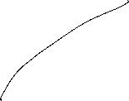



Inflation, Unemployment, and the Phillips Curve
The Philipps curve states that inflation π depends on
expected inflation π^{e}
the deviation of unemployment from the natural rate u-u*
For further analysis we add an supply shock ε
π = π^{e} - β(u-u*) + ε

Slide 12


The short run Phillips curve
π
Trade off between
unemployment and inflation
β
1
π^{e} + ε
u*
u

Slide 13













Long run Phillips Curve
π
2
π₂ =π₃
3
1
π₁
u*
u
u₂
u₃=u₁

Slide 14
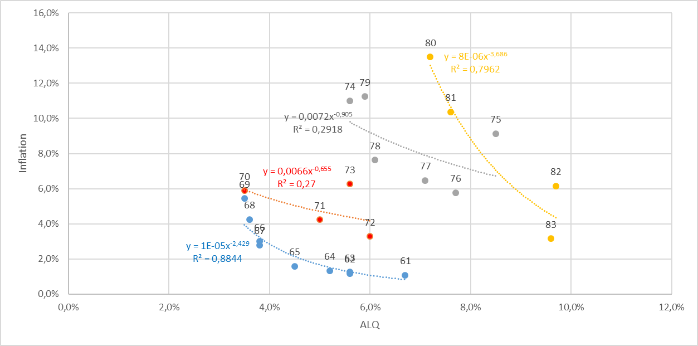




Philipps-curve USA I
Source: FRED
From the 1960 to 1980ies we seen an outward shift of the Philipps-curve
In this example, the regression used the Ansatz:
y=xª
Thus, the exponent can directly interpreted as the elasticity between x and y
e=(dy/y):(dx/x)
Can you show this ☺?.

Slide 15
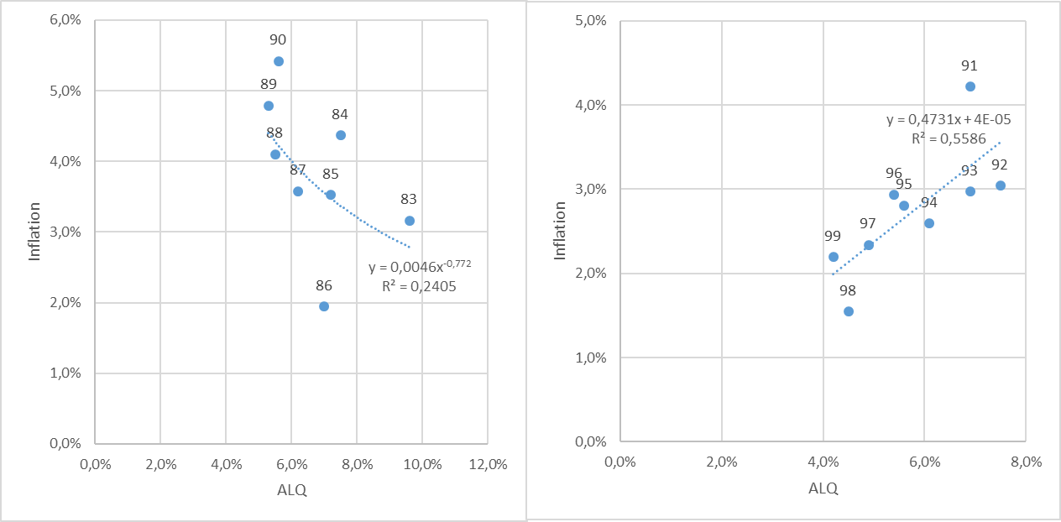



Philipps-curve USA II
Source: FRED
From the 1980ies to 2000, the data shows only a weak or even a inverted dependence between inflation and umemployment. A possible reason is the drastic change of the economic sircumstandes due to the break down of the soviet union and after that the dramatic change in the global economic dependencies

Slide 16
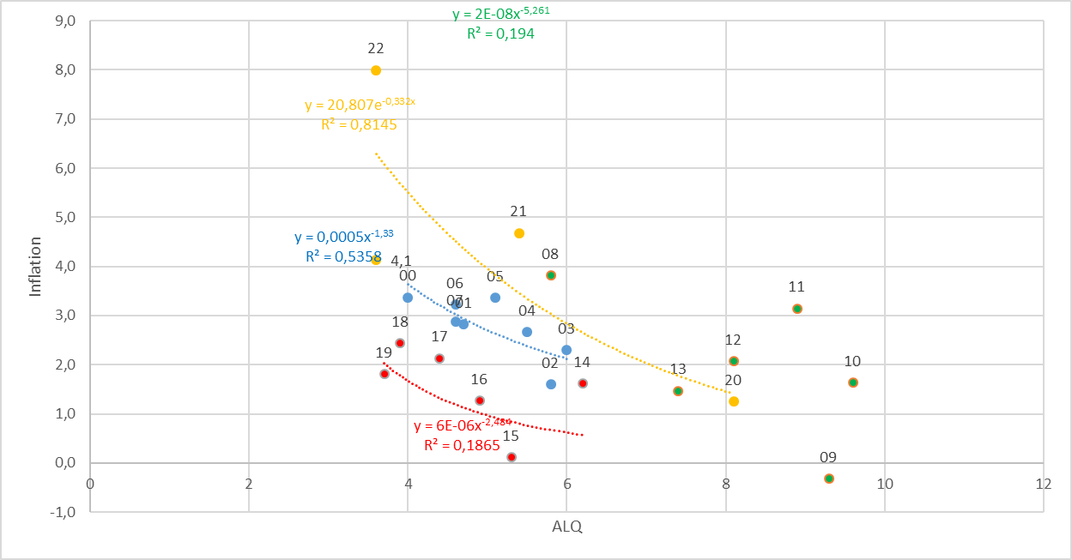
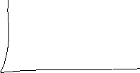








Philipps-curve USA III
Source: FRED
With the first push of globalization from 2000 until the financial crisis, again there is a quite stable „classical“ philipps-curve like dependence.
But within in following turmoil in the aftermath of the financial crisis, we had again no stable dependence again!
Using the data from 2020 to 2023 for a regression, we obtain a R^2=0,82. Are we therefore back to a stable dependence between inflation and unemployment?

Slide 17

Inflation – Economic Policy – Philipps curve
π
Longrun PC
Until the 1980, people were of the opinion thatone could freely choose the point on the Phillips curve via monetary or fiscal policy (cf. data before) and therefore could lower unemployment by allowing higher inflation rates
X
Then it was realized that expectations adjust and there is a rightward shift/rotation into the vertical of the Phillips curve!
c
c
π^{e}
Y
Shortrun PC
u*
u

Slide 18


Inflation – Economic Policy – Philipps curve
→ In order to be able to permanently reduce the unemployment rate π > π^{e} would have to apply permanently.
→ in the long run this is unrealistic and stable condition results!
→ thus, in principle, under rational expectations π = π^{e} will hold
→ thus u=u*
→ motion only on the long-run (vertical) Phillips curve possible!
→ Stagflation

Slide 19
The short run IS-LM-Model
► Modeling the goods market
IS: Investment = Saving
► Modelling the money market
LM: Money Supply = Money Demand (Liquidity Preference)

Slide 20
Commodity Market
Budget restriction of the economy:
Y = C(Y) + I(i= r+π^{e}) + G
Y: Income C: Consumption I: Investment G: Government expenditure
i: Nominal interest rate r: Real interest rate π^{e}: Inflation expectations
keynesian consumption hypotheses
“+“
opportunity costs
“−“
“(0,1)“
“+“
“−“
< 0
dY=∂C/∂Y∙dY + ∂I/∂i∙di ⇒ dr/dY = (1- ∂C/∂Y)/∂I/∂i
i
IS-curve
(investment=savings)
i.e IS: y=A-Bi A,B>0
Y

Slide 21

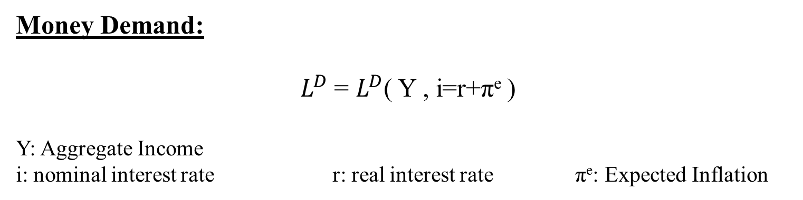
Money Market
Money Demand:
$L^{D}$= $L^{D}$( Y , i=r+π^{e} )
Y: Aggregate Income
i: nominal interest rate r: real interest rate π^{e}: Expected Inflation
Transaction motive
„+“
Opportunity cost, Speculations motive
„−“
Money Supply:
m=M/P
M: Nominal money supply P: Price level
Money market equilibrium:
m= $L^{D}$ ⇒ M/P=m= $L^{D}$(Y, i=r+π^{e} )

Slide 22







Die LM-Curve
$$\frac{M}{P}$$
LM Curve
i
Y₀ <Y₁ <Y₂
i
$$i_{2}$$
$$i_{1}$$
$$i_{0}$$
$$L(Y_{2})$$
$$L(Y_{0})$$
$$L(Y_{1})$$
Quantity of real money
Y₀
Y₁
Y₂

Slide 23
General Equilibrium
i
LM-Curve
i*
IS-Curve
Y*
Y
Intersection of LM- and IS-Curve determines the general equilibrium
with the simultanous equlibrium in the commodity and money market

Slide 24

General Solution of the IS/LM-Model
Y = C(Y) + I(i) + G
m= $L^{D}$(Y, i )

Slide 25
Monetary Policy within the IS-LM-Model
i
LM
LM`
i*(m₁)
i*(m₂)
IS curve
Y* (M₁)
Y* (M₂)
Y
m↑➔ LM right ➔ a given income Y corresponds to a lower interest rate i↓ on the money market ➔ the lower interest rate pushes investment at the commodity market I↑ ➔ overall increase of Y↑

Slide 26
Example
IS/LM-Model:
C(Y)=300+0,7Y I=100-200i G=50
L(Y,i)=2Y-1000i M=200 P=1
Determine the simultanous equilibrium at the commodity and money market.
Determine the effekt of a (c.p.) 5% increase of money supply.

Slide 27
Example
IS/LM-Model:
C(Y)=300+0,7Y I=100-200i G=50
L(Y,i)=2Y-1000i M=200 P=1
Determine the simultanous equilibrium at the commodity and money market.
Determine the effekt of a (c.p.) 5% increase of money supply.

Slide 28
IS-LM-Model and monetary policy
Direct interest rate effect – Capital cost effekt
Indirect interest rate effect – Substitution effect
– Income and wealth effect

Slide 29
IS-LM-Model and capital cost effekt
Central bank decreases interest rates
refinancing costs decrease
credit interest rates decrease
higher loan growth and higher credit financed demand of investment and consumption
increasing production

Slide 30
IS-LM-Model and substitution effect
Central bank decreases interest rates
Rate of return of bonds are falling
Stock market prices increase until stock market yield adjust to bond markets rate of return
Income of stock owners increases, which increases demand of investment and consumption
increasing production

Slide 31
IS-LM-Model and income effect
Central bank decreases interest rates
credit interest rates decrease
income redistribution between creditors and debtors
Debtors becomes relatively richer and increase demand
Since debtors are in general the poorer people in a society and poorer people consume relatively more (keynesian consumption hypothesis), the increase of demand by the poor outperforms the decrease of demand by the rich
Increase of production

Slide 32
IS-LM-Model and wealth effect
Central bank decreases substantially interest rates
risk of illequidity taking credits decreases
increase of demand for durable consumption goods
Especially demand for real estate increases
Increase of production

Slide 33
Liquidity trap
Decrease of nominal interest rate to i=0%
households become almost indifferent between holding money and holding bonds, as soon as they hold enough money for transactions
The demand for money becomes highly interest rate elastic
Further increase of money supply will not have any effect on nominal interest rates anymore

Slide 34



Liquidity trap
i
Y₀ <Y₁ <Y₂
i
$$L(Y_{1})$$
$$L(Y_{0})$$
$$L(Y_{2})$$
inelastic
range
highly
elastic
range
Quantity of real money
Y₀
Y₁
Y₂
Y
For low production LM is highly interest rate elastic with an nominal interest rate of zero. An increase in income does not imply an increase in interest rates
For larger interest rates LM becomes increasing and interest rate sensitive. An increase in income implies an increase in interest rates

Slide 35
Liquidity trap
i
LM(M₀ )
LM(M₁ )
LM(M₂ )
M₀ <M₁ <M₂
IS
Y₀
Y₂
Y₁
Y
Within the liquidity trap monetary policy has almost no impact, since in the interest rate elastic part LM does not shift substantially to the right.
Thus, it is possible that production cannot be pushed to natural output

Slide 36
Liquidity trap with inflation and deflation
Real interest rates depend on expected inflation. Suppose expected inflation is 10% and nominal interest rates are 0%:
r = i - π^{e} = 0% − 10% = -10%
If real interest rates are that negativ, consumption and investment are supposed to be quite high, sind „today money“ is much more valuable than „tomorrow money“.
In that case the liquidity trap will not be a serious problem.
Additionally this is an incentive for the central bank to aggressively push expected inflation

Slide 37
Liquidity trap with inflation and deflation
Suppose the economy is in a situation of deflation and expected inflation is -5%:
r = i - π^{e} = 0% − (-5%) = 5%
Such high real interest rates have the potential to dampen the economy.
Traditional monetary policy cannot push the economy
An increase of real interest rates even shifts th IS-curve to the left and worsens the problem
This is the reason, why a central bank deeply tries to prevent such a scenario

