Slide 1
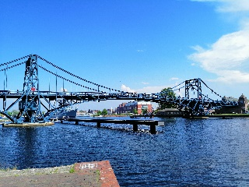

Global Economics
Wilhelmshaven
This lecture will be recorded and
Subsequently uploaded in the
world-wide-web
Prof. Dr. Bernhard Köster
Jade-Hochschule Wilhelmshaven
http://www.bernhardkoester.de/vorlesungen/inhalt.html

Slide 2

Global Economics
Winter term 2025
Prof. Dr. Bernhard Köster

Slide 3
Prof. Dr. Bernhard Köster
Room: S 113
Street: Friedrich-Paffrath-Straße 101
location: 26389 Wilhelmshaven
Tel. +49 4421 985-2766
Email: bernhard.koester@jade-hs.de
Consultation hour: by arrangement
or just have a look into my office!
or Webex/Zoom …

Slide 4
Content
Overview of macroeconomic indicators
Okun`s law and time series analysis
General developments in the global economy and international trade
Exchange rates, Siegels paradoxon Interest parity and the Mundell-Felming-model
The Philippscurve, Taylor-Rule, time inconsistency and general problems in monetary policy
The Solow growth model
Selected topics

Slide 5
Literature
Okun, Arthur M. (1962). “Potential GNP: Its Measurement and Significance.” Reprinted as Cowles Foundation Paper 190.
Siegel, J. J. (1972). Risk, interest rates and the forward exchange. The Quarterly Journal of Economics, 86 (2), 303–309.
Marcus Fleming (1062): Domestic financial policies under fixed and floating exchange rates. IMF Staff Papers 9, 369-379
Robert Mundell (1962) Capital mobility and stabilization policy under fixed and flexible exchange rates. In: Canadian Journal of Economic and Political Science. Vol. 29, 1962, 475-485 (Nobel Prize 1999)
Philipps, A. (1958) The Relation between Unemployment and the Rate of Change of Money Wages in the United Kingdom, 1861–1957, Economica, Vol. 25, S. 283–299
Phelps, Edmund S. (1967) “Phillips Curves, Expectations of Inflation and Optimal Employment over Time.” Economica, n.s., 34, no. 3, 254–281. (NobelPrize 2006)
Barro, R., and D. Gordon (1983): “A Positive Theory of Monetary Policy in a Natural Rate Model,” Journal of Political Economy, 91, 589–610
Barro, R.J. and D. Gordon, (1983) Rules, Discretion, and Reputation in a Model of Monetary Policy, Journal of Monetary Economics, Vol. 12, 101 – 120
Köster, Bernhard (2011), Decision Rules, Transparency and Central Banks, Disseratation, University of Heidelberg
Gersbach, H, and Pachl, B. 2009. "Flexible Majority Rules for Central Banks," Journal of Money, Credit and Banking, Blackwell Publishing, vol. 41(2‐3), pages 507-516, March.
Mundell, R.A. (1961) A Theory of Optimum Currency Areas Author(s): Source: The American Economic Review, Vol. 51, No. 4, Sep., 657-665 (Nobel Prize 1999)
Solow, R.M. (1956) A Contribution to the Theory of Economic Growth, The Quarterly Journal of Economics, Vol. 70, No. 1, Feb., 65-94 (Nobel Prize 1987)
Swan, T. (1956) Economic Growth and Capital Accumulation, Economic Record, Band 32, No. 2, 334–361

Slide 6


Global Economic Trends

Slide 7
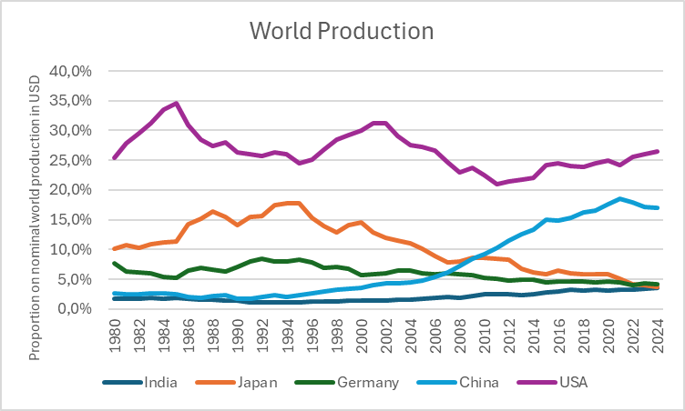
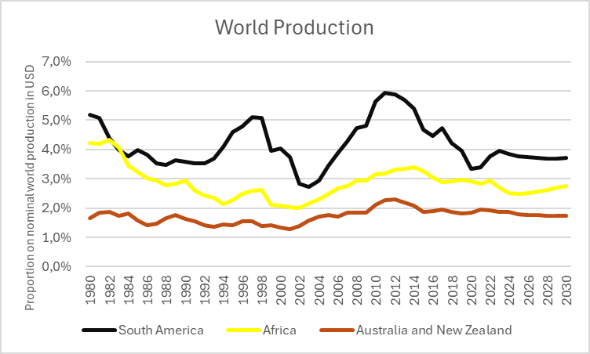
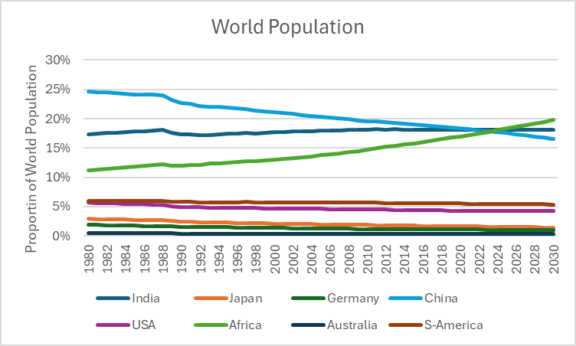
Global Economic Trends

Slide 8
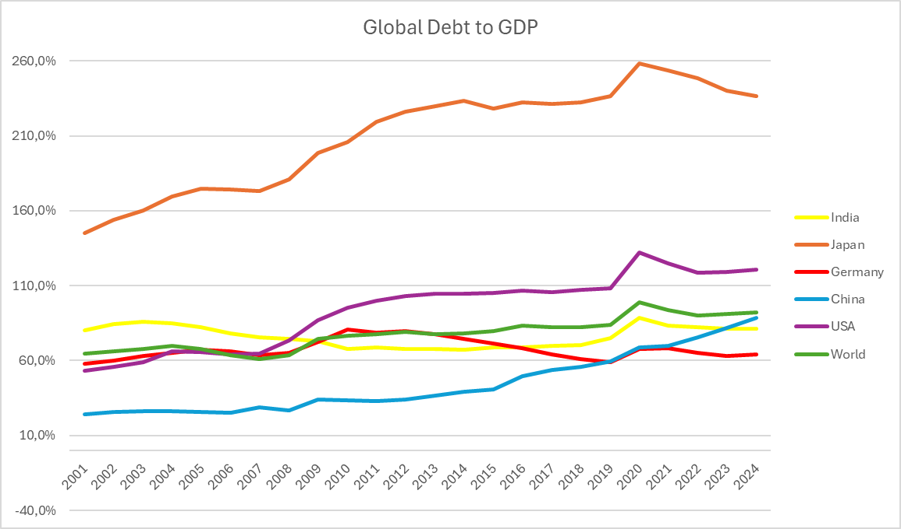
Global Economic Trends since the start of globalization

Slide 9
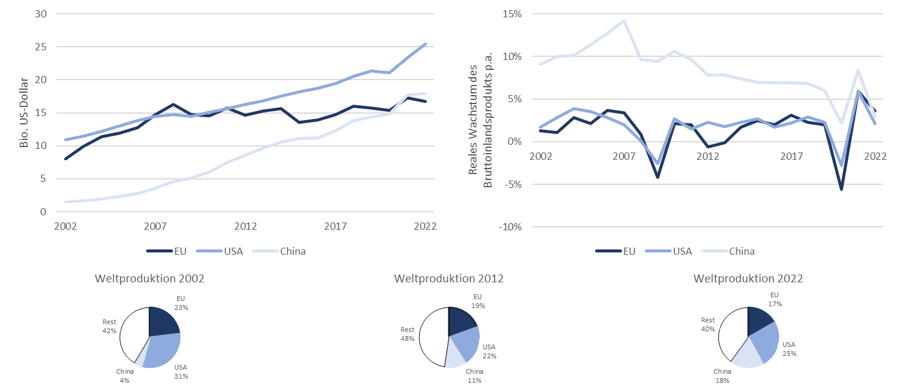
Global Economic Trends since the start of globalization
Source: Köster, Bernhard und Mühe, Felix Internationale Handelskonflikte: eine verhaltensökonomische Analyse (2024) WiSt -- Wirtschaftswissenschaftliches Studium, Heft 5-2024, 26 -- 32

Slide 10
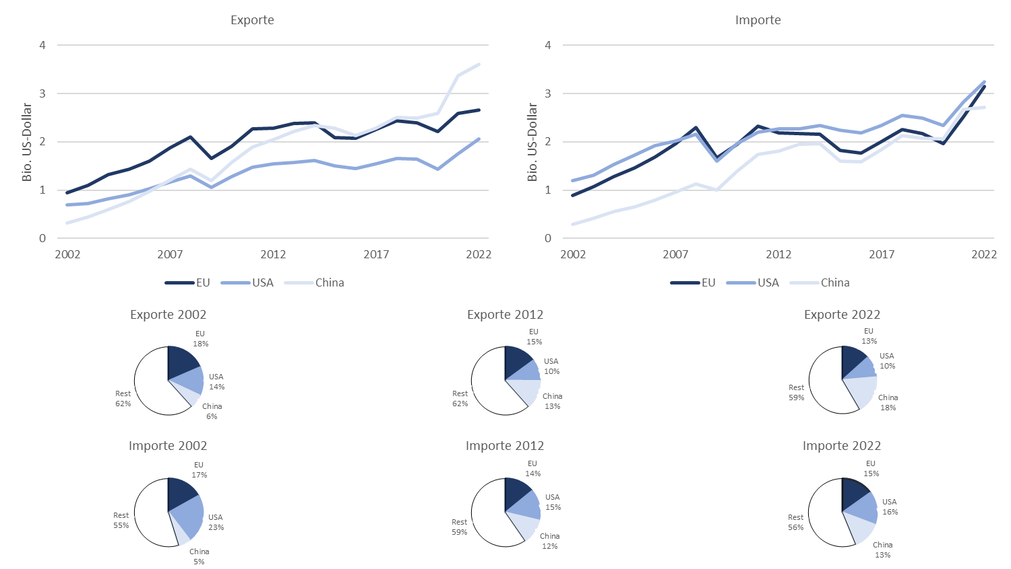
Global Economic Trends since the start of globalization
Source: Köster, Bernhard und Mühe, Felix Internationale Handelskonflikte: eine verhaltensökonomische Analyse (2024) WiSt -- Wirtschaftswissenschaftliches Studium, Heft 5-2024, 26 -- 32

Slide 11
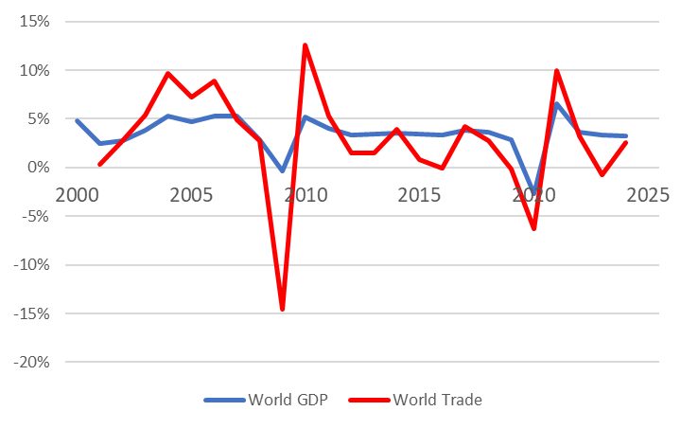
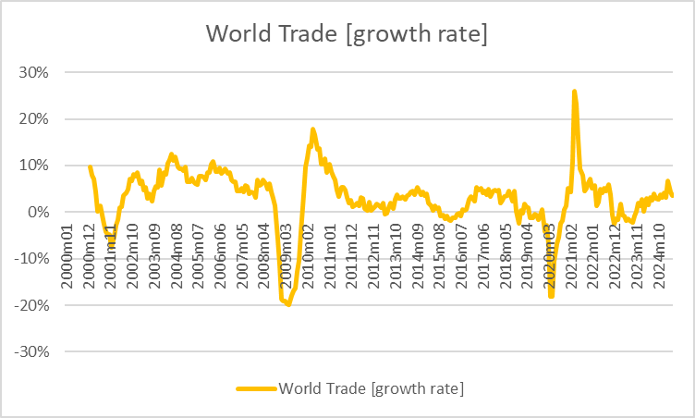
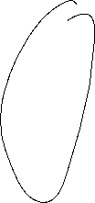

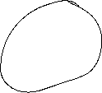


Global Economic Trends since the start of globalization
Source: World Bank, CPB

Slide 12




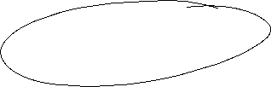




Macroeconomic indicators
Inflation
Unemployment
Interest rates
Economic growth
Exchange rates
Government Debt
Trade-to-GDP-ratio
Current account

Slide 13
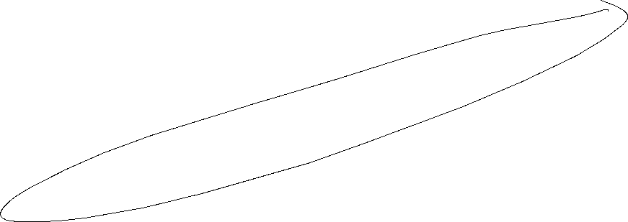

Economic growth and the business cycle
The business cycle is measured by the fluctuations of real GDP in time around some long time trend.
Real GDP
Be careful: This is no linear line for constant growth
Expansion
Peak
Recession
Trough
time
Notes:
13

Slide 14
Potential Output
In general, we want to limit the fluctuations within the business cycle.
In order to have a reference for the fluctuations, the concept of potential output is developed:
Potential output is the maximum amount an economy can produce over the long run (production at full capacity).
In the long run it should be the economic aime to increase potential output, since the pure development of real GDP can be below or above the production possibilities of an economy.
But: Potential output is only a theoretical concept. Therefore the true value of potential out is difficult to estimate.
Notes:
14

Slide 15
Further definitions
Potential output is the maximum amount of goods and services an economy can turn out when it is most efficient—that is, at full capacity. Often, potential output is referred to as the production capacity of the economy.­ (IMF Definition)
But:
“…it must be noted that potential output cannot be observed directly, but has to be inferred from existing data using statistical and econometric methods. There is considerable uncertainty in the measurement of potential output, which translates across to the derived indicators.” (ECB, 2011)
Notes:
15

Slide 16
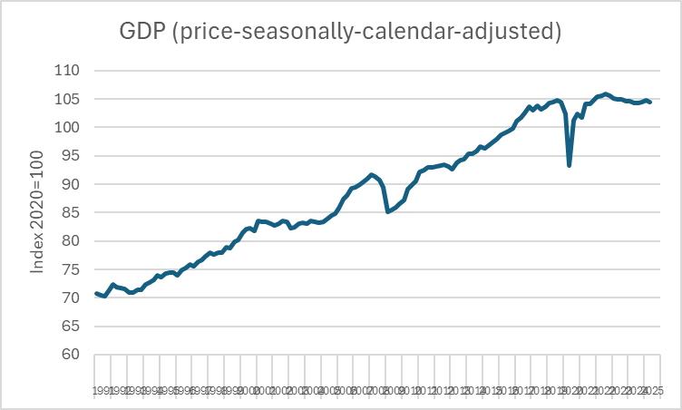
Simple calculation of average growth with quaterly data for Germany
Calculate the yearly average growth rates for different significant periods
Source:Destatis

Slide 17
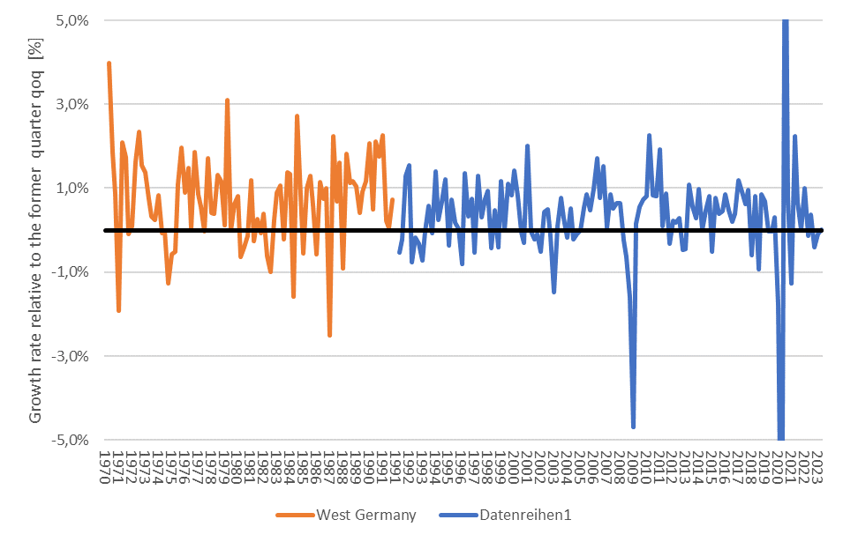



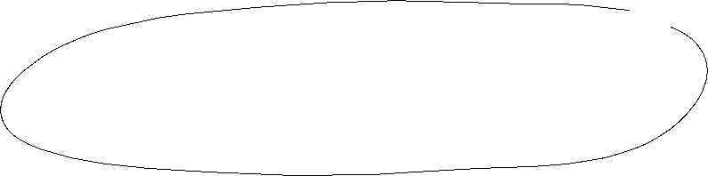
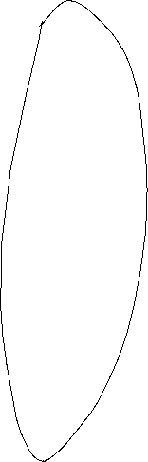

Business cycle – Germany
2.
3.
6.
7.
1.
4.
5.
Source: Destatis; price, seasonly, calendar adjusted

Slide 18
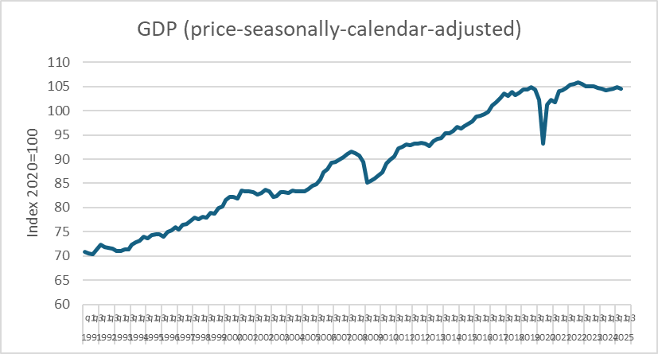
Macroeconomic parameters
Economic growth
Source: Destatis

Slide 19
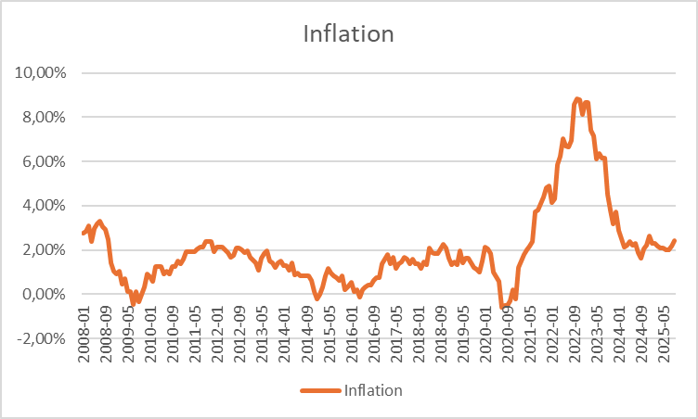
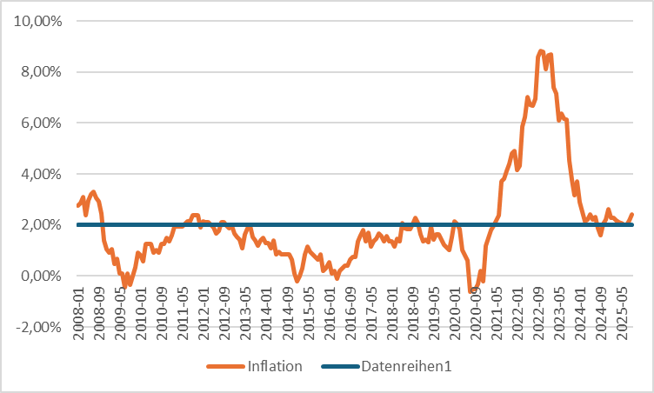






Macroeconomic parameters
Inflation
Source: Bundesbank

Slide 20
Macroeconomic parameters
Unemployment
Source: Bundesbank

Slide 21
Macroeconomic parameters
Ex- and Imports
Source: Destatis

Slide 22
Macroeconomic parameters
Exchange rate
Source: Bundesbank

Slide 23
Macroeconomic parameters
Interest rates
Source: Bundesbank

Slide 24
Macroeconomic parameters
Interest rates
Source: Bundesbank

Slide 25
Macroeconomic parameters
Key interest rates
Source: national central banks (Bundesbank) or www.leitzinsen.info

Slide 26
Macroeconomic parameters
Government debt
Source: Bundesbank
Fiscal Deficit
Source: Bundesbank

