Slide 1

Global Economics
Wilhelmshaven
This lecture will be recorded and
Subsequently uploaded in the
world-wide-web
Prof. Dr. Bernhard Köster
Jade-Hochschule Wilhelmshaven
http://www.bernhardkoester.de/vorlesungen/inhalt.html

Slide 2

Global Economics
Winter term 2024
Prof. Dr. Bernhard Köster

Slide 3
Short-run Output Gaps: Why do they matter?
Output Gap = Actual Output - Potential Output
_______________________________________
Potential Output
= Y - Y*
_______________________________________
Y*
(Y – Y*)/Y* > 0 → a positive output gap
is called expansionary gap
(Y – Y*)/Y* < 0 → a negative output gap
is called recessionary gap

Slide 4
Output Gaps: Two kinds of Costs
(Y – Y*)/Y* > 0 expansionary gap
inflation can be high
economy incurs costs of inflation
(Y – Y*)/Y* < 0 recessionary gap
unemployment rate high (above normal)
economy incurs costs of unemployment

Slide 5
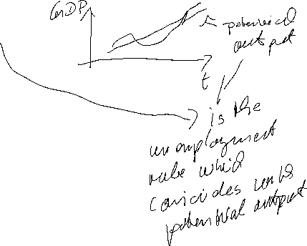



Natural Rate of Unemployment
u* : Natural rate of unemployment
Mainly caused by:
frictional unemployment
structural unemployment
or
generally a worker who is not able to get a job because she doesn’t have the right skills.
⇒ The natural rate of unemployment is caused by supply side factors rather than demand side factors

Slide 6

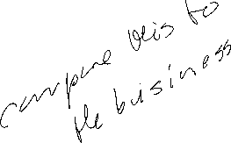


Cyclical Unemployment
Actual unemployment rate = u
Natural unemployment rate = u*
Cyclical unemployment rate = u - u*
recessionary Gap: u - u* > 0
expansionary Gap: u - u* < 0

Slide 7
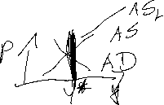
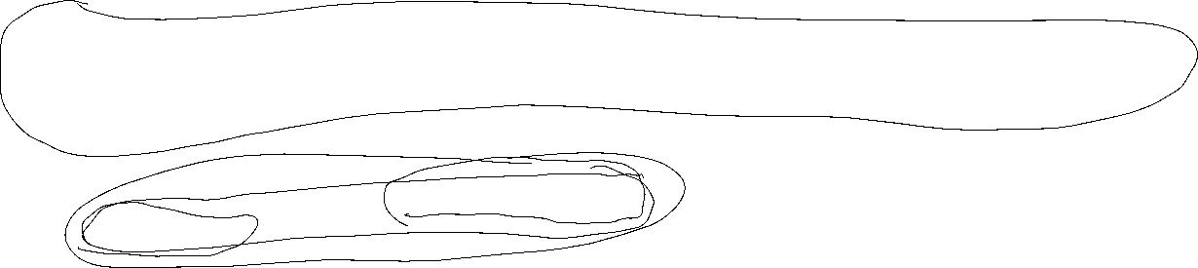
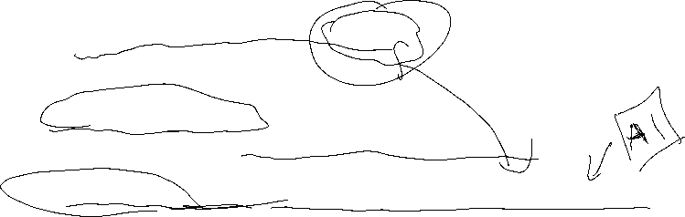
Relationship between unemployment and economic growth
In general, one would expect unemployment to fall when economic growth is high.
Thus, one could identify natural unemployment directly with potential output (cf. neoclassical theory and the long-run supply curve (AS)).
But Okun (1962) showed empirically:
Okun, Arthur M. (1962). “Potential GNP: Its Measurement and Significance.” Reprinted as Cowles Foundation Paper 190.
In general Okun´s law implies that if output growth is 1%-point over potential growth than unemployment falls only by 0,5%-points.
Okun, Arthur M. 1962. “Potential GNP: Its Measurement and Significance.” Reprinted as Cowles Foundation Paper 190.
Reasons:
Firms adjust employment less than one for one in response to deviations of output to the natural growth rate.
The labor force participation of the population increases over time (for Germany, especially the labor force participation of women).
Labor productivity increases (currently in particular due to digitalization)

Slide 8
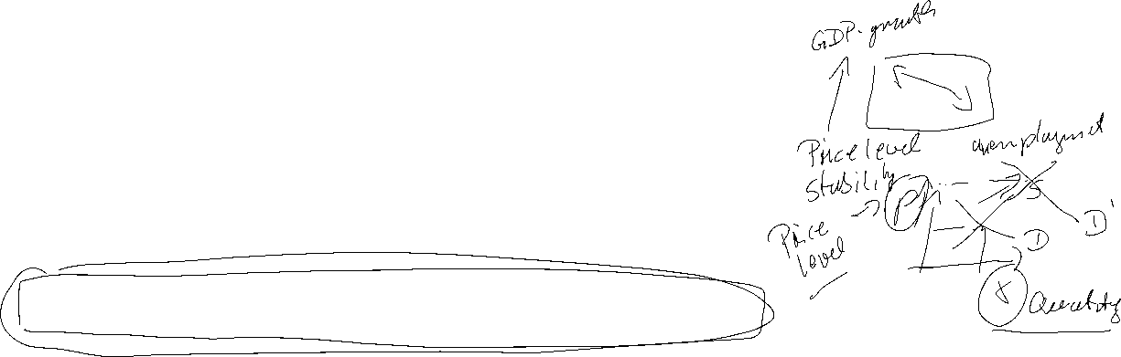
Okun’s Law
Arthur Melvin Okun based on
empirical observations (1962):
Every rise of 1%-point in cyclical unemployment is
associated with a lowering of 2%-points of the output gap.
−2(u - u*) = (Y – Y*)/Y* (Gap Version)
or
-2Δu = g_{y} – g_{Y*} (Growth Version)
g_{y}, g_{Y*}: growth rates of actual and potential out respectively
Δu: change in unemployment over time

Slide 9
Okun’s Law
In general Okun´s law implies that if output growth is 1%-point over potential growth than unemployment falls only by ½%-points.
Reasons:
Firms adjust employment less than one for one in response to deviations of output to the natural growth rate.
Labor participation increases
Labor productivity increases

Slide 10




Inflation and Unemployment as macroeconomic targets
In practical economic policy, the primary direct objectives macroeconomic variables
inflation (π) and unemployment (u)
rather than economic growth
For example the 2%-target of the ECB or the dual target of the Fed pursuing the economic goals of maximum employment and price stability (i.e u = 6% in the aftermath of the financial crisis)
Although price level (p) and (y) are directly related to (π) and (u) these variables, but these variables are generally not used as operationalized target variables!

Slide 11



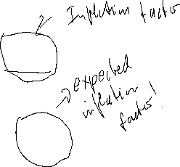


Inflation and Unemployment : Philippskurve
Transition from price level to inflation:
Price level (P) → Inflation (π) determine the percentage change!
Inflation: π_{t}=(P_{t}-P_{t-1})/P_{t-1}=P_{t}/P_{t-1}-1 relative change compared to the former period
Expected Inflation: π_{t}^{e}=(P_{t}^{e}-P_{t-1})/P_{t-1}=P_{t}^{e}/P_{t-1}-1 relative expected change compared to the former period
output (y) → unemployment (u)
Okuns law!
-A(u_{t}-u*)=(Y_{t}-Y*)/Y* (A>0)

Slide 12


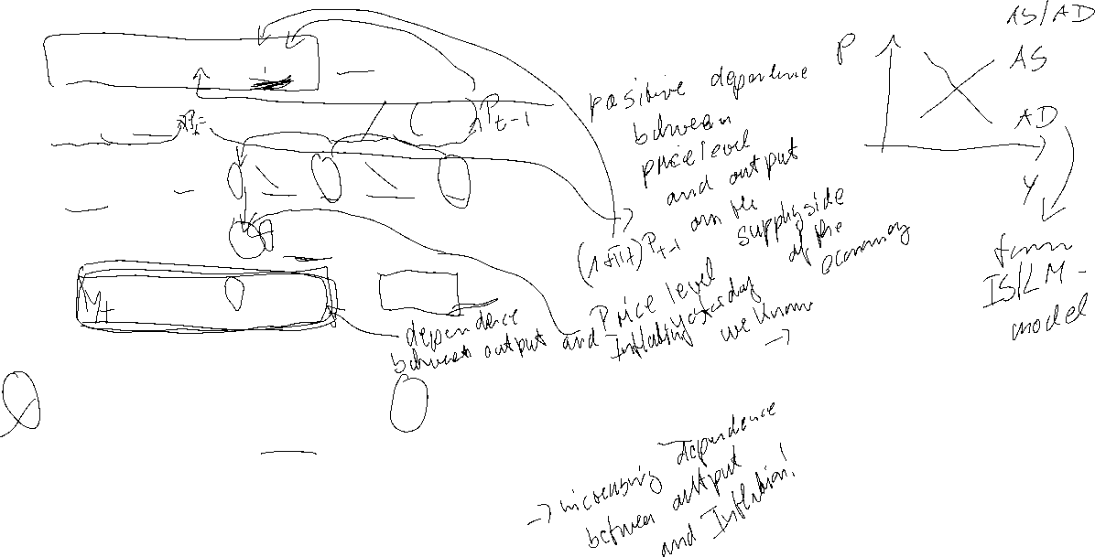

Philippskurve and short run aggregrated supply (AS-curve)
AS: Y_{t} = Y* + a(P_{t}-P_{t}^{e}) (a>0) (P_{t}^{e}: expected price level)
replace P_{t}/P_{t-1}=1+ π_{t} and P_{t}^{e}/P_{t-1}= 1+π_{t}^{e}
→ Y_{t} = Y* + a((1+ π_{t})P_{t-1} - (1+ π_{t}^{e})P_{t-1} )
= Y* + P_{t-1}a(π_{t} - π_{t}^{e})
= Y* + ã(π_{t} - π_{t}^{e}) with ã= P_{t-1}a>0
With given expectations, we obtain
or
P_{t}
π _{t}
$$AS$$
$AS$`
Y_{t}
Y_{t}

Slide 13
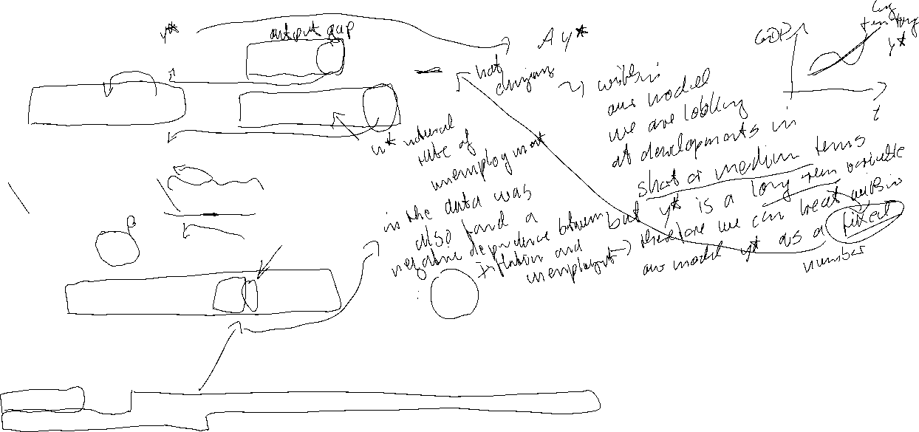

Philippskurve and short run aggregrated supply (AS-curve) and Okun´s law
Okun´s law: -A(u_{t}-u*) = (Y_{t}-Y*)/Y* set Ã=AY*
⇒ -Ã(u_{t}-u*) = Y_{t}-Y* ⇒ Y*- Ã(u_{t}-u*) = Y_{t}
Together with the AS-curve we obtain:
Y*- Ã(u_{t}-u*) = Y_{t}=Y* + ã(π_{t} - π_{t}^{e})
⇒ - (Ã/ã)(u_{t}-u*) = π_{t} - π_{t}^{e}
⇒ π_{t} = π_{t}^{e} - β(u_{t}-u*) with β = (Ã/ã)>0 Expectation augmented Philipps curve
In its original form, the Phillips curve, like Okun's law, merely reflected the empirical finding that rising inflation tends to lead to falling unemployment.
Philipps, A. (1958) The Relation between Unemployment and the Rate of Change of Money Wages in the United Kingdom, 1861–1957, Economica, Vol. 25, S. 283–299
Phelps, Edmund S. (1967) “Phillips Curves, Expectations of Inflation and Optimal Employment over Time.” Economica, n.s., 34, no. 3, 254–281.
(Nobel Prize 2006)

Slide 14
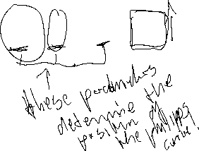


Inflation, Unemployment, and the Phillips Curve
The Philipps curve states that inflation π depends on
  expected inflation π^{e}
  the deviation of unemployment from the natural rate u-u*
  For further analysis we add an supply shock ε
π = π^{e} - β(u-u*) + ε

Slide 15
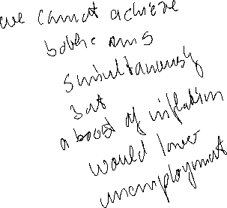

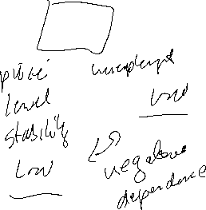
The short run Phillips curve
π
Trade off between
unemployment and inflation
β
1
π^{e} + ε
u*
u

Slide 16
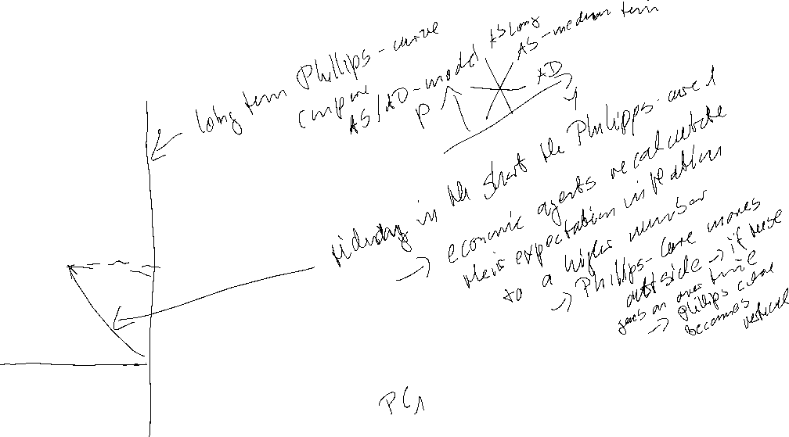
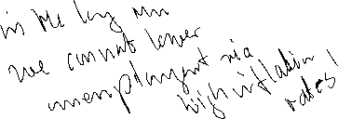
Long run Phillips Curve
π
2
π₂ =π₃
3
1
π₁
u*
u
u₂
u₃=u₁

Slide 17
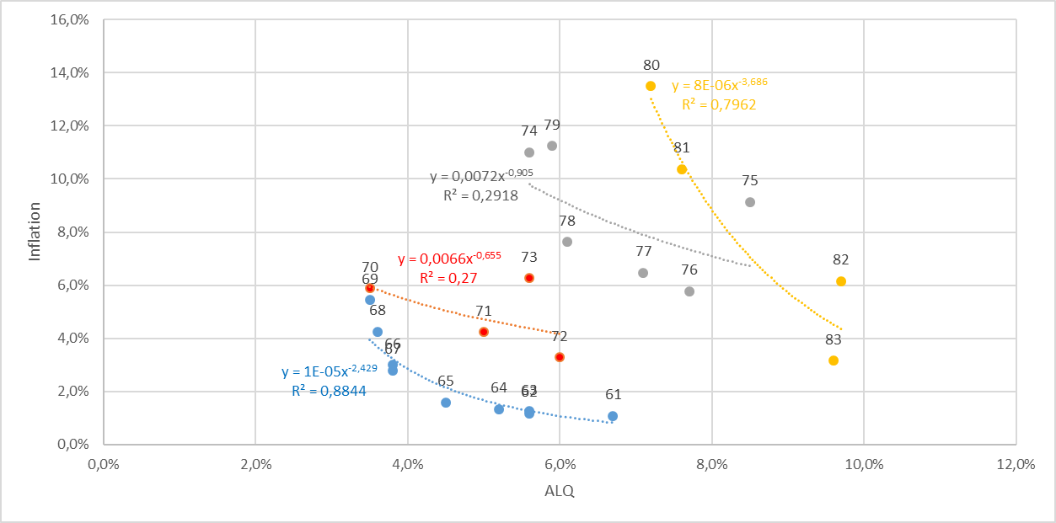

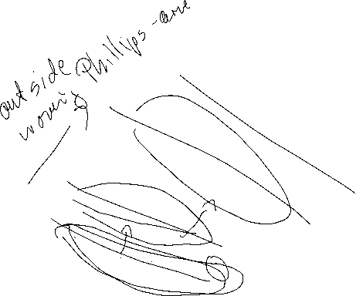

Philipps-curve USA I
Source: FRED
From the 1960 to 1980ies we seen an outward shift of the Philipps-curve
In this example, the regression used the Ansatz:
y=xª
Thus, the exponent can directly interpreted as the elasticity between x and y
e=(dy/y):(dx/x)
Can you show this ☺?.

Slide 18
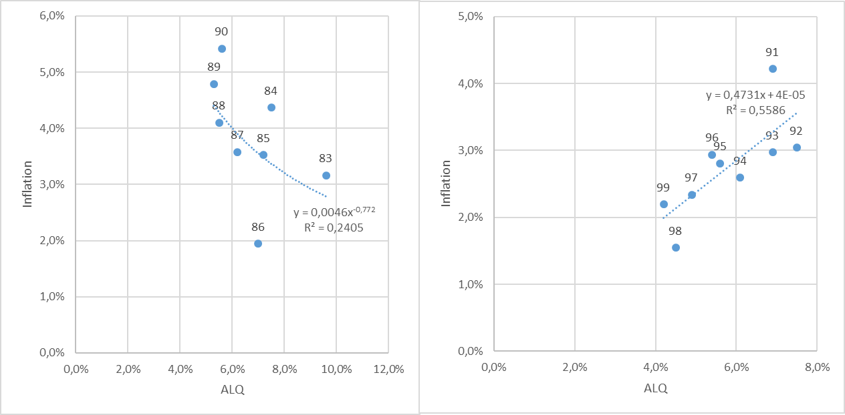
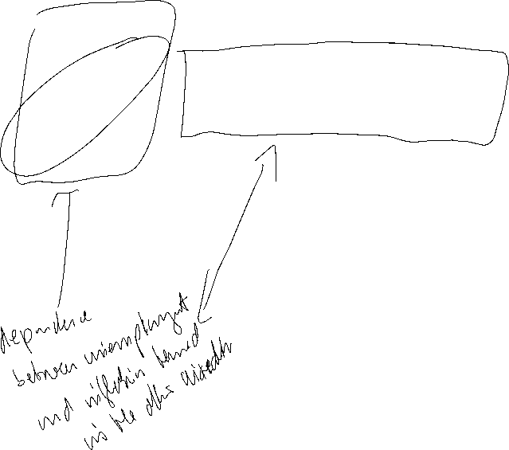
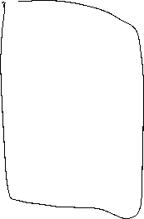
Philipps-curve USA II
Source: FRED
From the 1980ies to 2000, the data shows only a weak or even a inverted dependence between inflation and umemployment. A possible reason is the drastic change of the economic circumstandes due to the break down of the soviet union and after that the dramatic change in the global economic dependencies

Slide 19
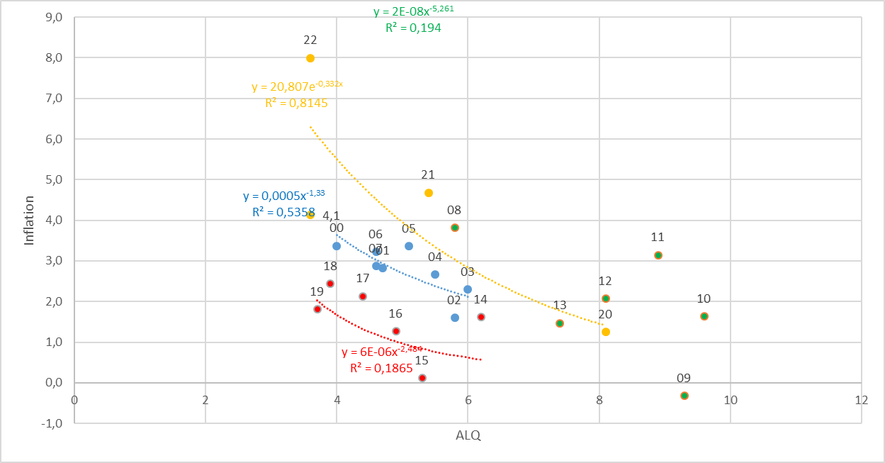
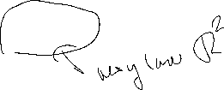

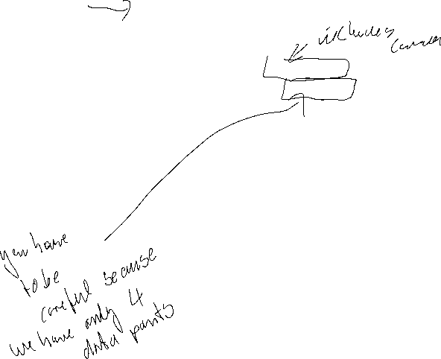
Philipps-curve USA III
Source: FRED
With the first push of globalization from 2000 until the financial crisis, again there is a quite stable „classical“ philipps-curve like dependence.
But within in following turmoil in the aftermath of the financial crisis, we had again no stable dependence again!
Using the data from 2020 to 2023 for a regression, we obtain a R^2=0,82. Are we therefore back to a stable dependence between inflation and unemployment?

Slide 20
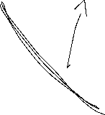
Inflation – Economic Policy – Philipps curve
π
Longrun PC
Until the 1980, people were of the opinion that one could freely choose the point on the Phillips curve via monetary or fiscal policy (cf. data before) and therefore could lower unemployment by allowing higher inflation rates
X
Then it was realized that expectations adjust and there is a rightward shift/rotation into the vertical of the Phillips curve!
c
c
π^{e}
Y
Shortrun PC
u*
u

Slide 21

Inflation – Economic Policy – Philipps curve
→ In order to be able to permanently reduce the unemployment rate π > π^{e} would have to apply permanently.
→ in the long run this is unrealistic and stable condition results!
→ thus, in principle, under rational expectations π = π^{e} will hold
→ thus u=u*
→ motion only on the long-run (vertical) Phillips curve possible!
→ Stagflation

Slide 22
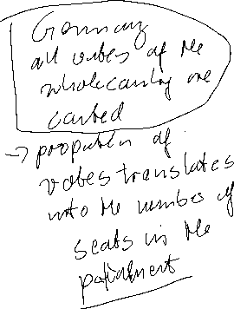

USA-Presidential Vote
All eligible voters have one vote for one party or one person in their state (see below)
The president is elected through an indirect election via the Electoral College (EC)
Each state + Washington D.C. sends a fixed number of electors to the EC
In most cases, relative majority voting applies with regard to the parties that occupy the EC for the respective states
In 48 states and Washington D.C. the rule “the winner-takes-all” applies
In Nebraska and Maine, two people are chosen for the EC according to the winner-takes-all rule, the other three people (1/Maine, 2/Nebraska) are chosen in single-member districts to elect the House of Representatives. In Nebraska this is done by relative majority vote, in Maine in a run-off election (successive veto rule)
In principle, the persons in the EC are not bound by the election results in the federal states
Notes:
  Due to electoral law, coalitions have not been necessary.
  Due to electoral law, a reversal of the majority situation - majority of votes vs. EC majority is possible e.g. (2000/Bush 2016/Trump)

Slide 23

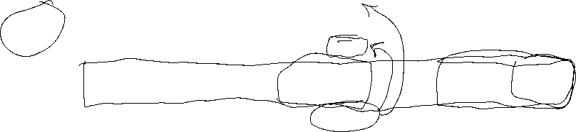
US-Präsidentschaftswahl

