Slide 1

Global Economics
Wilhelmshaven
This lecture will be recorded and
Subsequently uploaded in the
world-wide-web
Prof. Dr. Bernhard Köster
Jade-Hochschule Wilhelmshaven
http://www.bernhardkoester.de/vorlesungen/inhalt.html

Slide 2

Global Economics
Winter term 2024
Prof. Dr. Bernhard Köster

Slide 3
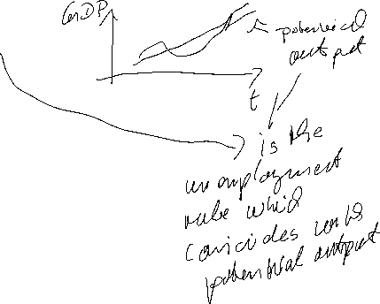


Natural Rate of Unemployment
u* : Natural rate of unemployment
Mainly caused by:
frictional unemployment
structural unemployment
or
generally a worker who is not able to get a job because she doesn’t have the right skills.
⇒ The natural rate of unemployment is caused by supply side factors rather than demand side factors

Slide 4

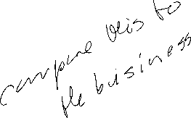


Cyclical Unemployment
Actual unemployment rate = u
Natural unemployment rate = u*
Cyclical unemployment rate = u - u*
recessionary Gap: u - u* > 0
expansionary Gap: u - u* < 0

Slide 5
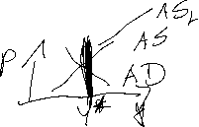
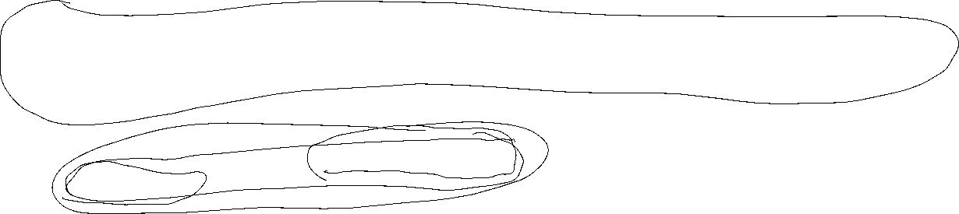
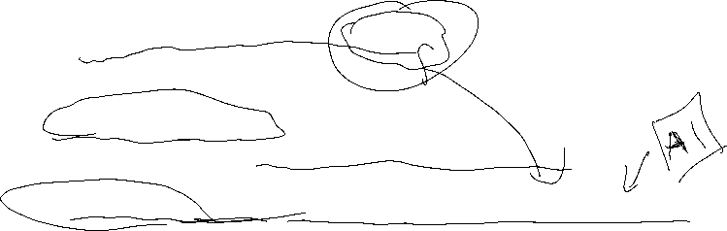
Relationship between unemployment and economic growth
In general, one would expect unemployment to fall when economic growth is high.
Thus, one could identify natural unemployment directly with potential output (cf. neoclassical theory and the long-run supply curve (AS)).
But Okun (1962) showed empirically:
Okun, Arthur M. (1962). “Potential GNP: Its Measurement and Significance.” Reprinted as Cowles Foundation Paper 190.
In general Okun´s law implies that if output growth is 1%-point over potential growth than unemployment falls only by 0,5%-points.
Okun, Arthur M. 1962. “Potential GNP: Its Measurement and Significance.” Reprinted as Cowles Foundation Paper 190.
Reasons:
Firms adjust employment less than one for one in response to deviations of output to the natural growth rate.
The labor force participation of the population increases over time (for Germany, especially the labor force participation of women).
Labor productivity increases (currently in particular due to digitalization)

Slide 6

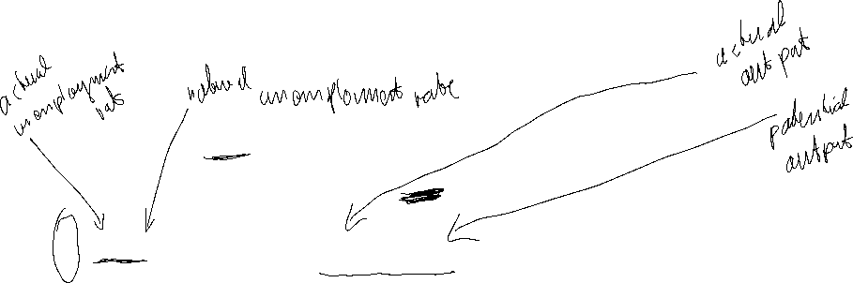
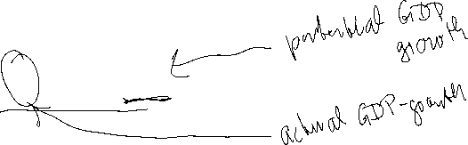
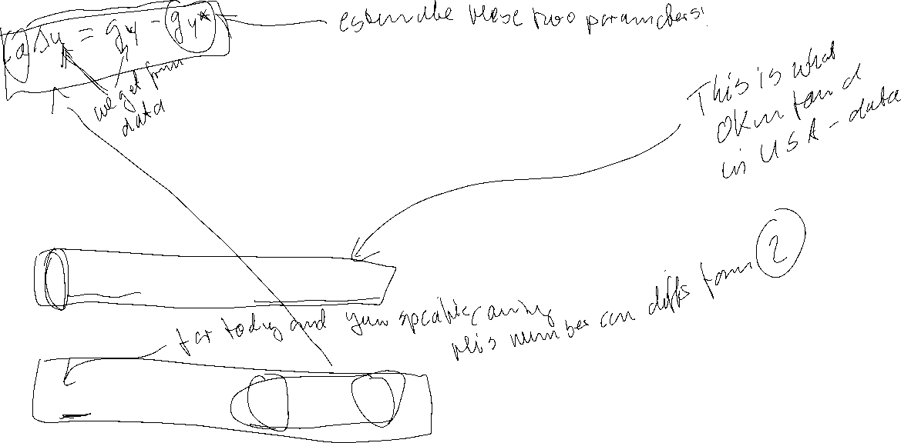
Okun’s Law
Arthur Melvin Okun based on
empirical observations (1962):
Every rise of 1%-point in cyclical unemployment is
associated with a lowering of 2%-points of the output gap.
−2(u - u*) = (Y – Y*)/Y* (Gap Version)
or
-2Δu = g_{y} – g_{Y*} (Growth Version)
g_{y}, g_{Y*}: growth rates of actual and potential out respectively
Δu: change in unemployment over time

Slide 7
Okun’s Law
In general Okun´s law implies that if output growth is 1%-point over potential growth than unemployment falls only by ½%-points.
Reasons:
Firms adjust employment less than one for one in response to deviations of output to the natural growth rate.
Labor participation increases
Labor productivity increases

Slide 8
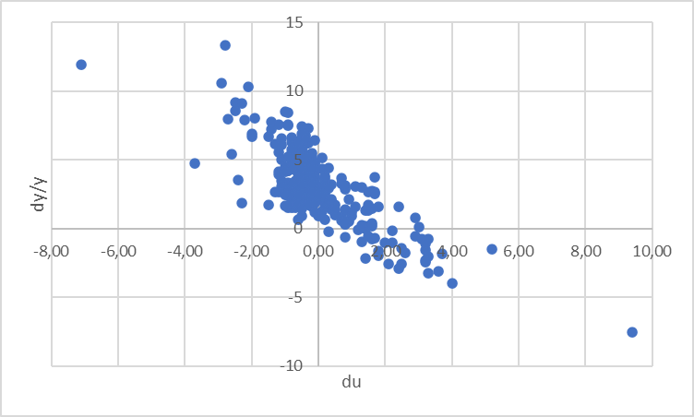
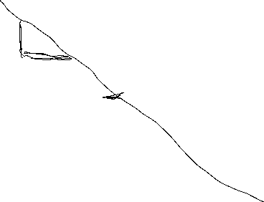
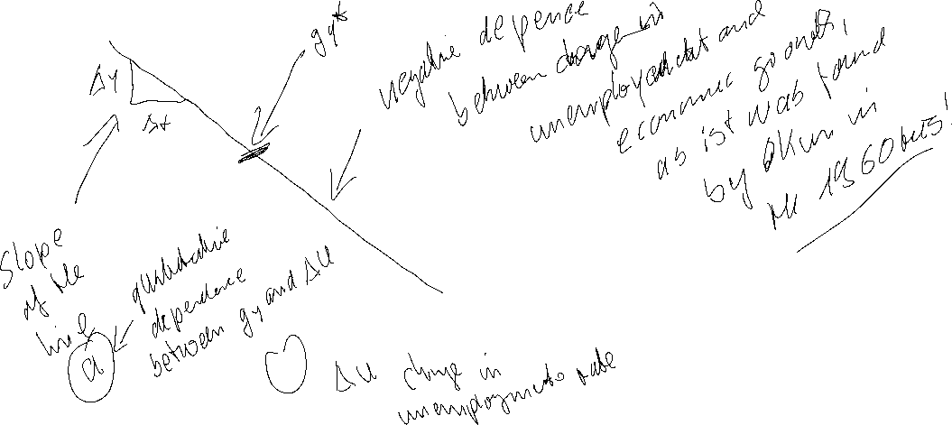

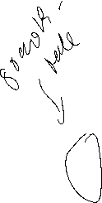

Estimating Okun’s Law: US-Data (1949 – )
Source: FRED, own calculation
Quelle: FRED
Quarterly Data, seasonally adjusted. In order to eliminate effects within a year, we do not use the growth rate respectively to the former quarter but with respect to the quarter of the previous year. Therefore the change of unemployment is also calculated with respect of the quarter of the previous year.

Slide 9
Linear Regression
Example:
A company wants to know how the sales volume depends on visits of representatives.
The company has collected the following data
c
We also want to answer the question, from a descriptive point of view, which sales volume we can expect, if we increase the visits up to x=30

Slide 10

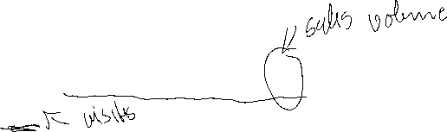



Linear Regression
Via a linear regression we want to analyse the dependence between two variables
We distinguish between a dependent variable (y) and an independent variable (x)
(x) is also called the explanatory variable
A change of (x) implicates a change (y)
The linear regression defines an empirical relation via a linear function
i.e. y = f(x) = 3 + 2x or generally y = a + bx
c

Slide 11

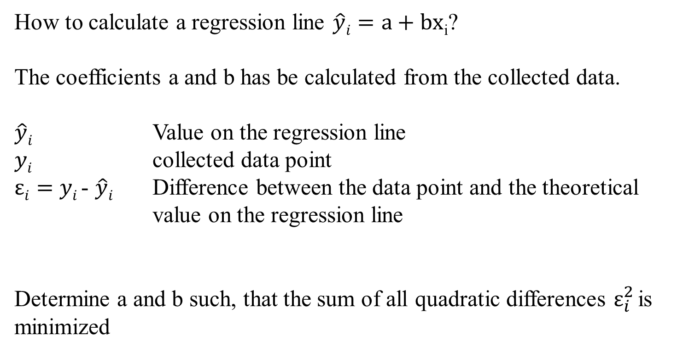

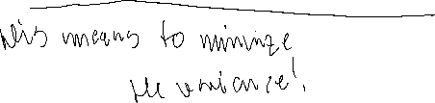

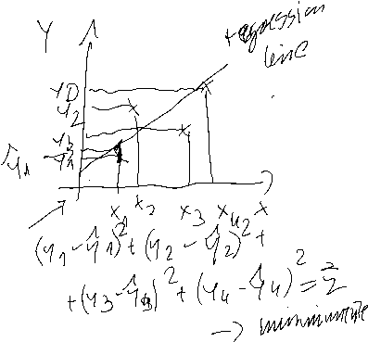

Optimizing problem
How to calculate a regression line $\hat{y}i=a+bx$_{i}?
The coefficients a and b has be calculated from the collected data.
$\hat{y}i$ Value on the regression line
$yi$ collected data point
$εi=$ $yi$- $\hat{y}i$ Difference between the data point and the theoretical value on the regression line
Determine a and b such, that the sum of all quadratic differences $ε_{i}^{2}$is minimized
c

Slide 12
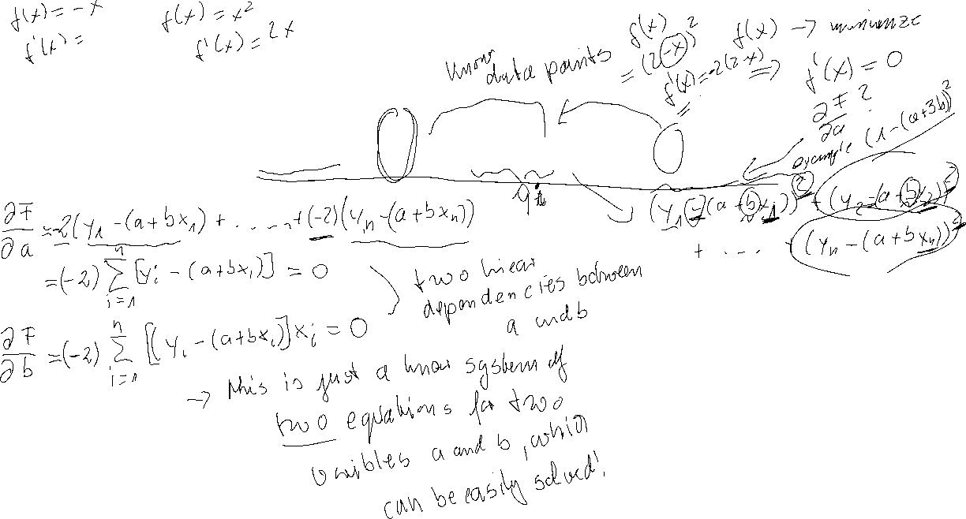
Least squared method
The formal optimizing problem
c

Slide 13
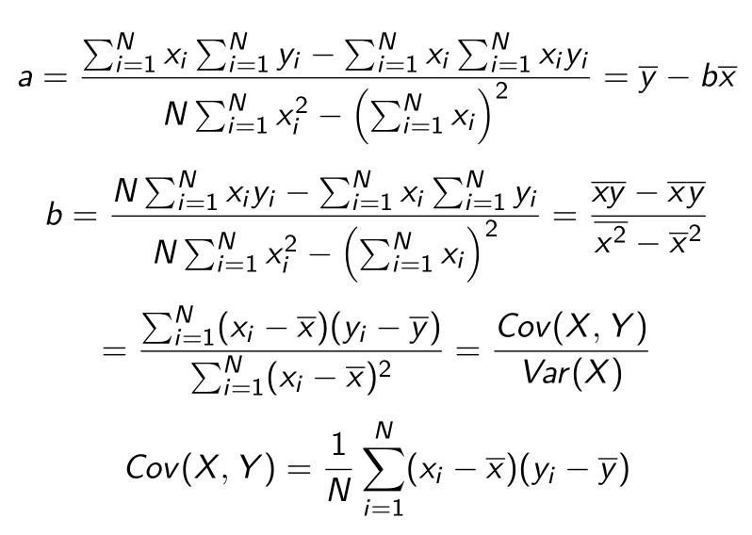
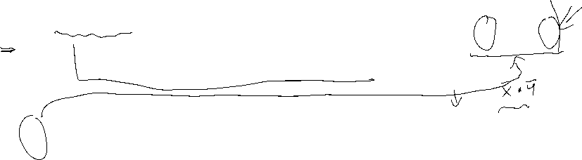
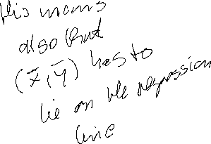
Formulas
:
c

Slide 14






Linear Regression
 | Visits | Sales volume [€]
year | x | y | xy | x^2
2008 | 9 | 24 | 216 | 81
2009 | 11 | 33 | 363 | 121
2010 | 5 | 10 | 50 | 25
2011 | 13 | 29 | 377 | 169
2012 | 20 | 42 | 840 | 400
2013 | 12 | 24 | 288 | 144
c
b=
a=

Slide 15
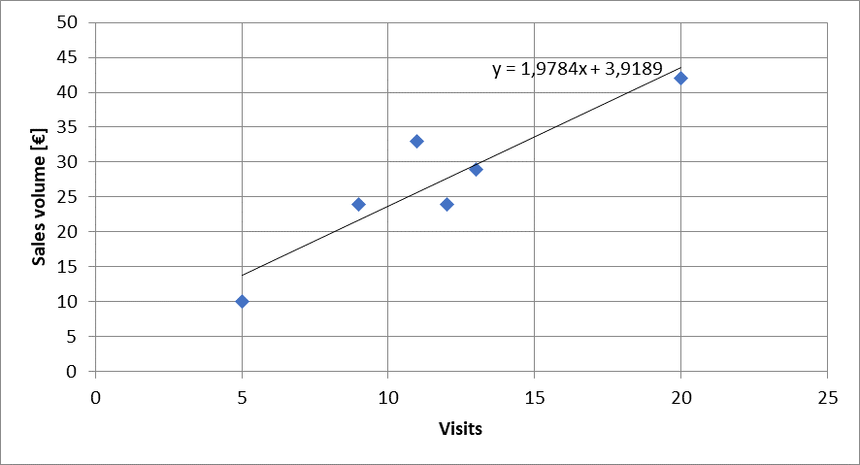
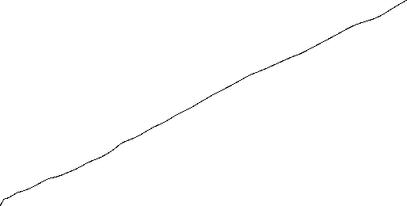


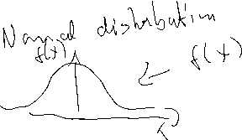

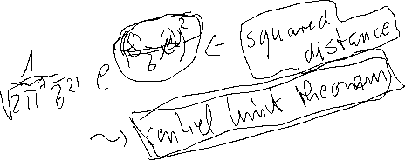


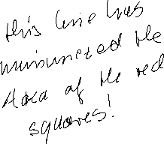

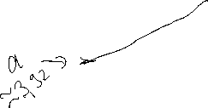
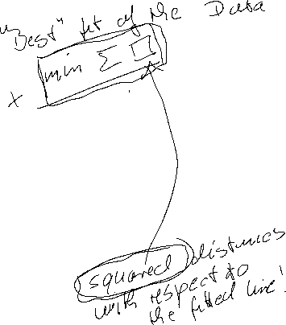
Calulating the regression line from empirical data
$$ei2$$
$\hat{y}i=a+bx$_{i}
c

Slide 16
Regressions coefficients
Regressions coefficient b
  Slope of the regression line.
  Determines the marginal effect of a change of one unit of the independent variable x onto the dependet variable y
Regressions coefficient a
  The value of the dependent variable if the independent variable x=0
    → intercept of the vertical axes
c

Slide 17
Correlation analysis
In principle for all data sets, we can calculate a regression line.
But we are also interested in the question meaningful is this calculated dependence?.
For this, we use the correlation analysis, wich gives the possibility to measure the strength of the dependence
For this, we use the correlation coefficient of Bravais-Pearson which is lying between -1 and +1
c

Slide 18
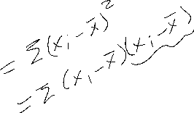
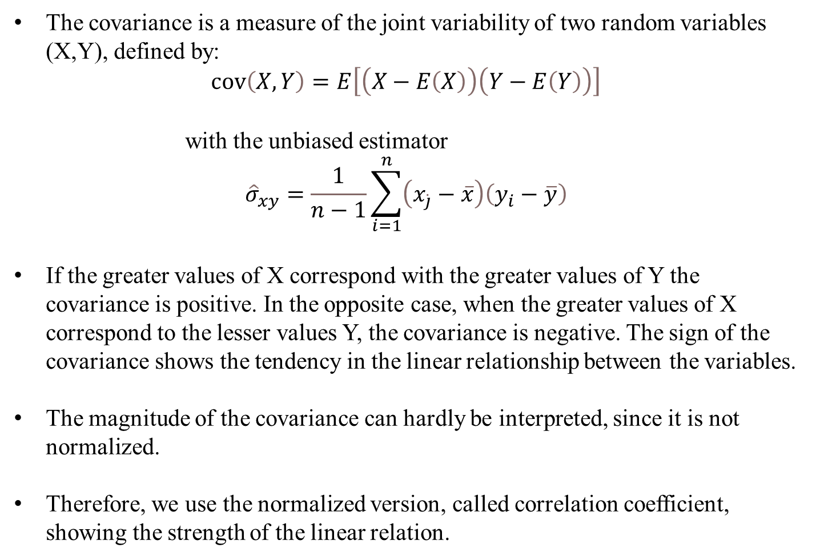

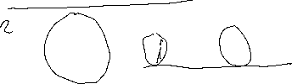
Covariance
The covariance is a measure of the joint variability of two random variables (X,Y), defined by:
$$\operatorname{cov}\left(X,Y\right)=E\left[\left(X−E\left(X\right)\right)\left(Y−E\left(Y\right)\right)\right]$$
with the unbiased estimator
$${\hat{σ}}_{xy}=\frac{1}{n−1}\sum_{i=1}^{n}{\left(x_{\dot{j}}−\overline{x}\right)\left(y_{i}−\overline{y}\right)}$$
If the greater values of X correspond with the greater values of Y the covariance is positive. In the opposite case, when the greater values of X correspond to the lesser values Y, the covariance is negative. The sign of the covariance shows the tendency in the linear relationship between the variables.
The magnitude of the covariance can hardly be interpreted, since it is not normalized.
Therefore, we use the normalized version, called correlation coefficient, showing the strength of the linear relation.
c

Slide 19
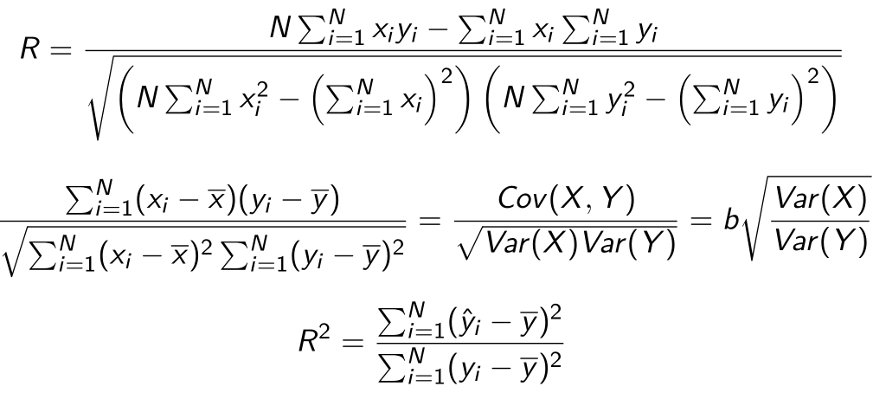
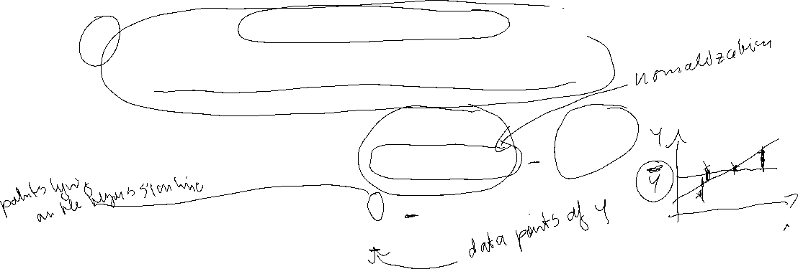
Correlation coefficient
General intervals for R
(0,0;0,2) → almost no dependence
[0,2;0,4) → low dependence
[0,4;0,6) → medium dependence
[0,6;0,8) → high dependence
[0,8;1,0) → almost full dependence
c

Slide 20
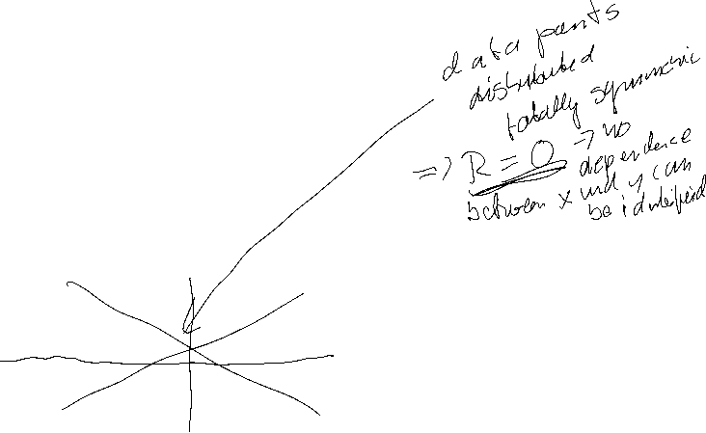
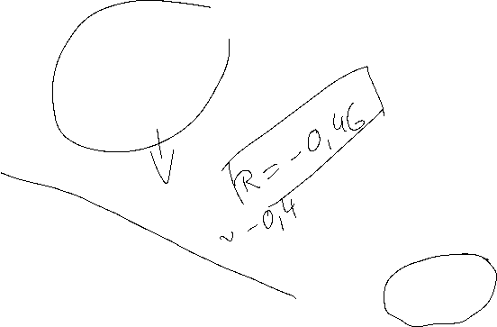
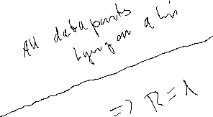
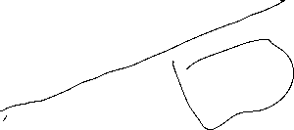
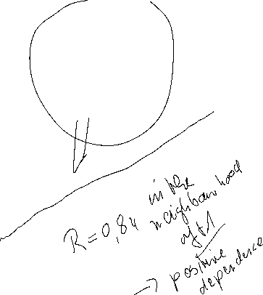
Correlation coefficiant examples
R=?
R=?
c
R=?
R=?

Slide 21



Coefficiant of determination R²
The squared correlation coefficiant R² is called coefficiant of determination.
In quantitative analysis, we often use the coefficiant of determination R², because it can be intuitively interpreted
But R² does not distinguish between + and – anymore.
R² is in the interval [0,1]
R² grafical interpretation:
  R² equals the proportion of variance explained by the model in relation to the total variance, i.e. how much percent is explained by the regression line
  (1-R²) equals the proportion of Variance not explained by the model in relation to the total variance, and has to be explained by other influencing factors
c

Slide 22
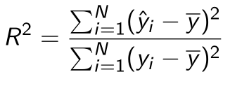

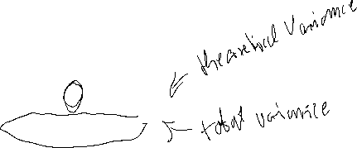

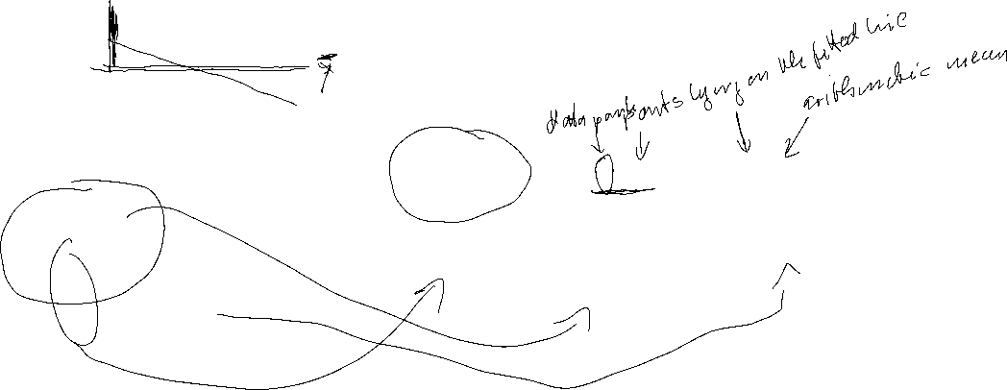


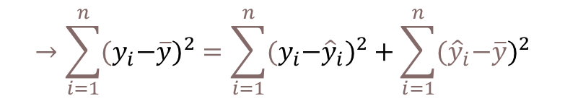
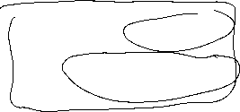
Coefficiant of determination R²
{
${\hat{y}}_{i}−\overline{y}$ explained difference
Total Difference
} Non explained difference
} Explained difference
${y_{i}−\hat{y}}_{i}$ not explained difference
Mean
$y_{i}−\overline{y}$ total difference
$$→\sum_{i=1}^{n}{{{(y}_{i}−\overline{y})}^{2}}=\sum_{i=1}^{n}{{{{(y}_{i}−\hat{y}}_{i})}^{2}}+\sum_{i=1}^{n}{{{(\hat{y}}_{i}−\overline{y})}^{2}}$$
Non explained squared difference y_{i}
total squared difference
explained squared difference
Mean
not explained squared difference
explained squared difference y_{i}
c
Total squared difference of y_{i}

Slide 23

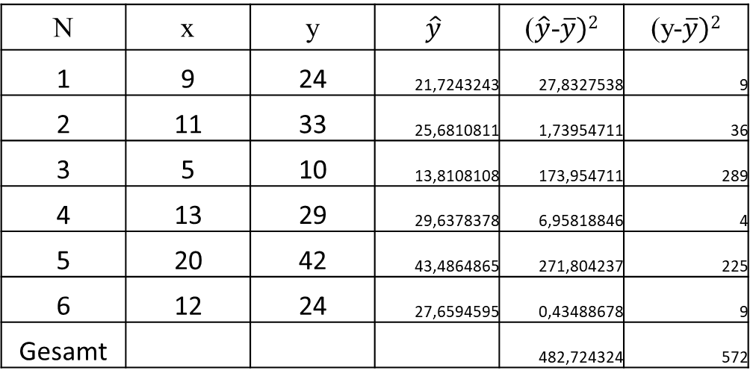
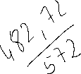
Coefficiant of determination R²
N | x | y | $$\hat{y}$$ | ($\hat{y}$-$\overline{y})2$ | (y-$\overline{y})2$
1 | 9 | 24 | 21,7243243 | 27,8327538 | 9
2 | 11 | 33 | 25,6810811 | 1,73954711 | 36
3 | 5 | 10 | 13,8108108 | 173,954711 | 289
4 | 13 | 29 | 29,6378378 | 6,95818846 | 4
5 | 20 | 42 | 43,4864865 | 271,804237 | 225
6 | 12 | 24 | 27,6594595 | 0,43488678 | 9
Gesamt |  |  |  | 482,724324 | 572
c
R²= R=

Slide 24
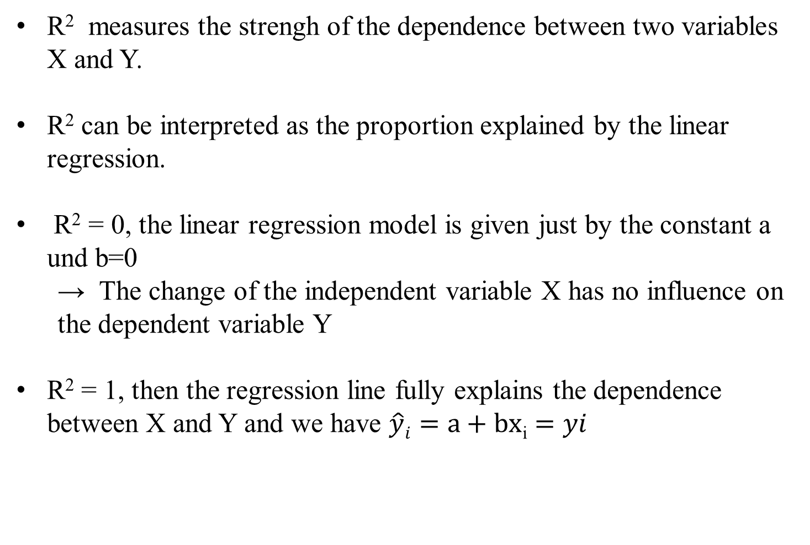
Interpretation of R²
R² measures the strengh of the dependence between two variables X and Y.
R² can be interpreted as the proportion explained by the linear regression.
R² = 0, the linear regression model is given just by the constant a und b=0
  → The change of the independent variable X has no influence on the dependent variable Y
R² = 1, then the regression line fully explains the dependence between X and Y and we have $\hat{y}i=a+bx$_{i} $=yi$
c

Slide 25
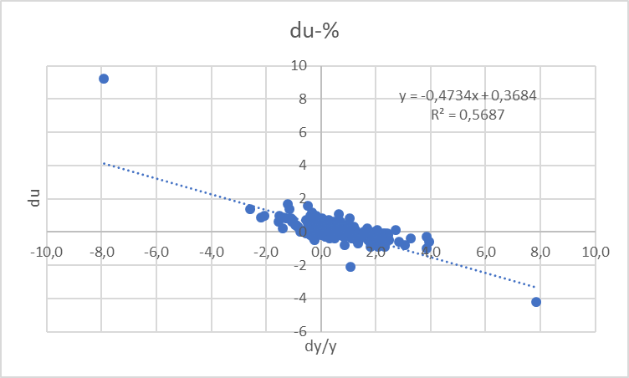

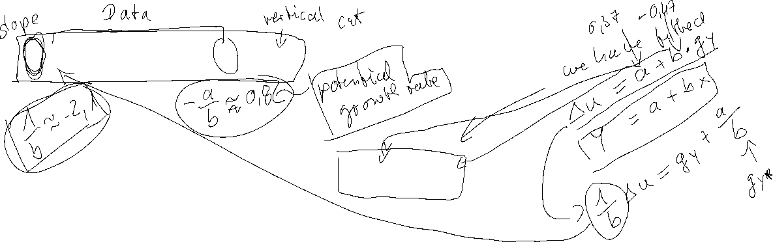
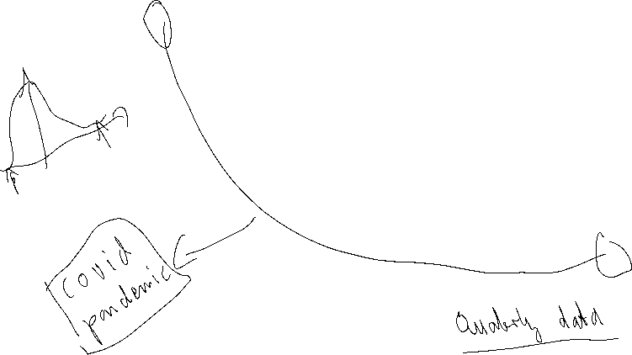
Estimating Okun’s Law: US-Data (1949 – )
Source: FRED, own calculation
-2Δu = g_{y} – g_{Y*} (Growth Version)

Slide 26
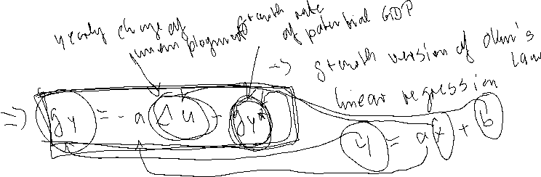

Estimation of Okun's Law - Country Analysis
Data: IMF Data mapper or other source. If you use quaterly data, think of
Contrast the data (1980-2023, per availability) of the variables Δu and g_{y} in a scatter plot
Linear regression of g_{y} and Δu .
Identify Okuns`s law with the regression parameters in g_{y} = -aΔu + g_{Y*} and interprete the parameters
Look for "meaningful" subperiods for your country for estimation purposes (consider especially structural breaks like crises, political changes,...)
Also evaluate your econometric analysis using the coefficient of determination R²
and the correlation coefficient R
aΔu = g_{y} – g_{Y*}

Slide 27
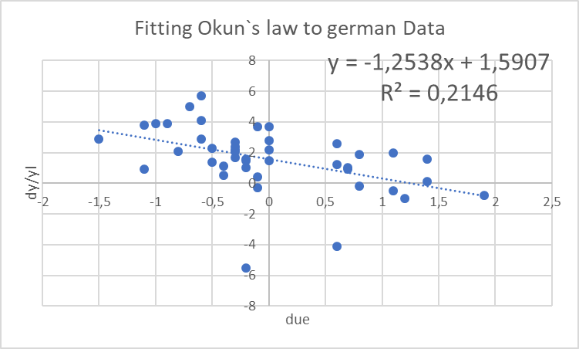



Estimation of Okun's Law - Country Analysis Germany

Slide 28









Estimation of Okun's Law - Country Analysis Germany subperiods

Slide 29
Short-run Output Gaps: Why do they matter?
Output Gap = Actual Output - Potential Output
_______________________________________
Potential Output
= Y - Y*
_______________________________________
Y*
(Y – Y*)/Y* > 0 → a positive output gap
is called expansionary gap
(Y – Y*)/Y* < 0 → a negative output gap
is called recessionary gap

Slide 30
Output Gaps: Two kinds of Costs
(Y – Y*)/Y* > 0 expansionary gap
inflation can be high
economy incurs costs of inflation
(Y – Y*)/Y* < 0 recessionary gap
unemployment rate high (above normal)
economy incurs costs of unemployment

Slide 31
Estimating Okun’s Law: Country (1980 – )
Source: IMF Data Mapper

Slide 32
Inflation and Unemployment as macroeconomic targets
In practical economic policy, the primary direct objectives macroeconomic variables
inflation (π) and unemployment (u)
rather than economic growth
For example the 2%-target of the ECB or the dual target of the Fed pursuing the economic goals of maximum employment and price stability (i.e u = 6% in the aftermath of the financial crisis)
Although price level (p) and (y) are directly related to (π) and (u) these variables, but these variables are generally not used as operationalized target variables!

Slide 33
Inflation and Unemployment : Philippskurve
Transition from price level to inflation:
Price level (P) → Inflation (π) determine the perventage change!
Inflation: π_{t}=(P_{t}-P_{t-1})/P_{t-1}=P_{t}/P_{t-1}-1 relative change compared to the former period
Expected Inflation: π_{t}^{e}=(P_{t}^{e}-P_{t-1})/P_{t-1}=P_{t}^{e}/P_{t-1}-1 relative expected change compared to the former period
output (y) → unemployment (u)
Okuns law!
-A(u_{t}-u*)=(Y_{t}-Y*)/Y* (A>0)

Slide 34


Philippskurve and short run aggregrated supply (AS-curve)
AS: Y_{t} = Y* + a(P_{t}-P_{t}^{e}) (a>0) (P_{t}^{e}: expected price level)
replace P_{t}/P_{t-1}=1+ π_{t} and P_{t}^{e}/P_{t-1}= 1+π_{t}^{e}
→ Y_{t} = Y* + a((1+ π_{t})P_{t-1} - (1+ π_{t}^{e})P_{t-1} )
= Y* + P_{t-1}a(π_{t} - π_{t}^{e})
= Y* + ã(π_{t} - π_{t}^{e}) with ã= P_{t-1}a>0
With given expectations, we obtain
or
P_{t}
π _{t}
$$AS$$
$AS$`
Y_{t}
Y_{t}

Slide 35
Philippskurve and short run aggregrated supply (AS-curve) and Okun´s law
Okun´s law: -A(u_{t}-u*) = (Y_{t}-Y*)/Y* set Ã=AY*
⇒ -Ã(u_{t}-u*) = Y_{t}-Y* ⇒ Y*- Ã(u_{t}-u*) = Y_{t}
Together with the AS-curve we obtain:
Y*- Ã(u_{t}-u*) = Y_{t}=Y* + ã(π_{t} - π_{t}^{e})
⇒ - (Ã/ã)(u_{t}-u*) = π_{t} - π_{t}^{e}
⇒ π_{t} = π_{t}^{e} - β(u_{t}-u*) with β = (Ã/ã)>0 Expectation augmented Philipps curve
In its original form, the Phillips curve, like Okun's law, merely reflected the empirical finding that rising inflation tends to lead to falling unemployment.
Philipps, A. (1958) The Relation between Unemployment and the Rate of Change of Money Wages in the United Kingdom, 1861–1957, Economica, Vol. 25, S. 283–299
Phelps, Edmund S. (1967) “Phillips Curves, Expectations of Inflation and Optimal Employment over Time.” Economica, n.s., 34, no. 3, 254–281.
(Nobel Prize 2006)

Slide 36
Inflation, Unemployment, and the Phillips Curve
The Philipps curve states that inflation π depends on
  expected inflation π^{e}
  the deviation of unemployment from the natural rate u-u*
  For further analysis we add an supply shock ε
π = π^{e} - β(u-u*) + ε

Slide 37
The short run Phillips curve
π
Trade off between
unemployment and inflation
β
1
π^{e} + ε
u*
u

Slide 38
Long run Phillips Curve
π
2
π₂ =π₃
3
1
π₁
u*
u
u₂
u₃=u₁

Slide 39

Philipps-curve USA I
Source: FRED
From the 1960 to 1980ies we seen an outward shift of the Philipps-curve
In this example, the regression used the Ansatz:
y=xª
Thus, the exponent can directly interpreted as the elasticity between x and y
e=(dy/y):(dx/x)
Can you show this ☺?.

Slide 40

Philipps-curve USA II
Source: FRED
From the 1980ies to 2000, the data shows only a weak or even a inverted dependence between inflation and umemployment. A possible reason is the drastic change of the economic sircumstandes due to the break down of the soviet union and after that the dramatic change in the global economic dependencies

Slide 41

Philipps-curve USA III
Source: FRED
With the first push of globalization from 2000 until the financial crisis, again there is a quite stable „classical“ philipps-curve like dependence.
But within in following turmoil in the aftermath of the financial crisis, we had again no stable dependence again!
Using the data from 2020 to 2023 for a regression, we obtain a R^2=0,82. Are we therefore back to a stable dependence between inflation and unemployment?

Slide 42
Inflation – Economic Policy – Philipps curve
π
Longrun PC
Until the 1980, people were of the opinion that one could freely choose the point on the Phillips curve via monetary or fiscal policy (cf. data before) and therefore could lower unemployment by allowing higher inflation rates
X
Then it was realized that expectations adjust and there is a rightward shift/rotation into the vertical of the Phillips curve!
c
c
π^{e}
Y
Shortrun PC
u*
u

Slide 43
Inflation – Economic Policy – Philipps curve
→ In order to be able to permanently reduce the unemployment rate π > π^{e} would have to apply permanently.
→ in the long run this is unrealistic and stable condition results!
→ thus, in principle, under rational expectations π = π^{e} will hold
→ thus u=u*
→ motion only on the long-run (vertical) Phillips curve possible!
→ Stagflation

