Slide 1

Global Economics
Wilhelmshaven
This lecture will be recorded and
Subsequently uploaded in the
world-wide-web
Prof. Dr. Bernhard Köster
Jade-Hochschule Wilhelmshaven
http://www.bernhardkoester.de/vorlesungen/inhalt.html

Slide 2

Global Economics
Winter term 2024
Prof. Dr. Bernhard Köster

Slide 3
Prof. Dr. Bernhard Köster
Room: S 113
Street: Friedrich-Paffrath-Straße 101
location: 26389 Wilhelmshaven
Tel. +49 4421 985-2766
Email: bernhard.koester@jade-hs.de
Consultation hour: by arrangement
or just have a look into my office!
or Webex/Zoom …

Slide 4
Content
Overview of macroeconomic indicators
Okun`s law and time series analysis
General developments in the global economy and international trade
Exchange rates, Siegels paradoxon Interest parity and the Mundell-Felming-model
The Philippscurve, Taylor-Rule, time inconsistency and general problems in monetary policy
The Solow growth model
Selected topics

Slide 5


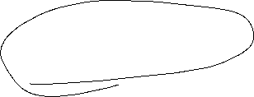
Macroeconomic indicators
Inflation
Unemployment
Interest rates
Economic growth
Exchange rates
Government Debt
Trade-to-GDP-ratio
Current account

Slide 6
Literature
Okun, Arthur M. (1962). “Potential GNP: Its Measurement and Significance.” Reprinted as Cowles Foundation Paper 190.
Siegel, J. J. (1972). Risk, interest rates and the forward exchange. The Quarterly Journal of Economics, 86 (2), 303–309.
Marcus Fleming (1062): Domestic financial policies under fixed and floating exchange rates. IMF Staff Papers 9, 369-379
Robert Mundell (1962) Capital mobility and stabilization policy under fixed and flexible exchange rates. In: Canadian Journal of Economic and Political Science. Vol. 29, 1962, 475-485 (Nobel Prize 1999)
Philipps, A. (1958) The Relation between Unemployment and the Rate of Change of Money Wages in the United Kingdom, 1861–1957, Economica, Vol. 25, S. 283–299
Phelps, Edmund S. (1967) “Phillips Curves, Expectations of Inflation and Optimal Employment over Time.” Economica, n.s., 34, no. 3, 254–281. (Nobel Prize 2006)
Barro, R., and D. Gordon (1983): “A Positive Theory of Monetary Policy in a Natural Rate Model,” Journal of Political Economy, 91, 589–610
Barro, R.J. and D. Gordon, (1983) Rules, Discretion, and Reputation in a Model of Monetary Policy, Journal of Monetary Economics, Vol. 12, 101 – 120
Köster, Bernhard (2011), Decision Rules, Transparency and Central Banks, Disseratation, University of Heidelberg
Mundell, R.A. (1961) A Theory of Optimum Currency Areas Author(s): Source: The American Economic Review, Vol. 51, No. 4, Sep., 657-665 (Nobel Prize 1999)
Solow, R.M. (1956) A Contribution to the Theory of Economic Growth, The Quarterly Journal of Economics, Vol. 70, No. 1, Feb., 65-94 (Nobel Prize 1987)
Swan, T. (1956) Economic Growth and Capital Accumulation, Economic Record, Band 32, No. 2, 334–361

Slide 7






Economic growth and the business cycle
The business cycle is measured by the fluctuations of real GDP in time around some long time trend.
Real GDP
Be careful: This is no linar line for constant growth
Expansion
Peak
Recession
Trough
time
Notes:
7

Slide 8

Potential Output
In general, we want to limit the fluctuations within the business cycle.
In order to have a reference for the fluctuations, the concept of potential output is developed:
Potential output is the maximum amount an economy can produce over the long run (production at full capacity).
In the long run it should be the economic aime to increase potential output, since the pure development of real GDP can be below or above the production possibilities of an economy.
But: Potential output is only a theoretical concept. Therefore the true value of potential out is difficult to estimate.
Notes:
8

Slide 9


Further definitions
Potential output is the maximum amount of goods and services an economy can turn out when it is most efficient—that is, at full capacity. Often, potential output is referred to as the production capacity of the economy.­ (IMF Definition)
But:
“…it must be noted that potential output cannot be observed directly, but has to be inferred from existing data using statistical and econometric methods. There is considerable uncertainty in the measurement of potential output, which translates across to the derived indicators.” (ECB, 2011)
Notes:
9

Slide 10
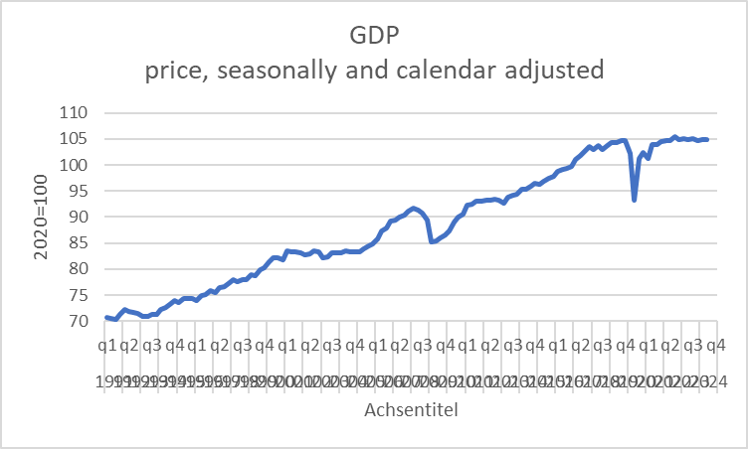




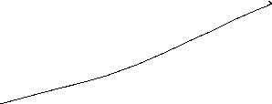


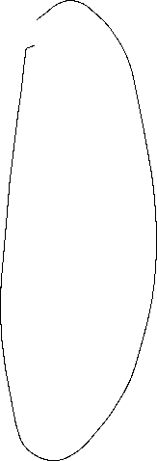
Simple calculation of average growth with quaterly data for Germany
Calculate the following average growth rates and interprete
Source:Destatis

Slide 11
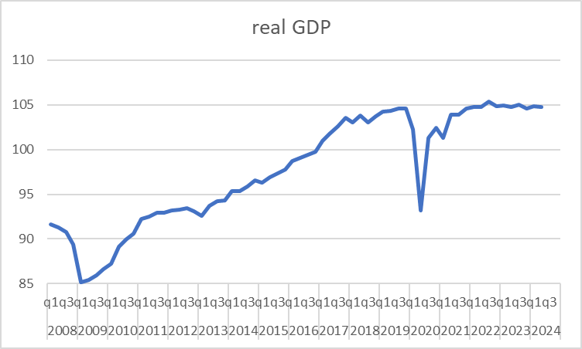
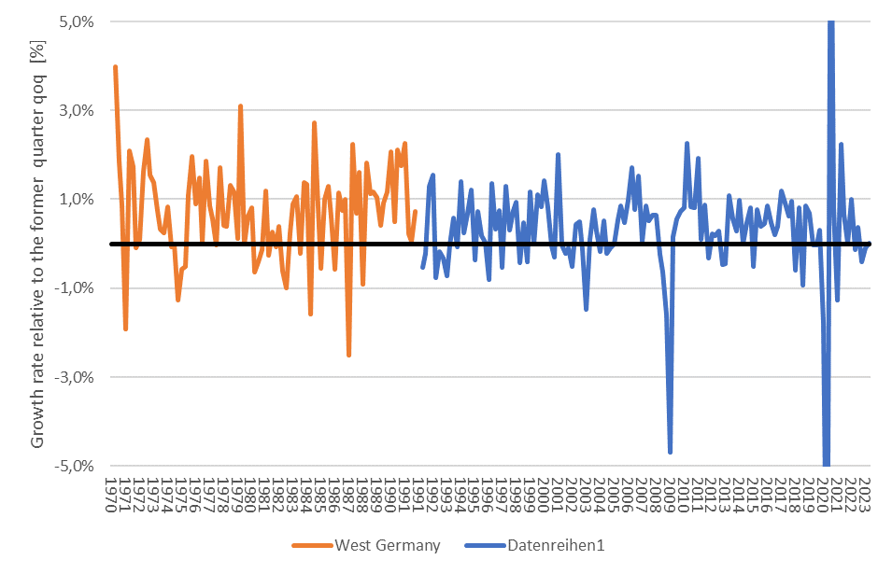





Business cycle – Germany
2.
3.
6.
7.
1.
4.
5.
Source: Destatis; price, seasonly, calendar adjusted

Slide 12
Macroeconomic parameters
Economic growth
Source: Destatis

Slide 13
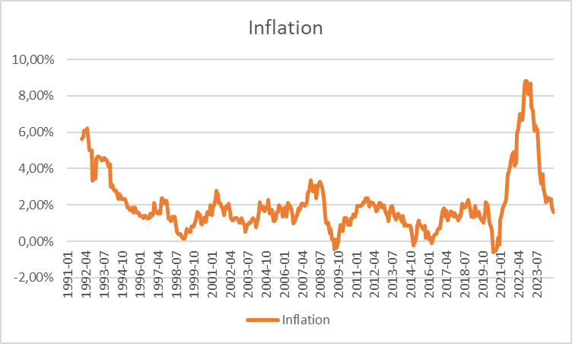



















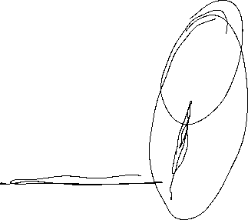











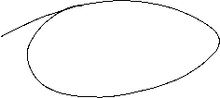
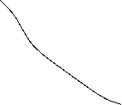
Macroeconomic parameters
Inflation
Source: Bundesbank

Slide 14
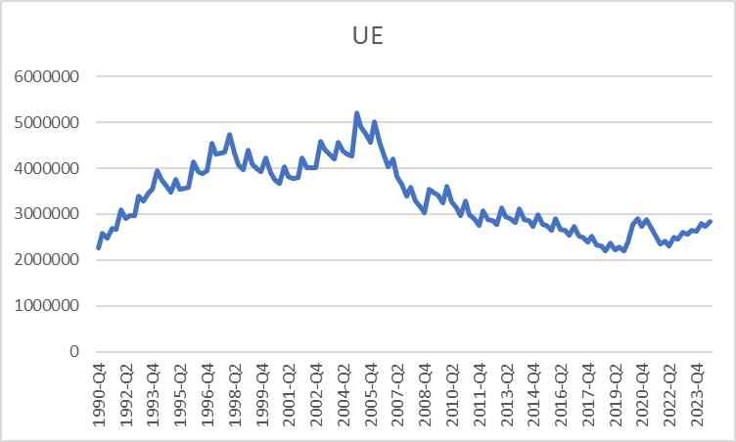








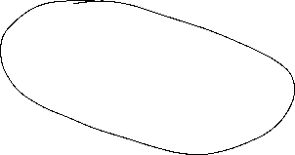
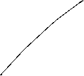









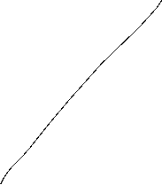





Macroeconomic parameters
Unemployment
Source: Bundesbank

Slide 15
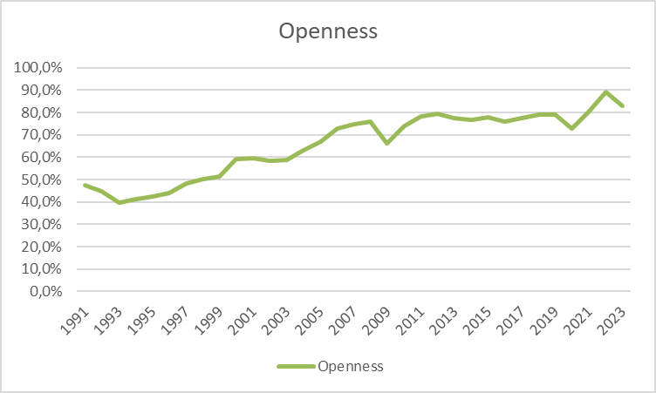





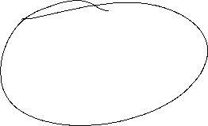







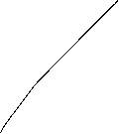

Macroeconomic parameters
Ex- and Imports
Source: Destatis

Slide 16
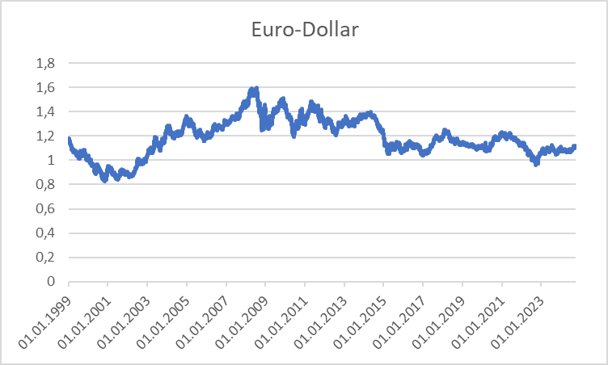





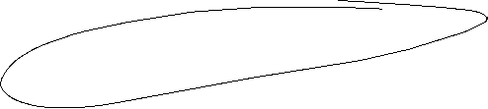




Macroeconomic parameters
Exchange rate
Source: Bundesbank

Slide 17
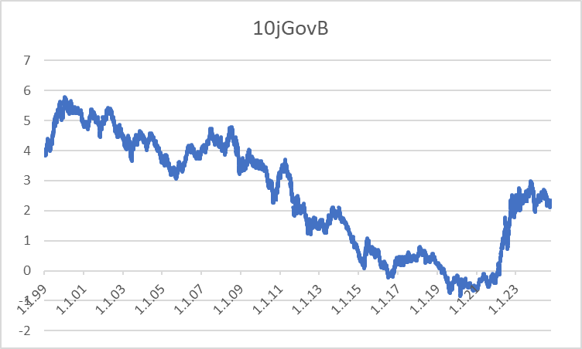

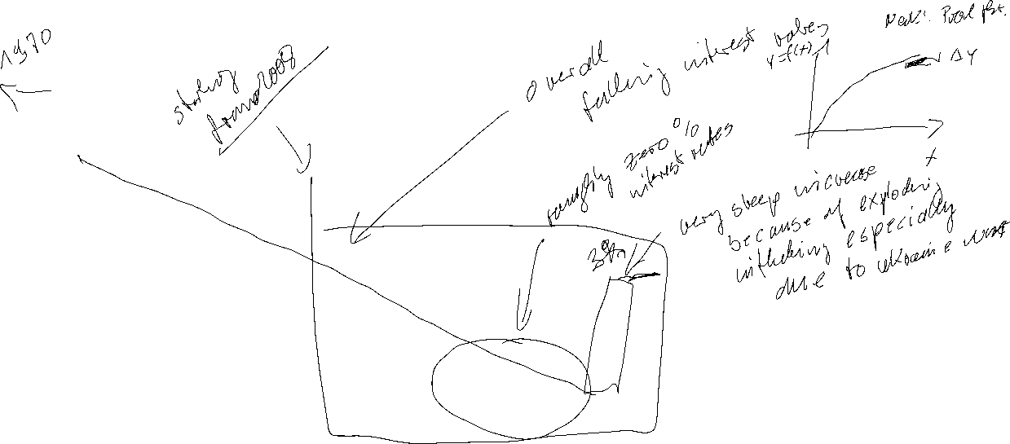
Macroeconomic parameters
Interest rates
Source: Bundesbank

Slide 18
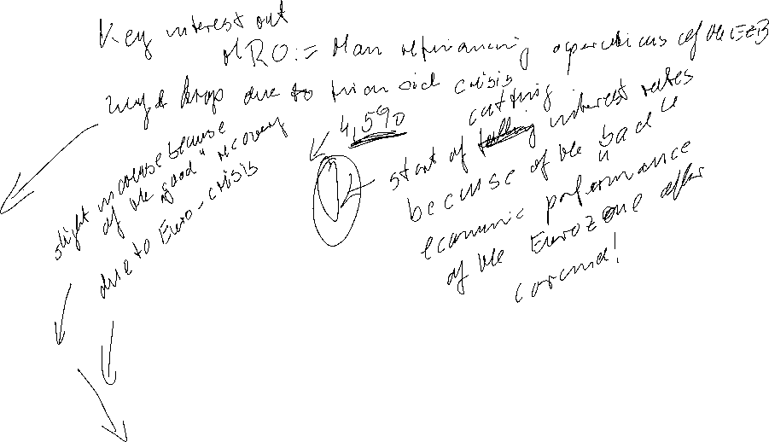
Macroeconomic parameters
Interest rates
Source: Bundesbank

Slide 19
Macroeconomic parameters
Key interest rates
Source: national central banks (Bundesbank) or www.leitzinsen.info
Macroeconomic parameters
Interest rates
Source: Bundesbank

Slide 20
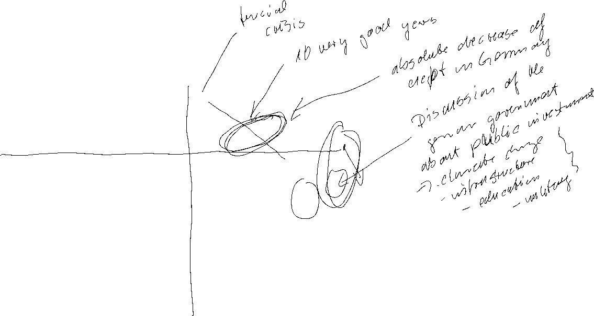
Macroeconomic parameters
Government debt
Source: Bundesbank
Fiscal Deficit
Source: Bundesbank

Slide 21
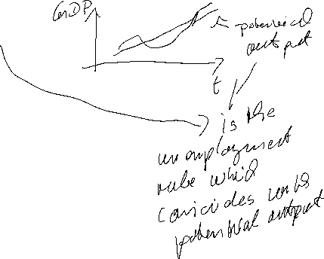


Natural Rate of Unemployment
u* : Natural rate of unemployment
Mainly caused by:
frictional unemployment
structural unemployment
or
generally a worker who is not able to get a job because she doesn’t have the right skills.
⇒ The natural rate of unemployment is caused by supply side factors rather than demand side factors

Slide 22

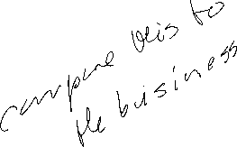


Cyclical Unemployment
Actual unemployment rate = u
Natural unemployment rate = u*
Cyclical unemployment rate = u - u*
recessionary Gap: u - u* > 0
expansionary Gap: u - u* < 0

Slide 23
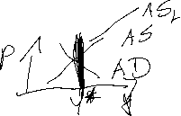

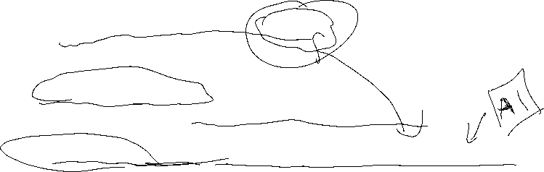
Relationship between unemployment and economic growth
In general, one would expect unemployment to fall when economic growth is high.
Thus, one could identify natural unemployment directly with potential output (cf. neoclassical theory and the long-run supply curve (AS)).
But Okun (1962) showed empirically:
Okun, Arthur M. (1962). “Potential GNP: Its Measurement and Significance.” Reprinted as Cowles Foundation Paper 190.
In general Okun´s law implies that if output growth is 1%-point over potential growth than unemployment falls only by 0,5%-points.
Okun, Arthur M. 1962. “Potential GNP: Its Measurement and Significance.” Reprinted as Cowles Foundation Paper 190.
Reasons:
Firms adjust employment less than one for one in response to deviations of output to the natural growth rate.
The labor force participation of the population increases over time (for Germany, especially the labor force participation of women).
Labor productivity increases (currently in particular due to digitalization)

Slide 24
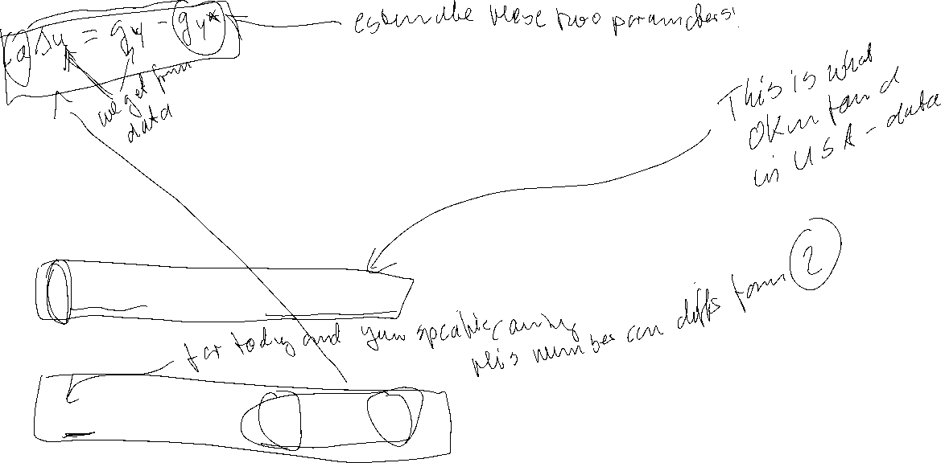
Okun’s Law
Arthur Melvin Okun based on
empirical observations (1962):
Every rise of 1%-point in cyclical unemployment is
associated with a lowering of 2%-points of the output gap.
−2(u - u*) = (Y – Y*)/Y* (Gap Version)
or
-2Δu = g_{y} – g_{Y*} (Growth Version)
g_{y}, g_{Y*}: growth rates of actual and potential out respectively
Δu: change in unemployment over time

Slide 25
Okun’s Law
In general Okun´s law implies that if output growth is 1%-point over potential growth than unemployment falls only by ½%-points.
Reasons:
Firms adjust employment less than one for one in response to deviations of output to the natural growth rate.
Labor participation increases
Labor productivity increases

Slide 26
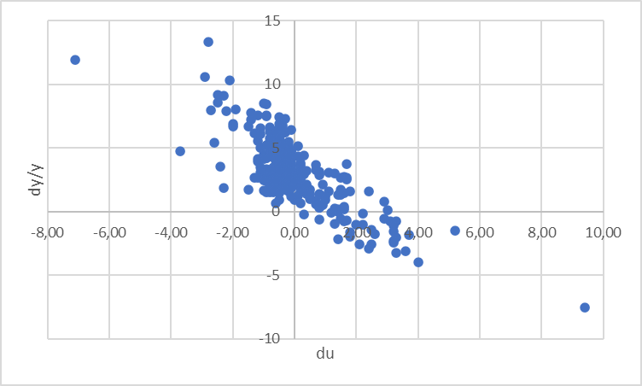
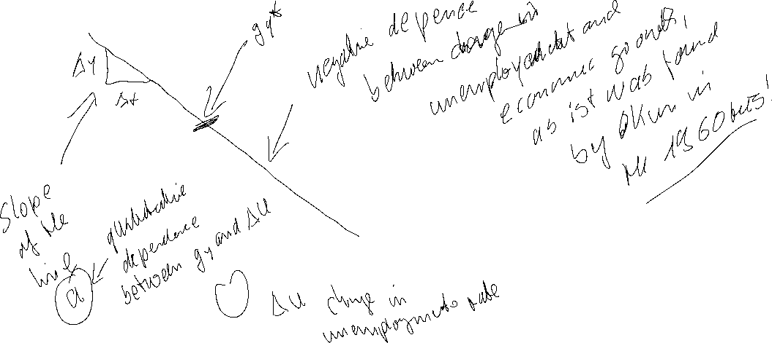

Estimating Okun’s Law: US-Data (1949 – )
Source: FRED, own calculation
Quelle: FRED
Quarterly Data, seasonally adjusted. In order to eliminate effects within a year, we do not use the growth rate respectively to the former quarter but with respect to the quarter of the previous year. Therefore the change of unemployment is also calculated with respect of the quarter of the previous year.

Slide 27
Linear Regression
Example:
A company wants to know how the sales volume depends on visits of representatives.
The company has collected the following data
c
We also want to answer the question, from a descriptive point of view, which sales volume we can expect, if we increase the visits up to x=30

Slide 28
Linear Regression
Via a linear regression we want to analyse the dependence between two variables
We distinguish between a dependent variable (y) and an independent variable (x)
(x) is also called the explanatory variable
A change of (x) implicates a change (y)
The linear regression defines an empirical relation via a linear function
i.e. y = f(x) = 3 + 2x or generally y = a + bx
c

Slide 29
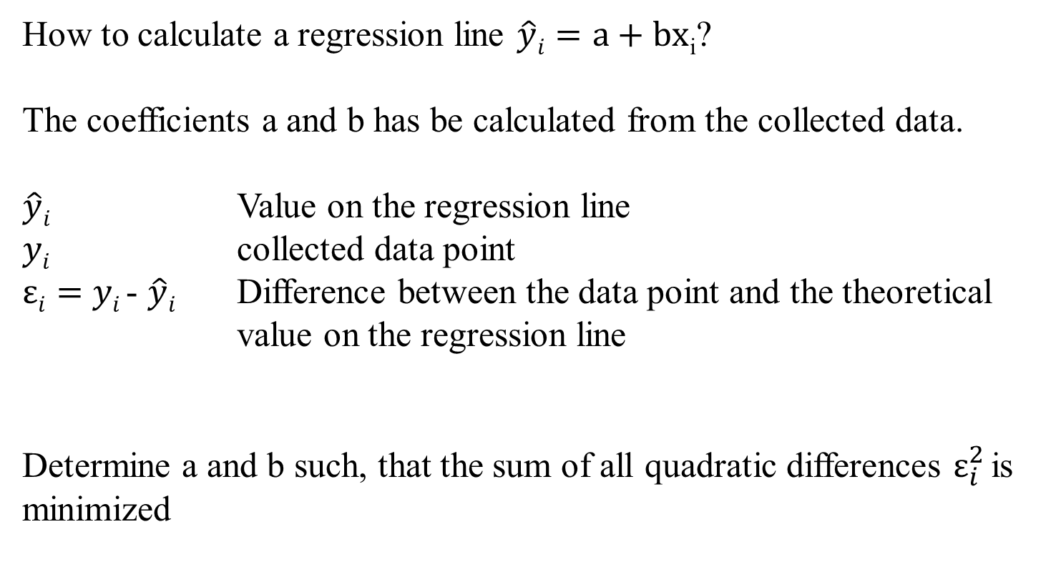
Optimizing problem
How to calculate a regression line $\hat{y}i=a+bx$_{i}?
The coefficients a and b has be calculated from the collected data.
$\hat{y}i$ Value on the regression line
$yi$ collected data point
$εi=$ $yi$- $\hat{y}i$ Difference between the data point and the theoretical value on the regression line
Determine a and b such, that the sum of all quadratic differences $ε_{i}^{2}$is minimized
c

Slide 30
Least squared method
The formal optimizing problem
c

Slide 31
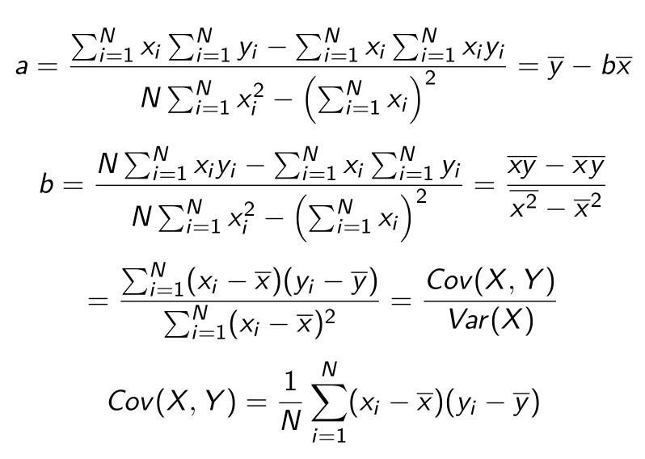
Formulas
:
c

Slide 32
Linear Regression
 | Visits | Sales volume [€]
year | x | y | xy | x^2
2008 | 9 | 24
2009 | 11 | 33
2010 | 5 | 10
2011 | 13 | 29
2012 | 20 | 42
2013 | 12 | 24
c
b=
a=

Slide 33
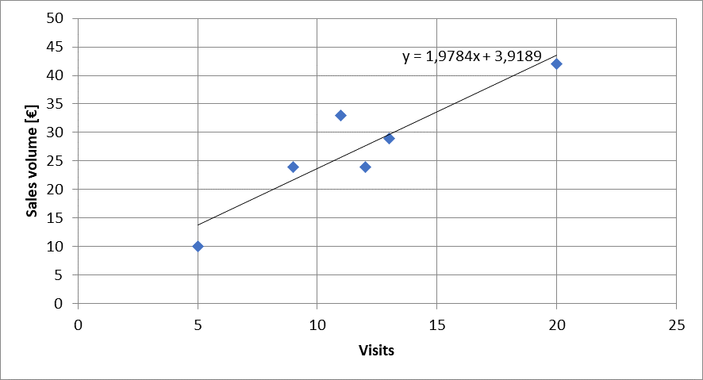


Calulating the regression line from empirical data
$$ei2$$
$\hat{y}i=a+bx$_{i}
c

Slide 34
Regressions coefficients
Regressions coefficient b
  Slope of the regression line.
  Determines the marginal effect of a change of one unit of the independent variable x onto the dependet variable y
Regressions coefficient a
  The value of the dependent variable if the independent variable x=0
    → intercept of the vertical axes
c

Slide 35
Correlation analysis
In principle for all data sets, we can calculate a regression line.
But we are also interested in the question meaningful is this calculated dependence?.
For this, we use the correlation analysis, wich gives the possibility to measure the strength of the dependence
For this, we use the correlation coefficient of Bravais-Pearson which is lying between -1 and +1
c

Slide 36
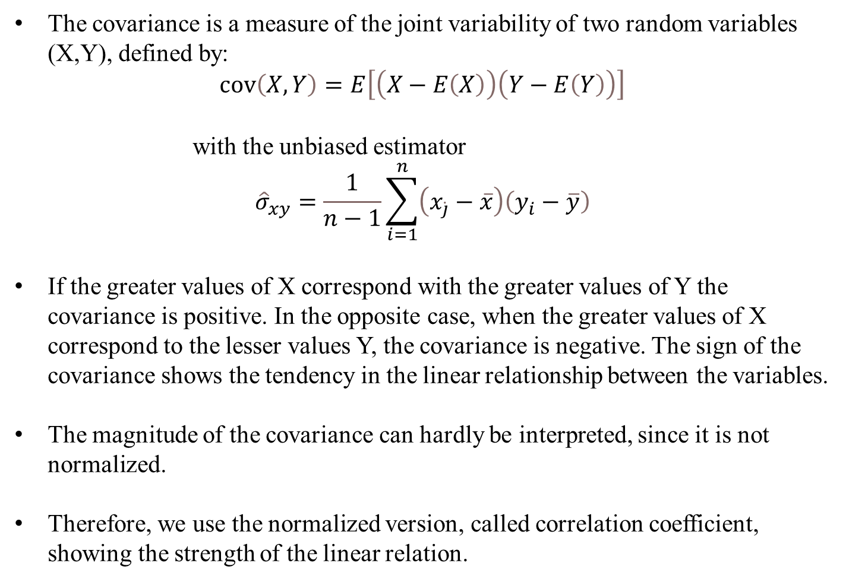
Covariance
The covariance is a measure of the joint variability of two random variables (X,Y), defined by:
$$\operatorname{cov}\left(X,Y\right)=E\left[\left(X−E\left(X\right)\right)\left(Y−E\left(Y\right)\right)\right]$$
with the unbiased estimator
$${\hat{σ}}_{xy}=\frac{1}{n−1}\sum_{i=1}^{n}{\left(x_{\dot{j}}−\overline{x}\right)\left(y_{i}−\overline{y}\right)}$$
If the greater values of X correspond with the greater values of Y the covariance is positive. In the opposite case, when the greater values of X correspond to the lesser values Y, the covariance is negative. The sign of the covariance shows the tendency in the linear relationship between the variables.
The magnitude of the covariance can hardly be interpreted, since it is not normalized.
Therefore, we use the normalized version, called correlation coefficient, showing the strength of the linear relation.
c

Slide 37
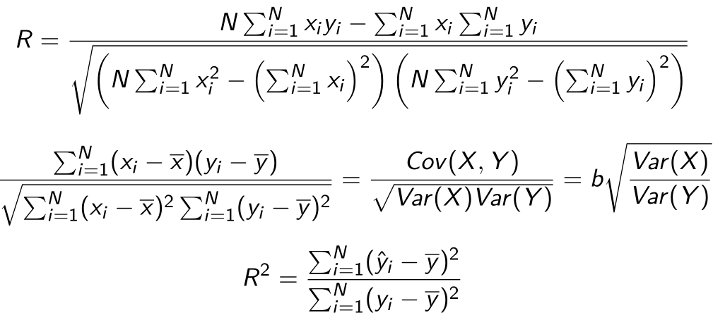
Correlation coefficient
General intervals for R
(0,0;0,2) → almost no dependence
[0,2;0,4) → low dependence
[0,4;0,6) → medium dependence
[0,6;0,8) → high dependence
[0,8;1,0) → almost full dependence
c

Slide 38
Correlation coefficiant examples
R=?
R=?
c
R=?
R=?

Slide 39
Coefficiant of determination R²
The squared correlation coefficiant R² is called coefficiant of determination.
In quantitative analysis, we often use the coefficiant of determination R², because it can be intuitively interpreted
But R² does not distinguish between + and – anymore.
R² is in the interval [0,1]
R² grafical interpretation:
  R² equals the proportion of variance explained by the model in relation to the total variance, i.e. how much percent is explained by the regression line
  (1-R²) equals the proportion of Variance not explained by the model in relation to the total variance, and has to be explained by other influencing factors
c

Slide 40
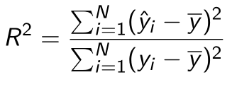



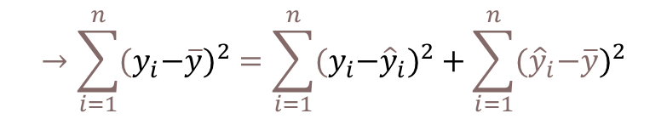
Coefficiant of determination R²
{
${\hat{y}}_{i}−\overline{y}$ explained difference
Total Difference
} Non explained difference
} Explained difference
${y_{i}−\hat{y}}_{i}$ not explained difference
Mean
$y_{i}−\overline{y}$ total difference
$$→\sum_{i=1}^{n}{{{(y}_{i}−\overline{y})}^{2}}=\sum_{i=1}^{n}{{{{(y}_{i}−\hat{y}}_{i})}^{2}}+\sum_{i=1}^{n}{{{(\hat{y}}_{i}−\overline{y})}^{2}}$$
Non explained squared difference y_{i}
total squared difference
explained squared difference
Mean
not explained squared difference
explained squared difference y_{i}
c
Total squared difference of y_{i}

Slide 41
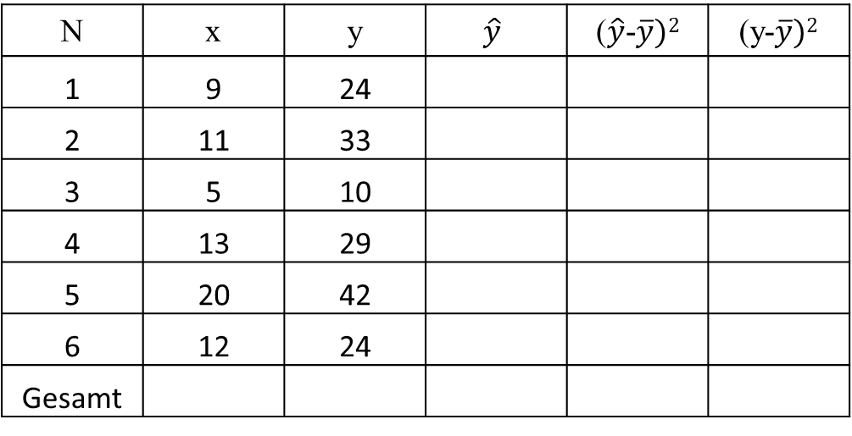
Coefficiant of determination R²
N | x | y | $$\hat{y}$$ | ($\hat{y}$-$\overline{y})2$ | (y-$\overline{y})2$
1 | 9 | 24
2 | 11 | 33
3 | 5 | 10
4 | 13 | 29
5 | 20 | 42
6 | 12 | 24
Gesamt
c
R²= R=

Slide 42
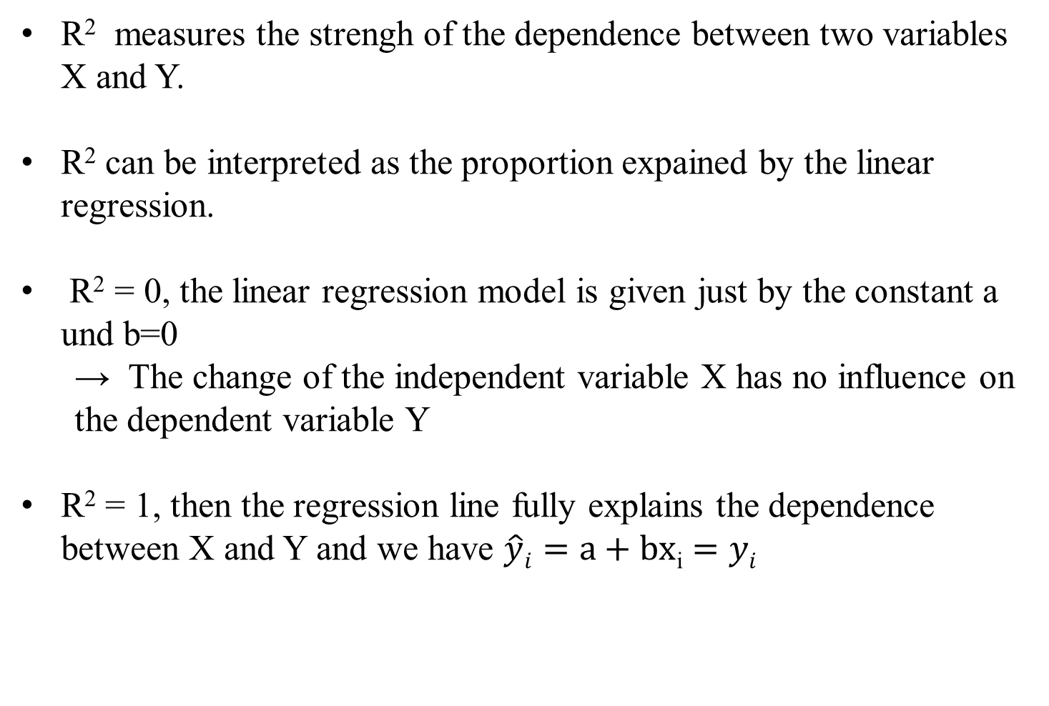
Interpretation of R²
R² measures the strengh of the dependence between two variables X and Y.
R² can be interpreted as the proportion expained by the linear regression.
R² = 0, the linear regression model is given just by the constant a und b=0
  → The change of the independent variable X has no influence on the dependent variable Y
R² = 1, then the regression line fully explains the dependence between X and Y and we have $\hat{y}i=a+bx$_{i} $=yi$
c

Slide 43
Estimating Okun’s Law: US-Data (1949 – )
Source: FRED, own calculation

Slide 44
Estimation of Okun's Law - Country Analysis
Data: IMF Data mapper or other source. If you use quaterly data, think of
Contrast the data (1980-2023, per availability) of the variables Δu and g_{y} in a scatter plot
Linear regression of g_{y} and Δu .
Identify Okuns`s law with the regression parameters in g_{y} = -aΔu + g_{Y*} and interprete the parameters
Look for "meaningful" subperiods for your country for estimation purposes (consider especially structural breaks like crises, political changes,...)
Also evaluate your econometric analysis using the coefficient of determination R²
and the correlation coefficient R

Slide 45
Estimating Okun’s Law: Country (1980 – )
Source: IMF Data Mapper

Slide 46
Short-run Output Gaps: Why do they matter?
Output Gap = Actual Output - Potential Output
_______________________________________
Potential Output
= Y - Y*
_______________________________________
Y*
(Y – Y*)/Y* > 0 → a positive output gap
is called expansionary gap
(Y – Y*)/Y* < 0 → a negative output gap
is called recessionary gap

Slide 47
Output Gaps: Two kinds of Costs
(Y – Y*)/Y* > 0 expansionary gap
inflation can be high
economy incurs costs of inflation
(Y – Y*)/Y* < 0 recessionary gap
unemployment rate high (above normal)
economy incurs costs of unemployment

