Slide 1



Global Economics
Wilhelmshaven
This lecture will be recorded and
Subsequently uploaded in the
world-wide-web
Prof. Dr. Bernhard Köster
Jade-Hochschule Wilhelmshaven
http://www.bernhardkoester.de/vorlesungen/inhalt.html

Slide 2


Wilhelmshaven
Dirk Gerlach
Leiter Stab der Hv-Präsidentin
Bundesbank – Filiale Hannover
Money, interest and prices
–
basics and current problems of European monetary policy
Dienstag 10.12.2024
Jade Hochschule Wilhelmshaven
10:15 – 11:45 Uhr: S123
Ansprechpartner:
Prof. Dr. Bernhard Köster
bernhard.koester@jade-hs.de

Slide 3

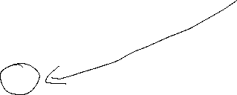

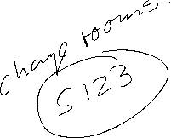

Wilhelmshaven
Vorstellung des Jahresgutachtens des Sachverständigenrats zur Begutachtung der gesamtwirtschaftlichen Entwicklung
Dr. Christopher Zuber
(Referent für Makroökonomik und Produktivität im Stab des SVR)
Dienstag 26. November 2024
Jade Hochschule Wilhelmshaven
10:15 – 11:45 Uhr, gHs
Hybrid, zoom-link
https://jade-hs.zoom-x.de/j/64843766756?pwd=lSRgFjY6B9HOpFZirXrOI5dD6BYTVM.1
Ansprechpartner:
Prof. Dr. Bernhard Köster
bernhard.koester@jade-hs.de
www.bernhardkoester.de

Slide 4

Global Economics
Winter term 2024
Prof. Dr. Bernhard Köster

Slide 5

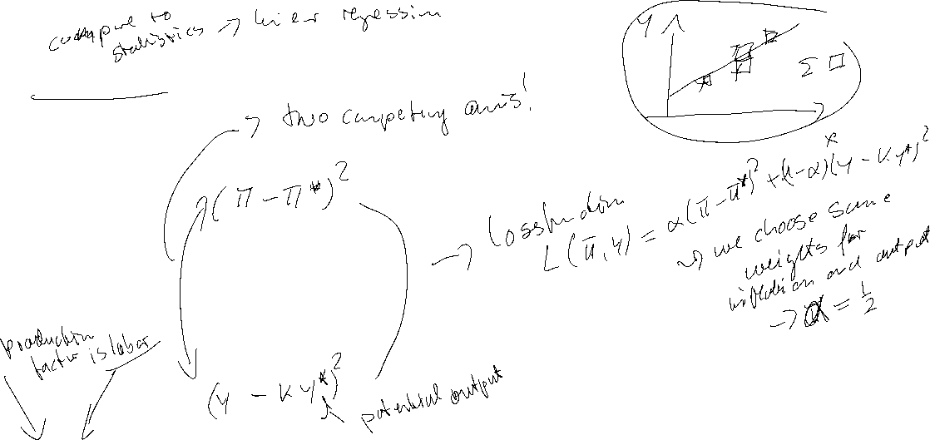

Loss function
Quadratic Approximation of deviations from targets
Inflation:
menue costs
uncertainty
transaction costs for obtaining information about future Inflation
Output:
wage rigidities would imply an output level below potential output → potential out put is weighted with k>1

Slide 6


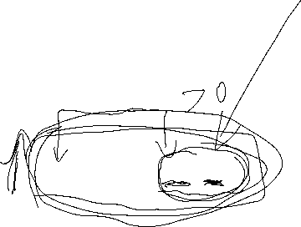



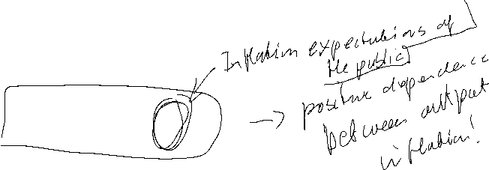
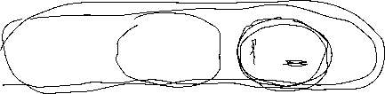
Time Inconsistency Problem in Monetary Policy
Barro Gordon (1981) “A Positive Theory of Monetary Policy in a Natural Rate Model”
Philipps-curve:
y = y* + b (π - π^{e} )
Central bank loss function:
L =1/2[a (π –π*)² + (y -ky*) ²]
a>0 k>1
π*, ky* Inflation and Output targets

Slide 7
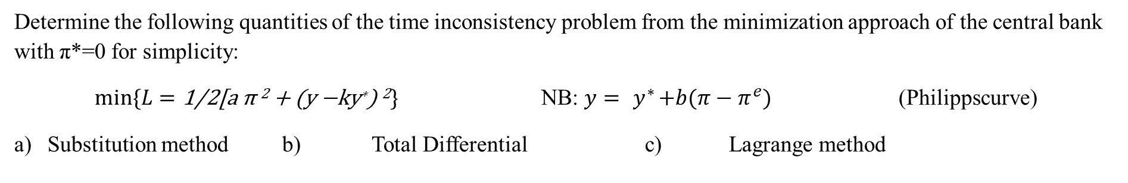

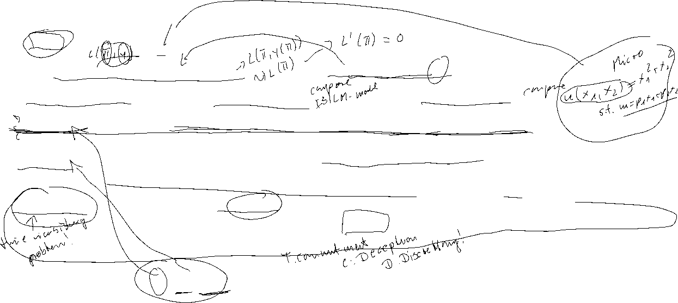



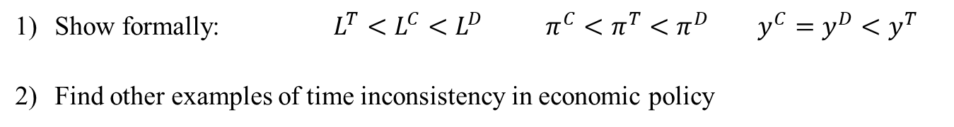

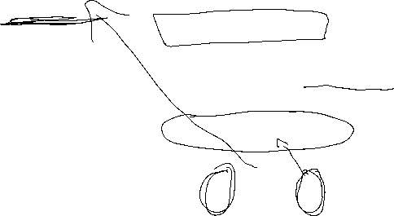
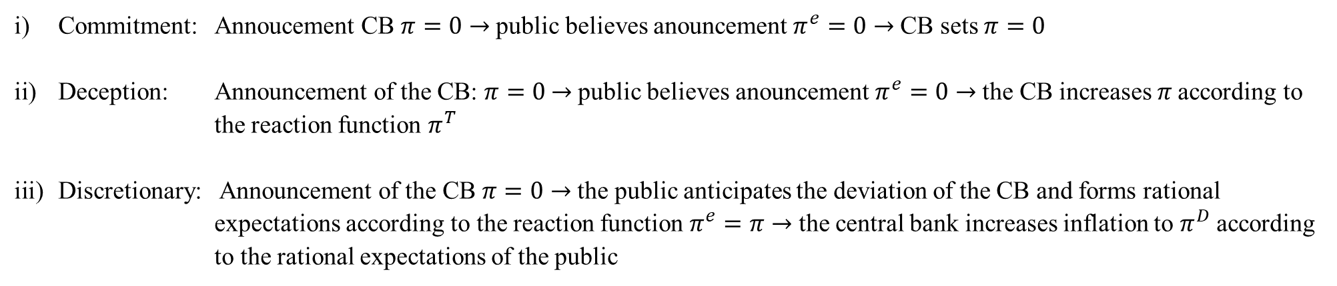


Time Inconsistency Problem
Determine the following quantities of the time inconsistency problem from the minimization approach of the central bank with π*=0 for simplicity:
$min⁡\{L=\text{1/2[}\text{a} \text{π}\text{ 2 + (}\text{y}\text{ −}\text{ky}\text{∗}\text{) }\text{2}\}$ NB: ${y={ y}^{∗}+b(π−π}^{e})$ (Philippscurve)
Substitution method b) Total Differential c) Lagrange method
Commitment: Annoucement CB $π=0$ → public believes anouncement $π^{e}=0$ → CB sets $π=0$
Deception: Announcement of the CB: $π=0$ → public believes anouncement $π^{e}=0$ → the CB increases 𝜋 according to the reaction function $π^{T}$
Discretionary: Announcement of the CB $π=0$ → the public anticipates the deviation of the CB and forms rational expectations according to the reaction function $π^{e}=π$ → the central bank increases inflation to $π^{D}$ according to the rational expectations of the public
Show formally: $L^{T}<L^{C}<L^{D}$ $π^{C}<π^{T}<π^{D}$ $y^{C}=y^{D}<y^{T}$
Find other examples of time inconsistency in economic policy

Slide 8
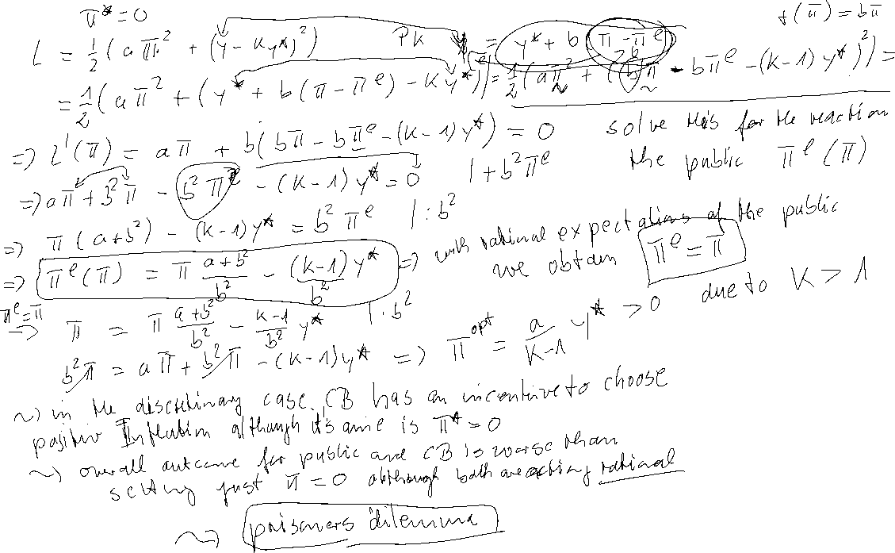
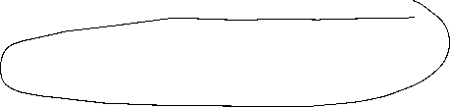

Time Inconsistency Problem – Calculation

Slide 9
Time Inconsistency Problem – Calculation

Slide 10
Time Inconsistency Problem – Calculation – Reactionfunction
π^{e}
π

Slide 11
Time Inconsistency Problem
y = y* + b (π - π^{e})
L =aπ² + (y -ky*) ²
y
ky*
y*
π

Slide 12
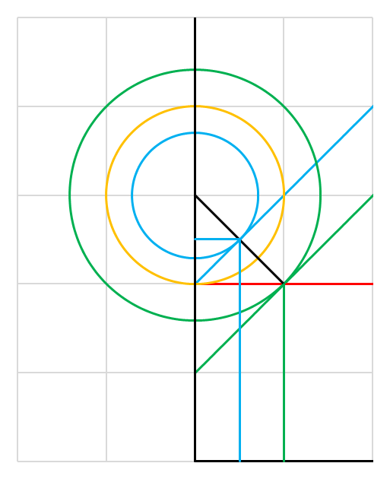


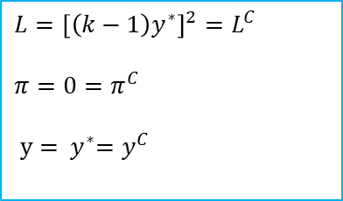
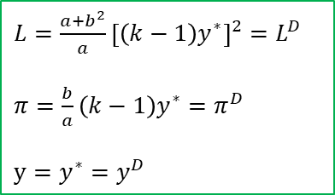



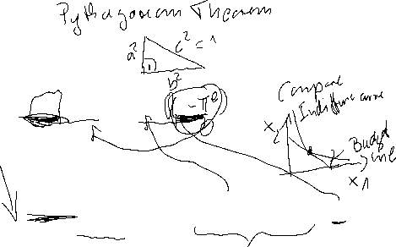

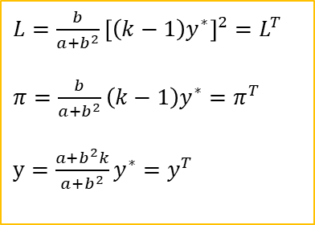




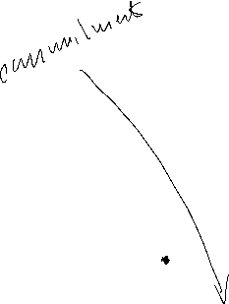





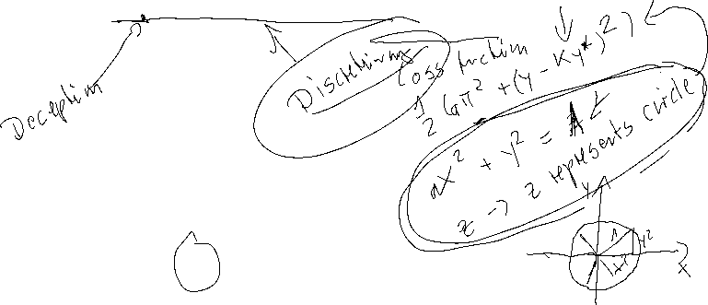
$$y$$
Time Inconsistency Problem
$$L^{D}$$
(short-run)
$${{L=aπ}^{2}+\left[y−ky^{∗}\right]}^{2}$$
$${y={ y}^{∗}+b(π−π}^{e})$$
$${ {{PC}^{T}}_{|π^{e}=0}: y=y}^{∗}+bπ$$
$$L^{C}$$
$$L^{T}$$
$L={\left[\left(k−1\right)y^{∗}\right]}^{2}=L^{C}$
$π=0=π^{C}$
$y={ y}^{∗}=y^{C}$
(short-run)
$${ky}^{∗}$$
$${{{PC}^{D}}_{|π^{e}=\frac{b}{a}\left(k−1\right)y^{∗}}: y=y}^{∗}[1−\frac{b^{2}}{a}\left(k−1\right)]+bπ$$
$$y^{T}$$
$L={\frac{b}{a+b^{2}}\left[\left(k−1\right)y^{∗}\right]}^{2}=L^{T}$
$π=\frac{b}{a+b^{2}}\left(k−1\right)y^{∗}=π^{T}$
$y=\frac{a+b^{2}k}{a+b^{2}}y^{∗}=y^{T}$
$y^{∗} PC$ (long-run)
$L={\frac{a+b^{2}}{a}\left[\left(k−1\right)y^{∗}\right]}^{2}=L^{D}$
$π=\frac{b}{a}\left(k−1\right)y^{∗}=π^{D}$
$y=y^{∗}=y^{D}$
$$π^{∗}=0$$
$$π^{T}$$
$$π^{D}$$
$$π$$

Slide 13

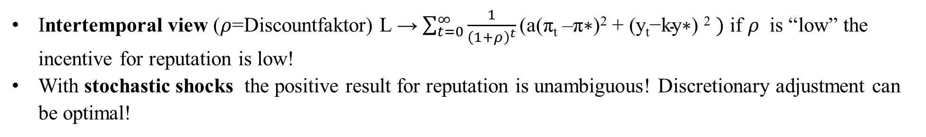



Time Inconsistency Problem – Solutions
Reputation via “large” a → “Falcons” within the ECB
Rogoff, Kenneth (1985) The Optimal Degree of Commitment to an Intermediate Monetary get, Quarterly Journal of Economic 110 (November), 1169-90
Rule-based → Taylor Rule or Inflation Targeting John B. Taylor, Discretion versus policy rules in practice (1993), Stanford University, Stanford, CA 94905“ Svensson, L.E.O. (2011) Inflation Targeting,” in Friedman, Benjamin M., and Michael Woodford, eds., Handbook of Monetary Economics, Volume 3b, chapter 22, Elsevier
Incentive Contracts → New Zealand Reserve Bank Act of 1989 Walsh, (1995) C.E. Is New Zealand's Reserve Bank Act of 1989 an Optimal Central Bank Contract? Journal of Money, Credit and Banking , Nov., 1995, Vol. 27, No. 4, Part 1 (Nov.,1995), pp. 1179-1191
Intertemporal view ($ρ$=Discountfaktor) L → $\sum_{t=0}^{∞}{\frac{1}{{\left(1+ρ\right)}^{t}}\text{(}\text{a}\text{(}\text{π}\text{t}\text{ –}\text{π}\text{∗)2 + (}\text{y}\text{t}\text{−}\text{ky}\text{∗) 2} })$ if $ρ$ is “low” the incentive for reputation is low!
With stochastic shocks the positive result for reputation is unambiguous! Discretionary adjustment can be optimal!

Slide 14
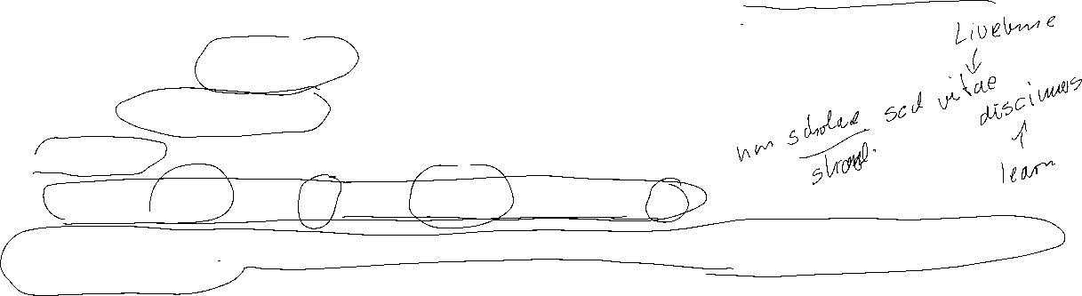

Time Inconsistency Problem
Literature
Within my PhD-Thesis, I also addressed, the problem of transparency and setting optimal interest rates, within the supernational institution of the ECB:
Köster, B. J. (2011) Decision Rules, Transparency and Central Banks (Dissertation) Heidelberg
(especially Barro-Gordon-Model with transparency)
Alan Blinder had a nice example within education and incentives
U = U(Time to correct an exam„–“; effort of learning for the students„+“)
Alan S. Blinder. The rules-versus-discretion debate in the light of recent experience. Weltwirtschaftliches Archiv, 123:399–414, 1987.
“Course examinations are stressful experiences for students and teachers alike. We use them both to rank students and to make sure they master the course material. To most educators, the latter is by far the more important purpose. But the learning objective does not require that the exam actually be given. It is enough to announce the exam, let students prepare for it, and then call it off at the last minute. In a real sense, everyone will be better off if the exam is cancelled. Thus it superficially seems to be the right thing to do. Yet it is rarely done, and for good reasons. Teachers know that this trick can only be pulled off once or twice. After that, students would cease believing the threat and would no longer study for exams. And that would be a real loss to bot faculty and students. Notice the obvious but important point that neither ignorance no incorrect objectives play any role in this example. An omniscient and benevolent despot presiding over the last year of the human race really would cancel exams. It's the optimal thing to do. The problem arises from taking a short-sighted perspective. It is cured by showing proper concern for the future consequences of current actions”

Slide 15
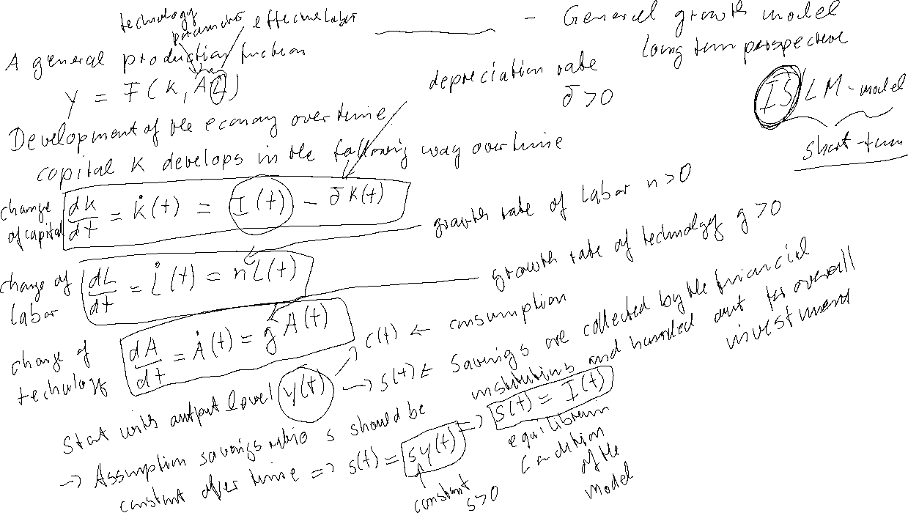
Solow Model

Slide 16
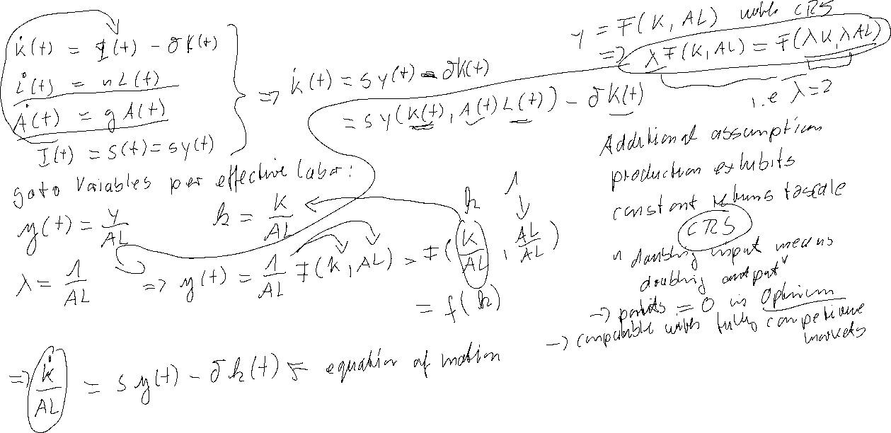
Solow Model

