Slide 1


Global Economics
Wilhelmshaven
This lecture will be recorded and
Subsequently uploaded in the
world-wide-web
Prof. Dr. Bernhard Köster
Jade-Hochschule Wilhelmshaven
http://www.bernhardkoester.de/vorlesungen/inhalt.html

Slide 2


Wilhelmshaven
Dirk Gerlach
Leiter Stab der Hv-Präsidentin
Bundesbank – Filiale Hannover
Money, interest and prices
–
basics and current problems of European monetary policy
Dienstag 10.12.2024
Jade Hochschule Wilhelmshaven
10:15 – 11:45 Uhr: S123
Ansprechpartner:
Prof. Dr. Bernhard Köster
bernhard.koester@jade-hs.de

Slide 3



Wilhelmshaven
Vorstellung des Jahresgutachtens des Sachverständigenrats zur Begutachtung der gesamtwirtschaftlichen Entwicklung
Dr. Christopher Zuber
(Referent für Makroökonomik und Produktivität im Stab des SVR)
Dienstag 26. November 2024
Jade Hochschule Wilhelmshaven
10:15 – 11:45 Uhr, gHs
Hybrid, zoom-link
https://jade-hs.zoom-x.de/j/64843766756?pwd=lSRgFjY6B9HOpFZirXrOI5dD6BYTVM.1
Ansprechpartner:
Prof. Dr. Bernhard Köster
bernhard.koester@jade-hs.de
www.bernhardkoester.de

Slide 4

Global Economics
Winter term 2024
Prof. Dr. Bernhard Köster

Slide 5

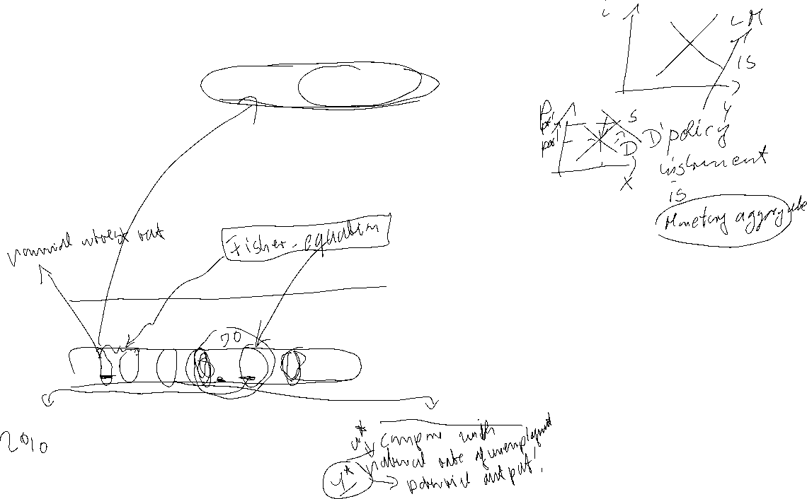
Money Market and the
Reaction Function of the Central Bank
In practice the central bank sets short term interest rates to meet its target level.
Most central banks communicate some kind of inflation target. Interest rates are therefore not only the outcome of an equilibrium process, but depend directly on the movements in prices
⇒ reaction function of the central bank
π↓ ⇒ r↓
Y↑ ⇒ r↑
⇒ r = i - π^{e} = r* + b(π - π*) +c(y - y*) b,c>0
π*: Inflation target y*: Potential output r*: Natural interest rate

Slide 6



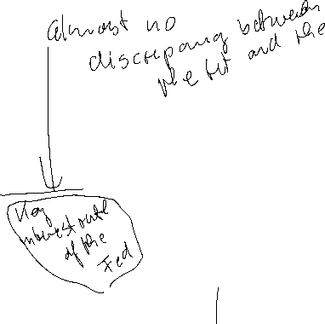


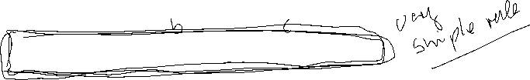
Taylor-Rule
John B. Taylor:
Professor of Economics
(Stanford University)
Council of Economic Advisers
1976 – 77
1989 – 91
Under Secretary of the Treasury for International Affairs
2001 – 05
Source: Taylor, J., B, (1993) 195-214 North-Holland Discretion versus policy rules in practice, Carnegie-Rochester Conference Series on Public Policy 39, 195-214, North Holland
r = i - π^{e} = 2% + 0,5(π - π*) +0,5(y - y*)
r* =2% π*=2% b=c=0,5

Slide 7


Taylor-Rule simplified
r = i - π^{e} = = r* + b(π - π*) +c(y - y*)
Since π* and y* are constants, we set in the following
r = i - π^{e} = = α + bπ +cy
⇒ dr/dY = c > 0
r
TR-Curve
Y
Same dependence as the LM-curve!!

Slide 8
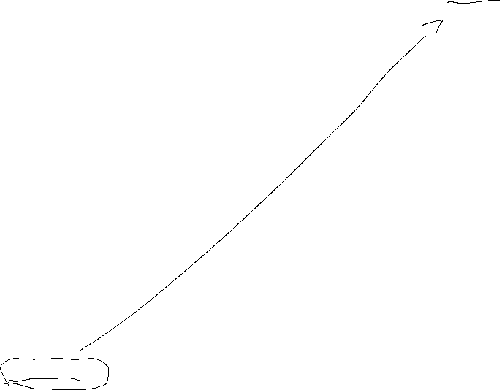
Short run equilibrium
r
TR
IS curve
Y
The intersection of the IS curve and the TR curve represents the short run equilibrium with fixed prices.
Mechanics are the same as in the case with LM-curve representing the
Money market equilibrium

Slide 9
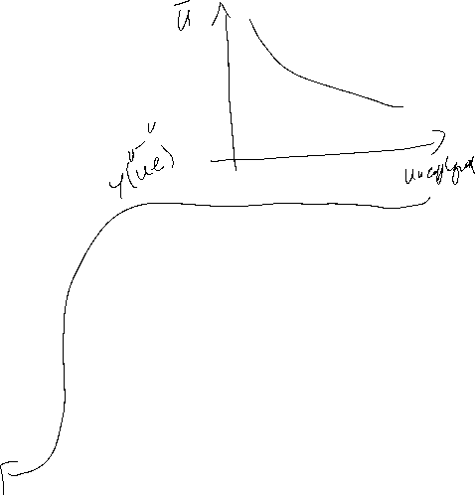


Price adjusting process – Phillips Curve
Originally: Negative dependence between inflation and unemployment
together with
declining unemployment implies increasing output
⇒
π = π^{e} + δY δ >0
π
PC
Y

Slide 10
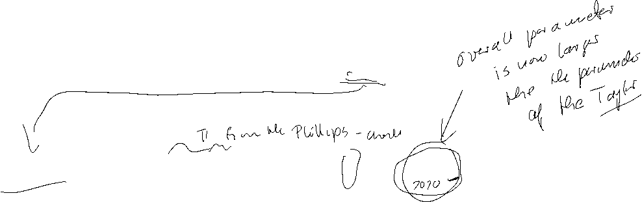
Monetary Policy Rule with flexible prices
Substitute the PC into the TR
⇒
Integrated monetary policy (MP) rule:
MP: r = r* + b[π^{e} + δY] + cY = a + b π^{e} + (bδ+c)Y
⇒
The coefficient on output (Y) is now (bδ+c) instead of c.
⇒
direct output affect in monetary policy through c
indirect effect through bδ.

Slide 11

Equilibrium with flexible prices
r
MP
TR
IS curve
Y
Taylor estimation for the Fed
https://www.atlantafed.org/cqer/research/taylor-rule#Tab1

Slide 12


Special cases of the MP-rule
Inflation targeting: c = 0
⇒ MP becomes flatter ⇒ real interest rates respond less to IS shocks that reduce output.
General Difference between ECB and Fed in their reaction on the different crisis during last 25 years
Output targeting:
Output targeting simply has a vertical TR or MP curve at the output target. Limiting case where the central bank is infinitely inflation-averse and δ is very large relative to b.
This seems to become more important since the financial crisis

Slide 13
Taylor Rule Phillips-curve Aggregate demand and the Nominal Zero Lower Bound
{
r* + b(π - π*) + c(y-y*) i>0
r = i - π^{e} =
- π^{e} otherwise
r
⇒
- π^{e}
Y
y* -1/c(r* + π^{e} + b(π - π*))

Slide 14
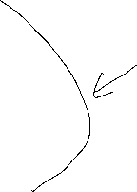
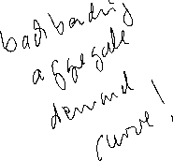
Aggregated Demand (AD)
Assumption: π^{e} depends positively on π
TR₂
TR₃
TR₁
r
- π^{e}(π₃)
- π^{e}(π₂)
π₁>π₂>π₃
- π^{e}(π₁)
Y
AD
π
π₁
●
π₂
●
π₃
●
y₃
y₁
y₂
Y

Slide 15


General equilibrium and the nominal zero lower bound
AD
π₁>π₂>π₃
π
Threat of a downward spiral at NZLB:
PC(π^{e} =π₁)
PC(π^{e} =π₂)
decreasing inflation expectations
⇒ decreasing output
PC(π^{e} =π₃)
⇒ decreasing inflation
⇒ decreasing inflation expectations
⇒ ….
⇒ downturn cycle
y₃
y₁
y₂
Y

Slide 16



Monetary Policy Rules
Simple rules
Policy instrument depends on a small set of variables
Easy to calculate
Predictable monetary policy
→ but in general not optimal
Optimal rules
Minimizing a loss function depending on all relevant variables
Often complicated
Not very predictable

Slide 17
Development of Monetary Policy
Historical view: The monetary policy instrument was assumed to be the money supply
Modern view: The policy instrument is the interest rate (signal rate, key rate, repo rate, etc)
“Ultra-modern” view: The policy instrument is in general central bank’s communication
+ forward guidance

Slide 18
Money Supply Rules
Milton Friedman (1912-2006, Nobel Laureate 1976) suggested that central banks should follow a money supply rule.
Due to quantity theory of money, money supply should grow at a given rate in order to provide price stability.
P ● Y=M ● V
→ Fix Money Growth Rule
However: - Many countries have bad experience with monetary supply rules/targets
- Money demand (i.e. velocity V) is unstable; gives undesired volatility in the interest rate

Slide 19
Money Supply Rules
Former governour of Bank of Canada
"In Canada, we did not abandon money supply targets, they abandoned us".
Bank of England skips a monetary target at all, since:
“Whenever a bank makes a loan, it simultaneously creates a matching deposit in the borrower’s bank account, thereby creating new money.”
(BoE, 2014)

Slide 20
Annual Report Governing Council of Economic Advisors
handover of annunal report
https://www.sachverstaendigenrat-wirtschaft.de/index.html
Annual Report 2024/25
https://www.sachverstaendigenrat-wirtschaft.de/start/aktuelles/uebergabe-des-jahresgutachtens-am-13-november-new672922094b0de462582667.html?returnUrl=%2Findex.html&cHash=2c34d9db7ffef0a32dc7f0e9b79d3ab4

Slide 21
Money Supply Rules
Milton Friedman (1912-2006, Nobel Laureate 1976) suggested that central banks should follow a money supply rule.
Due to quantity theory of money, money supply should grow at a given rate in order to provide price stability.
P ● Y=M ● V
→ Fix Money Growth Rule
However: - Many countries have bad experience with monetary supply rules/targets
- Money demand (i.e. velocity V) is unstable; gives undesired volatility in the interest rate

Slide 22
Money Supply Rules
Former governour of Bank of Canada
"In Canada, we did not abandon money supply targets, they abandoned us".
Bank of England skips a monetary target at all, since:
“Whenever a bank makes a loan, it simultaneously creates a matching deposit in the borrower’s bank account, thereby creating new money.”
(BoE, 2014)

Slide 23
Time inconsistency of monetary policy
Why has central bank independence developed?
Is rule-based or "conservative" monetary policy superior to discretionary monetary policy?
Barro, R. and Gordon, D- (1983) Rules, Discretion, and Reputation in a Model of Monetary Policy, Journal of Monetary Economics 12 (July) 101-22.
Kydland, F. and Prescott, E. (1977) Rules Rather than Discretion: The Inconsistency of Optimal Plans, Journal of Political Economy 85 (June), 473-90

Slide 24
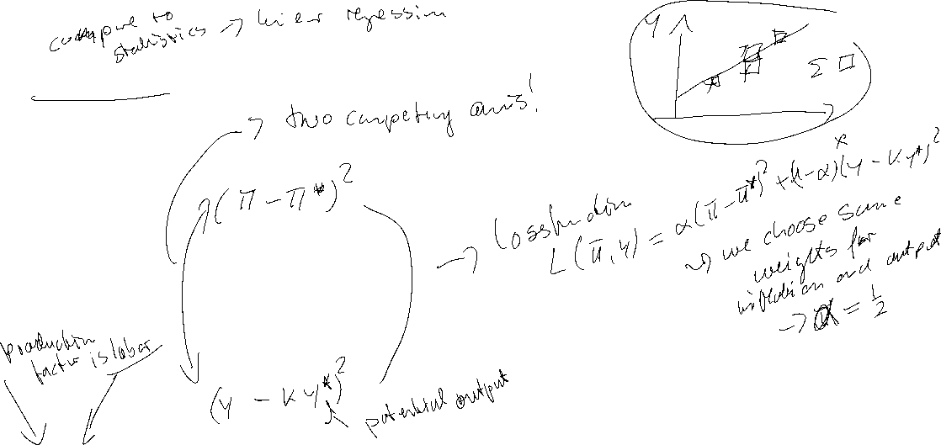

Loss function
Quadratic Approximation of deviations from targets
Inflation:
menue costs
uncertainty
transaction costs for obtaining information about future Inflation
Output:
wage rigidities would imply an output level below potential output → potential out put is weighted with k>1

Slide 25





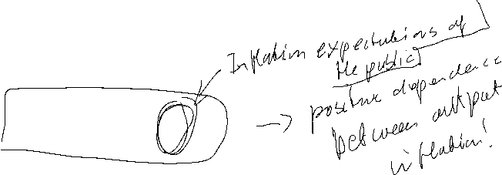
Time Inconsistency Problem in Monetary Policy
Barro Gordon (1981) “A Positive Theory of Monetary Policy in a Natural Rate Model”
Philipps-curve:
y = y* + b (π - π^{e} )
Central bank loss function:
L =1/2[a (π –π*)² + (y -ky*) ²]
a>0 k>1
π*, ky* Inflation and Output targets

Slide 26
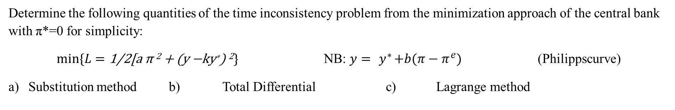
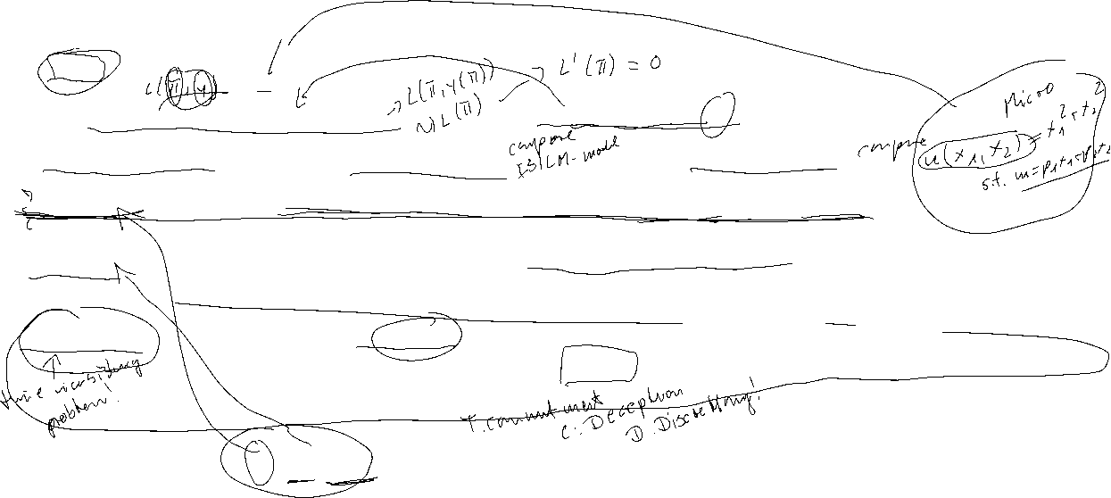
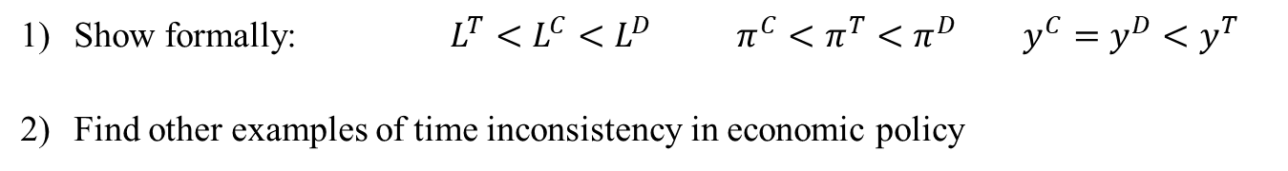
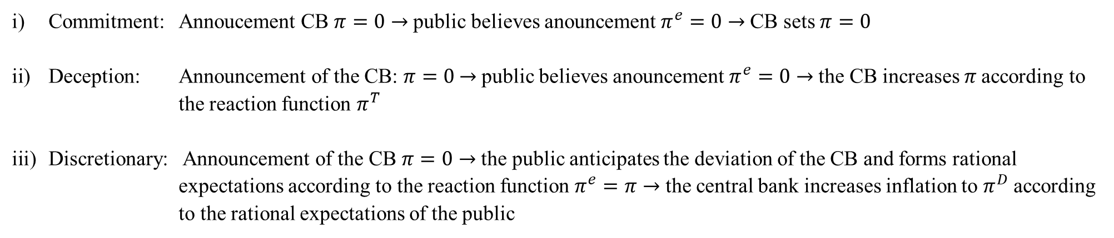
Time Inconsistency Problem
Determine the following quantities of the time inconsistency problem from the minimization approach of the central bank with π*=0 for simplicity:
$min⁡\{L=\text{1/2[}\text{a} \text{π}\text{ 2 + (}\text{y}\text{ −}\text{ky}\text{∗}\text{) }\text{2}\}$ NB: ${y={ y}^{∗}+b(π−π}^{e})$ (Philippscurve)
Substitution method b) Total Differential c) Lagrange method
Commitment: Annoucement CB $π=0$ → public believes anouncement $π^{e}=0$ → CB sets $π=0$
Deception: Announcement of the CB: $π=0$ → public believes anouncement $π^{e}=0$ → the CB increases 𝜋 according to the reaction function $π^{T}$
Discretionary: Announcement of the CB $π=0$ → the public anticipates the deviation of the CB and forms rational expectations according to the reaction function $π^{e}=π$ → the central bank increases inflation to $π^{D}$ according to the rational expectations of the public
Show formally: $L^{T}<L^{C}<L^{D}$ $π^{C}<π^{T}<π^{D}$ $y^{C}=y^{D}<y^{T}$
Find other examples of time inconsistency in economic policy

Slide 27
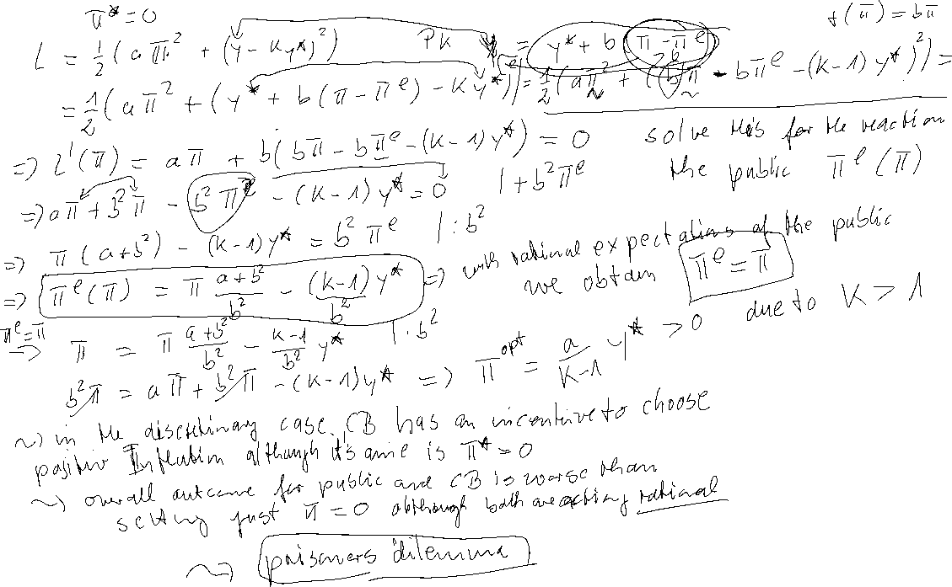
Time Inconsistency Problem – Calculation

Slide 28
Time Inconsistency Problem – Calculation

Slide 29
Time Inconsistency Problem – Calculation – Reactionfunction
π^{e}
π

Slide 30
Time Inconsistency Problem
y = y* + b (π - π^{e})
L =aπ² + (y -ky*) ²
y
ky*
y*
π

Slide 31
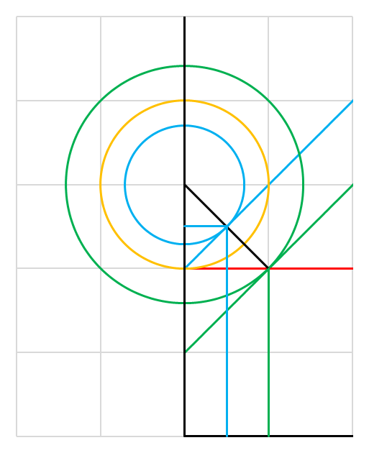


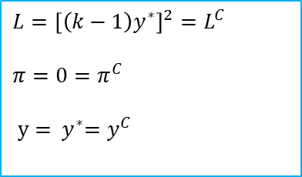
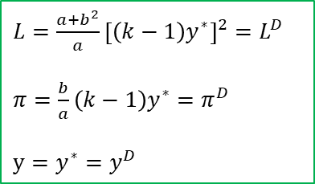




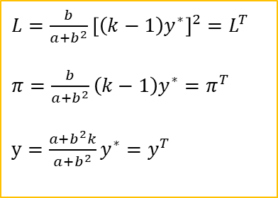









$$y$$
Time Inconsistency Problem
$$L^{D}$$
(short-run)
$${{L=aπ}^{2}+\left[y−ky^{∗}\right]}^{2}$$
$${y={ y}^{∗}+b(π−π}^{e})$$
$${ {{PC}^{T}}_{|π^{e}=0}: y=y}^{∗}+bπ$$
$$L^{C}$$
$$L^{T}$$
$L={\left[\left(k−1\right)y^{∗}\right]}^{2}=L^{C}$
$π=0=π^{C}$
$y={ y}^{∗}=y^{C}$
(short-run)
$${ky}^{∗}$$
$${{{PC}^{D}}_{|π^{e}=\frac{b}{a}\left(k−1\right)y^{∗}}: y=y}^{∗}[1−\frac{b^{2}}{a}\left(k−1\right)]+bπ$$
$$y^{T}$$
$L={\frac{b}{a+b^{2}}\left[\left(k−1\right)y^{∗}\right]}^{2}=L^{T}$
$π=\frac{b}{a+b^{2}}\left(k−1\right)y^{∗}=π^{T}$
$y=\frac{a+b^{2}k}{a+b^{2}}y^{∗}=y^{T}$
$y^{∗} PC$ (long-run)
$L={\frac{a+b^{2}}{a}\left[\left(k−1\right)y^{∗}\right]}^{2}=L^{D}$
$π=\frac{b}{a}\left(k−1\right)y^{∗}=π^{D}$
$y=y^{∗}=y^{D}$
$$π^{∗}=0$$
$$π^{T}$$
$$π^{D}$$
$$π$$

Slide 32
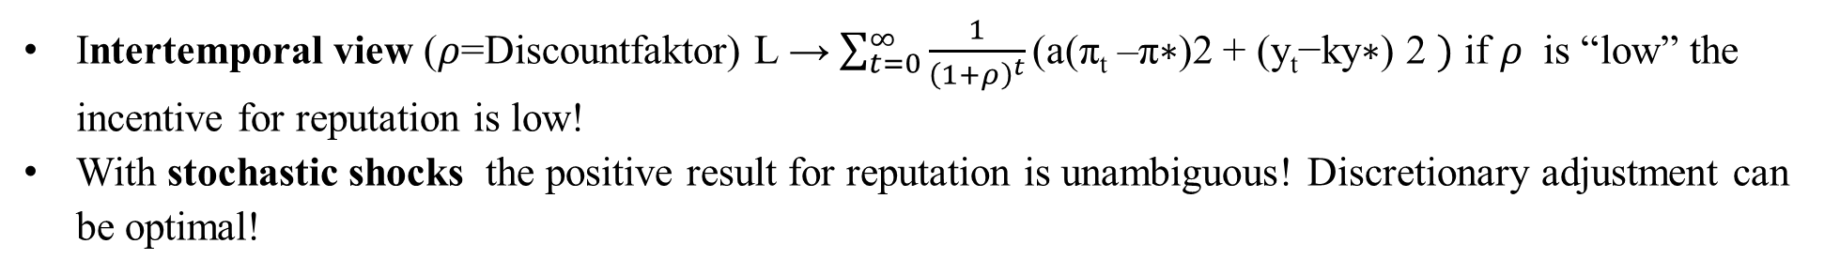
Time Inconsistency Problem – Solutions
Reputation via “large” a → “Falcons” within the ECB
Rogoff, Kenneth (1985) The Optimal Degree of Commitment to an Intermediate Monetary get, Quarterly Journal of Economic 110 (November), 1169-90
Rule-based → Taylorregel or Inflation Targeting John B. Taylor, Discretion versus policy rules in practice (1993), Stanford University, Stanford, CA 94905“ Svensson, L.E.O. (2011) Inflation Targeting,” in Friedman, Benjamin M., and Michael Woodford, eds., Handbook of Monetary Economics, Volume 3b, chapter 22, Elsevier
Incentive Contracts → New Zealand Reserve Bank Act of 1989 Walsh, (1995) C.E. Is New Zealand's Reserve Bank Act of 1989 an Optimal Central Bank Contract? Journal of Money, Credit and Banking , Nov., 1995, Vol. 27, No. 4, Part 1 (Nov.,1995), pp. 1179-1191
Intertemporal view ($ρ$=Discountfaktor) L → $\sum_{t=0}^{∞}{\frac{1}{{\left(1+ρ\right)}^{t}}\text{(}\text{a}\text{(}\text{π}\text{t}\text{ –}\text{π}\text{∗)2 + (}\text{y}\text{t}\text{−}\text{ky}\text{∗) 2} })$ if $ρ$ is “low” the incentive for reputation is low!
With stochastic shocks the positive result for reputation is unambiguous! Discretionary adjustment can be optimal!

Slide 33
Time Inconsistency Problem
Literature
Within my PhD-Thesis, I also addressed, the problem of transparency and setting optimal interest rates, within the supernational institution of the ECB:
Köster, B. J. (2011) Decision Rules, Transparency and Central Banks (Dissertation) Heidelberg
(especially Barro-Gordon-Model with transparency)
Alan Blinder had a nice example within education and incentives
U = U(Time to correct an exam„–“; effort of learning for the students„+“)
Alan S. Blinder. The rules-versus-discretion debate in the light of recent experience. Weltwirtschaftliches Archiv, 123:399–414, 1987.
“Course examinations are stressful experiences for students and teachers alike. We use them both to rank students and to make sure they master the course material. To most educators, the latter is by far the more important purpose. But the learning objective does not require that the exam actually be given. It is enough to announce the exam, let students prepare for it, and then call it off at the last minute. In a real sense, everyone will be better off if the exam is cancelled. Thus it superficially seems to be the right thing to do. Yet it is rarely done, and for good reasons. Teachers know that this trick can only be pulled off once or twice. After that, students would cease believing the threat and would no longer study for exams. And that would be a real loss to bot faculty and students. Notice the obvious but important point that neither ignorance no incorrect objectives play any role in this example. An omniscient and benevolent despot presiding over the last year of the human race really would cancel exams. It's the optimal thing to do. The problem arises from taking a short-sighted perspective. It is cured by showing proper concern for the future consequences of current actions”

