Slide 1

Global Economics
Wilhelmshaven
This lecture will be recorded and
Subsequently uploaded in the
world-wide-web
Prof. Dr. Bernhard Köster
Jade-Hochschule Wilhelmshaven
http://www.bernhardkoester.de/vorlesungen/inhalt.html

Slide 2

Global Economics
Winter term 2024
Prof. Dr. Bernhard Köster

Slide 3
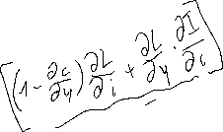



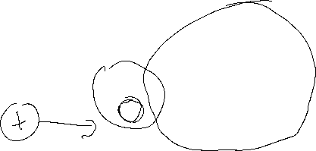
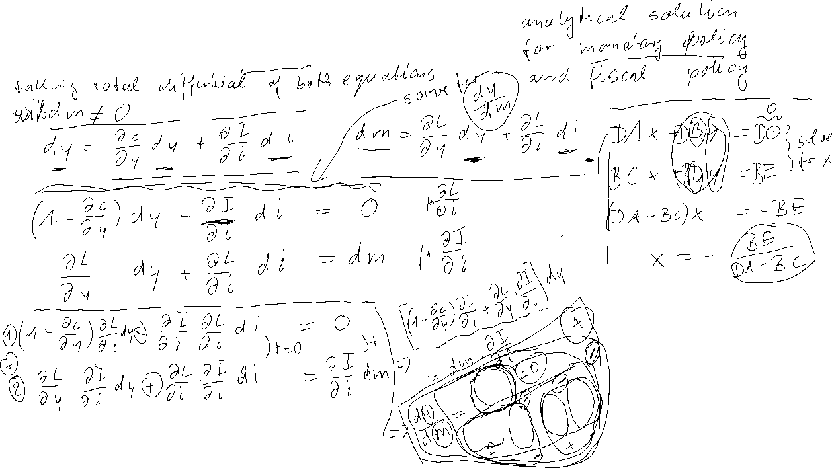
General Solution of the IS/LM-Model
Y = C(Y) + I(i) + G
m= $L^{D}$(Y, i )

Slide 4







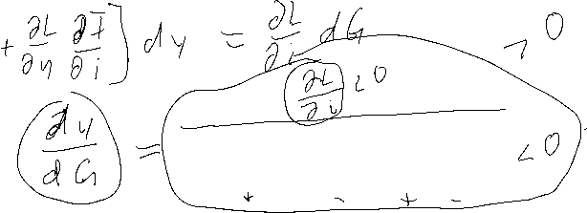












General Solution of the IS/LM-Model
Y = C(Y) + I(i) + G
m= $L^{D}$(Y, i )

Slide 5





Monetary Policy within the IS-LM-Model
i
LM
LM`
i*(m₁)
i*(m₂)
IS curve
Y* (M₁)
Y* (M₂)
Y
m↑➔ LM right ➔ a given income Y corresponds to a lower interest rate i↓ on the money market ➔ the lower interest rate pushes investment at the commodity market I↑ ➔ overall increase of Y↑

Slide 6



Example
IS/LM-Model:
C(Y)=300+0,7Y I=100-200i G=50
L(Y,i)=2Y-1000i M=200 P=1
Determine the simultanous equilibrium at the commodity and money market.
Determine the effekt of a (c.p.) 5% increase of money supply.

Slide 7
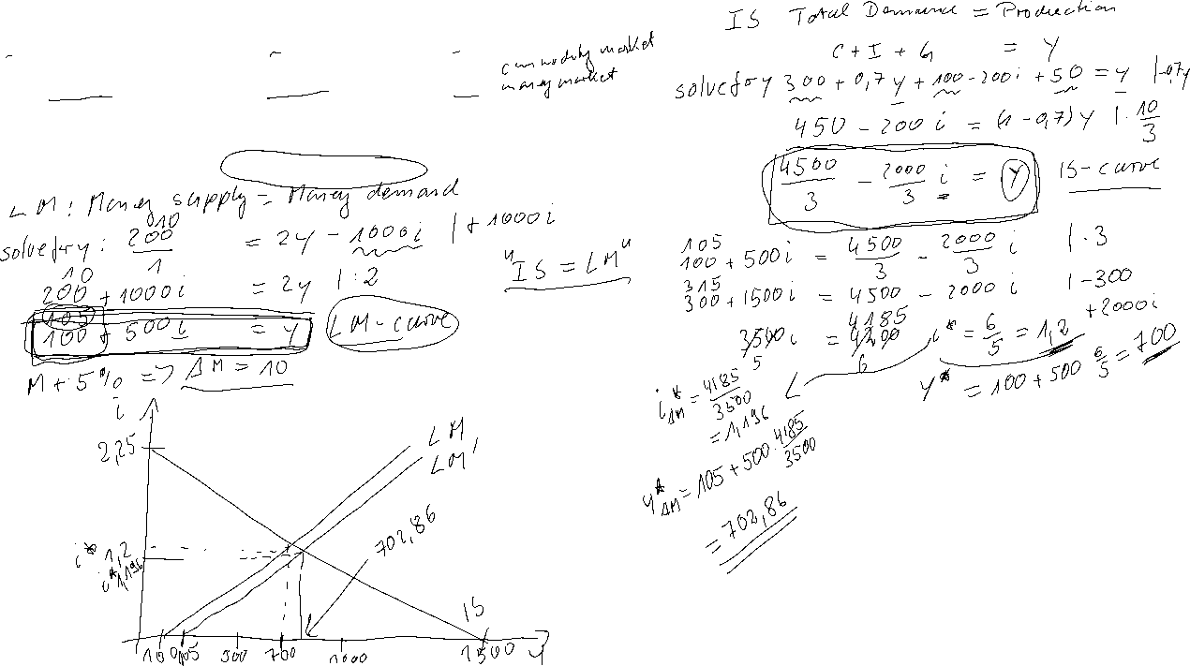
IS/LM-Model:
C(Y)=300+0,7Y I=100-200i G=50
L(Y,i)=2Y-1000i M=200 P=1
Determine the simultanous equilibrium at the commodity and money market.
Determine the effekt of a (c.p.) 5% increase of money supply.

Slide 8









IS-LM-Model and monetary policy
Direct interest rate effect – Capital cost effekt
Indirect interest rate effect – Substitution effect
– Income and wealth effect

Slide 9

IS-LM-Model and capital cost effekt
Central bank decreases interest rates
  refinancing costs decrease
    credit interest rates decrease
      higher loan growth and higher credit financed demand of investment and consumption
        increasing production

Slide 10


IS-LM-Model and substitution effect
Central bank decreases interest rates
  Rate of return of bonds are falling
    Stock market prices increase until stock market yield adjust to bond markets rate of return
      Income of stock owners increases, which increases demand of investment and consumption
        increasing production

Slide 11

IS-LM-Model and income effect
Central bank decreases interest rates
  credit interest rates decrease
    income redistribution between creditors and debtors
      Debtors becomes relatively richer and increase demand
        Since debtors are in general the poorer people in a society and poorer people consume relatively more (keynesian consumption hypothesis), the increase of demand by the poor outperforms the decrease of demand by the rich
          Increase of production

Slide 12



IS-LM-Model and wealth effect
Central bank decreases substantially interest rates
  risk of illequidity taking credits decreases
    increase of demand for durable consumption goods
      Especially demand for real estate increases
        Increase of production

Slide 13

Liquidity trap
Decrease of nominal interest rate to i=0%
  households become almost indifferent between holding money and holding bonds, as soon as they hold enough money for transactions
    The demand for money becomes highly interest rate elastic
      Further increase of money supply will not have any effect on nominal interest rates anymore

Slide 14
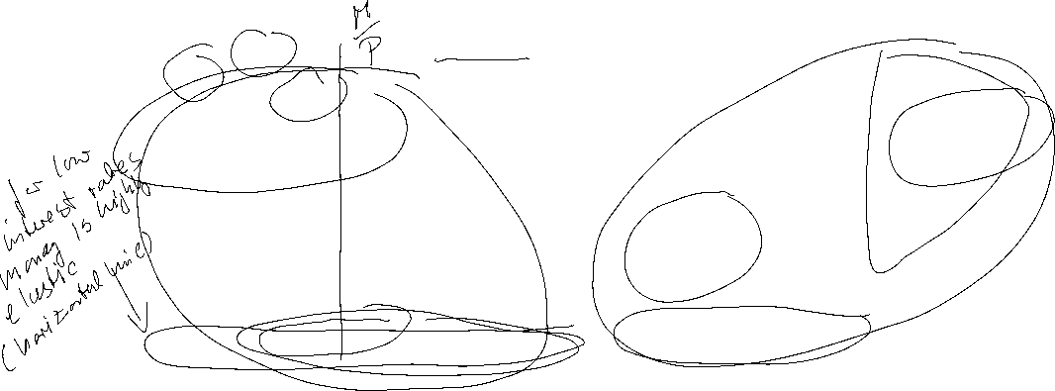


Liquidity trap
i
Y₀ <Y₁ <Y₂
i
$$L(Y_{1})$$
$$L(Y_{0})$$
$$L(Y_{2})$$
inelastic
range
highly
elastic
range
Quantity of real money
Y₀
Y₁
Y₂
Y
For low production LM is highly interest rate elastic with an nominal interest rate of zero. An increase in income does not imply an increase in interest rates
For larger interest rates LM becomes increasing and interest rate sensitive. An increase in income implies an increase in interest rates

Slide 15
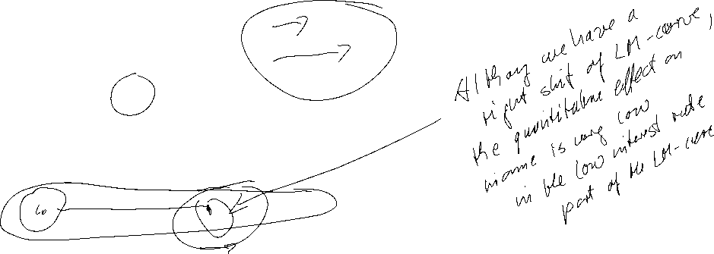
Liquidity trap
i
LM(M₀ )
LM(M₁ )
LM(M₂ )
M₀ <M₁ <M₂
IS
Y₀
Y₂
Y₁
Y
Within the liquidity trap monetary policy has almost no impact, since in the interest rate elastic part LM does not shift substantially to the right.
Thus, it is possible that production cannot be pushed to natural output

Slide 16





Liquidity trap with inflation and deflation
Real interest rates depend on expected inflation. Suppose expected inflation is 10% and nominal interest rates are 0%:
r = i - π^{e} = 0% − 10% = -10%
If real interest rates are that negativ, consumption and investment are supposed to be quite high, sind „today money“ is much more valuable than „tomorrow money“.
In that case the liquidity trap will not be a serious problem.
  Additionally this is an incentive for the central bank to aggressively push expected inflation

Slide 17
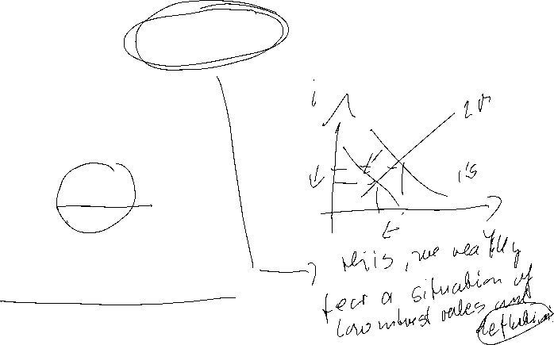

Liquidity trap with inflation and deflation
Suppose the economy is in a situation of deflation and expected inflation is -5%:
r = i - π^{e} = 0% − (-5%) = 5%
Such high real interest rates have the potential to dampen the economy.
Traditional monetary policy cannot push the economy
An increase of real interest rates even shifts th IS-curve to the left and worsens the problem
  This is the reason, why a central bank deeply tries to prevent such a scenario

Slide 18
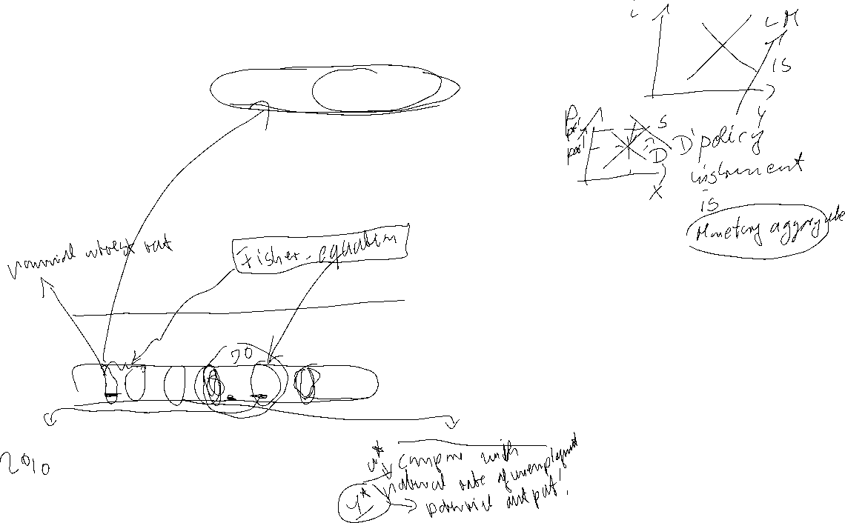
Money Market and the
Reaction Function of the Central Bank
In practice the central bank sets short term interest rates to meet its target level.
Most central banks communicate some kind of inflation target. Interest rates are therefore not only the outcome of an equilibrium process, but depend directly on the movements in prices
⇒ reaction function of the central bank
π↓ ⇒ r↓
Y↑ ⇒ r↑
⇒ r = i - π^{e} = r* + b(π - π*) +c(y - y*) b,c>0
π*: Inflation target y*: Potential output r*: Natural interest rate

Slide 19


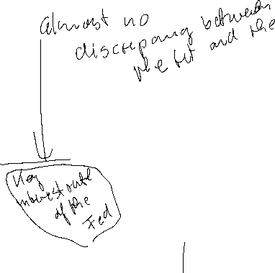



Taylor-Rule
John B. Taylor:
Professor of Economics
(Stanford University)
Council of Economic Advisers
1976 – 77
1989 – 91
Under Secretary of the Treasury for International Affairs
2001 – 05
Source: Taylor, J., B, (1993) 195-214 North-Holland Discretion versus policy rules in practice, Carnegie-Rochester Conference Series on Public Policy 39, 195-214, North Holland
r = i - π^{e} = 2% + 0,5(π - π*) +0,5(y - y*)
r* =2% π*=2% b=c=0,5

Slide 20


Taylor-Rule simplified
r = i - π^{e} = = r* + b(π - π*) +c(y - y*)
Since π* and y* are constants, we set in the following
r = i - π^{e} = = α + bπ +cy
⇒ dr/dY = c > 0
r
TR-Curve
Y
Same dependence as the LM-curve!!

Slide 21
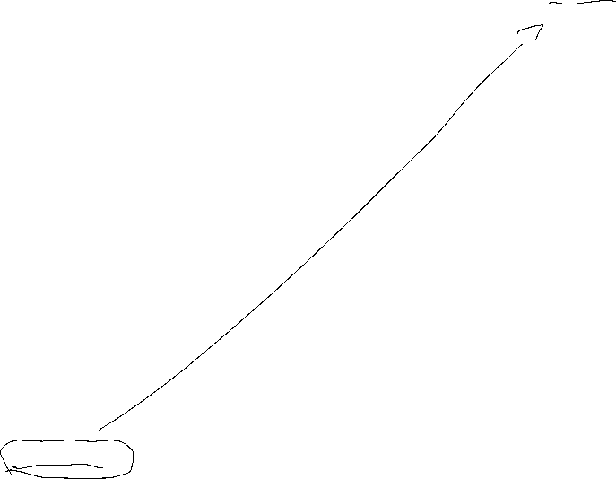
Short run equilibrium
r
TR
IS curve
Y
The intersection of the IS curve and the TR curve represents the short run equilibrium with fixed prices.
Mechanics are the same as in the case with LM-curve representing the
Money market equilibrium

Slide 22
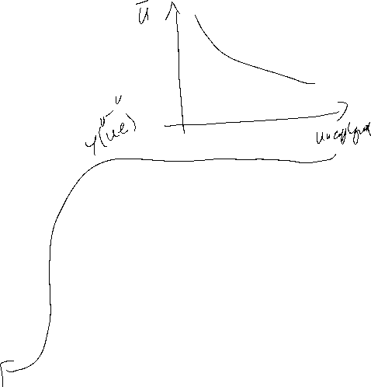


Price adjusting process – Phillips Curve
Originally: Negative dependence between inflation and unemployment
together with
declining unemployment implies increasing output
⇒
π = π^{e} + δY δ >0
π
PC
Y

Slide 23

Monetary Policy Rule with flexible prices
Substitute the PC into the TR
⇒
Integrated monetary policy (MP) rule:
MP: r = r* + b[π^{e} + δY] + cY = a + b π^{e} + (bδ+c)Y
⇒
The coefficient on output (Y) is now (bδ+c) instead of c.
⇒
direct output affect in monetary policy through c
indirect effect through bδ.

Slide 24

Equilibrium with flexible prices
r
MP
TR
IS curve
Y
Taylor estimation for the Fed
https://www.atlantafed.org/cqer/research/taylor-rule#Tab1

Slide 25
Special cases of the MP-rule
Inflation targeting: c = 0
⇒ MP becomes flatter ⇒ real interest rates respond less to IS shocks that reduce output.
General Difference between ECB and Fed in their reaction on the different crisis during last 25 years
Output targeting:
Output targeting simply has a vertical TR or MP curve at the output target. Limiting case where the central bank is infinitely inflation-averse and δ is very large relative to b.
This seems to become more important since the financial crisis

Slide 26
Taylor Rule Phillips-curve Aggregate demand and the Nominal Zero Lower Bound
{
r* + b(π - π*) + c(y-y*) i>0
r = i - π^{e} =
- π^{e} otherwise
r
⇒
- π^{e}
Y
y* -1/c(r* + π^{e} + b(π - π*))

Slide 27
Aggregated Demand (AD)
Assumption: π^{e} depends positively on π
TR₂
TR₃
TR₁
r
- π^{e}(π₃)
- π^{e}(π₂)
π₁>π₂>π₃
- π^{e}(π₁)
Y
AD
π
π₁
●
π₂
●
π₃
●
y₃
y₁
y₂
Y

Slide 28
General equilibrium and the nominal zero lower bound
AD
π₁>π₂>π₃
π
Threat of a downward spiral at NZLB:
PC(π^{e} =π₁)
PC(π^{e} =π₂)
decreasing inflation expectations
⇒ decreasing output
PC(π^{e} =π₃)
⇒ decreasing inflation
⇒ decreasing inflation expectations
⇒ ….
⇒ downturn cycle
y₃
y₁
y₂
Y

Slide 29
Monetary Policy Rules
Simple rules
Policy instrument depends on a small set of variables
Easy to calculate
Predictable monetary policy
→ but in general not optimal
Optimal rules
Minimizing a loss function depending on all relevant variables
Often complicated
Not very predictable

Slide 30
Development of Monetary Policy
Historical view: The monetary policy instrument was assumed to be the money supply
Modern view: The policy instrument is the interest rate (signal rate, key rate, repo rate, etc)
“Ultra-modern” view: The policy instrument is in general central bank’s communication
+ forward guidance

Slide 31
Money Supply Rules
Milton Friedman (1912-2006, Nobel Laureate 1976) suggested that central banks should follow a money supply rule.
Due to quantity theory of money, money supply should grow at a given rate in order to provide price stability.
P ● Y=M ● V
→ Fix Money Growth Rule
However: - Many countries have bad experience with monetary supply rules/targets
- Money demand (i.e. velocity V) is unstable; gives undesired volatility in the interest rate

Slide 32
Money Supply Rules
Former governour of Bank of Canada
"In Canada, we did not abandon money supply targets, they abandoned us".
Bank of England skips a monetary target at all, since:
“Whenever a bank makes a loan, it simultaneously creates a matching deposit in the borrower’s bank account, thereby creating new money.”
(BoE, 2014)

Slide 33
Annual Report Governing Council of Economic Advisors
handover of annunal report
https://www.sachverstaendigenrat-wirtschaft.de/index.html
Annual Report 2024/25
https://www.sachverstaendigenrat-wirtschaft.de/start/aktuelles/uebergabe-des-jahresgutachtens-am-13-november-new672922094b0de462582667.html?returnUrl=%2Findex.html&cHash=2c34d9db7ffef0a32dc7f0e9b79d3ab4

