Slide 1
Global Economics
Wilhelmshaven
This lecture will be recorded and
Subsequently uploaded in the
world-wide-web
Prof. Dr. Bernhard Köster
Jade-Hochschule Wilhelmshaven
http://www.bernhardkoester.de/vorlesungen/inhalt.html

Slide 2
Global Economics
Winter term 2024
Prof. Dr. Bernhard Köster

Slide 3
Inflation and Unemployment as macroeconomic targets
In practical economic policy, the primary direct objectives macroeconomic variables
inflation (π) and unemployment (u)
rather than economic growth
For example the 2%-target of the ECB or the dual target of the Fed pursuing the economic goals of maximum employment and price stability (i.e u = 6% in the aftermath of the financial crisis)
Although price level (p) and (y) are directly related to (π) and (u) these variables, but these variables are generally not used as operationalized target variables!

Slide 4
Inflation and Unemployment : Philippskurve
Transition from price level to inflation:
Price level (P) → Inflation (π) determine the perventage change!
Inflation: π_{t}=(P_{t}-P_{t-1})/P_{t-1}=P_{t}/P_{t-1}-1 relative change compared to the former period
Expected Inflation: π_{t}^{e}=(P_{t}^{e}-P_{t-1})/P_{t-1}=P_{t}^{e}/P_{t-1}-1 relative expected change compared to the former period
output (y) → unemployment (u)
Okuns law!
-A(u_{t}-u*)=(Y_{t}-Y*)/Y* (A>0)

Slide 5
Philippskurve and short run aggregrated supply (AS-curve)
AS: Y_{t} = Y* + a(P_{t}-P_{t}^{e}) (a>0) (P_{t}^{e}: expected price level)
replace P_{t}/P_{t-1}=1+ π_{t} and P_{t}^{e}/P_{t-1}= 1+π_{t}^{e}
→ Y_{t} = Y* + a((1+ π_{t})P_{t-1} - (1+ π_{t}^{e})P_{t-1} )
= Y* + P_{t-1}a(π_{t} - π_{t}^{e})
= Y* + ã(π_{t} - π_{t}^{e}) with ã= P_{t-1}a>0
With given expectations, we obtain
or
P_{t}
π _{t}
$$AS$$
$AS$`
Y_{t}
Y_{t}

Slide 6
Philippskurve and short run aggregrated supply (AS-curve) and Okun´s law
Okun´s law: -A(u_{t}-u*) = (Y_{t}-Y*)/Y* set Ã=AY*
⇒ -Ã(u_{t}-u*) = Y_{t}-Y* ⇒ Y*- Ã(u_{t}-u*) = Y_{t}
Together with the AS-curve we obtain:
Y*- Ã(u_{t}-u*) = Y_{t}=Y* + ã(π_{t} - π_{t}^{e})
⇒ - (Ã/ã)(u_{t}-u*) = π_{t} - π_{t}^{e}
⇒ π_{t} = π_{t}^{e} - β(u_{t}-u*) with β = (Ã/ã)>0 Expectation augmented Philipps curve
In its original form, the Phillips curve, like Okun's law, merely reflected the empirical finding that rising inflation tends to lead to falling unemployment.
Philipps, A. (1958) The Relation between Unemployment and the Rate of Change of Money Wages in the United Kingdom, 1861–1957, Economica, Vol. 25, S. 283–299
Phelps, Edmund S. (1967) “Phillips Curves, Expectations of Inflation and Optimal Employment over Time.” Economica, n.s., 34, no. 3, 254–281.
(Nobel Prize 2006)

Slide 7
Inflation, Unemployment, and the Phillips Curve
The Philipps curve states that inflation π depends on
expected inflation π^{e}
the deviation of unemployment fromt the natural rate u-u*
For further analysis we add an supply shock ε
π = π^{e} - β(u-u*) + ε

Slide 8
The short run Phillips curve
π
Trade off between
unemployment and inflation
β
1
π^{e} + ε
u*
u

Slide 9
Long run Phillips Curve
π
2
π₂ =π₃
3
1
π₁
u*
u
u₂
u₃=u₁

Slide 10
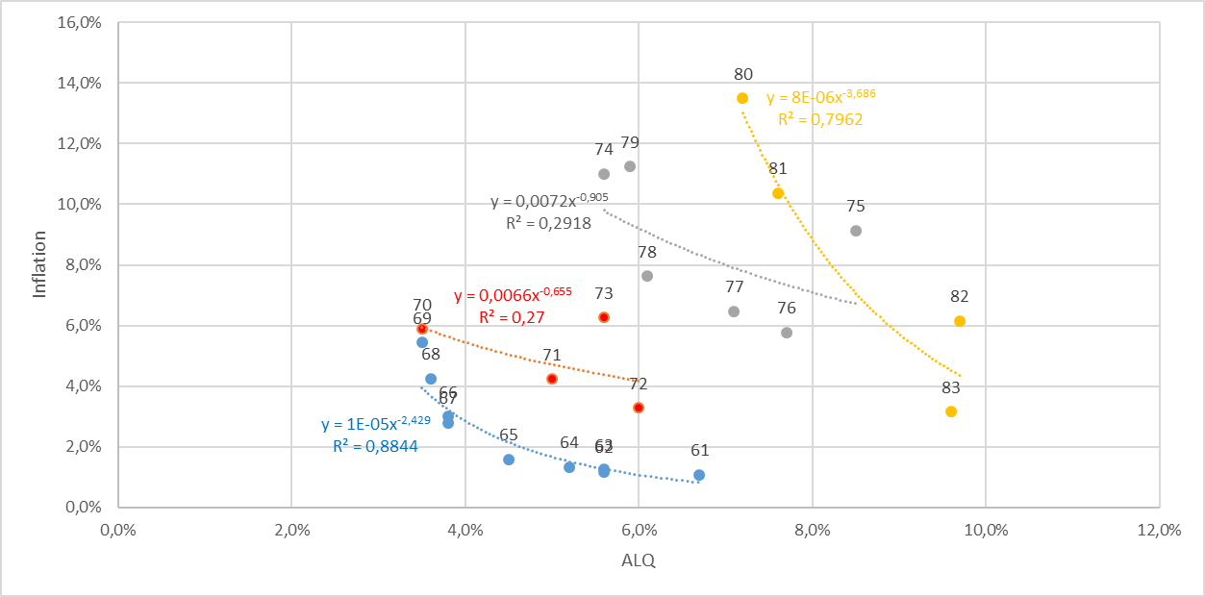
Philipps-curve USA I
Source: FRED
From the 1960 to 1980ies we seen an outward shift of the Philipps-curve
In this example, the regression used the Ansatz:
y=xª
Thus, the exponent can directly interpreted as the elasticity between x and y
e=(dy/y):(dx/x)
Can you show this ☺?.

Slide 11
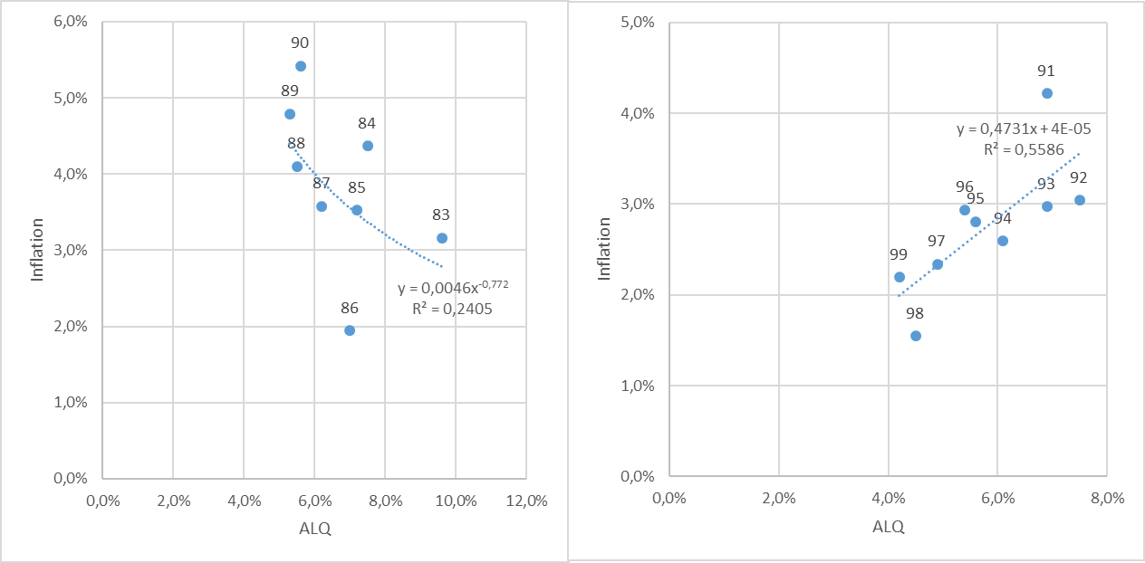
Philipps-curve USA II
Source: FRED
From the 1980ies to 2000, the data shows only a weak or even a inverted dependence between inflation and umemployment. A possible reason is the drastic change of the economic sircumstandes due to the break down of the soviet union and after that the dramatic change in the global economic dependencies

Slide 12
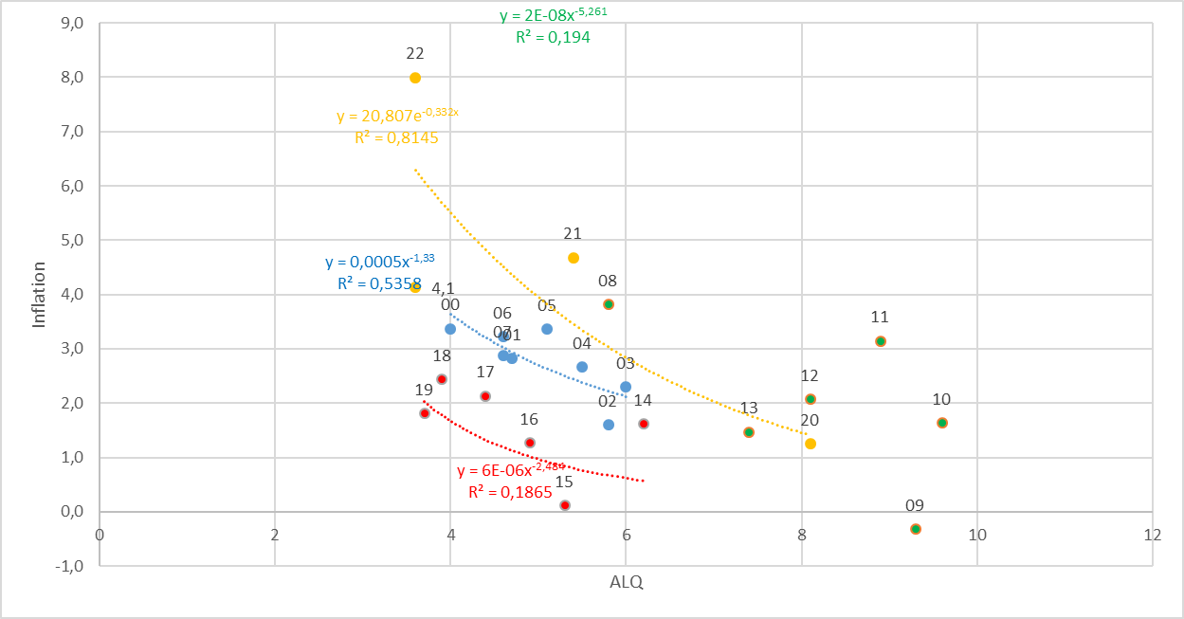
Philipps-curve USA III
Source: FRED
With the first push of globalization from 2000 until the financial crisis, again there is a quite stable „classical“ philipps-curve like dependence.
But within in following turmoil in the aftermath of the financial crisis, we had again no stable dependence again!
Using the data from 2020 to 2023 for a regression, we obtain a R^2=0,82. Are we therefore back to a stable dependence between inflation and unemployment?

Slide 13
Inflation – Economic Policy – Philipps curve
π
Longrun PC
Until the 1980, people were of the opinion thatone could freely choose the point on the Phillips curve via monetary or fiscal policy (cf. data before) and therefore could lower unemployment by allowing higher inflation rates
X
Then it was realized that expectations adjust and there is a rightward shift/rotation into the vertical of the Phillips curve!
c
c
π^{e}
Y
Shortrun PC
u*
u

Slide 14
Inflation – Economic Policy – Philipps curve
→ In order to be able to permanently reduce the unemployment rate π > π^{e} would have to apply permanently.
→ in the long run this is unrealistic and stable condition results!
→ thus, in principle, under rational expectations π = π^{e} will hold
→ thus u=u*
→ motion only on the long-run (vertical) Phillips curve possible!
→ Stagflation

Slide 15
The short run IS-LM-Model
► Modeling the goods market
IS: Investment = Saving
► Modelling the money market
LM: Money Supply = Money Demand (Liquidity Preference)

Slide 16
Commodity Market
Budget restriction of the economy:
Y = C(Y) + I(i= r+π^{e}) + G
Y: Income C: Consumption I: Investment G: Government expenditure
i: Nominal interest rate r: Real interest rate π^{e}: Inflation expectations
keynesian consumption hypotheses
“+“
opportunity costs
“−“
“(0,1)“
“+“
“−“
< 0
dY=∂C/∂Y∙dY + ∂I/∂i∙di ⇒ dr/dY = (1- ∂C/∂Y)/∂I/∂i
i
IS-curve
(investment=savings)
i.e IS: y=A-Bi A,B>0
Y

Slide 17
Money Market
Money Demand:
$L^{D}$= $L^{D}$( Y , i=r+π^{e} )
Y: Aggregate Income
i: nominal interest rate r: real interest rate π^{e}: Expected Inflation
Transaction motive
„+“
Opportunity cost, Speculations motive
„−“
Money Supply:
m=M/P
M: Nominal money supply P: Price level
Money market equilibrium:
m= $L^{D}$ ⇒ M/P=m= $L^{D}$(Y, i=r+π^{e} )

Slide 18
Die LM-Curve
$$\frac{M}{P}$$
LM Curve
i
Y₀ <Y₁ <Y₂
i
$$i_{2}$$
$$i_{1}$$
$$i_{0}$$
$$L(Y_{2})$$
$$L(Y_{0})$$
$$L(Y_{1})$$
Quantity of real money
Y₀
Y₁
Y₂

Slide 19
General Equilibrium
i
LM-Curve
i*
IS-Curve
Y*
Y
Intersection of LM- and IS-Curve determines the general equilibrium
with the simultanous equlibrium in the commodity and money market

Slide 20
General Solution of the IS/LM-Model
Y = C(Y) + I(i) + G
m= $L^{D}$(Y, i )

Slide 21
Monetary Policy within the IS-LM-Model
i
LM
LM`
i*(m₁)
i*(m₂)
IS curve
Y* (M₁)
Y* (M₂)
Y
m↑➔ LM right ➔ a given income Y corresponds to a lower interest rate i↓ on the money market ➔ the lower interest rate pushes investment at the commodity market I↑ ➔ overall increase of Y↑

Slide 22
Example
IS/LM-Model:
C(Y)=300+0,7Y I=100-200i G=50
L(Y,i)=2Y-1000i M=200 P=1
Determine the simultanous equilibrium at the commodity and money market.
Determine the effekt of a (c.p.) 5% increase of money supply.

Slide 23
IS-LM-Model and monetary policy
Direct interest rate effect – Capital cost effekt
Indirect interest rate effect – Substitution effect
– Income and wealth effect

Slide 24
IS-LM-Model and capital cost effekt
Central bank decreases interest rates
refinancing costs decrease
credit interest rates decrease
higher loan growth and higher credit financed demand of investment and consumption
increasing production

Slide 25
IS-LM-Model and substitution effect
Central bank decreases interest rates
Rate of return of bonds are falling
Stock market prices increase until stock market yield adjust to bond markets rate of return
Income of stock owners increases, which increases demand of investment and consumption
increasing production

Slide 26
IS-LM-Model and income effect
Central bank decreases interest rates
credit interest rates decrease
income redistribution between creditors and debtors
Debtors becomes relatively richer and increase demand
Since debtors are in general the poorer people in a society and poorer people consume relatively more (keynesian consumption hypothesis), the increase of demand by the poor outperforms the decrease of demand by the rich
Increase of production

Slide 27
IS-LM-Model and wealth effect
Central bank decreases substantially interest rates
risk of illequidity taking credits decreases
increase of demand for durable consumption goods
Especially demand for real estate increases
Increase of production

Slide 28
Liquidity trap
Decrease of nominal interest rate to i=0%
households become almost indifferent between holding money and holding bonds, as soon as they hold enough money for transactions
The demand for money becomes highly interest rate elastic
Further increase of money supply will not have any effect on nominal interest rates anymore

Slide 29
Liquidity trap
i
Y₀ <Y₁ <Y₂
i
$$L(Y_{1})$$
$$L(Y_{0})$$
$$L(Y_{2})$$
inelastic
range
highly
elastic
range
Quantity of real money
Y₀
Y₁
Y₂
Y
For low production LM is highly interest rate elastic with an nominal interest rate of zero. An increase in income does not imply an increase in interest rates
For larger interest rates LM becomes increasing and interest rate sensitive. An increase in income implies an increase in interest rates

Slide 30
Liquidity trap
i
LM(M₀ )
LM(M₁ )
LM(M₂ )
M₀ <M₁ <M₂
IS
Y₀
Y₂
Y₁
Y
Within the liquidity trap monetary policy has almost no impact, since in the interest rate elastic part LM does not shift substantially to the right.
Thus, it is possible that production cannot be pushed to natural output

Slide 31
Liquidity trap with inflation and deflation
Real interest rates depend on expected inflation. Suppose expected inflation is 10% and nominal interest rates are 0%:
r = i - π^{e} = 0% − 10% = -10%
If real interest rates are that negativ, consumption and investment are supposed to be quite high, sind „today money“ is much more valuable than „tomorrow money“.
In that case the liquidity trap will not be a serious problem.
Additionally this is an incentive for the central bank to aggressively push expected inflation

Slide 32
Liquidity trap with inflation and deflation
Suppose the economy is in a situation of deflation and expected inflation is -5%:
r = i - π^{e} = 0% − (-5%) = 5%
Such high real interest rates have the potential to dampen the economy.
Traditional monetary policy cannot push the economy
An increase of real interest rates even shifts th IS-curve to the left and worsens the problem
This is the reason, why a central bank deeply tries to prevent such a scenario

