Slide 1

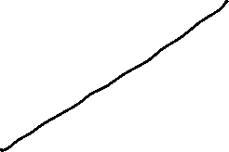


Global Economics
Wilhelmshaven
This lecture will be recorded and
Subsequently uploaded in the
world-wide-web
Prof. Dr. Bernhard Köster
Jade-Hochschule Wilhelmshaven
http://www.bernhardkoester.de/vorlesungen/inhalt.html

Slide 2


Global economic Trends and the Regional Change
Source: IMF Datamapper and Trade-Data
Try to figure out different Periods in the change of world production and world Trade in the last four decades by setting both time series for 1980 to 100 and calculation (average) growth rates.

Slide 3
Global economic Trends and the Regional Change
Source: IMF Datamapper and Trade-Data
Try to figure out different Periods in the change of world production and world Trade in the last four decades by setting both time series for 1980 to 100 and calculation (average) growth rates.

Slide 4
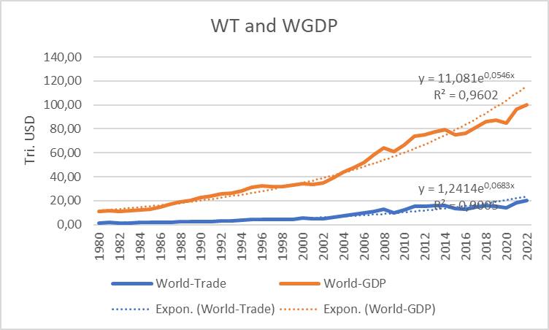
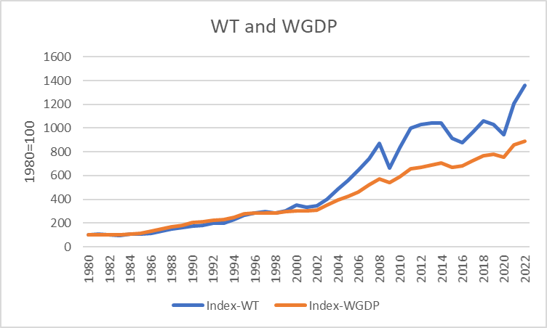
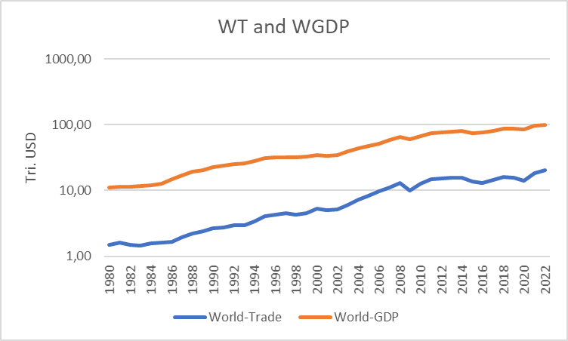



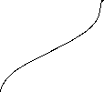





Global economic Trends and the Regional Change
Source: IMF Datamapper and Trade-Data

Slide 5
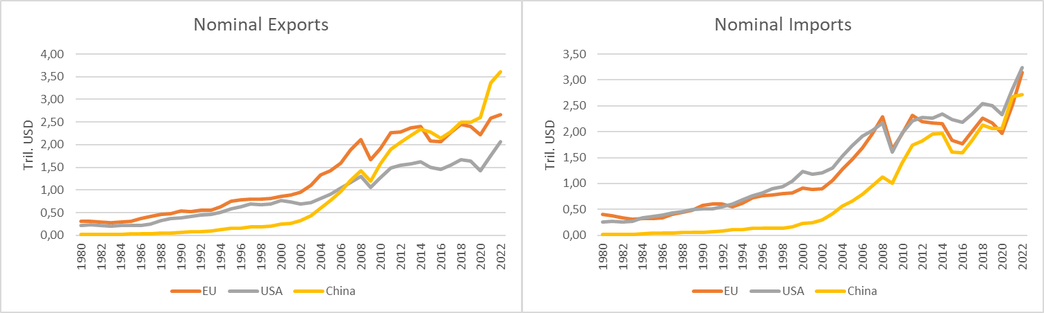
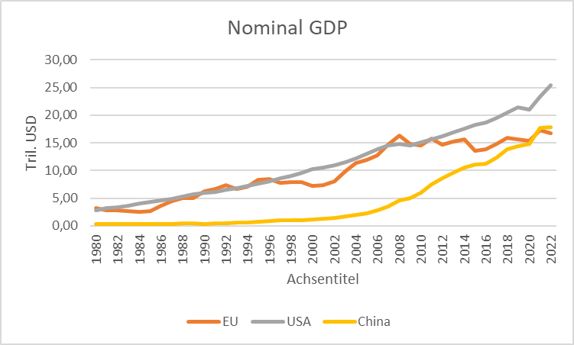




















Global economic Trends and the Regional Change

Slide 6
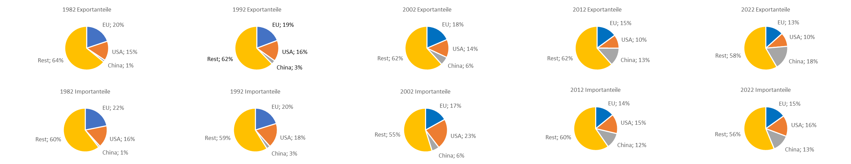
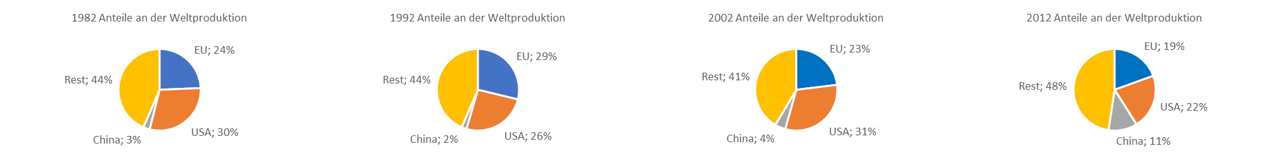
Global economic Trends and the Regional Change

Slide 7
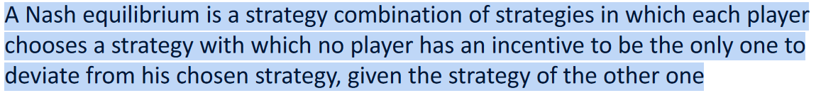





Gametheoretic modelling of change in Regional Trade in the last two Decades
Assume a classical situation in foreign trade, where a region is profiting from free market access to other countries with simultaneous protection of the own market. The entries in the payoff matrix represents the utility for both regions in different strategy combinations (EU,CN).
Analyze this game for Nash-equilibria in pure strategies and interprete the result!

Slide 8


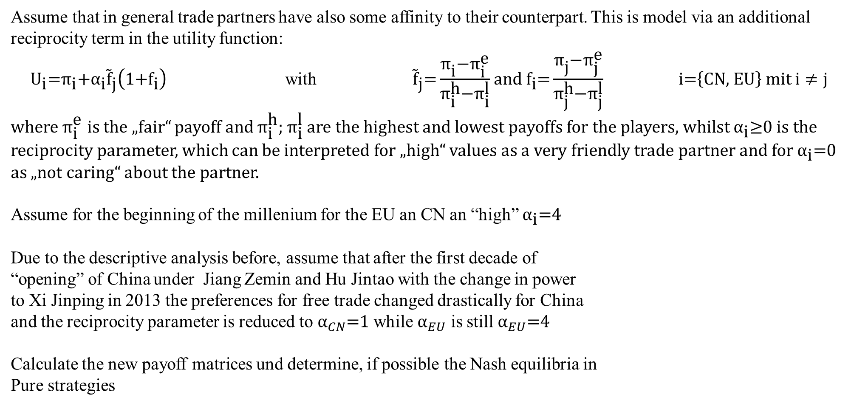

Gametheoretic modelling of change in Regional Trade in the last two Decades
Assume that in general trade partners have also some affinity to their counterpart. This is model via an additional reciprocity term in the utility function:
${\text{U}}_{\text{i}}\text{=}{\text{π}}_{\text{i}}\text{+}{{\text{α}}_{\text{i}}\tilde{\text{f}}}_{\text{j}}\left(\text{1+}{\text{f}}_{\text{i}}\right)$ with ${\tilde{\text{f}}}_{\text{j}}\text{=}\frac{{\text{π}}_{\text{i}}\text{−}{\text{π}}_{\text{i}}^{\text{e}}}{{\text{π}}_{\text{i}}^{\text{h}}\text{−}{\text{π}}_{\text{i}}^{\text{l}}}$ and ${\text{f}}_{\text{i}}\text{=}\frac{{\text{π}}_{\text{j}}\text{−}{\text{π}}_{\text{j}}^{\text{e}}}{{\text{π}}_{\text{j}}^{\text{h}}\text{−}{\text{π}}_{\text{j}}^{\text{l}}}$ $\text{i}\text{=}\left\{\text{CN}\text{, }\text{EU}\right\}$ mit $i≠j$
where ${\text{π}}_{\text{i}}^{\text{e}}$ is the „fair“ payoff and ${\text{π}}_{\text{i}}^{\text{h}}\text{; }{\text{π}}_{\text{i}}^{\text{l}}$ are the highest and lowest payoffs for the players, whilst ${\text{α}}_{\text{i}}\text{≥0}$ is the reciprocity parameter, which can be interpreted for „high“ values as a very friendly trade partner and for ${\text{α}}_{\text{i}}\text{=}\text{0}$ as „not caring“ about the partner.
Assume for the beginning of the millenium for the EU an CN an “high” ${\text{α}}_{\text{i}}\text{=4}$
Due to the descriptive analysis before, assume that after the first decade of
“opening” of China under Jiang Zemin and Hu Jintao with the change in power
to Xi Jinping in 2013 the preferences for free trade changed drastically for China
and the reciprocity parameter is reduced to ${\text{α}}_{CN}\text{=1}$ while ${\text{α}}_{EU}$ is still ${\text{α}}_{EU}\text{=}\text{4}$
Calculate the new payoff matrices und determine, if possible the Nash equilibria in
Pure strategies
Rabin, M. (1993) Incorporating Fairness into Game Theory and Economics, in: American Economic Review, Vol. 83, No. 5, S. 1281-1302.

Slide 9




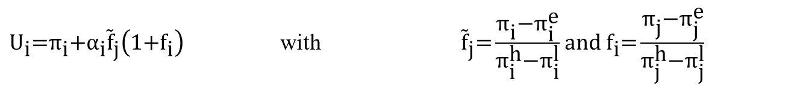
Gametheoretic modelling of change in Regional Trade in the last two Decades
${\text{U}}_{\text{i}}\text{=}{\text{π}}_{\text{i}}\text{+}{{\text{α}}_{\text{i}}\tilde{\text{f}}}_{\text{j}}\left(\text{1+}{\text{f}}_{\text{i}}\right)$ with ${\tilde{\text{f}}}_{\text{j}}\text{=}\frac{{\text{π}}_{\text{i}}\text{−}{\text{π}}_{\text{i}}^{\text{e}}}{{\text{π}}_{\text{i}}^{\text{h}}\text{−}{\text{π}}_{\text{i}}^{\text{l}}}$ and ${\text{f}}_{\text{i}}\text{=}\frac{{\text{π}}_{\text{j}}\text{−}{\text{π}}_{\text{j}}^{\text{e}}}{{\text{π}}_{\text{j}}^{\text{h}}\text{−}{\text{π}}_{\text{j}}^{\text{l}}}$

Slide 10




Gametheoretic modelling of change in Regional Trade in the last two Decades
${\text{α}}_{CN}\text{=4}$ ${\text{α}}_{EU}\text{=}\text{4}$

Slide 11


















Gametheoretic modelling of change in Regional Trade in the last two Decades
${\text{α}}_{CN}\text{=1}$ ${\text{α}}_{EU}\text{=}\text{4}$

