Slide 1

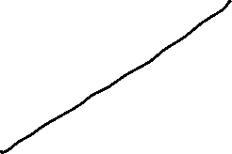


Global Economics
Wilhelmshaven
This lecture will be recorded and
Subsequently uploaded in the
world-wide-web
Prof. Dr. Bernhard Köster
Jade-Hochschule Wilhelmshaven
http://www.bernhardkoester.de/vorlesungen/inhalt.html

Slide 2
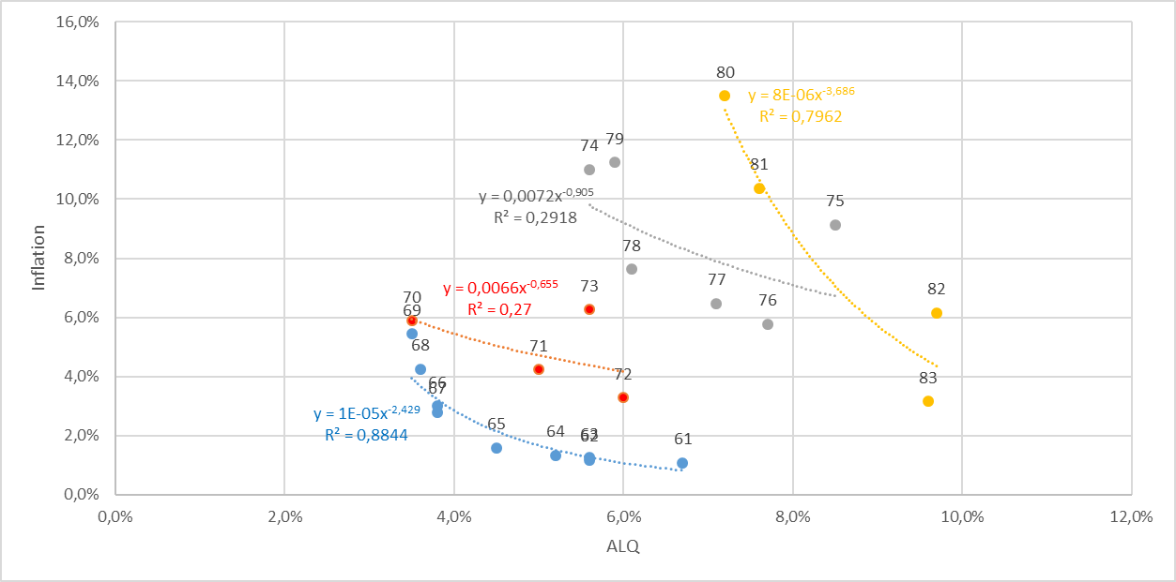
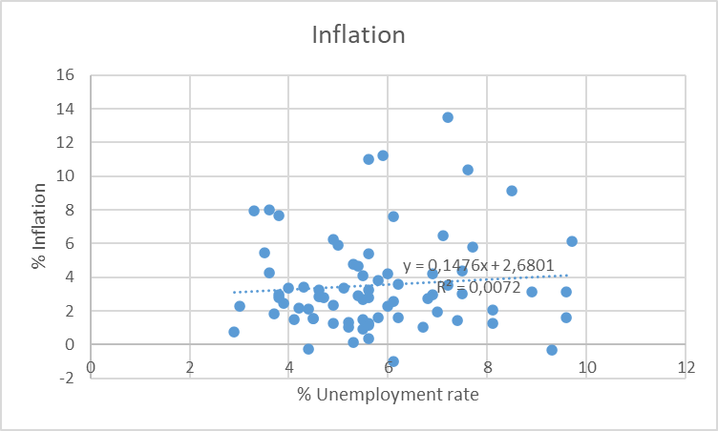









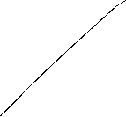




Philipps-curve USA I
Source: FRED
From the 1960 to 1980ies we seen an outward shift of the Philipps-curve
In this example, the regression used the Ansatz:
y=xª
Thus, the exponent can directly interpreted as the elasticity between x and y
e=(dy/y):(dx/x)
Can you show this ☺?.

Slide 3
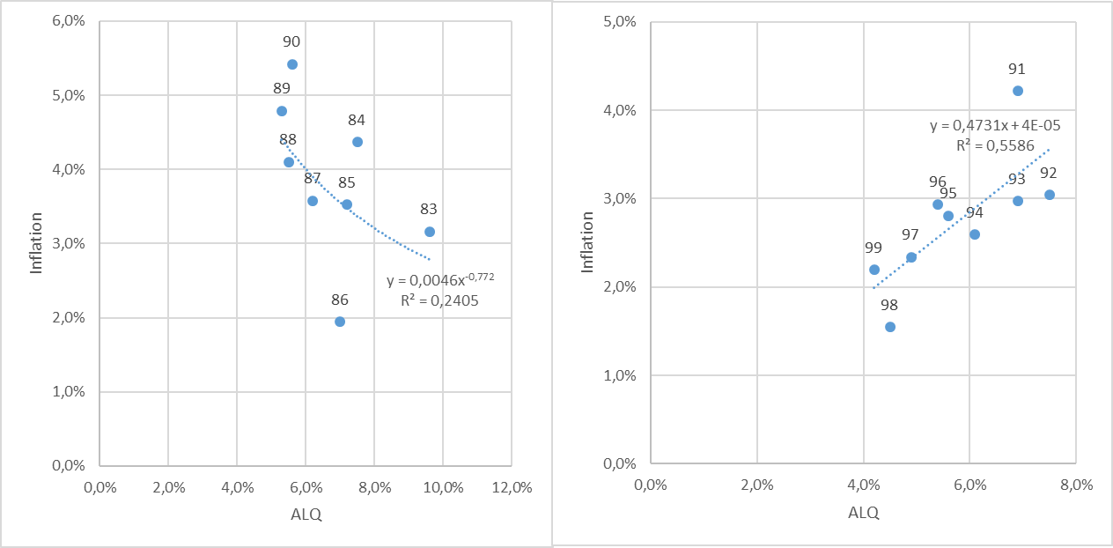
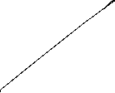



Philipps-curve USA II
Source: FRED
From the 1980ies to 2000, the data shows only a weak or even a inverted dependence between inflation and umemployment. A possible reason is the drastic change of the economic sircumstandes due to the break down of the soviet union and after that the dramatic change in the global economic dependencies

Slide 4
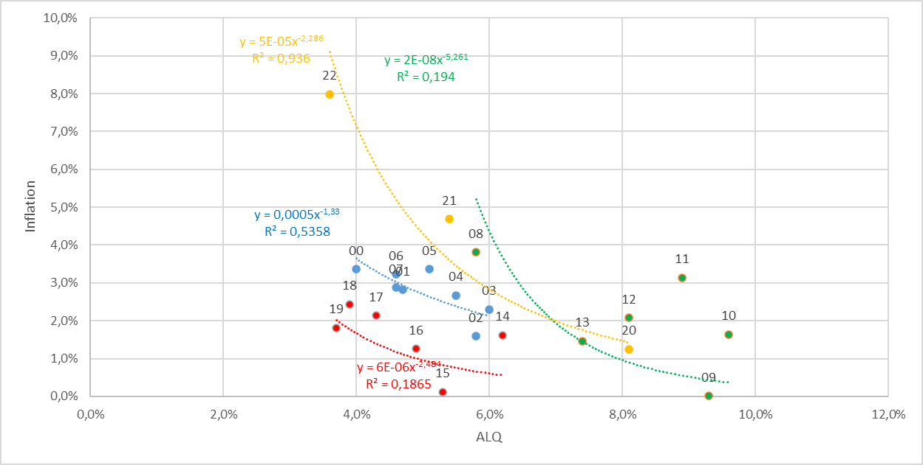










Philipps-curve USA III
Source: FRED
With the first push of globalization from 2000 until the financial crisis, again there is a quite stable „classical“ philipps-cirve like dependence.
But within in following turmoil in the aftermath of the financial crisis, we had again no stable dependence again!
Using the data from 2020 to 2022 for a regression, we obtain a R^2=0,94. Are we therefore back to a stable dependence between inflation and unemployment?

Slide 5








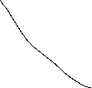
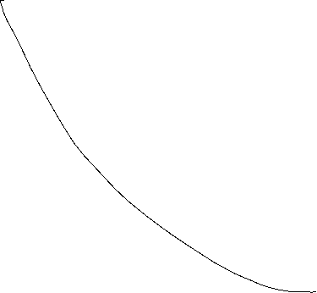

Inflation – Economic Policy – Philipps curve
π
Longrun PC
Until the 1980, people were of the opinion thatone could freely choose the point on the Phillips curve via monetary or fiscal policy (cf. data before) and therefore could lower unemployment by allowing higher inflation rates
X
Then it was realized that expectations adjust and there is a rightward shift/rotation into the vertical of the Phillips curve!
c
c
π^{e}
Y
Shortrun PC
u*
u

Slide 6



Inflation – Economic Policy – Philipps curve
→ In order to be able to permanently reduce the unemployment rate π > π^{e} would have to apply permanently.
→ in the long run this is unrealistic and stable condition results!
→ thus, in principle, under rational expectations π = π^{e} will hold
→ thus u=u*
→ motion only on the long-run (vertical) Phillips curve possible!
→ Stagflation

Slide 7


Global economic Trends and the Regional Change
Source: IMF Datamapper and Trade-Data
Try to figure out different Periods in the change of world production and world Trade in the last four decades by setting both time series for 1980 to 100 and calculation (average) growth rates.

Slide 8
Global economic Trends and the Regional Change
Source: IMF Datamapper and Trade-Data
Try to figure out different Periods in the change of world production and world Trade in the last four decades by setting both time series for 1980 to 100 and calculation (average) growth rates.

Slide 9
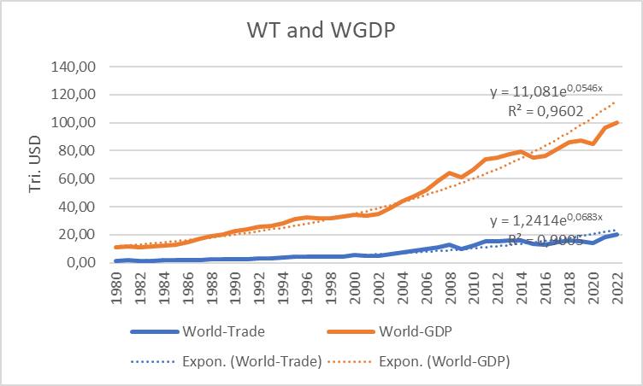
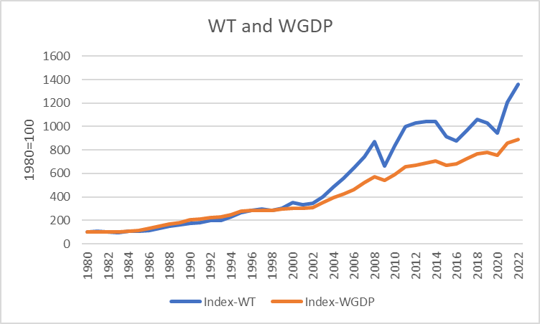
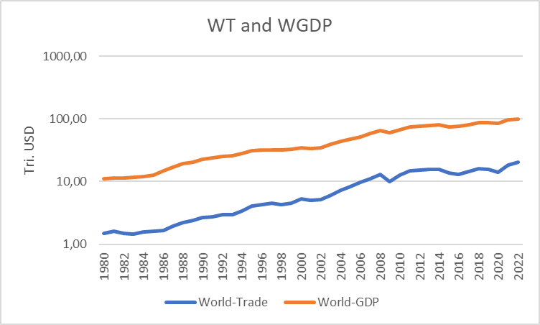







Global economic Trends and the Regional Change
Source: IMF Datamapper and Trade-Data

Slide 10
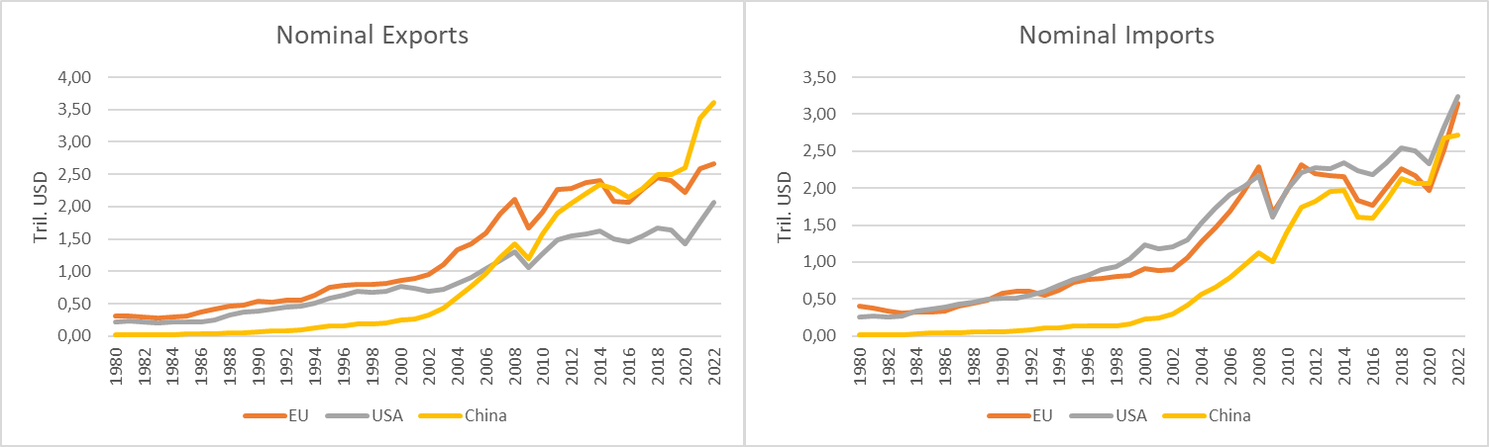
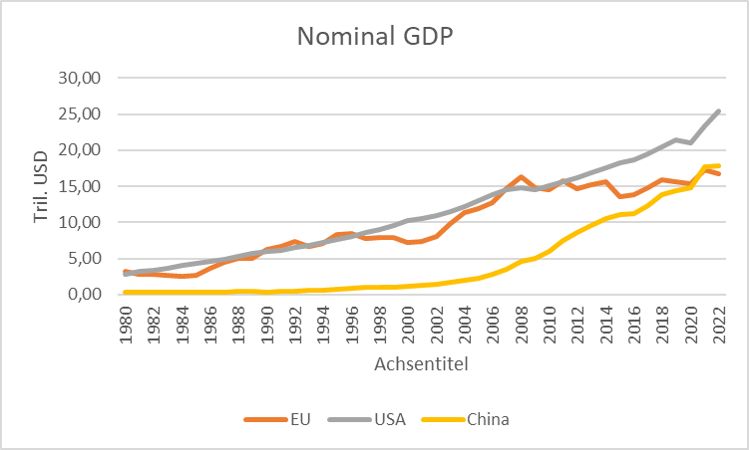







Global economic Trends and the Regional Change

Slide 11
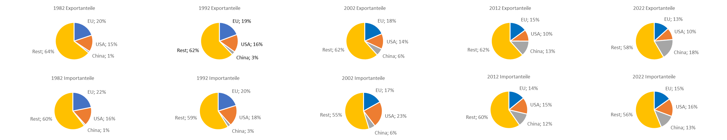
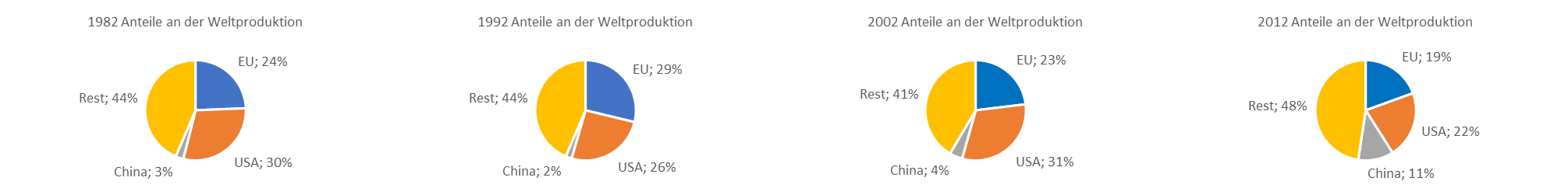
Global economic Trends and the Regional Change

Slide 12
Gametheoretic modelling of change in Regional Trade in the last two Decades
Assume a classical situation in foreign trade, where a region is profiting from free market access to other countries with simultaneous protection of the own market. The entries in the payoff matrix represents the utility for both regions in different strategy combinations (EU,CN).
Analyze this game for Nash-equilibria in pure strategies and interprete the result!

Slide 13
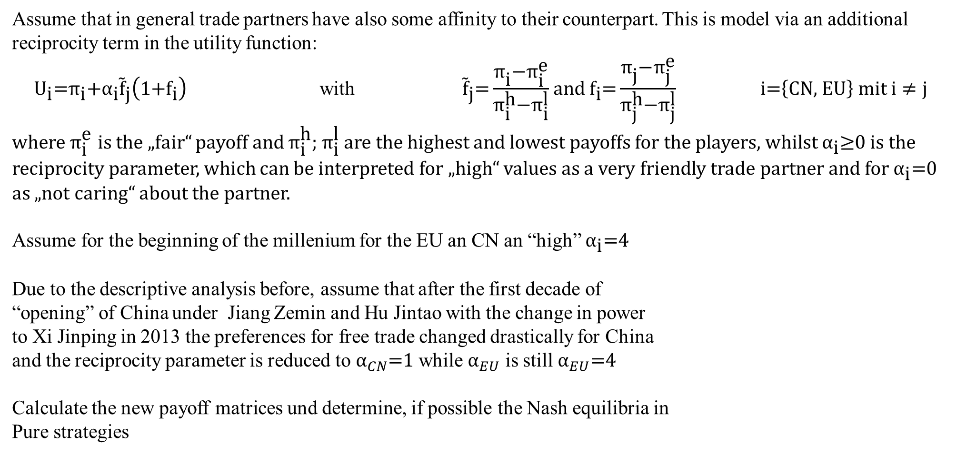
Gametheoretic modelling of change in Regional Trade in the last two Decades
Assume that in general trade partners have also some affinity to their counterpart. This is model via an additional reciprocity term in the utility function:
${\text{U}}_{\text{i}}\text{=}{\text{π}}_{\text{i}}\text{+}{{\text{α}}_{\text{i}}\tilde{\text{f}}}_{\text{j}}\left(\text{1+}{\text{f}}_{\text{i}}\right)$ with ${\tilde{\text{f}}}_{\text{j}}\text{=}\frac{{\text{π}}_{\text{i}}\text{−}{\text{π}}_{\text{i}}^{\text{e}}}{{\text{π}}_{\text{i}}^{\text{h}}\text{−}{\text{π}}_{\text{i}}^{\text{l}}}$ and ${\text{f}}_{\text{i}}\text{=}\frac{{\text{π}}_{\text{j}}\text{−}{\text{π}}_{\text{j}}^{\text{e}}}{{\text{π}}_{\text{j}}^{\text{h}}\text{−}{\text{π}}_{\text{j}}^{\text{l}}}$ $\text{i}\text{=}\left\{\text{CN}\text{, }\text{EU}\right\}$ mit $i≠j$
where ${\text{π}}_{\text{i}}^{\text{e}}$ is the „fair“ payoff and ${\text{π}}_{\text{i}}^{\text{h}}\text{; }{\text{π}}_{\text{i}}^{\text{l}}$ are the highest and lowest payoffs for the players, whilst ${\text{α}}_{\text{i}}\text{≥0}$ is the reciprocity parameter, which can be interpreted for „high“ values as a very friendly trade partner and for ${\text{α}}_{\text{i}}\text{=}\text{0}$ as „not caring“ about the partner.
Assume for the beginning of the millenium for the EU an CN an “high” ${\text{α}}_{\text{i}}\text{=4}$
Due to the descriptive analysis before, assume that after the first decade of
“opening” of China under Jiang Zemin and Hu Jintao with the change in power
to Xi Jinping in 2013 the preferences for free trade changed drastically for China
and the reciprocity parameter is reduced to ${\text{α}}_{CN}\text{=1}$ while ${\text{α}}_{EU}$ is still ${\text{α}}_{EU}\text{=}\text{4}$
Calculate the new payoff matrices und determine, if possible the Nash equilibria in
Pure strategies
Rabin, M. (1993) Incorporating Fairness into Game Theory and Economics, in: American Economic Review, Vol. 83, No. 5, S. 1281-1302.

Slide 14
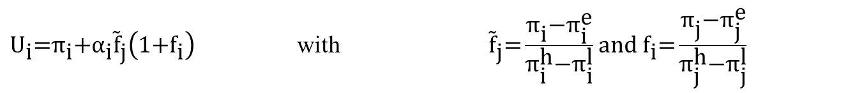
Gametheoretic modelling of change in Regional Trade in the last two Decades
${\text{U}}_{\text{i}}\text{=}{\text{π}}_{\text{i}}\text{+}{{\text{α}}_{\text{i}}\tilde{\text{f}}}_{\text{j}}\left(\text{1+}{\text{f}}_{\text{i}}\right)$ with ${\tilde{\text{f}}}_{\text{j}}\text{=}\frac{{\text{π}}_{\text{i}}\text{−}{\text{π}}_{\text{i}}^{\text{e}}}{{\text{π}}_{\text{i}}^{\text{h}}\text{−}{\text{π}}_{\text{i}}^{\text{l}}}$ and ${\text{f}}_{\text{i}}\text{=}\frac{{\text{π}}_{\text{j}}\text{−}{\text{π}}_{\text{j}}^{\text{e}}}{{\text{π}}_{\text{j}}^{\text{h}}\text{−}{\text{π}}_{\text{j}}^{\text{l}}}$

Slide 15
Gametheoretic modelling of change in Regional Trade in the last two Decades
${\text{α}}_{CN}\text{=4}$ ${\text{α}}_{EU}\text{=}\text{4}$

Slide 16
Gametheoretic modelling of change in Regional Trade in the last two Decades
${\text{α}}_{CN}\text{=1}$ ${\text{α}}_{EU}\text{=}\text{4}$

