Slide 1
Global Economics
Wilhelmshaven
This lecture will be recorded and
Subsequently uploaded in the
world-wide-web
Prof. Dr. Bernhard Köster
Jade-Hochschule Wilhelmshaven
http://www.bernhardkoester.de/vorlesungen/inhalt.html

Slide 2
Estimation of Okun's Law - Country Analysis
Data: IMF Data mapper or other source. If you use quaterly data, think of
Contrast the data (1980-2023, per availability) of the variables Δu and g_{y} in a scatter plot
Linear regression of g_{y} and Δu .
Identify Okuns`s law with the regression parameters in g_{y} = -aΔu + g_{Y*} and interprete the parameters
Look for "meaningful" subperiods for your country for estimation purposes (consider especially structural breaks like crises, political changes,...)
Also evaluate your econometric analysis using the coefficient of determination R²
and the correlation coefficient R

Slide 3
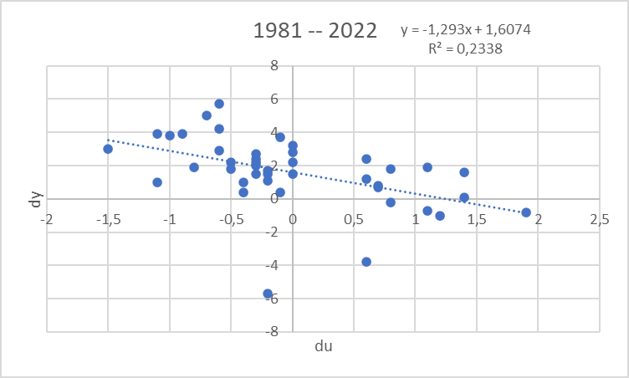
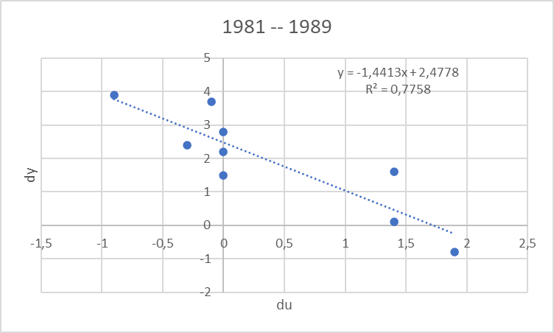
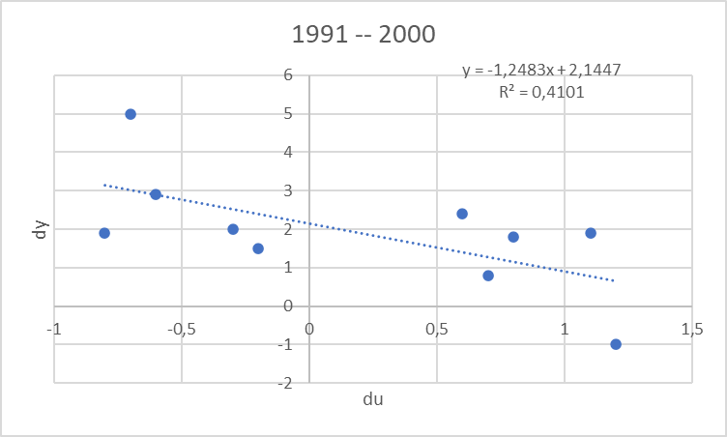
Estimating Okun’s Law: Country (1980 – ) Germany
Source: IMF Data Mapper

Slide 4
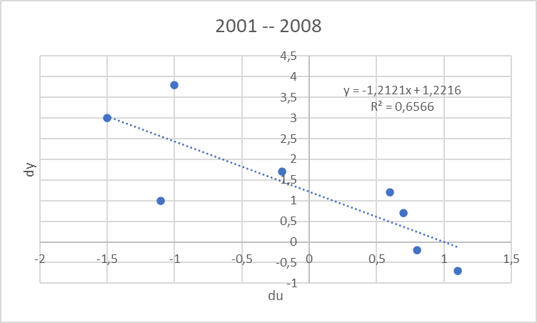
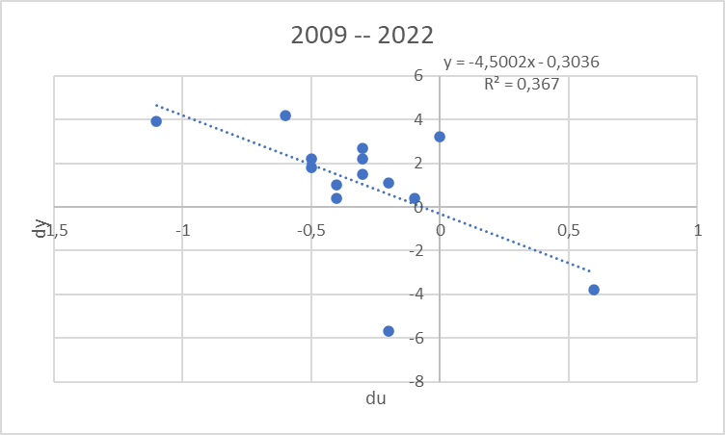
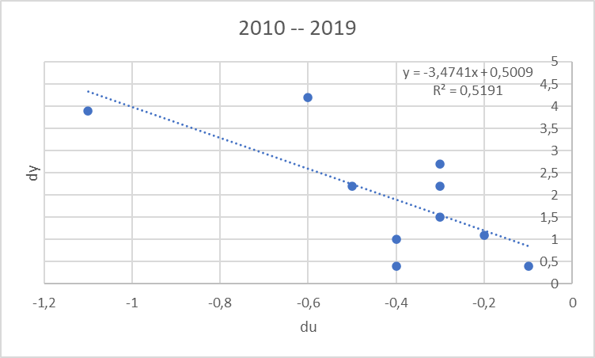
Estimating Okun’s Law: Country (1980 – ) Germany
Source: IMF Data Mapper

Slide 5
Inflation and Unemployment as macroeconomic targets
In practical economic policy, the primary direct objectives macroeconomic variables
inflation (π) and unemployment (u)
rather than economic growth
For example the 2%-target of the ECB or the dual target of the Fed pursuing the economic goals of maximum employment and price stability (i.e u = 6% in the aftermath of the financial crisis)
Although price level (p) and (y) are directly related to (π) and (u) these variables, but these variables are generally not used as operationalized target variables!

Slide 6
Inflation and Unemployment : Philippscurve
Transition from price level to inflation:
Price level (P) → Inflation (π) determine the perventage change!
Inflation: π_{t}=(P_{t}-P_{t-1})/P_{t-1}=P_{t}/P_{t-1}-1 relative change compared to the former period
Expected Inflation: π_{t}^{e}=(P_{t}^{e}-P_{t-1})/P_{t-1}=P_{t}^{e}/P_{t-1}-1 relative expected change compared to the former period
output (y) → unemployment (u)
Okuns law!
-A(u_{t}-u*)=(Y_{t}-Y*)/Y* (A>0)

Slide 7
Philippskurve and short run aggregrated supply (AS-curve)
AS: Y_{t} = Y* + a(P_{t}-P_{t}^{e}) (a>0) (P_{t}^{e}: expected price level)
replace P_{t}/P_{t-1}=1+ π_{t} and P_{t}^{e}/P_{t-1}= 1+π_{t}^{e}
→ Y_{t} = Y* + a((1+ π_{t})P_{t-1} - (1+ π_{t}^{e})P_{t-1} )
= Y* + P_{t-1}a(π_{t} - π_{t}^{e})
= Y* + ã(π_{t} - π_{t}^{e}) with ã= P_{t-1}a>0
With given expectations, we obtain
or
P_{t}
π _{t}
$$AS$$
$AS$`
Y_{t}
Y_{t}

Slide 8
Philippscurve and short run aggregrated supply (AS-curve) and Okun´s law
Okun´s law: -A(u_{t}-u*) = (Y_{t}-Y*)/Y* set Ã=AY*
⇒ -Ã(u_{t}-u*) = Y_{t}-Y* ⇒ Y*- Ã(u_{t}-u*) = Y_{t}
Together with the AS-curve we obtain:
Y*- Ã(u_{t}-u*) = Y_{t}=Y* + ã(π_{t} - π_{t}^{e})
⇒ - (Ã/ã)(u_{t}-u*) = π_{t} - π_{t}^{e}
⇒ π_{t} = π_{t}^{e} - β(u_{t}-u*) with β = (Ã/ã)>0 Expectation augmented Philipps curve
In its original form, the Phillips curve, like Okun's law, merely reflected the empirical finding that rising inflation tends to lead to falling unemployment.
Philipps, A. (1958) The Relation between Unemployment and the Rate of Change of Money Wages in the United Kingdom, 1861–1957, Economica, Vol. 25, S. 283–299
Phelps, Edmund S. (1967) “Phillips Curves, Expectations of Inflation and Optimal Employment over Time.” Economica, n.s., 34, no. 3, 254–281.
(Nobel Prize 2006)

Slide 9
Inflation, Unemployment, and the Phillips Curve
The Philipps curve states that inflation π depends on
expected inflation π^{e}
the deviation of unemployment from the natural rate u-u*
For further analysis we add an supply shock ε
π = π^{e} - β(u-u*) + ε

Slide 10
The short run Phillips curve
π
Trade off between
unemployment and inflation
β
1
π^{e} + ε
u*
u

Slide 11
Long run Phillips Curve
π
2
π₂ =π₃
3
1
π₁
u*
u
u₂
u₃=u₁

Slide 12
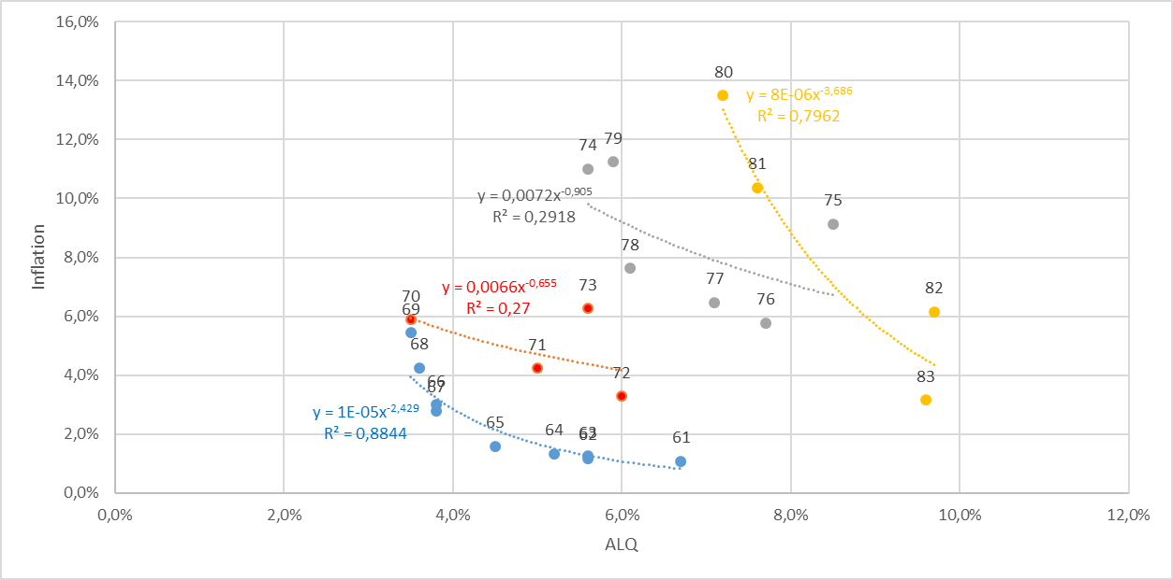
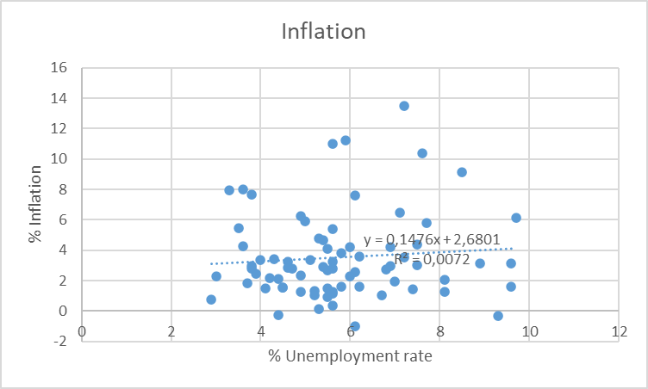
Philipps-curve USA I
Source: FRED
From the 1960 to 1980ies we seen an outward shift of the Philipps-curve
In this example, the regression used the Ansatz:
y=xª
Thus, the exponent can directly interpreted as the elasticity between x and y
e=(dy/y):(dx/x)
Can you show this ☺?.

Slide 13
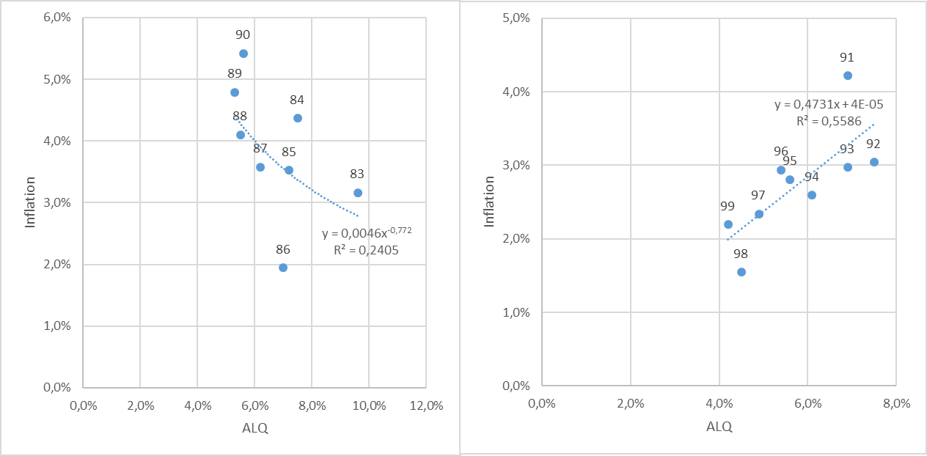
Philipps-curve USA II
Source: FRED
From the 1980ies to 2000, the data shows only a weak or even a inverted dependence between inflation and umemployment. A possible reason is the drastic change of the economic sircumstandes due to the break down of the soviet union and after that the dramatic change in the global economic dependencies

Slide 14
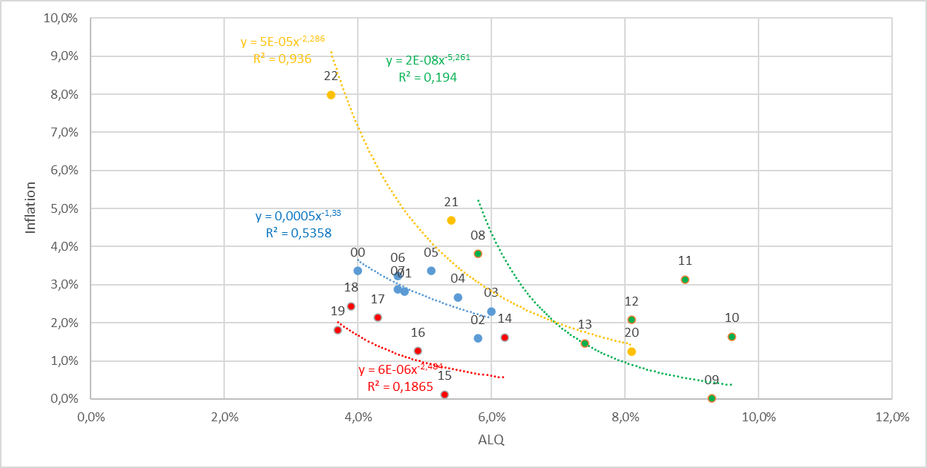
Philipps-curve USA III
Source: FRED
With the first push of globalization from 2000 until the financial crisis, again there is a quite stable „classical“ philipps-cirve like dependence.
But within in following turmoil in the aftermath of the financial crisis, we had again no stable dependence again!
Using the data from 2020 to 2022 for a regression, we obtain a R^2=0,94. Are we therefore back to a stable dependence between inflation and unemployment?

