Slide 1

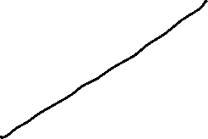


Global Economics
Wilhelmshaven
This lecture will be recorded and
Subsequently uploaded in the
world-wide-web
Prof. Dr. Bernhard Köster
Jade-Hochschule Wilhelmshaven
http://www.bernhardkoester.de/vorlesungen/inhalt.html

Slide 2

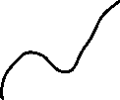

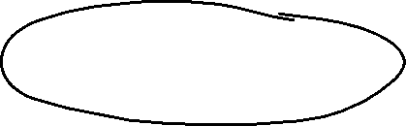
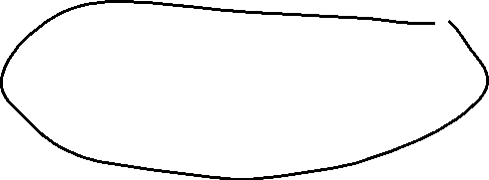
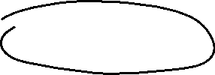

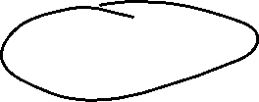
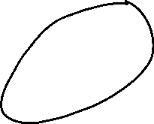


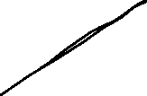

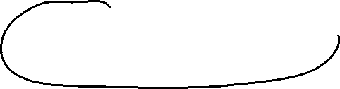
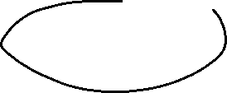

Short-run Output Gaps: Why do they matter?
Output Gap = Actual Output - Potential Output
_______________________________________
Potential Output
= Y - Y*
_______________________________________
Y*
(Y – Y*)/Y* > 0 → a positive output gap
is called expansionary gap
(Y – Y*)/Y* < 0 → a negative output gap
is called recessionary gap

Slide 3
Output Gaps: Two kinds of Costs
(Y – Y*)/Y* > 0 expansionary gap
inflation can be high
economy incurs costs of inflation
(Y – Y*)/Y* < 0 recessionary gap
unemployment rate high (above normal)
economy incurs costs of unemployment

Slide 4
Natural Rate of Unemployment
u* : Natural rate of unemployment
Mainly caused by:
frictional unemployment
structural unemployment
or
generally a worker who is not able to get a job because she doesn’t have the right skills.
⇒ The natural rate of unemployment is caused by supply side factors rather than demand side factors

Slide 5


Cyclical Unemployment
Actual unemployment rate = u
Natural unemployment rate = u*
Cyclical unemployment rate = u - u*
recessionary Gap: u - u* > 0
expansionary Gap: u - u* < 0

Slide 6



Relationship between unemployment and economic growth
In general, one would expect unemployment to fall when economic growth is high.
Thus, one could identify natural unemployment directly with potential output (cf. neoclassical theory and the long-run supply curve (AS)).
But Okun (1962) showed empirically:
In general Okun´s law implies that if output growth is 1%-point over potential growth than unemployment falls only by 0,5%-points.
Okun, Arthur M. 1962. “Potential GNP: Its Measurement and Significance.” Reprinted as Cowles Foundation Paper 190.
Reasons:
Firms adjust employment less than one for one in response to deviations of output to the natural growth rate.
The labor force participation of the population increases over time (for Germany, especially the labor force participation of women).
Labor productivity increases (currently in particular due to digitalization)

Slide 7






Okun’s Law
Arthur Melvin Okun based on
empirical observations (1962):
Every rise of 1%-point in cyclical unemployment is
associated with a lowering of 2%-points of the output gap.
−2(u - u*) = (Y – Y*)/Y* (Gap Version)
or
-2Δu = g_{y} – g_{Y*} (Growth Version)
g_{y}, g_{Y*}: growth rates of actual and potential out respectively
Δu: change in unemployment over time

Slide 8
Okun’s Law
In general Okun´s law implies that if output growth is 1%-point over potential growth than unemployment falls only by ½%-points.
Reasons:
Firms adjust employment less than one for one in response to deviations of output to the natural growth rate.
Labor participation increases
Labor productivity increases

Slide 9
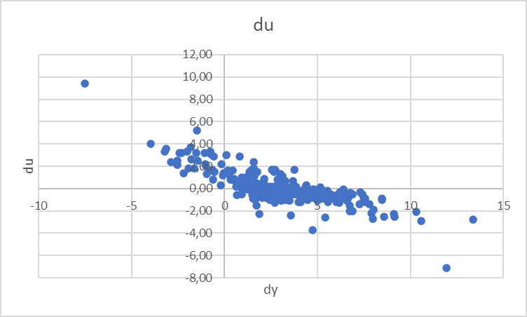
Estimating Okun’s Law: US-Data (1949 – )
Source: FRED, own calculation

Slide 10
Estimation of Okun's Law - Country Analysis
Data: IMF Data mapper or other source. If you use quaterly data, think of
Contrast the data (1980-2022, per availability) of the variables Δu and gy in a scatter plot
Linear regression of g_{y} and Δu .
Identify Okuns`s law with the regression parameters in g_{y} = -aΔu + g_{Y*} and interprete the parameters
Look for "meaningful" subperiods for your country for estimation purposes (consider especially structural breaks like crises, political changes,...)
Also evaluate your econometric analysis using the coefficient of determination R²
and the correlation coefficient R

Slide 11
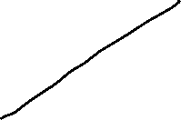

Linear Regression
Example:
A company wants to know how the sales volume depends on visits of representatives.
The company has collected the following data
c
We also want to answer the question, from a descriptive point of view, which sales volume we can expect, if we increase the visits up to x=30

Slide 12
Linear Regression
Via a linear regression we want to analyse the dependence between two variables
We distinguish between a dependent variable (y) and an independent variable (x)
(x) is also called the explanatory variable
A change of (x) implicates a change (y)
The linear regression defines an empirical relation via a linear function
i.e. y = f(x) = 3 + 2x or generally y = a + bx
c

Slide 13
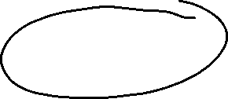


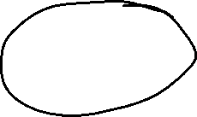


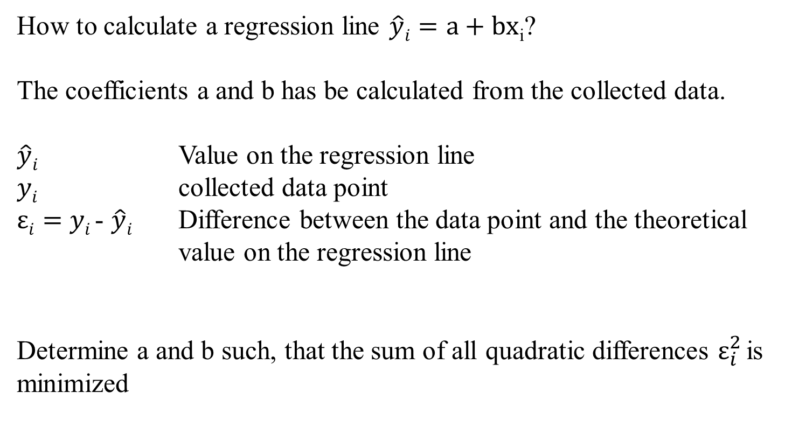



Optimizing problem
How to calculate a regression line $\hat{y}i=a+bx$_{i}?
The coefficients a and b has be calculated from the collected data.
$\hat{y}i$ Value on the regression line
$yi$ collected data point
$εi=$ $yi$- $\hat{y}i$ Difference between the data point and the theoretical value on the regression line
Determine a and b such, that the sum of all quadratic differences $ε_{i}^{2}$is minimized
c

Slide 14





Least squared method
The formal optimizing problem
c

Slide 15
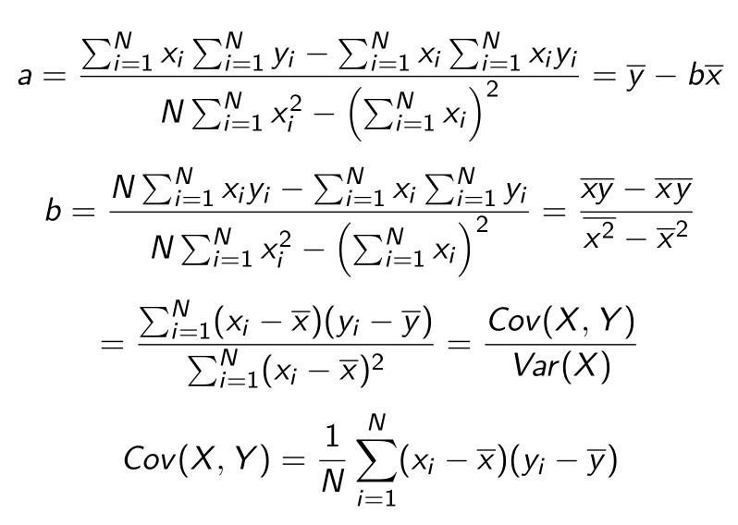
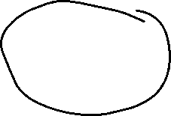
Formulas
:
c

Slide 16
Linear Regression
 | Visits | Sales volume [€]
year | x | y | xy | x^2
2008 | 9 | 24
2009 | 11 | 33
2010 | 5 | 10
2011 | 13 | 29
2012 | 20 | 42
2013 | 12 | 24
c
b=
a=

Slide 17
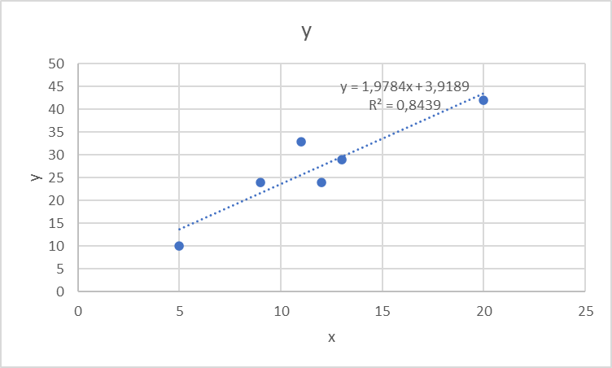
Linear Regression
c

Slide 18
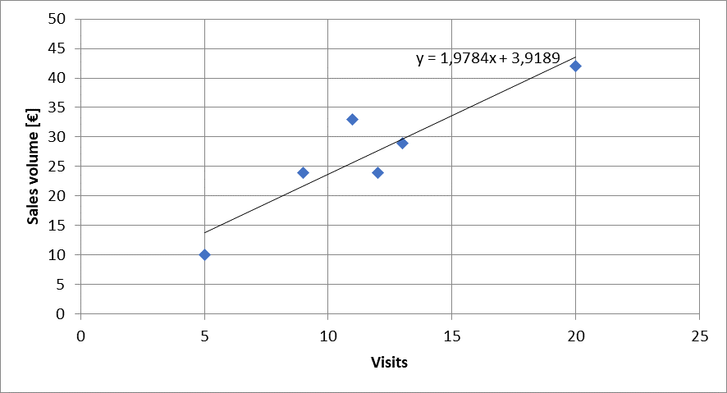




Calulating the regression line from empirical data
$$ei2$$
$\hat{y}i=a+bx$_{i}
c

Slide 19

Regressions coefficients
Regressions coefficient b
  Slope of the regression line.
  Determines the marginal effect of a change of one unit of the independent variable x onto the dependet variable y
Regressions coefficient a
  The value of the dependent variable if the independent variable x=0
    → intercept of the vertical axes
c

Slide 20
Correlation analysis
In principle for all data sets, we can calculate a regression line.
But we are also interested in the question meaningful is this calculated dependence?.
For this, we use the correlation analysis, wich gives the possibility to measure the strength of the dependence
For this, we use the correlation coefficient of Bravais-Pearson which is lying between -1 and +1
c

Slide 21
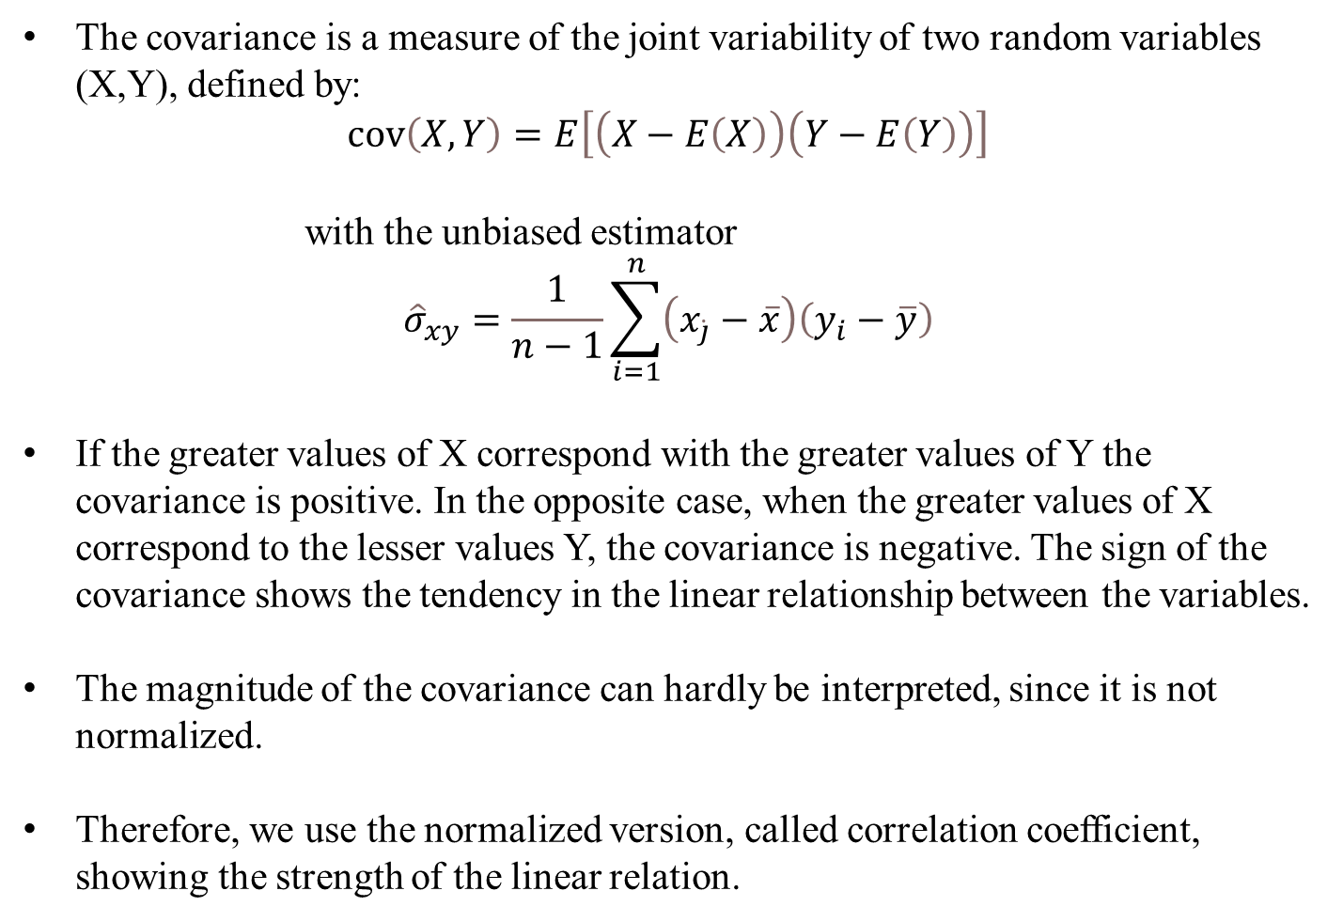
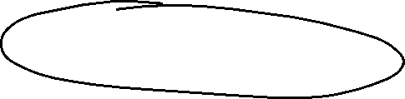
Covariance
The covariance is a measure of the joint variability of two random variables (X,Y), defined by:
$$\operatorname{cov}\left(X,Y\right)=E\left[\left(X−E\left(X\right)\right)\left(Y−E\left(Y\right)\right)\right]$$
with the unbiased estimator
$${\hat{σ}}_{xy}=\frac{1}{n−1}\sum_{i=1}^{n}{\left(x_{\dot{j}}−\overline{x}\right)\left(y_{i}−\overline{y}\right)}$$
If the greater values of X correspond with the greater values of Y the covariance is positive. In the opposite case, when the greater values of X correspond to the lesser values Y, the covariance is negative. The sign of the covariance shows the tendency in the linear relationship between the variables.
The magnitude of the covariance can hardly be interpreted, since it is not normalized.
Therefore, we use the normalized version, called correlation coefficient, showing the strength of the linear relation.
c

Slide 22
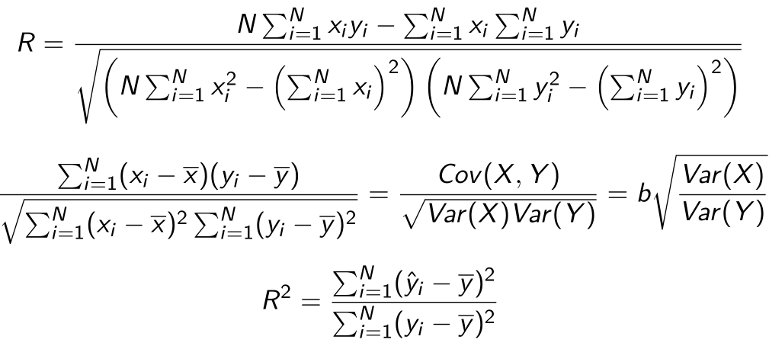





Correlation coefficient
General intervals for R
(0,0;0,2) → almost no dependence
[0,2;0,4) → low dependence
[0,4;0,6) → medium dependence
[0,6;0,8) → high dependence
[0,8;1,0) → almost full dependence
c

Slide 23

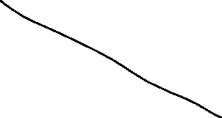
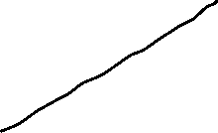
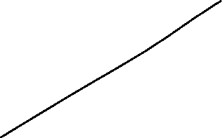
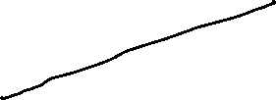
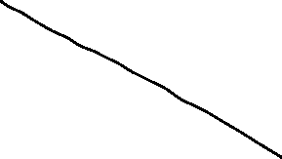
Correlation coefficiant examples
R=?
R=?
c
R=?
R=?

Slide 24
Coefficiant of determination R²
The squared correlation coefficiant R² is called coefficiant of determination.
In quantitative analysis, we often use the coefficiant of determination R², because it can be intuitively interpreted
But R² does not distinguish between + and – anymore.
R² is in the interval [0,1]
R² grafical interpretation:
  R² equals the proportion of variance explained by the model in relation to the total variance, i.e. how much percent is explained by the regression line
  (1-R²) equals the proportion of Variance not explained by the model in relation to the total variance, and has to be explained by other influencing factors
c

Slide 25
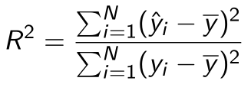

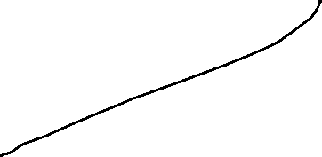






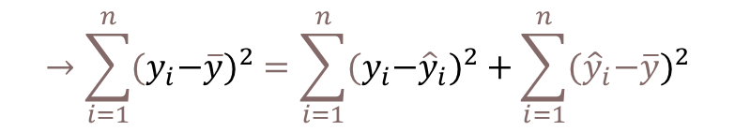
Coefficiant of determination R²
{
${\hat{y}}_{i}−\overline{y}$ explained difference
Total Difference
} Non explained difference
} Explained difference
${y_{i}−\hat{y}}_{i}$ not explained difference
Mean
$y_{i}−\overline{y}$ total difference
$$→\sum_{i=1}^{n}{{{(y}_{i}−\overline{y})}^{2}}=\sum_{i=1}^{n}{{{{(y}_{i}−\hat{y}}_{i})}^{2}}+\sum_{i=1}^{n}{{{(\hat{y}}_{i}−\overline{y})}^{2}}$$
Non explained squared difference y_{i}
total squared difference
explained squared difference
Mean
not explained squared difference
explained squared difference y_{i}
c
Total squared difference of y_{i}

Slide 26
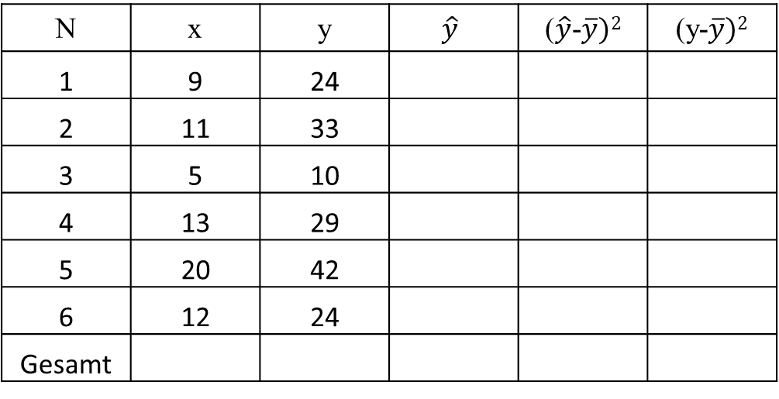
Coefficiant of determination R²
N | x | y | $$\hat{y}$$ | ($\hat{y}$-$\overline{y})2$ | (y-$\overline{y})2$
1 | 9 | 24
2 | 11 | 33
3 | 5 | 10
4 | 13 | 29
5 | 20 | 42
6 | 12 | 24
Gesamt
c
R²= R=

Slide 27
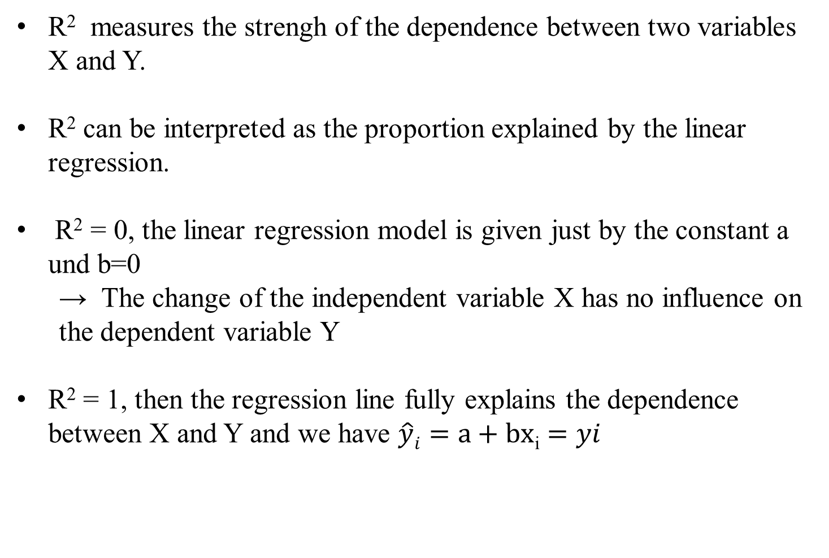
Interpretation of R²
R² measures the strengh of the dependence between two variables X and Y.
R² can be interpreted as the proportion explained by the linear regression.
R² = 0, the linear regression model is given just by the constant a und b=0
  → The change of the independent variable X has no influence on the dependent variable Y
R² = 1, then the regression line fully explains the dependence between X and Y and we have $\hat{y}i=a+bx$_{i} $=yi$
c

Slide 28
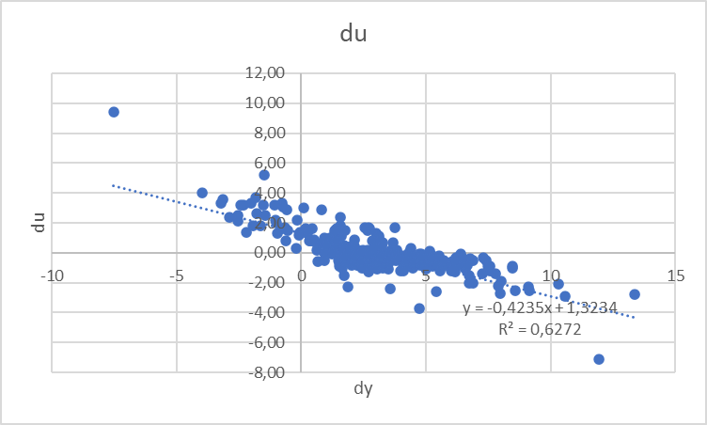





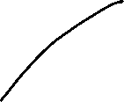





Estimating Okun’s Law: US-Data (1949 – )
Source: FRED, own calculation
-2Δu = g_{y} – g_{Y*} (Growth Version)

Slide 29



Estimation of Okun's Law - Country Analysis
Data: IMF Data mapper or other source. If you use quaterly data, think of
Contrast the data (1980-2023, per availability) of the variables Δu and g_{y} in a scatter plot
Linear regression of g_{y} and Δu .
Identify Okuns`s law with the regression parameters in g_{y} = -aΔu + g_{Y*} and interprete the parameters
Look for "meaningful" subperiods for your country for estimation purposes (consider especially structural breaks like crises, political changes,...)
Also evaluate your econometric analysis using the coefficient of determination R²
and the correlation coefficient R

Slide 30
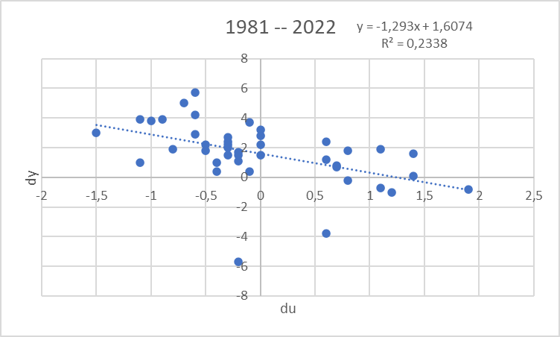
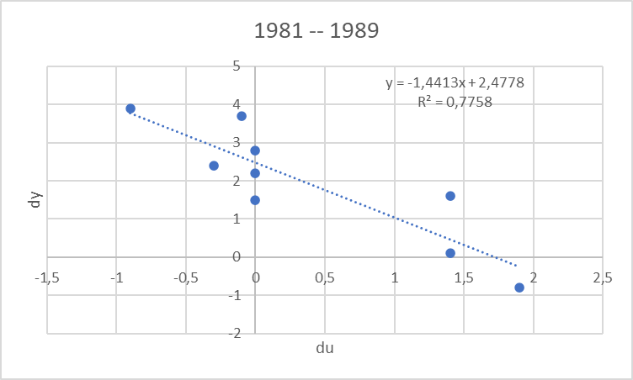
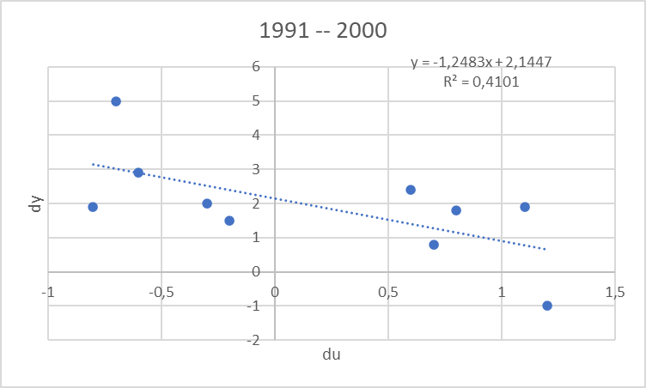

Estimating Okun’s Law: Country (1980 – ) Germany
Source: IMF Data Mapper

Slide 31
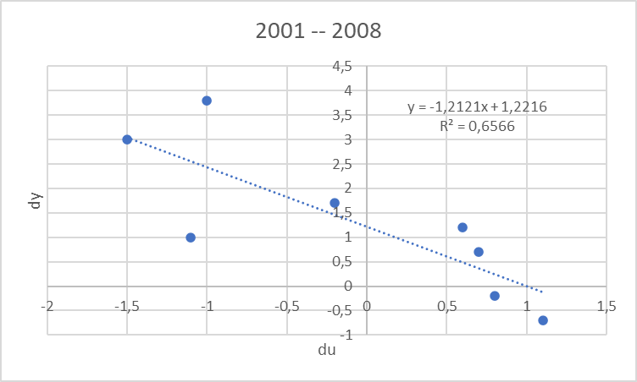
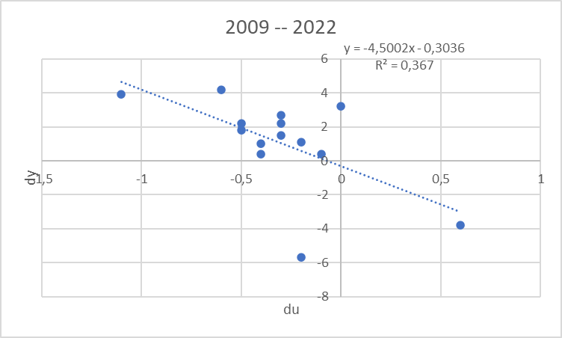
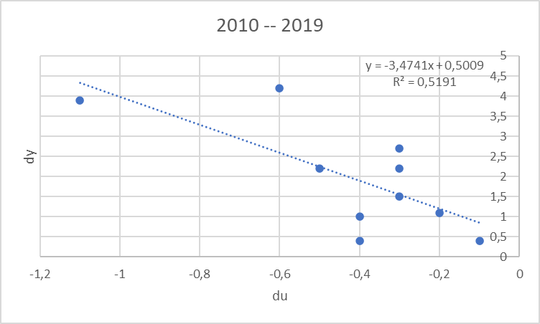







Estimating Okun’s Law: Country (1980 – ) Germany
Source: IMF Data Mapper

