Slide 1
Macroeconomic indicators
Inflation
Unemployment
Interest rates
Economic growth
Exchange rates
Government Debt
Trade-to-GDP-ratio
Current account

Slide 2
Economic growth and the business cycle
The business cycle is measured by the fluctuations of real GDP in time around some long time trend.
Real GDP
Be careful: This is no linar line for constant growth
Expansion
Peak
Recession
Trough
time
Notes:
2

Slide 3
Potential Output
In general, we want to limit the fluctuations within the business cycle.
In order to have a reference for the fluctuations, the concept of potential output is developed:
Potential output is the maximum amount an economy can produce over the long run (production at full capacity).
In the long run it should be the economic aime to increase potential output, since the pure development of real GDP can be below or above the production possibilities of an economy.
But: Potential output is only a theoretical concept. Therefore the true value of potential out is difficult to estimate.
Notes:
3

Slide 4
Further definitions
Potential output is the maximum amount of goods and services an economy can turn out when it is most efficient—that is, at full capacity. Often, potential output is referred to as the production capacity of the economy.­ (IMF Definition)
But:
“…it must be noted that potential output cannot be observed directly, but has to be inferred from existing data using statistical and econometric methods. There is considerable uncertainty in the measurement of potential output, which translates across to the derived indicators.” (ECB, 2011)
Notes:
4

Slide 5
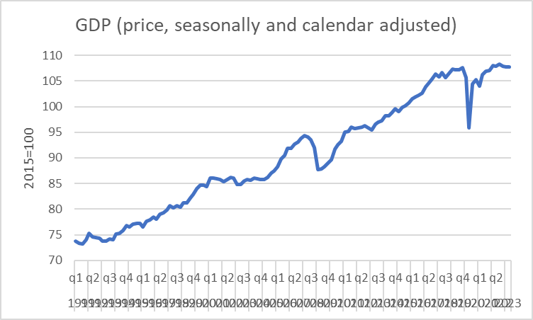
Simple calculation of average growth with quaterly data for Germany
Calculate the following average growth rates and interprete
 |  |  |  | ∅-GR qoq [%] | annualized ∅-GR qoq [%]
1991 | q1 | 2019 | q4 | 0,33% | 1,32%
1991 | q1 | 2020 | q1 | 0,31% | 1,25%
1991 | q1 | 2020 | q2 | 0,23% | 0,91%
1991 | q1 | 2020 | q3 | 0,30% | 1,19%
1991 | q1 | 2020 | q4 | 0,30% | 1,21%
1991 | q1 | 2021 | q1 | 0,29% | 1,15%
1991 | q1 | 2021 | q2 | 0,30% | 1,22%
1991 | q1 | 2021 | q3 | 0,31% | 1,23%
1991 | q1 | 2021 | q4 | 0,30% | 1,22%
1991 | q1 | 2022 | q1 | 0,31% | 1,24%
1991 | q1 | 2022 | q2 | 0,31% | 1,23%
1991 | q1 | 2022 | q3 | 0,31% | 1,23%
1991 | q1 | 2022 | q4 | 0,30% | 1,21%
1991 | q1 | 2023 | q1 | 0,30% | 1,19%
1991 | q1 | 2023 | q2 | 0,30% | 1,19%
1991 | q1 |  | q3 | 0,33% | 1,32%
1991 | q1 |  | q4 | 0,31% | 1,25%
Source:Destatis

Slide 6
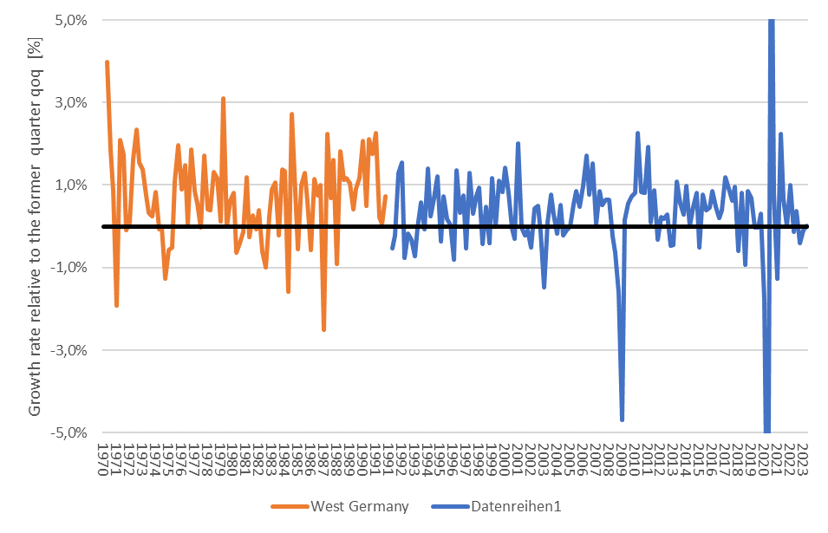
Business cycle – Germany
2.
3.
7.
1.
4.
5.
6.
Source: Destatis; price, seasonly, calendar adjusted

Slide 7
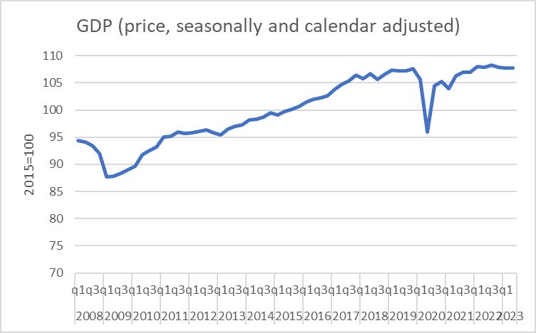
Macroeconomic parameters
Economic growth
Source: Destatis

Slide 8
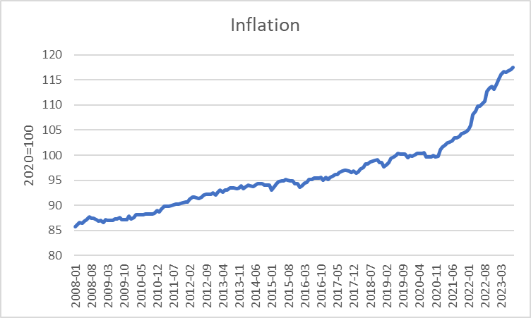
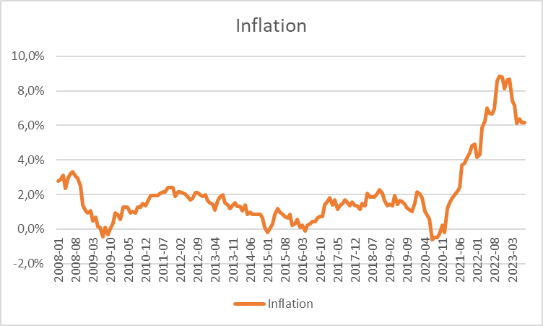
Macroeconomic parameters
Inflation
Source: Bundesbank

Slide 9
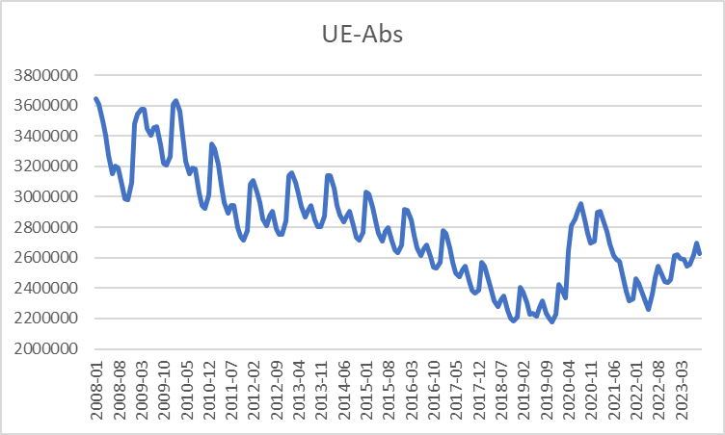
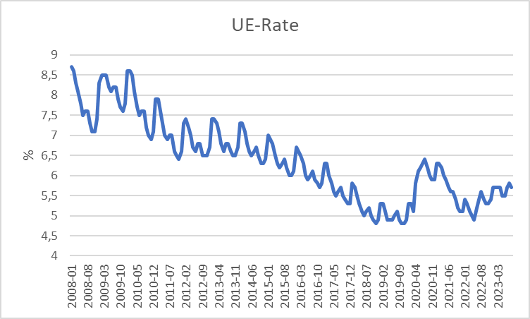
Macroeconomic parameters
Unemployment
Source: Bundesbank

Slide 10
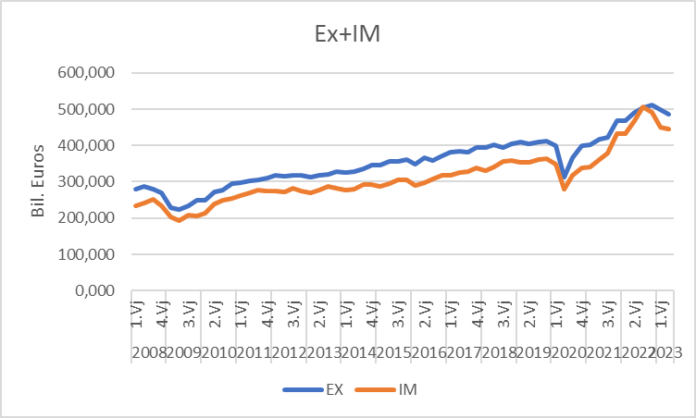
Macroeconomic parameters
Ex- and Imports
Source: Destatis

Slide 11
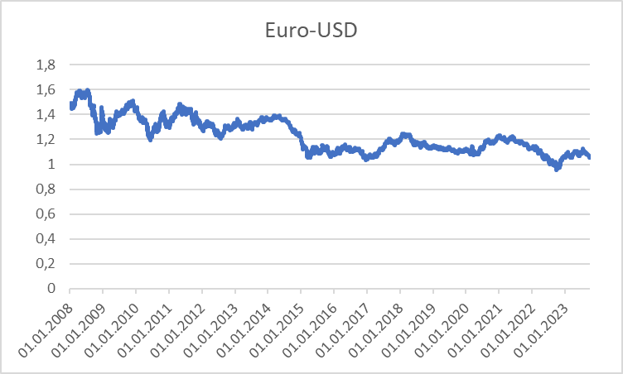
Macroeconomic parameters
Exchange rate
Source: Bundesbank

Slide 12
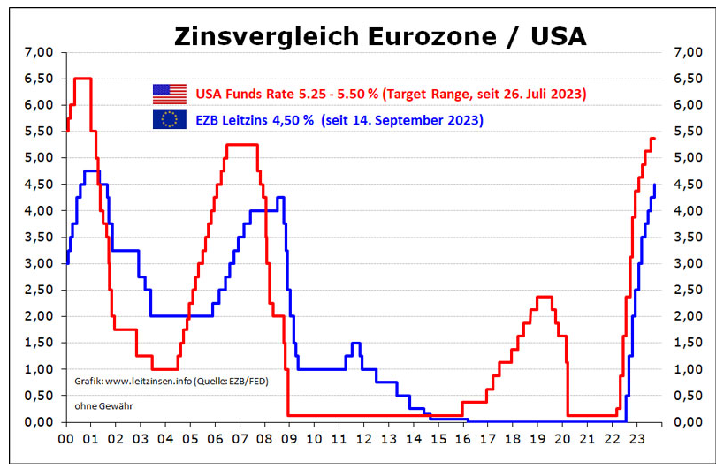
Macroeconomic parameters
Interest rates
Source: Bundesbank

Slide 13
Macroeconomic parameters
Key interest rates
Source: national central banks (Bundesbank) or www.leitzinsen.info

Slide 14
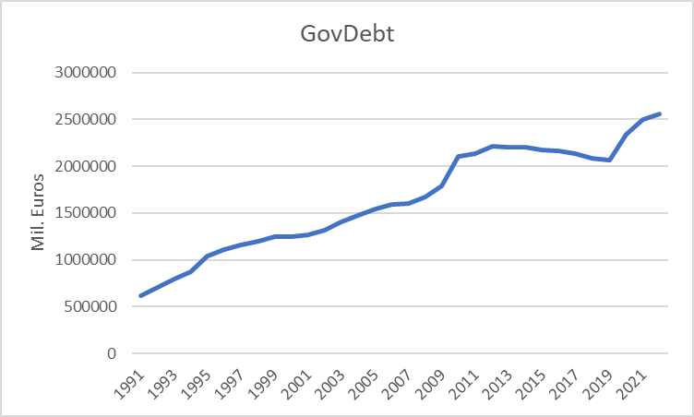
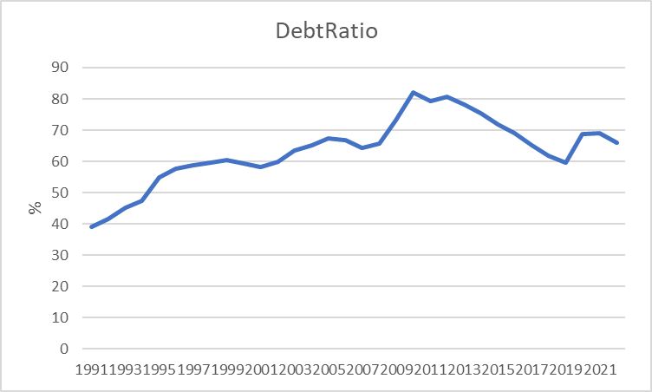
Macroeconomic parameters
Government debt
Source: Bundesbank

Slide 15
Short-run Output Gaps: Why do they matter?
Output Gap = Actual Output - Potential Output
_______________________________________
Potential Output
= Y - Y*
_______________________________________
Y*
(Y – Y*)/Y* > 0 → a positive output gap
is called expansionary gap
(Y – Y*)/Y* < 0 → a negative output gap
is called recessionary gap

Slide 16
Output Gaps: Two kinds of Costs
(Y – Y*)/Y* > 0 expansionary gap
inflation can be high
economy incurs costs of inflation
(Y – Y*)/Y* < 0 recessionary gap
unemployment rate high (above normal)
economy incurs costs of unemployment

Slide 17
Natural Rate of Unemployment
u* : Natural rate of unemployment
Mainly caused by:
frictional unemployment
structural unemployment
or
generally a worker who is not able to get a job because she doesn’t have the right skills.
⇒ The natural rate of unemployment is caused by supply side factors rather than demand side factors

Slide 18
Cyclical Unemployment
Actual unemployment rate = u
Natural unemployment rate = u*
Cyclical unemployment rate = u - u*
recessionary Gap: u - u* > 0
expansionary Gap: u - u* < 0

Slide 19
Relationship between unemployment and economic growth
In general, one would expect unemployment to fall when economic growth is high.
Thus, one could identify natural unemployment directly with potential output (cf. neoclassical theory and the long-run supply curve (AS)).
But Okun (1962) showed empirically:
In general Okun´s law implies that if output growth is 1%-point over potential growth than unemployment falls only by 0,5%-points.
Okun, Arthur M. 1962. “Potential GNP: Its Measurement and Significance.” Reprinted as Cowles Foundation Paper 190.
Reasons:
Firms adjust employment less than one for one in response to deviations of output to the natural growth rate.
The labor force participation of the population increases over time (for Germany, especially the labor force participation of women).
Labor productivity increases (currently in particular due to digitalization)

Slide 20
Okun’s Law
Arthur Melvin Okun based on
empirical observations (1962):
Every rise of 1%-point in cyclical unemployment is
associated with a lowering of 2%-points of the output gap.
−2(u - u*) = (Y – Y*)/Y* (Gap Version)
or
-2Δu = g_{y} – g_{Y*} (Growth Version)
g_{y}, g_{Y*}: growth rates of actual and potential out respectively
Δu: change in unemployment over time

Slide 21
Okun’s Law
In general Okun´s law implies that if output growth is 1%-point over potential growth than unemployment falls only by ½%-points.
Reasons:
Firms adjust employment less than one for one in response to deviations of output to the natural growth rate.
Labor participation increases
Labor productivity increases

Slide 22
Estimating Okun’s Law: US-Data (1949 – )
Source: FRED, own calculation

Slide 23
Estimation of Okun's Law - Country Analysis
Data: IMF Data mapper or other source. If you use quaterly data, think of
Contrast the data (1980-2022, per availability) of the variables Δu and gy in a scatter plot
Linear regression of g_{y} and Δu .
Identify Okuns`s law with the regression parameters in g_{y} = -aΔu + g_{Y*} and interprete the parameters
Look for "meaningful" subperiods for your country for estimation purposes (consider especially structural breaks like crises, political changes,...)
Also evaluate your econometric analysis using the coefficient of determination R²
and the correlation coefficient R

