Slide 1

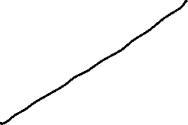


Global Economics
Wilhelmshaven
This lecture will be recorded and
Subsequently uploaded in the
world-wide-web
Prof. Dr. Bernhard Köster
Jade-Hochschule Wilhelmshaven
http://www.bernhardkoester.de/vorlesungen/inhalt.html

Slide 2








Money Market and the
Reaction Function of the Central Bank
In practice the central bank sets short term interest rates to meet its target level.
Most central banks communicate some kind of inflation target. Interest rates are therefore not only the outcome of an equilibrium process, but depend directly on the movements in prices
⇒ reaction function of the central bank
π↓ ⇒ r↓
Y↑ ⇒ r↑
⇒ r = i - π^{e} = r* + b(π - π*) +c(y - y*) b,c>0
π*: Inflation target y*: Potential output r*: Natural interest rate

Slide 3



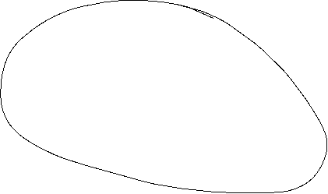



Taylor-Rule
John B. Taylor:
Professor of Economics
(Stanford University)
Council of Economic Advisers
1976 – 77
1989 – 91
Under Secretary of the Treasury for International Affairs
2001 – 05
Source: Taylor, J., B, (1993) 195-214 North-Holland Discretion versus policy rules in practice, Carnegie-Rochester Conference Series on Public Policy 39, 195-214, North Holland
r = i - π^{e} = 2% + 0,5(π - π*) +0,5(y - y*)
r* =2% π*=2% b=c=0,5

Slide 4





Taylor-Rule simplified
r = i - π^{e} = = r* + b(π - π*) +c(y - y*)
Since π* and y* are constants, we set in the following
r = i - π^{e} = = α + bπ +cy
⇒ dr/dY = c > 0
r
TR-Curve
Y
Same dependence as the LM-curve!!

Slide 5

Short run equilibrium
r
TR
IS curve
Y
The intersection of the IS curve and the TR curve represents the short run equilibrium with fixed prices.
Mechanics are the same as in the case with LM-curve representing the
Money market equilibrium

Slide 6

Price adjusting process – Phillips Curve
Originally: Negative dependence between inflation and unemployment
together with
declining unemployment implies increasing output
⇒
π = π^{e} + δY δ >0
π
PC
Y

Slide 7





Monetary Policy Rule with flexible prices
Substitute the PC into the TR
⇒
Integrated monetary policy (MP) rule:
MP: r = r* + b[π^{e} + δY] + cY = a + b π^{e} + (bδ+c)Y
⇒
The coefficient on output (Y) is now (bδ+c) instead of c.
⇒
direct output affect in monetary policy through c
indirect effect through bδ.

Slide 8



Equilibrium with flexible prices
r
MP
TR
IS curve
Y
Taylor estimation for the Fed
https://www.atlantafed.org/cqer/research/taylor-rule#Tab1

Slide 9


Special cases of the MP-rule
Inflation targeting: c = 0
⇒ MP becomes flatter ⇒ real interest rates respond less to IS shocks that reduce output.
General Difference between ECB and Fed in their reaction on the different crisis during last 15 years
Output targeting:
Output targeting simply has a vertical TR or MP curve at the output target. Limiting case where the central bank is infinitely inflation-averse and δ is very large relative to b.
This seems to become more important since the financial crisis

Slide 10






Monetary Policy Rules
Simple rules
Policy instrument depends on a small set of variables
Easy to calculate
Predictable monetary policy
→ but in general not optimal
Optimal rules
Minimizing a loss function depending on all relevant variables
Often complicated
Not very predictable

Slide 11




Development of Monetary Policy
Historical view: The monetary policy instrument was assumed to be the money supply
Modern view: The policy instrument is the interest rate (signal rate, key rate, repo rate, etc)
“Ultra-modern” view: The policy instrument is in general central bank’s communication

Slide 12
Money Supply Rules
Milton Friedman (1912-2006, Nobel Laureate 1976) suggested that central banks should follow a money supply rule.
Due to quantity theory of money, money supply should grow at a given rate in order to provide price stability.
P ● Y=M ● V
→ Fix Money Growth Rule
However: - Many countries have bad experience with monetary supply rules/targets
- Money demand (i.e. velocity V) is unstable; gives undesired volatility in the interest rate

Slide 13
Money Supply Rules
Former governor of Bank of Canada
"In Canada, we did not abandon money supply targets, they abandoned us".
Bank of England skips a monetary target at all, since:
“Whenever a bank makes a loan, it simultaneously creates a matching deposit in the borrower’s bank account, thereby creating new money.”
(BoE, 2014)

Slide 14
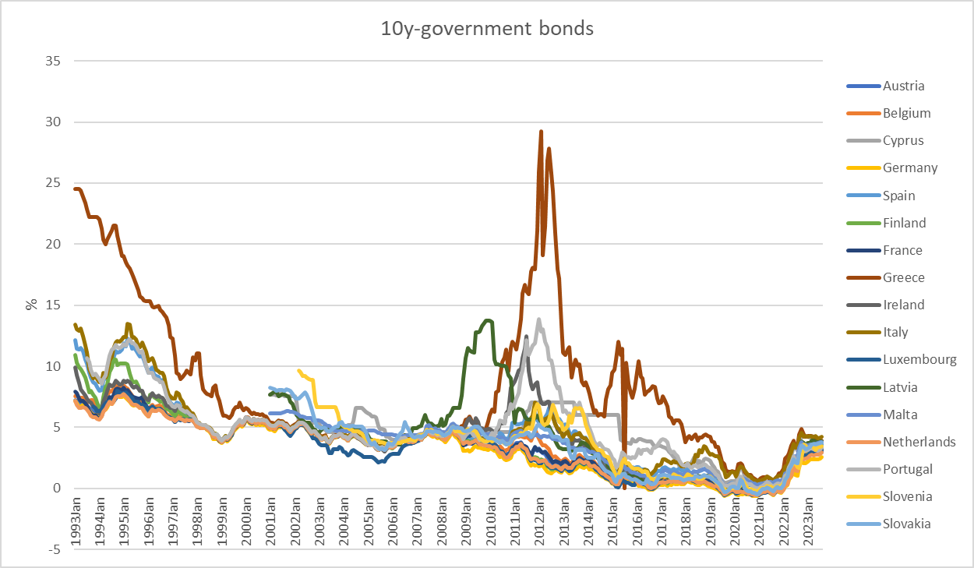









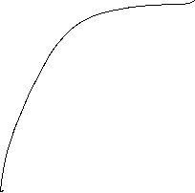


10 Year government bonds Eurozone
Source: ECB

Slide 15
Further economic goals
Fair balanced income distribution → German constitution Art. 72 Satz 2 GG
Sustainable ecological conditions → German constitution Art. 20a GG
Sustainable public financial budget → German constitution Art. 109 Satz 3 GG
→ Maastricht criteria 3% Deficit
60% government debt ratio

Slide 16
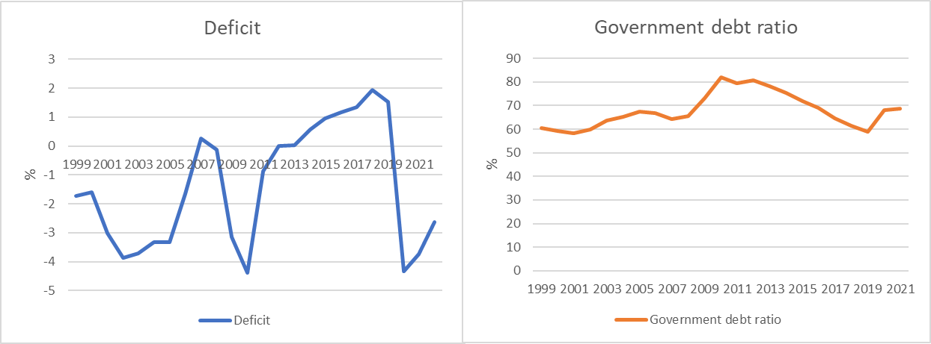



Development of the public budget and debt (Germany)
Cource: Destatis, Bundesbank
Deficit: Public Budget in relation to GDP
Government debt ratio : governemnt debt in relation to GDP

Slide 17






German debt brake
Art. 109 Satz 3 GG
3) The budgets of the Federal Government and the federal states must generally be balanced without loans. The Federal Government and the federal states may make provisions for symmetrical consideration of the effects of an economic development that deviates from the normal situation during upswings and downswings, as well as an exception for natural disasters or extraordinary emergency situations that are beyond the control of the state and significantly affect the state's financial situation. A corresponding repayment regulation must be provided for the exception. The details of the federal budget shall be governed by Article 115, with the proviso that sentence 1 is complied with if the loans does not exceed 0.35 percent of nominal gross domestic product. The details of the regional budgets shall be regulated by the regions within the scope of their constitutional powers, with the proviso that sentence 1 is only complied with if no revenue from loans is permitted.

Slide 18
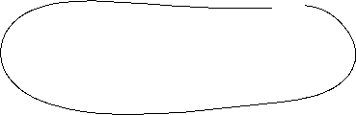
Time inconsistency of monetary policy
Why has central bank independence developed?
Is rule-based or "conservative" monetary policy superior to discretionary monetary policy?
Barro, R. and Gordon, D- (1983) Rules, Discretion, and Reputation in a Model of Monetary Policy, Journal of Monetary Economics 12 (July) 101-22.
Kydland, F. and Prescott, E. (1977) Rules Rather than Discretion: The Inconsistency of Optimal Plans, Journal of Political Economy 85 (June), 473-90

Slide 19





Loss function
Quadratic Approximation of deviations from targets
Inflation:
menue costs
uncertainty
transaction costs for obtaining information about future Inflation
Output:
wage rigidities would imply an output level below potential output → potential out put is weighted with k>1

Slide 20



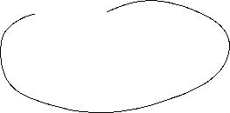






Time Inconsistency Problem in Monetary Policy
Barro Gordon (1981) “A Positive Theory of Monetary Policy in a Natural Rate Model”
Philipps-curve:
y = y* + b (π - π^{e} )
Central bank loss function:
L =1/2[a (π –π*)² + (y -ky*) ²]
a>0 k>1
π*, ky* Inflation and Output targets

Slide 21


Time Inconsistency Problem
For simplicity assume π*=0
Calculate Inflation and Social losses under rational expectations and compare this with π^{e} =π=0
Why can π^{e} =π=0 not be an equilibrium?
How can π^{e} =π=0 be achieved?

Slide 22

Time Inconsistency Problem
For simplicity assume π*=0
Calculate Inflation and Social losses under rational expectations and compare this with π^{e} =π=0
Why can π^{e} =π=0 not be an equilibrium?
How can π^{e} =π=0 be achieved?

Slide 23



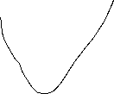


















Time Inconsistency Problem – Calculation
L =1/2[a π² + (y -ky*) ²]
y = y* + b (π - π^{e} )

Slide 24



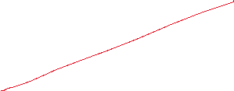






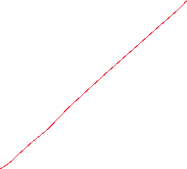







Time Inconsistency Problem – Calculation

Slide 25
Time Inconsistency Problem – Calculation – Reactionfunction
π^{e}
π

Slide 26
Time Inconsistency Problem
y = y* + b (π - π^{e})
L =aπ² + (y -ky*) ²
y
ky*
y*
π

Slide 27
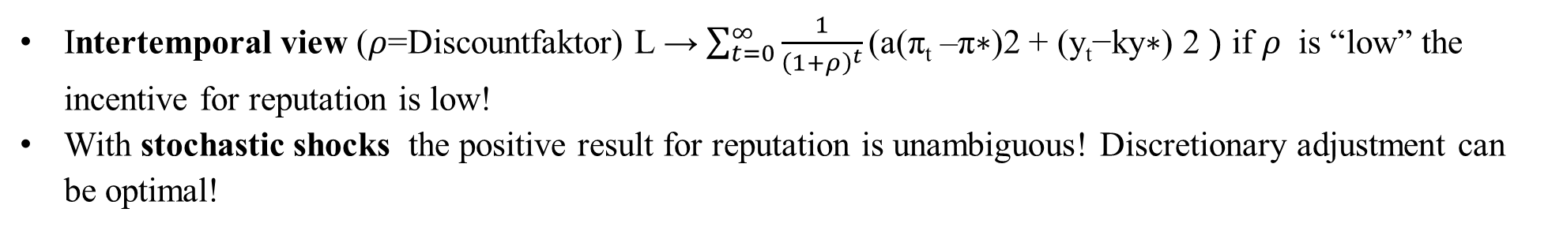
Time Inconsistency Problem – Solutions
Reputation via “large” a → “Falcons” within the ECB
Rogoff, Kenneth (1985) The Optimal Degree of Commitment to an Intermediate Monetary get, Quarterly Journal of Economic 110 (November), 1169-90
Rule-based → Taylorregel or Inflation Targeting John B. Taylor, Discretion versus policy rules in practice (1993), Stanford University, Stanford, CA 94905“ Svensson, L.E.O. (2011) Inflation Targeting,” in Friedman, Benjamin M., and Michael Woodford, eds., Handbook of Monetary Economics, Volume 3b, chapter 22, Elsevier
Incentive Contracts → New Zealand Reserve Bank Act of 1989 Walsh, (1995) C.E. Is New Zealand's Reserve Bank Act of 1989 an Optimal Central Bank Contract? Journal of Money, Credit and Banking , Nov., 1995, Vol. 27, No. 4, Part 1 (Nov.,1995), pp. 1179-1191
Intertemporal view ($ρ$=Discountfaktor) L → $\sum_{t=0}^{∞}{\frac{1}{{\left(1+ρ\right)}^{t}}\text{(}\text{a}\text{(}\text{π}\text{t}\text{ –}\text{π}\text{∗)2 + (}\text{y}\text{t}\text{−}\text{ky}\text{∗) 2} })$ if $ρ$ is “low” the incentive for reputation is low!
With stochastic shocks the positive result for reputation is unambiguous! Discretionary adjustment can be optimal!

Slide 28
Time Inconsistency
Further Literature:
Besides the already adressed problems, also the question of transparency is a widely discussed issue in central banks:
Köster, B. J. (2011) Decision Rules, Transparency and Central Banks (Dissertation) Heidelberg
(especially you find an application of the Barro-Gordon-Model with the aspect of external shocks ans transparency)
Alan Blinder has used this model in the context of the incentive for the professor to cancel an exam! U = U(correction of the exam„–“; preparation of the exam „+“)
Alan S. Blinder. The rules-versus-discretion debate in the light of recent experience. Weltwirtschaftliches Archiv, 123:399–414, 1987.
“Course examinations are stressful experiences for students and teachers alike. We use them both to rank students and to make sure they master the course material. To most educators, the latter is by far the more important purpose. But the learning objective does not require that the exam actually be given. It is enough to announce the exam, let students prepare for it, and then call it off at the last minute. In a real sense, everyone will be better off if the exam is cancelled. Thus it superficially seems to be the right thing to do. Yet itis rarely done, and for good reasons. Teachers know that this trick can only be pulled off once or twice. After that, students would cease believing the threat and would no longer study for exams. And that would be a real loss to bot faculty and students. Notice the obvious but important point that neither ignorance no incorrect objectives play any role in this example. An omniscient and benevolent despot presiding over the last year of the human race really would cancel exams. It's the optimal thing to do. The problem arises from taking a short-sighted perspective. It is cured by showing proper concern for the future consequences of current actions”

