Slide 1

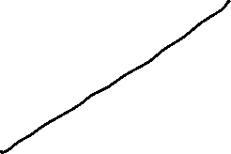


Global Economics
Wilhelmshaven
This lecture will be recorded and
Subsequently uploaded in the
world-wide-web
Prof. Dr. Bernhard Köster
Jade-Hochschule Wilhelmshaven
http://www.bernhardkoester.de/vorlesungen/inhalt.html

Slide 2


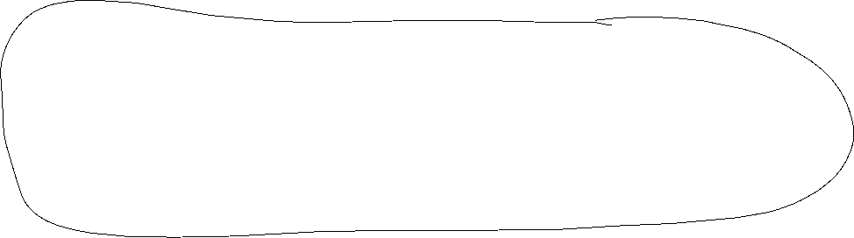





The Mundell – Fleming – Modell
commodity market: → IS-curve
    “investment = savings“
money market: → LM-curve
“monetary policy“
Exchange markets: → ZZ-curve
“Balance of Payment“
Assumptions:
  Country depends on an globally exogen interest rate
  Fixed price level in the short run

Slide 3






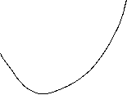








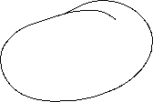

Commodity Market IS-curve
Budget restriction of the economy:
Y = C(Y) + I(i) + G + NX(e, Y*, Y)
Y,Y*: (foreign) Income C: Consumption I: Investment G: Government expenditure
i: Nominal interest rate NX: Net exports (EX-IM) e: Nominal exchange rate
+
−
−
+
−
In order to obtain the negative dependence of NX on e, the Marshall-Lerner condition has to be hold, which is empirically supported in the long-run. But! In the short-run, due to frictions, the so called J-Curve effect is possible
(Indirect quotation: price of a unit domestic currency in terms of the foreign currency, this means, that e is going up, if the domestic currency is appreciating!)
IS-curve
i
Y

Slide 4

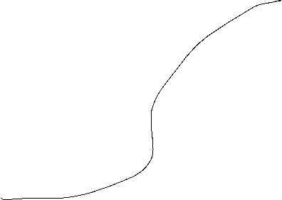
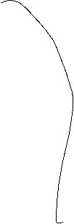









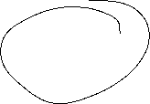




















Note: Marshall-Lerner Condition
Why, in general, it is not clear, that NX(e)=EX(e) – (1/e)IM(e) is negatively dependent on e?
Show, that (starting from NX=0) NX(e) is falling in e, if the sum of the absolute values of the exchangerate elasticities of EX and IM are larger than 1!

Slide 5

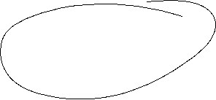

Note: Siegel`s Paradoxon
Does it matter, if one uses the direct or indirect quotation for the exchange rate e?
Assume in indirect quotation for the Euro, we have 1,15 USD equals 1 Euro and the Euro depreciates with p=0,25 down to 1,05 USD per 1 Euro and with 1-p=0,75 the Euro appreciates up to 1,25 USD per 1 Euro.
Calculate the expected exchange rate in direct and indirect quotation.
Puzzled? Explaination?

Slide 6
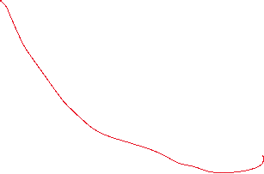



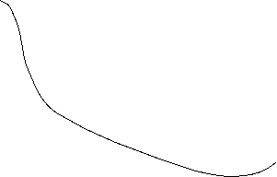





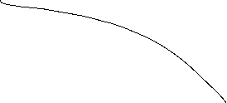
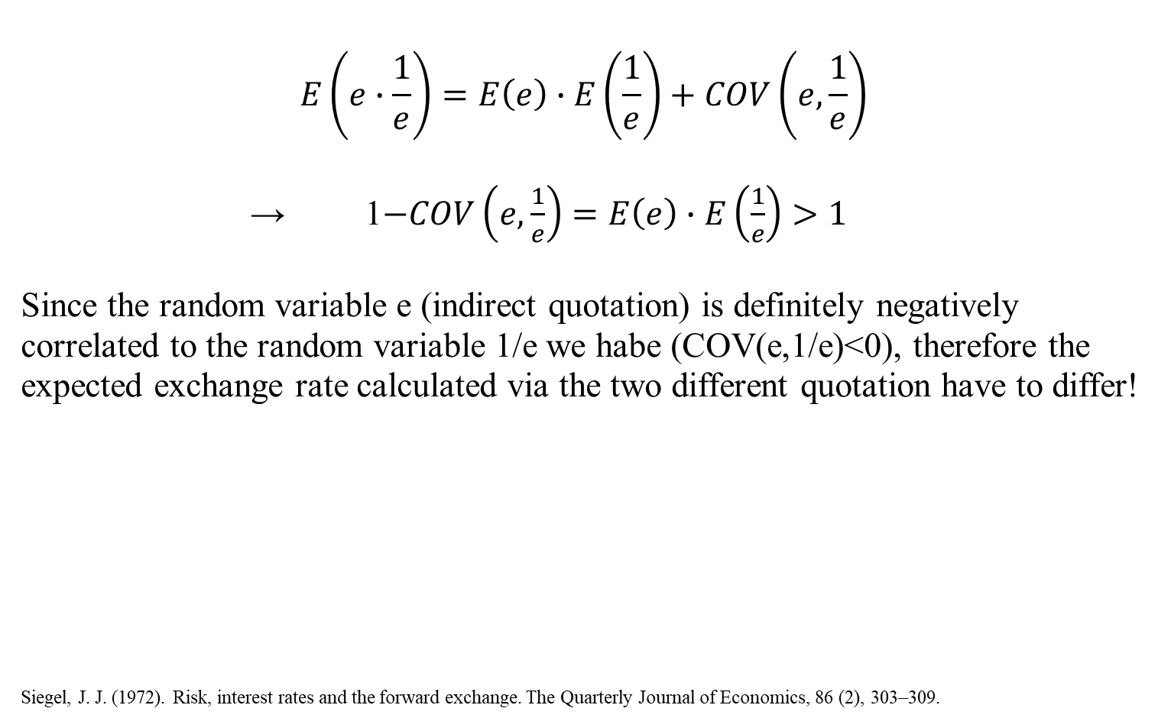

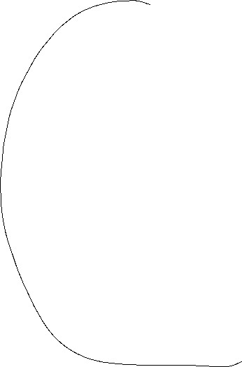



Note: Siegel`s Paradoxon − Explaination
$$E\left(e∙\frac{1}{e}\right)=E\left(e\right)∙E\left(\frac{1}{e}\right)+COV\left(e,\frac{1}{e}\right)$$
→ 1$−COV\left(e,\frac{1}{e}\right)=E\left(e\right)∙E\left(\frac{1}{e}\right)>1$
Since the random variable e (indirect quotation) is definitely negatively correlated to the random variable 1/e we habe (COV(e,1/e)<0), therefore the expected exchange rate calculated via the two different quotation have to differ!
Siegel, J. J. (1972). Risk, interest rates and the forward exchange. The Quarterly Journal of Economics, 86 (2), 303–309.

Slide 7




Money market LM-curve
Money Market equilibrium:
m=m^{s} = m^{d} = L( Y, i )
m^{s} : Money supply m^{d} : Money demand
+
−
LM-curve
i
Y

Slide 8



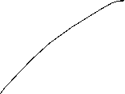





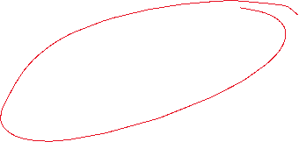


Balance of Payments ZZ-curve
Balance of Payments:
Balance of Payments = Current Account + Capital Account = 0
NX(e, Y*, Y) + CA(i-i* , E(e)) = 0
−
+
−
+
+
An increase of Y increases Imports and thus lowers NX
-> Capital imports have also to increase, but this is the case, if i increases, since the investment from abroad is more attractive!
ZZ-curve
i
Y

Slide 9
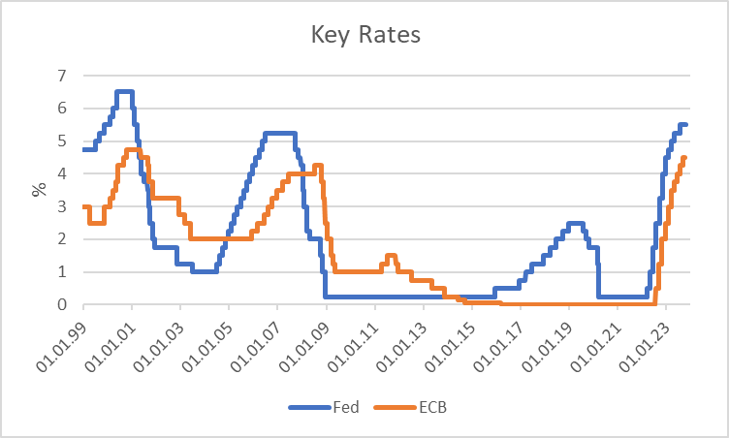
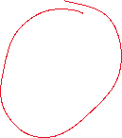
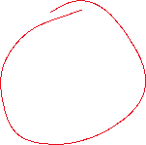
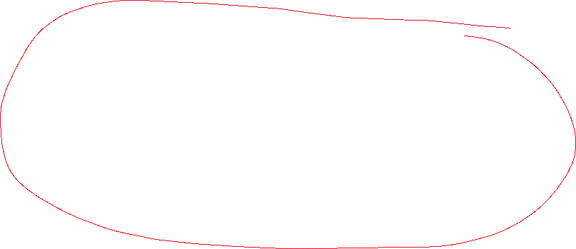
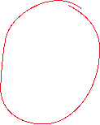
Key Interest rates
Source: ECB, Fed

Slide 10





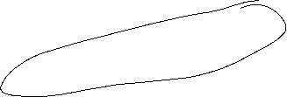
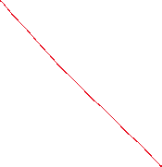
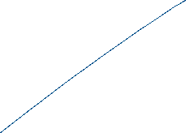
IS-LM-ZZ-Model

Slide 11

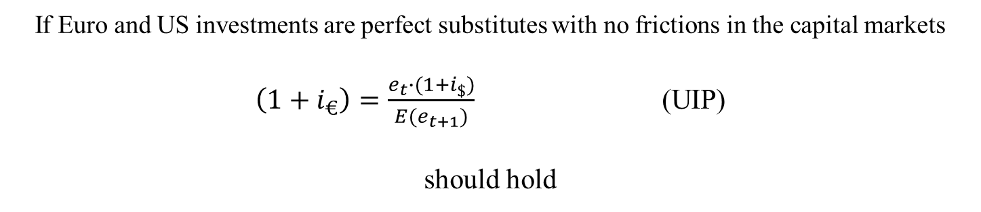


Uncovered interest rate parity (UIP)
  $i_{€}, i_{\$}$ : interest rates in €- and $-investments
  $e_{t}$: nominal $/€ exchange rate at time t
  $E{(e}_{t+1})$: expected $/€ exchange rate in t+1
1 €
Investment in Euro
Investment in US-Dollar
$$(1+i_{€})$$
$$\frac{e_{t}∙(1+i_{\$})}{{E(e}_{t+1})}$$
If Euro and US investments are perfect substitutes with no frictions in the capital markets
$\left(1+i_{€}\right)=\frac{e_{t}∙(1+i_{\$})}{{E(e}_{t+1})}$ (UIP)
should hold

Slide 12
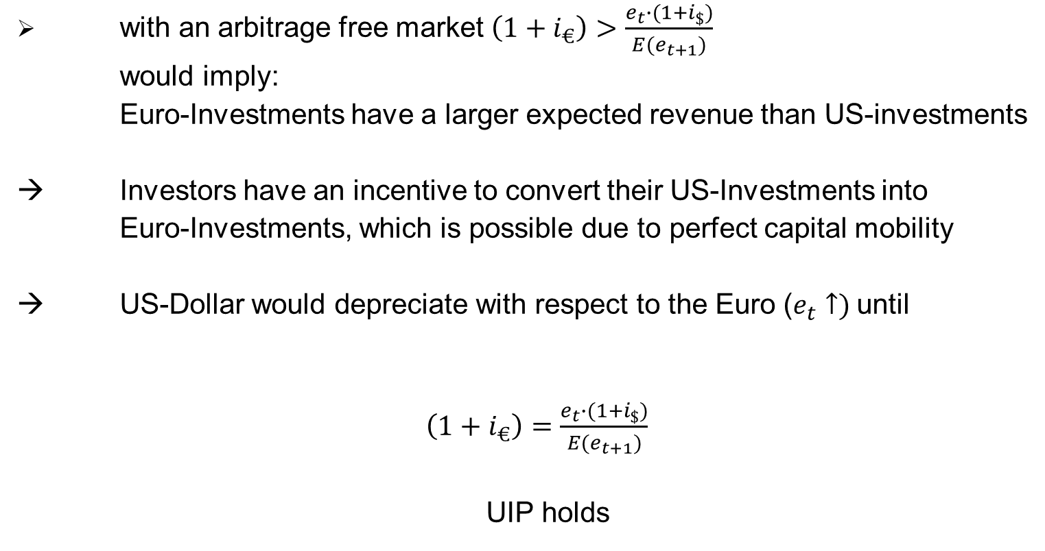
UIP holds with perfect capital mobility
with an arbitrage free market $\left(1+i_{€}\right)>\frac{e_{t}∙(1+i_{\$})}{{E(e}_{t+1})}$
  would imply:
      Euro-Investments have a larger expected revenue than US-investments
  Investors have an incentive to convert their US-Investments into
      Euro-Investments, which is possible due to perfect capital mobility
  US-Dollar would depreciate with respect to the Euro ($e_{t}↑)$until
    $\left(1+i_{€}\right)=\frac{e_{t}∙(1+i_{\$})}{{E(e}_{t+1})}$
    UIP holds

Slide 13

Foreign Exchange Market
Balance of Payments:
Balance of Payments = Current Account + Capital Account = 0
NX(e, Y*, Y) + CA(i-i* , E(e)) = 0
−
+
−
+
+
ZZ-curve
Perfect capital mobility →
Uncovered interest rate parity holds:
i
1+i =(1+i*)e/E(e)
→ horizontal ZZ-curve
ZZ-curve
Y

Slide 14
General equlibrium
i
LM
IS
Simultanous equilibrium on
external and
internal markets
ZZ
i₀
Y₀
Y

Slide 15
Exchange rate scenarios
Y (Europe), Y* (USA), e [€/$]
→ exogen: G, Y*, i*, e
Fixed exchange rates:
→ endogen: i, Y, m
→ exogen: G, Y*, i*, m
Flexible exchange rates:
→ endogen: i, Y, e

Slide 16
Fixed exchange rates − Monetary policy
i
IS₀
LM₁
A
i₀
ZZ
B
LM₀
Y₀
Y`
Y
Start A:
m↑
⇒
⇒
i↓
AD↑
A→B
LM right
⇒
⇒
y↑
⇒
In B:
capital exports (i<i*)
⇒
US-$-demand ↑⇒ CB sells US-$
⇒ m ↓ ⇒ LM back ⇒ similar equlibrium as before
⇒ monetary policy is ineffective

Slide 17
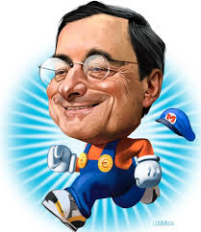
Flexible exchange rates – Monetary policy
40-80 Bil. Euro p. month
i
IS₀
LM₁
A
C
i₀
FE
B
LM₀
IS₁
Y₀
Y`
Y₁
Y
Start A:
m↑
⇒
LM right
⇒
i↓
⇒
AD↑
⇒
y↑
⇒
A→B
In B:
Capital exports (i<i*)
⇒
⇒
NX↑
US-$-demand ↑⇒ e↓
⇒
IS right
y↑
Monetary policy is effective
Even more than in a closed economy,
⇒
⇒

Slide 18
Summary
 | Fixed Exchange rates | Flexible Exchange rates
Monetary policy | ineffective | effective

Slide 19
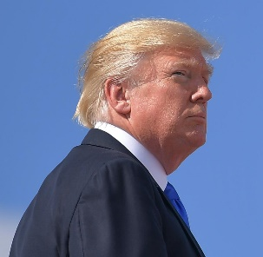
Flexible exchange rates – monetary policy – tariff
25% Tariff
i
IS₀
A
i₀
Consider a tariff in USA:
B
→ Exports become
more expensive
IS₁
Y₀
Y
Start A:
⇒
IS to the left
⇒
A→B
NX↓
⇒
Demand for Dollar e↓
⇒
Imports become more expensive
⇒
NX ↑
IS to the right
⇒
⇒
Monetary Policy would have the same effect as before
But: Since Euro has already devaluated MP is less effective
And: Trump has not reduced his current account deficit!
⇒
exports ↓, imports ↓, MP ↓

Slide 20
Two large currency areas
IS and IS*
LM and LM*
again connection via exchange rate and interest rate parity
→ solution
aggregates Y+Y* and m+m*
differences Y-Y* and m-m*
→ considering
(Aoki-trick (1981))
Main results:
→ Money Policy is beggar the neighbour
→ Incentive for coordination (2008 October/November)
exploiting positive spillovers from free trade
→ Incentive for sanctioning
(2016 June (Brexit) / November 2018 (Trump))
protecting own markets

