Slide 1
Economic growth and the business cycle
The business cycle is measured by the fluctuations of real GDP in time around some long time trend.
Real GDP
Be careful: This is no linar line for constant growth
Expansion
Peak
Recession
Trough
time
Notes:
1

Slide 2
Potential Output
In general, we want to limit the fluctuations within the business cycle.
In order to have a reference for the fluctuations, the concept of potential output is developed:
Potential output is the maximum amount an economy can produce over the long run (production at full capacity).
In the long run it should be the economic aime to increase potential output, since the pure development of real GDP can be below or above the production possibilities of an economy.
But: Potential output is only a theoretical concept. Therefore the true value of potential out is difficult to estimate.
Notes:
2

Slide 3
Further definitions
Potential output is the maximum amount of goods and services an economy can turn out when it is most efficient—that is, at full capacity. Often, potential output is referred to as the production capacity of the economy.­ (IMF Definition)
But:
“…it must be noted that potential output cannot be observed directly, but has to be inferred from existing data using statistical and econometric methods. There is considerable uncertainty in the measurement of potential output, which translates across to the derived indicators.” (ECB, 2011)
Notes:
3

Slide 4
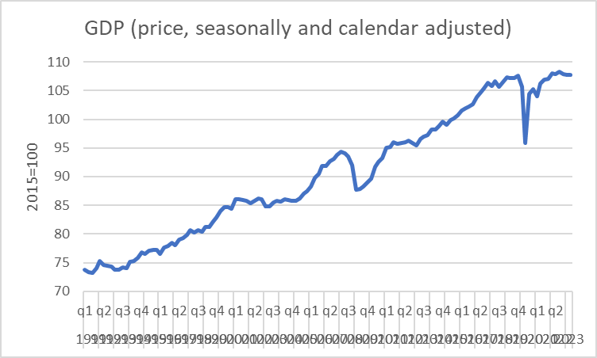
Simple calculation of average growth with quaterly data for Germany
Calculate the following average growth rates and interprete
 |  |  |  | ∅-GR qoq [%] | annualized ∅-GR qoq [%]
1991 | q1 | 2019 | q4
1991 | q1 | 2020 | q1
1991 | q1 | 2020 | q2
1991 | q1 | 2020 | q3
1991 | q1 | 2020 | q4
1991 | q1 | 2021 | q1
1991 | q1 | 2021 | q2
1991 | q1 | 2021 | q3
1991 | q1 | 2021 | q4
1991 | q1 | 2022 | q1
1991 | q1 | 2022 | q2
1991 | q1 | 2022 | q3
1991 | q1 | 2022 | q4
1991 | q1 | 2023 | q1
1991 | q1 | 2023 | q2
1991 | q1 |  | q3
1991 | q1 |  | q4
Source:Destatis

Slide 5
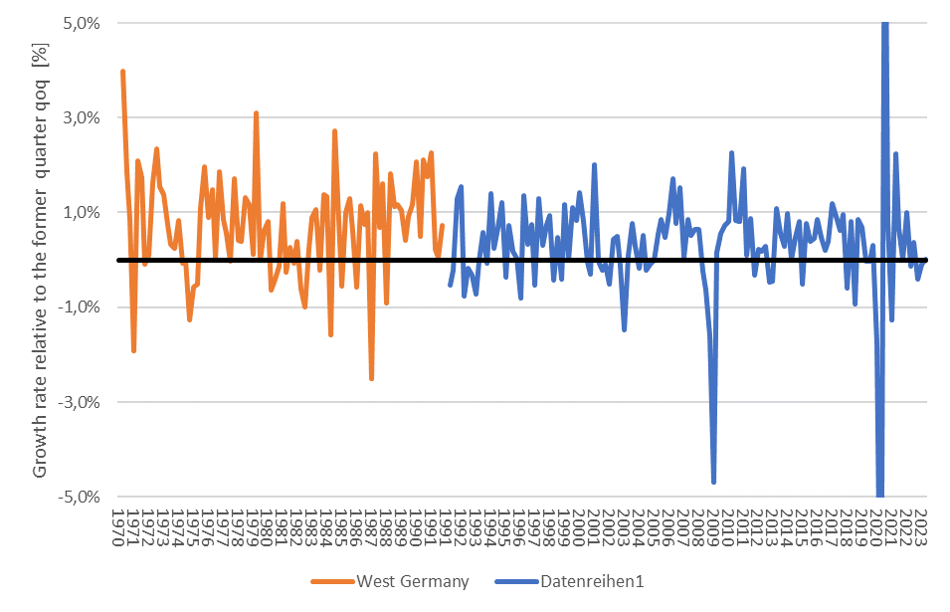
Business cycle – Germany
2.
3.
7.
1.
4.
5.
6.
Source: Destatis; price, seasonly, calendar adjusted

Slide 6
Macroeconomic parameters
Economic growth
Source: Destatis

Slide 7
Macroeconomic parameters
Inflation
Source: Bundesbank

Slide 8
Macroeconomic parameters
Unemployment
Source: Bundesbank

Slide 9
Macroeconomic parameters
Ex- and Improts
Source: Destatis

Slide 10
Macroeconomic parameters
Exchange rate
Source: Bundesbank

Slide 11
Macroeconomic parameters
Interest rates
Source: Bundesbank

Slide 12
Macroeconomic parameters
Interest rates
Source: Bundesbank

Slide 13
Macroeconomic parameters
Key interest rates
Source: national central banks (Bundesbank) or www.leitzinsen.info

Slide 14
Macroeconomic parameters
Government debt
Source: Bundesbank

