Slide 1
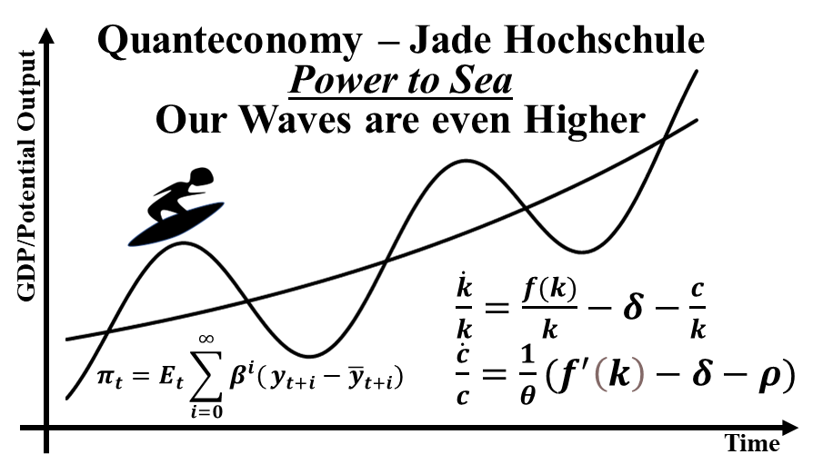
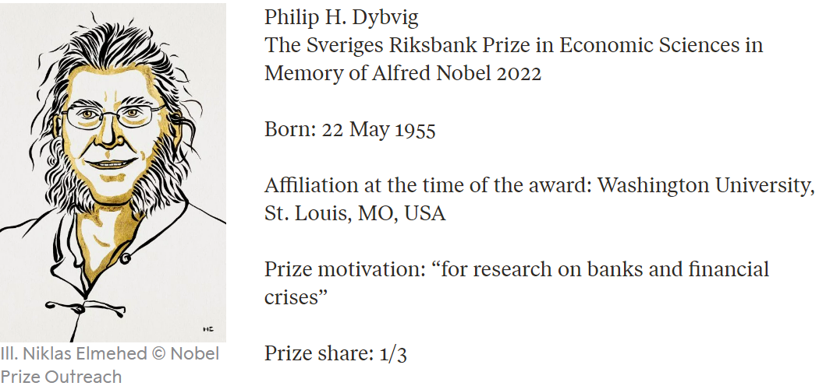
Nobelprize 2022
The Bank Run Model of Diamond and Dybvig
!!!Be careful!!!
It will be complicated
Prof. Dr. Bernhard Köster
Jade-Hochschule Wilhelmshaven
30.10.2022
www.bernhardkoester.de

Slide 2
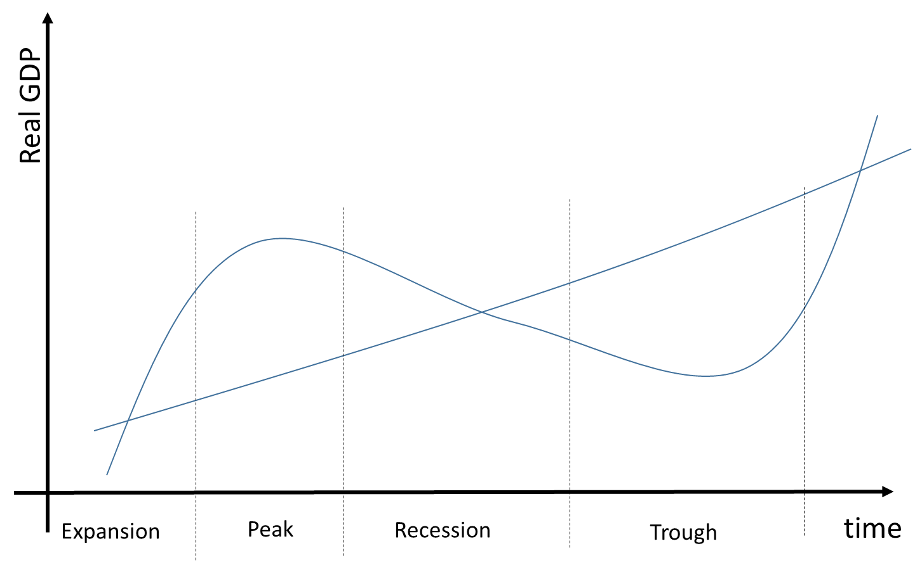
Two agents A and B
Deposit 1 Euro
Interest rate i
A
1 Euro
B ≙ H
B ≙ T

Slide 3
Nash equilibria in pure Strategies
 |  | B
 |  | H | T
A | H | 1+i , 1+i | 0 , 1
 | T | 1 , 0 | 1/2 , 1/2
Nash equilibria in mixed Strategies → Strategy a:
V(H,a) =
V(T,a) =

Slide 4
Evolutionary Game theory
Learning process over time:
V(H,a_{t+1})= a_{t} [V (H , a_{t}) – V (a_{t} , a_{t})] + a_{t} =

Slide 5
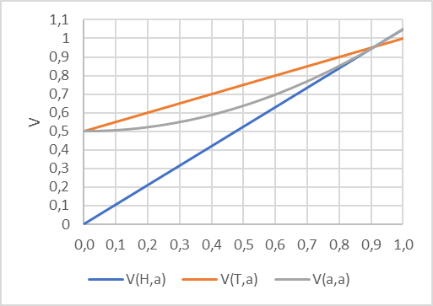
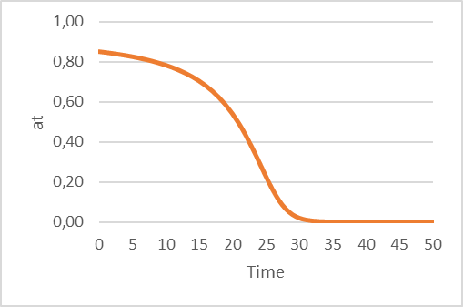
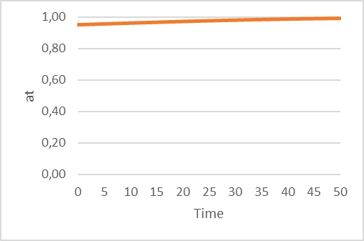
The Bank Run Model of Diamond and Dybvig – Summary
 |  | B
 |  | H | T
A | H | 1+i , 1+i | 0 , 1
 | T | 1 , 0 | 1/2 , 1/2
Nash equilibria in mixed Strategies
→ a*=1/(1+2i)

